Slide 1
Chapter 1
The Where, Why, and How of
Data Collection
A Course In Business Statistics
4th Edition

Slide 2
Chapter Goals
After completing this chapter, you should be able to:
Describe key data collection methods
Know key definitions:
  ♦Population vs. Sample ♦Primary vs. Secondary data types
  ♦Qualitative vs. Qualitative data ♦Time Series vs. Cross-Sectional data
Explain the difference between descriptive and
inferential statistics
Describe different sampling methods

Slide 3
Tools of Business Statistics
Descriptive statistics
  Collecting, presenting, and describing data
Inferential statistics
  Drawing conclusions and/or making decisions concerning a population based only on sample data

Slide 4

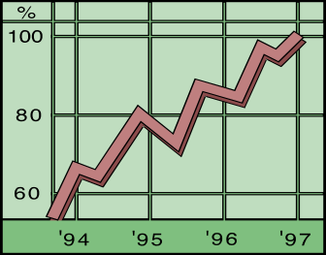
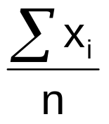
Descriptive Statistics
Collect data
  e.g. Survey, Observation,
  Experiments
Present data
  e.g. Charts and graphs
Characterize data
  e.g. Sample mean =

Slide 5



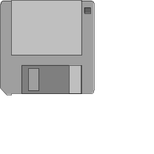

Data Sources
Primary
Data Collection
Secondary
Data Compilation
Print or Electronic
Observation
Survey
Experimentation

Slide 6
Survey Design Steps
Define the issue
  what are the purpose and objectives of the survey?
Define the population of interest
Formulate survey questions
  make questions clear and unambiguous
  use universally-accepted definitions
  limit the number of questions

Slide 7
Survey Design Steps
(continued)
Pre-test the survey
  pilot test with a small group of participants
  assess clarity and length
Determine the sample size and sampling method
Select Sample and administer the survey

Slide 8
Types of Questions
Closed-end Questions
  Select from a short list of defined choices
    Example: Major: __business __liberal arts
    __science __other
Open-end Questions
  Respondents are free to respond with any value, words, or statement
    Example: What did you like best about this course?
Demographic Questions
  Questions about the respondents’ personal characteristics
  Example: Gender: __Female __ Male

Slide 9
Populations and Samples
A Population is the set of all items or individuals of interest
  Examples: All likely voters in the next election
All parts produced today
All sales receipts for November
A Sample is a subset of the population
  Examples: 1000 voters selected at random for interview
        A few parts selected for destructive testing
        Every 100th receipt selected for audit

Slide 10
Population vs. Sample
Population
Sample
a b c d
ef gh i jk l m n
o p q rs t u v w
x y z
b c
g i n
o r u
y

Slide 11
Why Sample?
Less time consuming than a census
Less costly to administer than a census
It is possible to obtain statistical results of a sufficiently high precision based on samples.

Slide 12
Sampling Techniques
Samples
Non-Probability Samples
Probability Samples
Simple
Random
Systematic
Judgement
Convenience
Cluster
Stratified

Slide 13
Statistical Sampling
Items of the sample are chosen based on known or calculable probabilities
Probability Samples
Simple
Random
Stratified
Systematic
Cluster

Slide 14
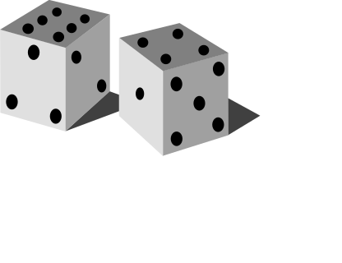
Simple Random Samples
Every individual or item from the population has an equal chance of being selected
Selection may be with replacement or without replacement
Samples can be obtained from a table of random numbers or computer random number generators

Slide 15
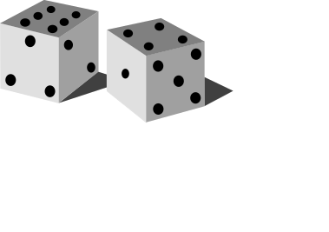
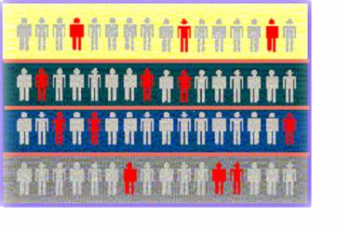

Stratified Samples
Population divided into subgroups (called strata) according to some common characteristic
Simple random sample selected from each subgroup
Samples from subgroups are combined into one
Population
Divided
into 4
strata
Sample

Slide 16
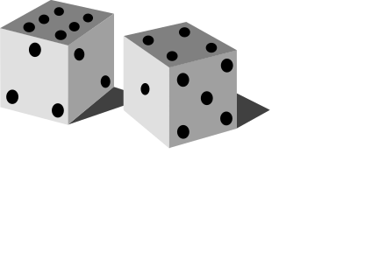
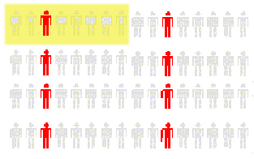
Systematic Samples
Decide on sample size: n
Divide frame of N individuals into groups of k individuals: k=N/n
Randomly select one individual from the 1st group
Select every k^{th} individual thereafter
N = 64
n = 8
k = 8
First Group

Slide 17
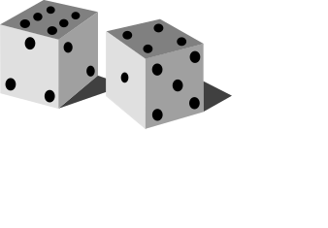
Cluster Samples
Population is divided into several “clusters,” each representative of the population
A simple random sample of clusters is selected
  All items in the selected clusters can be used, or items can be chosen from a cluster using another probability sampling technique
Population divided into 16 clusters.
Randomly selected clusters for sample

Slide 18
Key Definitions
A population is the entire collection of things under consideration
  A parameter is a summary measure computed to describe a characteristic of the population
A sample is a portion of the population selected for analysis
  A statistic is a summary measure computed to describe a characteristic of the sample

Slide 19
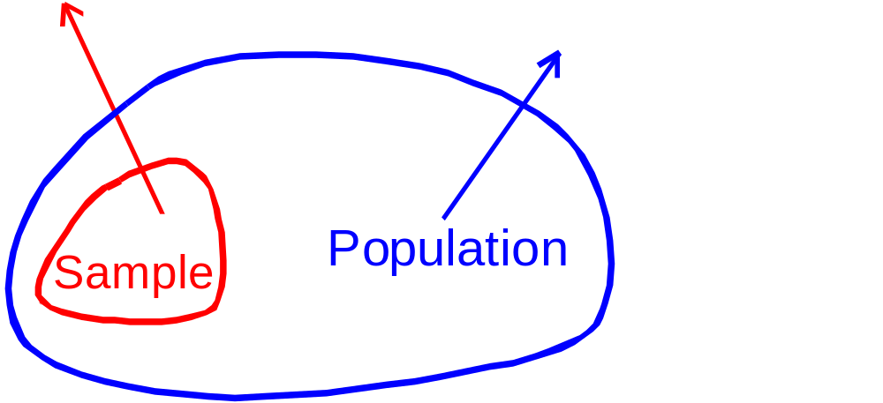
Inferential Statistics
Making statements about a population by examining sample results
Sample statistics Population parameters
(known) Inference (unknown, but can
be estimated from
sample evidence)

Slide 20
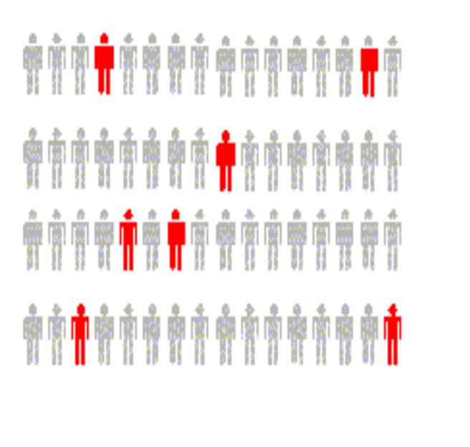
Inferential Statistics
Drawing conclusions and/or making decisions concerning a population based on sample results.
Estimation
  e.g.: Estimate the population mean weight using the sample mean weight
Hypothesis Testing
  e.g.: Use sample evidence to test the claim that the population mean weight is 120 pounds

Slide 21
Data Types
Data
Qualitative
(Categorical)
Quantitative
(Numerical)
Examples:
Marital Status
Political Party
Eye Color
(Defined categories)
Discrete
Continuous
Examples:
Number of Children
Defects per hour
(Counted items)
Examples:
Weight
Voltage
(Measured characteristics)

Slide 22
Data Types
Time Series Data
  Ordered data values observed over time
Cross Section Data
  Data values observed at a fixed point in time

Slide 23
Data Types
 | Sales (in $1000’s)
 | 2003 | 2004 | 2005 | 2006
Atlanta | 435 | 460 | 475 | 490
Boston | 320 | 345 | 375 | 395
Cleveland | 405 | 390 | 410 | 395
Denver | 260 | 270 | 285 | 280
Time Series Data
Cross Section Data

Slide 24
Data Measurement Levels
Highest Level
Complete Analysis
Measurements
Ratio/Interval Data
Rankings
Ordered Categories
Higher Level
Mid-level Analysis
Ordinal Data
Categorical Codes ID Numbers Category Names
Lowest Level
Basic Analysis
Nominal Data

Slide 25
Chapter Summary
Reviewed key data collection methods
Introduced key definitions:
  ♦Population vs. Sample ♦Primary vs. Secondary data types
  ♦Qualitative vs. Qualitative data ♦Time Series vs. Cross-Sectional data
Examined descriptive vs. inferential statistics
Described different sampling techniques
Reviewed data types and measurement levels

