Slide 1

Chapter 3
Summarizing Scores with Measures of Central Tendency: The Mean, Median, and Mode
Notes:
Do Homework 2-1, 2-2, & 2-3

Slide 2
Outline of the Course
III. Descriptive Statistics
A. Measures of Central Tendency (Chapter 3)
1. Mean
2. Median
3. Mode
B. Measures of Variability (Chapter 4)
1. Range
2. Mean deviation
3. Variance
4. Standard Deviation
C. Skewness (Chapter 2)
1. Positive skew
2. Normal distribution
3. Negative skew
D. Kurtosis
1. Platykurtic
2. Mesokurtic
3. Leptokurtic
Notes:
-There are four things we need to know to fully describe a distribution of data.

Slide 3
Measures of Central Tendency
The goal of measures of central tendency is to come up with the one single number that best describes a distribution of scores.
Lets us know if the distribution of scores tends to be composed of high scores or low scores.

Slide 4
Measures of Central Tendency
There are three basic measures of central tendency, and choosing one over another depends on two different things.
  1. The scale of measurement used, so that a summary makes sense given the nature of the scores.
  2. The shape of the frequency distribution, so that the measure accurately summarizes the distribution.

Slide 5
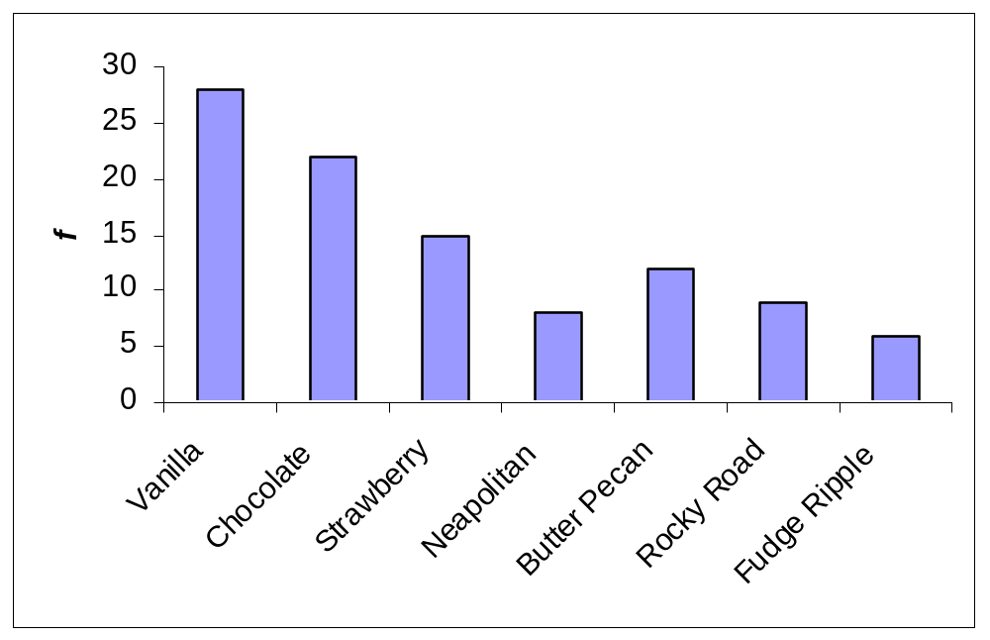
Measures of Central Tendency
Mode
The most common observation in a group of scores.
  Distributions can be unimodal, bimodal, or multimodal.
If the data is categorical (measured on the nominal scale) then only the mode can be calculated.
The most frequently occurring score (mode) is Vanilla.
Flavor | f
Vanilla | 28
Chocolate | 22
Strawberry | 15
Neapolitan | 8
Butter Pecan | 12
Rocky Road | 9
Fudge Ripple | 6

Slide 6
Measures of Central Tendency
Mode
The mode can also be calculated with ordinal and higher data, but it often is not appropriate.
  If other measures can be calculated, the mode would never be the first choice!
7, 7, 7, 20, 23, 23, 24, 25, 26 has a mode of 7, but obviously it doesn’t make much sense.
Notes:
-Remember, measures of central tendency look for the one number which best describe all of the numbers.

Slide 7
Measures of Central Tendency
Median
The number that divides a distribution of scores exactly in half.
  The median is the same as the 50th percentile.
Better than mode because only one score can be median and the median will usually be around where most scores fall.
If data are perfectly normal, the mode is the median.
The median is computed when data are ordinal scale or when they are highly skewed.
Notes:
-Draw some distributions and show how 50% of the distribution falls to the left no matter what the shape is.

Slide 8
Measures of Central Tendency
Median
There are three methods for computing the median, depending on the distribution of scores.
  First, if you have an odd number of scores pick the middle score.
    1 4 6 7 12 14 18
    Median is 7
  Second, if you have an even number of scores, take the average of the middle two.
    1 4 6 7 8 12 14 16
    Median is (7+8)/2 = 7.5
  Third, if you have several scores with the same value in the middle of the distribution use the formula for percentiles (not found in your book).
Notes:
-Scores must be in order to compute the median.

Slide 9
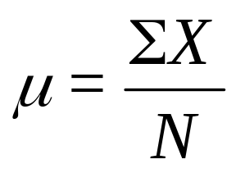
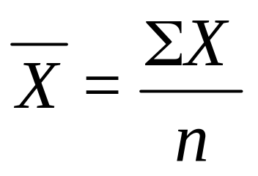
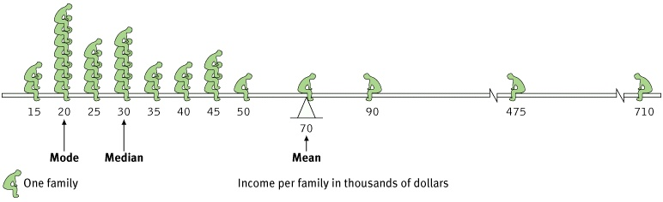
Measures of Central Tendency
Mean
The arithmetic average, computed simply by adding together all scores and dividing by the number of scores.
It uses information from every single score.
For a population: For a Sample:
Notes:
-The mean is the mathematical center of the distribution of scores.

Slide 10
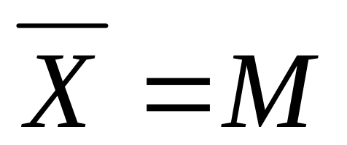
Measures of Central Tendency
Mean
Other Notes
If data are perfectly normal, then the mean, median and mode are exactly the same.
I would prefer to use the mean whenever possible since it uses information from EVERY score.
Though the preferred symbol for the mean is an X with a line over the top, creating this symbol is pretty tricky on the computer. APA style says:

Slide 11
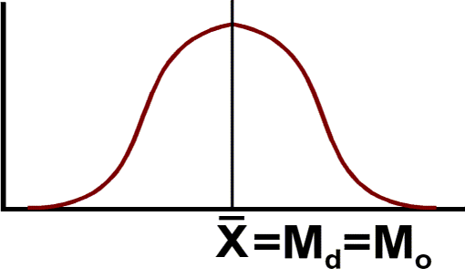
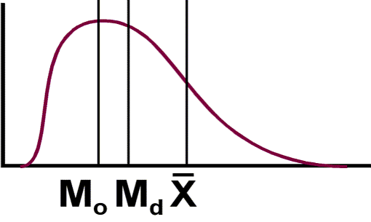
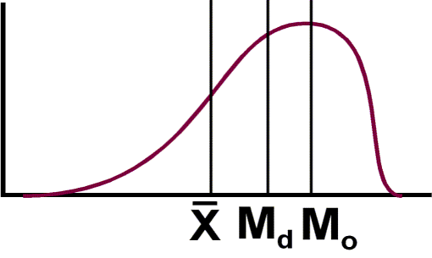
Measures of Central Tendency
The Shape of Distributions
With perfectly bell shaped distributions, the mean, median, and mode are identical.
With positively skewed data, the mode is lowest, followed by the median and mean.
With negatively skewed data, the mean is lowest, followed by the median and mode.

Slide 12
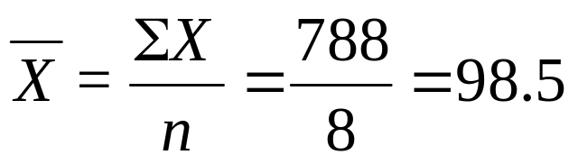
Measures of Central Tendency
Mean vs. Median
Salary Example
On one block, the income from the families are (in thousands of dollars) 40, 42, 41, 45, 38, 40, 42, 500
  ΣX=788,
  The Mean salary for this sample is $98,500 which is more than twice almost all of the scores.
Arrange the scores 38, 40, 40, 41, 42, 42, 45, 500
  The middle two #’s are 41 and 42, thus the average is $41500, perhaps a more accurate measure of central tendency.
Notes:
-When data are skewed, we should avoid the mean as a measure of central tendency.

Slide 13
Measures of Central Tendency
Mean vs. Median
Reaction Time Example
Data is time to complete task (in s):
  45, 34, 87, 56, 21, didn’t finish, 49
It is not possible to compute a mean with this unknown number.
Even though we do not know this person’s time, I do know it is REALLY big.
  21, 34, 45, 49, 56, 87, something bigger
  The median is the middle number, 49
Notes:
-If the data contains scores of undetermined value, then the mean may be impossible to calculate. You may not know the exact values of some scores, however you do know the relative positions of these scores.

Slide 14
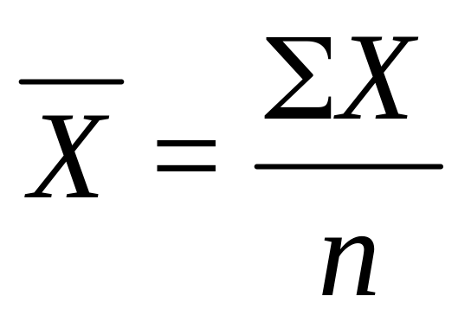
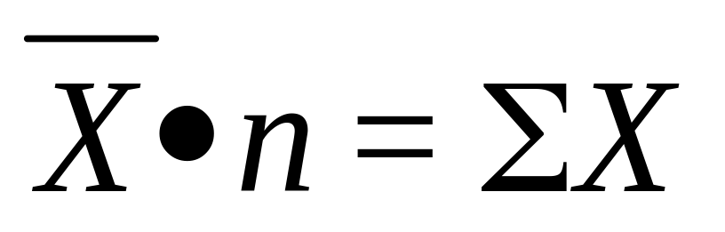
Measures of Central Tendency
Mean
Algebra Revisited
Its useful to consider the formula as the same as any other algebraic formulas, subject to the same rules.
Therefore, if we know the mean of a group of scores, we can figure out the ΣX.

Slide 15
Measures of Central Tendency
Mean
Weighted Mean
Lets pretend that one semesters class of 23 students scored M₁ = 18 points on a quiz. The same quiz was then given the next semester to 34 students who then got M₂ = 22 points. What is the overall (weighted) mean for these 57 students.
  ΣX₁ can be computed by multiplying M₁ times the sample size (ΣX₁= M₁*n₁ = 18*23 = 414).
  For the second class, ΣX₂ = M₂*n₂ = 22 * 34 = 748
  ΣX_{total} = ΣX₁ + ΣX₂ = 414 + 748 = 1206
  n_{total} = n₁ + n₂ = 23 + 34 = 57
  M_{total} = ΣX_{total} / n_{total} = 1206/57 = 21.158

Slide 16
Measures of Central Tendency
Mean
Adding a Score
On the first exam, 15 students had M = 85.
  One kid came in late and took the test and scored 53, what is M_{new}?
  ΣX_{original} = M_{original}*n_{original} = 85*15 = 1275
  ΣX_{new} = ΣX_{original} + new score = 1275 + 53 = 1328
  n_{new} = n_{original} + 1
  M_{new} = ΣX_{new}/n_{new} = 1328/16 = 83

Slide 17
Measures of Central Tendency
Mean
Changing an Existing Score
On the first exam, 16 students had M = 83.
  One kid came in after the test and complained, I listened and decided to give him 10 extra points, now what?
  ΣX_{original} = M_{original}*n_{original} = 83*16 = 1328
  ΣX_{new} = ΣX_{original} + extra points = 1328 + 10 = 1338
  M_{new} = ΣX_{new}/n = 1338/16 = 83.625

Slide 18
Measures of Central Tendency
Mean
Transformations
If a constant is added (or subtracted) to each score, the same constant will be added (or subtracted) to the mean.
  If M for an exam is 82, then I find that I screwed up a question and give everyone 5 extra points, M simply becomes 82+5=87.
If every score is multiplied or divided by a constant number, then the mean will also be multiplied or divided by the same number.
  This last property is particularly useful when converting between units of measurement.
  If the M for the height of a group of first-graders is 47 inches, but I need to know their heights in cm I could:
    Take every kids height * 2.54, then recompute M
    Or, I could take the mean times 2.54 and conclude the M height of these kids is 119.38 cm.
Notes:
-Transformations refer to ways in which the distribution of scores could be changed.
1 inch = 2.54 cm

Slide 19
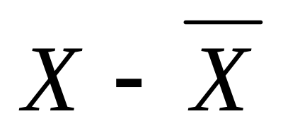
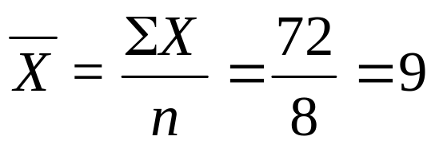
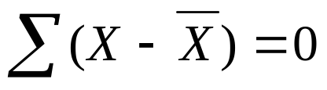
Measures of Central Tendency
Deviations around the Mean
A common formula we will be working with extensively is the deviation:
Exam Score
7
6
8
9
12
10
11
9
(7-9) = -2
(6-9) = -3
(8-9) = -1
(9-9) = 0
(12-9) = 3
(10-9) = 1
(11-9) = 2
(9-9) = 0
ΣX = 72
n = 8
Notes:
-The sum of X – mean must always equal 0 because the mean is the mathematical center of the distribution.

Slide 20
Measures of Central Tendency
Using the Mean to Interpret Data
Predicting Scores
If asked to predict a score, and you know nothing else, then predict the mean.
However, we will probably be wrong, and our error will equal:
A score’s deviation indicates the amount of error we have when using the mean to predict an individual score.

Slide 21
Measures of Central Tendency
Using the Mean to Interpret Data
Describing a Score’s Location
If you take a test and get a score of 45, the 45 means nothing in and of itself. However, if you learn that the M = 50, then we know more. Your score was 5 units BELOW M.
  Positive deviations are above M.
  Negatives deviations are below M.
  Large deviations indicate a score far from M.
  Large deviations occur less frequently.

Slide 22
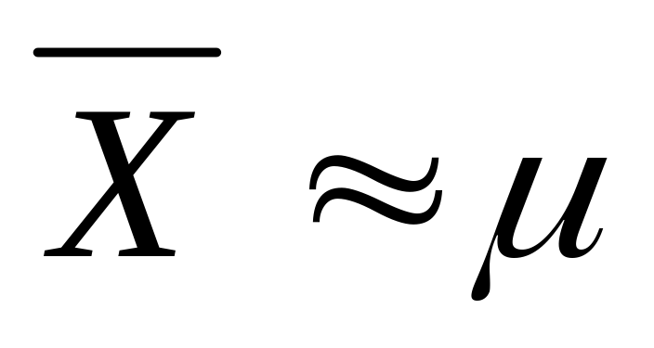
Measures of Central Tendency
Using the Mean to Interpret Data
Describing the Population Mean
Remember, we usually want to know population parameters, but populations are too large.
So, we use the sample mean to estimate the population mean.

