Slide 1
Chapter 3 Describing Data Using Numerical Measures
A Course In Business Statistics
4th Edition

Slide 2
Summary Measures
Describing Data Numerically
Center and Location
Other Measures of Location
Variation
Mean
Range
Percentiles
Median
Interquartile Range
Quartiles
Mode
Variance
Weighted Mean
Standard Deviation
Coefficient of Variation

Slide 3
Measures of Shape
1) Measures of Skewness
2) Measures of Kurtosis

Slide 4
1) Measures of Skewness
Measures of skewness describe the degree to which the data deviates from symmetry.
If a distribution is not symmetrical, then it is called as asymmetrical or skewed.
There are 2 types of skewness:
Positively skewed – skewed to the right
Negatively skewed – skewed to the left

Slide 5
Distribution Shape and Box and Whisker Plot
Left-Skewed
Symmetric
Right-Skewed
Q1
Q2
Q3
Q1
Q2
Q3
Q1
Q2
Q3
Notes:
If the concentration of the values is at the left-end of the
distribution and the upper tail of the distribution stretches
out more than the lower tail, then the distribution is said to
be positively skewed or skewed to the right
If the concentration of the values is at the right-end of the
distribution and the lower tail of the distribution stretches
out more than the upper tail then the distribution is said to
be negatively skewed or skewed to the left.

Slide 6
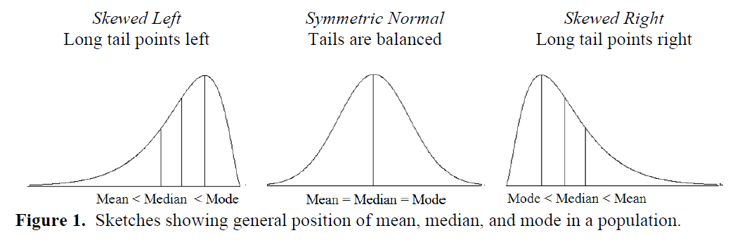
Relationship of the Three Measures of Central Tendency for Unimodal Distributions
Source: Doane, D.P., Seward, L. E. (2011). Measuring Skewness: A Forgotten Statistic?, Journal of Statistics Education, Vol.19, No.2.

Slide 7
If a distribution is symmetrical, it does not have to be bell-shaped.
If a distribution is skewed, it does not have to be uni-modal (having only one mode).

Slide 8
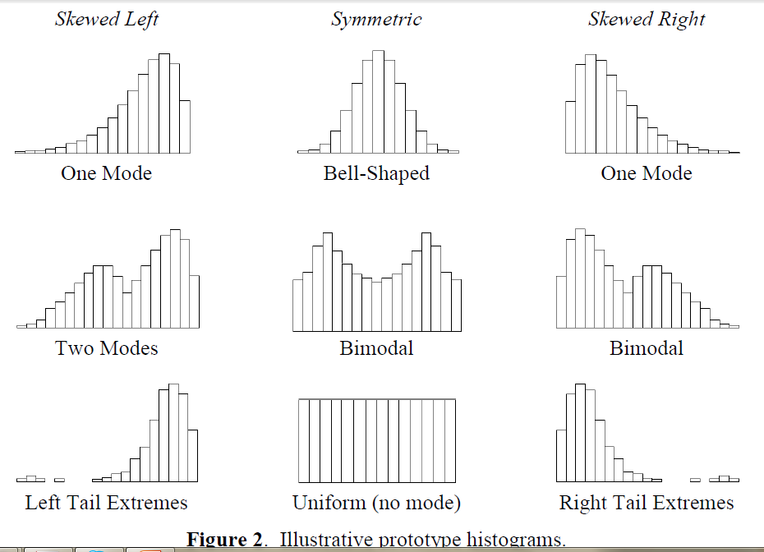
Source: Doane, D.P., Seward, L. E. (2011). Measuring Skewness: A Forgotten Statistic?, Journal of Statistics Education, Vol.19, No.2.

Slide 9
How to detect Skewness? Charts vs Statistical Measures?
The simplest way to see if a distribution is skewed or symmetrical is to construct a histogram or a box-plot.
A measure of skewness is a single value that indicates the degree and direction of asymmetry.
Signs of skewness measures:
Skewness = 0 Symmetrical distribution
Skewness >0 Skewed to the right (positively skewed)
Skewness <0 Skewed to the lef (negatively skewed)
The larger the measure of skewness, the more skewed the distribution is.

Slide 10
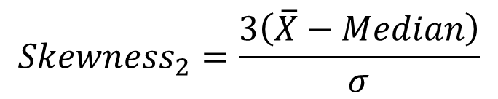
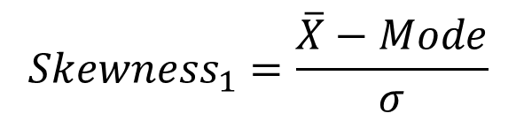
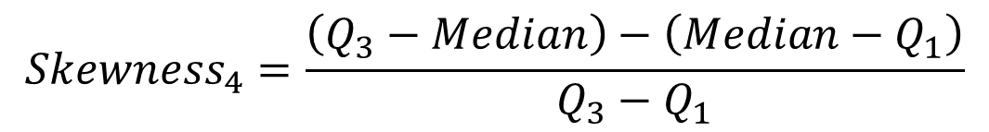
Measures of Skewness
There are a few measures for skewness:
Pearson’s 1st coefficient of skewness: Based on the distance between the mean and the mode
Pearson’s 2nd coefficient of skewness: Based on the distance between the mean and the median
Skewness based on the quartiles (boxplot)
$${Skewness}_{1}=\frac{\overline{X}−Mode}{σ}$$
$${Skewness}_{2}=\frac{3\left(\overline{X}−Median\right)}{σ}$$
$${Skewness}_{4}=\frac{\left(Q_{3}−Median\right)−\left(Median−Q_{1}\right)}{Q_{3}−Q_{1}}$$

Slide 11
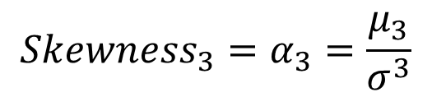
Measures of Skewness
Most traditional measure for skewness:
Fisher-Pearson coefficient of skewness: Based on the 2nd and 3rd moments around the mean.
$${{Skewness}_{3}=α}_{3}=\frac{μ_{3}}{σ^{3}}$$

Slide 12
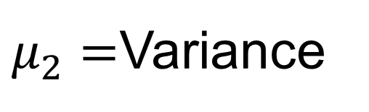
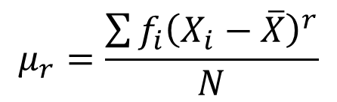
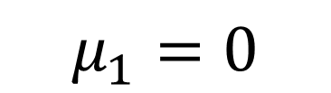

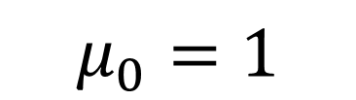

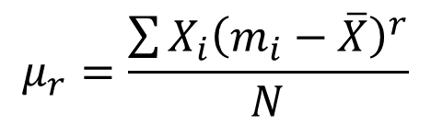
rth Moment Around the Mean
The rth moment around the mean is denoted by
and it is calculated as follows:
Note that:
$$μ_{r}$$
$$μ_{r}=\frac{\sum{{\left(X_{i}−\overline{X}\right)}^{r}}}{N}$$
$$μ_{r}=\frac{\sum{{f_{i}\left(X_{i}−\overline{X}\right)}^{r}}}{N}$$
$$μ_{r}=\frac{\sum{{X_{i}\left(m_{i}−\overline{X}\right)}^{r}}}{N}$$
$$μ_{0}=1$$
$$μ_{1}=0$$
$μ_{2}=$Variance

Slide 13

Fisher-Pearson coefficient of skewness
$$α_{3}=\frac{μ_{3}}{σ^{3}}$$

Slide 14
Interpretation of Fisher-Pearson’s Skewness Measure
Bulmer, M. G., Principles of Statistics (Dover, 1979) — a classic — suggests this rule of thumb:
If skewness is less than −1 or greater than +1, the distribution is highly skewed.
If skewness is between −1 and −½ or between +½ and +1, the distribution is moderately skewed.
If skewness is between −½ and +½, the distribution is approximately symmetric.

Slide 15
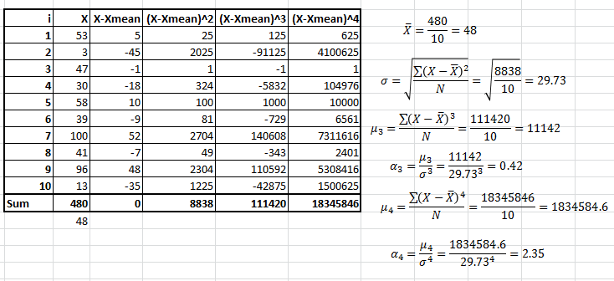
An Example

Slide 16
Another example:
Female Life Expectancy at birth (years) High Income OECD (2009)
Australia | 84 |  | Japan | 86
Austria | 83 |  | Korea, Rep. | 84
Belgium | 82 |  | Luxembourg | 83
Canada | 83 |  | Netherlands | 83
Czech Republic | 80 |  | New Zealand | 82
Denmark | 81 |  | Norway | 83
Estonia | 80 |  | Poland | 80
Finland | 83 |  | Portugal | 82
France | 85 |  | Slovak Republic | 79
Germany | 83 |  | Slovenia | 82
Greece | 83 |  | Spain | 85
Hungary | 78 |  | Sweden | 83
Iceland | 83 |  | Switzerland | 84
Ireland | 82 |  | United Kingdom | 82
Israel | 84 |  | United States | 81
Italy | 84
Source: World Bank

Slide 17
Female Life Expectancy at birth (years) Sub-Saharan Africa (2009)
Angola | 52 |  | Gabon | 63 |  | Niger | 54
Benin | 57 |  | Gambia, The | 59 |  | Nigeria | 52
Botswana | 52 |  | Ghana | 64 |  | Rwanda | 56
Burkina Faso | 55 |  | Guinea | 55 |  | Sao Tome and Principe | 66
Burundi | 51 |  | Guinea-Bissau | 49 |  | Senegal | 60
Cameroon | 52 |  | Kenya | 57 |  | Seychelles | 78
Cape Verde | 78 |  | Lesotho | 46 |  | Sierra Leone | 48
Central African Republic | 48 |  | Liberia | 56 |  | Somalia | 52
Chad | 50 |  | Madagascar | 68 |  | South Africa | 52
Comoros | 62 |  | Malawi | 53 |  | Sudan | 63
Congo, Dem. Rep. | 49 |  | Mali | 52 |  | Swaziland | 48
Congo, Rep. | 58 |  | Mauritania | 60 |  | Tanzania | 57
Cote d'Ivoire | 55 |  | Mauritius | 77 |  | Togo | 58
Eritrea | 63 |  | Mozambique | 50 |  | Uganda | 54
Ethiopia | 60 |  | Namibia | 62 |  | Zambia | 48
 |  |  |  |  |  | Zimbabwe | 47

Slide 18
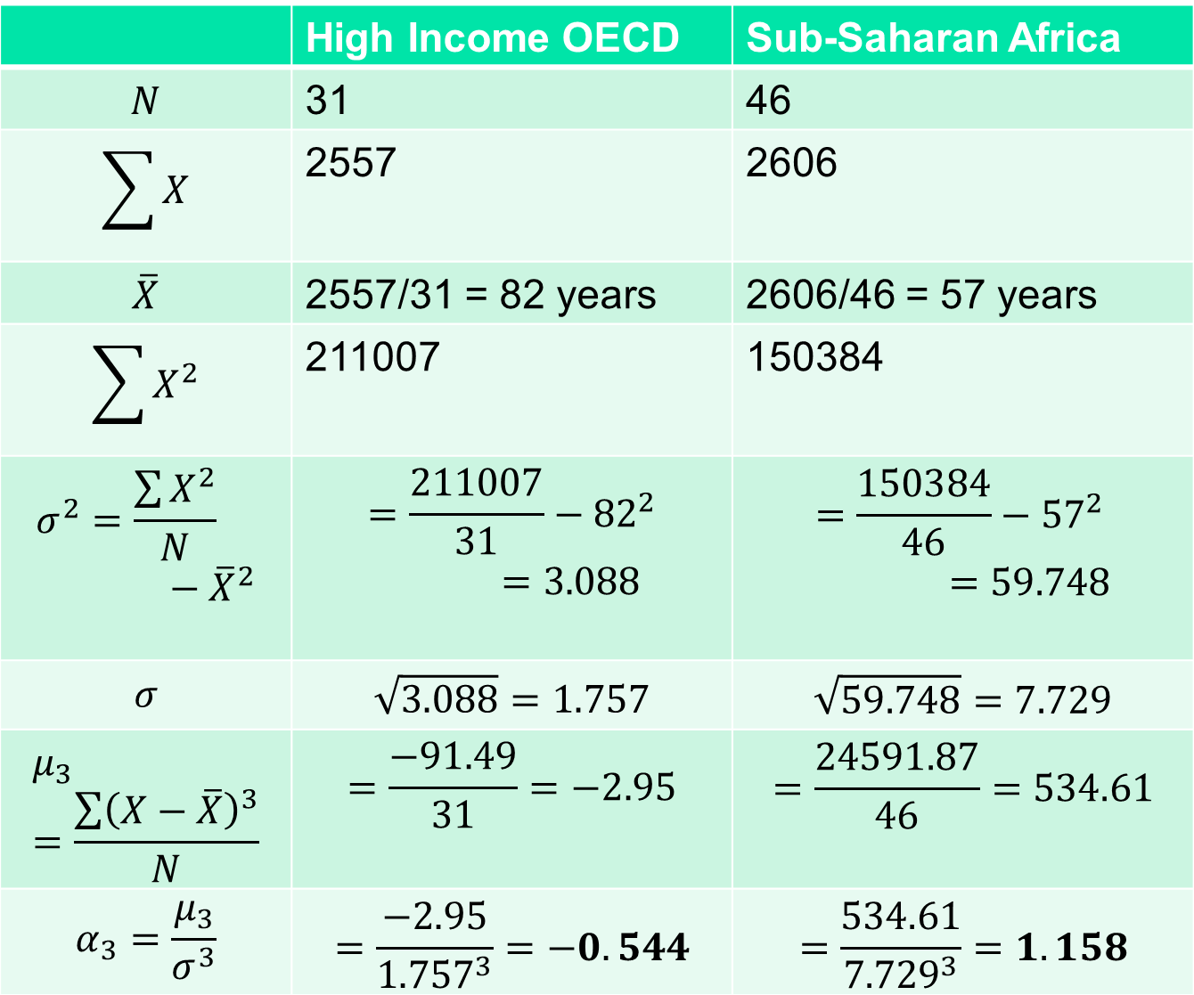
 | High Income OECD | Sub-Saharan Africa
$$N$$ | 31 | 46
$$\sum{X}$$ | 2557 | 2606
$$\overline{X}$$ | 2557/31 = 82 years | 2606/46 = 57 years
$$\sum{X^{2}}$$ | 211007 | 150384
$$σ^{2}=\frac{\sum{X^{2}}}{N}−{\overline{X}}^{2}$$ | $$=\frac{211007}{31}−{82}^{2}=3.088$$ | $$=\frac{150384}{46}−{57}^{2}=59.748$$
$$σ$$ | $$\sqrt{3.088}=1.757$$ | $$\sqrt{59.748}=7.729$$
$$μ_{3}=\frac{\sum{{\left(X−\overline{X}\right)}^{3}}}{N}$$ | $$=\frac{−91.49}{31}=−2.95$$ | $$=\frac{24591.87}{46}=534.61$$
$$α_{3}=\frac{μ_{3}}{σ^{3}}$$ | $$=\frac{−2.95}{{1.757}^{3}}=−0.544$$ | $$=\frac{534.61}{{7.729}^{3}}=1.158$$

Slide 19
2) Measure of Kurtosis
Karl Pearson introduced the following terms to classify a unimodal distribution according to the shape of its hump (kambur) as compared to a normal distribution with the same variance:
Kurtosis = 3 Symmetrical distribution (mesokurtic)
Kurtosis >3 Peaked distribution (leptokurtic)
Kurtosis <3 Flat distribution (platykurtic - platus)
The larger the measure of kurtosis, the more peaked or flattened the distribution is.
Kurtosis – 3 shows the «excess kurtosis».

Slide 20
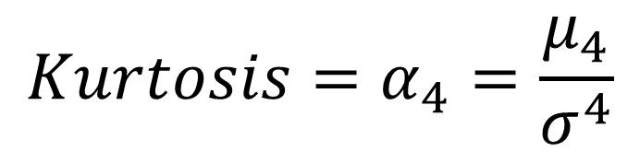
Measures of Kurtosis
Most traditional measure for kurtosis:
Coefficient of kurtosis: Based on the 2nd and 4th moments around the mean.
$${Kurtosis=α}_{4}=\frac{μ_{4}}{σ^{4}}$$

Slide 21
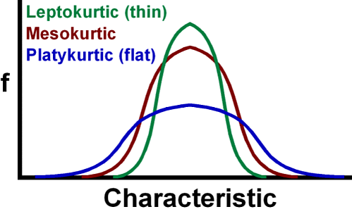

Slide 22
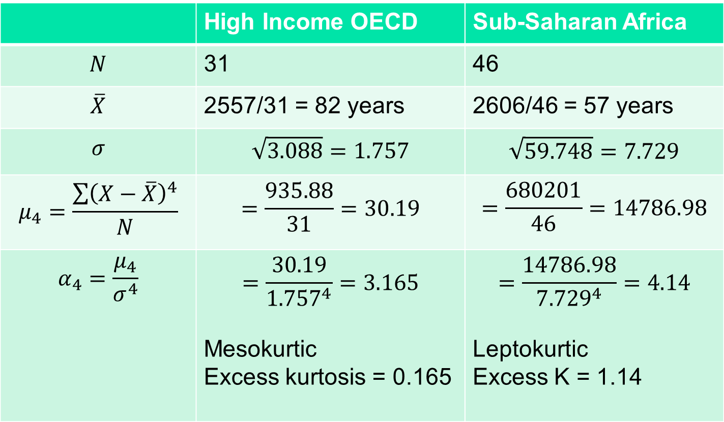
 | High Income OECD | Sub-Saharan Africa
$$N$$ | 31 | 46
$$\overline{X}$$ | 2557/31 = 82 years | 2606/46 = 57 years
$$σ$$ | $$\sqrt{3.088}=1.757$$ | $$\sqrt{59.748}=7.729$$
$$μ_{4}=\frac{\sum{{\left(X−\overline{X}\right)}^{4}}}{N}$$ | $$=\frac{935.88}{31}=30.19$$ | $$=\frac{680201}{46}=14786.98$$
$$α_{4}=\frac{μ_{4}}{σ^{4}}$$ | $$=\frac{30.19}{{1.757}^{4}}=3.165$$ Mesokurtic Excess kurtosis = 0.165 | $$=\frac{14786.98}{{7.729}^{4}}=4.14$$ Leptokurtic Excess K = 1.14

