Slide 1
LEARN
learn everything for free
Students: Fareeha Mirza, Lippay Zachary, Sebnem Sevinc

Slide 2
What is it?
A mobile application for android, to support high school students academically.
This application works alongside the school board to provide up to date content.
Students can access all of the offered subjects according to school board, grade level and academic level.
Target User Audience
High school students that want an easy and free way to reinforce the material covered in class.

Slide 3
Features
Top Ranked
Multiple ways to practice.
Ability to choose school board.
Ability to track your progress.
Lowest Ranked
Ability to interact with other users via the discussion board.
Ability to narrow the search based on grade and academic level.
Features Not Considered
Time limit on quiz.
Average quiz score.

Slide 4
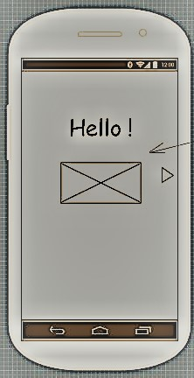
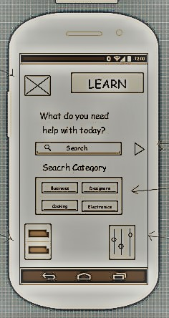
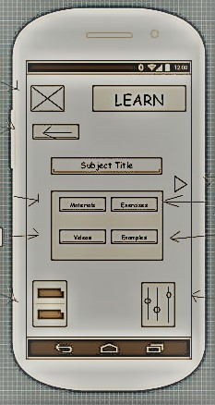
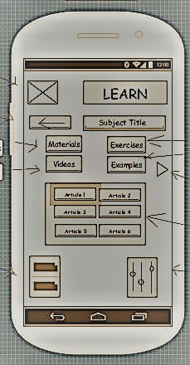
initial Wireframes

Slide 5
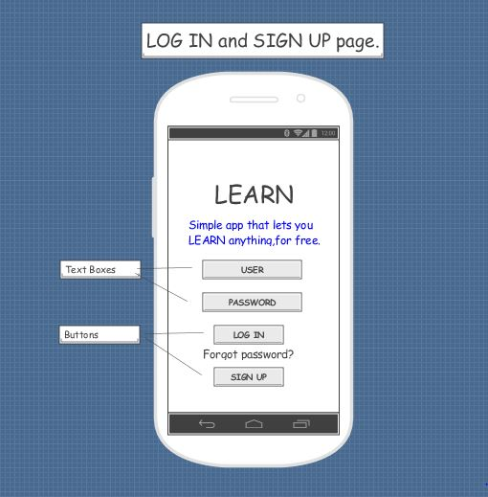
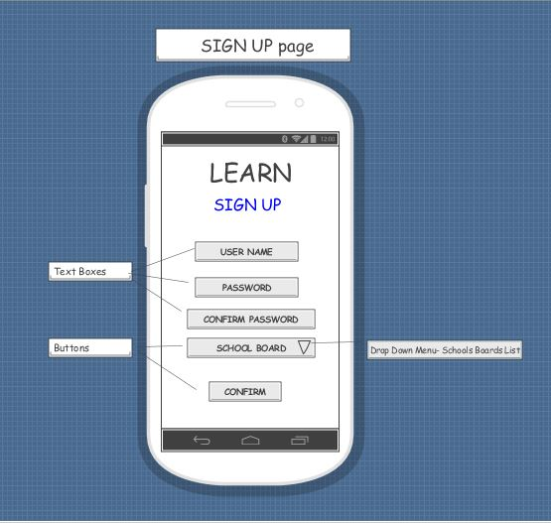
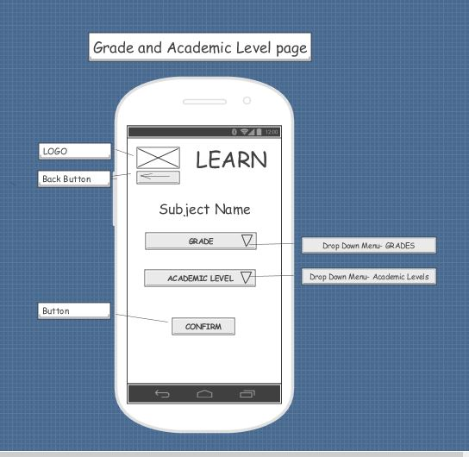
Revised Wireframes

Slide 6
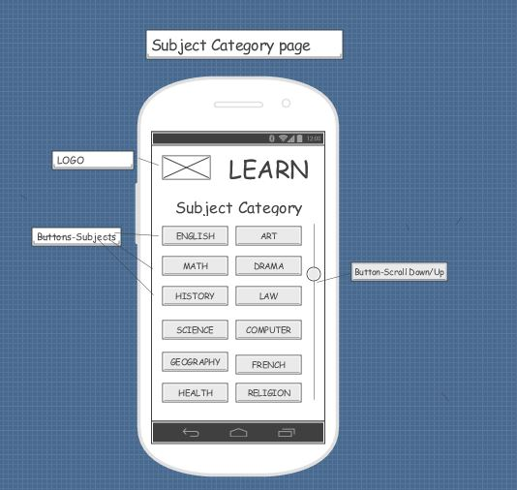
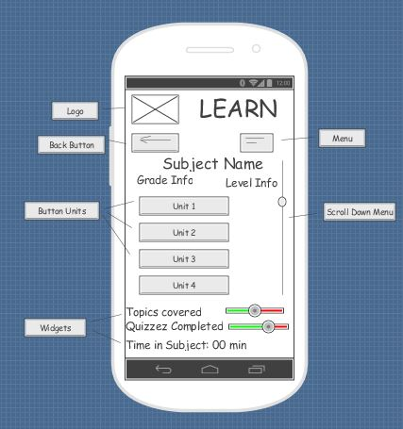
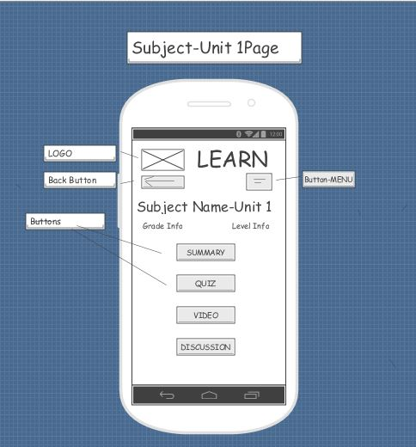
Revised Wireframes

Slide 7
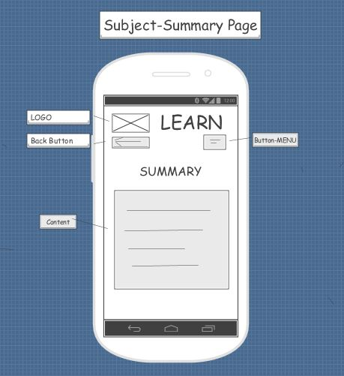
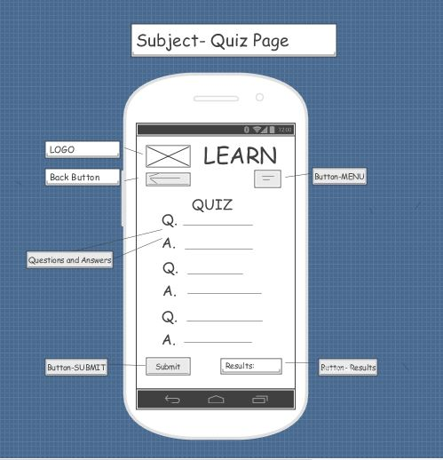
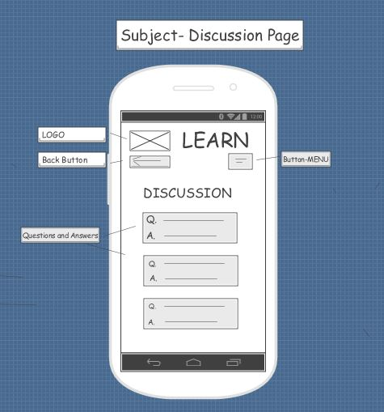
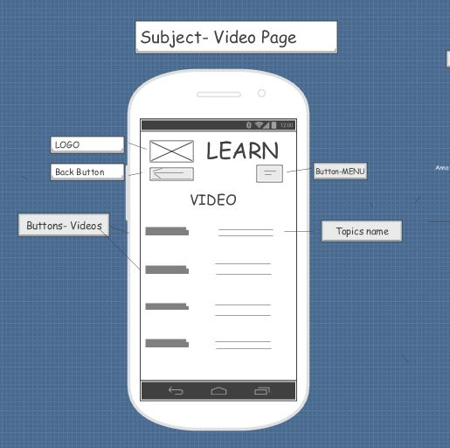
Revised Wireframes

Slide 8
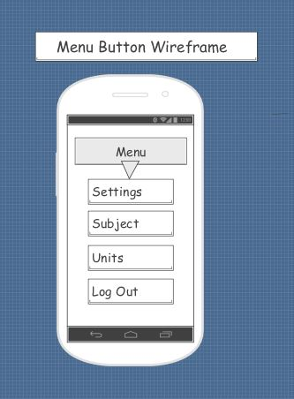
Menu Button Clarification

Slide 9
Findings from user Testing
What went well?
Users were able to complete all the tasks.
Users liked the fact that they had a choice in how they would like to learn.
Users liked how straight-forward and simple the application was.
What didn’t go well?
Navigation buttons posed some confusion.
Pages were not clearly labelled.

Slide 10
Findings from user Testing
Positive Feedback
The application was clear and simple.
The application provides a much needed online addition for high school students.
Negative Feedback
Students might not see this as an “addition”.
Surprise Findings
Users wanted a menu button, and a back button on top of the built in back button that Android phones provide.

Slide 11
Lessons Learned
Clarity and simplicity are key.
Have to have an open mindset before starting this process.
Need to put the user first.
The importance of navigation buttons.

Slide 12
Next Launch
Ability to connect via social media.
Ability to challenge your friends within the quiz page.

