Slide 1

Predicting arrhythmia Based on ECG
ABOUT
Supervised Learning
Predictions will be used
Data analysis

Slide 2

About
Supervised Learning
Predictions will be used
Data analysis

Slide 3

Dataset
109446 entries in total
Each column represents position of heartbeat rate in X-Y axis
Each row describes entries for different persons
Total 188 columns
The final element of each row denotes the class to which that example belongs

Slide 4
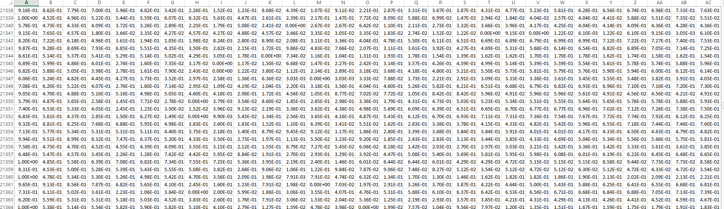

Slide 5
Explanation about the Algorithm
One Hot Encoding- For Simplifying the Dataset.

Slide 6
Explanation about Code/Library
Availability of Resources (libraries like Pandas, NumPy, SciPy, matplotlib etc)
Relevant examples from github , researchgate, youtube channels
Enough Github Repository
Plentiful Published Papers for background study

Slide 7
Explanation about your Program
Analyze the dataset to generate the ECG.
We will use various library functions from Tensor flow and Keras Model to recreate a new model.
We used classification_report, confusion_matrix functions to calculate the precision, recall and f1 score.

Slide 8

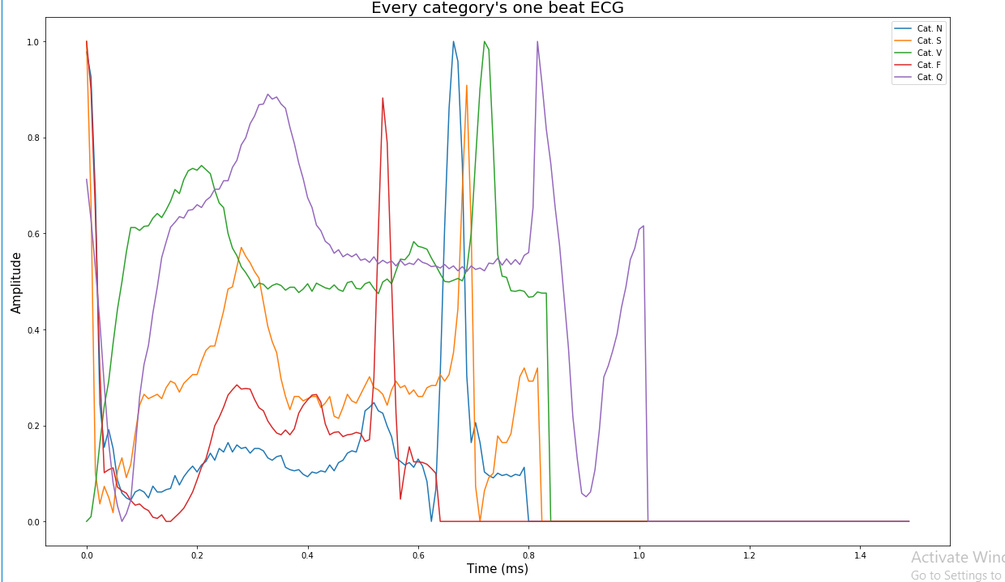
RESULT ANALYSIS
One beat ECG For each category

Slide 9
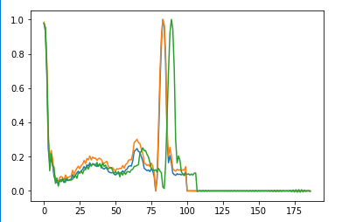
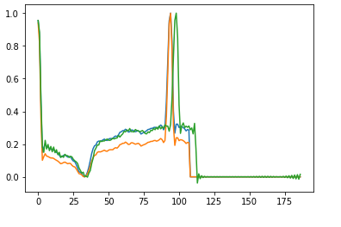
ECG graphs after Data Augmentation

Slide 10
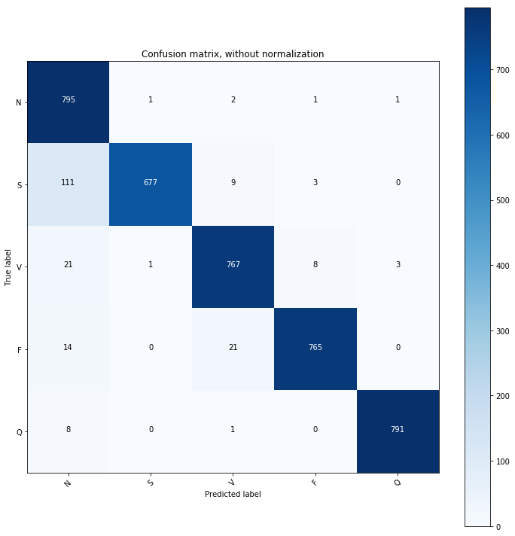
CONFUSION MATRIX

Slide 11
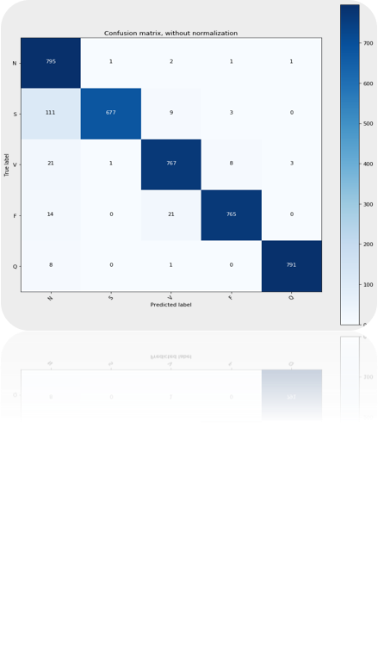
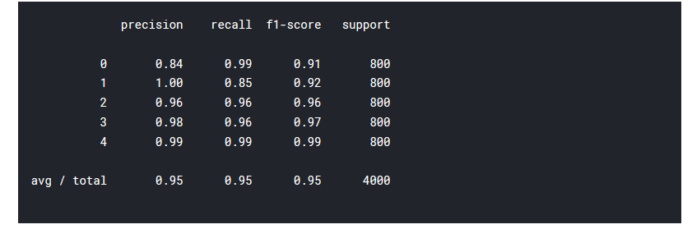
PRECISION, RECALL AND F1 SCORE
F1 score = 2*(Recall * Precision) / (Recall + Precision)

Slide 12
References
1.https://www.researchgate.net/publication/228495437_ECG_measurements_and_acquisition_system_for_heart_rate_variability_analysis
2. https://github.com/mmontana/ECG-heartbeat- classification?fbclid=IwAR0Mtrh1xKgFruLcBqXszi4EnhDskLPDMGE-jI6mR0tNfTJ10LWxxAABxX8
3. https://github.com/mondejar/ecg-classification?fbclid=IwAR1uIhgK4g8cnB3vUGULfxXjD1X3nKp7lVCF5HTNrmukFJFbgvOZFwRFB-M

