Slide 1
CAPSTONE PROJECT
Battle of the neighbourhoods

Slide 2
Business Question
If I want to open a new food venue in Toronto which serves an emerging cuisine, which neighbourhoods would be most likely to embrace it and thus better to open the venue in?

Slide 3
Emerging Cuisine Criteria
An emerging cuisine, is one that has an appreciable commercial presence within a given community but is not:
Associated with a geographic location
Chinatown serves Chinese food. Chinese is not an emerging cuisine
Associated with a major fast food chain
Thai Express serve Thai food. Thai is not an emerging cuisine
The cuisine selected for this project was ETHIOPIAN

Slide 4
Required data
Toronto post codes
Data source: Wikipedia
Food venues in Toronto
Data source: Foursquare location data platform
Venues retrieved using latitude and longitude information

Slide 5
Methodology
Explore similarities between neighbourhoods based on the restaurants/food vendors present.
Use a correlation measure e.g. Pearson
Can certain neighourhood characteristics be used to group together those likely to embrace emerging cuisines?
Use K-means clustering

Slide 6
Results
Neighbourhoods already with Ethiopian restaurants:
Garden District, Ryerson
Church and Welseley
After clustering, neighbourhoods likely embrace a new Ethipoian restaurant:
Garden District, Ryerson
Church and Welseley
Central Bay Street

Slide 7
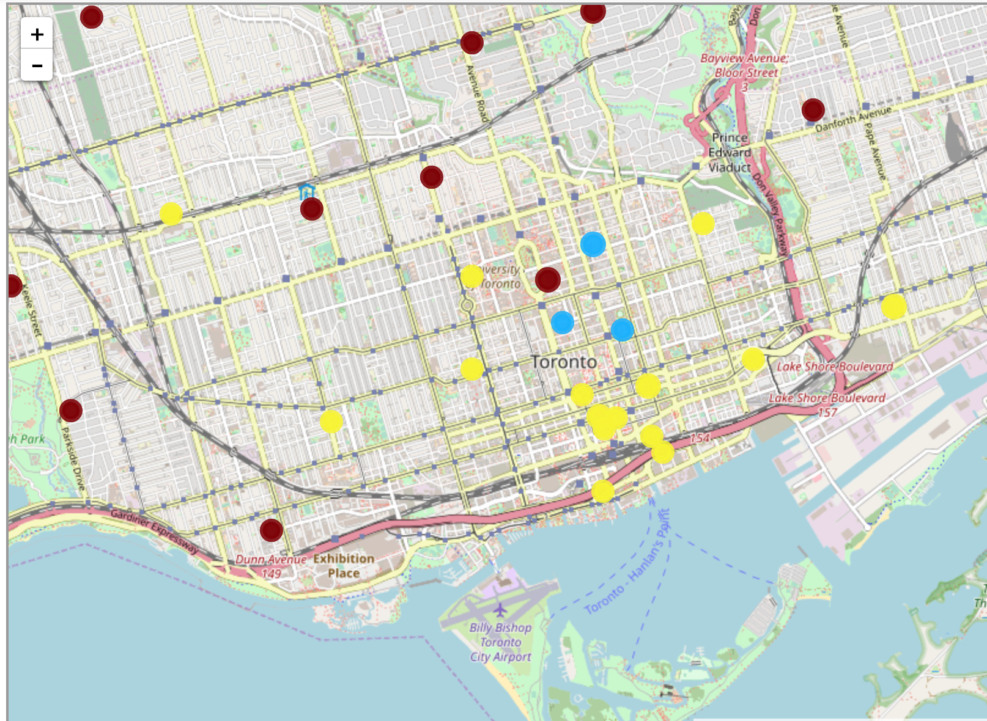
Map
Blue: Likely to embrace
Yellow: Unlikely to embrace
Red: Neither

Slide 8
Correlation
Food venue categories with highest positive correlation with Ethiopian:
Ethiopian
Afghan
Japanese
Bubble Tea shop
Juice Bar
Having a good combination of these could indicate a high likelihood of embracing Ethiopian food

Slide 9
Correlation
Food venue categories with strongest negative correlation with Ethiopian:
Bakery
Fried Chicke Joing
Brewery
French restaurant
New American Restaurant
Having a good combination of these could indicate a low likelihood of embracing Ethiopian food

Slide 10
Conclusion
Clustering and correlation using venue information from Foursquare can potentially guide decisions on where to open up a new Ethiopian food vendor. In this case, on top of where there are already Ethiopian restaurants, Central Bay Street looks promising.
As neighbourhoods evolve, this process would need to be repeated to identify updated correlations
Demographic data could also help paint a clearer picture.

