Slide 1
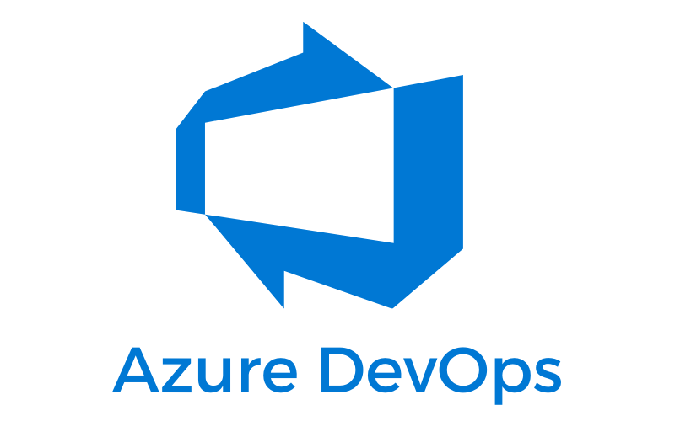
Azure DevOps
Boards
Repos
Pipelines
Test Plans
Artifacts
Prepared by Manoop

Slide 2

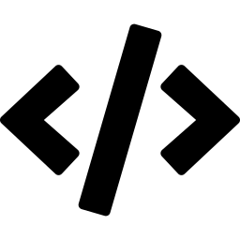








OVERVIEW
What is Azure DevOps?
Azure DevOps is Microsoft's cloud platform that gives teams everything needed to plan work, write code, run automated builds and tests, and release software — all in one connected place. It supports the full software lifecycle so developers, testers and operations work together instead of in silos.
The DevOps Lifecycle
A continuous loop — not a one-time process
Plan
Track work & backlog
Code
Write & review code
Collaboration
Automation
Build
Compile & package
One shared space for dev, QA and ops teams.
Build, test and deploy without manual steps.
Test
Automated quality checks
Cloud or On-Prem
Secure & Governed
Release
Ship to environments
Use Azure DevOps Services or Azure DevOps Server.
Permissions, approvals and audit built in.
Monitor
Watch health & feedback
02

Slide 3
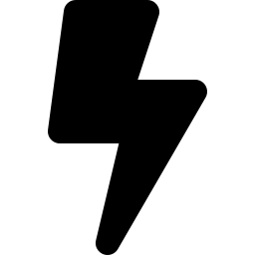

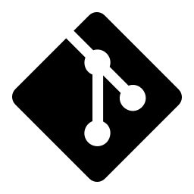
WHY IT MATTERS
Why teams choose Azure DevOps
Faster
Fewer
Full
Releases
Bugs
Visibility
Automation removes slow, error-prone manual steps.
Every change is built and tested automatically.
Work, code and deployments tracked in one place.
What you actually gain
Repeatable, one-click deployments
Approvals, gates and audit trails for safety
Works with any language, cloud or on-prem target
Native Git & tight GitHub integration
03

Slide 4
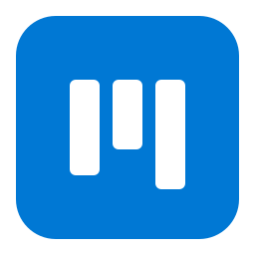
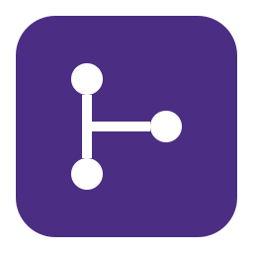

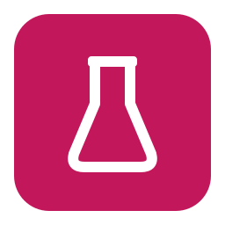
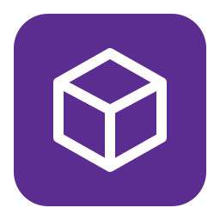
THE PLATFORM
Five core services, one platform
Azure DevOps is made of five services. You can use them together for the full lifecycle, or adopt just the ones you need.
Boards
Repos
Pipelines
Plan & track work with backlogs, boards and sprints.
Host code in unlimited private Git repositories.
Automate builds, tests and deployments (CI/CD).
Test Plans
Artifacts
Manual and exploratory testing with rich reporting.
Share packages (npm, NuGet, Maven, Python) with feeds.
04

Slide 5
WHAT IT DOES
Boards turns your work into visible, trackable items — user stories, tasks and bugs — organised on Kanban boards and sprint backlogs so everyone knows what to do next.
SERVICE 01
HOW TO USE IT
Boards
Create work items Add epics, user stories, tasks and bugs.
1
Plan, track and discuss work across your whole team.
2
Organise on a board Drag cards across columns: To Do → Doing → Done.
3
Plan sprints Group work into time-boxed iterations with capacity.
4
Link to code & builds Connect commits and pull requests to work items.
05

Slide 6
WHAT IT DOES
Repos gives you unlimited private Git repositories to store code, track every change, and review contributions through pull requests before they merge.
SERVICE 02
HOW TO USE IT
Repos
Clone the repo git clone the repository to your machine.
1
Store, version and review your source code with Git.
2
Branch & commit Create a branch, make changes, commit them.
3
Open a pull request Propose merging your branch into main.
4
Review & merge Teammates review, approve, then merge safely.
06

Slide 7
WHAT IT DOES
Pipelines automatically builds and tests your code every time you push, then deploys it to your environments. Defined as YAML, it runs on Microsoft-hosted or your own agents.
SERVICE 03
HOW TO USE IT
Pipelines
Write a YAML file Define stages, jobs and steps in azure-pipelines.yml.
1
Automate build, test and deployment — the heart of CI/CD.
2
Trigger on push Pipeline runs automatically on every commit.
3
Build & test Compile code, run tests, produce artifacts.
4
Deploy with stages Release to dev, staging and prod with approvals.
07

Slide 8
WHAT IT DOES
Test Plans provides tools for planned manual testing, exploratory testing and user acceptance testing, with rich reporting so you can track quality across releases.
SERVICE 04
HOW TO USE IT
Test Plans
Create a test plan Group test cases by feature or release.
1
Plan, run and track manual and exploratory tests.
2
Write test cases Define steps and expected results.
3
Run & record results Mark each step pass or fail as you test.
4
Track quality Report on pass rates and open bugs.
08

Slide 9
WHAT IT DOES
Artifacts lets you host and share packages — npm, NuGet, Maven, Python — through feeds, so pipelines and developers pull consistent, versioned dependencies.
SERVICE 05
HOW TO USE IT
Artifacts
Create a feed A feed is a container for your packages.
1
Share build outputs and packages across teams.
2
Publish packages Push build outputs or libraries to the feed.
3
Connect your project Point npm / NuGet / pip to the feed URL.
4
Consume in pipelines Restore dependencies during builds.
09

Slide 10
CORE CONCEPT
What is CI/CD?
CI — Continuous Integration
CD — Continuous Delivery
Every code change is automatically merged, built and tested. Problems are caught early — within minutes of a commit — instead of days later.
Tested code is automatically packaged and released to your environments. Deployments become routine, fast and low-risk instead of stressful events.
In simple terms
Think of a factory line. CI is the station that checks every part the moment it arrives — bad parts are rejected instantly. CD is the conveyor that carries approved parts all the way to the customer automatically. Together, code moves from a developer's keyboard to live users quickly, safely and without manual hand-offs.
10

Slide 11
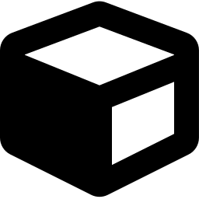

CI/CD IN ACTION
How a CI/CD pipeline works
A single push travels through six automated stages — from a developer's commit to running in production.
1
2
3
4
5
6
Commit
Build
Test
Artifact
Deploy
Monitor
Developer pushes code to Repos
Pipeline compiles & packages the app
Automated tests run on the build
Versioned package is stored
Released to staging, then production
Health & feedback watched live
CONTINUOUS INTEGRATION (CI)
CONTINUOUS DELIVERY (CD)
If any stage fails, the pipeline stops and the team is notified — broken code never reaches users.
11

Slide 12
HANDS-ON
Building your first pipeline
1
Connect your repo
Point Pipelines at your Azure Repos or GitHub project.
azure-pipelines.yml
trigger:
2
Add azure-pipelines.yml
- main
Define the pipeline as code in your repository root.
pool:
3
Choose a trigger
vmImage: ubuntu-latest
Run automatically on every push to main.
steps:
- script: npm install
4
Define stages
displayName: Install deps
Build, then Test, then Deploy — with approvals.
- script: npm test
displayName: Run tests
5
Run & watch logs
- script: npm run build
View live logs; fix failures and re-run.
displayName: Build app
Save this file in your repo — the pipeline runs on the next push.
12

Slide 13

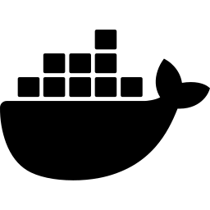
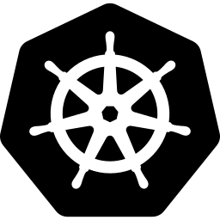
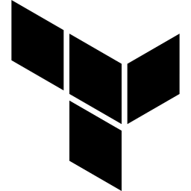
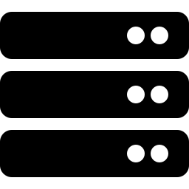
ECOSYSTEM
Works with your favourite tools
Azure DevOps deploys to any cloud and integrates with the tools DevOps teams already use every day.
GitHub
Docker
Kubernetes
Source hosting & Actions
Build & push containers
Deploy to AKS clusters
Terraform
Azure
Any Host
Provision infra as code
Native deployment target
VMs, on-prem or other clouds
13

Slide 14
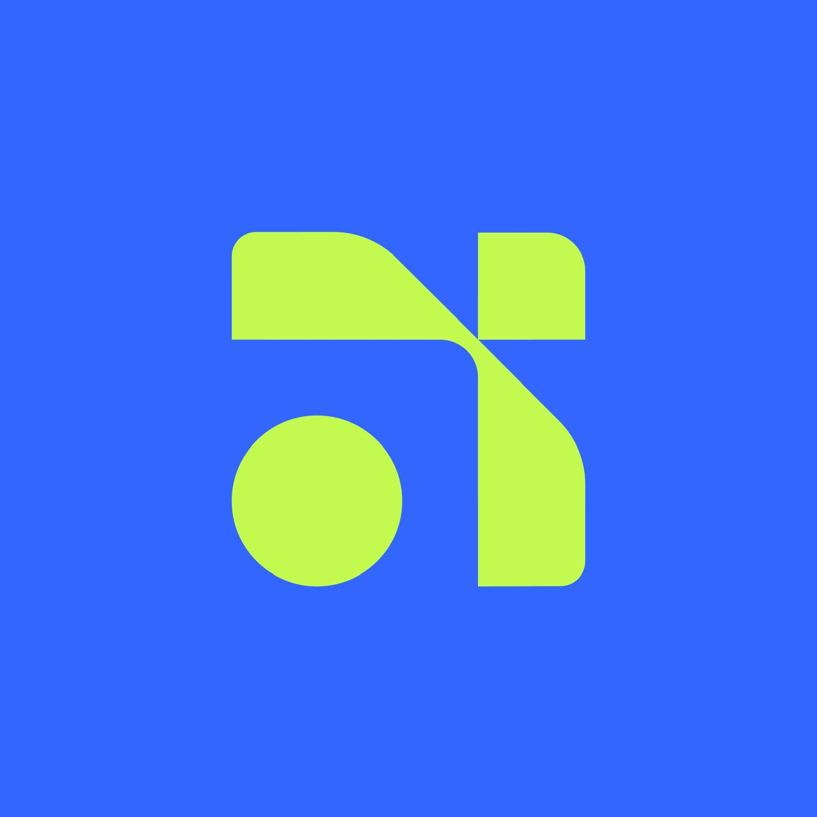
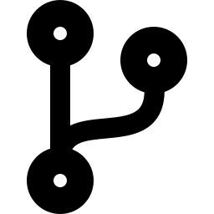

GET STARTED
Your first steps with Azure DevOps
Create an organization
Sign in at dev.azure.com and create a free org.
Make a project
Key takeaway
Add a project — it enables all five services.
Azure DevOps unites planning, code, testing and automated delivery so your team ships better software, faster — with confidence at every step.
Push your code
Create a repo in Repos and push your first commit.
Add a pipeline
Add azure-pipelines.yml and watch CI/CD run.
Thank you · Prepared by Manoop
14

