Slide 1
A guided Tour through Sparseland

Slide 2
Tour overview
the sparseland idea
a brief history
sparse coding
  coding
  learning dictionaries
future work

Slide 3
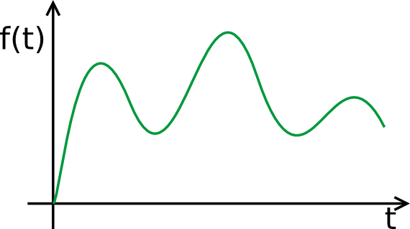
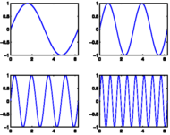
sparseland idea
expose signals via combination of limited signal samples
Why?

Slide 4
sparseland idea
expose signals via combination of limited signal samples
Why?
  signal analysis, compression etc.

Slide 5
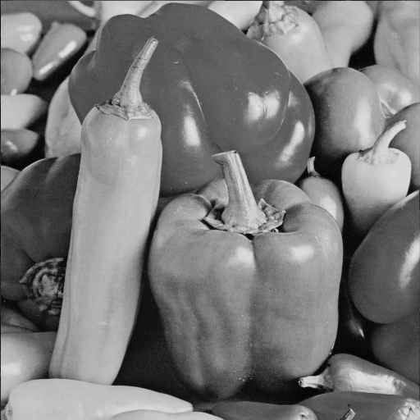

sparseland idea
structured data not just random noise
representation as 2D signal

Slide 6
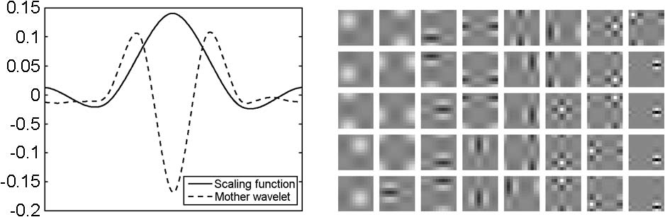
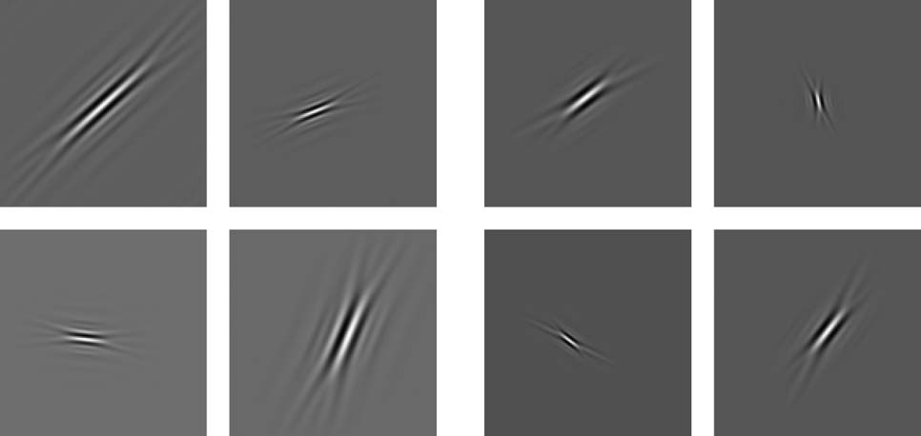
a brief history
orthogonal transforms of basis functions
60s cosine
80s wavelets
90s curvelets, contourlets, bandelets etc.

Slide 7
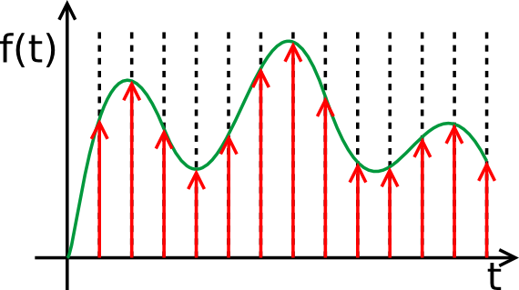
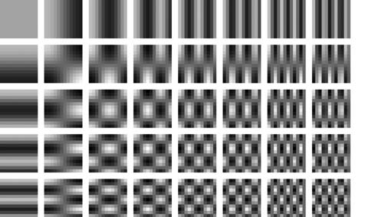
a brief history
continuous
discrete
Idea: interpret the basis transforms as sparse linear combination of dictionary atoms
Benefit: decouple signal coding and dictionary design

Slide 8
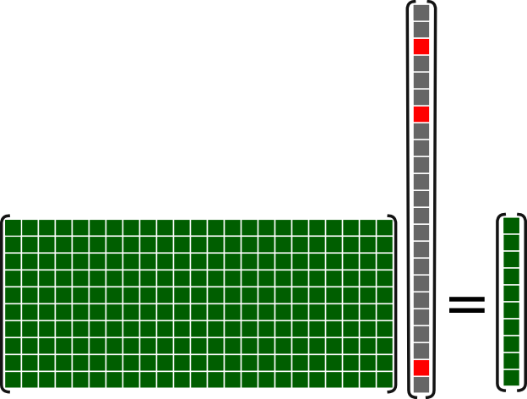
Sparse coding – basic idea
Dictionary
of atoms
Sparse code
solve under-determined linear system
we want the sparsest solution
signal
Da=X

Slide 9
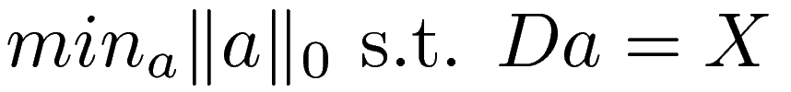
Sparse coding – basic idea
Dictionary
of atoms
Sparse code
solve under-determined linear system
we want the sparsest solution
  measure sparsity via l0-norm ||a||0
signal
Da=X

Slide 10
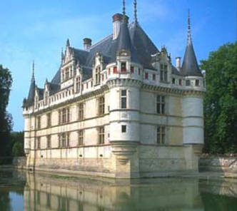
Sparse Coding – basic idea
Analogy: response of neurons to visuals
  break image down into patches
  decompose patch into activities of a few neurons
+

Slide 11
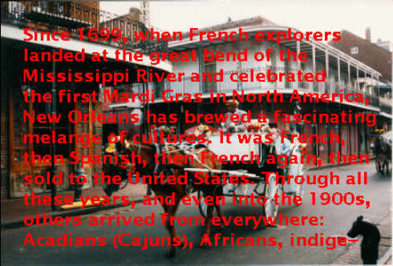
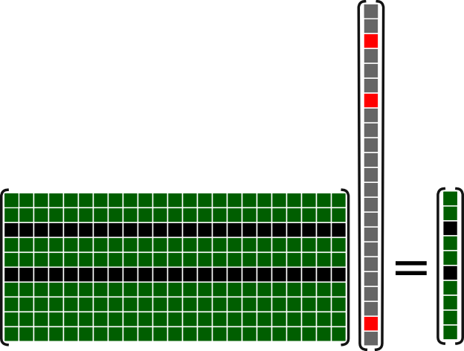
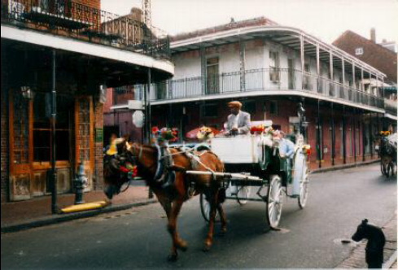
Sparse coding - usage
In-painting
  fill missing parts by removing row from the dictionary

Slide 12
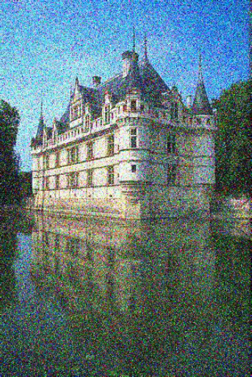
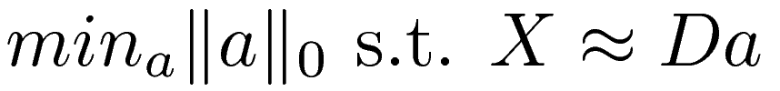
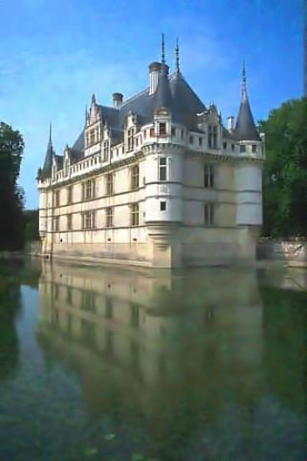
Sparse coding - usage
de-noising
  Remove noisy signal from image

Slide 13
Sparse coding
||a||0 makes the problem NP-hard
  to get best solution you need to test every combination
Solution:
  use greedy approach or make it convex (e.g. use ||a||1)

Slide 14
Sparse coding
greedy approaches
  basis pursuit
  (orthogonal) matching pursuit
alter the problem to make it convex
  LARS-Lasso
  FOCUSS

Slide 15
Sparse coding – matching pursuit
a=(0,0,0)
d
1
signal
d
2
d
3

Slide 16
Sparse coding – matching pursuit
a=(0,0,0.75)
d
1
signal
d
2
rest
d
3

Slide 17
Sparse coding – matching pursuit
a=(0,0,0.75)
d
1
d
2
signal
d
3

Slide 18
Sparse coding – matching pursuit
a=(0.2,0,0.75)
d
1
d
rest
2
signal
d
3

Slide 19
Sparse coding – matching pursuit
a=(0.2,0,0.75)
d
1
d
2
d
3
signal

Slide 20
Sparse coding – matching pursuit
a=(0.2,0,0.65)
d
1
d
2
d
3
signal
rest

Slide 21
Sparse coding
OK we found the code a by solving Da=X
But wait!

Slide 22
Sparse coding
OK we found the code a by solving Da=X
But wait!
What about our dictionary D?
Didn't we say “decouple signal coding and dictionary design” before?

Slide 23
learning dictionaries
analytic dictionaries
cosin
wavelets
curvelets, contourlets, bandelets etc.

Slide 24
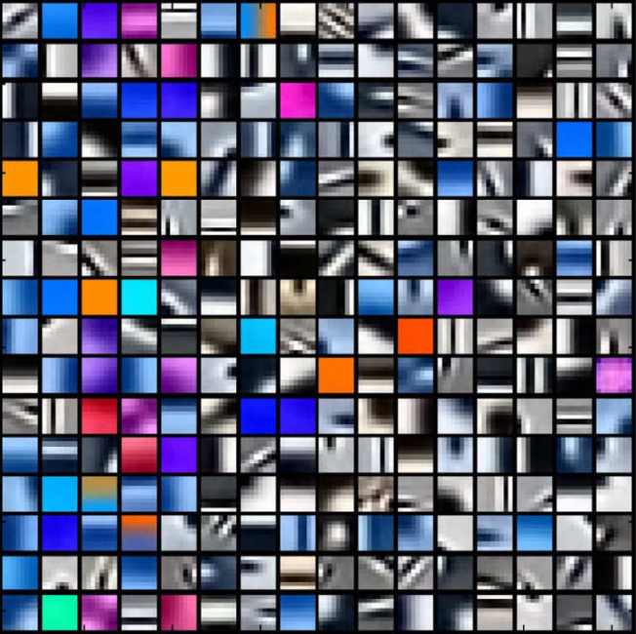
learning dictionaries
learned over-complete dictionaries
  recent research has shown that learnd dictionaries show better compression quality than small analytic dictionaries [1] [2]

Slide 25
learning dictionaries
Problem: how to learn D?
Solutions:
  neural network [3]
  Batch learn K-SVD, MOD, MAP, ILS-DLA, generalized PCA
  online learning RLS-DLA, Mairal2010

Slide 26
learning dictionaries
Problem: how to learn D?
Solutions:
  neural network [3]
  Batch learn K-SVD, MOD, MAP, ILS-DLA, generalized PCA
  online learning RLS-DLA, Mairal2010

Slide 27
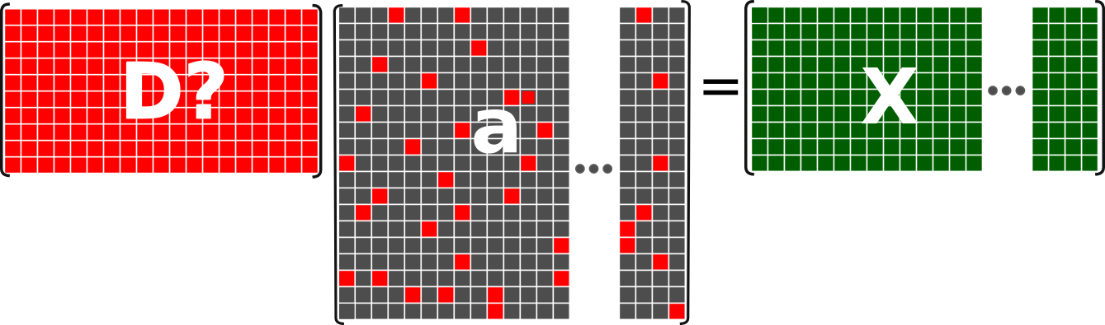
learning dictionaries - k-svd
learn D from trainig data X

Slide 28
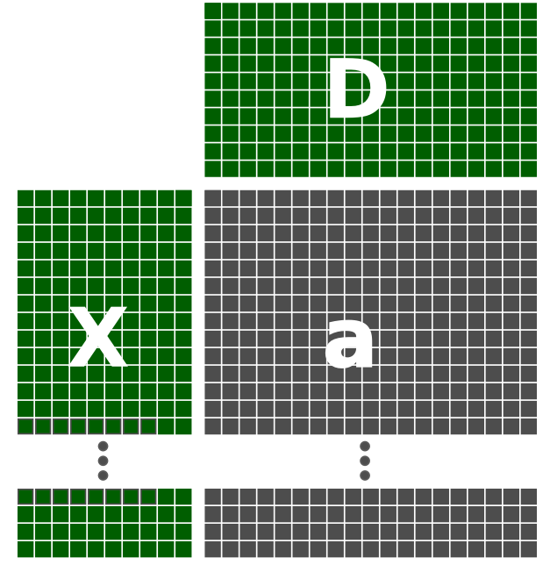
learning dictionaries - k-svd
Initialize D
with random samples from X
Sparse Code
Update
Dictionary D

Slide 29
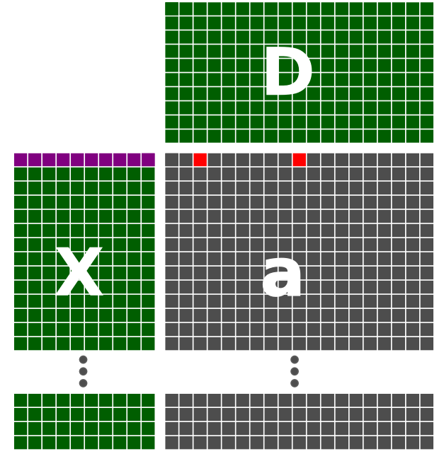
learning dictionaries - k-svd
Initialize D
samples with
max L atoms
Sparse Code
Update
Dictionary D

Slide 30
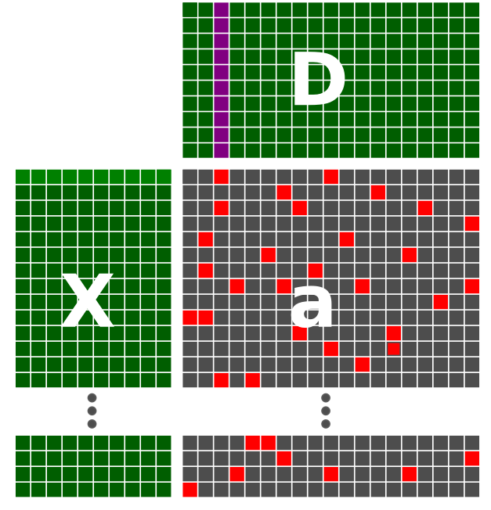
learning dictionaries - k-svd
Update each i-th atom
Initialize D
Sparse Code
Update
Dictionary D

Slide 31

learning dictionaries - k-svd
change i-th atom of D and i-th column of a that
X-Da becomes minimal
Initialize D
Sparse Code
Update
Dictionary D

Slide 32
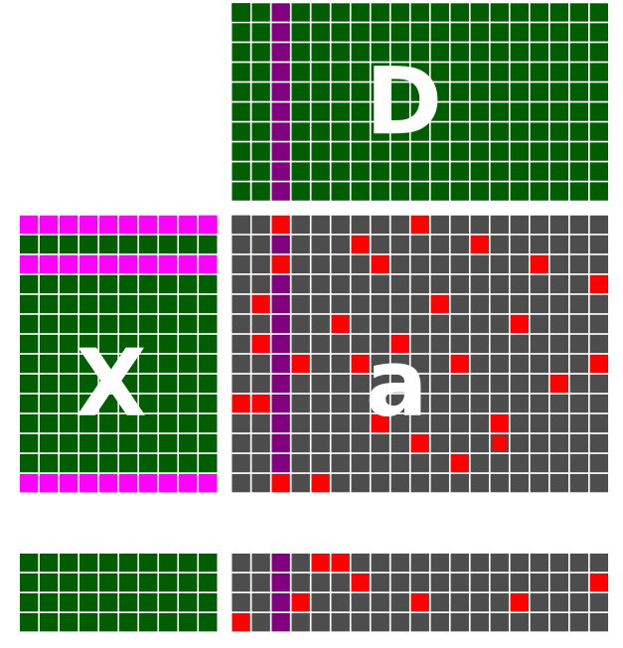
learning dictionaries - k-svd
only some examples use the i-th atom so only
update the coefficents
of the i-th a that use
them
Initialize D
Sparse Code
Update
Dictionary D

Slide 33
learning dictionaries - k-svd
Initialize D
Sparse Code
Repeat until
convergence of D
Update
Dictionary D

Slide 34
Future work
what about a universal dictionary for natural images?
how many elements for a 'good' sparse representation?
add structure for and model improvements
  Multi-scale, multi-channel, hirarchy

Slide 35
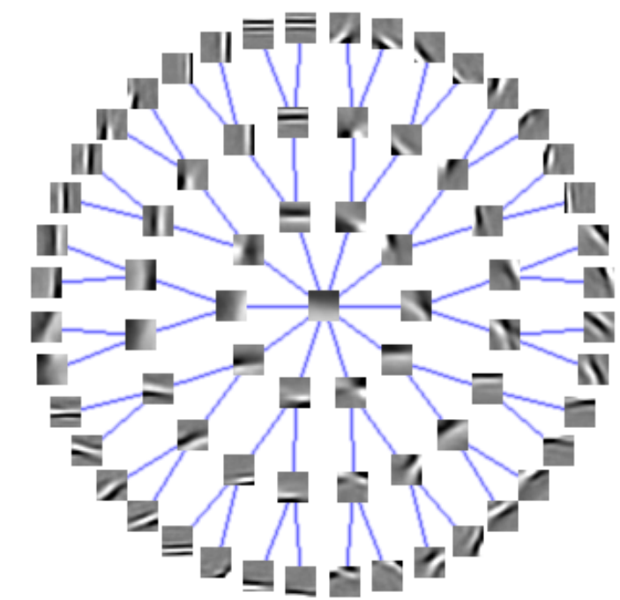
Summary
from orthogonal basis transforms
via simple sparse linear combinations of discrete dictionary atoms (Da=X)
to structured trained over-complete dictionaries

Slide 36
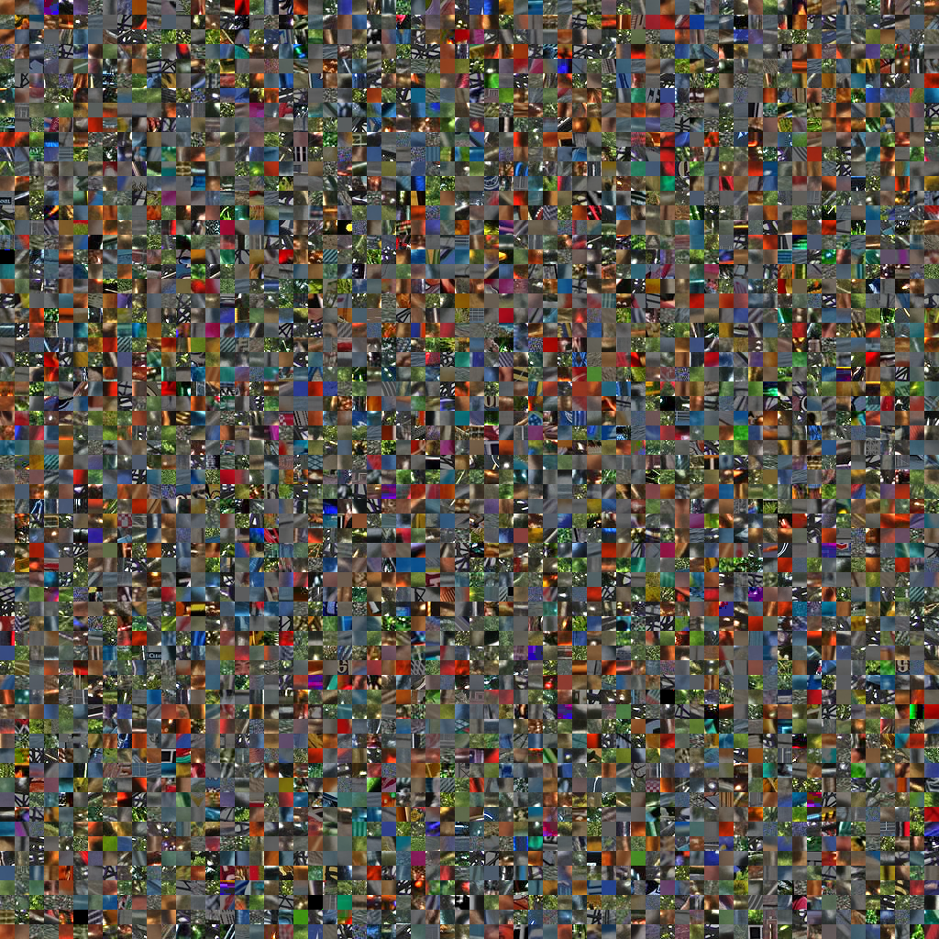

Slide 37
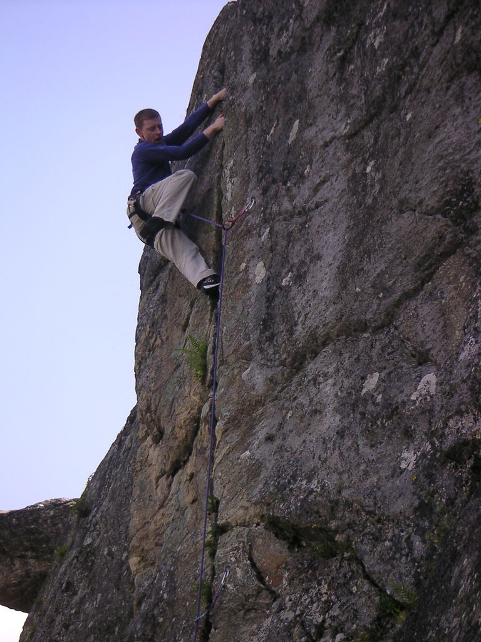


Slide 38
References
[1] Scott S. Chen, David L. Donoho, and Michael A.Saunders. “Atomic decomposition by basis pursuit.” SIAM Journal on Scientic Computing, 20(1):33-61, 1998.
[2] M. Aharon, M. Elad, and A. Bruckstein. “K-svd: An algorithm for designing overcomplete dictionaries for sparse representation.” Signal Processing, IEEE Transactions on [see also Acoustics, Speech, and Signal Processing, IEEE Transactions on], 54(11):4311-4322, 2006.
[3] Alex Krizhevsky. “Learning multiple layers of features from tiny images.” Master's thesis, 2009.

Slide 39
backup

Slide 40
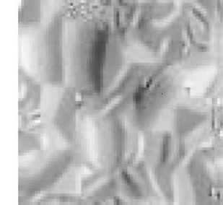
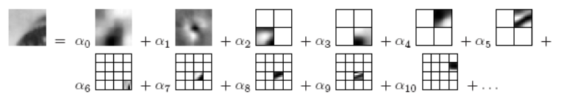
New models
Image signature
hirarchy
multi-scale

Slide 41

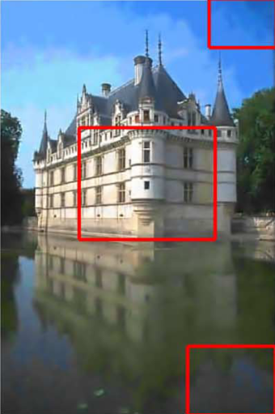
New models – multi-channel
code every channel separate or combine them into single signal
  can lead to color bleeding \cite{mairal08sparse}

Slide 42
New models – multi-channel
Why?
  color channels can be highly correlated
  combined channels show better results

Slide 43
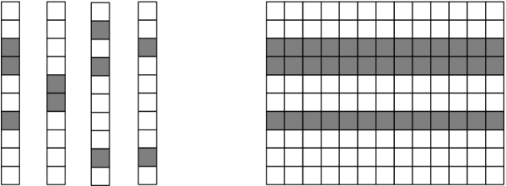
New models
double sparsity
group sparsity
  similar patches should admit similar patterns

