Slide 1

Inulin supplementation's effect on microbial abundance and short-chain fatty acids (scfa) production

Slide 2
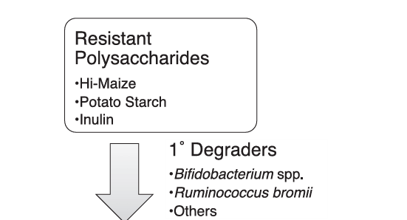
Background
Specialized bacteria that break down complex carbohydrates.
Start the fermentation process and release the SCFA precursors

Slide 3
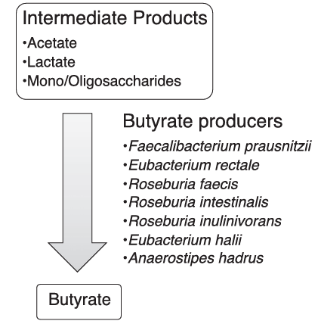
Butyrate is a energy source for colonocytes.
Maintains gut barrier function.
Anti-inflammatory effects
Metabolic benefits
Strongest direct health benefits

Slide 4
Does inulin treatment increase SCFA production (e.g., butyrate), and is this linked to changes in fiber-fermenting bacteria?
Null (H₀): Inulin treatment has no effect on SCFA production or microbial composition.
Alternative (H₁): Inulin treatment increases SCFAs, particularly butyrate, and promotes growth of key degraders and fermenters.

Slide 5
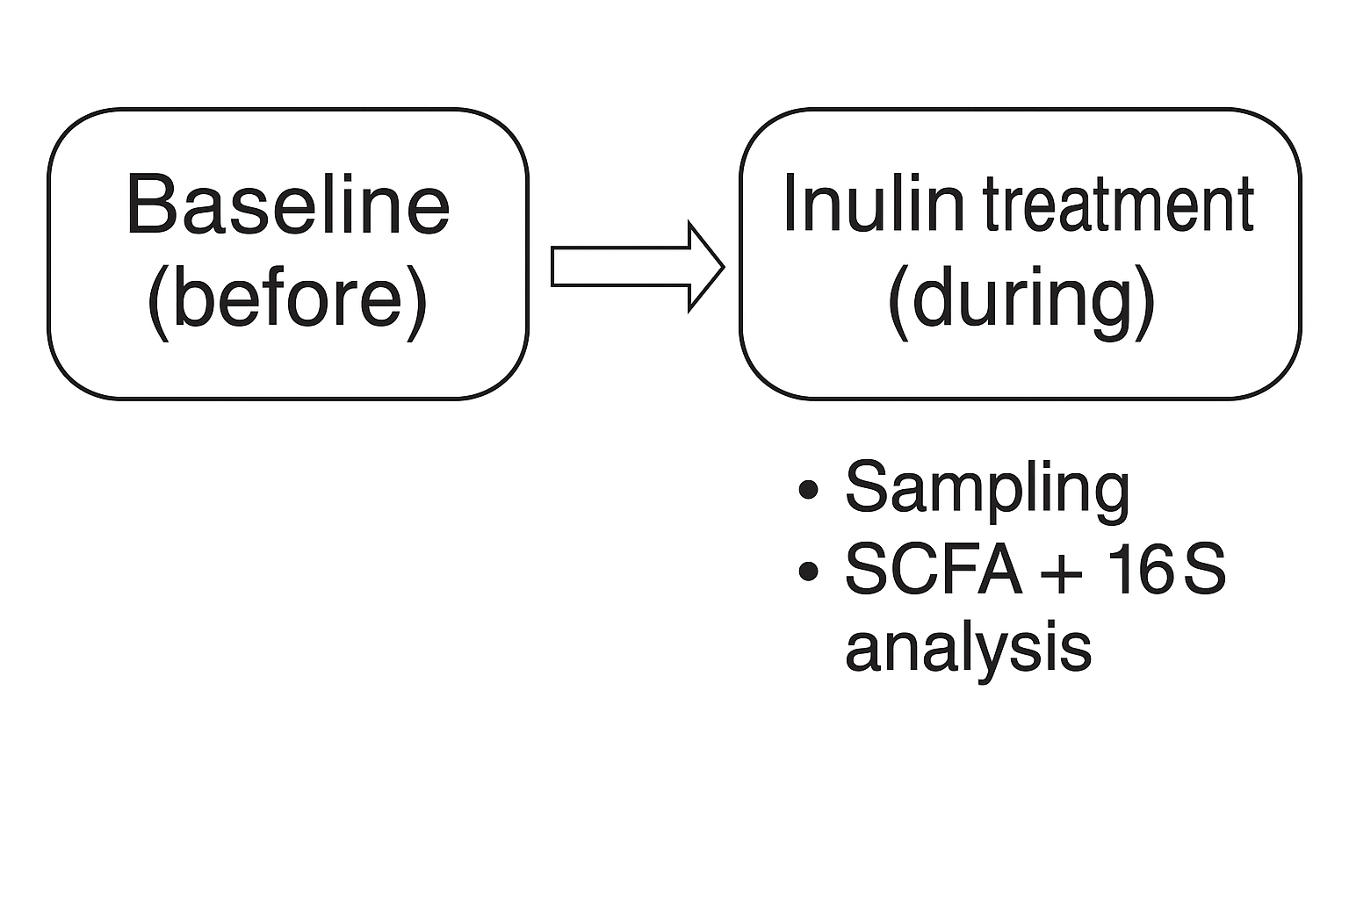
Methods
Human diet intervention with inulin supplementation.
Focusing on butyrate production and SCFA concentrations.
161 samples
16s rRNA

Slide 6
Analytical approach
Changes in SCFA concentrations in response to treatment
SCFA | Before | During | % Change | p-value
Acetate | 40.21 ± 20.32 | 42.92 ± 25.12 | +6.7% | 0.561
Butyrate | 10.08 ± 5.28 | 10.76 ± 6.36 | +6.8% | 0.559
Propionate | 17.39 ± 12.90 | 20.78 ± 20.22 | +19.5% | 0.512
Total_scfa | 69.2 ± 34.4 | 80.4 ± 58.2 | +16.32% | 0.356
Define degraders, focused on butyrate because of biological importance.
Track abundances and key phyla

Slide 7
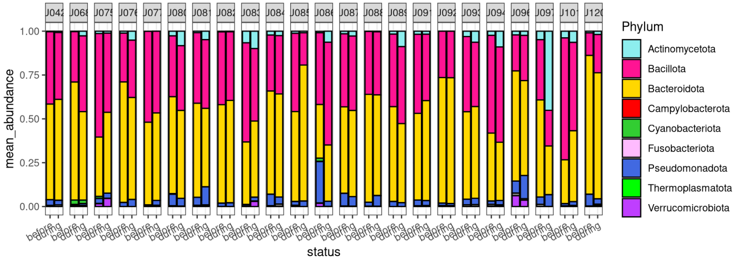
Top 10 phyla change in abundance

Slide 8
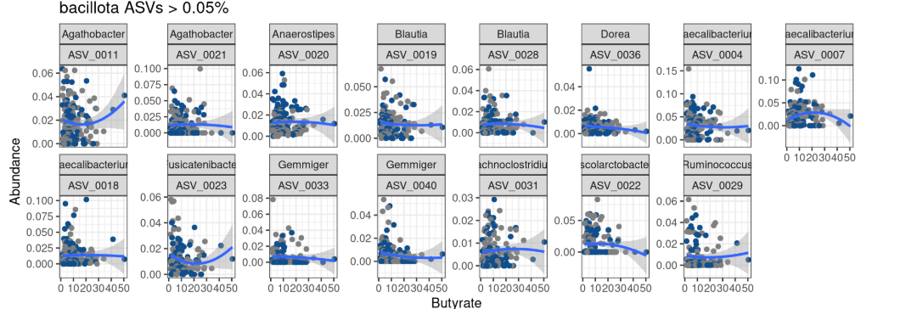
Bacillotas ASVs abundance v Butyrate concentrations

Slide 9
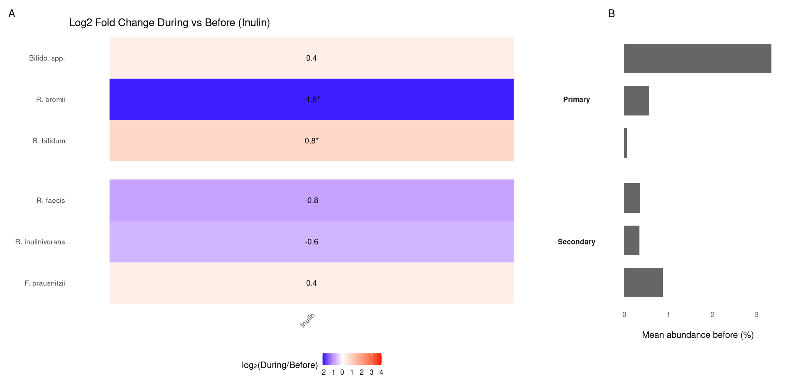

Slide 10
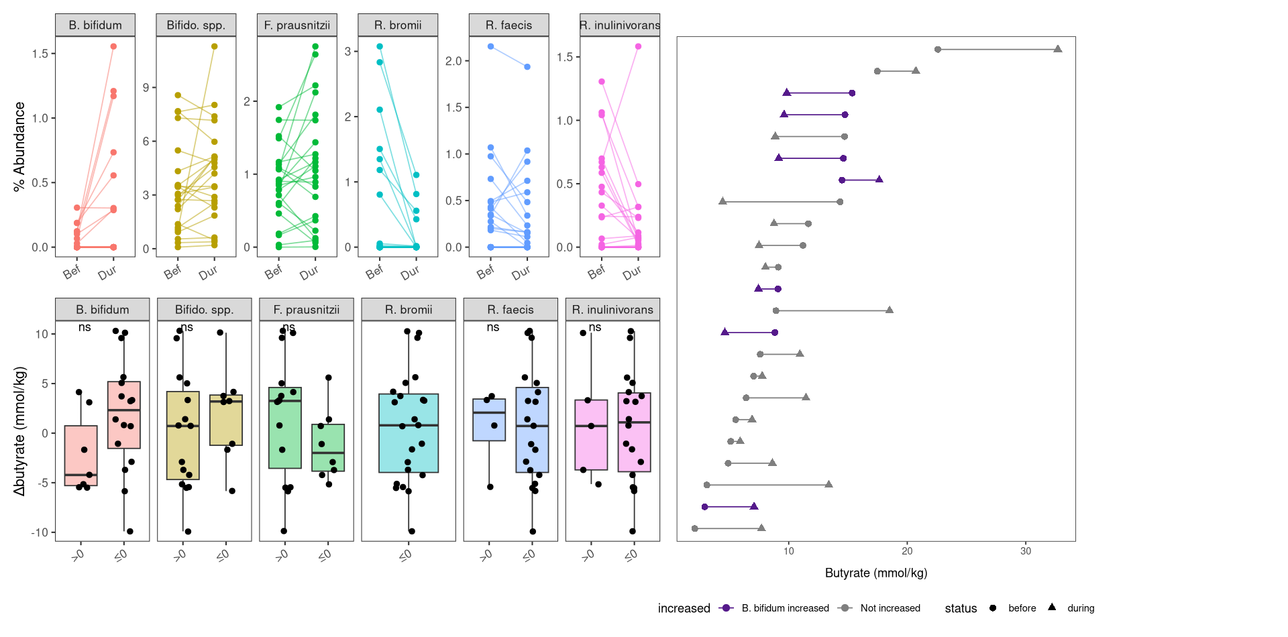

Slide 11
conclusions
Inulin supplementation significantly shifted microbial composition, increasing different Bifidobacterium species.
Butyrate did not significantly increase despite increases in butyrate producers
Propionate showed a larger and more consistent increase, but it had a lot of variance, possibility of different metabolic pathways processing inulin

Slide 12
bibliography
Baxter NTSchmidt AW, Venkataraman AKim KS, Waldron C, Schmidt TM2019.Dynamics of Human Gut Microbiota and Short-Chain Fatty Acids in Response to Dietary Interventions with Three Fermentable Fibers. mBio10:10.1128/mbio.02566-18.https://doi.org/10.1128/mbio.02566-18
Kalkan, A. E., BinMowyna, M. N., Raposo, A., Ahmad, M. F., Ahmed, F., Otayf, A. Y., Carrascosa, C., Saraiva, A., & Karav, S. (2025). Beyond the Gut: Unveiling Butyrate’s Global Health Impact Through Gut Health and Dysbiosis-Related Conditions: A Narrative Review. Nutrients, 17(8), 1305. https://doi.org/10.3390/nu17081305

