Slide 1
Bi-Weekly Progress
Team H

Slide 2
Contents
Progress
After Plan

Slide 3
Progress
The person in charge of frontend was sick for a week and could not proceed...

Slide 4
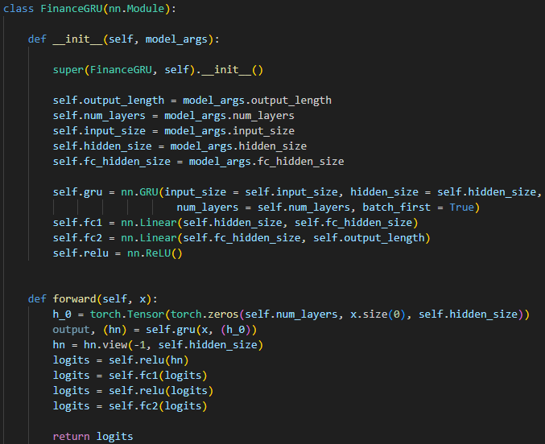
Progress
GRU, Trainer Implementation
FinanceGRU.py

Slide 5
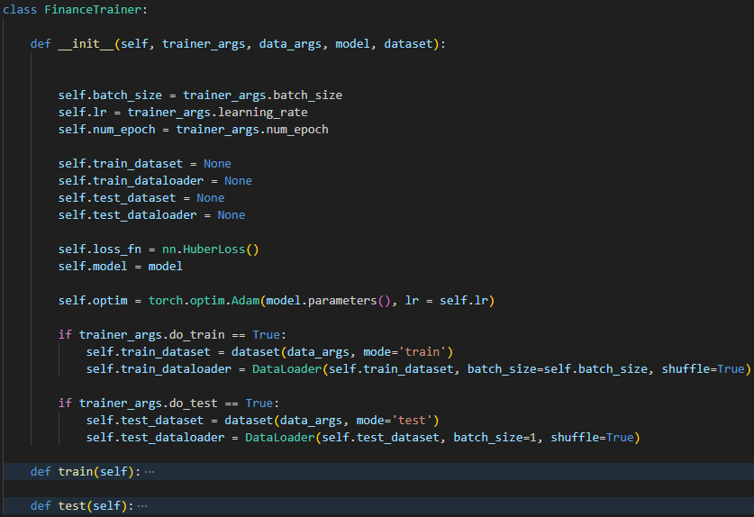
Progress
GRU, Trainer Implementation
FinanceTrainer.py

Slide 6
Progress
GRU, Trainer Implementation
Trainer
Train Dataset
Model
train()
Test Dataset
test()

Slide 7
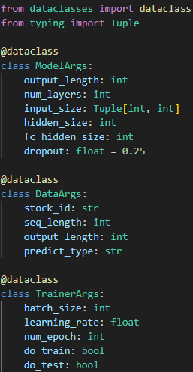
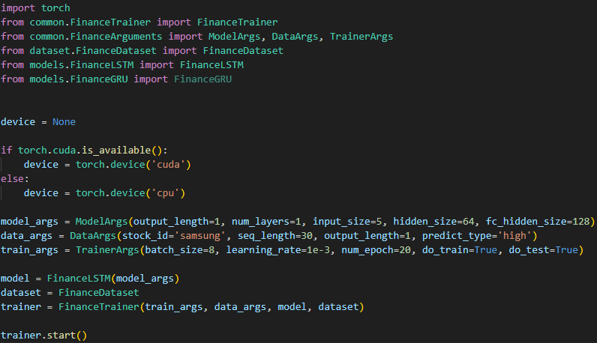
Progress
Argument Formatting
FinanceArguments.py
main.py

Slide 8
Progress
Some Experiments
Environments
CPU : Intel Core i5-12600KF
GPU : GeForce RTX 3060
VRAM : 12GB
Loss Function : Huber Loss (δ = 1.0)
Evaluation Metrics : MAE

Slide 9
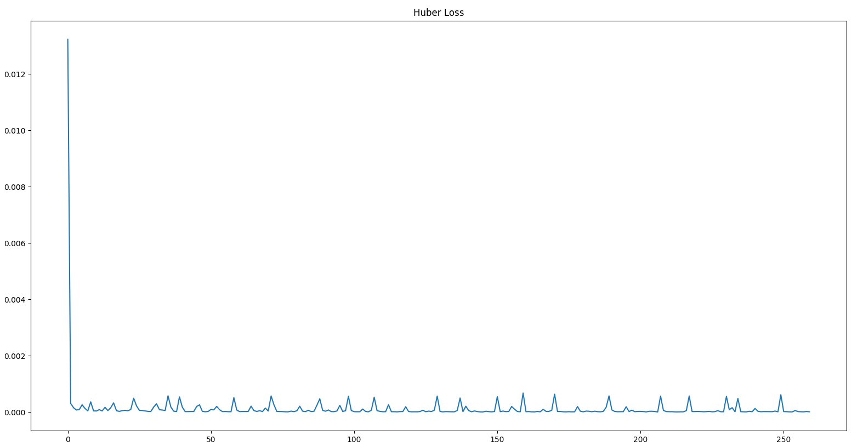
Progress
LSTM

Slide 10
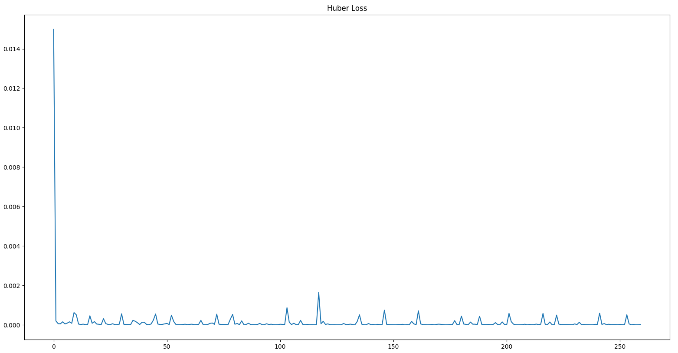
Progress
GRU

Slide 11
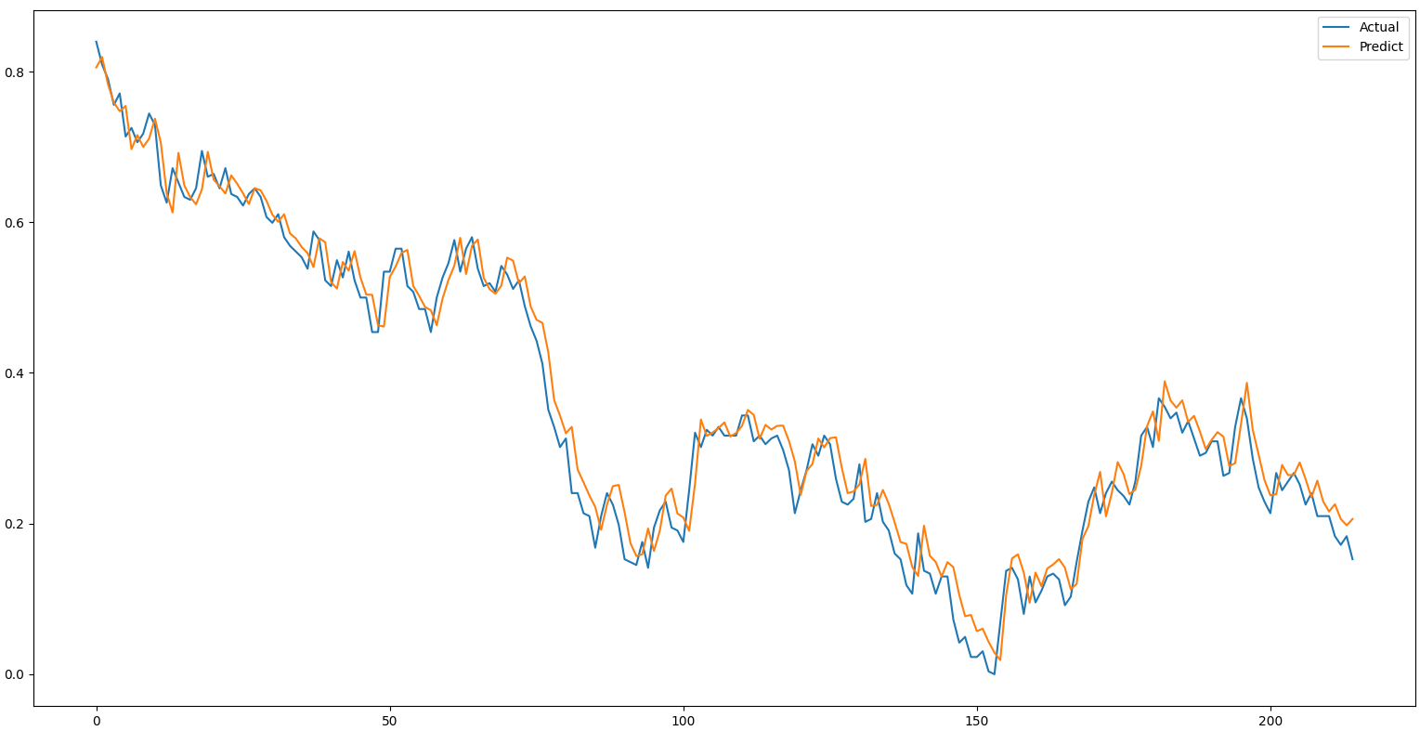
Something went wrong...

Slide 12
Something went wrong...
Models just saying
“Tomorrow’s stock price will be Today’s stock price”
Possible Solutions : Re-defining data, or applying external data, etc...

Slide 13
Plan
Frontend : UI/UX Design
AI : 1dCNN, Transformer Implementation, Data Re-defining
Disclosure sentiment analysis

Slide 14
Schedule
 | 9 | 10 | 11 | 12 | 13 | 14 | 15
정동훈 Frontend | UI/UX Design |  | AWS Server Build |  | Testing
이찬영 AI | Data Re-define Sentiment analysis | Transformer | Hyperparameter Tuning
서유진 AI |  | 1D CNN

