Slide 1

딥러닝을 이용한 자폐 아동 감정통합발달교육 프로그램
EMOTIONAL DEVELOPMENT EDUCATION PROGRAM FOR AUTISM SPECTRUM CHILDREN
USING DEEP LEARNING
삼김이최고 :D조
최나영 김세연 김지원 김용택 이종우
03.24.2023
Notes:
Now we're going to start our QNA session.

Slide 2
Questions from other teams
I don't know it can actually help autistic children. I think it requires medical knowledge.
Why YoLov8 for human expression detection?
What function will make the autism kids use the application?
Any prior work or research?
Is it enough for children to feel excited and get immersed in this service?
How do you guarantee this service will work for children with autism?
Notes:
These are the questions we've got.
There are two main categories for our questions.
One is whether our project can actually help autistic children, and the other is why we chose the YOLOv8 model for this project.
Therefore, we would like to focus on these two things.

Slide 3
Previous education
for autistic children
Notes:
To help your understanding, I will shortly explain the background.

Slide 4
Autism - Difficult in Communication, Interaction, Emotion
Behavioral Therapy - To control inappropriate behavior
Music Therapy – To control emotions and improve sociality
Physical Therapy – To Improve immature movements, sense of balance
PECS(Picture Exchange Communication System) – communication and emotion
Notes:
Autism refers to a condition in which it is difficult to communicate and interact with others.
Autistic children also got difficult for expressing and understanding "emotions."
Therefore, considering the characteristics of these autistic children, special education has been continuously developed,
For the previous education for autistic children, there are behavioral therapy, music therapy and physical therapy, etc.
Among them, PECS program is the very effective method at the communication area.
Therefore, we will apply these proven education programs into our project.

Slide 5
PECS/ABA
Notes:
Then, I will show our basic principle of therapy program.
PECS and ABA
ABA is Applied Behavior Analysis which is used wide in education for autism.
PECS is Picture Exchange Communication System.

Slide 6

PECS/ABA
[EBS부모] 아이를 위한 언어발달 소통 방법 2가지! - 'PECS', 'ABA기법' – YouTube
6:20
Notes:
To help you understand them, let's first look at a video.

Slide 7
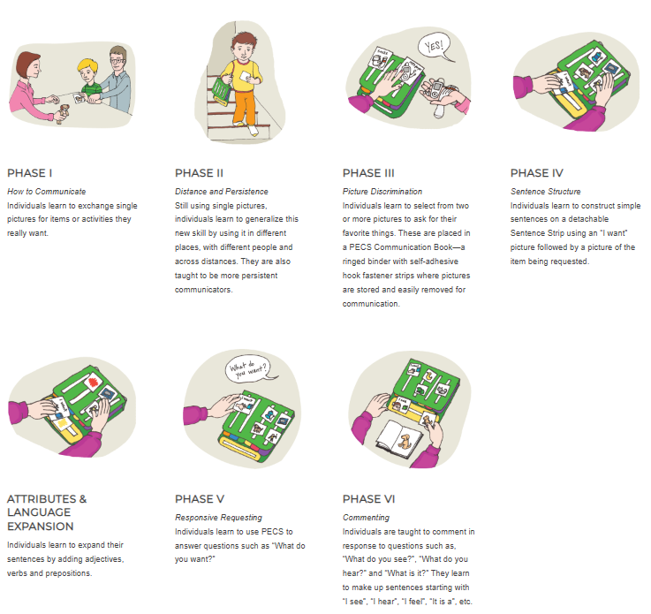
Notes:
This is 6 sequences of PECS.

Slide 8
Related papers

Slide 9
Related papers
USING THE PICTURE EXCHANGE COMMUNICATION SYSTEM (PECS) WITH CHILDREN WITH AUTISM: ASSESSMENT OF PECS ACQUISITION, SPEECH, SOCIAL‐COMMUNICATIVE BEHAVIOR, AND PROBLEM BEHAVIOR - Charlop‐Christy - 2002 - Journal of Applied Behavior Analysis - Wiley Online Library – Examine the effectiveness of PECS by multiple baseline design.
Effects of an iPad-based Speech-Generating Device Infused into Instruction with the Picture Exchange Communication System for Adolescents and Young Adults with Severe Autism Spectrum Disorder (sagepub.com) – Effectiveness of PECS by using i-Pad app.
그림교환의사소통 체계(PECS) - Pyramid Educational Consultants, Korea, Inc. (pecs-korea.com)
Notes:
These are studies that have proven the effectiveness of PECS program.
The first paper examines the effectiveness of PECS by multiple baseline design.
The Second paper examines the effectiveness of PECS by using digital devices.

Slide 10
Why YOLO ?
Notes:
Hello, I'm Nayoung Choi, and I'm in charge of answering questions about yolo.
Last week, One of student asked us a question about
“Why we chose yolo when there are many other models besides yolo to use the object detection function?”
So from now on, i would like to explain why we chose yolo among various models.

Slide 11
categories
Speed -> How fast?
Accuracy -> Is it Correct?
Ease of Implementation
Notes:
now, we will be comparing the three object detection models that are most commonly used in computer vision.
the comparison is based on three categories.
First, speed that is basically how fast the model can give the results
Second, accuracy that is how accurate those results are
and third is the ease of implementation that is how easy it is to implement these models

Slide 12
Famous 3 models
YOLO
SSD
Faster-RCNN
Notes:
we will be comparing the three most common models that are yolo/ ssd/ and faster rcnn
there are other models as well, but we will be focusing on most famous three models.

Slide 13
Result
 | Speed | Accuracy | Ease Of Implementation
Faster R-CNN
SSD
YOLO
Notes:
so the first criteria of comparison was speed of inference that is how fast a model can give results

Slide 14
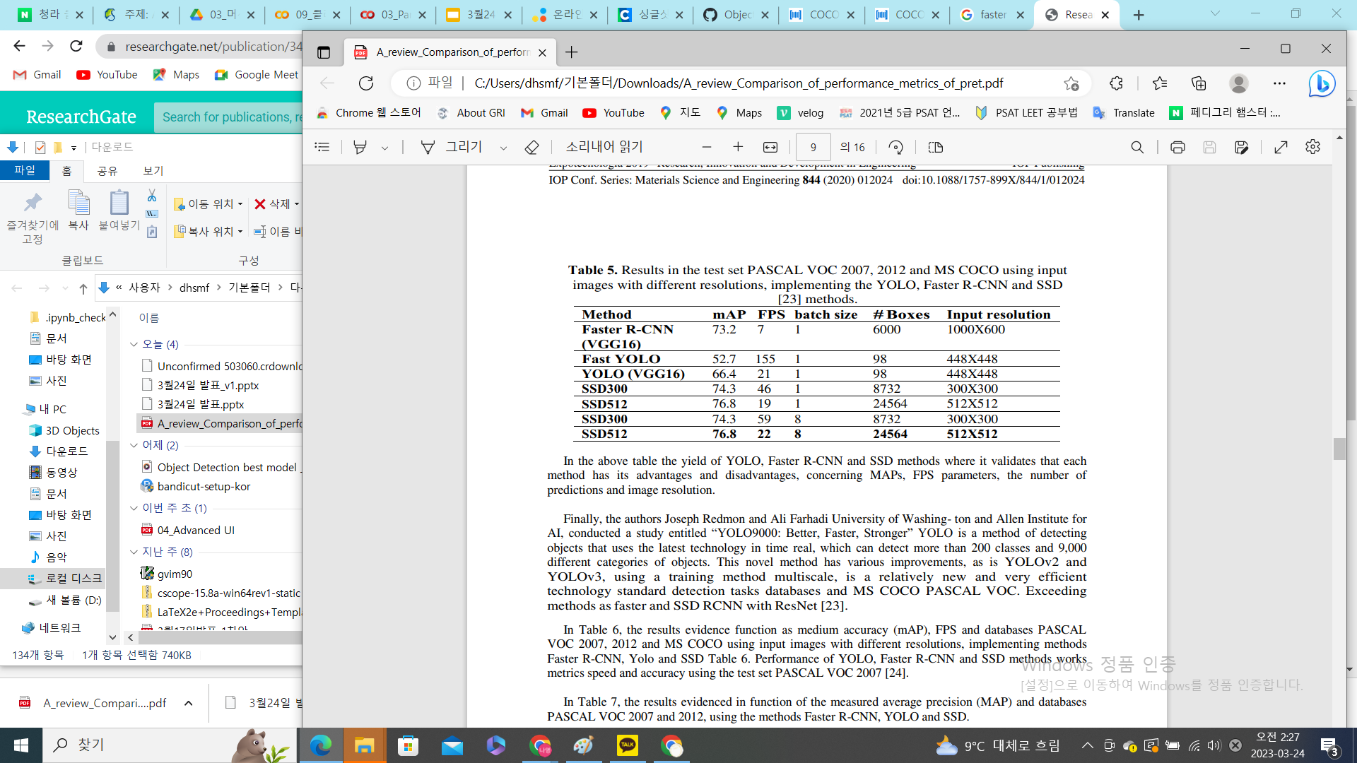
FPS Comparision
[Reference] https://www.researchgate.net/publication/342570032_A_review_Comparison_of_performance_metrics_of_pretrained_models_for_object_detection_using_the_TensorFlow_framework#pf11
Notes:
This table is taken from a paper published in 2020.
And you can see that ssd and yolo recorded fps 19 and above, while fast rcnn recorded a very slow number of fps 7.

Slide 15
Result
 | Speed | Accuracy | Ease Of Implementation
Faster R-CNN | BAD
SSD
YOLO
Notes:
Therefore, we can be sure that among this three models, Faster r-cnn shows poor performance in terms of speed.
//아래 x
now you may ask what are these two short detectors
well, it basically means that the algorithm takes a look at the image twice once for extracting the features from the backbone network and the other for calculating the recent proposals even though the faster rcnn takes a bit different approach from other rcnn models it is still slow

Slide 16
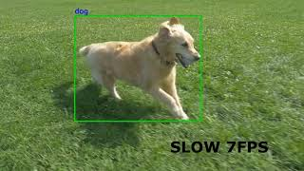
faster-rcnn (7FPS)
Notes:
And if you look at this video, you can see how slow 7 fps is.

Slide 17
Famous 3 models
YOLO
SSD
Faster-RCNN
Notes:
on the other hand,
both yolo and ssd algorithm were designed to work in real time.

Slide 18
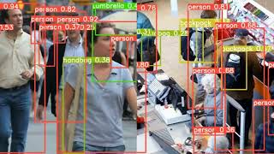
YOLO(left) / SSD(right)
Notes:
and If you look at this video, you can see that it's definitely fast enough to use it in real time.

Slide 19
Result
 | Speed | Accuracy | Ease Of Implementation
Faster R-CNN | BAD
SSD | GOOD
YOLO | GOOD
Notes:
hence, the speed of both yolo and ssd is quite high compared to faster rcnn
now let’s talk about the second criteria of comparison which was accuracy of the models .
on this criteria i would say that three models are kind of comparable.
but it is also important to note that all these models have some problems of their own.

Slide 20
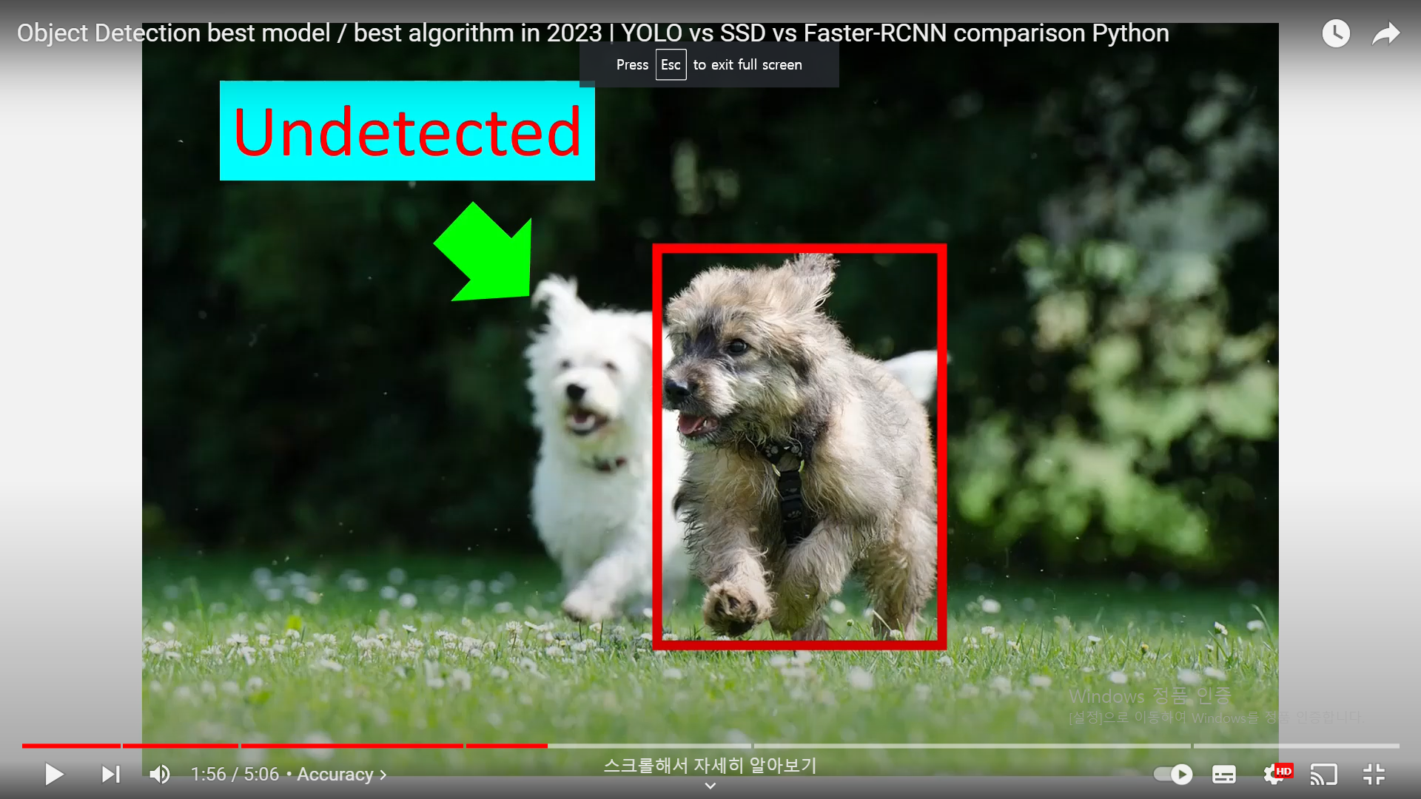
Undetected problem (When two instances are overlapped)
Notes:
For example, in the case of yolo, it is sometimes impossible to recognize the object behind it when objects overlap rapidly.
However, the objects we need to recognize in our planned program are one autistic child and one or two objects held by the autistic child.
Because there are not many obejcts and fast-moving movements are not required, it is judged that the undetected problem is not a major obstacle to the project.

Slide 21
Result
 | Speed | Accuracy | Ease Of Implementation
Faster R-CNN | BAD | GOOD
SSD | GOOD | GOOD
YOLO | GOOD | GOOD

Slide 22
Result
 | Speed | Accuracy | Ease Of Implementation
Faster R-CNN | BAD | GOOD
SSD | GOOD | GOOD
YOLO | GOOD | GOOD
Notes:
Lastly, third consideration is ease of implementation.

Slide 23
Ease of Implementation
For Only inference
Faster-RCNN / ssd : 10 - 15 lines
yolo : 2 - 3 lines
For Fine Tuning
Faster-RCNN / ssd : 25 lines
yolo : 5 - 6 lines
Notes:
now let’s talk about the least number of lins of code that you need to write in order to get your object detection model works
so assuming that you don’t have to do any fine tuning on a custom data set
the minimum number of lines of code required for faster rcnn and ssd is going to be around 10 to 15 lines .
and for yolo it’s going to be either two or three lines
now assuming you have your own dataset and want to do fine tuning then ssd and faster rcnn will take anything more than
25 lines
but with yolo ultralytics v8 it will take less than five to six lines

Slide 24
Result
 | Speed | Accuracy | Ease Of Implementation
Faster R-CNN | BAD | GOOD | BAD
SSD | GOOD | GOOD | BAD
YOLO | GOOD | GOOD | GOOD
Notes:
so among these three models,
the clear winner is yolo
, with ssd at the second position
and faster rcnn at third

Slide 25

Thank YOU
Q&A
Notes:
This is the end of my presentation. Thank you.
and If you have any questions, please let us know

