Slide 1
UniCoop
University + Cooperation
Team F
조명하 남하임 백준선 조재범
UniCoop is a collaboration service that supports a series of processes from team building to collaboration for University team project classes.

Slide 2
Objective
UniCoop has these objective
Register Project | Team Matching | Team Chatting
Meeting / Working Time | Task Timeline | Projects Management

Slide 3
Milestone
UniCoop has been in progress as schedule
Week | 3 | 4 | 5 | 6 | 7 | 8 | 9 | 10 | 11 | 12 | 13 | 14
기획 및 DB 설계
회원가입 / 로그인
프로젝트 생성 / 참여
UI / UX 디자인
팀 빌딩 기능 구현
팀 협업 기능 구현
기능 테스트
퀄리티업

Slide 4
Role of each member
Roles and Participation
Frontend
Reusable components, My Page, Apply, Group Activity
남하임
Frontend
조명하
Login/Register, Manage Projects, Register Projects
Server
백준선
Class related APIs, Team matching algorithm, Server Test codes
Server
DB Schema, Auth related APIs, Server building
조재범

Slide 5
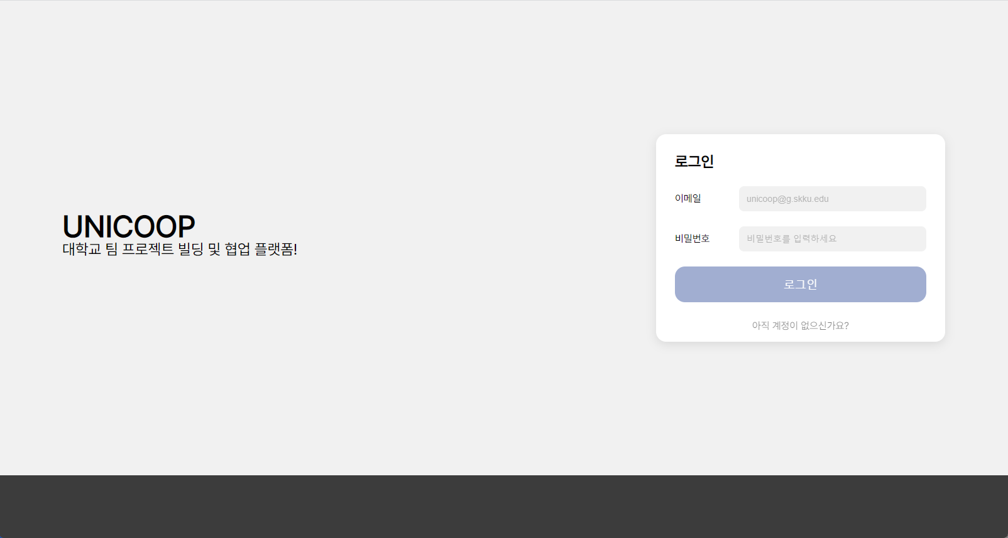
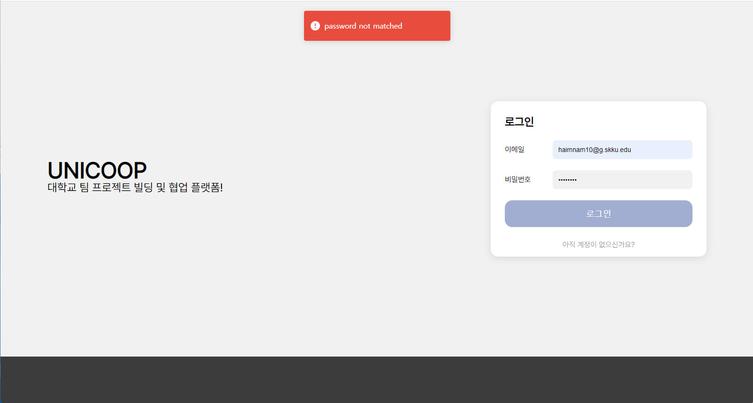
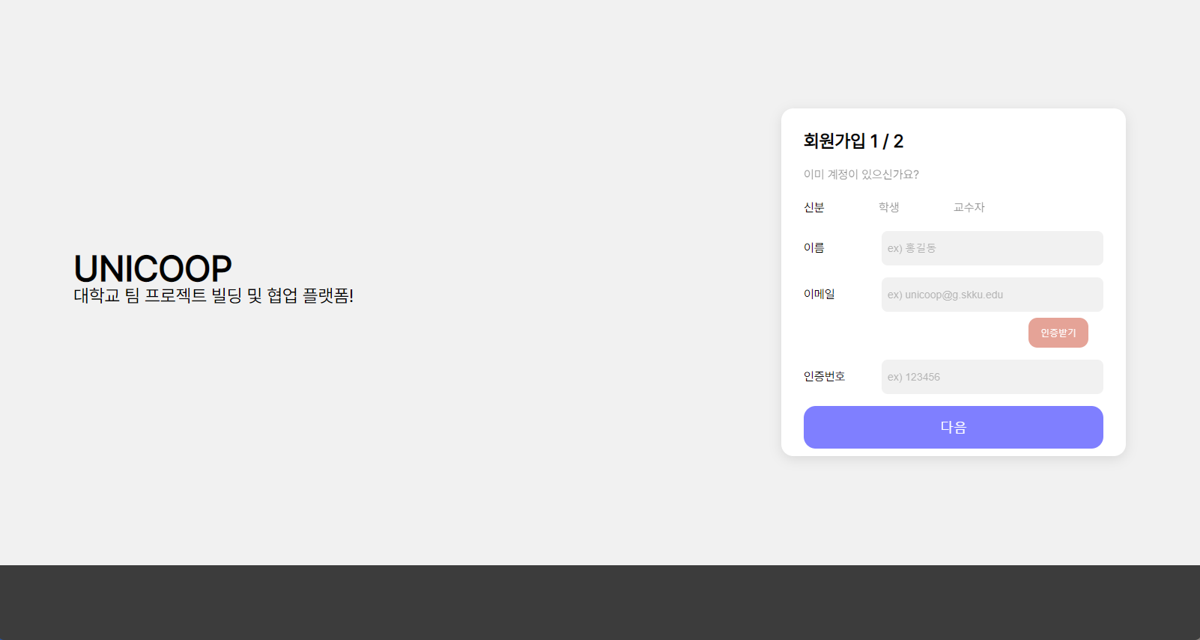
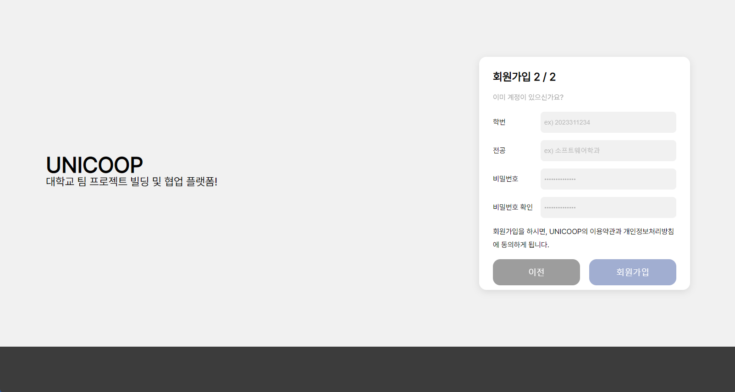
Design

Slide 6
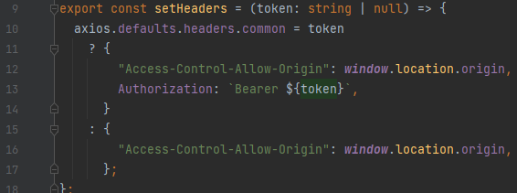

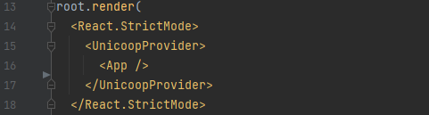
Challenges
Issue | Solved
Had to put token every time to confirm the user | Set config header to axios.defaults.headers. common
Hard to track the localStorage | Access the token value through useContext

Slide 7
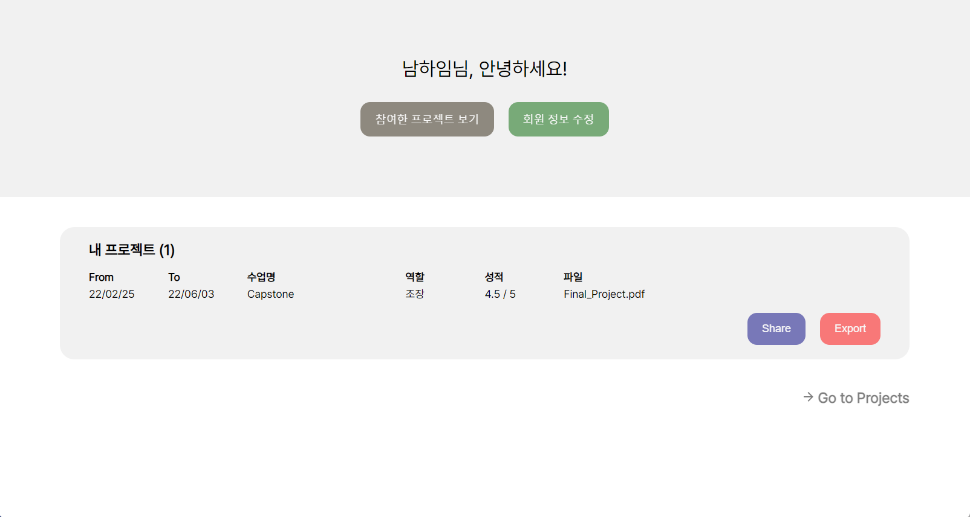
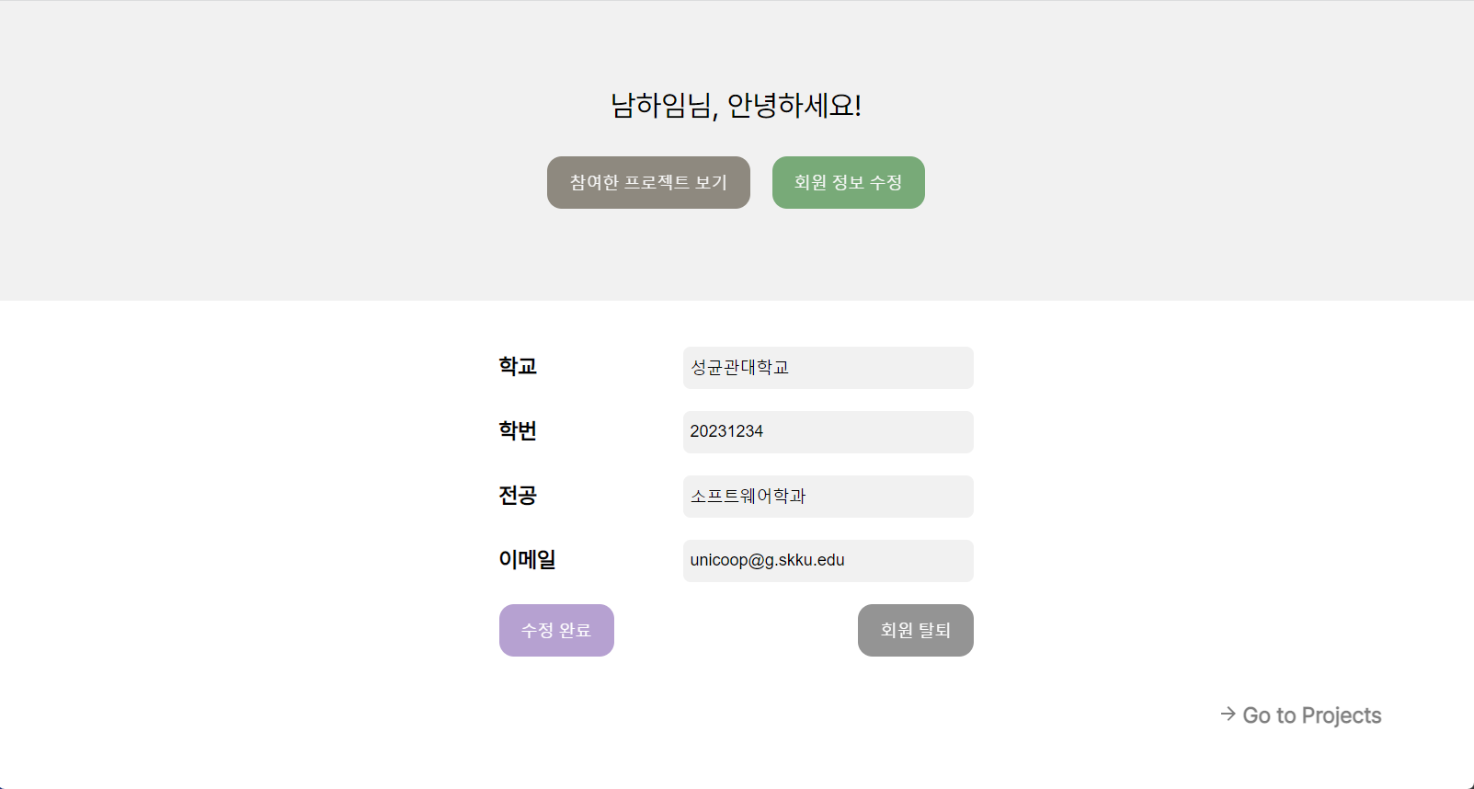
Design

Slide 8
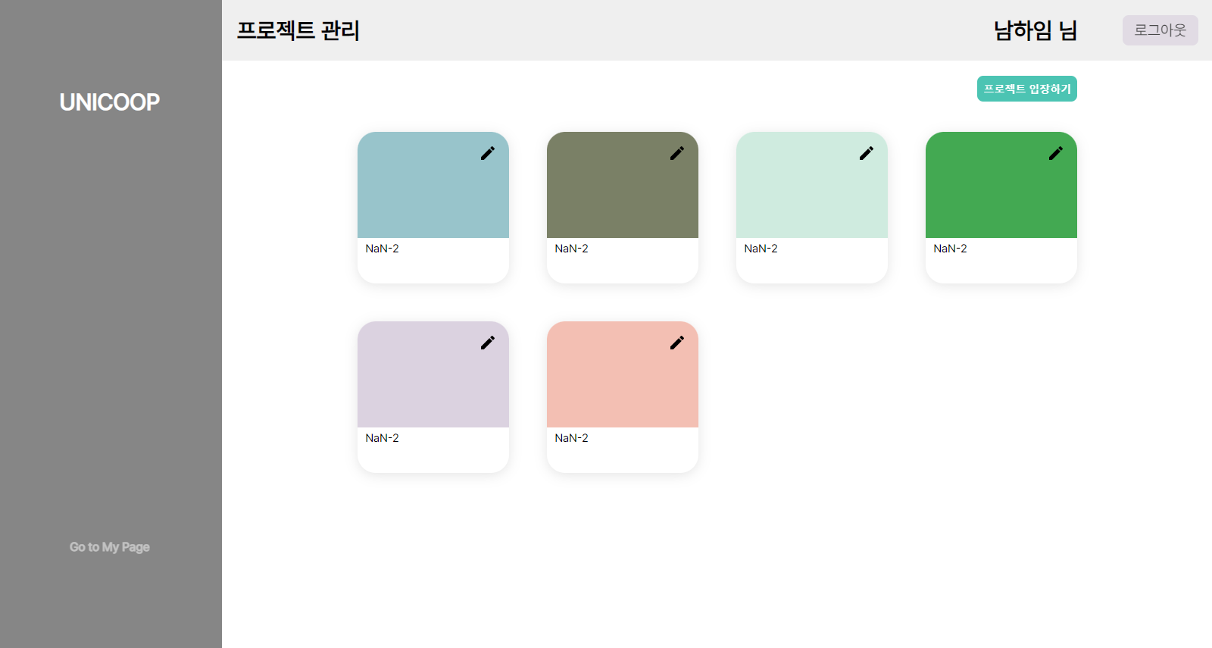
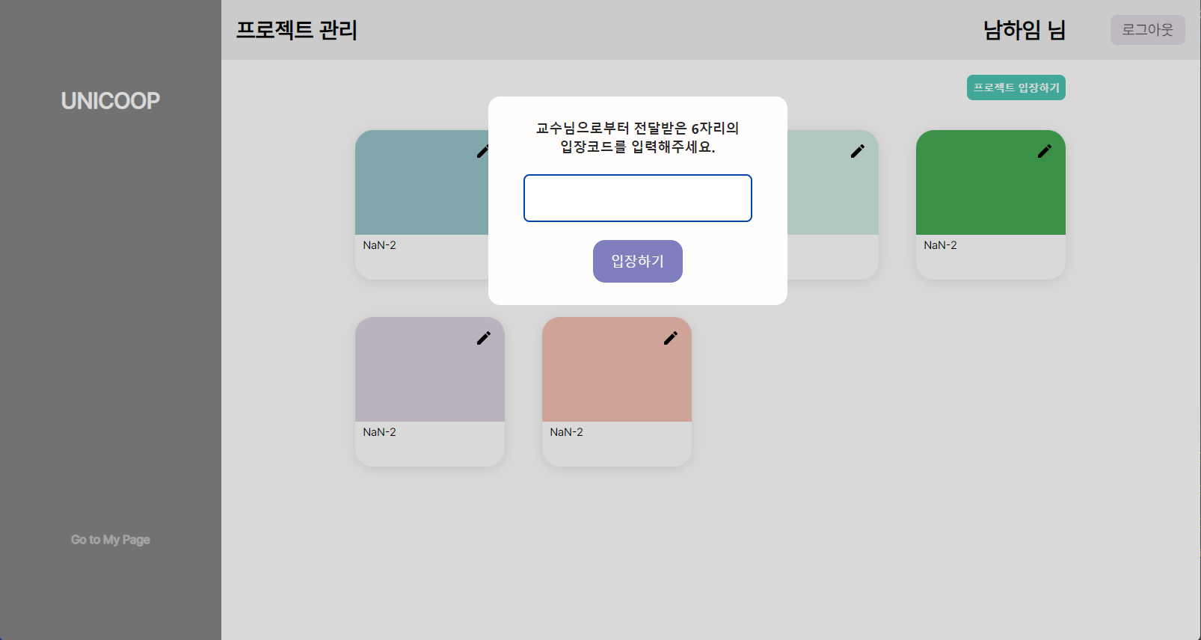
Design

Slide 9
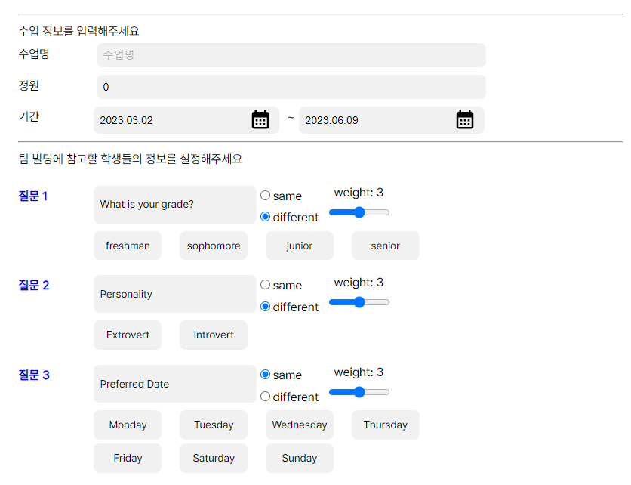
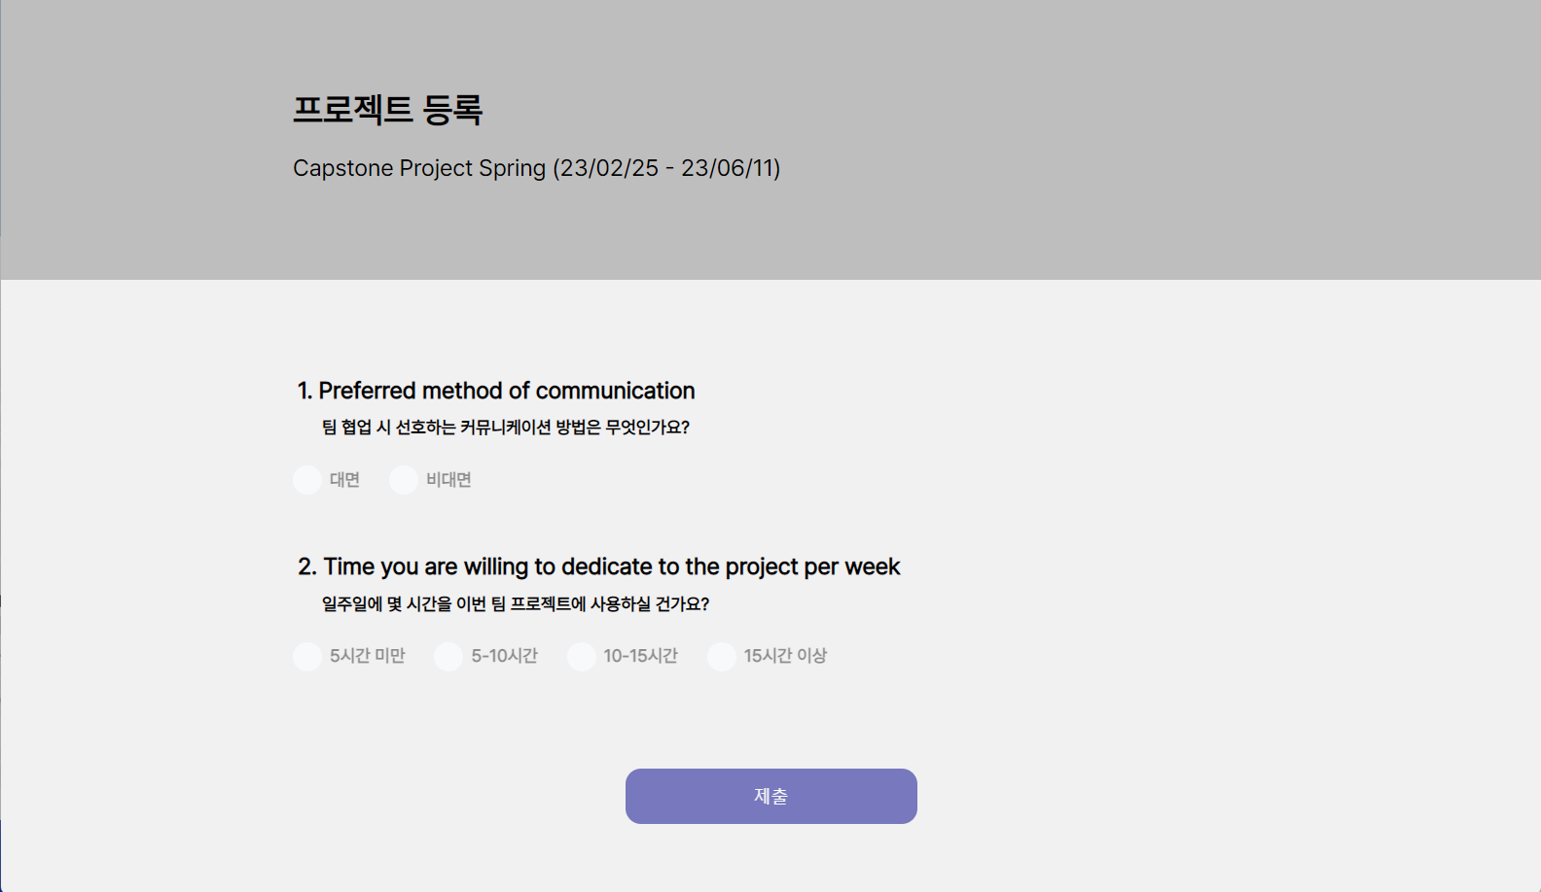
Design

Slide 10
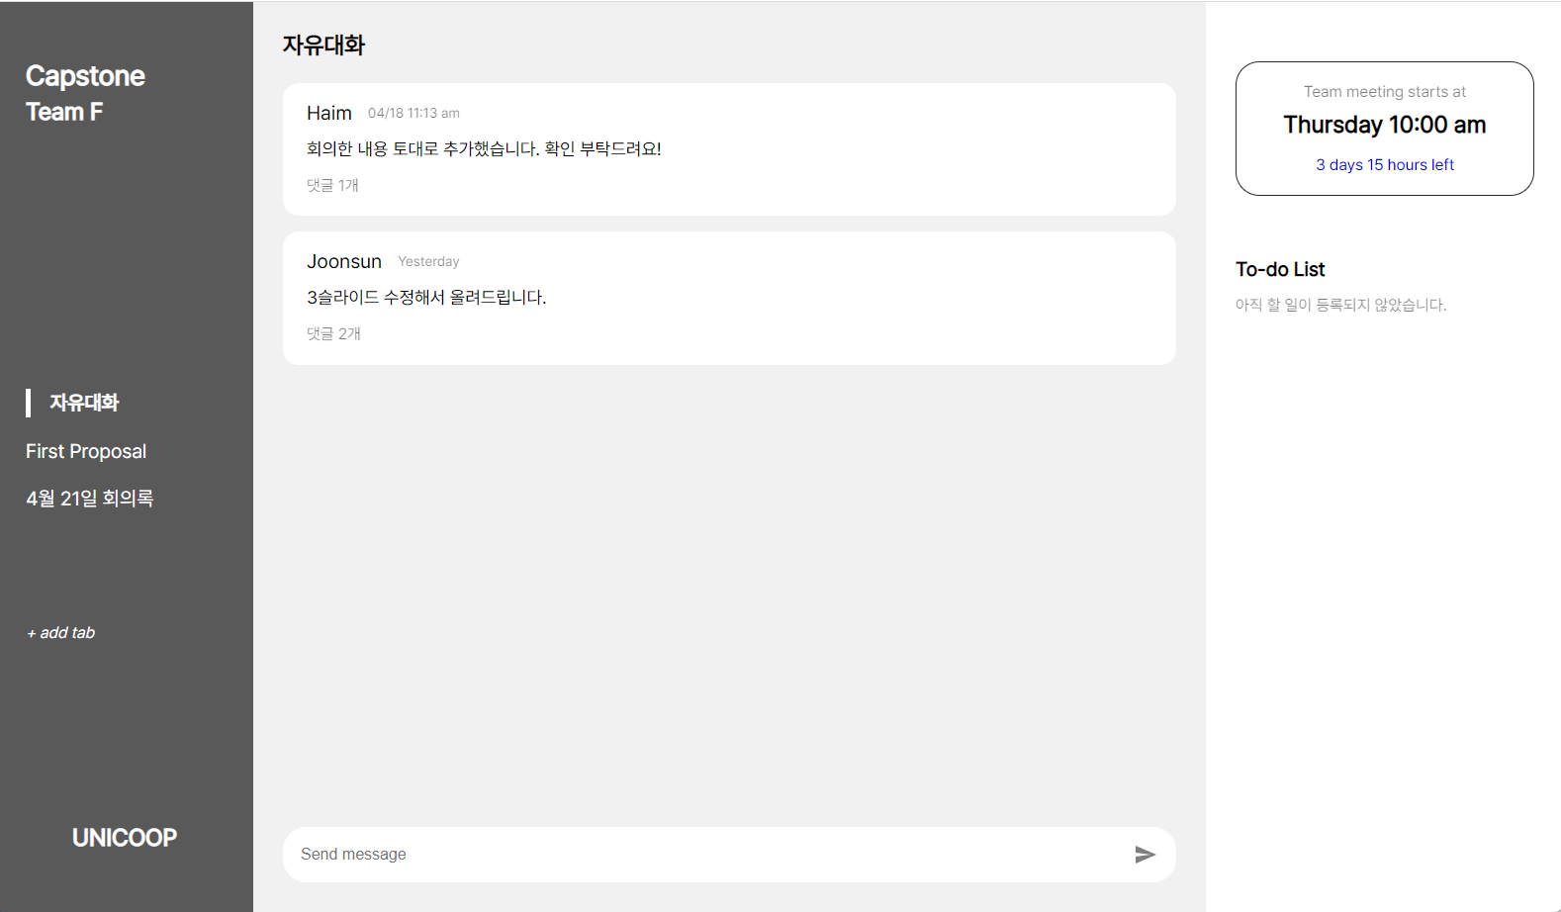
Design

Slide 11
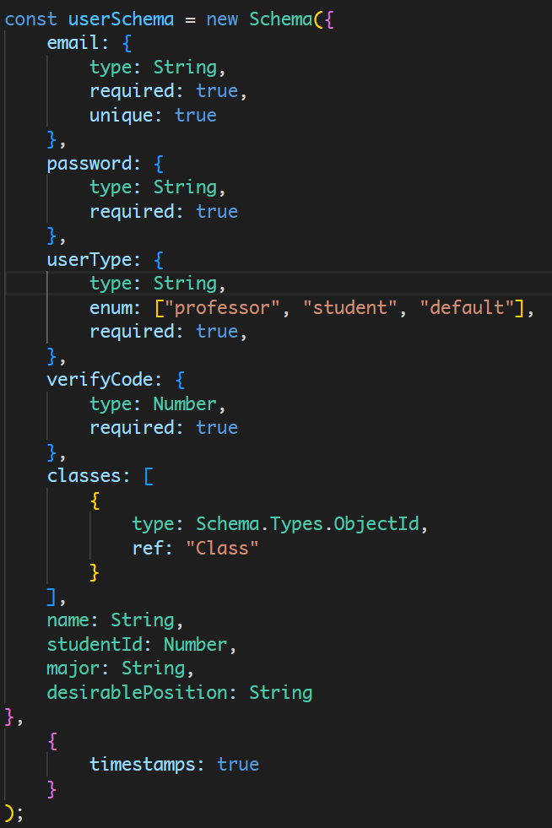
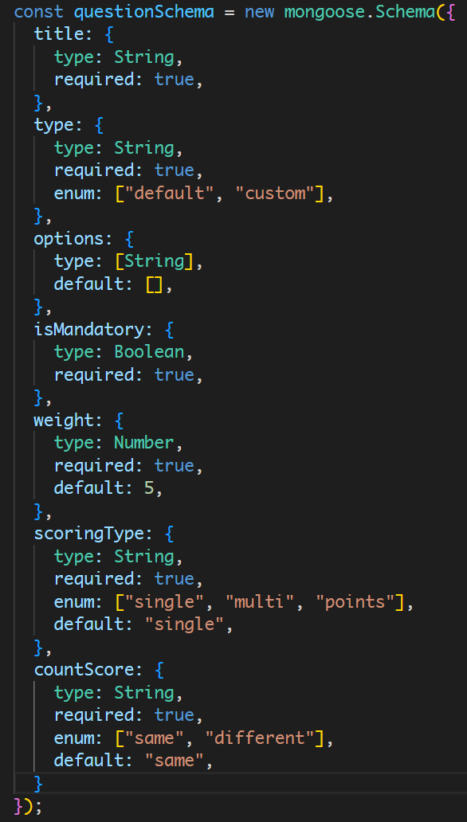
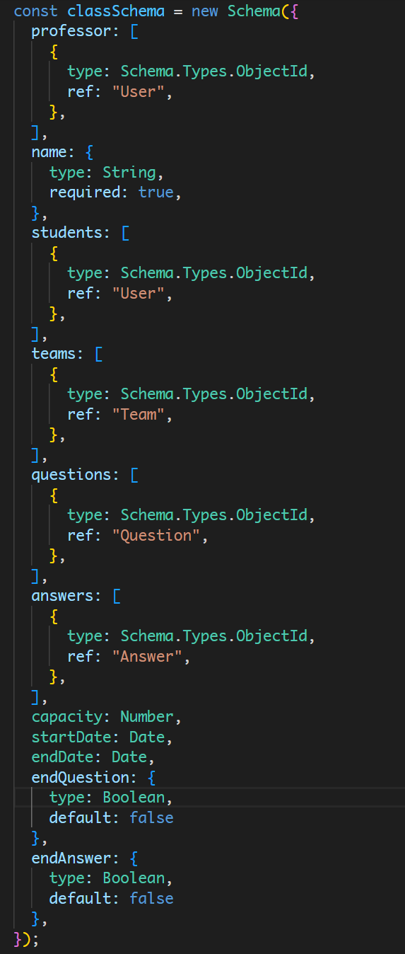
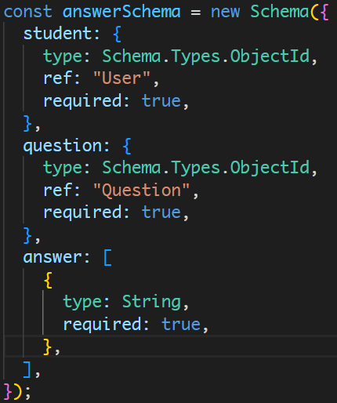
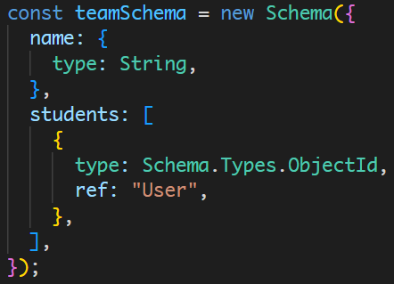
Implementation - DB

Slide 12
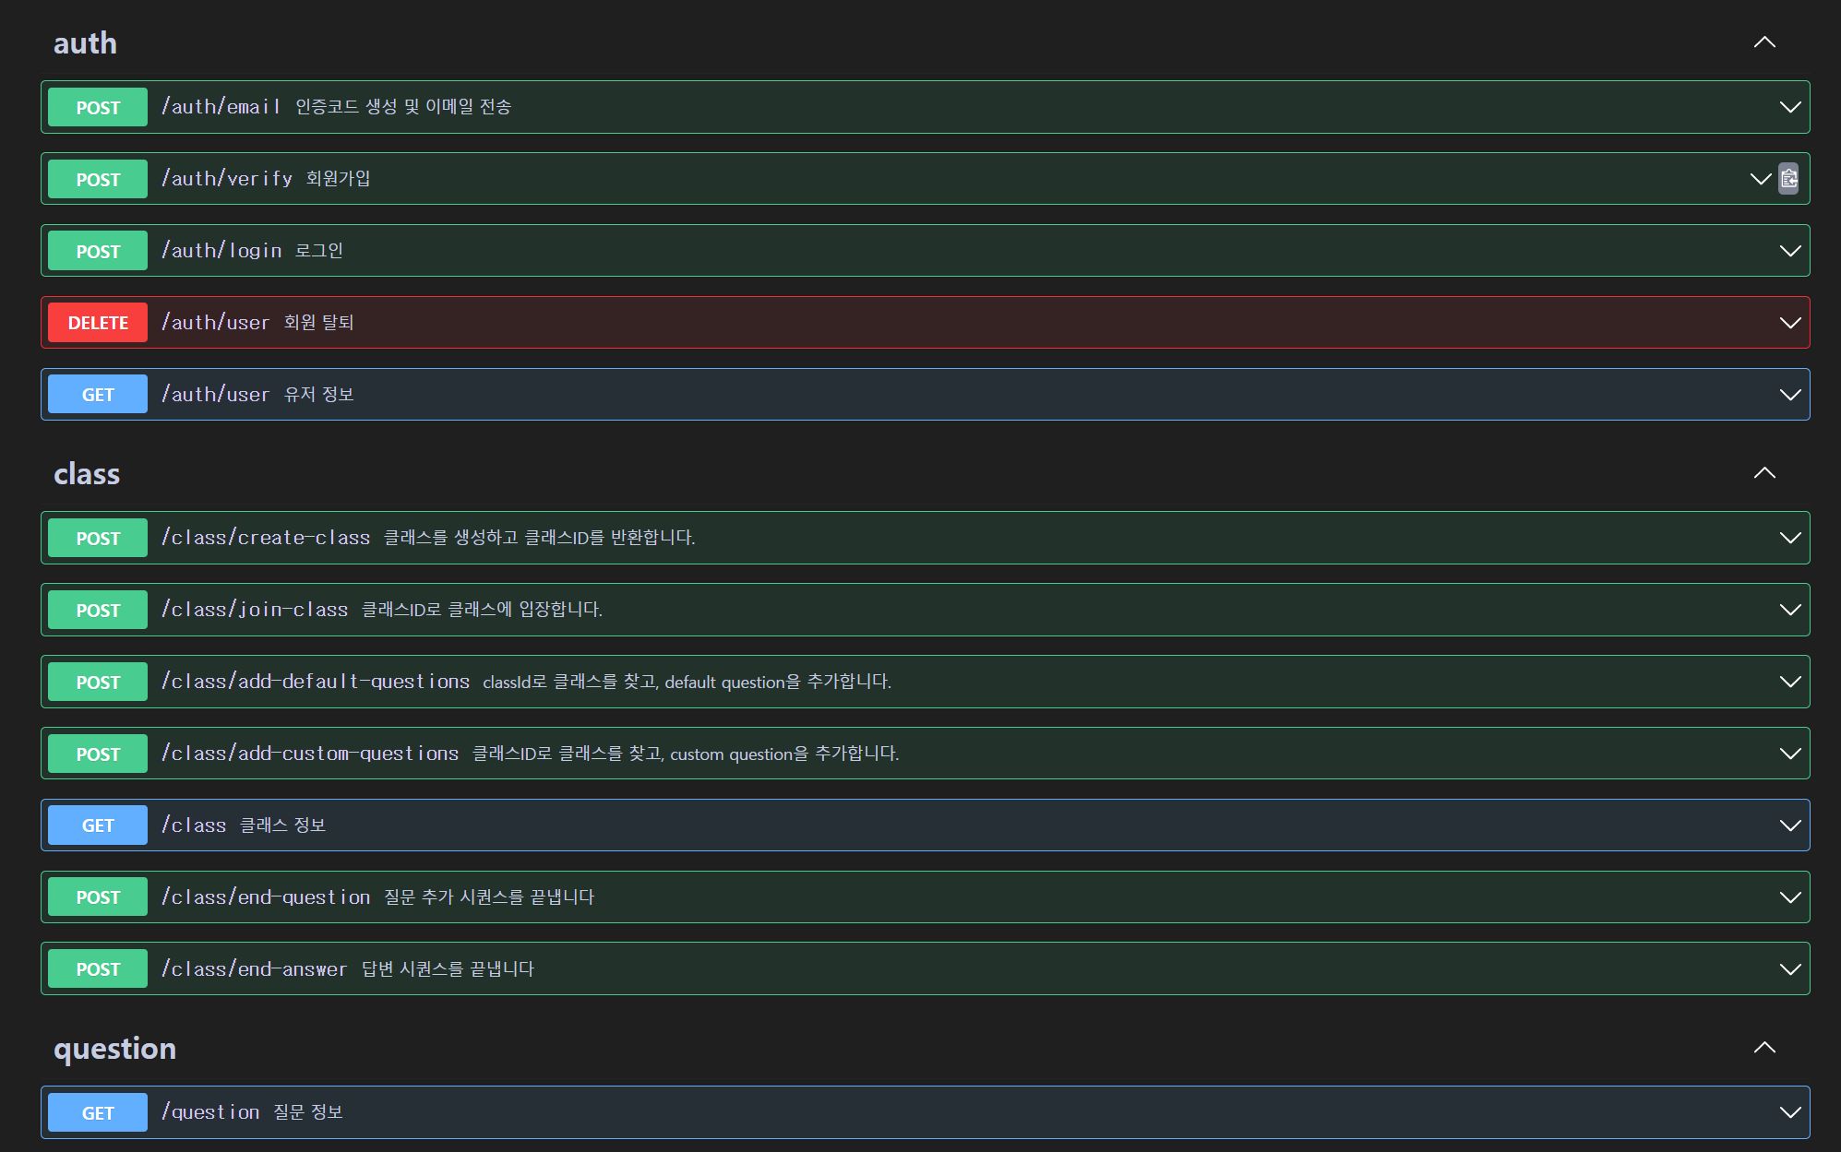
Implementation - API

Slide 13
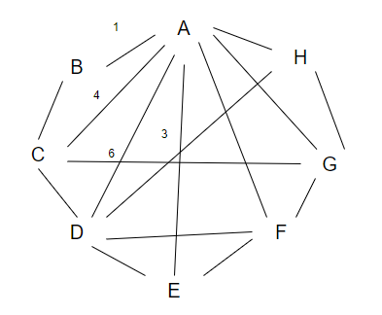
Implementation - Algorithms
Questions | Options
AI vs Non-AI | AI / NON-AI
Personality | Extrovert / Introvert
English Skills | Good / Average / Bad
Age | Freshman / Sophomore / Junior / Senior
Questions / students | A | B | C | D | E | F | G | H | I | J | K
AI vs Non-AI | AI | AI | AI | AI | AI | AI | AI | AI | Non | Non | Non
Personality | In | In | Ex | Ex | In | In | Ex | Ex | In | Ex | In
English Skills | G | A | B | G | B | A | G | G | A | B | B
Age | 21 | 23 | 25 | 27 | 27 | 21 | 23 | 25 | 27 | 27 | 27
Team A | Team B
Student A | Student B
Student D | Student E
Student F | Student H
Student G | Student C
From | To | Weight
A | D | 6
B | E | 6
A | F | 6
D | E | 5
E | H | 5
F | G | 5
A | C | 4

Slide 14
Implementation – Algorithms (Improvement Points)
Handle Exception
Ex) What if they all have the same weight?
Imbalance in teams
Ex) what if particular team has too matching score?

Slide 15
Challenges
Issue | Solved
Unable to test before deployment due to cors policy error | Solved by Unifying client request domain and allow only that domain.
Swagger API specification installation error | Solved by adding a library installation command for the development environment when deploying the server
Code duplication problem that checks the user's session in all APIs after login | Solved by creating a middleware that validate jwt and linking it to all the necessary methods
The difficulty of creating users every time to do the team matching algorithm | Solved by creating a method that randomly creates a user DB using question options and random numbers

Slide 16
Demo
https://port-0-unicoop-nx562olfpi8ozh.sel3.cloudtype.app/

Slide 17
Thank you

