Slide 1
Front-End

Slide 2
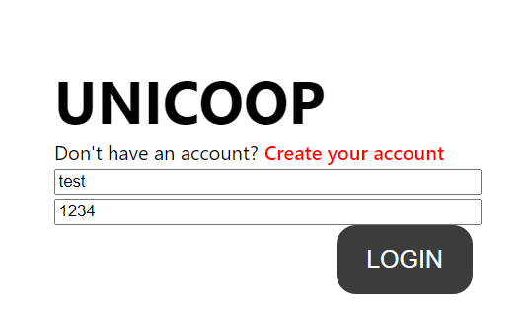
UI: What has been done
Development environment settings
Typescirpt, react, scss, node version setting
Make simple page structure and add APIs which backend team made
Haim : SignIn
Myungha : LogIn
LogIn

Slide 3
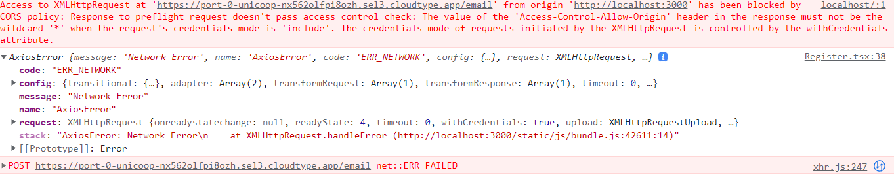
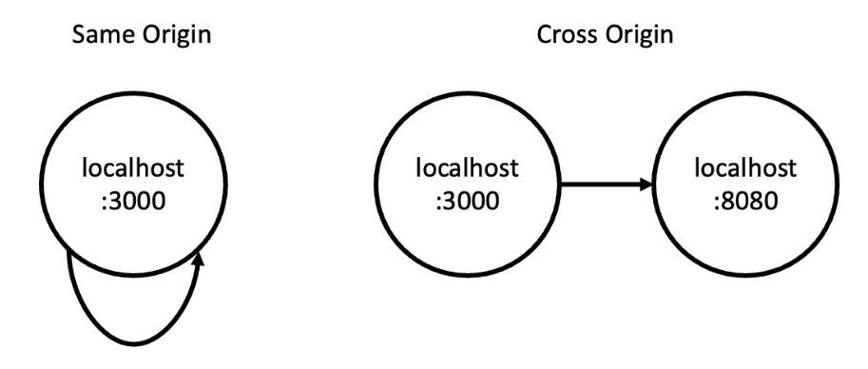
UI: Challenges
CORS(Cross Origin Resource Sharing) error
Exchange resources between different origin(URL)

Slide 4
UI: Challenges
Server needs to verify the request is reliable or not
Check header value
Access-Control-Allow-Origin : http://some-url-info.com
Access-Control-Allow-Methods : GET, POST …
If that origin is included in current origin, OK
If not, make error

Slide 5
UI: What will do
Haim
Myungha

Slide 6
Back-End

Slide 7
Server
Algorithm

Slide 8
Server: What has been done
Development environment settings
nodejs, express, mongodb, cors, body-parser, bcryptjs, jsonwebtoken.
Server deployment
cloud service
API
Implementation of member registration and login
documentation using swagger

Slide 9
Server: To-do
Implementation of session maintenance using jwt
Implement project creation API

Slide 10
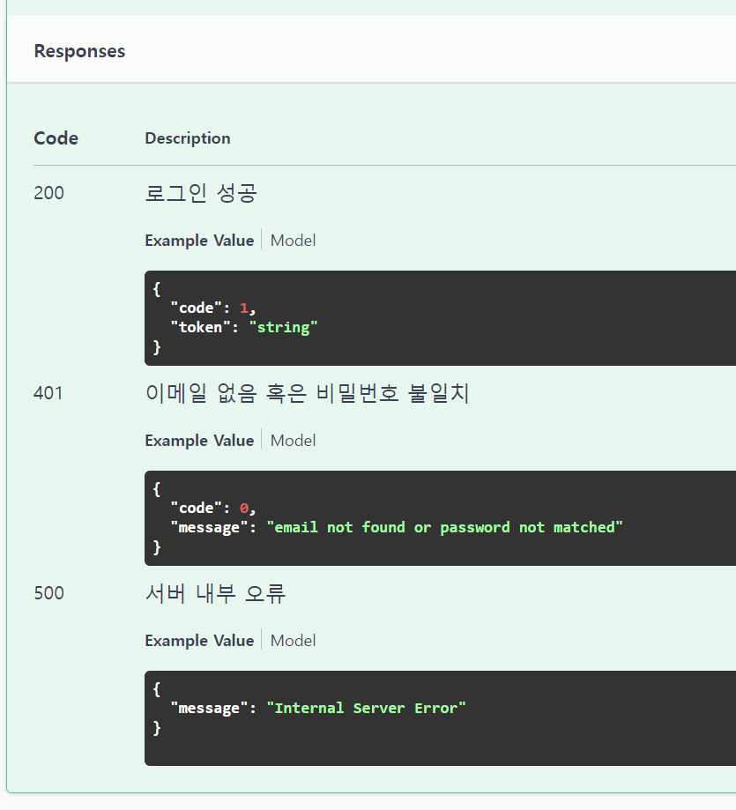
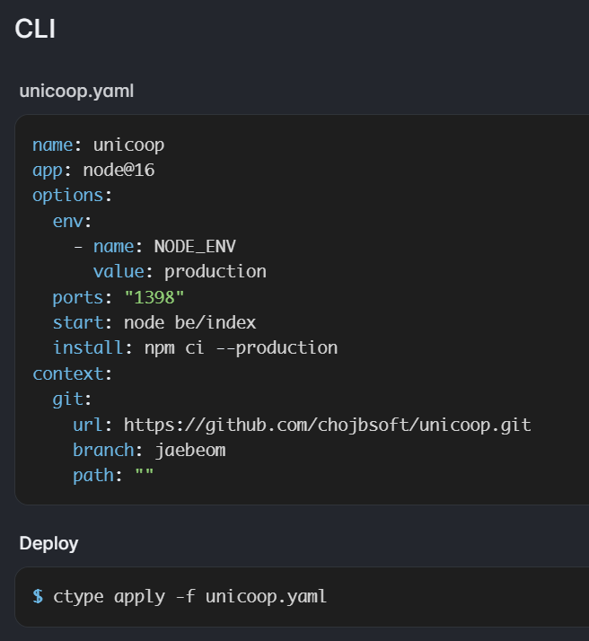
Server: Trial and error

Slide 11
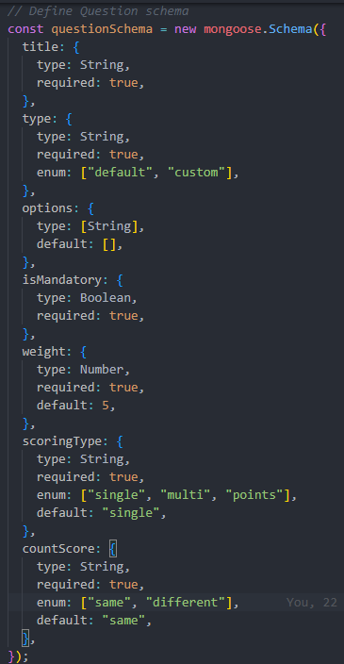
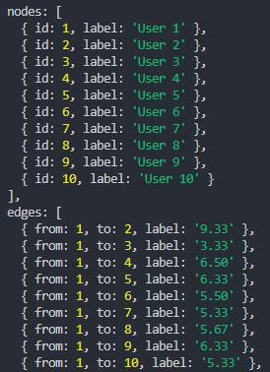
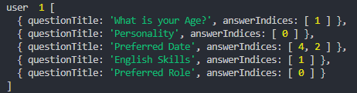
Algorithm: What has been done
Team Matching Algorithm
Creating a graph of students
Testing with random users

Slide 12

Algorithm: What has been done
Team Matching Algorithm
Dividing Teams based on Graph
Choosing high weight edges
Greedy Algorithm
Heuristic Algorithm

Slide 13
Algorithm: To do
Confirm Algorithm
Connecting above two
Create Graph -> Create Team
Implement with real data
Get User Data -> Create Graph -> Create Team -> Form Team

Slide 14
Thank you

