Slide 1
Week 7 Weekly Progress
Team F
조명하, 조재범, 남하임, 백준선

Slide 2
Table of Contents
Frontend
1 Trial and Error
2 Progress
3 To-do
Backend
1 Progress
2 Trial and Error
3 To-do

Slide 3
Frontend

Slide 4
Frontend : Trial and error
Hard to implement code without any design!

Slide 5
Frontend: Progress
Design & Web Flow
Landing Page
Project Registration
Team Activity
Implementation
Login
Register
Get MyInfo
Responsive UI
Code Refactoring
Error Status

Slide 6
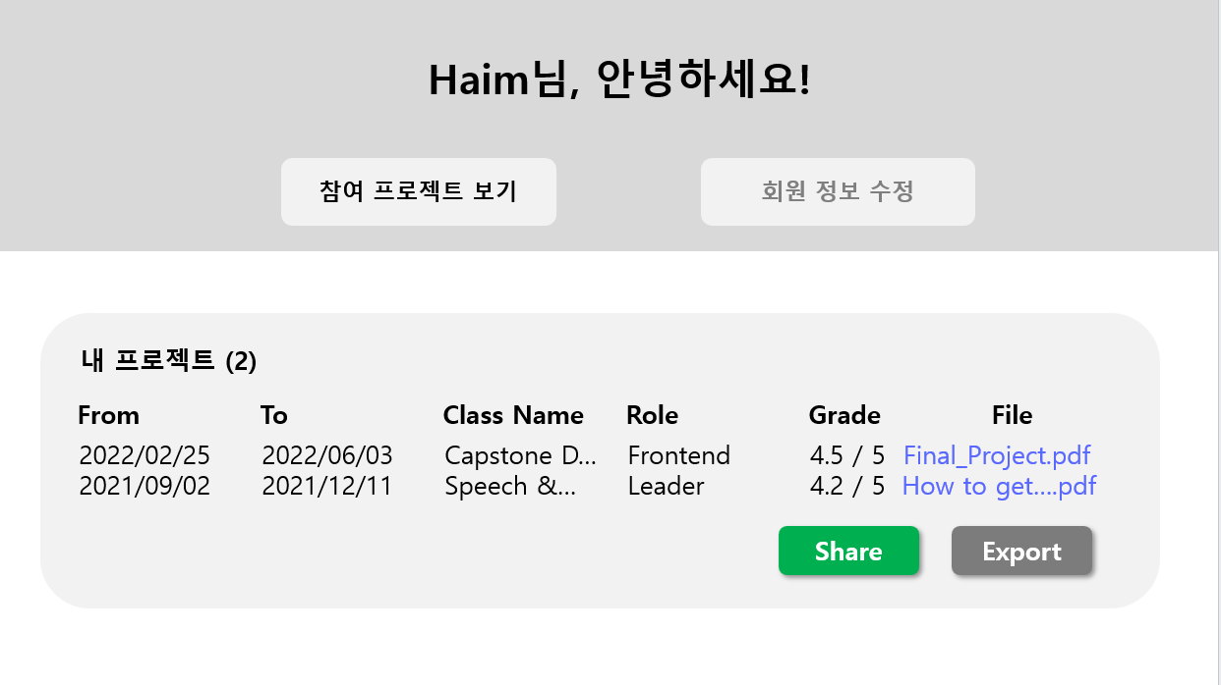
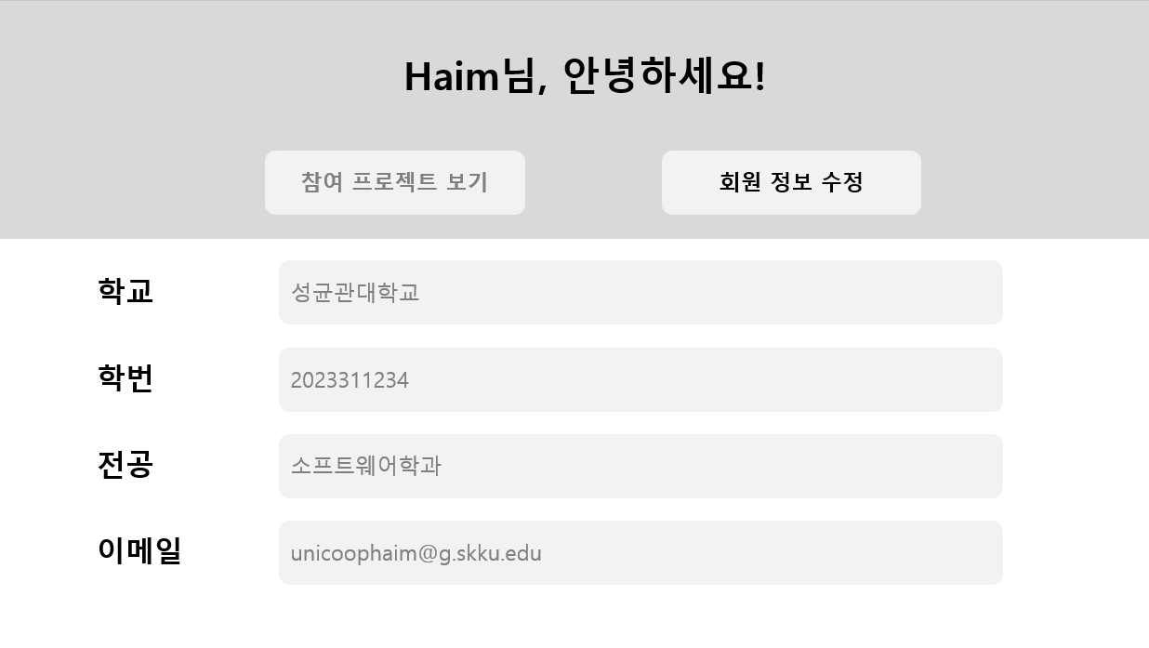
Design & Web Flow
My Page

Slide 7
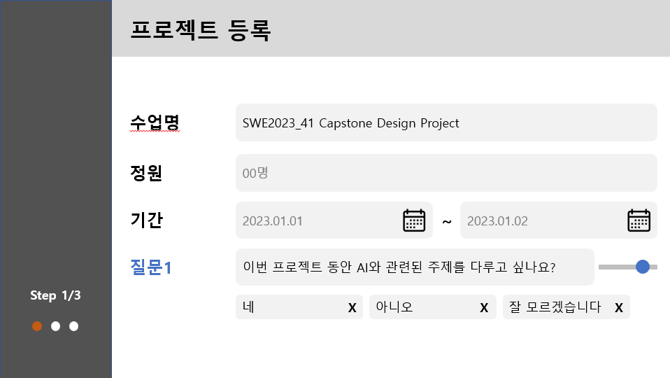
Design & Web Flow
Project Registration (for professors)

Slide 8
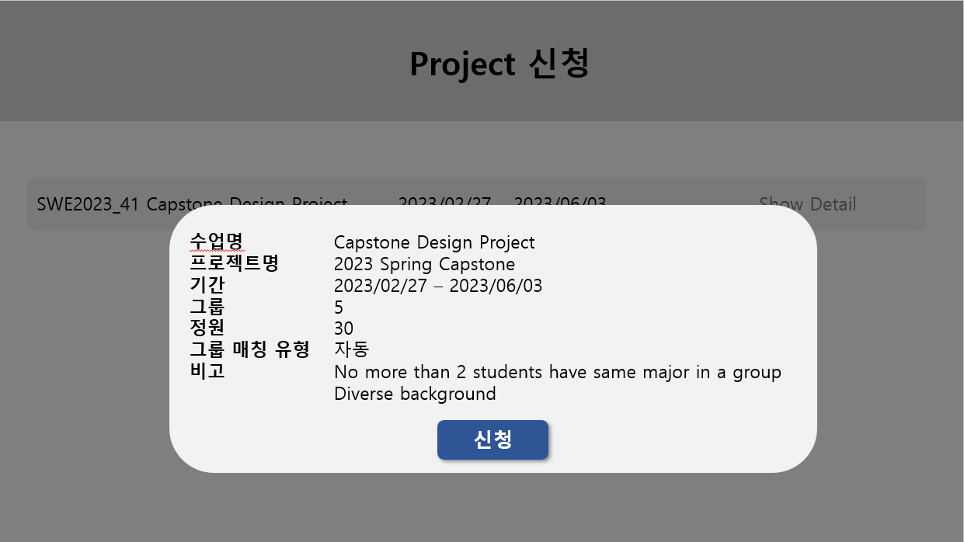
Design & Web Flow
Project Application (for students)

Slide 9
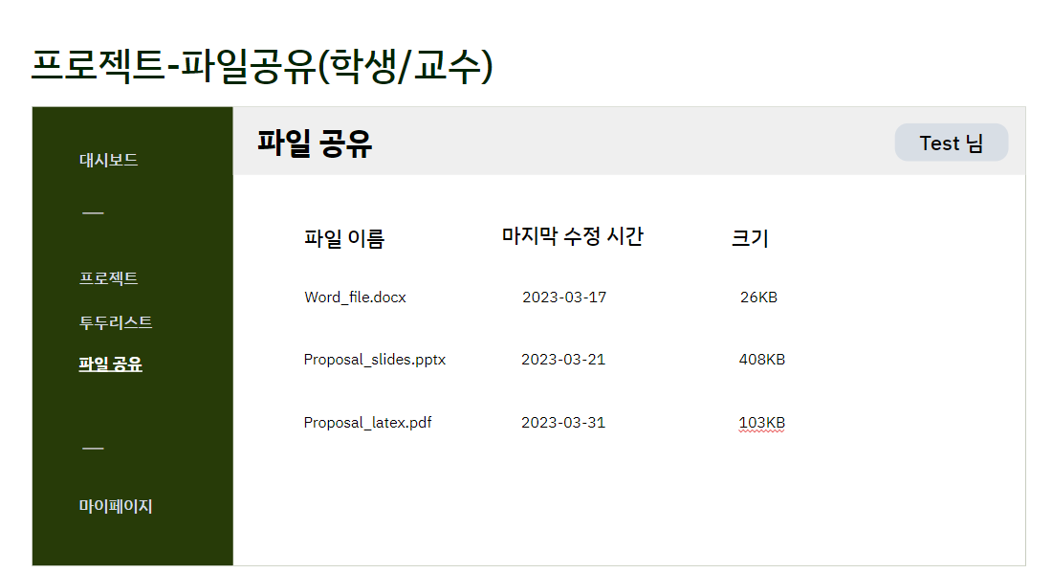
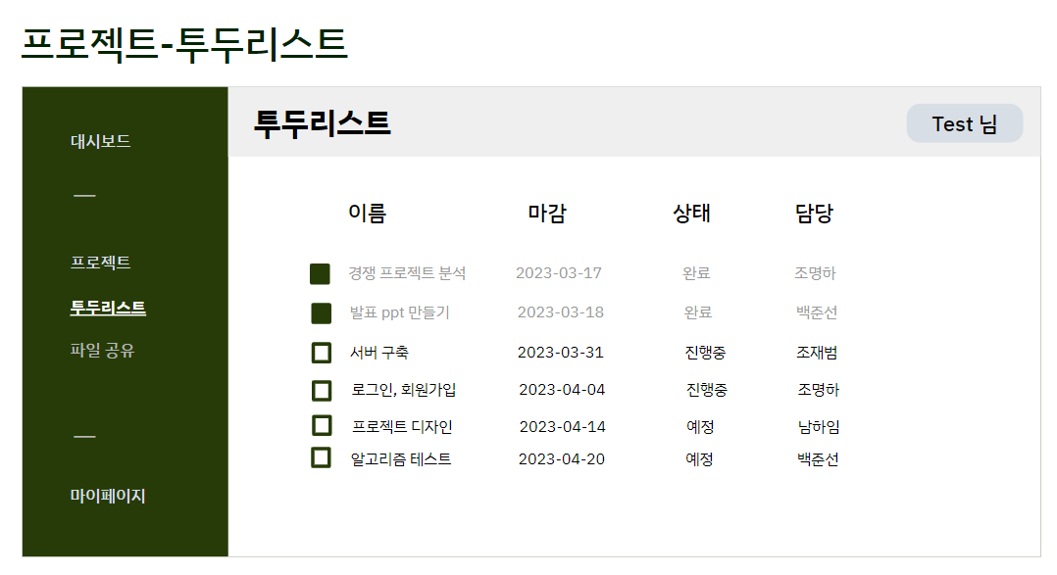
Design & Web Flow
Team Activity (for students)

Slide 10
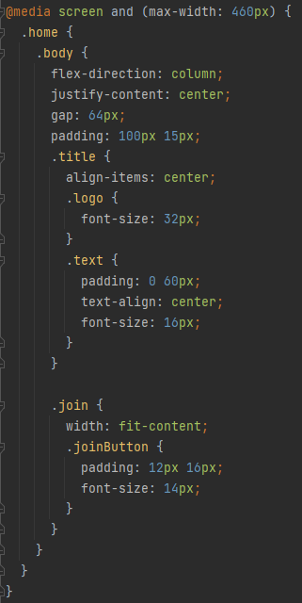
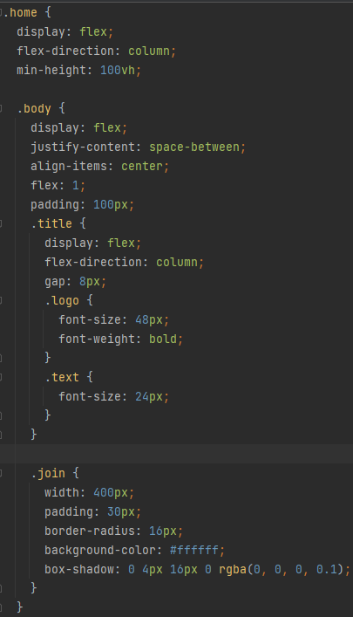
Implementation
Responsive UI
Desktop-centric vs Mobile-centric

Slide 11
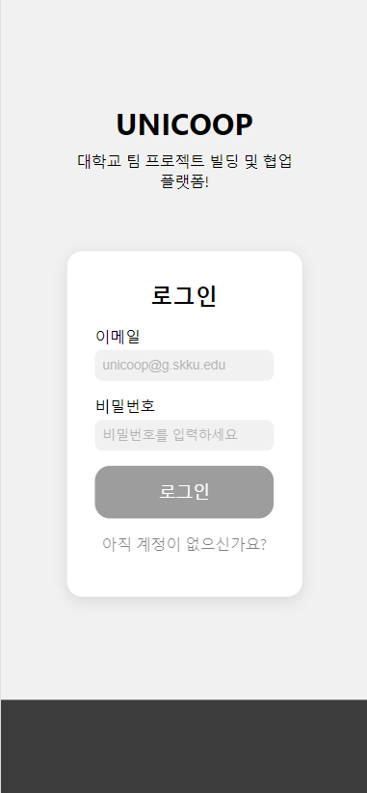
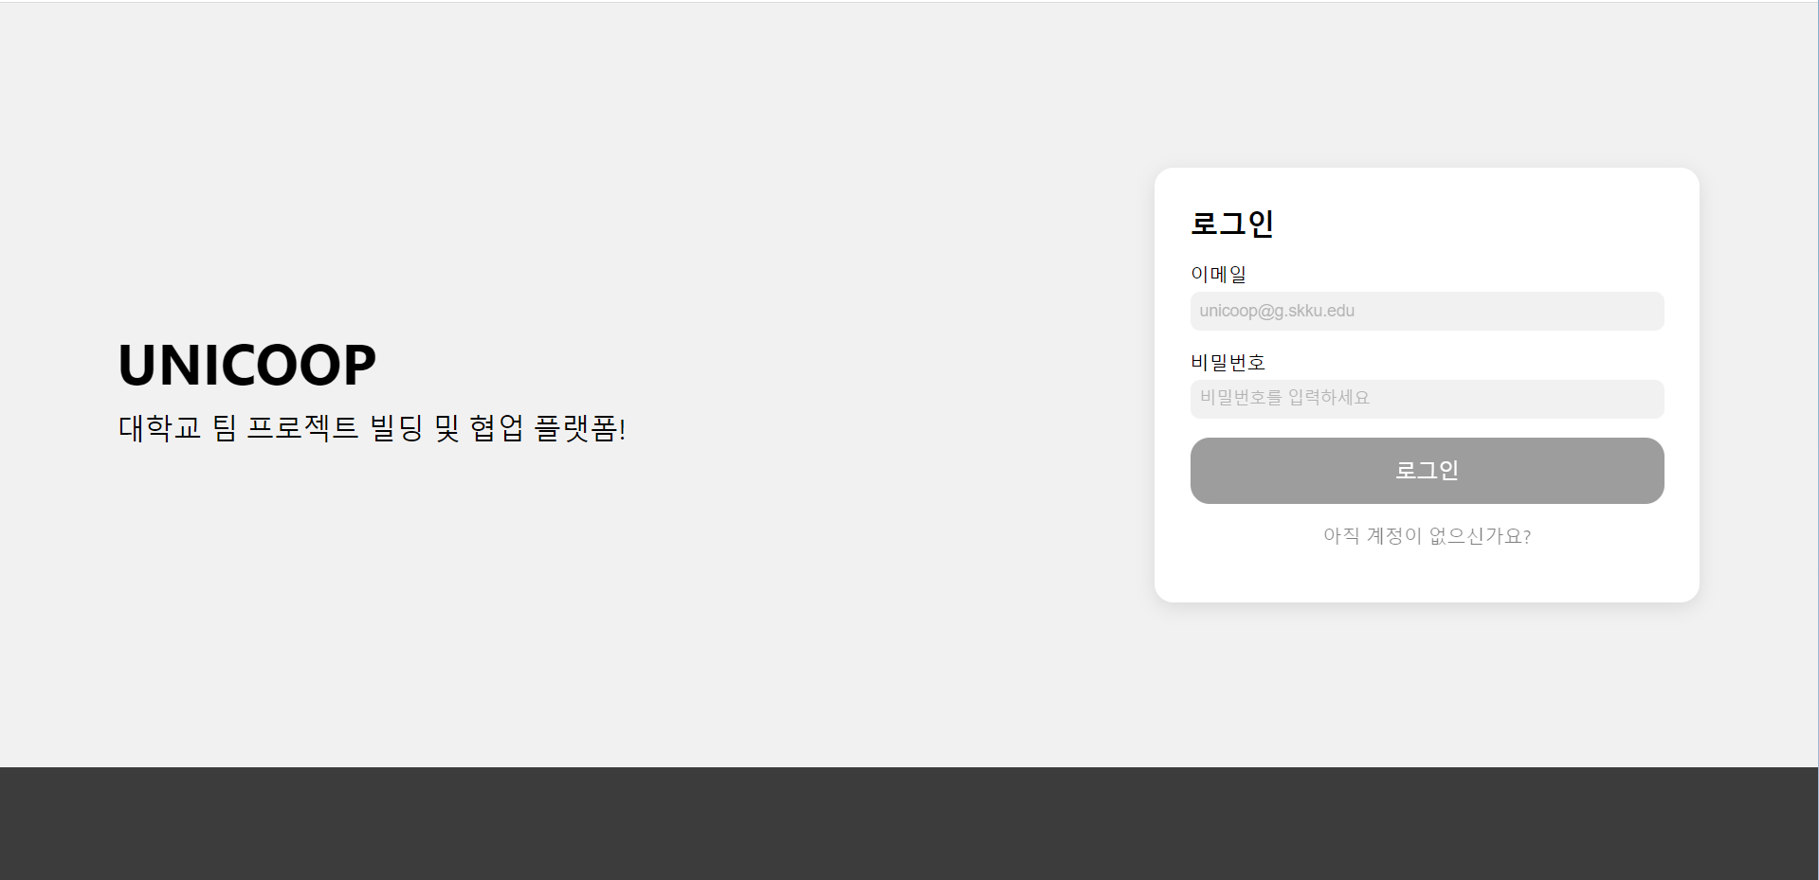
Implementation
Responsive UI

Slide 12
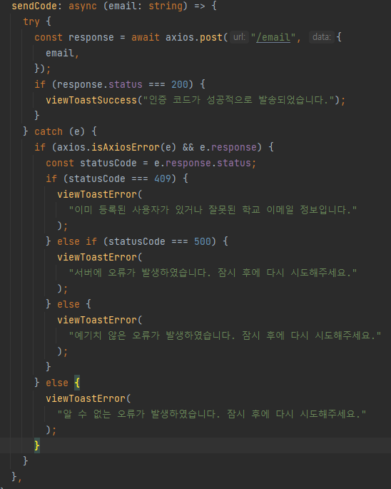
Code Refactoring
Error status

Slide 13
Frontend : To-do
My Page
Project Registration

Slide 14
Backend

Slide 15
Backend: Progress
APIs
Email Authentication
Bringing University domains
Creating Class
Adding Questions
Join Class
Algorithm
Single Process
Create Graph
Create Teams
Code Refactoring
Routing

Slide 16
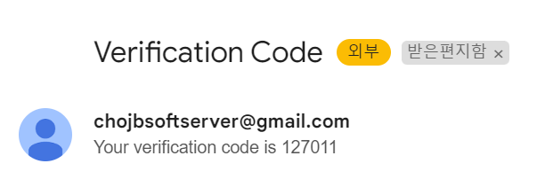
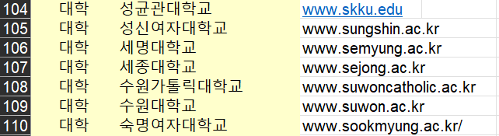
API : Email Verification
Implement email authentication API
Implement university domain authentication

Slide 17
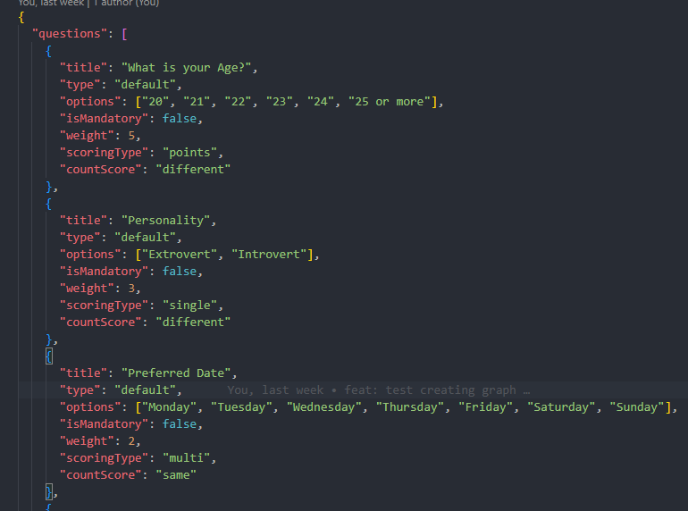
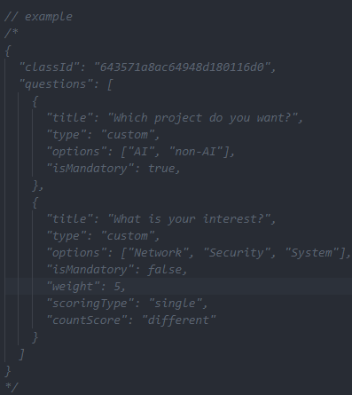
API: Creating Class
Adding Questions
Adding Default Questions
Adding Custom Questions
Default Question Lists (partial)
Custom Question Example

Slide 18
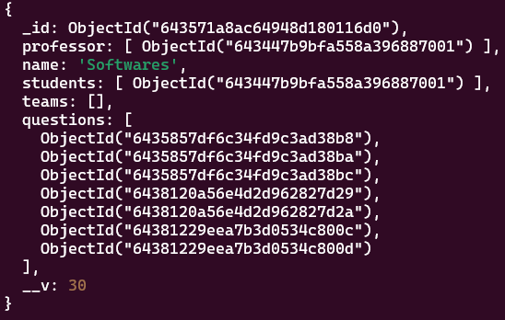
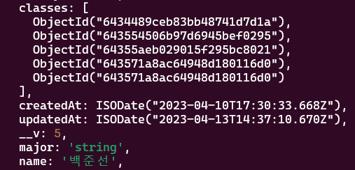
API: Creating Class
Join Class
Add Class to User
Add User to Class
User DB
Class DB

Slide 19
Algorithm
Students’ Answers
Create Graph
Create Group

Slide 20
Code Refactoring
Routes
Splitting APIs
auth
class
Login
Verify
Add question
Join Class
…
…

Slide 21
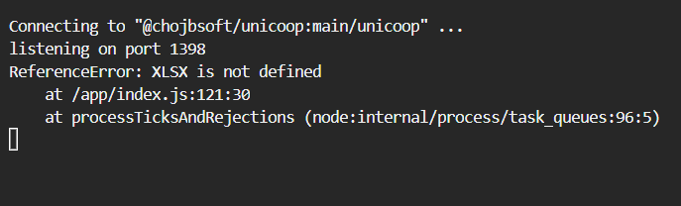
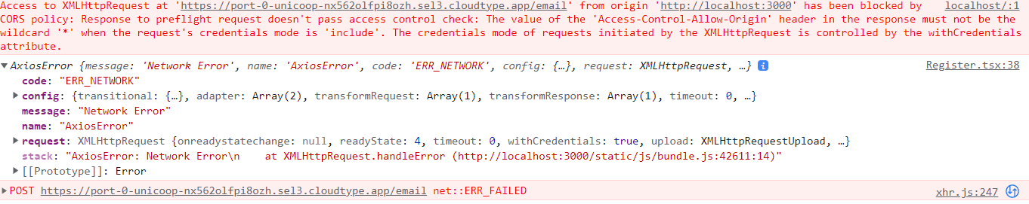
Backend: Trial and Error

Slide 22
Backend : To-do
Add Logging Middleware
Algorithm + API integration
Api Specification -> Swagger Module

Slide 23
Thank you

