Slide 1
Week 8 Weekly Progress
Team F
조명하, 조재범, 남하임, 백준선

Slide 2
Table of Contents
Frontend
1 Progress
2 To-do
Backend
1 Progress
2 Trial and Error
3 To-do

Slide 3
Frontend

Slide 4
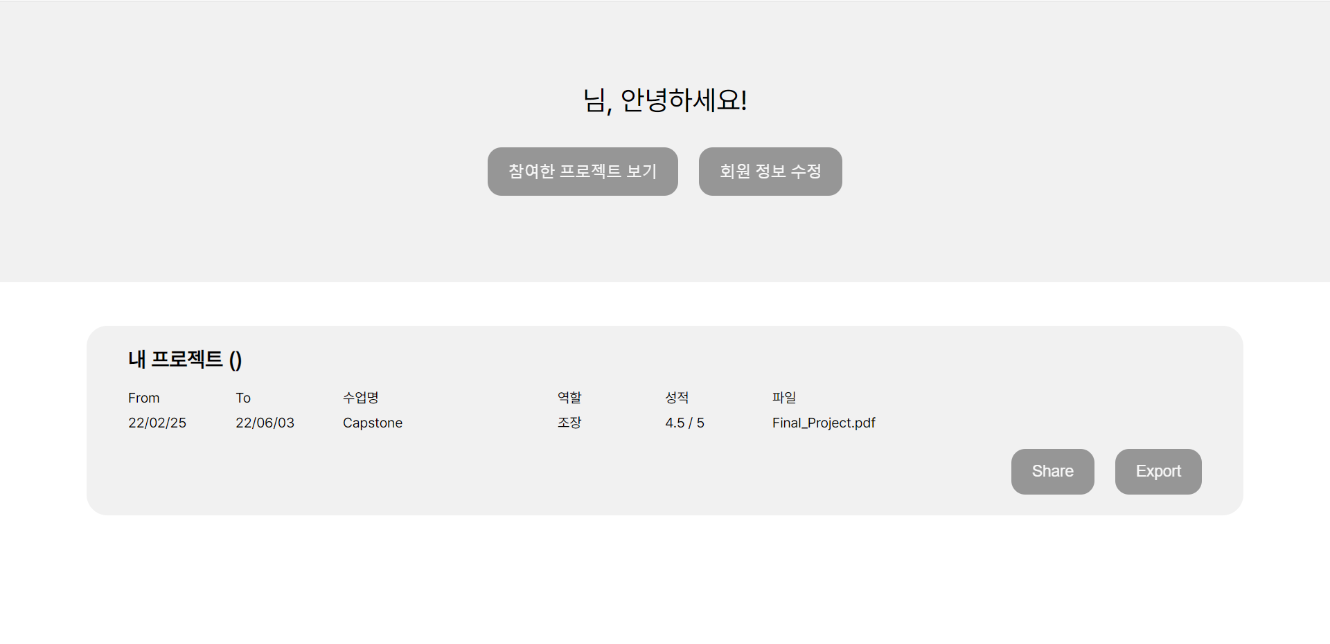
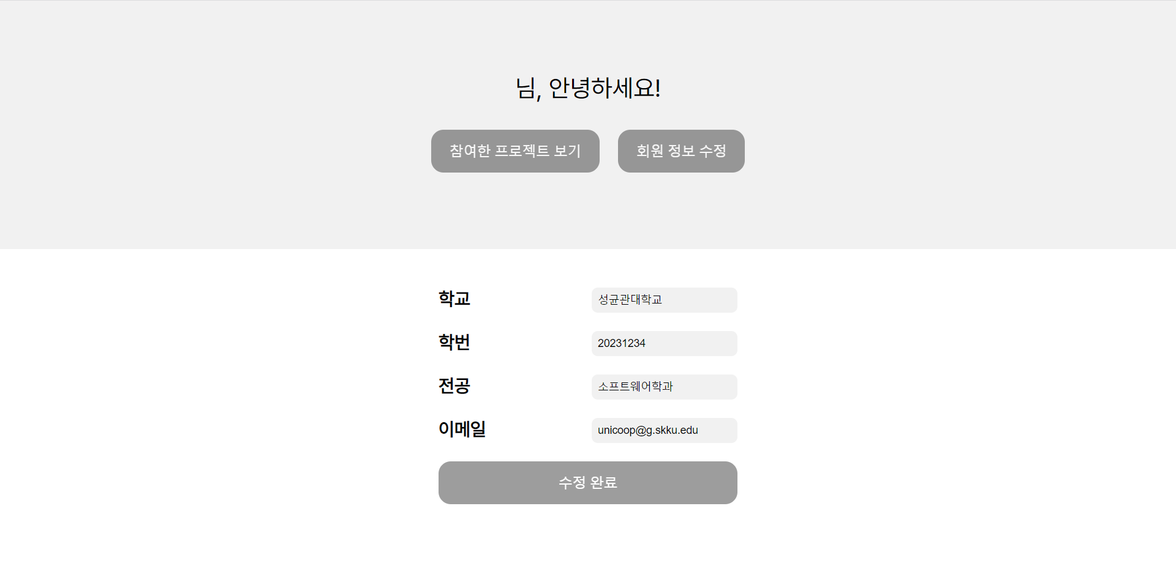
Frontend: Progress

Slide 5
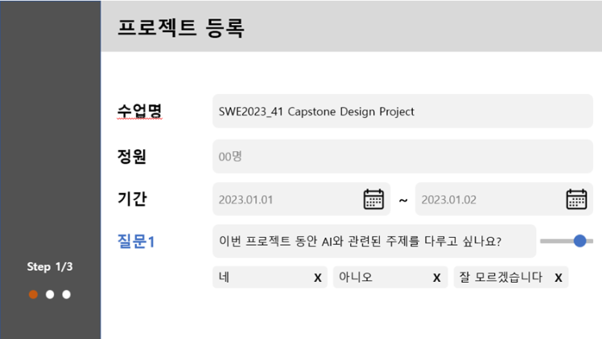
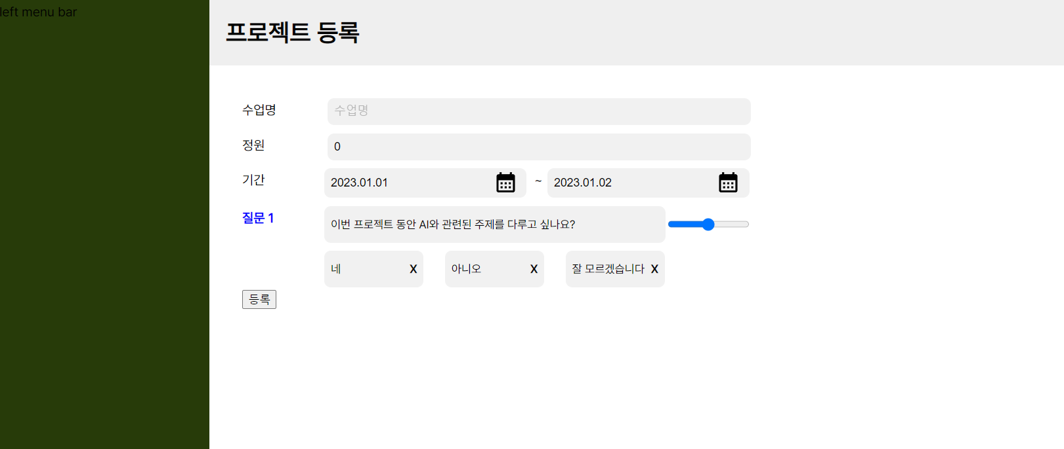
Frontend: Progress

Slide 6
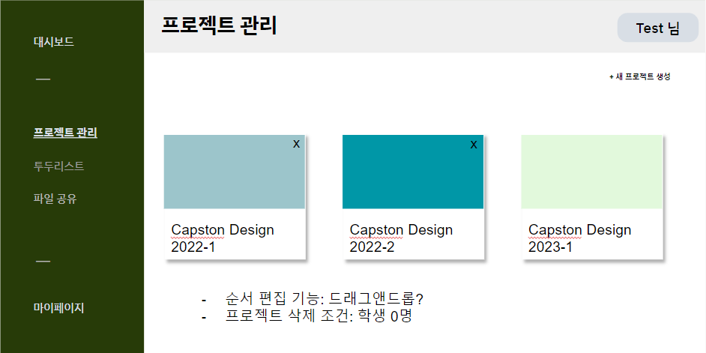
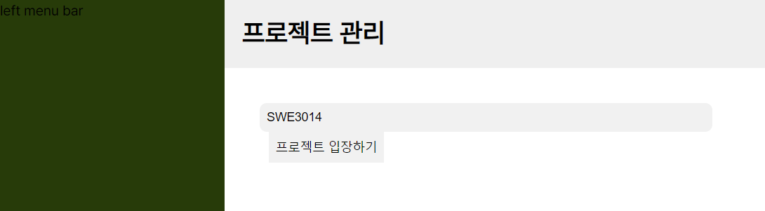
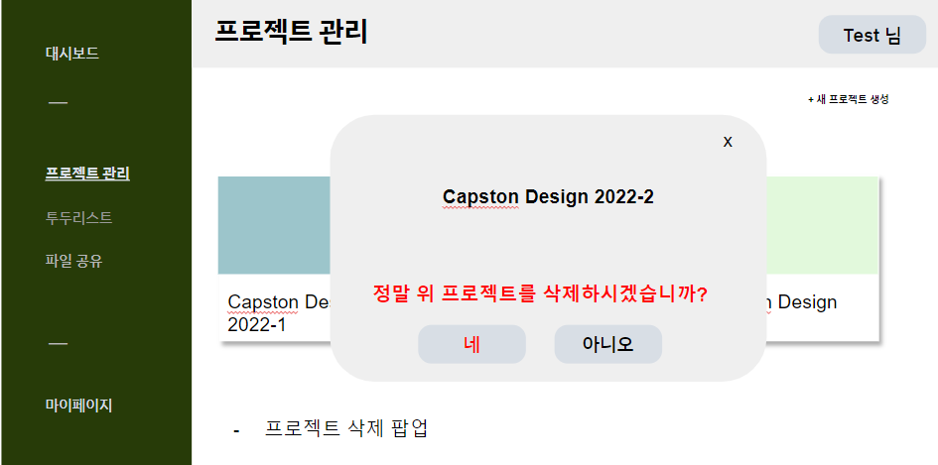
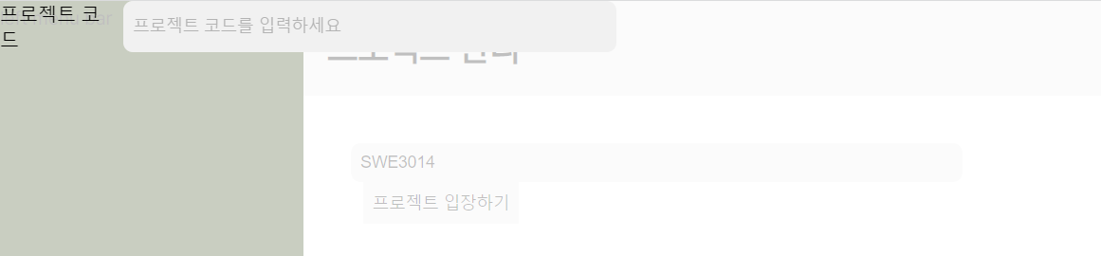
Frontend: Progress

Slide 7
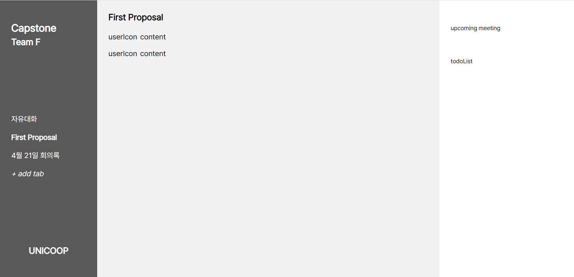
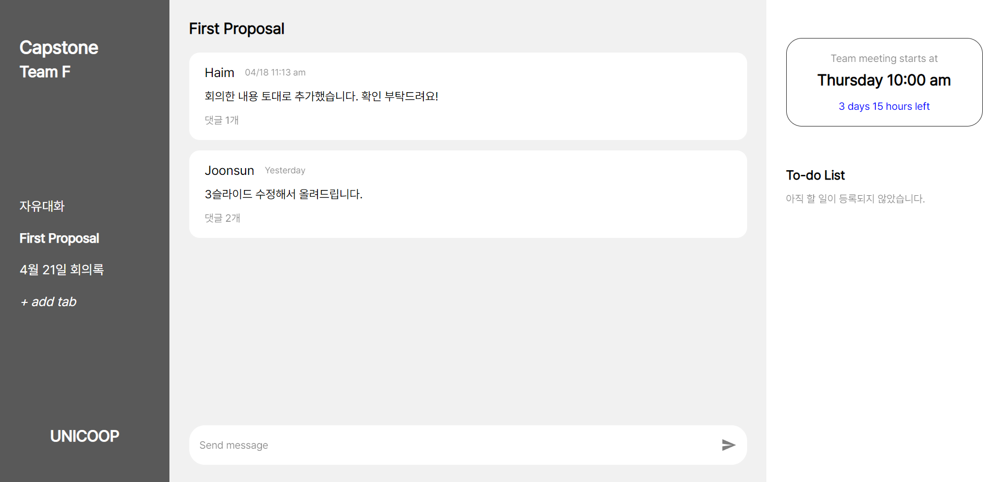
Frontend: Progress

Slide 8
Frontend: To-do
Backend interworking with
1. My Page (Projects Info, Delete Account)
2. Project Registration
3. Project Management (access with code)
4. Team Activity (Share messages, time scheduling, to-do list, and files)

Slide 9
Backend

Slide 10
Backend: Team Matching Algorithm
Questions | Options | Is Mandatory | Weight | Count Score | Partial Points
AI vs Non-AI | AI / NON-AI | True | - | - | -
Personality | Extrovert / Introvert | False | 2 | Different | False
English Skills | Good / Average / Bad | False | 1 | Same | False
Age | 20-21 / 22-23 / 24-25 / 26+ | False | 3 | Different | True

Slide 11
Backend: Team Matching Algorithm
Questions / students | A | B | C | D | E | F | G | H | I | J | K
AI vs Non-AI | AI | AI | AI | AI | AI | AI | AI | AI | Non | Non | Non
Personality | In | In | Ex | Ex | In | In | Ex | Ex | In | Ex | In
English Skills | G | A | B | G | B | A | G | G | A | B | B
Age | 21 | 23 | 25 | 27 | 27 | 21 | 23 | 25 | 27 | 27 | 27

Slide 12
Backend: Team Matching Algorithm
Questions / students | A | B | C | D | E | F | G | H | I | J | K
AI vs Non-AI | AI | AI | AI | AI | AI | AI | AI | AI | Non | Non | Non
Personality | In | In | Ex | Ex | In | In | Ex | Ex | In | Ex | In
English Skills | G | A | B | G | B | A | G | G | A | B | B
Age | 21 | 23 | 25 | 27 | 27 | 21 | 23 | 25 | 27 | 27 | 27

Slide 13
Backend: Team Matching Algorithm
Questions / students | A | B | C | D | E | F | G | H
Personality | In | In | Ex | Ex | In | In | Ex | Ex
English Skills | G | A | B | G | B | A | G | G
Age | 21 | 23 | 25 | 27 | 27 | 21 | 23 | 25
2 Groups of 4

Slide 14
Backend: Team Matching Algorithm
Weight Between A and B
Personality: Same = 2 * 0
English Skill: different = 1 * 0
Age: different = 3 * 1/3
Total = 1
Questions / students | A | B | C | D | E | F | G | H
Personality | In | In | Ex | Ex | In | In | Ex | Ex
English Skills | G | A | B | G | B | A | G | G
Age | 21 | 23 | 25 | 27 | 27 | 21 | 23 | 25
Questions | Options | Weight | Count Score | Partial Points
Personality | Extrovert / Introvert | 2 | Different | False
English Skills | Good / Aver / Bad | 1 | Same | False
Age | 20-21 / 22-23 / 24-25 / 26+ | 3 | Different | True
3 * 1
[20-21] [22-23] [24-25] [26+]
3*1/3 3*1/3 3*1/3

Slide 15
Backend: Team Matching Algorithm
Questions / students | A | B | C | D | E | F | G | H
Personality | In | In | Ex | Ex | In | In | Ex | Ex
English Skills | G | A | B | G | B | A | G | G
Age | 21 | 23 | 25 | 27 | 27 | 21 | 23 | 25
Weight Between A and C
Personality: Different = 2 * 1
English Skill: different = 1 * 0
Age: different = 3 * 2/3
Total = 4
Questions | Options | Weight | Count Score | Partial Points
Personality | Extrovert / Introvert | 2 | Different | False
English Skills | Good / Aver / Bad | 1 | Same | False
Age | 20-21 / 22-23 / 24-25 / 26+ | 3 | Different | True

Slide 16
Backend: Team Matching Algorithm
Questions / students | A | B | C | D | E | F | G | H
Personality | In | In | Ex | Ex | In | In | Ex | Ex
English Skills | G | A | B | G | B | A | G | G
Age | 21 | 23 | 25 | 27 | 27 | 21 | 23 | 25
Weight Between A and D
Personality: Different = 2 * 1
English Skill: Same = 1 * 1
Age: Different = 3 * 3/3
Total = 6
Questions | Options | Weight | Count Score | Partial Points
Personality | Extrovert / Introvert | 2 | Different | False
English Skills | Good / Aver / Bad | 1 | Same | False
Age | 20-21 / 22-23 / 24-25 / 26+ | 3 | Different | True

Slide 17
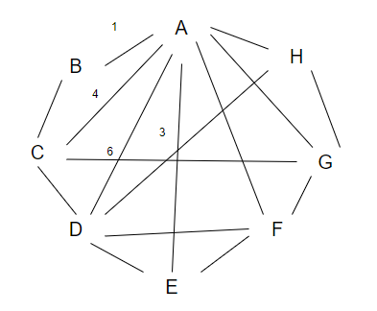
Backend: Team Matching Algorithm
Form a Graph
There will be lines between all students
There will be weights for all the lines

Slide 18
Backend: Team Matching Algorithm
Process
A-D (group1)
B-E (group2)
A-D-F (group1)
Skip D-E (both already in group)
B-E-H (group2)
A-D-F-G (group1)
Skip A-C (A already in group with full members)
B-E-H-C (group2)
Form a Team
Order connection in descending order
Form team with Greedy Algorithm
From | To | Weight
A | D | 6
B | E | 6
A | F | 6
D | E | 5
E | H | 5
F | G | 5
A | C | 4

Slide 19
Thank you

