Slide 1

Generating In-game 3D Self-Expression using Motion Diffusion Model
: Update With Feedback
Team E: Unreal Neural
박수호 이재훈 제해찬 조용현 차승종

Slide 2
Contents
Unreal Engine
Main Proposal
Plug-in
Questions

Slide 3

Unreal Engine
C++ based game development software
Many recent games are developed and made through Unreal Engine.

Slide 4
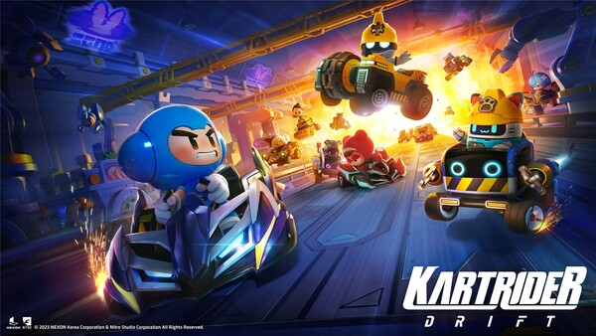


Unreal Engine: Games
PlayerUnkown’s BattleGround
Kartrider Drift
Seven Knights
Lost Ark
Valorant
Black Desert

Slide 5
Main Proposal
Not presenting a ‘Service’, but providing a function for the Unreal Engine Software
Similar to the concept of open-source library or APIs
Creating a plugin(function) which generates an animation for a character in runtime
The game with our plugin can provide infinite scalability

Slide 6
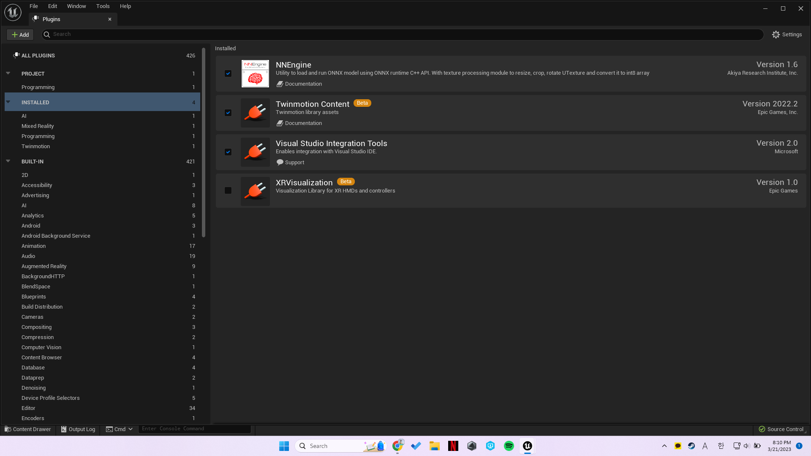
Main Proposal: Plugin
If you install our plugin in a Unreal Engine project, plugin source code will be added to the project.
Notes:
This, Deep Motion program makes 3D model too.
It is web application that convert video to 3D animation.
AI motion capture

Slide 7
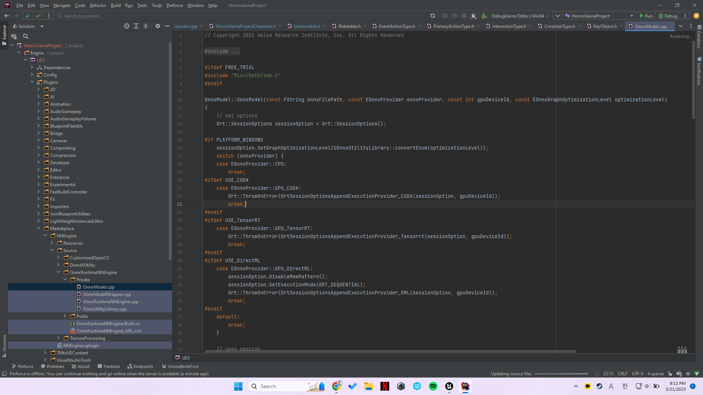
Main Proposal: Plugin
.cpp files containing source codes are added
Notes:
This, Deep Motion program makes 3D model too.
It is web application that convert video to 3D animation.
AI motion capture

Slide 8
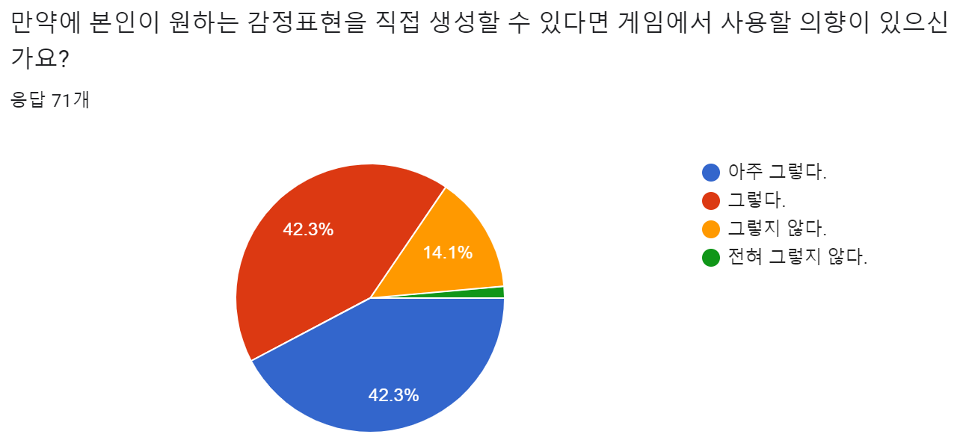
Questions: Project
Is this project necessary?
About 80% of people want to use this emote function
We provide functionality, and this has infinite expandability
Notes:
We want to make animation easily in real-game play time.
Then, we inspired from 'kakaotalk Emotions with typing command'. Why only motion?

Slide 9
Questions
What is difference between current emote system?
Motion creation during runtime is supported
Based on “Text” input
 | Text | Video
Strength | Easy to Use Accessibility Easy to implement different type of motion sequentially | High Quality
Weakness | Hard to specify motion | Find or Make Video files

Slide 10
Questions
Is it possible to demonstrate a working prototype?
It is our final goal to make simple demo project with our plugin
Simple example of converting 3D model to character

Slide 11
Questions
Aren’t there are any commercial problem with freely created motion in game? The game allows specific motion and sell expressions explicitly. Is it okay to use?
When using our plugin, the game has just “function” that users can create new motion in real-time gaming.
Usage of our function depends on Game developer
How are you going to prevent people from typing inappropriate motions?
By using another plugin which provide text filtering functions, developer can reject inappropriate text input.
Maybe can be the future work of our project

Slide 12
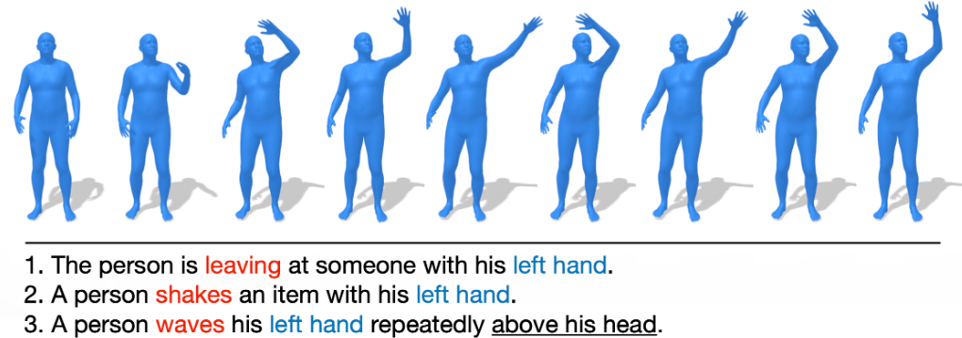
Questions: AI
What is difference from the existing models?
Modify the model for using Unreal Engine
Speed, Input, Output
How to collect labeled dataset?
We will not collect data but proceed augmentation focused on “emotion”
Ex) a person is talking on the phone angrily = a person is talking on the phone aggressively

Slide 13
Questions: Technical Problem
How to extract key-point(key frame) of the pose?
Convert .bvh motion data into .fbx format that can be used in Unreal Engine
With .fbx format, we can extract key-point(joint) and keyframe of animation on Unreal Engine
How to cover the GPU problem?
We will include the ONNX model in the plugin to run it not only local, but also on a server
Notes:
We want to make animation easily in real-game play time.
Then, we inspired from 'kakaotalk Emotions with typing command'. Why only motion?

Slide 14
Thank you

