Slide 1
Building a Virtual Hack Lab
Bill Swearingen
Thomas Gardner

Slide 2
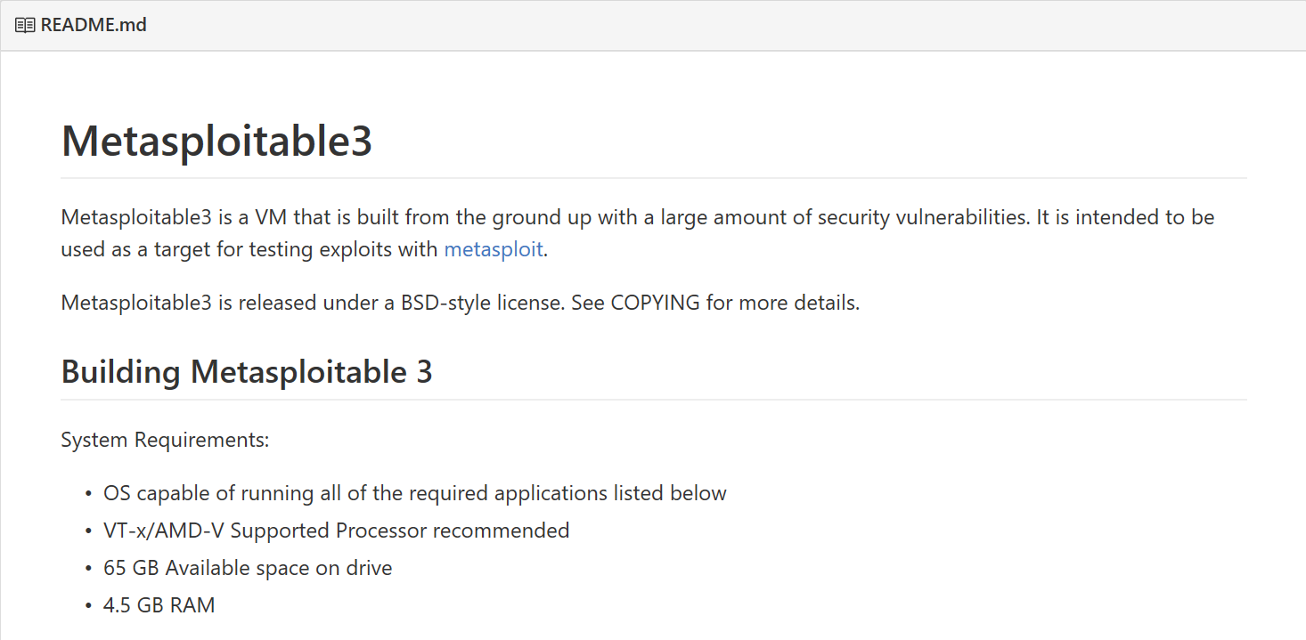
U Wut M8
Pre-made lab environment for learning offensive security techniques
Collection of scripts and config files for building a VM image
Vulnerable services: WinRM, vulnerable web apps, SSH, MySQL, etc.

Slide 3



Install Requirements
Packer
Vagrant
VirtualBox

Slide 4
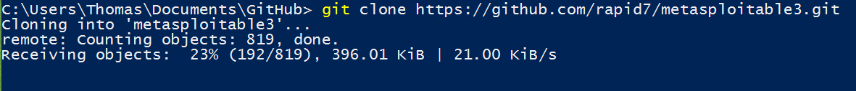
1. Clone the git repository
git clone https://github.com/rapid7/metasploitable3.git
MSP1+2 used Sourceforge
New updates are a `git pull` away

Slide 5
2. Patch the Vagrant Build (If you’re using a local .ISO)
cd metapsloitable3/
Open up “windows_2008_r2.json”
Use your favorite text editor
Go down to line 74
Starts with “iso_url”
Change the Microsoft URL to a path to your local copy of the ISO
Now, it should look something like “iso_url”: “./server.iso”
Be sure to escape if you’re using “\”

Slide 6
3. Patch the PowerShell script (If you’re Building on Windows)
Note: A fix for this issue was applied on Jan. 9th
If you cloned the repository since then, then you do NOT need to do this step
If you have an older version of the repository. Run `git pull` inside the metasploitable3 folder, which will update your files and apply the patch for you
Open up build_win2008.ps1
Go down to line 37
Starts with “If (CompareVersions –actualVersion $vboxVersion”
Find “--exactMatch” and remove a single dash
Issue #78 has a reference to this problem
This lets newer VirtualBox versions be accepted by the script

Slide 7
4. Run the build script
In Windows, ensure you have the proper PowerShell Execution Policy set
Run `Set-ExecutionPolicy RemoteSigned` in an Admin PowerShell window
In Linux, ensure you are using BASH or a shell that is compatible with BASH (not sh)
If you do not have a local copy of the Windows 2008 ISO file, your build will take 30-60 minutes longer depending on bandwidth because the script downloads a 2GB file from Microsoft.com
Either script can be run by navigating to the metasploitable3 directory and running `.\build_win2008.(ps1|sh)`
Your OS determines which version you should run
.ps1 → PowerShell
.sh → BASH

Slide 8
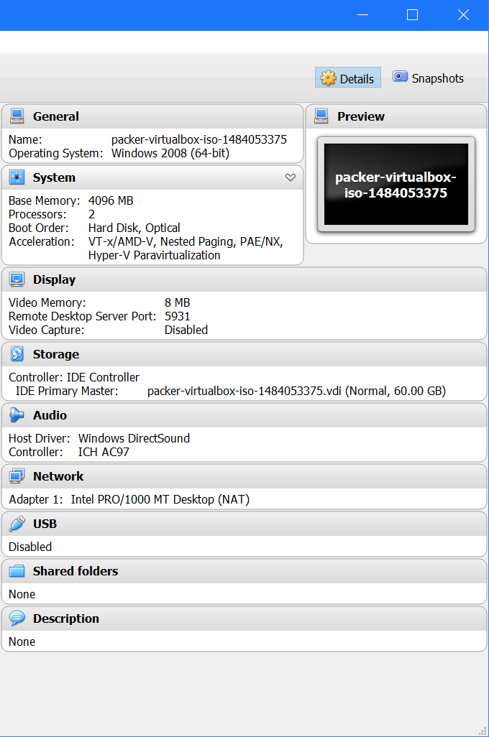
5. Check server and Test Connection
Take a look at VirtualBox specs
Runs headless, so connect via RDP to 127.0.0.1:5931
The port (5931) may be changed on your machine. Look at the build script’s output to determine what your RDP port should be

Slide 9
6. Go Out 7. Build things 8. do research 9. come back to SecKC 10. Give a talk!
Congratulations! You have a virtual lab to hack!

