Slide 1
Real-Time Human Activity Recognition with a Full-Body Tracking suit
Presenter: Jierui Li

Slide 2
Content
Motivation
Why exploring HAR?
Review
How to HAR?
Related research results
Implementation
Dataset
Model training
Prototype
Evaluation
Study design
Hypothesis
Results
Summary
Further discussion
Limitations
Future works
Demo

Slide 3
Motivation: Why exploring HAR?
Human Activity Recognition (HAR) aims to:
Monitor human activities with sensor equipped environment/wearable sensors
Benefits:
Health care system (e.g., falling detection of elderly people)
Security & Surveillance system (e.g., detection of driving behavior)
Assistant system (e.g., smart devices reaction to specified behavior)
…

Slide 4
Review: How to HAR?
Data source:
Vision based (e.g., 2D/3D image or video)
Sensor based (i.e., Inertial Measurement Unit (IMU) based)
Dang et al. “Sensor-based and vision-based human activity recognition: A comprehensive survey,” Pattern Recognition, vol. 108, p. 107 561, 2020
Machine Learning methods:
Logistic Regression
Naive Bayes
Random Forest
Decision Tree
Neural Networks
(Good result without professional handcraft feature making)
…

Slide 5
Review: Related research results
Ref. | Dataset | Device | Classes | Methods | Acc.
Saha et al. (2020) | Self-prepared | Smart phone | Sit, Stand, Lay down, Walk, Climb up and down the staircase | Logistic Regression | 65~95%
Kern et al. (2003) | Self-prepared | Accelerometer on body | Ambulation, Writing, Typing, Shaking Hand | Naive Bayes | 95.25%
Sikder et al. (2019) | UCI HAR | Smart phone on waist | Walk, Sit, Stand, Lay, Upstairs, downstairs | CNN | 95.25%
Ragab et al. (2020) | UCI HAR |  |  | RS-1D-CNN | 95.4%
Dogan et al. (2021) | SHL | Smart phone | Still, Walk, Run, bike, bus, car, train and subway | CNN | 79.33%
Roggen et al. (2016) | SkodaDataset | USB sensors on arm | 46 Activities of assembly line workers in the factory | DeepConvLSTM | 95.8%
Xia et al. (2020) | WISDM | Device on waist | Walking, Jogging, upstairs, downstairs, Sitting, Standing | LSTM-CNN | 95.85%
Notes:
Upstairs/downstairs -> walk, jump instead

Slide 6
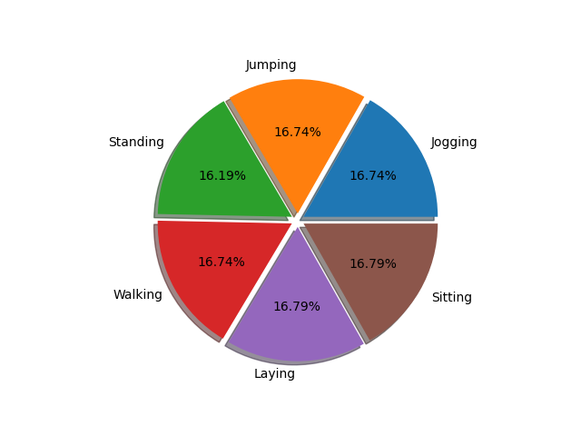
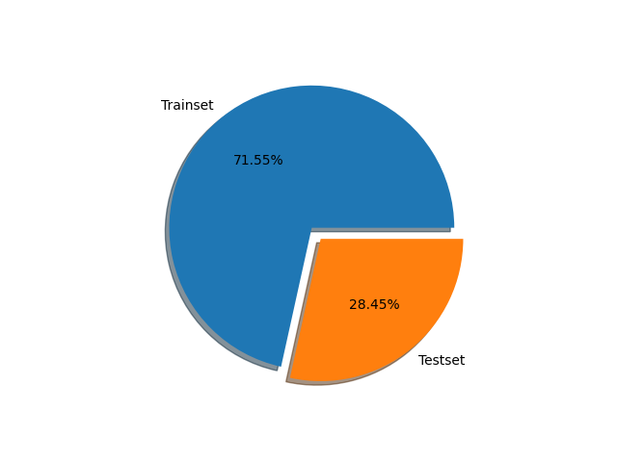

Implementation: Dataset
6 Classes: Jogging, Jumping, Laying, Sitting, Standing, Walking
Participant: a 173cm height male
Proportion: Trainset 20s, Testset 9s (ca. 7:3)

Slide 7
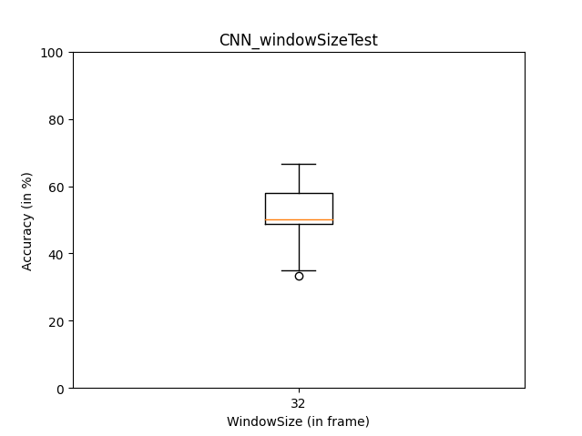
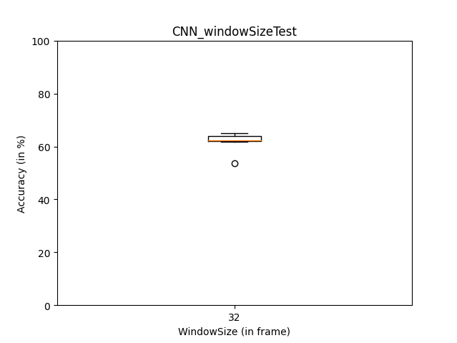
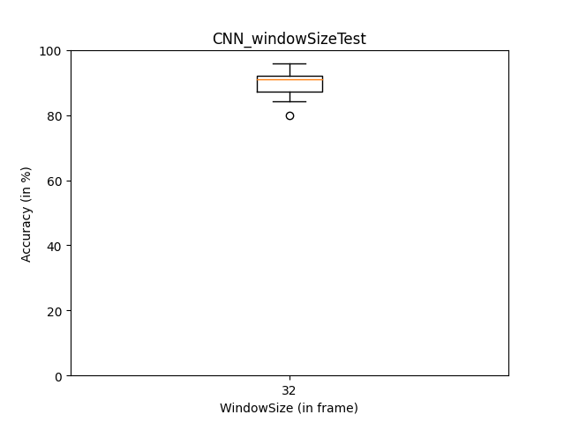
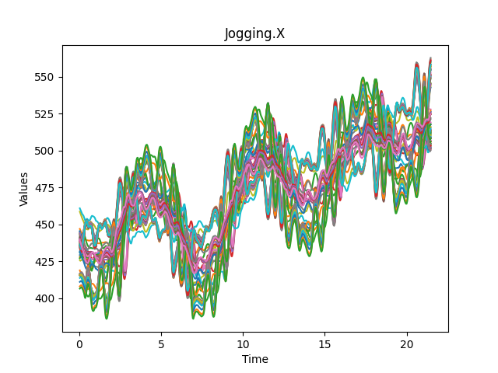
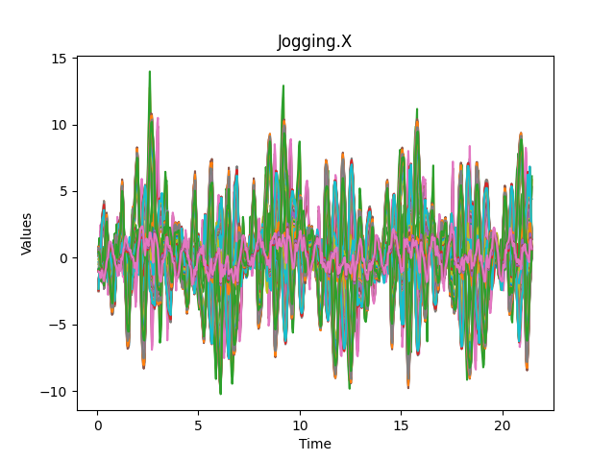
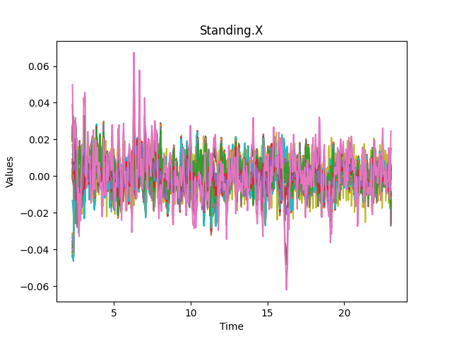
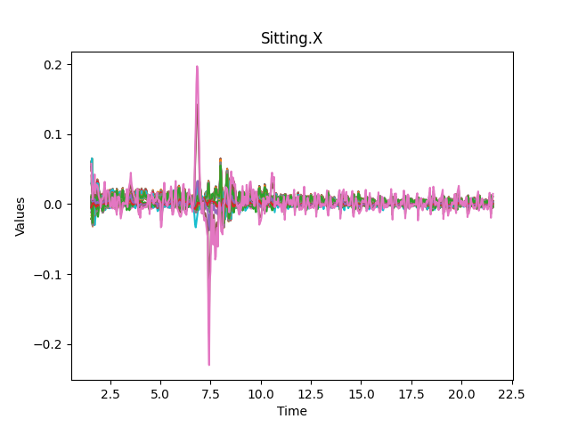
Implementation: Dataset
Stride
Sliding window approach:
window size - 32 frames;
sliding stride - 2 frames
Feature columns:
XYZ position for 21 body part – 63 columns;
-> Unable to distinguish activity in different places
Absolute coordinates -> relative movement
-> Unable to distinguish static activities
Hips.Y as Hips_height – 1 column
=> 64 feature columns
Signal
Window size
Notes:
Use several window to slice signal
50% -> 60% results more stable (convergent)
60% -> 90%

Slide 8
Implementation: Model training
Stride (1)
Model Types:
One Dimension Convolutional Neural Network (1D-CNN)
Long Short Term Memory (LSTM)
Model structure:
Conv – (1,2,3)(0,1,0) = (2)
Max-Pool – Max(1,4) = (4)
64*32*1
Signal
16*30

Flatten
Dense
16*28
Kernel (3)
Input
Conv 3*1
Conv 3*1
Dropout 0.5
…
Max-Pool 2*1
Dense
16*14
Signal after Conv
Max(St,St+1)
224
Pool (2)
…
100
6
CNN model
Signal after Pool
Notes:
Signal processed in convolution layer – similar to sliding window approach
16*28: filter = 16, 16 kinds of conv kernel for each feature

Slide 9
Implementation: Model training
Model Types:
One Dimension Convolutional Neural Network (1D-CNN)
Long Short Term Memory (LSTM)
Model structure:
LSTM – (1,2,…)
(1)*(c,h) = (3),
c = c*1, h = h*1;
(2)*(c,h) = (5),
c = c*2*1, h = h*2*1;
…
Dense
C0, h0
64*32*1
Input
Signal
32
LSTM 64
Dropout 0.5
Depth = 1
Dense
…
64
6
Signal after LSTM 1
Depth = 2
…
LSTM model
Notes:
There are some parameters from the previous data to affect the later data

Slide 10
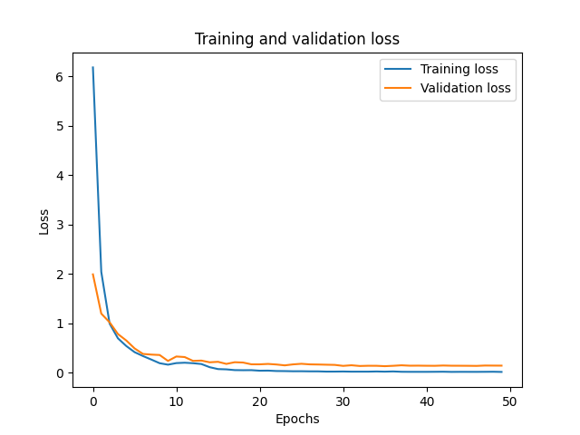
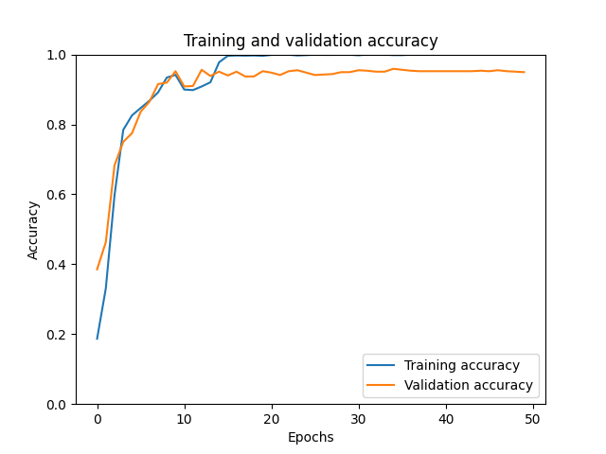
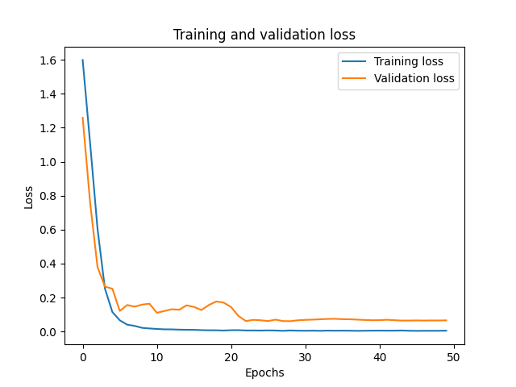
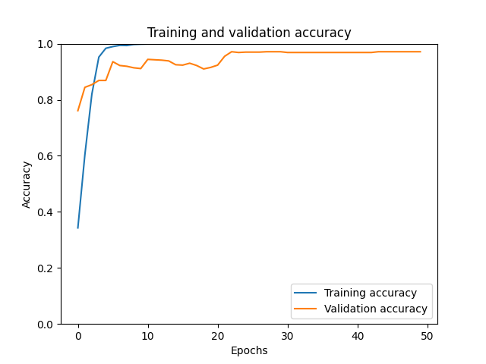
Implementation: Model training
CNN:
LSTM:
Notes:
Validation loss didn’t rise up, steady -> fit well to the data

Slide 11
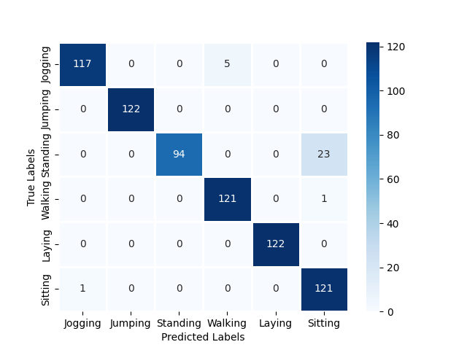
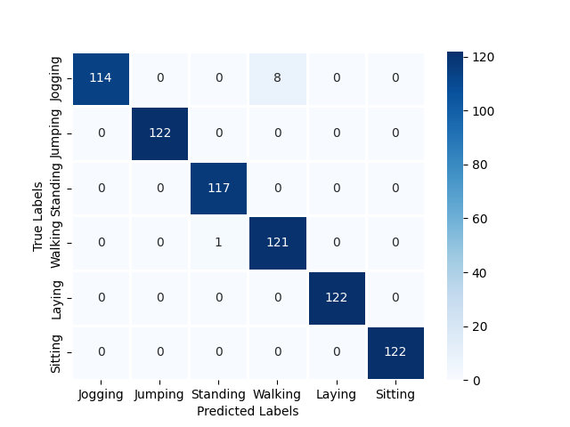
Implementation: Model training
CNN: Acc = 95.87%
LSTM: Acc = 98.76%
Notes:
CNN: Standing -> sitting
Both kinds of model: jogging -> walking

Slide 12
Implementation: Prototype
ROKOKO Smart suit
ROKOKO Studio
input
Real-Time classifier
output
Type of activity
UDP packet
UDP packet
Time stamp,
Raw data
JSON file:
Time stamp,
Position, Rotation
Real-Time classifier
*32
CNN/LSTM
Model
Type of activity
input
output
Data frame
Notes:
Collect enough frames (e.g., 32 frames) -> feed in model for classification

Slide 13
Evaluation: Study design
Q1: Which kind of model fits better for real-time classification?
Q2: How does window size affect the model performance (for the same length of recorded data)?
Variables:
6 window sizes (in frame: 8, 16, 32, 64, 128, 256)
2 model types (CNN, LSTM)
In terms of:
Accuracy
Time consumption (i.e., time used for processing testset)
Dealing with randomness:
10 test rounds for each combination of variables
Study 1
Randomness:
Model training -> dataset shuffle
Dropout: 50% possibility to deactivate neural unit

Slide 14
Evaluation: Study design
Q3: How does splitting out single axis of data affect the model accuracy?
Variables:
1 window sizes (in frame: 32)
2 model types (CNN, LSTM)
3 axes of position data (X, Y, Z)
In terms of:
Accuracy
Dealing with randomness:
10 test rounds for each combination of variables
Study 2
Risks:
Information loss
Unable to distinguish difference in split-out axis

Slide 15
Evaluation: Study design
Q4: Which kind of body part data contributes model constructing?
Variables:
1 window sizes (in frame: 32)
2 model types (CNN, LSTM)
12 body part position data (Head, Neck and Hips, shoulder, arm, fore arm, hand, thigh, shin, foot, toe and toe end for both left side and right side of the body)
In terms of:
Accuracy
Dealing with randomness:
10 test rounds for each combination of variables
Study 3

Slide 16
Evaluation: Hypothesis
H1:
CNN model performs better that LSTM model for constructing real-time classifier.
H2:
Using larger window size could make the activity classification more accurate.
H3:
Splitting out data columns and only use data of one of the axis will obtain a higher recognition accuracy.
H4:
Using data columns from specified body parts contributes to better model performance.

Slide 17
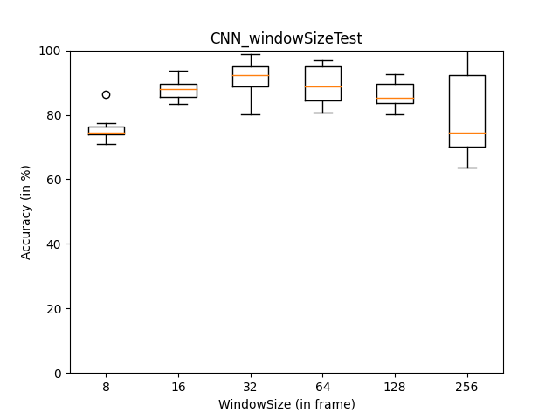
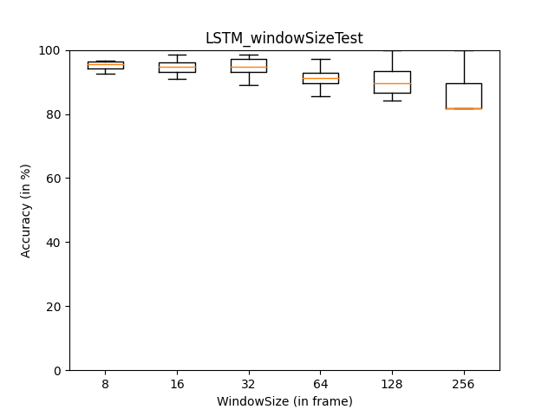


Evaluation: Results
CNN: Overall (M=0.85, SD=0.0064)
Accuracy $∝$ Window size (8-128: r=0.22)
LSTM: Overall (M=0.95, SD=0.0005)
Accuracy $∝$ (1/Window size) (8-128: r=-0.47)
Study 1
Notes:
Positive correlative with
Negative …
Relative coefficient of 0.22, -0.47

Slide 18
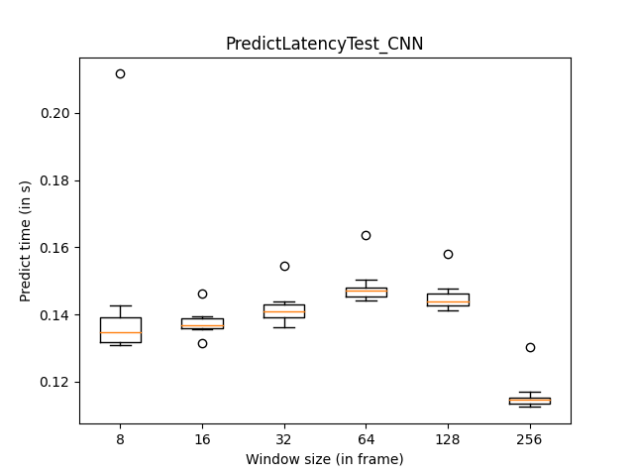
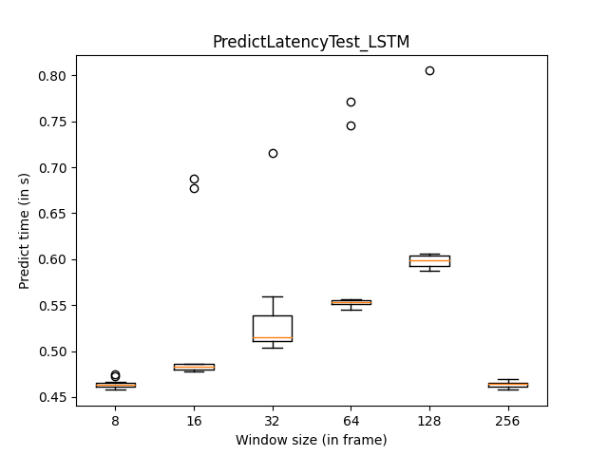


Evaluation: Results
CNN: Overall (M=0.141, SD=0.0002)
Time consumption $∝$ Window size (8-128: r=0.61)
LSTM: Overall (M=0.509, SD=0.0046)
Time consumption $∝$ Window size (8-128: r=0.90)
Study 1
Notes:
Positive correlative with
Relative coefficient of 0.61, 0.90

Slide 19
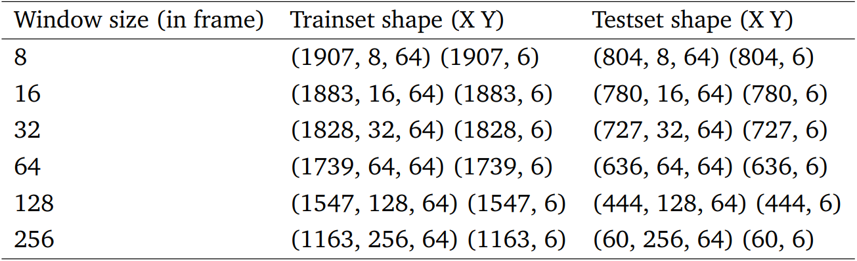
Evaluation: Results
Dataset shape (samples, window size, features) (samples, classes):
For the data with same length:
Large window -> Lacking in training samples -> Lower accuracy & less time consumption
Study 1
Notes:
Model cannot learn enough features with less samples

Slide 20
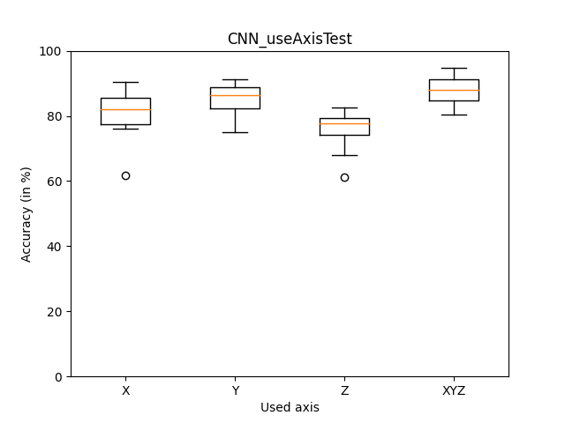
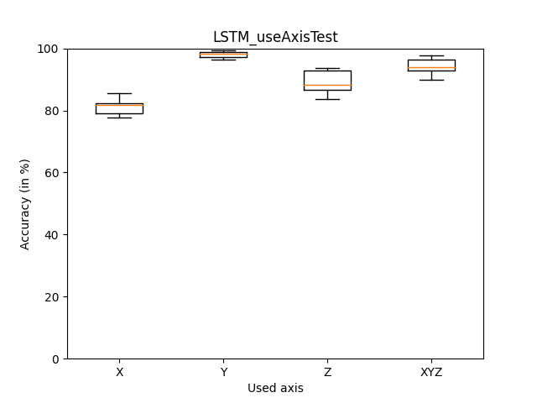
Evaluation: Results
CNN: three axes (M=0.88, SD=0.0021)
Y-axis (M=0.85, SD=0.0026) P(T<=t): 0.1223
LSTM: three axes (M=0.94, SD=0.0006)
Y-axis (M=0.98, SD=0.0001) P(T<=t): 0.0017
Study 2
Notes:
Model using data in Y axis get highest acc among single axes
After making t-pair test,
CNN didn’t get significantly higher acc

Slide 21
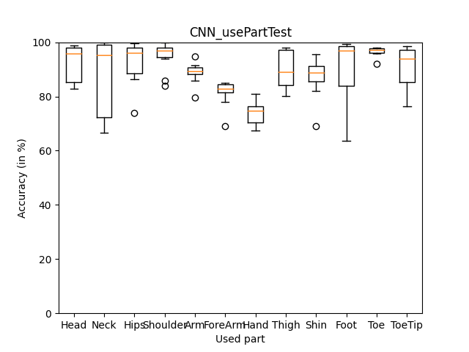
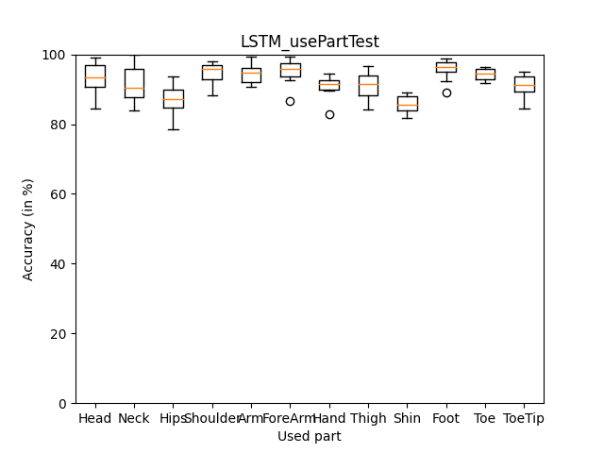
Evaluation: Results
CNN: Overall (M=0.89, SD=0.0090)
toe (M=0.97, SD=0.0003)
fore arm (M=0.81, SD=0.0024)
hand (M=0.74, SD=0.0019)
shin (M=0.87, SD=0.0057)
LSTM: Overall (M=0.92, SD=0.0021)
foot (M=0.96, SD=0.0008)
hips (M=0.87, SD=0.0019)
shin (M=0.86, SD=0.0006)
Study 3

Slide 22
Evaluation: Summary
Answering hypothesis:
H1:
CNN model performs better that LSTM model for constructing real-time classifier.
This hypothesis could be accepted.
H2:
Using larger window size could make the activity classification more accurate.
This hypothesis could not be totally accepted.
H3:
Splitting out data columns and only use data of one of the axis will obtain a higher recognition accuracy.
This hypothesis should be rejected.
H4:
Using data columns from specified body parts contributes to better model performance.
This hypothesis could be accepted.
Notes:
Compared with LSTM. CNN consume much less time without losing too much acc
Larger window contributes to acc of CNN
Lose information, cannot distinguish activity in split-out axis
Foot/toe -> higher acc

Slide 23
Further discussion: Limitations
Prototype design:
Limited sample frequency - 30Hz
Fine-tune model params
Relies on RKK studio
Lacking in dataset:
6 classes
Participants
Unbalanced dataset:
Standing 16.19%, others > 16.70%
Dealing with randomness:
Test rounds > 10
Or
Random seeds
Notes:
More participant -> better generalization performance of model
Less data of standing -> lower acc when classifying standing activity
Random seed -> improve reproducibility of expr

Slide 24
Further discussion: Future works
Self-supervising model:
Without handcraft data annotation
Dataset making
Implement with AI:
HAR -> smart devices reaction (e.g. health care: falling detection)
Integrated application:
Without complicated environment configuration
Data pipe (Suit-->RKK studio-->BVH file--bvh_converter-->CSV file--Pandas-->Dataset-->Model-->Classifier)
-> (Suit--Data pipe-->Dataset--> Model-->Classifier)
Integrated devices:
Less sensors
Lower cost
More Portable
Notes:
AI assistant help calling ambulance
Simplify constructing of model

Slide 25
Demo: Real-Time HAR
Notes:
Jogging – confused with walking

Slide 26
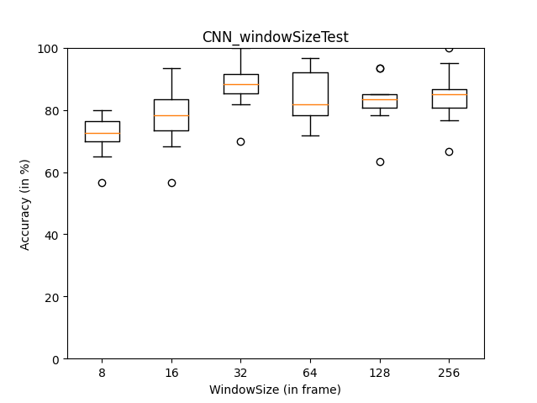
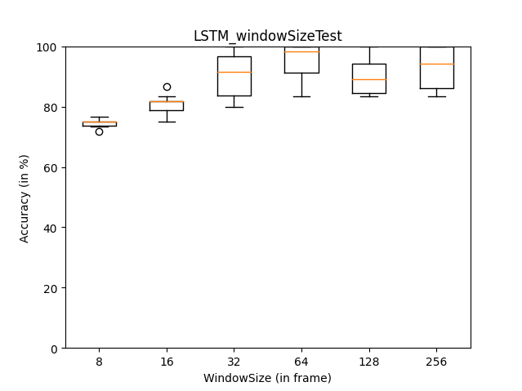
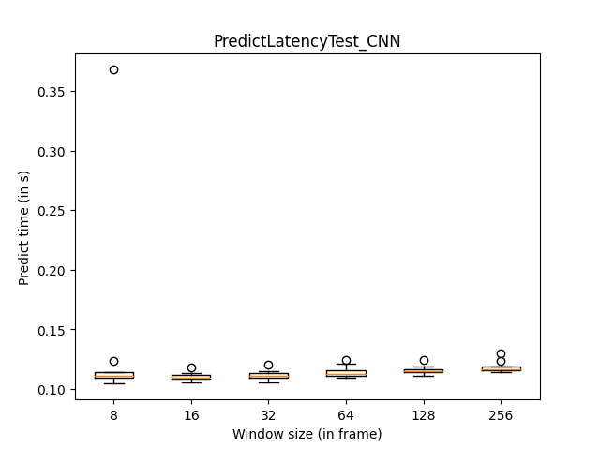
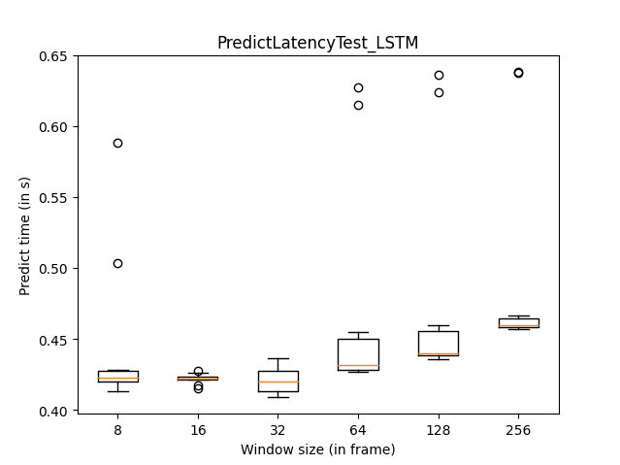
Extra expr (same sample quantity)

Slide 27
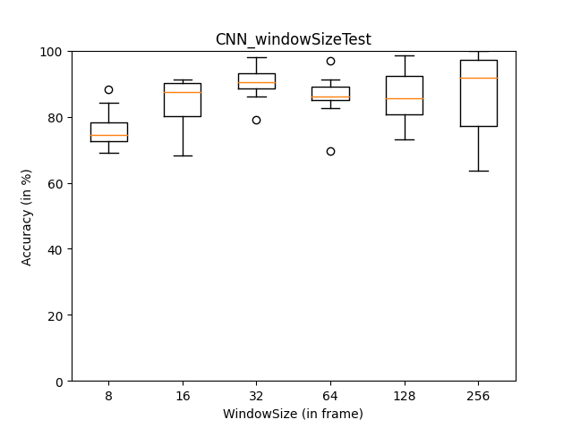
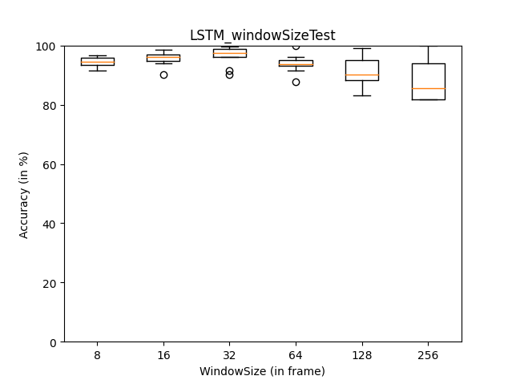
Repetitive expr (random seed = 42)

