Slide 1
jQuery
CP 221: Internet Programming and Applications I

Slide 2
What is jQuery?
jQuery is a fast and concise JavaScript Library that simplifies HTML document traversing, event handling, animating, and Ajax interactions for rapid web development. (jQuery.com)

Slide 3
About jQuery
jQuery is a JavaScript Library.
jQuery simplifies JavaScript programming.
jQuery is a lightweight, "write less, do more", JavaScript library
The purpose of jQuery is to make it much easier to use JavaScript on your website.
jQuery was originally released in January 2006 at BarCamp NYC by John Resig

Slide 4
Why learn jQuery?
Write less, do more:
$("p.neat").addClass("ohmy").show("slow");
Performance
Plugins
It’s standard
… and fun!
Notes:
That little snippet loops through all <p> elements with the class "neat" and then adds the class "ohmy" to it, whilst slowly showing the paragraph in an animated effect. No browser checks, no loop code, no complex animation functions, just one line of code!

Slide 5
How to use jQuery?
Download the jQuery library from jQuery.com
Include jQuery from a CDN, like Google
<head> <script src="jquery-3.3.1.min.js"></script> </head>
<head> <script src="https://ajax.googleapis.com/ajax/libs/jquery/3.3.1/jquery.min.js"></script> </head>

Slide 6
<!DOCTYPE html>
<html>
<head>
<title>Hello, World!</title>
</head>
<body>
<div>
<p id="hello">Some random text</p>
</div>
<script src="https://code.jquery.com/jquery-2.2.4.min.js">
</script>
<script>
$(document).ready(function() {
$('#hello').text('Hello, World!');
});
</script>
</body>
</html>

Slide 7
jQuery Syntax
Basic syntax is: $(selector).action()
A $ sign to define/access jQuery
A (selector) to "query (or find)" HTML elements
A jQuery action() to be performed on the element(s)
The Document Ready Event
$(document).ready(function(){ // jQuery methods go here... });
$(function(){ // jQuery methods go here... });

Slide 8
Example: Show/Hide Button

Slide 9
window.onload
We cannot use the DOM before the page has been constructed. jQuery gives us a more compatibile way to do this.
The DOM way
The direct jQuery translation
The jQuery way
window.onload = function() { // do stuff with the DOM }
$(document).ready(function() { // do stuff with the DOM });
$(function() { // do stuff with the DOM });

Slide 10
Aspects of the DOM and jQuery
Identification: how do I obtain a reference to the node that I want.
Traversal: how do I move around the DOM tree.
Node Manipulation: how do I get or set aspects of a DOM node.
Tree Manipulation: how do I change the structure of the page.

Slide 11
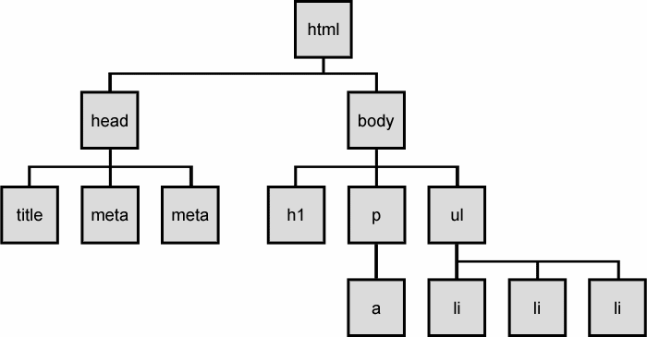
The DOM tree

Slide 12
Selecting groups of DOM objects
name | description
getElementById | returns array of descendents with the given tag, such as "div"
getElementsByTagName | returns array of descendents with the given tag, such as "div"
getElementsByName | returns array of descendents with the given name attribute (mostly useful for accessing form controls)
querySelector * | returns the first element that would be matched by the given CSS selector string
querySelectorAll * | returns an array of all elements that would be matched by the given CSS selector string
Notes:
const collection = document.getElementsByTagName("li");

Slide 13
jQuery / DOM comparison
DOM method | jQuery equivalent
getElementById("id") | $("#id")
getElementsByTagName("tag") | $("tag")
getElementsByName("somename") | $("[name='somename']")
querySelector("selector") | $("selector")
querySelectorAll("selector") | $("selector")

Slide 14
jQuery node identification
// id selector
var elem = $("#myid");
// group selector
var elems = $("#myid, p");
// context selector
var elems = $("#myid < div p");
// complex selector
var elems = $("#myid < h1.special:not(.classy)");

Slide 15
Exercise
Use jQuery selectors to identify elements with these properties in a hypothetical page:
All p tags that have no children, but only if they don't have a class of ignore
Any element with the text "REPLACE_ME" in it.
All div tags with a child that has a class of special
All heading elements (h1, h2, h3, h4, h5, h6)
Every other visible li.
Use the DOM API to target the #square and periodically change it's position in a random direction.
Use jQuery selectors instead of the DOM API.

Slide 16
jQuery terminology
the jQuery function
refers to the global jQuery object or the $ function depending on the context
a jQuery object
the object returned by the jQuery function that often represents a group of elements
selected elements
the DOM elements that you have selected for, most likely by some CSS selector passed to the jQuery function and possibly later filtered further

Slide 17
The jQuery object
The $ function always (even for ID selectors) returns an array-like object called a jQuery object.
The jQuery object wraps the originally selected DOM objects.
You can access the actual DOM object by accessing the elements of the jQuery object.
// false
document.getElementById("id") == $("#myid");
document.querySelectorAll("p") == $("p");
// true
document.getElementById("id") == $("#myid")[0];
document.getElementById("id") == $("#myid").get(0);
document.querySelectorAll("p")[0] == $("p")[0];

Slide 18
Using $ as a wrapper
$ adds extra functionality to DOM elements
passing an existing DOM object to $ will give it the jQuery upgrade
// convert regular DOM objects to a jQuery object
var elem = document.getElementById("myelem");
elem = $(elem);
var elems = document.querySelectorAll(".special");
elems = $(elems);

Slide 19
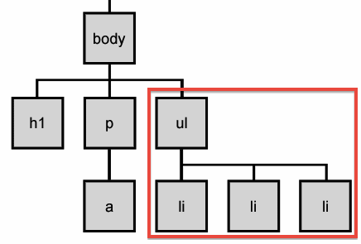
DOM context identification
You can use querySelectorAll() and querySelector() on any DOM object.
When you do this, it simply searches from that part of the DOM tree downward.
Programmatic equivalent of a CSS context selector
var list = document.getElementsByTagName("ul")[0];
var specials = list.querySelectorAll('li.special');

Slide 20
find / context parameter
jQuery gives two identical ways to do contextual element identification
var elem = $("#myid");
// These are identical
var specials = $("li.special", elem);
var specials = elem.find("li.special");

Slide 21
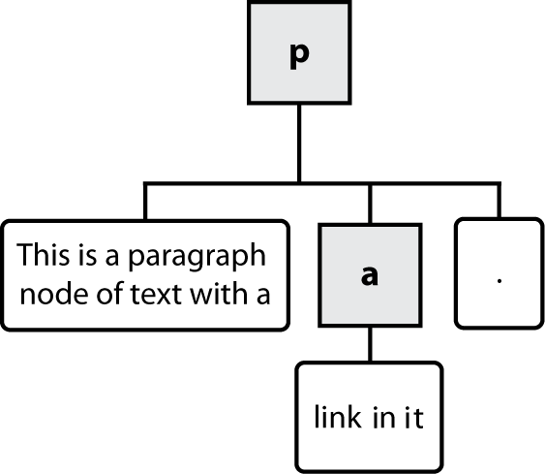
Types of DOM nodes
<p>
This is a paragraph of text with a
<a href="/path/page.html">link in it</a>.
</p>

Slide 22
Traversing the DOM tree
name(s) | description
firstChild, lastChild | start/end of this node's list of children
childNodes | array of all this node's children
nextSibling, previousSibling | neighboring nodes with the same parent
parentNode | the element that contains this node

Slide 23
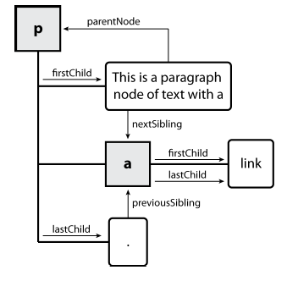
DOM tree traversal example
<p id="foo">This is a paragraph of text with a
<a href="/path/to/another/page.html">link</a>.</p> HTML

Slide 24
Id Selector
$(document).ready(function(){ $("button").click(function(){ $("#test").hide(); }); });
Class Selector
$(document).ready(function(){ $("button").click(function(){ $(".test").hide(); }); });
Select First P from Groups
$(document).ready(function(){
$("button").click(function(){
$("p:first").hide();
});
});
Select First li from Groups
$(document).ready(function(){
$("button").click(function(){
$("ul li:first").hide();
});
});
Select all href Attributes
$(document).ready(function(){
$("button").click(function(){
$("[href]").hide();
});
});
Select even rows from a Table $(document).ready(function(){
$("tr:even").css("background-color", "yellow");
});

Slide 25
jQuery Event Methods
Mouse Events | Keyboard Events | Form Events | Document/Window Events
click | keypress | submit | load
dblclick | keydown | change | resize
mouseenter | keyup | focus | scroll
mouseleave |  | blur | unload
$("p").click(function(){ $(this).hide(); });
$("#p1").mouseenter(function(){ alert("You entered p1!"); });
$("#p1").mouseleave(function(){ alert("Bye! You now leave p1!"); });
$("#p1").mouseup(function(){ alert("Mouse up over p1!"); });
$("input").blur(function(){ $(this).css("background-color", "#ffffff"); });
$("input").focus(function(){ $(this).css("background-color", "#cccccc"); });

Slide 26
jQuery Effects
Hide & Show Effect
$("#hide").click(function(){ $("p").hide(); //.hide(1000); //.toggle(); }); $("#show").click(function(){ $("p").show(); });
FadeOut & FadeIn Effect
$("button").click(function(){ $("#div1").fadeIn(); //.fadeOut();//.fadeToggle(); $("#div2").fadeIn("slow"); //.fadeTo("slow", 0.5); $("#div3").fadeIn(3000); });
Slide up and Slide down Effect
$("#flip").click(function(){ $("#panel").slideDown(); });
$("#flip").click(function(){ $("#panel").slideToggle(); });
$("button").click(function(){ $("div").animate({ left: '250px', opacity: '0.5', height: '150px', width: '150px' }); });

Slide 27
jQuery - Get & Set
$(document).ready(function(){
$("#btn1").click(function(){
alert( $("#test").text() ); //.text(“setting the txt”);
});
})
<p id="test">This is some <b>bold</b> text in a paragraph.</p>
<button id="btn1">Show Text</button>
$(document).ready(function(){
$("button").click(function(){
alert( $("#test").val() );
}); //.val(“Jquery is best");
});
<p>Name:
<input type="text" id="test" value="Mickey Mouse">
</p>
$(document).ready(function(){
$("button").click(function(){
alert($("#w3s").attr("href"));
});
});
<p><a href="https://www.w3schools.com" id="w3s">W3Schools</a></p>
<button>Show href Value</button>
$(document).ready(function(){
$("#btn2").click(function(){
alert("HTML: " + $("#test").html() );
}); //.html("<b>Hello world!</b>");
});
<p id="test">This is some <b>bold</b> text in a paragraph.</p>
<button id="btn2">Show HTML</button>

Slide 28
jQuery - Add & Remove
$("p").append("Some appended text.");
$("p").prepend("Some prepended text.");
$("img").after("Some text after"); $("img").before("Some text before");
$("#div1").remove();
$("p").remove(".test");
$("p").remove(".test, .demo");
$("#div1").empty();

Slide 29
jQuery - CSS Manipulation
.design { font-weight: bold; font-size: xx-large; } $("button").click(function(){ $("h1, h2, p").addClass("design");
//.addClass("important blue"); $("div").addClass(“design"); });
$("button").click(function(){ $("h2").removeClass(“design"); });
$("button").click(function(){ $("p").toggleClass(“design"); });
$("p").css("background-color", "yellow");
$("p").css({"background-color": "yellow",
"font-size": “20px"});

Slide 30
jQuery - Dimensions
jQuery has several important methods for working with dimensions:
width()
height()
innerWidth()
innerHeight()
outerWidth()
outerHeight()
$(document).ready(function(){
$("button").click(function(){
var msg = "";
msg += "Width of div: " + $("#div1").width() + "</br>";
msg += "Height of div: " + $("#div1").height() + "</br>";
msg += "Inner width of div: " + $("#div1").innerWidth() + "</br>";
msg += "Inner height of div: " + $("#div1").innerHeight();
$("#div1").html(msg );
});
});
<div style=“width:300px; height:100px; background:blue;” id="div1"></div>
<button>click me </button>

Slide 31
jQuery tutorials
Code Academy
http://www.codecademy.com/courses/you-and-jquery/0?curriculum_id=4fc3018f74258b0003001f0f#!/exercises/0
Code School:
http://www.codeschool.com/courses/jquery-air-first-flight

