Slide 1
Word-Embedding

Slide 2
Word
Vector
Sentence(句子)
document(文件)
Document classification
(文件分類)

Slide 3
Archie used to live in New York, he then moved to Santa Clara. He loves apples and strawberries.
Word2vec model generates the vector representation for each of the words in the preceding text.

Slide 4
with word2vec model, we can learn the meaningful vector representation of a word which helps the neural networks to understand what the word is about.

Slide 5
兩種實作
CBOW model
(Continuous Bag-of-Words Model)
2. Skip-gram model

Slide 6
The Sun rises in the ____
east
If we were asked to predict the blank term in the preceding sentence, we would probably say east.
Why would we predict that the word east would be the right word here? Because we read the whole sentence, understood the context, and predicted that the word east would be an appropriate word to complete the sentence.

Slide 7
CBOW model
將一個詞所在的上下文中的詞作為輸入，而那個詞本身作為輸出，
也就是說，看到一個上下文，希望大概能猜出這個詞和它的意思
window

Slide 8
one-hot encoding
The Sun rises in the east
All the unique words we have in our corpus is called the vocabulary(詞彙表)

Slide 9
將一個詞所在的上下文中的詞作為輸入，而那個詞本身作為輸出，
也就是說，看到一個上下文，希望大概能猜出這個詞和它的意思
In the initial iteration, the network cannot predict the target word correctly.
But over a series of iterations, it learns to predict the correct target word using gradient descent. With gradient descent, we update the weights of the network and find the optimal weights with which we can predict the correct target word.

Slide 10
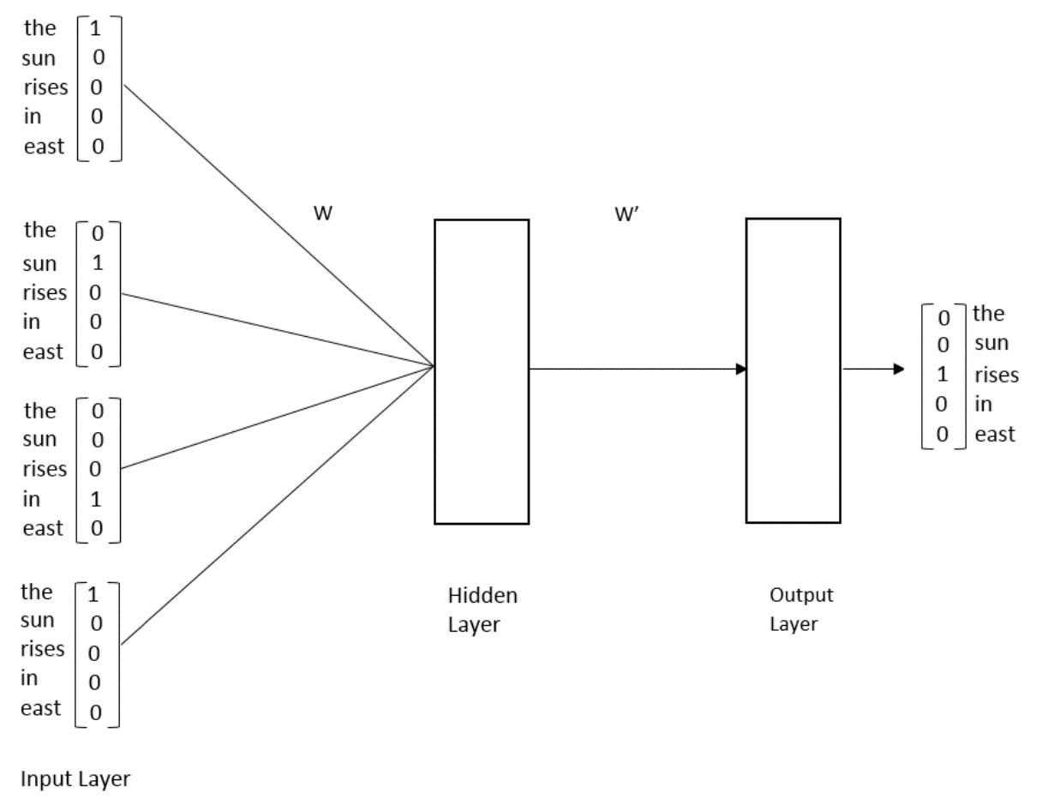
範例模型只有兩個權重weight
During the training process, the network will try to find the optimal values for these two sets of weights so that it can predict the correct target word.
It turns out that the optimal weights between the input to a hidden layer forms the vector representation of words. They basically constitute the semantic meaning of the words.
So, after training, we simply remove the output layer and take the weights between the input and hidden layers and assign them to the corresponding words.

Slide 11
訓練完後的W就是word embedding
例如底下的範例
the embedding for the word sun is [0.0, 0.3,0.3,0.6,0.1 ]

Slide 12
CBOW with a single context word
CBOW with
multiple context words

Slide 13
CBOW with a single context word
V :the size of the vocabulary (that is, number of words)
N: number of neurons in the hidden layer.

Slide 14
CBOW with a single context word
V :the size of the vocabulary (that is, number of words)
N: number of neurons in the hidden layer.

Slide 15
CBOW with a single context word
Forward propagation
Y tells us the probability for a word to the target word given an input context word.
We compute the probability for all the words in our vocabulary and select the word that
has a high probability as the target word.
V :the size of the vocabulary (that is, number of words)
N: number of neurons in the hidden layer.

Slide 16
CBOW with a single context word
Forward propagation
正確的預測值
objective function?
我們要讓正確的預測值的機率最大
可以使用
gradient descent algorithm

Slide 17
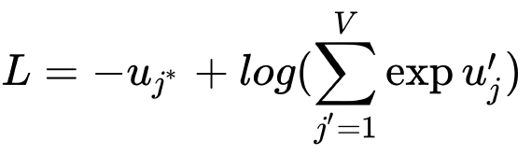
CBOW with a single context word
Forward propagation
可以使用
gradient descent algorithm

Slide 18

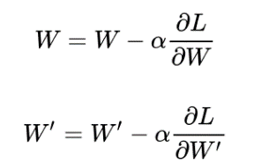
CBOW with a single context word
Backward propagation

Slide 19
CBOW with a single context word

Slide 20
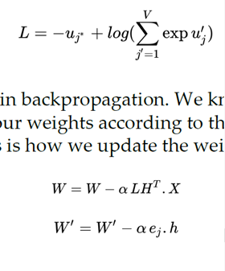
CBOW with multiple context words
simply take the average of
them and multiply with the weight matrix

Slide 21
Skip-gram model

Slide 22
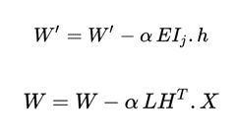
softmax function
有C個context words 所以➔

Slide 23
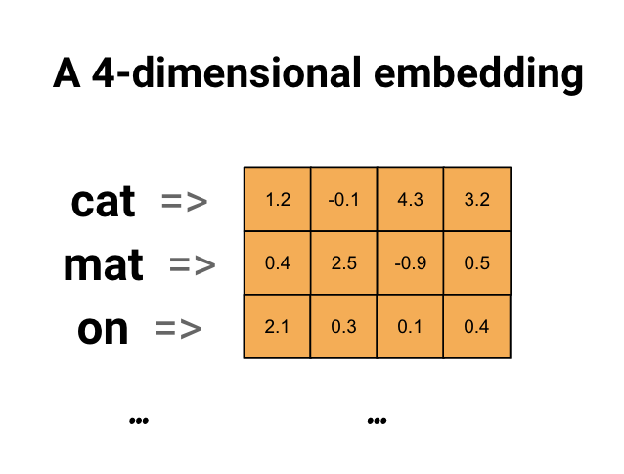
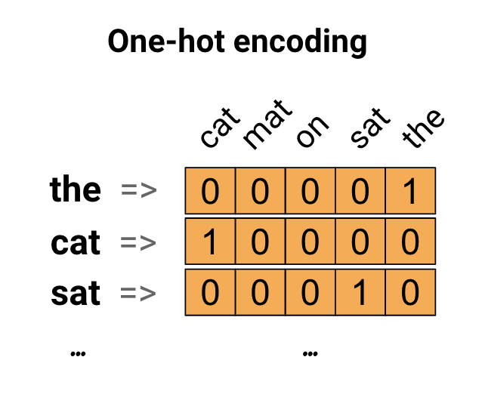
word embedding
Each word is represented as a 4-dimensional vector of floating point values.
Another way to think of an embedding is as "lookup table".
After these weights have been learned, we can encode each word by looking up the dense vector it corresponds to in the table

Slide 24
各種實測
Gensim
Tensorflow
https://www.tensorflow.org/tutorials/text/word_embeddings

Slide 25
使用gensim訓練維琪百科中文語料wordvec模型
https://www.jianshu.com/p/e2d13d058ac6
由於最近在研究旅遊評論的極性情感分析，想利用深度學習的方式來訓練一個情感分類模型，苦於沒有高品質的語料庫，訓練的模型準確率不高。
於是決定自己基於維琪百科語料訓練一個wordvec2 模型，為下一步的研究工作做準備。
1、語料的下載下載地址,下載大小大概有1.5G，裡面的內容以為xml格式保存。
2、資料的處理1、去除原始的資料是包含了各種xml標籤，使用網上開源處理常式提取文本資料Wikipedia Extractor

