Slide 1
評估指標與效能調教 Model Evaluation and Hyperparameter Tuning
經濟部工業局108年度「AI 智慧應用新世代人才培育計畫」
Tensorflow 人工智慧與 資訊安全應用實務課程

Slide 2
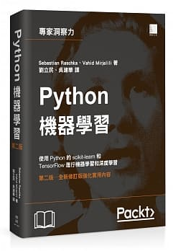
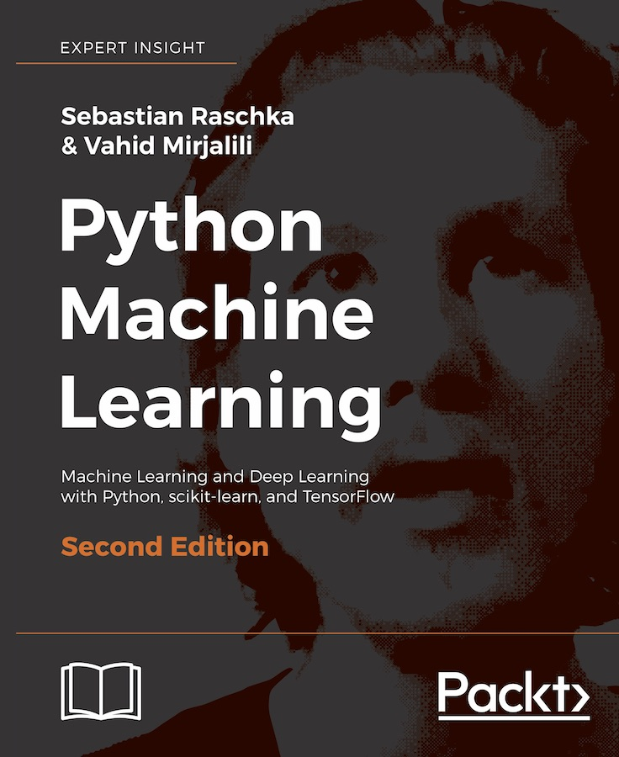
Ch 6.
Streamlining workflows with pipelines
Using k-fold cross-validation to assess model performance
Debugging algorithms with learning and validation curves
Fine-tuning machine learning models via grid search
Looking at different performance evaluation metrics
Dealing with class imbalance
Python機器學習(第二版)
Python Machine Learning – Second Edition
作者： Sebastian Raschka, Vahid Mirjalili
譯者： 劉立民, 吳建華
博碩出版社 出版日期：2018/08/30
https://github.com/rasbt/python-machine-learning-book-2nd-edition
https://github.com/rasbt/python-machine-learning-book[第一版]

Slide 3
cross-validation
交叉驗證

Slide 4
進行模型驗證的一個重要目的是要選出一個最合適的模型
監督學習:希望模型對於未知數據的泛化能力強
=== >使用模型驗證過程來體現不同的模型對於未知數據的表現效果
過擬合問題
使用全部資料進行訓練和測試來衡量模型的準確度表現，這種方法常會導致模型過擬合
為了解決過擬合問題== >測試準確度
將所有資料分成訓練集和測試集兩部分:
用訓練集進行模型訓練，得到的模型再用測試集來衡量模型的預測表現能力
可有效避免過擬合

Slide 5
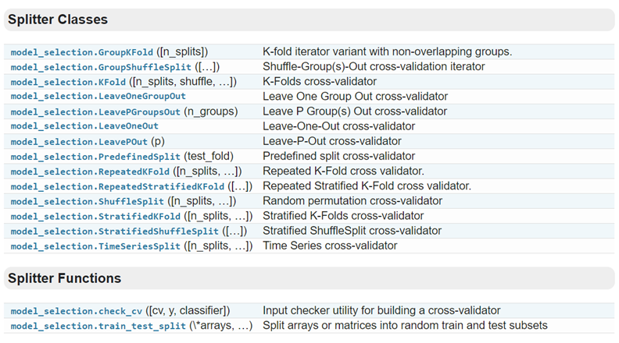
sklearn 中的模型選擇(交叉驗證)
https://blog.csdn.net/xiaodongxiexie/article/details/71915259
https://scikit-learn.org/stable/modules/classes.html#module-sklearn.model_selection
https://nbviewer.jupyter.org/github/cs109/content/blob/master/lec_10_cross_val.ipynb

Slide 6
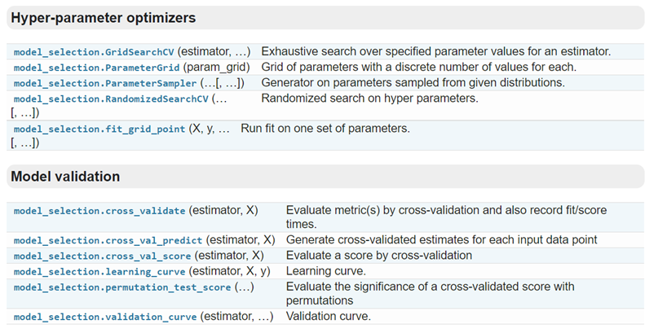
https://scikit-learn.org/stable/modules/classes.html#module-sklearn.model_selection

Slide 7
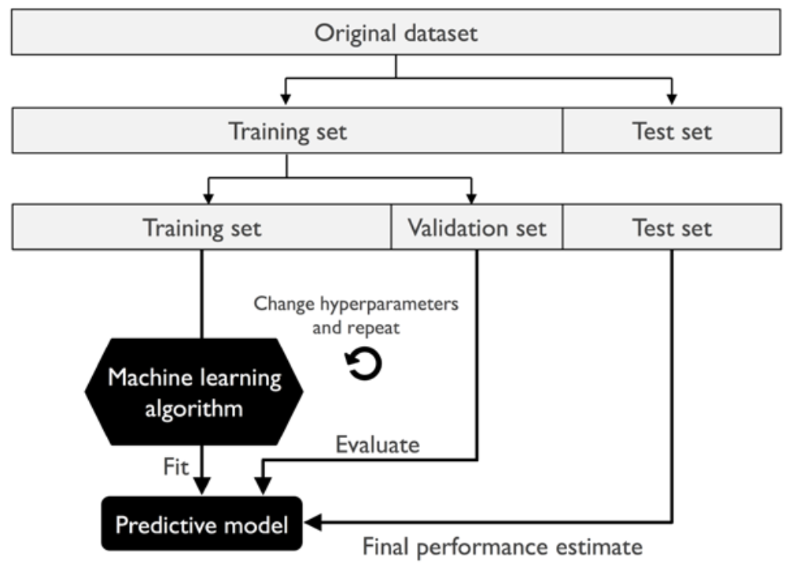
holdout cross-validation
the performance estimate may be very sensitive to
how we partition the training set into the training and validation subsets

Slide 8

k-fold cross-validation (CV for short)
https://scikit-learn.org/stable/modules/cross_validation.html#cross-validation
In the basic approach, called k-fold CV,
the training set is split into k smaller sets
A test set should still be held out for final evaluation
The performance measure reported by k-fold cross-validation is then the average of the values computed in the loop.
This approach can be computationally expensive, but does not waste too much data
A model is trained using of the folds as training data;
the resulting model is validated on the remaining part of the data
(i.e., it is used as a test set to compute a performance measure such as accuracy).

Slide 9
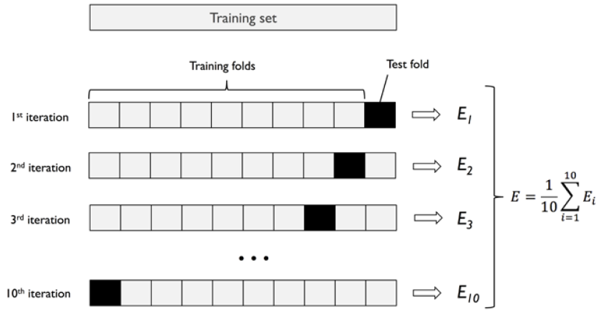
https://scikit-learn.org/stable/modules/cross_validation.html#cross-validation

Slide 10
from pandas import read_csv
from sklearn.model_selection import KFold
from sklearn.model_selection import cross_val_score
from sklearn.linear_model import LogisticRegression
filename = 'pima_data.csv'
names = ['preg', 'plas', 'pres', 'skin', 'test', 'mass', 'pedi', 'age', 'class']
data = read_csv(filename, names=names)
array = data.values
X = array[:, 0:8]
Y = array[:, 8]
num_folds = 10
seed = 7
kfold = KFold(n_splits=num_folds, random_state=seed)
model = LogisticRegression()
result = cross_val_score(model, X, Y, cv=kfold)
print("演算法評估結果準確度：%.3f%% (%.3f%%)" % (result.mean(), result.std()))
演算法評估結果準確度：0.770% (0.048%)

Slide 11
class sklearn.model_selection.KFold(
n_splits=’warn’,
shuffle=False,
random_state=None)
表示劃分幾等份
將訓練/測試資料集劃分n_splits個互斥子集，每次用其中一個子集當作驗證集，剩下的n_splits-1個作為訓練集，進行n_splits次訓練和測試，得到n_splits個結果
在每次劃分時，是否進行洗牌
隨機種子數
shuffle：在每次劃分時，是否進行洗牌
①若為Falses時，其效果等同於random_state等於整數，每次劃分的結果相同
②若為True時，每次劃分的結果都不一樣，表示經過洗牌，隨機取樣的
random_state
If int, random_state is the seed used by the random number generator;
If RandomState instance, random_state is the random number generator;
If None, the random number generator is the RandomState instance used by np.random.
Used when shuffle == True.
https://scikit-learn.org/stable/modules/generated/sklearn.model_selection.KFold.html

Slide 12
K要取多少??
A Study of Cross-Validation and Bootstrap for Accuracy Estimation and Model Selection, Kohavi, Ron, International Joint Conference on Artificial Intelligence (IJCAI), 14 (12): 1137-43, 1995).
10-fold cross-validation
offers the best trade-off between bias and variance

Slide 13
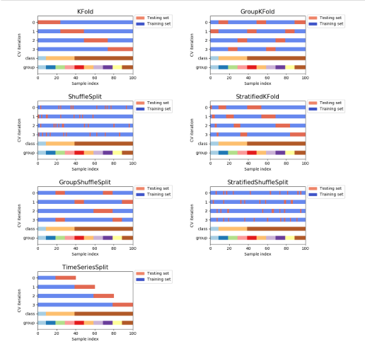
進階研讀
https://scikit-learn.org/stable/auto_examples/model_selection/plot_cv_indices.html
Visualizing cross-validation behavior in scikit-learn

Slide 14
sklearn.model_selection.cross_val_score(
estimator,
X,
y=None,
groups=None,
scoring=None,
cv=’warn’,
n_jobs=None,
verbose=0,
fit_params=None,
pre_dispatch=‘2*n_jobs’,
error_score=’raise-deprecating’)
https://blog.csdn.net/weixin_38536057/article/details/78702564

Slide 15
計算cross-validated metrics
See 3.1.1. Computing cross-validated metrics
使用 cross_val_score helper function on the estimator and the dataset
from sklearn.model_selection import cross_val_score
clf = svm.SVC(kernel='linear', C=1)
scores = cross_val_score(clf, iris.data, iris.target, cv=5)
scores
array([0.96..., 1. ..., 0.96..., 0.96..., 1. ])
The mean score and the 95% confidence interval of the score estimate are hence given by:
print("Accuracy: %0.2f (+/- %0.2f)" % (scores.mean(), scores.std() * 2))
Accuracy: 0.98 (+/- 0.03)

Slide 16
https://blog.csdn.net/FontThrone/article/details/79220127
可為cross_val_score選擇不同的性能度量(scoring parameter)函數
from sklearn import metrics
scores_clf_svc_cv_f1 = cross_val_score(clf_svc_cv,iris.data,iris.target,cv=5, scoring='f1_macro')
See 3.3.1. The scoring parameter: defining model evaluation rules
https://scikit-learn.org/stable/modules/model_evaluation.html#scoring-parameter

Slide 17
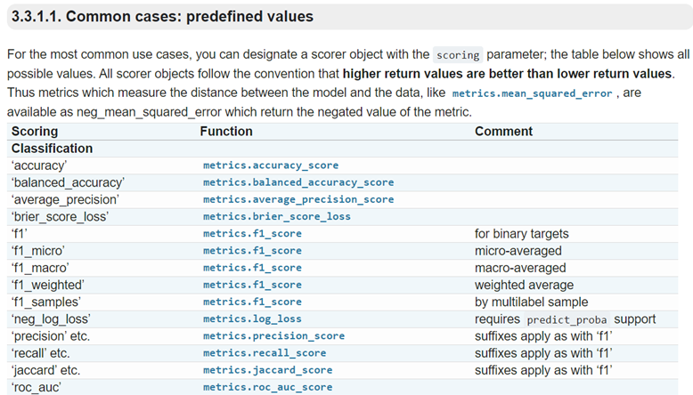
scoring='f1_macro'

Slide 18
from pandas import read_csv
from sklearn.model_selection import KFold
from sklearn.model_selection import cross_val_score
from sklearn.linear_model import LogisticRegression
filename = 'pima_data.csv'
names = ['preg', 'plas', 'pres', 'skin', 'test', 'mass', 'pedi', 'age', 'class']
data = read_csv(filename, names=names)
array = data.values
X = array[:, 0:8]
Y = array[:, 8]
num_folds = 10
seed = 7
kfold = KFold(n_splits=num_folds, random_state=seed)
model = LogisticRegression()
result = cross_val_score(model, X, Y, cv=kfold)
print("演算法評估結果準確度：%.3f%% (%.3f%%)" % (result.mean(), result.std()))
演算法評估結果準確度：0.770% (0.048%)

Slide 19
評估指標
metrics

Slide 20
參考資料
3.3. Model evaluation: quantifying the quality of predictions
https://scikit-learn.org/stable/modules/model_evaluation.html
3.3.1. The scoring parameter: defining model evaluation rules
3.3.2. Classification metrics
3.3.3. Multilabel ranking metrics
3.3.4. Regression metrics
3.3.5. Clustering metrics
3.3.6. Dummy estimators

Slide 21
3.3.2. Classification metrics
3.3.2.1. From binary to multiclass and multilabel
3.3.2.2. Accuracy score
3.3.2.3. Balanced accuracy score
3.3.2.4. Cohen’s kappa
3.3.2.5. Confusion matrix
3.3.2.6. Classification report
3.3.2.7. Hamming loss
3.3.2.8. Precision, recall and F-measures
3.3.2.8.1. Binary classification
3.3.2.8.2. Multiclass and multilabel classification
3.3.2.9. Jaccard similarity coefficient score
3.3.2.10. Hinge loss
3.3.2.11. Log loss
3.3.2.12. Matthews correlation coefficient
3.3.2.13. Multi-label confusion matrix
3.3.2.14. Receiver operating characteristic (ROC)
3.3.2.15. Zero one loss
3.3.2.16. Brier score loss
!wget https://raw.githubusercontent.com/MyDearGreatTeacher/AI201909/master/data/pima_data.csv

Slide 22



confusion_matrix混淆矩陣
$Recall=\frac{TP}{TP+FN}=$查全率 = 召回率
預測值
真實值為True的情況下
預測值仍為True所佔的比例
(查得全，對正樣本的區分能力)
0
1
0
True
negative(TN)
False
positive(FP)
$Precision=\frac{TP}{TP+FP}=$查準率 = 精度
真實
值
1
False
negative(FN)
True
positive(TP)
預測值為True情況下
真實值仍為True所佔的比例(查得準)
$$F1=\frac{2TP}{2TP+FN+FP}=\frac{2∙Precision∙Recall}{Precision∙Recall}$$
用來評估模型穩健程度的標準
越大越好，是一個綜合的評判標準
再提高召回率的同時是不是有維持一定的準確率??

Slide 23
confusion_matrix混淆矩陣
Predicted class
Cat
Dog
Rabbit
Cat
5
3
0
Actual
class
Dog
2
3
1
Rabbit
0
2
11

Slide 24
confusion_matrix 混淆矩陣
from pandas import read_csv
import pandas as pd
from sklearn.model_selection import train_test_split
from sklearn.linear_model import LogisticRegression
from sklearn.metrics import confusion_matrix
filename = 'pima_data.csv'
names = ['preg', 'plas', 'pres', 'skin', 'test', 'mass', 'pedi', 'age', 'class']
data = read_csv(filename, names=names)
array = data.values
X = array[:, 0:8]
Y = array[:, 8]
test_size = 0.33
seed = 4
X_train, X_test, Y_traing, Y_test = train_test_split(X, Y, test_size=test_size, random_state=seed)

Slide 25
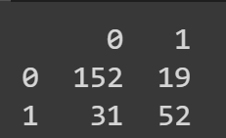
model = LogisticRegression()
model.fit(X_train, Y_traing)
predicted = model.predict(X_test)
matrix = confusion_matrix(Y_test, predicted)
classes = ['0', '1']
dataframe = pd.DataFrame(data=matrix,
index=classes,
columns=classes)
print(dataframe)

Slide 26
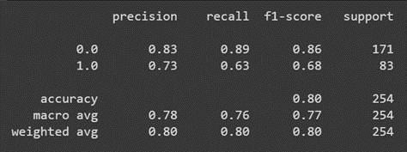
Classification report

Slide 27
from pandas import read_csv
from sklearn.model_selection import train_test_split
from sklearn.linear_model import LogisticRegression
from sklearn.metrics import classification_report
filename = 'pima_data.csv'
names = ['preg', 'plas', 'pres', 'skin', 'test', 'mass', 'pedi', 'age', 'class']
data = read_csv(filename, names=names)
array = data.values
X = array[:, 0:8]
Y = array[:, 8]
test_size = 0.33
seed = 4
X_train, X_test, Y_traing, Y_test = train_test_split(X, Y, test_size=test_size, random_state=seed)
model = LogisticRegression()
model.fit(X_train, Y_traing)
predicted = model.predict(X_test)
report = classification_report(Y_test, predicted)
print(report)

Slide 28
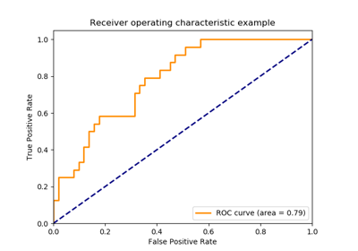
ROC（Receiver Operating Characteristic）曲線和AUC
常被用來評價一個二值分類器（binary classifier）的優劣。
AUC（Area Under Curve）被定義為ROC曲線下的面積，顯然這個面積的數值不會大於1。
由於ROC曲線一般都處於y=x這條直線的上方，所以AUC的取值範圍在0.5和1之間。
使用AUC值作為評價標準是因為很多時候ROC曲線並不能清晰的說明哪個分類器的效果更好，而作為一個數值，對應AUC更大的分類器效果更好。

Slide 29
num_folds = 10
seed = 7
kfold = KFold(n_splits=num_folds, random_state=seed)
model = LogisticRegression()
scoring = 'roc_auc'
result = cross_val_score(model, X, Y, cv=kfold, scoring=scoring)
print('AUC %.3f (%.3f)' % (result.mean(), result.std()))
AUC 0.824 (0.041)
scoring = 'neg_log_loss‘
result = cross_val_score(model, X, Y, cv=kfold, scoring=scoring)
print('Logloss %.3f (%.3f)' % (result.mean(), result.std()))
Logloss -0.493 (0.047)

Slide 30
完成SVM對pima 資料集的分類指標計算
model = SVC()
result = cross_val_score(model, X, Y, cv=kfold)
完成決策樹對pima 資料集的分類指標計算
model = DecisionTreeClassifier()
result = cross_val_score(model, X, Y, cv=kfold)

Slide 31
3.3.4. Regression metrics
3.3.4.1. Explained variance score
3.3.4.2. Max error
3.3.4.3. Mean absolute error
3.3.4.4. Mean squared error
3.3.4.5. Mean squared logarithmic error
3.3.4.6. Median absolute error
3.3.4.7. R² score, the coefficient of determination
!wget https://raw.githubusercontent.com/MyDearGreatTeacher/AI201909/master/data/housing.csv

Slide 32
from pandas import read_csv
from sklearn.model_selection import KFold
from sklearn.model_selection import cross_val_score
from sklearn.linear_model import LinearRegression
filename = 'housing.csv'
names = ['CRIM', 'ZN', 'INDUS', 'CHAS', 'NOX', 'RM', 'AGE', 'DIS',
'RAD', 'TAX', 'PRTATIO', 'B', 'LSTAT', 'MEDV']
data = read_csv(filename, names=names, delim_whitespace=True)
array = data.values
X = array[:, 0:13]
Y = array[:, 13]
n_splits = 10
seed = 7
kfold = KFold(n_splits=n_splits, random_state=seed)
model = LinearRegression()
scoring = 'neg_mean_absolute_error'
result = cross_val_score(model, X, Y, cv=kfold, scoring=scoring)
print('MAE: %.3f (%.3f)' % (result.mean(), result.std()))

Slide 33
from pandas import read_csv
from sklearn.model_selection import KFold
from sklearn.model_selection import cross_val_score
from sklearn.linear_model import LinearRegression
filename = 'housing.csv'
names = ['CRIM', 'ZN', 'INDUS', 'CHAS', 'NOX', 'RM', 'AGE', 'DIS',
'RAD', 'TAX', 'PRTATIO', 'B', 'LSTAT', 'MEDV']
data = read_csv(filename, names=names, delim_whitespace=True)
array = data.values
X = array[:, 0:13]
Y = array[:, 13]
n_splits = 10
seed = 7
kfold = KFold(n_splits=n_splits, random_state=seed)
model = LinearRegression()
scoring = 'neg_mean_squared_error'
result = cross_val_score(model, X, Y, cv=kfold, scoring=scoring)
print('MSE: %.3f (%.3f)' % (result.mean(), result.std()))

Slide 34
from pandas import read_csv
from sklearn.model_selection import KFold
from sklearn.model_selection import cross_val_score
from sklearn.linear_model import LinearRegression
filename = 'housing.csv'
names = ['CRIM', 'ZN', 'INDUS', 'CHAS', 'NOX', 'RM', 'AGE', 'DIS',
'RAD', 'TAX', 'PRTATIO', 'B', 'LSTAT', 'MEDV']
data = read_csv(filename, names=names, delim_whitespace=True)
array = data.values
X = array[:, 0:13]
Y = array[:, 13]
n_splits = 10
seed = 7
kfold = KFold(n_splits=n_splits, random_state=seed)
model = LinearRegression()
scoring = 'r2'
result = cross_val_score(model, X, Y, cv=kfold, scoring=scoring)
print('R2: %.3f (%.3f)' % (result.mean(), result.std()))

Slide 35
參數調教的技術
網格搜索：GridSearchCV
隨機搜索：RandomizedSearchCV
hyper-parameter optimization
Random Search for Hyper-Parameter Optimization
James Bergstra, Yoshua Bengio; 13(Feb):281−305, 2012.
http://jmlr.csail.mit.edu/papers/v13/bergstra12a.html

Slide 36
自動調參
只要把參數輸進去，就能給出最優化的結果和參數。
適合於小資料集，一旦資料的量級上去了，很難得出結果
from sklearn.model_selection import GridSearchCV
使用GridSearchCV

Slide 37
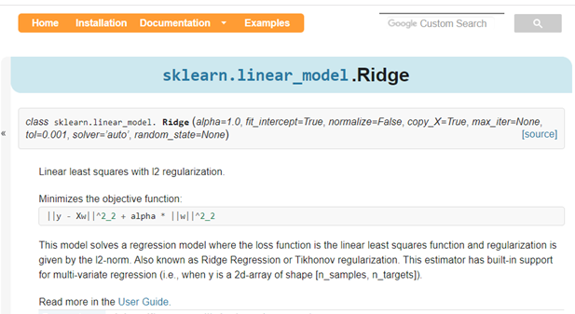
Ridge regression
Alpha參數要如何取?

Slide 38
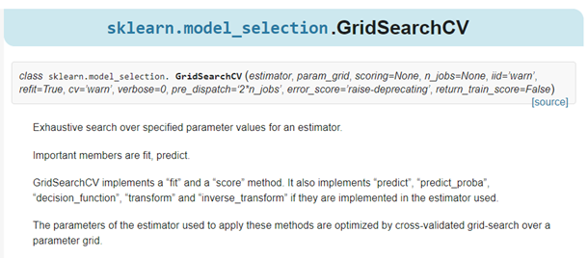
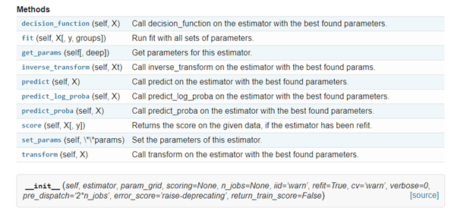
https://scikit-learn.org/stable/modules/generated/
sklearn.model_selection.GridSearchCV.html
盡所能的對所有指定的參數做搜尋
可用的方法

Slide 39
Parameters 參數說明
class sklearn.model_selection.GridSearchCV(
estimator,
param_grid,
scoring=None,
n_jobs=None,
iid=’warn’,
refit=True,
cv=’warn’,
verbose=0,
pre_dispatch=‘2*n_jobs’,
error_score=’raise-deprecating’, return_train_score=False)
使用的分類器
要調教的各種參數

Slide 40
Attributes重要屬性說明
best_score_ : float
Mean cross-validated score of the best_estimator
For multi-metric evaluation, this is present only if refit is specified.
best_params_ : dict
Parameter setting that gave the best results on the hold out data.
For multi-metric evaluation, this is present only if refit is specified.
grid.fit()：運行網格搜索
grid_scores_：給出不同參數情況下的評價結果
best_params_：描述了已取得最佳結果的參數的組合
best_score_：成員提供優化過程期間觀察到的最好的評分

Slide 41
GridSearchCV計算之後，結果是存放在(.cv_results_)中，
cv_results_ : dict of numpy (masked) ndarrays
A dict with keys as column headers and values as columns, that can be imported into a pandas DataFrame.
import pandas as pd
cv_result = pd.DataFrame.from_dict(grid.cv_results_)
cv_result

Slide 42
from pandas import read_csv
from sklearn.linear_model import Ridge
from sklearn.model_selection import GridSearchCV
# 導入數據
filename = 'pima_data.csv'
names = ['preg', 'plas', 'pres', 'skin', 'test', 'mass', 'pedi', 'age', 'class']
data = read_csv(filename, names=names)
# 將資料分為輸入資料和輸出結果
array = data.values
X = array[:, 0:8]
Y = array[:, 8]

Slide 43
#演算法產生instance
model = Ridge()
#設置要調教的各種參數
param_grid = {'alpha': [1, 0.1, 0.01, 0.001, 0]}
#通過GridSearchCV查詢最優參數
grid = GridSearchCV(estimator=model,param_grid=param_grid)
grid.fit(X, Y)
# 搜索結果
print('最高得分：%.3f' % grid.best_score_)
print('最優參數：%s' % grid.best_estimator_.alpha)
使用的分類器
最高得分：0.280
最優參數：1

Slide 44
使用RandomSearchCV

Slide 45
RandomSearchCV是如何"隨機搜索“??
搜索策略如下：
（a）對於搜索範圍是distribution的超參數，根據給定的distribution隨機採樣；
（b）對於搜索範圍是list的超參數，在給定的list中等概率採樣；
（c）對a、b兩步中得到的n_iter組採樣結果，進行遍歷。
（補充）如果給定的搜索範圍均為list，則不放回抽樣n_iter次。
Random Search for Hyper-Parameter Optimization
James Bergstra, Yoshua Bengio; 13(Feb):281−305, 2012.
http://jmlr.csail.mit.edu/papers/v13/bergstra12a.html

Slide 46
from pandas import read_csv
from sklearn.linear_model import Ridge
from sklearn.model_selection import RandomizedSearchCV
from scipy.stats import uniform
# 載入數據
filename = 'pima_data.csv'
names = ['preg', 'plas', 'pres', 'skin', 'test', 'mass', 'pedi', 'age', 'class']
data = read_csv(filename, names=names)
# 將資料分為輸入資料和輸出結果
array = data.values
X = array[:, 0:8]
Y = array[:, 8]

Slide 47
# 演算法產生instance
model = Ridge()
# 設置要調教的各種參數
param_grid = {'alpha': uniform()}
# 通過RandomizedSearchCV查詢最優參數
grid = RandomizedSearchCV(estimator=model, param_distributions=param_grid, n_iter=100, random_state=7)
grid.fit(X, Y)
# 搜索結果
print('最高得分：%.3f' % grid.best_score_)
print('最優參數：%s' % grid.best_estimator_.alpha)
最高得分：0.280
最優參數：0.9779895119966027

Slide 48
python機器學習庫sklearn——參數優化（網格搜索GridSearchCV、隨機搜索RandomizedSearchCV、hyperopt）
https://blog.csdn.net/luanpeng825485697/article/details/79831703

Slide 49
https://xgboost.readthedocs.io/en/latest/parameter.html#general-parameters
XGboost資料比賽實戰之調參篇(完整流程)
https://zhuanlan.zhihu.com/p/35061092
使用GridSearch對xgboost進行調參（全部流程）
https://blog.csdn.net/jh1137921986/article/details/84754868

