Slide 1
TF-regression

Slide 2
單變數線性回歸演算法
Linear Regression: Inverse Matrix Method

Slide 3
# Linear Regression: Inverse Matrix Method
#----------------------------------
#
# This function shows how to use TensorFlow to
# solve linear regression via the matrix inverse.
#
# Given Ax=b, solving for x:
# x = (t(A) * A)^(-1) * t(A) * b
# where t(A) is the transpose of A

Slide 4
import matplotlib.pyplot as plt
import numpy as np
import tensorflow as tf
from tensorflow.python.framework import ops
ops.reset_default_graph()
# Create graph
sess = tf.Session()
# Create the data
x_vals = np.linspace(0, 10, 100)
y_vals = x_vals + np.random.normal(0, 1, 100)

Slide 5
# Create design matrix
x_vals_column = np.transpose(np.matrix(x_vals))
ones_column = np.transpose(np.matrix(np.repeat(1, 100)))
A = np.column_stack((x_vals_column, ones_column))
# Create b matrix
b = np.transpose(np.matrix(y_vals))
# Create tensors
A_tensor = tf.constant(A)
b_tensor = tf.constant(b)
# Matrix inverse solution
tA_A = tf.matmul(tf.transpose(A_tensor), A_tensor)
tA_A_inv = tf.matrix_inverse(tA_A)
product = tf.matmul(tA_A_inv, tf.transpose(A_tensor))
solution = tf.matmul(product, b_tensor)
solution_eval = sess.run(solution)

Slide 6
# Extract coefficients
slope = solution_eval[0][0]
y_intercept = solution_eval[1][0]
print('slope: ' + str(slope))
print('y_intercept: ' + str(y_intercept))
# Get best fit line
best_fit = []
for i in x_vals:
best_fit.append(slope*i+y_intercept)
slope: 0.9809565641484451
y_intercept: -0.1455643941313134

Slide 7
# Plot the results
plt.plot(x_vals, y_vals, 'o', label='Data')
plt.plot(x_vals, best_fit, 'r-', label='Best fit line', linewidth=3)
plt.legend(loc='upper left')
plt.show()

Slide 8
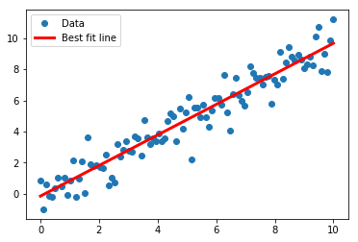
# Plot the results
plt.plot(x_vals, y_vals, 'o', label='Data')
plt.plot(x_vals, best_fit, 'r-', label='Best fit line', linewidth=3)
plt.legend(loc='upper left')
plt.show()

Slide 9
單變數線性回歸演算法
Linear Regression:

Slide 10
The the output of our model is a 2D linear regression:
y = A * x + b
The x matrix input will be a 2D matrix, where it's dimensions will be (batch size x 1). The y target output will have the same dimensions, (batch size x 1).
The loss function we will use will be the mean of the batch L2 Loss:
loss = mean( (y_target - model_output)^2 )
We will then iterate through random batch size selections of the data.

Slide 11
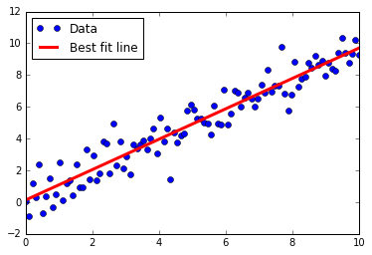

Slide 12
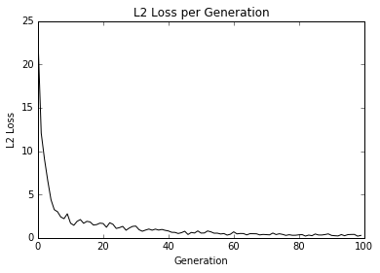

Slide 13
Deming regression

Slide 14
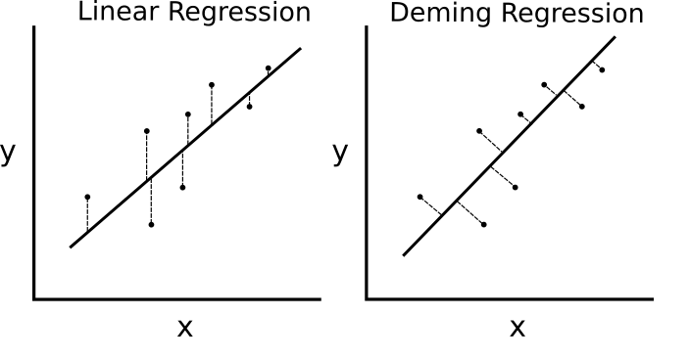
tensorflow_cookbook/03_Linear_Regression/05_Implementing_Deming_Regression
Deming regression
Deming regression, also known as total regression, is regular regression that minimizes the shortest distance to the line.
Contrast this to regular regression, in which we aim to minimize the vertical distance between the model output and the y-target values.

Slide 15
The model will be the same as regular linear regression:
y = A * x + b
Instead of measuring the vertical L2 distance, we will measure the shortest distance between the line and the predicted point in the loss function.
loss = |y_target - (A * x_input + b)| / sqrt(A^2 + 1)

Slide 16
import matplotlib.pyplot as plt
import numpy as np
import tensorflow as tf
from sklearn import datasets
from tensorflow.python.framework import ops
ops.reset_default_graph()
# Set a random seed
tf.set_random_seed(42)
np.random.seed(42)
# Create graph
sess = tf.Session()

Slide 17
# Create graph
sess = tf.Session()
# Load the data
# iris.data = [(Sepal Length, Sepal Width, Petal Length, Petal Width)]
iris = datasets.load_iris()
x_vals = np.array([x[3] for x in iris.data])
y_vals = np.array([y[0] for y in iris.data])
# Declare batch size
batch_size = 50
# Initialize placeholders
x_data = tf.placeholder(shape=[None, 1], dtype=tf.float32)
y_target = tf.placeholder(shape=[None, 1], dtype=tf.float32)
# Create variables for linear regression
A = tf.Variable(tf.random_normal(shape=[1,1]))
b = tf.Variable(tf.random_normal(shape=[1,1]))
# Declare model operations
model_output = tf.add(tf.matmul(x_data, A), b)

Slide 18
# Declare Deming loss function
deming_numerator = tf.abs(tf.subtract(y_target, tf.add(tf.matmul(x_data, A), b)))
deming_denominator = tf.sqrt(tf.add(tf.square(A),1))
loss = tf.reduce_mean(tf.truediv(deming_numerator, deming_denominator))
# Declare optimizer
my_opt = tf.train.GradientDescentOptimizer(0.15)
train_step = my_opt.minimize(loss)
# Initialize variables
init = tf.global_variables_initializer()
sess.run(init)

Slide 19
# Training loop
loss_vec = []
for i in range(1000):
rand_index = np.random.choice(len(x_vals), size=batch_size)
rand_x = np.transpose([x_vals[rand_index]])
rand_y = np.transpose([y_vals[rand_index]])
sess.run(train_step, feed_dict={x_data: rand_x, y_target: rand_y})
temp_loss = sess.run(loss, feed_dict={x_data: rand_x, y_target: rand_y})
loss_vec.append(temp_loss)
if (i+1)%50 == 0:
print('Step #' + str(i+1) + ' A = ' + str(sess.run(A)) + ' b = ' + str(sess.run(b)))
print('Loss = ' + str(temp_loss))

Slide 20
# Get the optimal coefficients
[slope] = sess.run(A)
[y_intercept] = sess.run(b)
# Get best fit line
best_fit = []
for i in x_vals:
best_fit.append(slope*i+y_intercept)

Slide 21
# Plot the result
plt.plot(x_vals, y_vals, 'o', label='Data Points')
plt.plot(x_vals, best_fit, 'r-', label='Best fit line', linewidth=3)
plt.legend(loc='upper left')
plt.title('Sepal Length vs Petal Width')
plt.xlabel('Petal Width')
plt.ylabel('Sepal Length')
plt.show()
# Plot loss over time
plt.plot(loss_vec, 'k-')
plt.title('L2 Loss per Generation')
plt.xlabel('Generation')
plt.ylabel('L2 Loss')
plt.show()

Slide 22
LASSO and Ridge Regression
TensorFlow-Machine-Learning-Cookbook-Second-Edition/Chapter03/03_Linear_Regression/06_Implementing_Lasso_and_Ridge_Regression/06_lasso_and_ridge_regression.py

Slide 23
LASSO and Ridge Regression
# This function shows how to use TensorFlow to solve LASSO or
# Ridge regression for
# y = Ax + b
#
# We will use the iris data, specifically:
# y = Sepal Length
# x = Petal Width

Slide 24
# import required libraries
import matplotlib.pyplot as plt
import sys
import numpy as np
import tensorflow as tf
from sklearn import datasets
from tensorflow.python.framework import ops

Slide 25
# Specify 'Ridge' or 'LASSO'
#regression_type = 'LASSO'
regression_type = 'Ridge'
# clear out old graph
ops.reset_default_graph()
# Create graph
sess = tf.Session()
###
# Load iris data
###
# iris.data = [(Sepal Length, Sepal Width, Petal Length, Petal Width)]
iris = datasets.load_iris()
x_vals = np.array([x[3] for x in iris.data])
y_vals = np.array([y[0] for y in iris.data])

Slide 26
###
# Model Parameters
###
# Declare batch size
batch_size = 50
# Initialize placeholders
x_data = tf.placeholder(shape=[None, 1], dtype=tf.float32)
y_target = tf.placeholder(shape=[None, 1], dtype=tf.float32)
# make results reproducible
seed = 13
np.random.seed(seed)
tf.set_random_seed(seed)
# Create variables for linear regression
A = tf.Variable(tf.random_normal(shape=[1,1]))
b = tf.Variable(tf.random_normal(shape=[1,1]))
# Declare model operations
model_output = tf.add(tf.matmul(x_data, A), b)

Slide 27
###
# Loss Functions
###
# Select appropriate loss function based on regression type
if regression_type == 'LASSO':
# Declare Lasso loss function
# Lasso Loss = L2_Loss + heavyside_step,
# Where heavyside_step ~ 0 if A < constant, otherwise ~ 99
lasso_param = tf.constant(0.9)
heavyside_step = tf.truediv(1., tf.add(1., tf.exp(tf.multiply(-50., tf.subtract(A, lasso_param)))))
regularization_param = tf.multiply(heavyside_step, 99.)
loss = tf.add(tf.reduce_mean(tf.square(y_target - model_output)), regularization_param)

Slide 28
elif regression_type == 'Ridge':
# Declare the Ridge loss function
# Ridge loss = L2_loss + L2 norm of slope
ridge_param = tf.constant(1.)
ridge_loss = tf.reduce_mean(tf.square(A))
loss = tf.expand_dims(tf.add(tf.reduce_mean(tf.square(y_target - model_output)), tf.multiply(ridge_param, ridge_loss)), 0)
else:
print('Invalid regression_type parameter value',file=sys.stderr)

Slide 29
###
# Optimizer
###
# Declare optimizer
my_opt = tf.train.GradientDescentOptimizer(0.001)
train_step = my_opt.minimize(loss)

Slide 30
###
# Run regression
###
# Initialize variables
init = tf.global_variables_initializer()
sess.run(init)
# Training loop
loss_vec = []
for i in range(1500):
rand_index = np.random.choice(len(x_vals), size=batch_size)
rand_x = np.transpose([x_vals[rand_index]])
rand_y = np.transpose([y_vals[rand_index]])
sess.run(train_step, feed_dict={x_data: rand_x, y_target: rand_y})
temp_loss = sess.run(loss, feed_dict={x_data: rand_x, y_target: rand_y})
loss_vec.append(temp_loss[0])
if (i+1)%300==0:
print('Step #' + str(i+1) + ' A = ' + str(sess.run(A)) + ' b = ' + str(sess.run(b)))
print('Loss = ' + str(temp_loss))
print('\n')

Slide 31
###
# Extract regression results
###
# Get the optimal coefficients
[slope] = sess.run(A)
[y_intercept] = sess.run(b)
# Get best fit line
best_fit = []
for i in x_vals:
best_fit.append(slope*i+y_intercept)

Slide 32
###
# Plot results
###
# Plot regression line against data points
plt.plot(x_vals, y_vals, 'o', label='Data Points')
plt.plot(x_vals, best_fit, 'r-', label='Best fit line', linewidth=3)
plt.legend(loc='upper left')
plt.title('Sepal Length vs Pedal Width')
plt.xlabel('Pedal Width')
plt.ylabel('Sepal Length')
plt.show()
# Plot loss over time
plt.plot(loss_vec, 'k-')
plt.title(regression_type + ' Loss per Generation')
plt.xlabel('Generation')
plt.ylabel('Loss')
plt.show()

Slide 33
Step #300 A = [[1.706729]] b = [[1.5547523]]
Loss = [8.266697]
Step #600 A = [[1.6157354]] b = [[2.5661898]]
Loss = [4.7824945]
Step #900 A = [[1.346329]] b = [[3.2469504]]
Loss = [3.079881]
Step #1200 A = [[1.1117644]] b = [[3.7608495]]
Loss = [2.0647893]
Step #1500 A = [[0.9335519]] b = [[4.153798]]
Loss = [1.4875126]

Slide 34
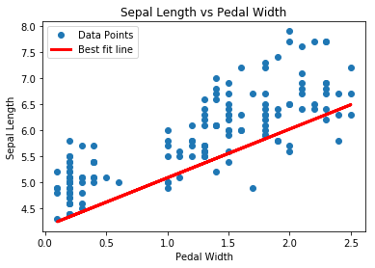

Slide 35
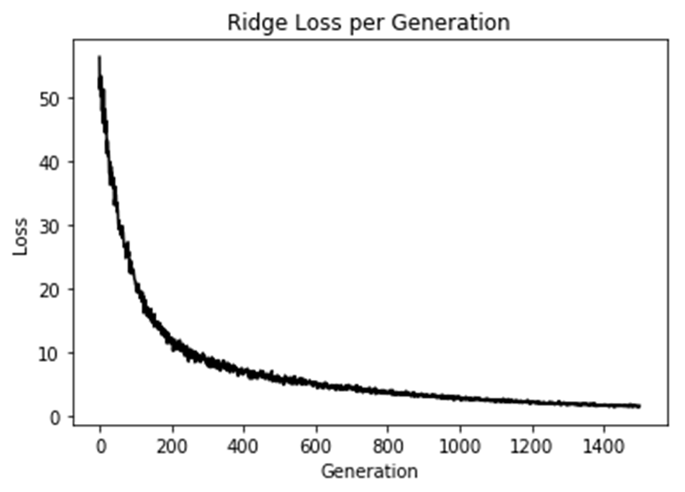

Slide 36
Elasticnet Regression
TensorFlow-Machine-Learning-Cookbook-Second-Edition
Chapter03/03_Linear_Regression/07_Implementing_Elasticnet_Regression

Slide 37
# Declare the elastic net loss function
elastic_param1 = tf.constant(1.)
elastic_param2 = tf.constant(1.)
l1_a_loss = tf.reduce_mean(tf.abs(A))
l2_a_loss = tf.reduce_mean(tf.square(A))
e1_term = tf.multiply(elastic_param1, l1_a_loss)
e2_term = tf.multiply(elastic_param2, l2_a_loss)
loss = tf.expand_dims(tf.add(tf.add(tf.reduce_mean(tf.square(y_target - model_output)), e1_term), e2_term

Slide 38
Step #250 A = [[1.2583933 ]
[0.40221712]
[0.40282184]] b = [[-0.14970286]]
Loss = [1.5915687]
Step #500 A = [[1.1765288 ]
[0.46809328]
[0.30075192]] b = [[-0.06897473]]
Loss = [1.4633968]
Step #750 A = [[1.1315887 ]
[0.5199738 ]
[0.21306184]] b = [[0.01743825]]
Loss = [1.3718343]
Step #1000 A = [[1.095119 ]
[0.5468024 ]
[0.13332367]] b = [[0.10219051]]
Loss = [1.278223]

Slide 39
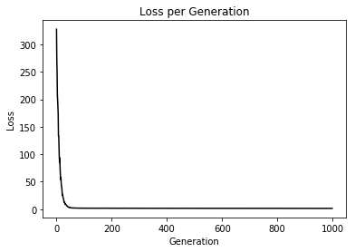

Slide 40
對數機率回歸 | 邏輯回歸
Logistic regression | logit regression
TensorFlow-Machine-Learning-Cookbook-Second-Edition
Chapter03/03_Linear_Regression/08_Implementing_Logistic_Regression

Slide 41
Logistic Regression
對數機率回歸（也稱「邏輯回歸」）（英語：Logistic regression 或logit regression），即對數機率模型（英語：Logit model，也譯作「邏輯模型」、「評定模型」、「分類評定模型」）是離散選擇法模型之一，屬於多重變量分析範疇，是社會學、生物統計學、臨床、數量心理學、計量經濟學、市場營銷等統計實證分析的常用方法
https://zh.wikipedia.org/wiki/邏輯迴歸

Slide 42
羅吉斯回歸(Logistic regression)
https://medium.com/@chih.sheng.huang821/%E6%A9%9F%E5%99%A8-%E7%B5%B1%E8%A8%88%E5%AD%B8%E7%BF%92-%E7%BE%85%E5%90%89%E6%96%AF%E5%9B%9E%E6%AD%B8-logistic-regression-aff7a830fb5d

Slide 43
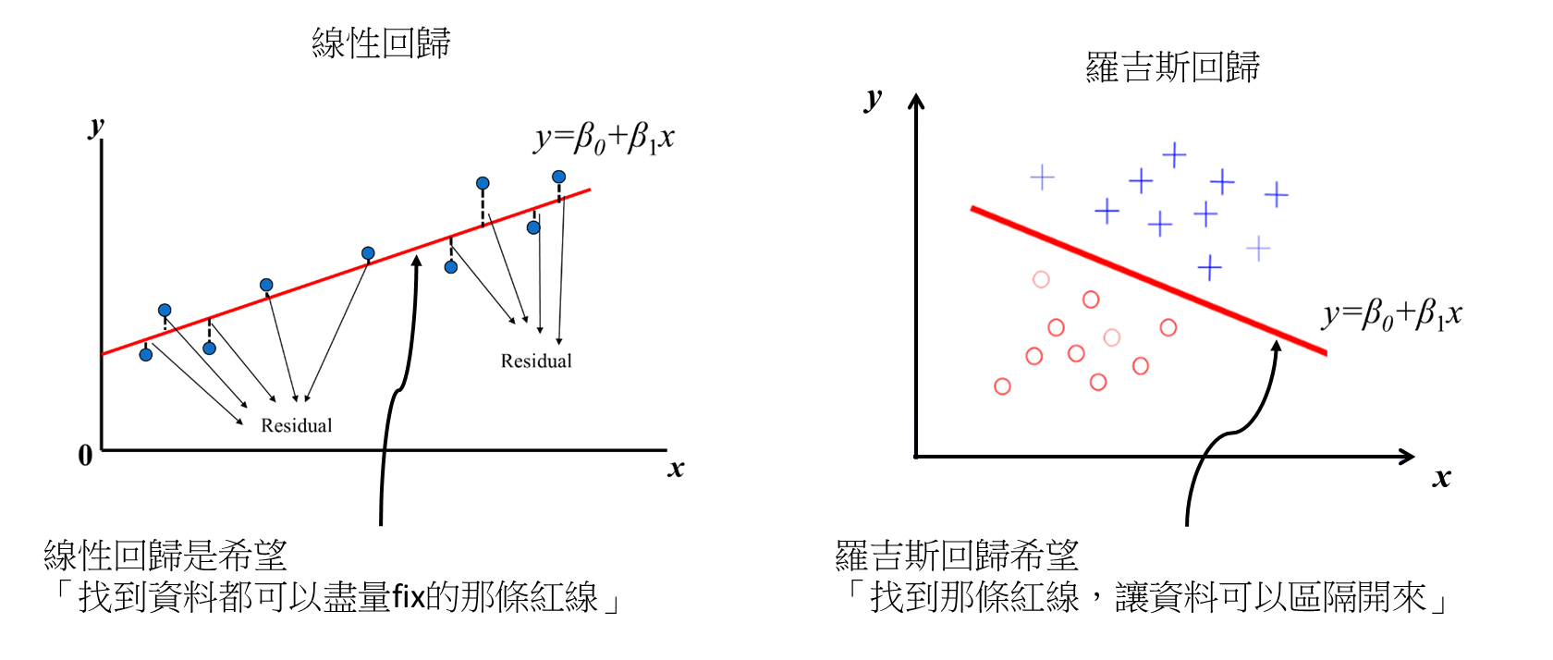
羅吉斯回歸(Logistic regression) VS 線性回歸(Linear regression)
線性回歸是用來預測一個連續的值，羅吉斯回歸是用來分類。

Slide 44

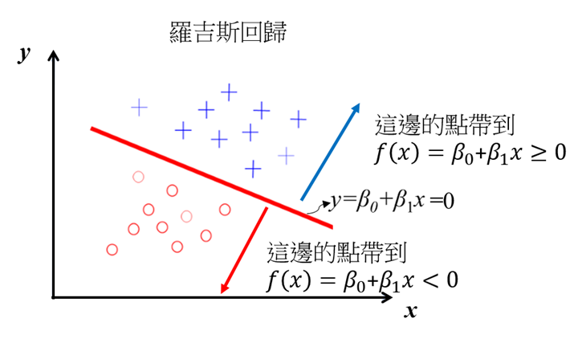
線性回歸輸出是一個連續的實數，
但羅吉斯回歸就是用線性回歸的輸出來判斷這個資料屬不屬於target(二分類問題: target和non-target)
羅吉斯回歸要怎麼做分類?
一個最簡單的概念，將點帶進去回歸線，
回歸線輸出值若是>=0，是一類(target)，
值<0是另一類(non-target)

Slide 45
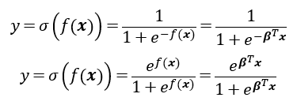
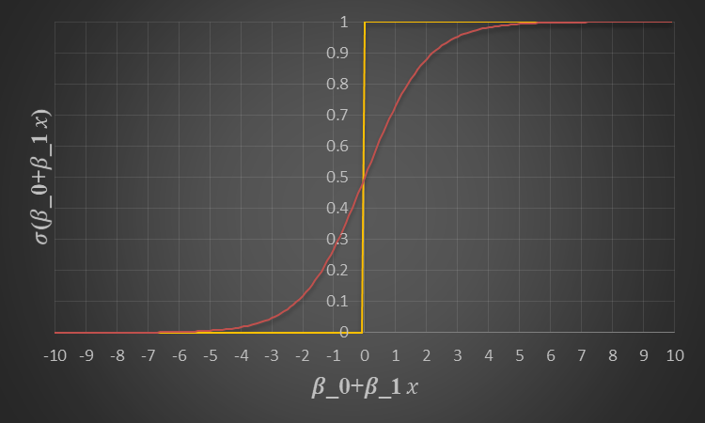
羅吉斯回歸用到的對數函數是Sigmoid函數

Slide 46
如何計算羅吉斯回歸參數(β)?
線性回歸是預測一個數字，所以我們會希望這個預測值和目標值越接近越好，所以可以利用最小化平均絕對誤差(Mean Absolute Error, MAE)或是平均平方誤差(Mean Square Error, MSE)來求解。
羅吉斯回歸是用來做分類的，分類問題在參數型學習(parameter learning)通常都是用最大概似函數估計法 (Maximum Likelihood Estimation, MLE)求解，當然羅吉斯回歸也是，
問題??
最大概似函數估計法是估計某一個函數的最大概似量，
羅吉斯回歸是哪種函數?

Slide 47

伯努利分布的機率密度函數(probability density function, pdf)
p:為成功的機率，(1-p):為失敗的機率
當試驗成功時，柏努利的隨機便量等於1(x=1)，
反之試驗失敗柏努利的隨機便量等於0(x=0)

Slide 48

羅吉斯回歸的目標，主要是做二分類問題，
羅吉斯回歸的輸出有兩個，target和non-target機率(也有人說是positive and negative的機率)
機率的輸出最後還是要判斷是不是target(y=1是target，y=0是non-target)
羅吉斯回歸的概似函數就是取伯努利分布的機率密度函數

Slide 49

用「最大概似函數估計法」和「伯努利分布的機率密度函數」對羅吉斯回歸做參數估計
有n組資料，概似函數為

Slide 50
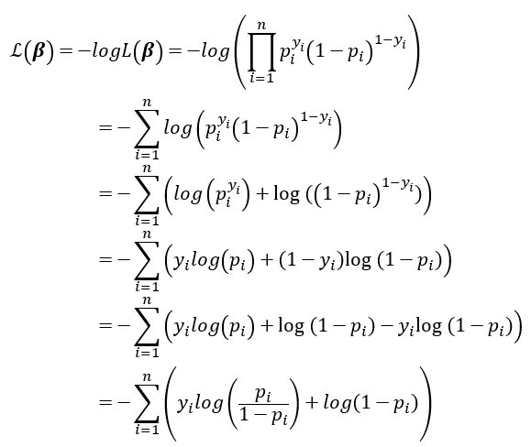
為了簡化針對概似函數取-log，
因為取負號所以最大化概似函數變成最小化對數概似函數，在機器學習稱這個為loglos

Slide 51
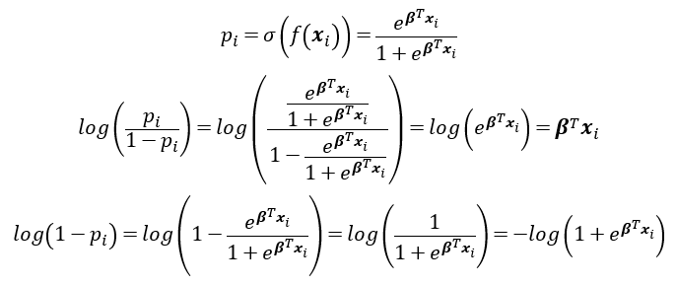

Slide 52
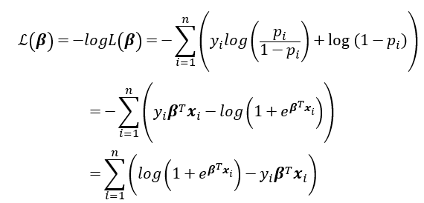

Slide 53
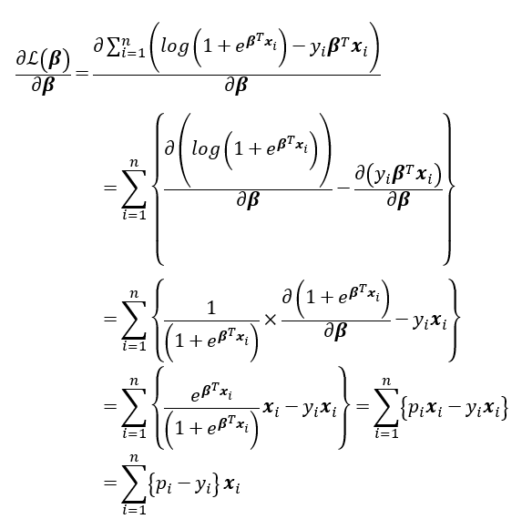
梯度法(偏微分)

Slide 54

α為學習率。

Slide 55
UMASS low birth weight data.
The the output of our model is the standard logistic regression:
y = sigmoid(A * x + b)
The x matrix input will have dimensions (batch size x # features). The y target output will have the dimension batch size x 1.
The loss function we will use will be the mean of the cross-entropy loss:
loss = mean( - y * log(predicted) + (1-y) * log(1-predicted) )
TensorFlow has this cross entropy built in, and we can use the function, 'tf.nn.sigmoid_cross_entropy_with_logits()'
We will then iterate through random batch size selections of the data.

Slide 56
# Logistic Regression
#----------------------------------
#
# This function shows how to use TensorFlow to
# solve logistic regression.
# y = sigmoid(Ax + b)
#
# We will use the low birth weight data, specifically:
# y = 0 or 1 = low birth weight
# x = demographic and medical history data

Slide 57
import matplotlib.pyplot as plt
import numpy as np
import tensorflow as tf
import requests
from tensorflow.python.framework import ops
import os.path
import csv
ops.reset_default_graph()
# Create graph
sess = tf.Session()

Slide 58
###
# Obtain and prepare data for modeling
###
# Set name of data file
birth_weight_file = 'birth_weight.csv'
# Download data and create data file if file does not exist in current directory
if not os.path.exists(birth_weight_file):
birthdata_url = 'https://github.com/nfmcclure/tensorflow_cookbook/raw/master/01_Introduction/07_Working_with_Data_Sources/birthweight_data/birthweight.dat‘
birth_file = requests.get(birthdata_url)
birth_data = birth_file.text.split('\r\n')
birth_header = birth_data[0].split('\t')
birth_data = [[float(x) for x in y.split('\t') if len(x)>=1] for y in birth_data[1:] if len(y)>=1]
with open(birth_weight_file, 'w', newline='') as f:
writer = csv.writer(f)
writer.writerow(birth_header)
writer.writerows(birth_data)
f.close()

Slide 59
# Read birth weight data into memory
birth_data = []
with open(birth_weight_file, newline='') as csvfile:
csv_reader = csv.reader(csvfile)
birth_header = next(csv_reader)
for row in csv_reader:
birth_data.append(row)
birth_data = [[float(x) for x in row] for row in birth_data]

Slide 60
# Pull out target variable
y_vals = np.array([x[0] for x in birth_data])
# Pull out predictor variables (not id, not target, and not birthweight)
x_vals = np.array([x[1:8] for x in birth_data])
# Set for reproducible results
seed = 99
np.random.seed(seed)
tf.set_random_seed(seed)

Slide 61
# Split data into train/test = 80%/20%
train_indices = np.random.choice(len(x_vals), round(len(x_vals)*0.8), replace=False)
test_indices = np.array(list(set(range(len(x_vals))) - set(train_indices)))
x_vals_train = x_vals[train_indices]
x_vals_test = x_vals[test_indices]
y_vals_train = y_vals[train_indices]
y_vals_test = y_vals[test_indices]

Slide 62
# Normalize by column (min-max norm)
def normalize_cols(m, col_min=np.array([None]), col_max=np.array([None])):
if not col_min[0]:
col_min = m.min(axis=0)
if not col_max[0]:
col_max = m.max(axis=0)
return (m-col_min) / (col_max - col_min), col_min, col_max
x_vals_train, train_min, train_max = np.nan_to_num(normalize_cols(x_vals_train))
x_vals_test, _, _ = np.nan_to_num(normalize_cols(x_vals_test, train_min, train_max))

Slide 63
###
# Define Tensorflow computational graph¶
###
# Declare batch size
batch_size = 25
# Initialize placeholders
x_data = tf.placeholder(shape=[None, 7], dtype=tf.float32)
y_target = tf.placeholder(shape=[None, 1], dtype=tf.float32)
# Create variables for linear regression
A = tf.Variable(tf.random_normal(shape=[7,1]))
b = tf.Variable(tf.random_normal(shape=[1,1]))
# Declare model operations
model_output = tf.add(tf.matmul(x_data, A), b)

Slide 64
# Declare loss function (Cross Entropy loss)
loss = tf.reduce_mean(tf.nn.sigmoid_cross_entropy_with_logits(logits=model_output, labels=y_target))
# Declare optimizer
my_opt = tf.train.GradientDescentOptimizer(0.01)
train_step = my_opt.minimize(loss)

Slide 65
###
# Train model
###
# Initialize variables
init = tf.global_variables_initializer()
sess.run(init)
# Actual Prediction
prediction = tf.round(tf.sigmoid(model_output))
predictions_correct = tf.cast(tf.equal(prediction, y_target), tf.float32)
accuracy = tf.reduce_mean(predictions_correct)

Slide 66
# Training loop
loss_vec = []
train_acc = []
test_acc = []
for i in range(1500):
rand_index = np.random.choice(len(x_vals_train), size=batch_size)
rand_x = x_vals_train[rand_index]
rand_y = np.transpose([y_vals_train[rand_index]])
sess.run(train_step, feed_dict={x_data: rand_x, y_target: rand_y})
temp_loss = sess.run(loss, feed_dict={x_data: rand_x, y_target: rand_y})
loss_vec.append(temp_loss)
temp_acc_train = sess.run(accuracy, feed_dict={x_data: x_vals_train, y_target: np.transpose([y_vals_train])})
train_acc.append(temp_acc_train)
temp_acc_test = sess.run(accuracy, feed_dict={x_data: x_vals_test, y_target: np.transpose([y_vals_test])})
test_acc.append(temp_acc_test)
if (i+1)%300==0:
print('Loss = ' + str(temp_loss))

Slide 67
Loss = 0.6944471
Loss = 0.7304496
Loss = 0.62496805
Loss = 0.69695
Loss = 0.6096429

Slide 68
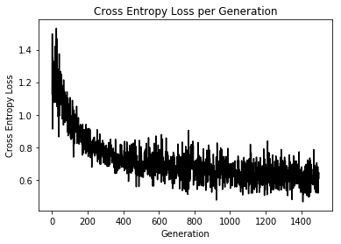
###
# Display model performance
###
# Plot loss over time
plt.plot(loss_vec, 'k-')
plt.title('Cross Entropy Loss per Generation')
plt.xlabel('Generation')
plt.ylabel('Cross Entropy Loss')
plt.show()

Slide 69
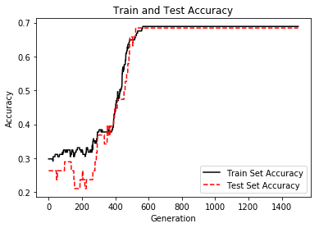
# Plot train and test accuracy
plt.plot(train_acc, 'k-', label='Train Set Accuracy')
plt.plot(test_acc, 'r--', label='Test Set Accuracy')
plt.title('Train and Test Accuracy')
plt.xlabel('Generation')
plt.ylabel('Accuracy')
plt.legend(loc='lower right')
plt.show()

Slide 70
Logistic regression | logit regression
logistic/softmax regression on the MNIST Dataset

Slide 71
# Import Modules needed
import tensorflow as tf
import matplotlib.pyplot as plt, matplotlib.image as mpimg
# %matplotlib inline
# Import Input
from tensorflow.examples.tutorials.mnist import input_data
mnist = input_data.read_data_sets("MNIST_data/", one_hot=True)
# Define Hyper Parameters of the model:
learning_rate = 0.05
batch_size = 100
max_epochs = 100

Slide 72
# Visualize the data
i = 55
img = mnist.train.images[i]
img=img.reshape((28,28))
plt.imshow(img,cmap='gray')
plt.title(mnist.train.labels[i])
# Tensorflow graph inputs
x = tf.placeholder(tf.float32, [None, 784], name='X')
y = tf.placeholder(tf.float32, [None, 10],name='Y')
# Learning Variables
W = tf.Variable(tf.zeros([784, 10]), name='W')
b = tf.Variable(tf.zeros([10]), name='b')
# Define the model
with tf.name_scope("wx_b") as scope:
y_hat = tf.nn.softmax(tf.matmul(x,W) + b)
#Add summary ops to collect data while training
w_h = tf.summary.histogram("weights", W)
b_h = tf.summary.histogram("biases", b)

Slide 73
# Define the cross-entropy loss function
with tf.name_scope('cross-entropy') as scope:
loss = tf.reduce_mean(tf.nn.softmax_cross_entropy_with_logits(labels=y, logits=y_hat))
tf.summary.scalar('cross-entropy', loss)
# Choose the optimizer
with tf.name_scope('Train') as scope:
optimizer = tf.train.GradientDescentOptimizer(0.01).minimize(loss)
# Define ops to test trained model
correct_prediction = tf.equal(tf.argmax(y_hat, 1), tf.argmax(y, 1))
accuracy = tf.reduce_mean(tf.cast(correct_prediction, tf.float32))
# Initializing the variables
init = tf.global_variables_initializer()
# Merge All summaries
merged_summary_op = tf.summary.merge_all()

Slide 74
with tf.Session() as sess:
sess.run(init) # initialize all variables
summary_writer = tf.summary.FileWriter('graphs', sess.graph) # Create an event file
# Training
for epoch in range(max_epochs):
loss_avg = 0
num_of_batch = int(mnist.train.num_examples/batch_size)
for i in range(num_of_batch):
batch_xs, batch_ys = mnist.train.next_batch(100) # get the next batch of data
_, l, summary_str = sess.run([optimizer,loss, merged_summary_op], feed_dict={x: batch_xs, y: batch_ys}) # Run the optimizer
loss_avg += l
summary_writer.add_summary(summary_str, epoch*num_of_batch + i)
# Add all summaries per batch
loss_avg = loss_avg/num_of_batch
print('Epoch {0}: Loss {1}'.format(epoch, loss_avg))
print('Done')
print(sess.run(accuracy, feed_dict={x: mnist.test.images,y: mnist.test.labels}))

Slide 75
Epoch 98: Loss 1.5864435863494872
Epoch 99: Loss 1.586151145588268
Done
0.909

Slide 76
Logistic regression | logit regression
乳腺癌檢測

Slide 77
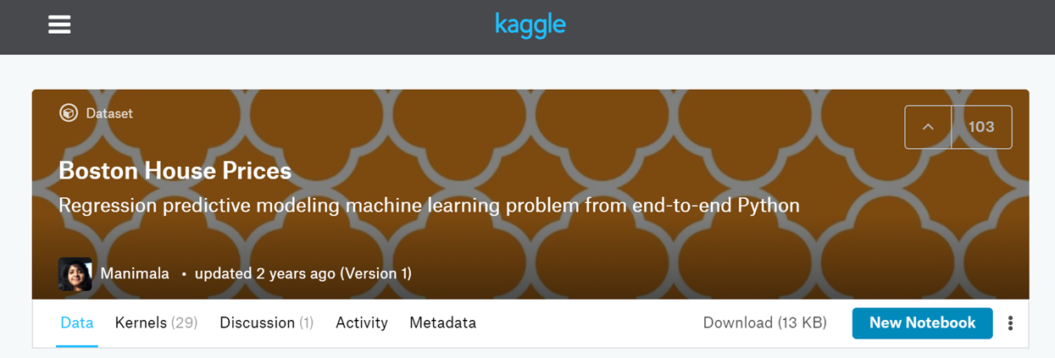
Boston House Prices
範例分析
波士頓房屋售價預測
https://www.kaggle.com/vikrishnan/boston-house-prices

Slide 78
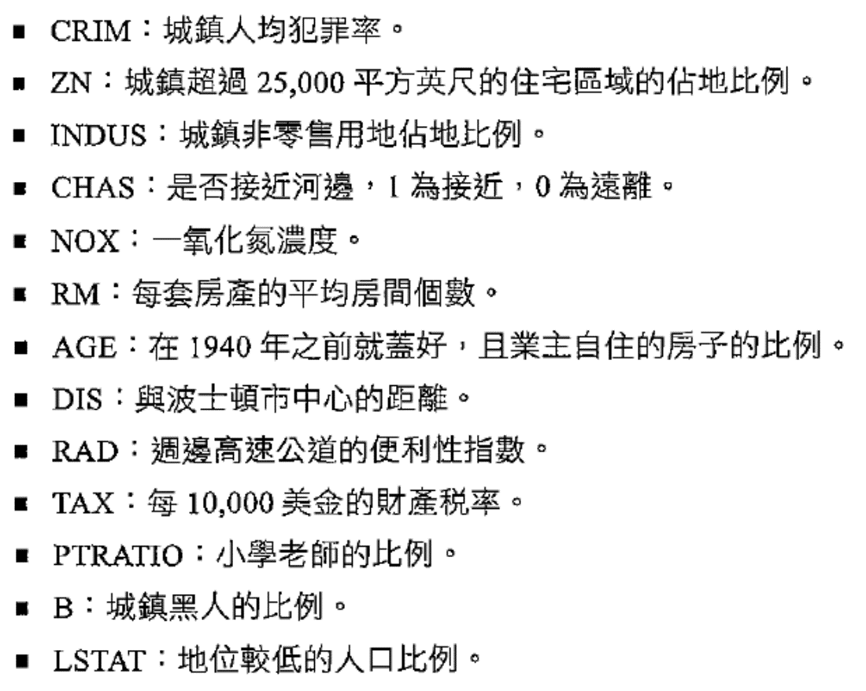

Slide 79
波士頓房屋售價預測
Simple_linear_regression
import tensorflow as tf
import numpy as np
import matplotlib.pyplot as plt
def normalize(X):
mean = np.mean(X)
std = np.std(X)
X = (X - mean)/std
return X
https://github.com/PacktPublishing/TensorFlow-1x-Deep-Learning-Cookbook
Chapter02/Simple_linear_regression.py

Slide 80
# Data
boston = tf.contrib.learn.datasets.load_dataset('boston')
X_train, Y_train = boston.data[:,5], boston.target
#X_train = normalize(X_train)
n_samples = len(X_train)
#print(X_train)
# Placeholder for the Training Data
X = tf.placeholder(tf.float32, name='X')
Y = tf.placeholder(tf.float32, name='Y')
# Variables for coefficients initialized to 0
b = tf.Variable(0.0)
w = tf.Variable(0.0)
# The Linear Regression Model
Y_hat = X * w + b

Slide 81
# Loss function
loss = tf.square(Y - Y_hat, name='loss')
# Gradient Descent with learning rate of 0.01 to minimize loss
optimizer = tf.train.GradientDescentOptimizer(learning_rate=0.01).minimize(loss)
# Initializing Variables
init_op = tf.global_variables_initializer()
total = []

Slide 82
# Computation Graph
with tf.Session() as sess:
# Initialize variables
sess.run(init_op)
writer = tf.summary.FileWriter('graphs', sess.graph)
# train the model for 100 epcohs
for i in range(100):
total_loss = 0
for x,y in zip(X_train,Y_train):
_, l = sess.run ([optimizer, loss], feed_dict={X:x, Y:y})
total_loss += l
total.append(total_loss / n_samples)
print('Epoch {0}: Loss {1}'.format(i, total_loss/n_samples))
writer.close()
b_value, w_value = sess.run([b, w])
Y_pred = X_train * w_value + b_value

Slide 83
print('Done')
# Plot the result
plt.plot(X_train, Y_train, 'bo', label='Real Data')
plt.plot(X_train,Y_pred, 'r', label='Predicted Data')
plt.legend()
plt.show()
plt.plot(total)
plt.show()

Slide 84
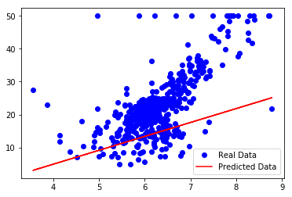

Slide 85
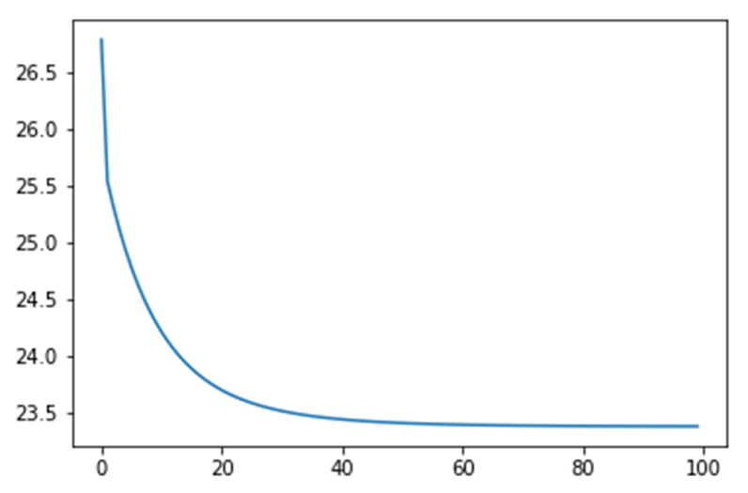

Slide 86
波士頓房屋售價預測
MultiLinearRegressor 1
import tensorflow as tf
import numpy as np
import matplotlib.pyplot as plt
TensorFlow-1x-Deep-Learning-Cookbook
Chapter02/MultiLinearRegressor.ipynb

Slide 87
def normalize(X):
mean = np.mean(X, axis=0)
std = np.std(X, axis=0)
X = (X - mean) / std
return X
def append_bias_reshape(features,labels):
m = features.shape[0]
n = features.shape[1]
x = np.reshape(np.c_[np.ones(m),features],[m,n + 1])
y = np.reshape(labels,[m,1])
return x, y

Slide 88
boston = tf.contrib.learn.datasets.load_dataset('boston')
X_train, Y_train = np.array(boston.data), np.array(boston.target)
X_train = normalize(X_train)
X_train, Y_train = append_bias_reshape(X_train, Y_train)
#Y_train = normalize(Y_train)
m = len(X_train) #Number of training examples
n = 14 # Number of features
# Placeholder for the Training Data
X = tf.placeholder(tf.float32, name='X', shape=[m,n])
Y = tf.placeholder(tf.float32, name='Y')

Slide 89
# Variables for coefficients
#b = tf.Variable(0.0)
w = tf.Variable(tf.random_normal([n,1]))
# The Linear Regression Model
Y_hat = tf.matmul(X, w)
# Loss function
loss = tf.reduce_mean(tf.square(Y - Y_hat, name='loss'))
# Gradient Descent with learning rate of 0.05 to minimize loss
optimizer = tf.train.GradientDescentOptimizer(learning_rate=0.01).minimize(loss)
# Initializing Variables
init_op = tf.global_variables_initializer()

Slide 90
total = []
# Computation Graph
with tf.Session() as sess:
# Initialize variables
sess.run(init_op)
writer = tf.summary.FileWriter('graphs', sess.graph)
# train the model for 100 epcohs
for i in range(2000):
_, l = sess.run([optimizer, loss], feed_dict={X: X_train, Y: Y_train})
total.append(l)
if i%100 == 0:
print('Epoch {0}: Loss {1}'.format(i, l))
writer.close()
Y_pred = sess.run(Y_hat,feed_dict = {X:X_train} )
w_value = sess.run(w)

Slide 91
N= 500
X_new = X_train
#Y_pred = np.matmul(X_new, w_value) # + b_value)
print('Predicted value: ${0:.2f} Actual value: ${1}'.format(Y_pred[N][0]*1000, Y_train[N][0]*1000) , '\nDone')
# Plot the result
#print(Y_pred.shape, Y_train.shape)
plt.plot(Y_train, Y_pred, 'bo')
plt.xlabel("Actual Price")
plt.ylabel("Predicted Price")
plt.show()
#
plt.plot(total)
plt.xlabel("Epochs")
plt.ylabel("Loss")
plt.show()
Predicted value: $20531.37
Actual value: $16800.0

Slide 92
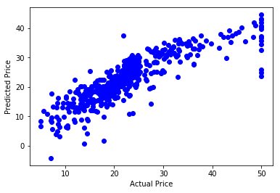

Slide 93
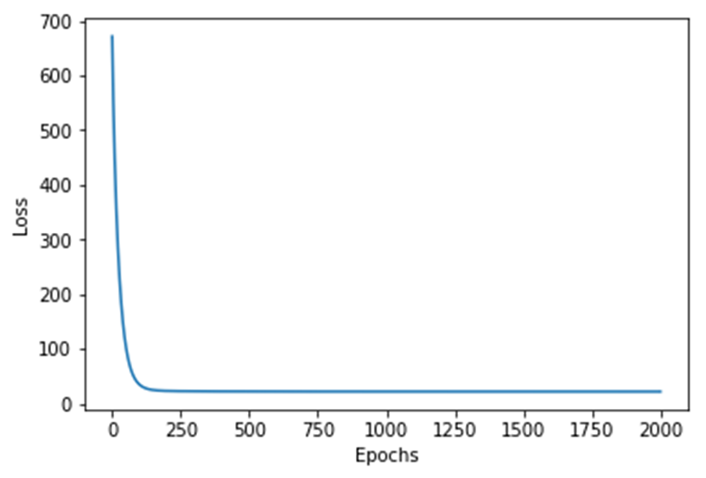

Slide 94
波士頓房屋售價預測
MultiLinearRegressor 2
import tensorflow as tf
import tensorflow.contrib.layers as layers
from sklearn import datasets
import matplotlib.pyplot as plt
from sklearn.model_selection import train_test_split
from sklearn.preprocessing import MinMaxScaler
import pandas as pd
import numpy as np
import seaborn as sns
# %matplotlib inline
# Data
boston = datasets.load_boston()
df = pd.DataFrame(boston.data, columns=boston.feature_names)
df['target'] = boston.target
#Understanding Data
df.describe()

Slide 95
# Plotting correlation color map
_ , ax = plt.subplots( figsize =( 12 , 10 ) )
corr = df.corr(method='pearson')
cmap = sns.diverging_palette( 220 , 10 , as_cmap = True )
_ = sns.heatmap(
corr,
cmap = cmap,
square=True,
cbar_kws={ 'shrink' : .9 },
ax=ax,
annot = True,
annot_kws = { 'fontsize' : 12 })

Slide 96
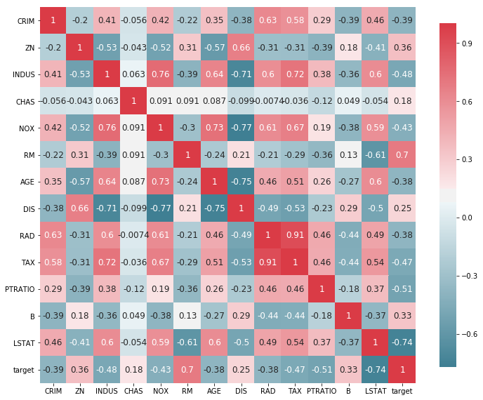

Slide 97
# Create Test Train Split
X_train, X_test, y_train, y_test = train_test_split(df [['RM', 'LSTAT', 'PTRATIO']], df[['target']], test_size=0.3, random_state=0)
# Normalize data
X_train = MinMaxScaler().fit_transform(X_train)
y_train = MinMaxScaler().fit_transform(y_train)
X_test = MinMaxScaler().fit_transform(X_test)
Y_test = MinMaxScaler().fit_transform(y_test)
#Network Parameters
m = len(X_train)
n = 3 # Number of features
n_hidden = 20 # Number of hidden neurons
# Hyperparameters
batch_size = 200
eta = 0.01
max_epoch = 1000

Slide 98
def multilayer_perceptron(x):
fc1 = layers.fully_connected(x, n_hidden, activation_fn=tf.nn.relu, scope='fc1')
out = layers.fully_connected(fc1, 1, activation_fn=tf.sigmoid, scope='out')
return out
def accuracy(a,b):
correct_prediction = tf.square(a -b)
return tf.reduce_mean(tf.cast(correct_prediction, "float"))
# build model, loss, and train op
x = tf.placeholder(tf.float32, name='X', shape=[m,n])
y = tf.placeholder(tf.float32, name='Y')
y_hat = multilayer_perceptron(x)
mse = accuracy(y, y_hat)
train = tf.train.AdamOptimizer(learning_rate= eta).minimize(mse)
init = tf.global_variables_initializer()

Slide 99
# Computation Graph
with tf.Session() as sess:
# Initialize variables
sess.run(init)
writer = tf.summary.FileWriter('graphs', sess.graph)
# train the model for 100 epcohs
for i in range(max_epoch):
_, l, p = sess.run([train, mse, y_hat], feed_dict={x: X_train, y: y_train})
if i%100 == 0:
print('Epoch {0}: Loss {1}'.format(i, l))
print("Training Done")
print("Optimization Finished!")
# Calculate accuracy
print(" Mean Squared Error (Train data):", mse.eval({x: X_train, y: y_train}))

Slide 100
plt.scatter(p,y_train)
plt.ylabel('Estimated Price')
plt.xlabel('Actual Price')
plt.title('Estimated vs Actual Price Train Data')
writer.close()

Slide 101
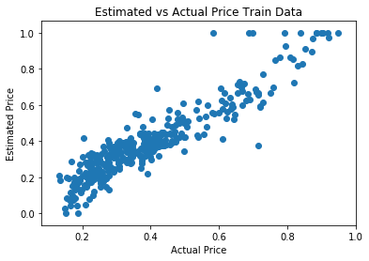

Slide 102
波士頓房屋售價預測
MultiLinearRegressor 3 使用 Keras
import tensorflow as tf
import tensorflow.contrib.layers as layers
from sklearn import datasets
import matplotlib.pyplot as plt
from sklearn.model_selection import train_test_split
from sklearn.preprocessing import MinMaxScaler
from sklearn.metrics import mean_squared_error
from sklearn.metrics import r2_score
import pandas as pd
import numpy as np
import seaborn as sns
from keras.models import Sequential
from keras.layers import Dense
import keras
%matplotlib inline
TensorFlow-1x-Deep-Learning-Cookbook
/Chapter03/Boston_House_Price_Prediction_MLP_with_Keras.ipynb

Slide 103
# Data
boston = datasets.load_boston()
df = pd.DataFrame(boston.data, columns=boston.feature_names)
df['target'] = boston.target
#Understanding Data
df.describe()

Slide 104
# Plotting correlation color map
_ , ax = plt.subplots( figsize =( 12 , 10 ) )
corr = df.corr(method='pearson')
cmap = sns.diverging_palette( 220 , 10 , as_cmap = True )
_ = sns.heatmap(
corr,
cmap = cmap,
square=True,
cbar_kws={ 'shrink' : .9 },
ax=ax,
annot = True,
annot_kws = { 'fontsize' : 12 })

Slide 105
# Create Test Train Split
X_train, X_test, y_train, y_test = train_test_split(df [['RM', 'LSTAT', 'PTRATIO']], df[['target']], test_size=0.3, random_state=0)
# Normalize data
X_train = np.array(MinMaxScaler().fit_transform(X_train))
# Need to convert dataframe to np.array for use with Keras
y_train = np.array(MinMaxScaler().fit_transform(y_train))
X_test = np.array(MinMaxScaler().fit_transform(X_test))
y_test = np.array(MinMaxScaler().fit_transform(y_test))

Slide 106
#Network Parameters
m = len(X_train)
n = 3 # Number of features
n_hidden = 20 # Number of hidden neurons
# Hyperparameters
batch = 20
eta = 0.01
max_epoch = 100

Slide 107
# Build Model
model = Sequential()
model.add(Dense(n_hidden, input_dim=n, activation='relu'))
model.add(Dense(1, activation='sigmoid'))
model.summary()

Slide 108
#Compile model
model.compile(loss='mean_squared_error', optimizer='adam')
#Fit the model
model.fit(X_train, y_train, validation_data=(X_test, y_test),epochs=max_epoch, batch_size=batch, verbose=1)

Slide 109
y_test_pred = model.predict(X_test)
y_train_pred = model.predict(X_train)
r2 = r2_score( y_test, y_test_pred )
rmse = mean_squared_error( y_test, y_test_pred )
print( "Performance Metrics R2 : {0:f}, RMSE : {1:f}".format( r2, rmse ) )
Performance Metrics R2 : 0.667622, RMSE : 0.014039

Slide 110
plt.figure(1)
plt.subplot(211)
plt.scatter(y_test, y_test_pred)
plt.title('Actual vs Predicted House Price Test Data')
plt.ylabel('Estimated House Price')
plt.subplots_adjust(hspace=.5)
plt.subplot(212)
plt.scatter(y_train, y_train_pred, color= 'red')
plt.title('Actual vs Predicted House Price Train Data')
plt.xlabel('Actual House Price')
plt.ylabel('Estimated House Price')

Slide 111
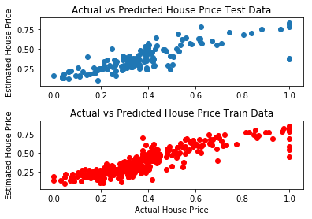

Slide 112
波士頓房屋售價預測
MultiLinearRegressor 4
TensorFlow-1x-Deep-Learning-Cookbook/Chapter03/Boston_House_Price_Prediction_MLP_with_Keras_Hyperparameter_Tuning.ipynb

Slide 113

範例分析
房屋售價預測
https://github.com/Shreyas3108/house-price-prediction/blob/master/housesales.ipynb
21613 筆房屋資料
每一筆資料有21 個不同的資訊

Slide 114
輕鬆學會Google TensorFlow 2.0人工智慧深度學習實作開發
黃士嘉, 林邑撰 博碩出版社：2019/08/30
|CHAPTER 02| 迴歸問題
id :房子的識別碼。
date: 房屋出售日期。
price: 房屋價格(目標)。
bedrooms: 臥室數量。
bathrooms: 浴室數量。
sqft_living :居住的坪數(平方英尺)。
sqft_lot :實際的坪數(平方英尺)。
floors: 房屋總共樓層。
waterfront :海景房。
view: 房屋是否看過。
condition: 整體條件有多好。
grade: 房屋的整體等級(根據KingCounty 評分系統)。
sqft_above: 除了地下室外的坪數(平方英尺)。
sqft_ basement :地下室的坪數(平方英尺)。
yr built :房屋建造時間。
yr_renovated :何時重新裝修過(一些沒重新裝修過或是裝修紀錄沒被記錄到的數值都為0) 。
zipcode: 郵政編碼。
lat :緯度座標。
long: 經度座標。
sqft_living15 : 2015 年記錄的居住坪數(可能是翻新的原因，導致sqft_living 15 與sqft_living 不同)。
sqft_lot15 : 2015 年記錄的實際坪數(可能是翻新的原因，導致sqft_lot1 5 與sqft_lot 不同)

