Slide 1


SMART INDIA HACKATHON 2026
TeamID: SIH-A0H-T091
Problem Statement ID: SIH26025
Problem Statement Title: Development of an AI-enabled Low Cost Real Time Mine Subsidence Monitoring, Prediction and Early Warning System for Underground Coal Mines in India
Theme: Smart Automation
PS Category: Hardware
Team Name (Registered on portal): DraftZero

Slide 2
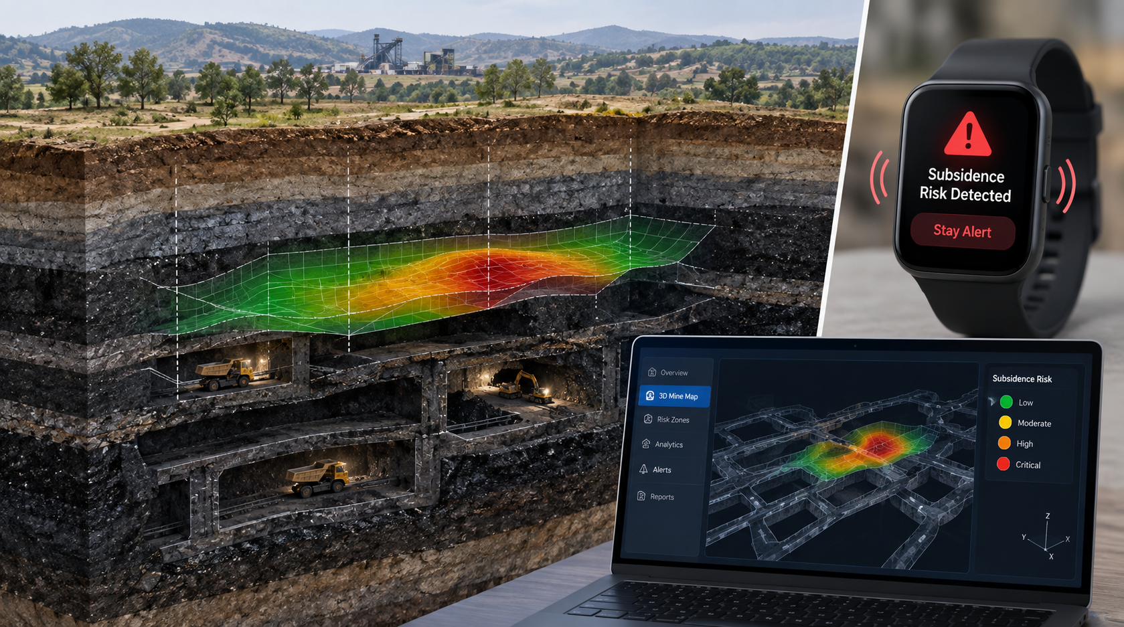
MINEGUARD
AI-Enabled Real-Time Mine Subsidence Monitoring & Early Warning System
DraftZero
Proposed Solution:
A low-cost wireless surface mesh deployed over underground coal mine panels to monitor tilt, displacement, cracks, and vibration in real time. Sensor data is analyzed using AI to detect abnormal ground movement and generate GIS-based risk zones and early warnings.
Features:
Smart Detection & Prediction: Combines tilt, displacement, crack, and vibration data with AI to detect abnormal ground movement and estimate subsidence risk.
Connected Monitoring & Alerts: Wireless mesh nodes transmit data to an edge gateway, while GIS maps visualize risk zones and trigger Watch / Warning / Critical alerts.
How it Works:
1. Sense: Distributed ESP32-based sensor nodes continuously monitor ground tilt, relative displacement, crack initiation, and vibration across the mine panel.
2. Connect & Analyze: Nodes share data through a wireless mesh network and send it to an edge gateway, where AI analyzes sensor trends and neighboring-node changes to identify abnormal deformation.
3. Map & Warn: The system displays deformation and subsidence-risk zones on a GIS/3D map, while automatically triggering Watch / Warning / Critical alerts when dangerous patterns are detected.

Slide 3
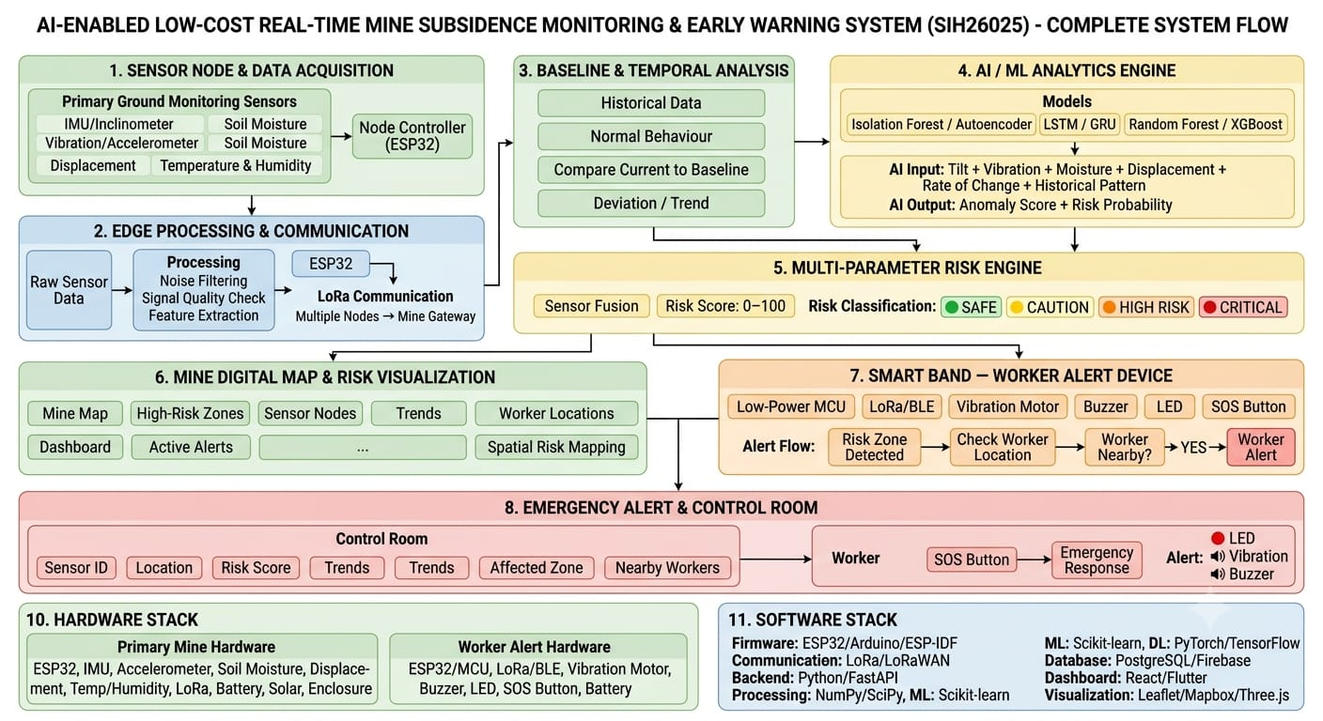
TECHNICAL APPROACH
DraftZero

Slide 4
DraftZero
FEASIBILITY AND VIABILITY
FEASIBILITY
Low-Cost Sensors
- Tilt, displacement, crack and vibration sensors are easily available.
Easy to Build
- Low-cost microcontrollers handle sensing and local processing.
Wireless Mesh Network
- LoRa-based communication enables long-range data transfer between nodes.
Real-Time Monitoring
- Continuous monitoring helps identify small ground movements early.
AI-Based Detection
- Sensor data is analyzed to detect abnormal movement and subsidence risk.
PROBLEMS & STRATEGIES
Sensor Noise & Errors
- Data filtering and sensor calibration improve reliability.
Limited Mine Data
- Initial detection uses threshold-based rules and collected field data.
Power Limitations
- Low-power components and battery-level monitoring extend node operation.
Internet Failure
- Local storage keeps monitoring active and syncs data when connectivity returns.
ECONOMIC VIABILITY
Low Hardware Cost
- Uses affordable ESP32 boards and commercially available sensors.
Reduced Installation Cost
- Wireless communication minimizes the need for cables and complex wiring.
Scalable Deployment
-Additional sensor nodes can be added as the monitored area increases.
Low Maintenance
-Remote monitoring reduces frequent manual inspection. Practical Value
-Early detection helps reduce damage to infrastructure, land and nearby communities.

Slide 5
IMPACT AND BENEFITS
DraftZero
Early Detection
Detects small changes in ground tilt and displacement
Identifies early crack formation and unusual vibrations
Provides early warning before serious ground failure
Real-Time Monitoring
Continuously monitors mine panels using distributed sensor nodes
Tracks changes between neighboring nodes
Provides live deformation data to mine operators
Risk Visualization
Displays ground movement on a GIS/3D mine map
Highlights areas with increasing subsidence risk
Helps operators identify Watch, Warning and Critical zones
Low Cost and scalable
Uses affordable ESP32 and commercial sensors
Wireless network reduces cabling and installation requirements
Additional nodes can be deployed as the mine area expands
Smart decision Support
AI combines multiple sensor readings to identify abnormal patterns
Estimates the severity and progression of ground movement
Supports faster inspection and preventive action
Safety and environment
Helps protect workers, nearby communities and infrastructure
Reduces potential damage to agricultural and forest areas
Enables faster response to developing ground instability

Slide 6
RESEARCH AND REFERENCES
DraftZero
1. A Review of Monitoring, Calculation, and Simulation Methods for Ground Subsidence Induced by Coal Mining
International Journal of Coal Science & Technology
DOI: 10.1007/s40789-023-00595-4
2. An Integrated Environment Monitoring System for Underground Coal Mines — Wireless Sensor Network Subsystem with Multi-Parameter Monitoring
Sensors, 2014
DOI: 10.3390/s140713149
3. Underground Coal Mine Monitoring with Wireless Sensor Networks
ACM Transactions on Sensor Networks, 2009
DOI: 10.1145/1498915.1498916
4. Design of Monitoring System for Coal Mine Safety Based on Wireless Sensor Network
IEEE, 2008
DOI: 10.1109/MESA.2008.4735664
5. Prediction of Mine Subsidence Based on InSAR Technology and the LSTM Algorithm
Remote Sensing, 2023
DOI: 10.3390/rs15112755
6. Research on Mining Maximum Subsidence Prediction Based on Genetic Algorithm Combined with XGBoost Model
Sustainability, 2022
DOI: 10.3390/su141610421
DATASETS :
InSAR → Surface deformation and subsidence monitoring
Wireless Sensor Networks → Distributed mine monitoring
ESP32 + LoRa → Low-cost sensor-node communication
LSTM / XGBoost → Subsidence trend and risk prediction
GIS / 3D Mapping → Deformation and risk-zone visualization

