Slide 1


SMART INDIA HACKATHON 2026
TeamID: SIH-A0H-T091
Problem Statement ID: SIH2618
Problem Statement Title: A secure, AI-powered Personal Health Companion
Theme: MedTech / BioTech / HealthTech
PS Category: Hardware
Team Name (Registered on portal): DraftZero

Slide 2
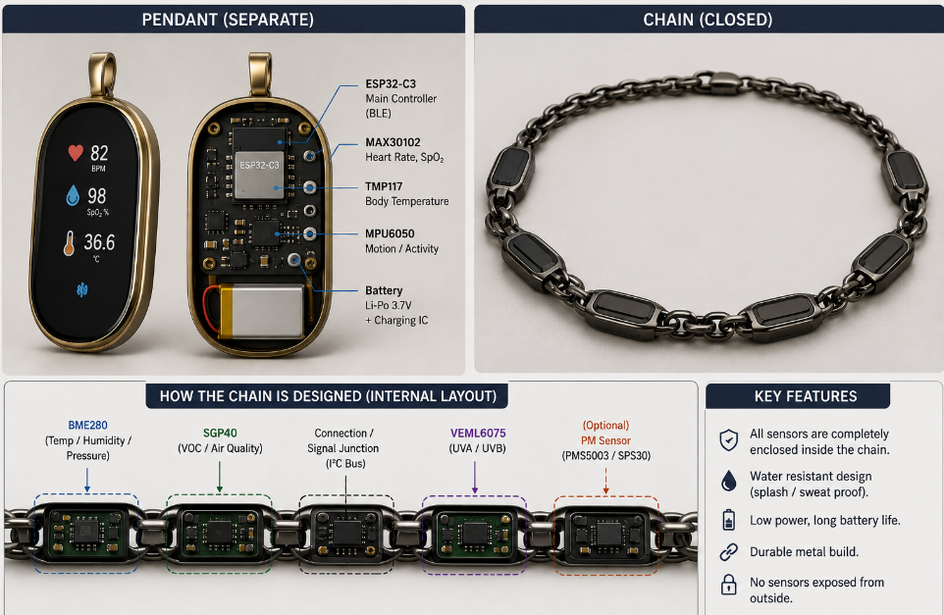
PHOENIX
Personal Health Observation And Early Warning
DraftZero
Proposed Solution:
A privacy-preserving edge health monitoring system that uses physiological, behavioral and environmental data to forecast the user's near-future vital signs, compare them with a personalized contextual baseline, and identify emerging physiological risks before they become severe.
Features:
Multimodal Risk Detection: Combines all signals mentioned to detect Thermal, Dehydration, Cardiovascular and Respiratory Distress.
Explainable Alerts: Highlights key factors contributing to a risk and provides actionable suggestions.
How it Works:
1. Forecast : Process and quality-checks signals, then forecasts the user’s physiological state 5-10 minutes ahead using lightweight temporal ML model.
2. Personalize : Compares predicted vitals against a context-aware personal baseline learned from the user’s historical data.
3. Act : and Forecast and Present signals are compared with baseline. According to the deviation, Confidence and persistence are checked before producing Stable/Monitor/Warning/Critical/Abstain states, followed by XAI and recommendations.

Slide 3
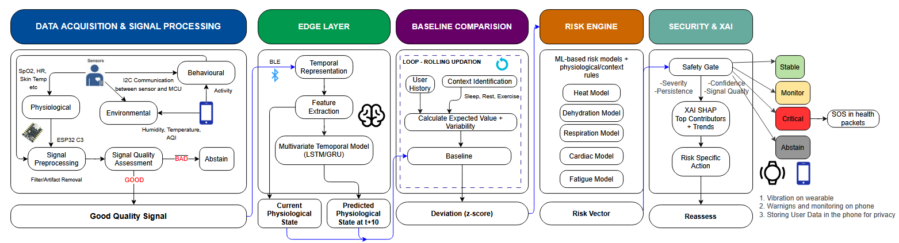
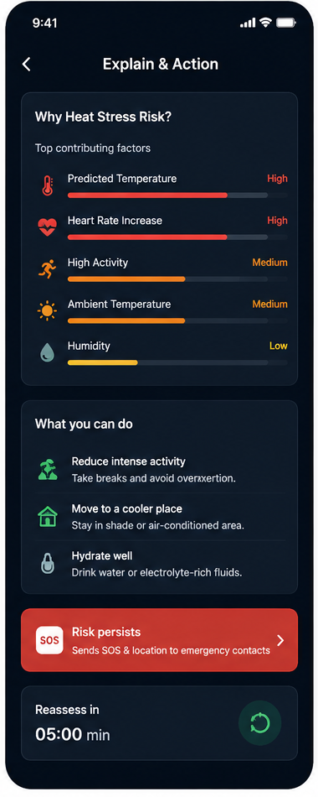

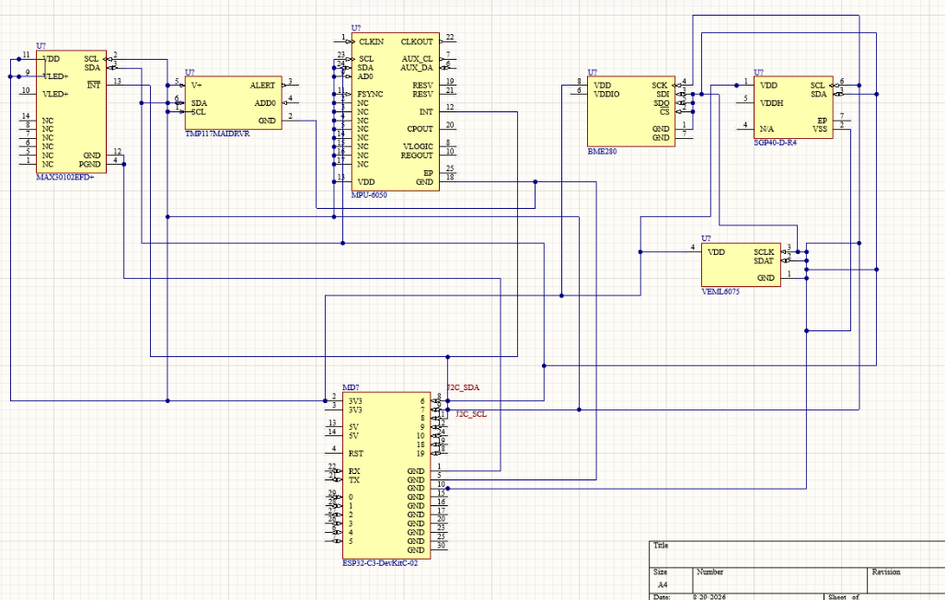
TECHNICAL APPROACH
DraftZero
Tech Stack:
Sensor Schematic:
Hardware: MAX30102, TMP117, MPU6050, BME280, SGP40, VEML6075, Smartphone, ESP32-C3
Connectivity: BLE / Health Connect
Edge: Android + Kotlin
Processing: Numpy, Scipy
AI: PyTorch → ONNX/TFLite
Risk: Scikit-learn / PyTorch
Explainable AI: SHAP
Storage: Room / SQLite
Security: Android Keystore, Encrypted Local Storage

Slide 4
DraftZero
FEASIBILITY AND VIABILITY
FEASIBILITY
Commercially Available Sensors
- HR/PPG, SpO₂, temperature & IMU sensors
Smartphone as Edge Device
- Local processing, storage & inference
Low Computational Overhead
-Lightweight forecasting and risk models
Available Research Datasets
-Public datasets for forecasting & risk-specific models
Hybrid AI Approach
- ML forecasting + statistical baseline + risk models
PROBLEMS & STRATEGIES
Noisy Wearable Signals
- Signal processing + quality assessment
Limited Risk Labels
- Risk-specific datasets + evidence-based rules
Personal Physiological Variability
- Personalized, context-aware baseline
Missing / Unreliable Data
- Quality-aware fusion + abstention
Intermittent Connectivity
- On-device processing & local storage
ECONOMIC VIABILITY
Low Infrastructure Cost
- Uses existing smartphones and wearables
Minimal Cloud Dependency
- Local processing reduces backend requirements
Scalable Architecture
-Supports different wearable devices and sensor sets
Practical Value
-Early warning + continuous personalized monitoring

Slide 5
IMPACT AND BENEFITS
DraftZero
Early Detection
Detects deviations from personal health baselines
Identifies heat stress, dehydration, respiratory risk & fatigue early
Enables preventive action before emergencies
Environmental Resilience
Combines vitals with temperature, humidity, AQI, weather & disaster data
Evaluates health in context of the environment and activity
Supports users during heat waves, pollution & disasters
Privacy-Preserving
On-device monitoring and AI inference.
Minimizes exposure of raw health data.
Enables monitoring with no cloud dependency (is this true)
Personalized Health
Learns separate baselines for sleep, idle & exercise customised to you
Adapts to individual physiological patterns
Reduces reliance on generic thresholds
Explainable AI
Shows why a risk was detected
Identifies key physiological & environmental factors
Provides actionable recommendations
Emergency Safety
Escalates alerts based on risk severity
Supports fall detection, SOS & caregiver notification
Enables faster emergency response

Slide 6
RESEARCH AND REFERENCES
DraftZero
1. Modeling personalized heart rate response to exercise and environmental factors with wearables data
Achille Nazaret, Sana Tonekaboni, Gregory Darnell, et al.,
DOI : 10.1038/s41746-023-00926-4
2. A review on multi-sensor data fusion for wearable health monitoring
Arlene John, Alex P. James, Barry Cardiff, Deepu John
DOI : 10.1016/j.inffus.2026.104319
3. Data Analytics of a Wearable Device for Heat Stroke Detection
Shih-Sung Lin, Chien-Wu Lan, Hao-Yen Hsu, Sheng-Tao Chen
DOI : 10.3390/s18124347
4. Towards On-Device Dehydration Monitoring Using Machine Learning from Wearable Device’s Data
Farida Sabry, Tamer Eltaras, Wadha Labda, et al.,
DOI : 10.3390/s22051887
5. TeleXAI-R: A Real-Time Explainable AI Model for Remote Patient Risk Stratification Using IoT-Integrated Consumer Devices
Jing Yang, Jialin Dai, Xinyi Tang, et al.,
DOI : 10.1109/TCE.2025.3644166
6. From Sensing to Sense-Making: A Framework for On-Person Intelligence with Wearable Biosensors and Edge LLMs
Tad T. Brunyé, Mitchell V. Petrimoulx, Julie A. Cantelon
DOI : 10.3390/s26072034
DATASETS :
1. PPG-DaLiA → Physiological forecasting
2. TILES-2018 → Personal/Contextual modelling
3. Wearable Dehydration Dataset → Dehydration model
4. Construction Heat-Stress Dataset → Heat-Stress model

