Slide 1
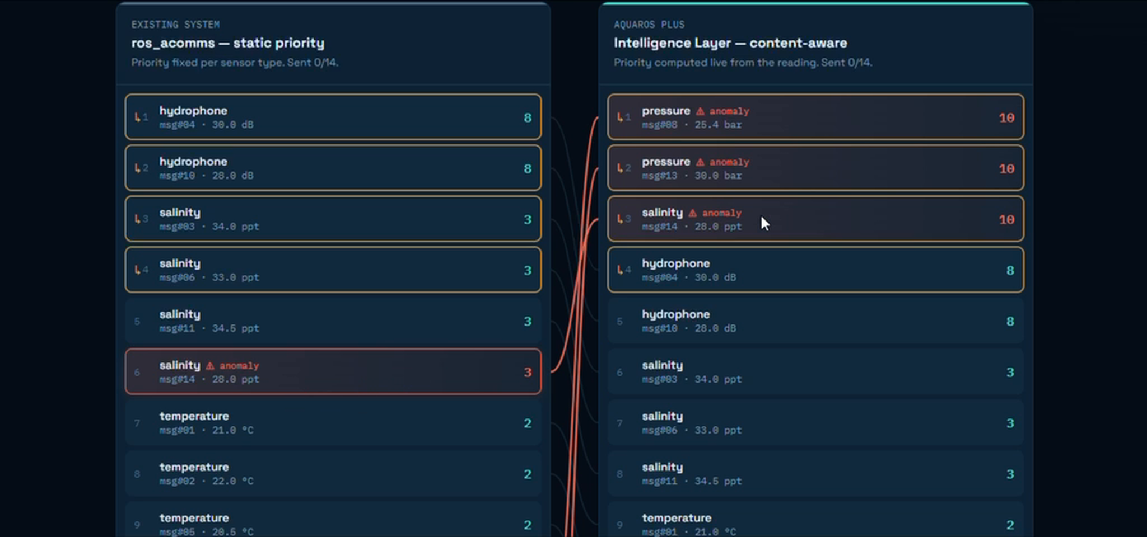
OPERATING SYSTEMS PROJECT · 2026–27
AQUAROS
PLUS
Content-aware priority scheduling for underwater acoustic sensor networks
J.J. Secilia · RA2511026020301
D. Shivani · RA2511026020265
II Year CSE-AIML · SRM Institute of Science and Technology, Ramapuram

Slide 2
THE SETTING
Underwater sensors can only talk in short windows
Sensors keep measuring
Acoustic links are scarce
Someone must choose
Temperature, salinity, pressure and hydrophone level are logged continuously.
Readings are stored in a buffer while no link is available.
Limited bandwidth and short communication windows.
Only a handful of messages fit in each window, and ~10% are lost.
When a window opens, the system decides which buffered messages go first.
That is exactly an OS scheduling decision.
6 + 2 + 1
4 / window
10%
3%
sensor, relay and sink nodes simulated
messages per sensor node
transmission loss probability
of readings are anomalies
OS analogy: buffered message = task · transmit queue = ready queue · window capacity = resource limit · retry after loss = rescheduling
AQUAROS PLUS · Content-Aware Priority Scheduling
2

Slide 3
PROBLEM STATEMENT
The problem: priority ignores what the reading says
In a static-priority baseline, priority depends only on sensor type. A dangerous reading and a normal reading from the same sensor get the same score.
STATIC-PRIORITY TRANSMIT QUEUE · capacity = 4 per window
Same score, different urgency
hydrophone
hydrophone
salinity
salinity
A 40 bar pressure spike scores the same as a 6 bar normal reading.
priority 8
priority 8
priority 3
priority 3
salinity
salinity ⚠ ANOMALY
temperature
priority 3
priority 3
priority 2
Capacity is the bottleneck
The scheduler only reorders; so order is everything when the window is small.
Window 1 sends only the first 4. The anomaly sits at position 6 behind routine messages and must wait for a later window.
Result: important anomalies are buffered behind routine data exactly when timely delivery matters most.
AQUAROS PLUS · Content-Aware Priority Scheduling
3

Slide 4
PROBLEM, QUANTIFIED
How bad is it? The baseline in numbers
10.86
52.6%
37.7
89.2%
mean anomaly latency (windows)
anomalies delivered within 3 windows
95th-percentile anomaly latency (windows)
anomalies delivered at all
What the numbers say
• Nearly half of anomalies wait longer than 3 windows.
• About 1 in 10 anomalies never arrives before the run ends.
• The worst 5% wait 37+ windows, far too late for alerts.
• Adding QLS-inspired aging makes it worse: only 35.4% within 3 windows.
• Routine messages wait about 11 windows in every setup, so the network is overloaded.
AQUAROS PLUS · Content-Aware Priority Scheduling
4

Slide 5
AIM & OBJECTIVES
Goal: let the value of the reading decide the priority
Design, implement and evaluate a content-aware priority layer that boosts abnormal readings, without changing the queue, MAC or modem layers.
01
Bounded scoring
02
Keep normal data stable
03
Realistic simulation
Priority adjusts with deviation from the normal range, capped at 10.
In-range readings keep their original base priority.
Multi-node, two-hop network with limited, lossy windows.
04
Fair comparison
05
Interactive demo
06
Link to OS theory
Anomaly latency, delivery rate and routine latency per policy.
Side-by-side browser dashboard of both schedulers.
Priority scheduling, aging, starvation, resource limits.
AQUAROS PLUS · Content-Aware Priority Scheduling
5

Slide 6
SOLUTION
The solution: AQUAROS PLUS content-aware scoring
SCORING FORMULA
Bounded and predictable
In range: score = base priority
Out of range:
deviation = max(low − v, v − high) / (high − low)
boost = min(10 − base, 6 + 4 × deviation)
score = min(10, base + boost)
Minimum boost of 6 for any anomaly, grows with severity, never exceeds priority 10.
Cheap to compute
O(1) per reading, computed locally at the origin node with no extra transmissions.
WORKED EXAMPLE · PRESSURE SENSOR (range 0–10 bar, base 2)
6 bar (normal)
40 bar (anomaly)
score 2
score 10
Drop-in layer
Only the priority value handed to the queue changes. Queue, MAC and modem layers stay as they are; ties break by arrival time (FCFS).
deviation = (40 − 10)/10 = 3, boost = min(8, 6 + 12) = 8, score = min(10, 2 + 8) = 10. The spike now jumps ahead of routine traffic.
AQUAROS PLUS · Content-Aware Priority Scheduling
6

Slide 7
SOLUTION DESIGN
Architecture: one new layer, everything else untouched
4
Routing layer
END-TO-END WORKFLOW
SHEEP-inspired · simplified residual-energy next-hop rule
1
Sensor reading generated
3
Content-aware scoring
2
Scored at origin node
AQUAROS PLUS · compares reading with normal range → priority score (NEW)
3
Enters transmit queue
2
Queue management
4
Window opens
QLS-inspired · picks highest score first, optional aging
5
Top-N by score sent
1
Link layer
Communication-window access and modem behaviour (simulated)
6
Relay queues & forwards
AQUAROS PLUS sits above the unchanged queue: it only supplies the priority value.
7
Sink records delivery
Lost messages stay eligible for retry in later windows.
AQUAROS PLUS · Content-Aware Priority Scheduling
7

Slide 8
SOLUTION COMPARISON
Baseline vs AQUAROS PLUS at a glance
Aspect
Static-priority baseline
AQUAROS PLUS
Priority source
Fixed by sensor type
Based on reading and normal range
In-range readings
Fixed type priority
Same base priority kept
Out-of-range readings
No extra boost
Boost, capped at 10
Window selection
Anomaly may wait behind routine data
High-scoring anomaly selected early
Adaptability
Priority table set manually
Score follows the reported value
Downstream layers
Queue and link as simulated
Identical, nothing changed
Comparison is against the static-priority baseline built for this project, not a claim about every ros_acomms deployment.
AQUAROS PLUS · Content-Aware Priority Scheduling
8

Slide 9
INTERACTIVE DEMO
Live dashboard: the same buffer, two schedulers
Static queue
Hydrophone (8) first. The salinity anomaly (3) is stuck at position 6.
AQUAROS PLUS queue
Pressure and salinity anomalies jump to the top with score 10.
Left: static priority (ros_acomms). Right: AQUAROS PLUS intelligence layer.
Controls: adjustable window capacity · open communication window · inject any reading (e.g. 40 bar pressure) · guided 2-minute demo mode.
AQUAROS PLUS · Content-Aware Priority Scheduling
9

Slide 10
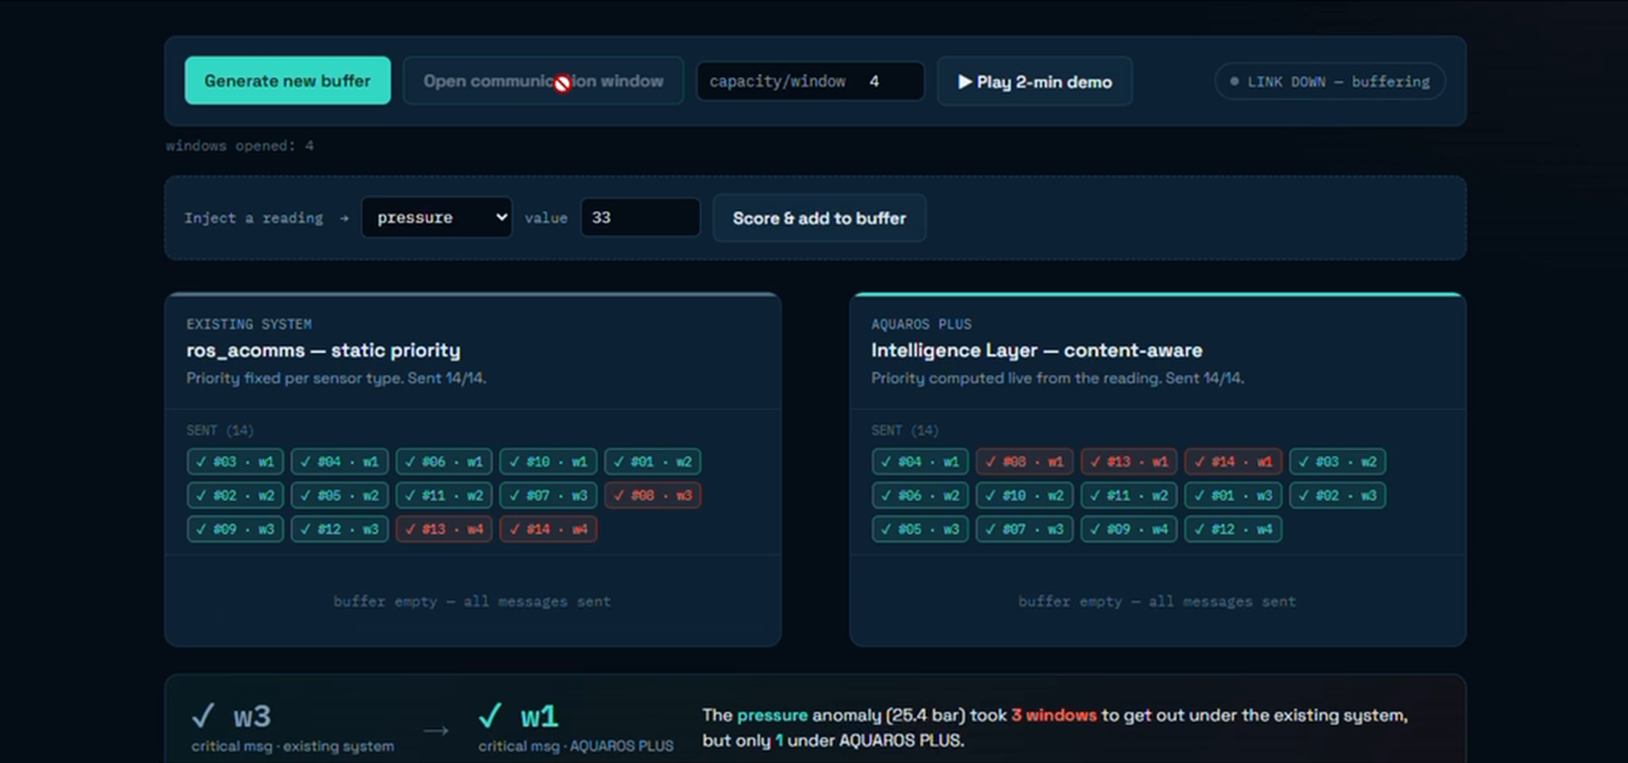
INTERACTIVE DEMO
Result on the dashboard: 3 windows vs 1 window
w3
existing system: pressure anomaly delivered
w1
AQUAROS PLUS: same anomaly delivered
3× faster
Critical message out two windows earlier.
Both buffers fully drained: sent messages shown as chips with their window number.
Takeaway: the dashboard reports it in one sentence: the pressure anomaly (25.4 bar) took 3 windows under the existing system but only 1 under AQUAROS PLUS. It illustrates the concept; the large metrics come from the Python simulation.
AQUAROS PLUS · Content-Aware Priority Scheduling
10

Slide 11
OS MAPPING
Operating-system concepts the project demonstrates
Buffered message
→
Process / task
Transmit queue
→
Ready queue
Window capacity
→
Resource limit
Static priority
→
Static priority scheduling
Content-aware score
→
Dynamic priority
Arrival-time tie-break
→
FCFS tie-breaking
Optional queue aging
→
Aging vs starvation
Retry after loss
→
Rescheduling
Starvation trade-off
Not a kernel
Aging weight 0.1 had no visible effect; weight 0.5 raised anomaly latency to ~2.6 windows.
It runs on a host OS; this is message scheduling, not CPU task scheduling.
AQUAROS PLUS · Content-Aware Priority Scheduling
11

Slide 12
EVALUATION (SIMULATED)
Results: anomalies go from 10.86 windows to 0.22
Mean anomaly latency (lower is better)
Anomaly delivery, % (higher is better)
50×
99.9%
1.0
40 runs
lower mean anomaly latency
anomalies within 3 windows
p95 latency vs 37.7 baseline
random seeds, 200 windows each
AQUAROS PLUS · Content-Aware Priority Scheduling
12

Slide 13
EVALUATION (SIMULATED)
The cost is small: routine messages barely notice
Configuration
Mean anomaly latency
Within 3 windows
Delivered
Routine latency
Static baseline
10.86
52.6%
89.2%
11.05
Static + QLS-inspired aging
10.93
35.4%
89.4%
11.05
AQUAROS PLUS
0.22
99.9%
99.9%
11.39
AQUAROS PLUS + aging
0.22
99.9%
99.9%
11.39
Routine +0.34 windows
Overloaded by design
Aging adds nothing here
Routine latency rises only from 11.05 to 11.39, a ~3% cost for a 50× anomaly gain.
Routine messages wait in every configuration. Scheduling reorders service; it adds no capacity.
With the small weight, results with and without aging are identical.
AQUAROS PLUS · Content-Aware Priority Scheduling
13

Slide 14
TESTING & STATUS
Verified and built: 7/7 tests, full prototype
AUTOMATED TESTS (pytest)
IMPLEMENTATION STATUS
T1
In-range score = base priority
✓ Passed
Scoring algorithm (Python + JS cross-checked)
Completed
T2
Anomaly score rises, capped at 10
✓ Passed
Interactive browser demo
Completed
T3
Anomaly flag correct
✓ Passed
Two-hop simulation, metrics, tests
Completed
T4
Queue order & tie-breaks
✓ Passed
Replay of logged sensor data
Future work
T5
Aging lets old message overtake
✓ Passed
ros_acomms integration
Future work
T6
Routing picks more residual energy
✓ Passed
Tank test with real modem
Future work
T7
End-to-end: lower anomaly latency
✓ Passed
Small field pilot
Future work
Stack: Python 3 stdlib · matplotlib · HTML/CSS/JS demo · pytest · ROS 1 wrapper (untested)
AQUAROS PLUS · Content-Aware Priority Scheduling
14

Slide 15
WRAP-UP
Limits, next steps and conclusion
Honest limitations
Future enhancements
Priority-aware buffers
• Simulation with synthetic data only
• QLS/SHEEP parts are simplified models
• Normal ranges are placeholders
• Faulty sensors look like anomalies
• Student prototype, not a safety system
• Faithful QLS and SHEEP implementations
• Calibrate with real oceanographic data
• Sensor-fault detection
• Tune aging vs fairness
• Logged data → ROS → tank test
• Bigger topologies and loads
• Preserve critical readings when buffers fill
• Watchdog to detect stalled queue tasks
• Real-time task scheduling for node processing
• Note: priority alone cannot guarantee deadlines
CONCLUSION
Using the value of a reading, not just its sensor type, lets urgent anomalies reach the sink in about 0.22 windows instead of 10.86, with only a small routine-latency cost. Validation with real sensor data and hardware is the next step.
AQUAROS PLUS · Content-Aware Priority Scheduling
15

