Slide 1
It’s All About Uncertainty
George Howard, DrPH
Department of Biostatistics
UAB School of Public Health

Slide 2
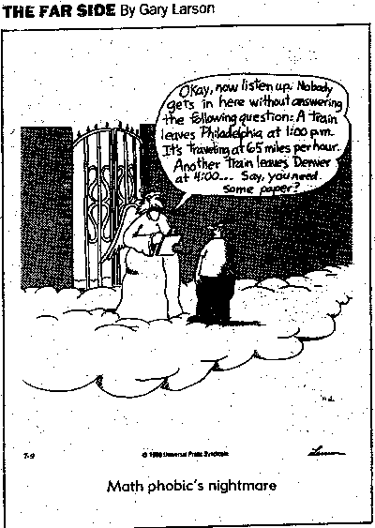
Overall Lecture Goals
It is surprising that as a society we accept bad math skills
Even if you are not an active researcher, you have to understand statistics to read the literature
Fortunately, statistics are mainly common sense
This lecture is to provide the foundation for common sense issues that underlie why and what is trying to be done with statistics
This is not a math lecture, so relax

Slide 3
The “Universe” and the “Sample”
The Universe
(we can never really understand what is going on here, it is just too big)
The Sample
(a representative part of the universe, it is nice and small, and we can understand this)
Participant Selection
Analysis
Statistics
The mathematical description of the sample
inference

Slide 4
Why do we deal with samples?
Measure everyone!
  Advantages:
    You will get the correct answer
    You don’t need to hire a statistician
  Disadvantages
    Expensive (statisticians save, not cost, money)
    Impractical (you need to be promoted)
Inferential approach
  If done correctly, you can almost be certain to get nearly the correct answer
  The entire field of statistics is to deal with the uncertainty (or to help define “almost” and “nearly”) when making inference
What’s the alternative?

Slide 5
The two types of inference
Estimation
  “Guessing” the value of the parameter
  Key to estimation is providing a measure of the quality (reliability) of the guess
Hypothesis Testing
  Making a yes-no decision regarding a parameter
  Key to hypothesis testing is understanding the chances of making an incorrect decision

Slide 6
What are the goals of “Estimation”
Again parameters (such as average BP) exist in the universe, but we are producing estimates in a sample
Parameters exist and do not change, but we cannot know them without measuring everyone
Our goal is to guess the parameters
  Natural question: How good is our guess?
  Some parameters describe the strength of an association
    Difference in one year survival among people treated with a standard versus a newly developed treatment

Slide 7
What is the role of statistics in estimation?
Dealing with uncertainty
Suppose we are interested estimating (guessing) the mean blood pressure of white men in the US
How much variation (uncertainty) can we reasonably expect to see?
The Universe
Parameter (true mean SBP)
The Sample
The other sample
Estimated Mean SBP
Another Estimated
Mean SBP

Slide 8
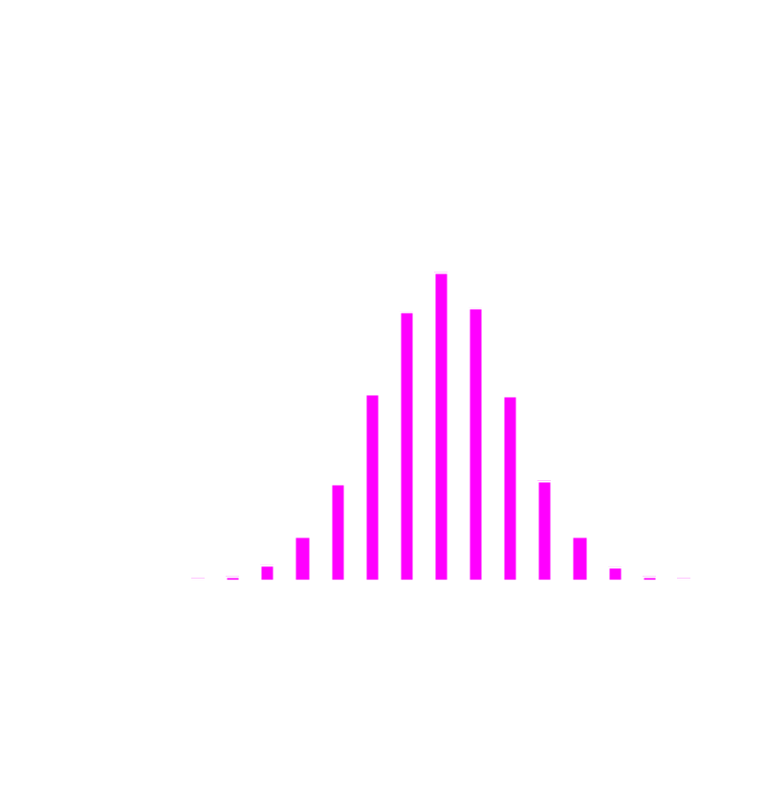
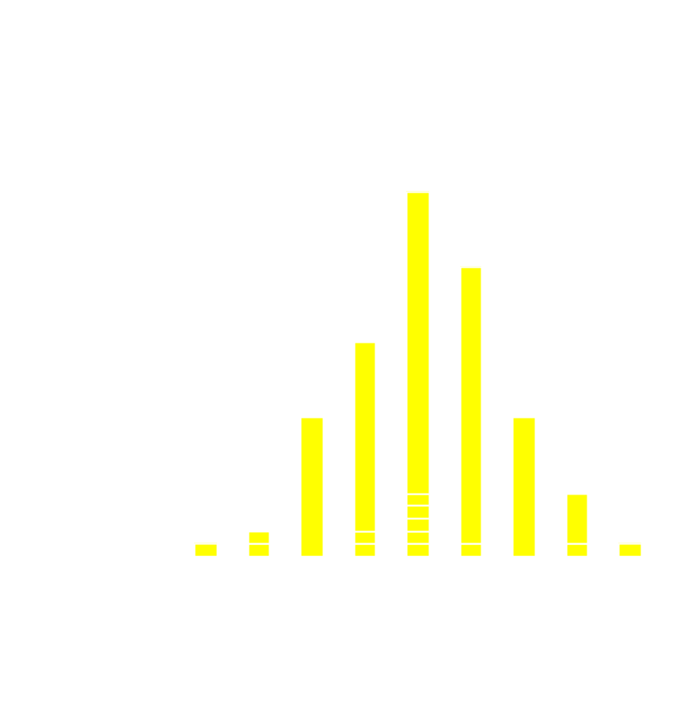
Example of Repeated Estimations of Means from a Universe
If you could repeat the experiment a large number of times, the estimates obtained would have a standard deviation
The standard deviation of the estimate is called the standard error
The standard error is the index of the reliability of an estimate
True mean = 120 mmHg
True SD = 10 mmHg
Mean of 100 means = 120.09 mmHg
SD of 100 means = 1.43 mmHg

Slide 9
Characterizing the Uncertainty in Estimation
The 95% Confidence Limits
Estimation is the guessing of parameters
Every estimate should has a standard error
  95% confidence limits
    Show the range that we can “reasonably” expect the true parameter to be within
    Approximately (estimate + 2 SE)
    For example:
      If the mean SBP is estimated to be 117
      And the standard error is 1.4
      Then we are “pretty sure” the true mean SBP is between 114.2 and 119.8
  Slightly incorrect interpretation of the 95% confidence limit is “I am 95% sure that the real parameter is between these numbers”

Slide 10
Estimation and the “Strength of the Association”
Studies frequently focus on the association between an “exposure” (treatment) and an “outcome”
In this case, parameter(s) that describe the strength of the association between the exposure and the outcome are of particular interest
Examples:
  Difference in cancer recurrence by 5-years between those receiving new versus standard treatment
  Reduction in average SBP associated with increased dosages of a drug
  Differences in the likelihood of being a full professor before age 40 in those who attend versus don’t attend a “Vocabulary of Clinical Research” lecture on statistics

Slide 11
Estimation and the “Strength of the Association”
There is some “true” benefit of attending a class like this (it exists across all universities that are currently or could offer a course like this)
We have a sample of 51 people from UAB in 1970
What type of measures of association can we estimate from this sample

Slide 12
Estimation and the “Strength of the Association”
Same
data
Measures of association:
Approach #1:
Calculate proportion in those attending (20/31 = 0.65)
Calculate proportion in those not attending (8/20 = 0.40)
Calculate difference in proportions (0.65 – 0.40 = 0.25)
You are 25% more likely to become a full professor by age 40 because you are here
Approach #2:
Calculate proportion in those attending (20/31 = 0.65)
Calculate proportion in those not attending (8/20 = 0.40)
Calculate the ratio of those succeeding if you attended relative to those who did not attend (0.65 / 0.40 = 1.6)
You are 1.6 times more likely to be a full professor by age 40 because you are here
Approach #3:
Calculate the odds for those attending (20/11 = 1.81)
Calculate the odds for those not attending (8/12 = 0.67)
Calculate the ratio of odds for those if you attended relative to those who did not attend (1.81 / 0.67 = 2.7)
Your odds are 2.7 times greater to be a full professor by age 40 because you are here

Slide 13
Estimation and the “Strength of the Association”
Three answers to the same question?
  1.25 times (25%) increase in the absolute likelihood
  1.6 times increase in the likelihood (“relative risk”)
  2.7 times increase in the odds (“odds ratio”)
All are correct approaches to estimating the magnitude of the association!
  Some approaches are wrong for some study designs
  Generally the “best” measure of association is the one that can be best understood in the context
It is not unusual to have multiple approaches to the same question (in statistics or otherwise)
  Try to understand what the author is using for the measure of association --- they are mostly common sense
  Don’t be fall into a fixed paradigm

Slide 14
Major take home points about estimation
Estimates from samples are only guesses (of the parameter)
Every estimate has a standard error, and it is a measure of the variation in the estimates
If you were to repeat the study, you would get a different answer
Now you have two answers
  It is almost certain that neither is correct
  However, in a well-designed experiment
    The guesses should be “close” to correct
    Statistics can help us understand how far our guesses are likely to be from the truth
Measures of association are estimates of special interest

Slide 15
The two types of inference
Estimation
  “Guessing” the value of the parameter
  Key to estimation is providing a measure of the quality (reliability) of the guess
Hypothesis Testing
  Making a yes-no decision regarding a parameter
  Key to hypothesis testing is understanding the chances of making an incorrect decision

Slide 16
Hypothesis Testing 101
We want to prove that a risk factor (HRT) is associated with some outcome (CHD risk)
Scientific method
  1: Assume that whatever you are trying to prove is not true – that there is no relationship (null hypothesis)
  2: Collect data
  3: Calculate a “test statistic”
    Function of the data
    “Small” if the null hypothesis is true, “big” if the null hypothesis is wrong (alternative hypothesis)

Slide 17
What does a p-value really mean?
(continued)
Scientific method (continued)
  4: Calculate the chance that we would get a test statistic as big as we observed under the assumption of no relationship. The p-value!
  5: If the observed data is unlikely under the null then:
    We have a strange sample
    The null hypothesis is wrong and should be rejected

Slide 18
Example of a Statistical Test
Return to our data regarding your success
How can be calculate the chance of getting data this different for these with and without the course?
Step 1: Assume the course has no impact

Slide 19
Example of a Statistical Test
Step 2: Calculate row %
If the course has no impact, then what is the “best” estimate of the chance of being full prof?

Slide 20
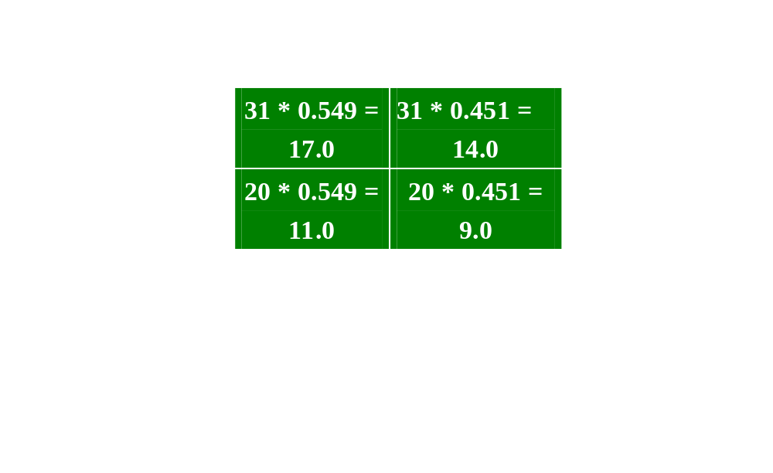
Example of a Statistical Test
Step 3: Calculate expected cell counts (null hypothesis of no difference between groups)
If there is no real impact of the course, then the observed cell counts should be close to those under the assumption of no impact

Slide 21
Example of a Statistical Test
Step 3: Calculate test statistic (just a function of the data that is “small” if the null hypothesis is true)
If null hypothesis is true, then observed and expected cell counts should be close
= 0.5219 + 0.6353 + 0.8090 + 09845
=2.95

Slide 22
Example of a Statistical Test
Step 4: Decide if the test statistic is “big”
  When the test statistic is calculated in this manner, only 5% of the time is the value bigger than 3.84 by chance alone (work by others, but tables exist)
  We have a test statistic value of 2.95
  Our test statistic is not “big” (i.e., 2.95 is less than 3.85)
  The chance that the we will get a test statistic this big by chance alone is not uncommon (p > 0.05)
  There is not evidence in these data that you are currently spending your time wisely

Slide 23
Example of a Statistical Test
Step 5: Make a decision
  Since our test statistic is not “big” we cannot reject the null hypothesis
  Note that you do not “accept” the null hypothesis of no effect, you just don’t reject it
  If the test statistic were bigger than 3.84, then we would have rejected the null hypothesis of no difference and accepted the alternative hypothesis of an effect

Slide 24
The Almighty P-value
The “p-value” is the chance that this sample could have happened under the null hypothesis
What constitutes a situation where it is “unlikely” for the data to have come from the null
  That is, how much evidence are we going to require before we “reject” the null?

Slide 25
The Almighty P-value
Standard: if the data has less than a 5% chance (p < 0.05) of happening by chance alone, then it is considered as “unlikely”
This is an arbitrary number
New software gives you the exact probability of the sample under the null
  If you get p = 0.0532 versus p = 0.0495 do you really want to have different conclusions?
  More modern thinking “interprets” the p-value
Interpretation may depend on the context of the problem (should you always require the same level of evidence?)

Slide 26
Ways to really mess up a p-value
Order of the steps in hypothesis testing is critical to the interpretation of p-value
Common pitfall (data dredging)
  Look at data – create hypothesis – test hypothesis – obtain p-value
  Hypothesis created from data
  1 of 20 relationships will be significant by chance alone
  Approach does not test relationships is in the data that are not “eye-catching” (and no count is made)
  Example of introducing spurious findings (discussed later) and leads to p-values that are not interpretable

Slide 27
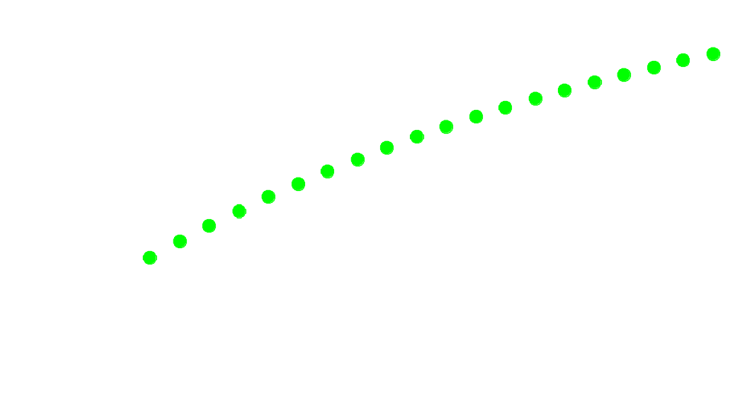
What is the impact of looking multiple times at a single question
If we look once at the data, the chance of a spurious finding is 0.05.
What happens to the chance of spurious findings with multiple “peeks”?

Slide 28
How do we take peeks (without thinking about it)
Interim examinations of study results
Looking at multiple outcome measures
Analyzing multiple predictor variables
Subgroup analysis in clinical trials
All of these can be done, but it requires planning

Slide 29
Reporting Post-Hoc Relationships
In reviewing data, suppose you discover a previously unknown relationship
Because you are not hypothesis driven, the interpretation of the p-value is not reliable
Should you present this relationship in the literature?
Absolutely, but must honestly describe conditions of discovery:
  In exploratory analysis, we noted an association between X and Y. While the nominal p-value of assessing the strength of this association is 0.001, because of the exploratory nature of the analysis we encourage caution in the interpretation of this p-value and encourage replication of the finding.
We were poking around in our data and found something that is really neat. We want to be on record as the first to report this, but because we were just poking around when we found the relationship it could really be misleading. We sure do hope that you other guys see this in your data too.

Slide 30
Two different ways to make mistakes in statistical testing: P-value versus Power
The p-value is the probability that you say there is a difference you are wrong
  You have assumed no difference
  Calculated chance that a difference as big as observed in the data could exist by chance alone
  If you say there is a difference, then this is the chance you are wrong
There is another way to make a mistake – not to say there is a difference when one exists

Slide 31
Outcomes from Statistical Testing
The Truth
 | Null Hypothesis: No Difference
Test conclusion of no evidence of difference
Test conclusion of a difference
Alternative Hypothesis:
The is a difference
Correct decision
(you win)
Incorrect decision
(you lose)
β
= Type 2 Error
The Test
Incorrect decision (you lose)
Correct decision (you win)
α
= Type 1 Error
1-β = Power

Slide 32
Statistical Power
Statistical power is the probability that given the null hypothesis is false (there is a difference), then we will reject (we will “see” the difference)
Influenced by
  Significance level (α): if we require more evidence to declare a difference, it will be harder to get
  Sample size: Provides greater precision (see smaller differences)
  True difference from the null hypothesis: big differences are easier to see than small differences
  The other parameter values: in this case the standard deviation (δ), with any difference harder to see in a high level of noise

Slide 33
Major take home points about hypothesis testing
Hypothesis testing is making a yes/no decision
The order of steps in a test is important (most important – make hypothesis before seeing data)
Two ways to make a mistake
  Say there is a difference when there is not one
    In design, the α level gives the chance of a Type I error
    P-value is the chance in the specific study
  Say there is not a difference when there is one
    In design, the β level gives the chance of a type II error, with 1- β being the “power” of the experiment
    Power is the chance of seeing a difference when one exists
P-value should be interpreted in the context of the study
Adjustments should be made for multiple peeks

Slide 34
Statistics in different study designs
What is “univariate” and “multivariable” statistics?
Why do a clinical trial?
Why are there so many different statistical tests?

Slide 35
The Spectrum of Evidence
Ecologic study
Observational Epidemiology
  Case/Control
  Cross Sectional Design
  Prospective Cohort
Randomized clinical trial

Slide 36
The Spectrum of Evidence
Multiple observational epidemiological studies have shown both HRT (estrogen) and beta-carotene are strongly associated to reduced atherosclerosis, MI risk and stroke risk
Clinical trials suggest HRT and beta-carotene are both not beneficial (perhaps harmful)
How can this occur?

Slide 37
Confounders of relationships
Confounder (SES)
???
Risk Factor (Estrogen)
Outcome (CHD risk)
A “confounder” is a factor that is associated to both the risk factor and the outcome, and leads to a false apparent association between the the risk factor and outcome

Slide 38
Examples of confounded potentially relationships
Single coronary vessel surgery and coronary risk
Homocyst(e)ine and cardiovascular risk
Antioxidants and cardiovascular risk
Black race and stroke risk
Hormone replacement and either stroke risk or coronary risk
In all of these, it is important to remove the impact of the confounder to see the “true” effect of the exposure

Slide 39
“Fixing” Confounders in Observational Epidemiology
Approach #1: Match for confounders
  Case / Control study approach finds people with the disease (case) and compares them to people without the disease
  If the comparison group is “matched” for confounders, then the two groups are identical for those factors (differences cannot be because of these factors)
  Example: In a case/control study of stroke, one may match for age and race, then differences in risk factors cannot be “confounded” by the higher rates in older and African American populations
  Matching most common in case/control studies

Slide 40
“Fixing” Confounders in Observational Epidemiology (continued)
Approach #2: Adjust for confounders
  In case/control, cross sectional or cohort studies, differences confounders between those with and without the “exposure” can be made equal by mathematical adjustment
  Multivariable (sometimes called multivariate) analysis has multiple predictors in a single model RISK = a + b(treatment) + c(confounder) + ….
  Interpretation: “b” is the difference in risk associated with treatment at a fixed level of the confounder
  Covarying for confounders is the main reason for “multivariate statistics”

Slide 41
Matching or Covarying Does Correct for Effects of Confounders
What can go wrong?
  Must know about confounders
    Could not adjust for homocyst(e)ine levels before it was appreciated as a risk factor
    Only 50% of stroke risk is explained, implying there many “unknown” risk factors
  Must appropriately measure confounders
    Most common representation for socio-economic status is education and income
    Incomplete representation of the underlying construct leaves possibility for “residual confounding”
  You can never perfectly measure all known and unknown risk factors

Slide 42
Confounders of relationships
What should you do?
  How can you control for all unknown and known risk factors
  Do a randomized clinical trial!
  Why does a clinical trial protect against confounders?

Slide 43
Confounders of relationships in Randomized Clinical Trials
In a RCT, those with and without the confounder as assigned to the risk factor at random
Confounder (SES)
Risk Factor (Estrogen)
CHD (CHD risk)
It now doesn’t matter if the confounder (SES) is related to stroke risk, because it is not related to the risk factor (estrogen) it cannot be a confounder

Slide 44
Selection of Statistical Tools
(Which Test Should I Use?)
Each problem can be characterized by the characteristics of the variables:
  Type
  Function
  Repeated/Single assessment
And these characteristics determine the statistical tool

Slide 45
Data Type
Categorical (also called nominal or dichotomous if 2 groups)
  Data are in categories - neither distance nor direction defined
  Gender (male/female), ethnicity (AA, NHW, Asian), or outcome (dead/alive), hypertension status (hypertensive, normotensive)
Ordinal
  Data in categories - direction but not distance defined
  Good/better/best, normotensive, borderline hypertension, hypertensive
Continuous (also called interval)
  Distance and direction defined
  Age or systolic blood pressure

Slide 46
Data Function
Dependent variable
  The “outcome” variable in the analysis
Independent variable (or “exposure”)
  The “predictor” or risk factor variable

Slide 47
Repeated/Single Assessments
Single assessment
  A variable is measured once on each study participant
  Baseline blood pressure measured on two different participants
Repeated measures (if two, also called “paired”)
  Measurements are repeated multiple times
  Frequently at different times, but also can be matched on some other variable
    Repeated measures on the same participant at baseline and then 5 years later
    Blood pressures of siblings in a genetic study
  Data “come in sets or pairs”

Slide 48
Selection of Statistical Tools
When planning study or reading a paper, stop and identify the variables including their roles and types
These determine how the statistical analysis should be undertaken
Examples
  Is there an association between gender and the prevalence of hypertension?
  Is there an association between age and the level of systolic blood pressure?

Slide 49
Gender and Hypertension
Is there evidence that men are more likely to be hypertensive in than women?
Collect data on 100 men and 100 women
Hypertensive Normotensive Total
Men 62 38 100
Women 51 49 100
Total 113 87 200
Defines a 2x2 table (in this case gender by hypertension) and we will test if two proportions differ of hypertensives differ

Slide 50
Gender and Hypertension
In this analysis
  Gender:
    Dichotomous (or categorical or nominal) factor
    Predictor (independent variable)
    Single measures on each individual
  Hypertension
    Dichotomous (or categorical or nominal) factor
    Outcome (or dependent variable)
    Single measure on each individual

Slide 51
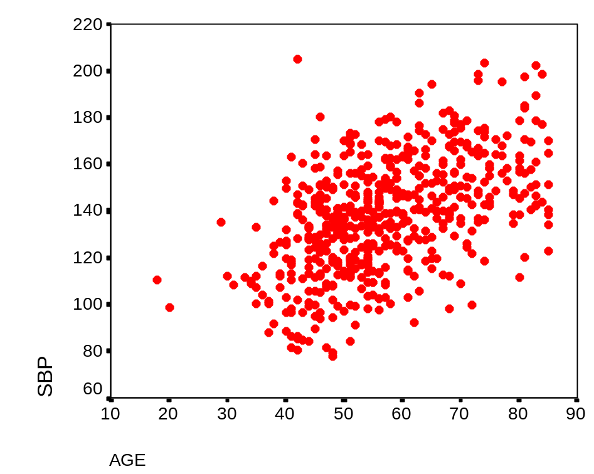
Age and Systolic Blood Pressure
Is there evidence that systolic blood pressure increases with age?
Collect SBP and age on 566 participants
Find the “average” value for SBP as a function of age
“Ask” if the average SBP changes with age?

Slide 52
Age and Systolic Blood Pressure
In this analysis:
  Age:
    Continuous (or interval) factor
    Predictor (independent variable)
    Single measures on each individual
  Systolic Blood pressure
    Continuous (or interval) factor
    Outcome (or dependent variable)
    Single measure on each individual

Slide 53
Statistics as a “Bag of Tools”
Is it reasonable to expect the analysis of these to types questions to be the same?
Hyper- Normo-
tensive tensive Total
Men 62 38 100
Women 51 49 100
Total 113 87 200
Obviously not --- just as a carpenter needs a saw and hammer for different tasks, a statistician needs different analysis tools

Slide 54
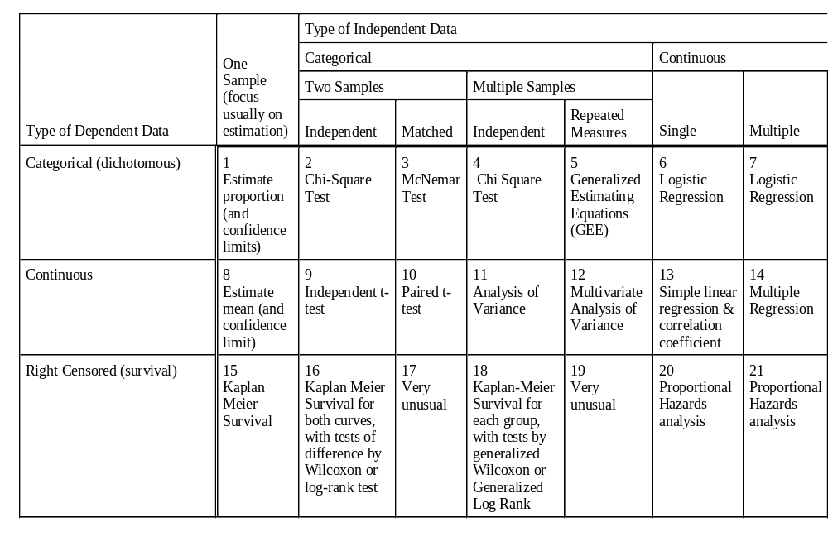
Types of Statistical Tests and Approaches
2
Chi-Square Test
Gender and hypertension
13
Simple Regression
Age & SBP

Slide 55
Conclusions
Most of statistics is common sense
Two main activities
  Estimation
  Hypothesis Testing
Accounting for confounders is a major task
  Epidemiology
    Matching (case/control only)
    Multivariate statistics
  Randomized clinical trial (gold standard since it works for known and unknown confounders)
Selection of “tools” depends on the data type, function, and repeated nature of variables
  Regardless of the tool, there are frequently both tests and estimates of the magnitude of the effect
Get to know a statistician

