Slide 1
Introduction to Biostatistics/Hypothesis Testing
Brian Healy, PhD

Slide 2
Course objectives
Introduction to concepts of biostatistics
  Type of data
  Hypothesis testing
  p-value
  Choosing the best statistical test
  Study design
  When you should get help
Statistical thinking, not math proofs

Slide 3
Office hour
Tuesday 9-11 in Room 2.140 of the Simches building
If you plan to come, please email me (bchealy@partners.org) with a brief description of your data so that I can prepare

Slide 4
Beyond the scope
Tutorial for a specific statistical package
  I will show output from some packages (STATA, SAS, GraphPad)
Topics that will be mentioned, but not focused on
  Mixed models
  Principal components analysis
  ROC curves

Slide 5
Class objectives
Introduction to biostatistics
  Stages of a research study
  Types of data
  Hypothesis test
  t-test
  Wilcoxon test
Questions and requests for next time

Slide 6
Research study
Study design
  Experimental question- What are you trying to learn? How will you prove this?
  Sample selection- Who are you going to study?
Data collection
  What should be collected?
Analysis of data
  Results- Was there any effect?
  Conclusions- What does this all mean? To whom do results apply?

Slide 7
How is statistics related to each stage?
Study design
  Experimental question- Define outcome, sources of variability, unit and analysis plan
  Sample selection- Sample size, type of sample
Data collection
  What to collect?
Analysis of data
  Results- Hypothesis test
  Conclusion- Significance of effect/generalizability

Slide 8
Experimental question: What? How?
Sample selection: Who? How many?
Collect Data
Analysis: Is there an effect?
Conclusion: To whom?

Slide 9
Example
Multiple sclerosis is a progressive neurological disorder
We would like to find treatments that help patients
Unfortunately, it is very difficult to determine a patient’s disease course because there are many things going on
How do we measure the change in the disease?
What is the outcome?

Slide 10
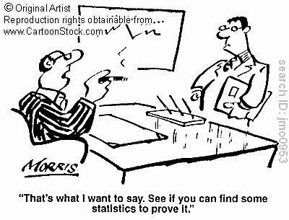

Slide 11
Outcome variables
An outcome variable is dependent variable of interest
The common outcome variables in MS experiments are:
  Expanded disability status scale (EDSS)-ordinal measure of disease severity
  Presence/absence of disease progression
  Expression a cytokine of interest (ex. IFN-γ)
  Time to next relapse

Slide 12
Types of variables
Continuous variable: Age, expression level
Dichotomous variable: Dead/alive, Wild type/mutant
Categorical variable: Race, nominal scales
Ordinal variable: Mild/Moderate/Severe, level of stat knowledge
Count outcomes: Number of lesions
Time to event outcome: Time to death

Slide 13
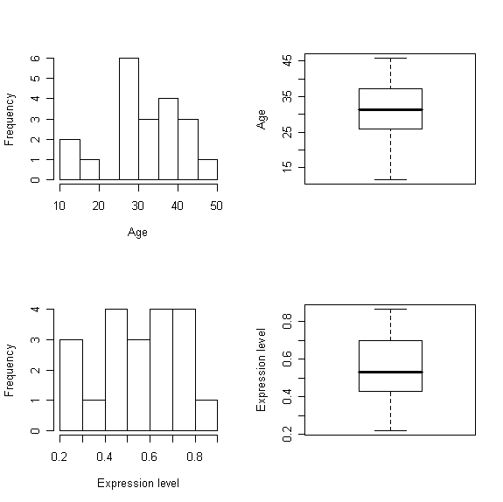
Continuous variables
Summary statistics
  Location
    Mean
    Median
  Variability
    Standard deviation
Graphs

Slide 14
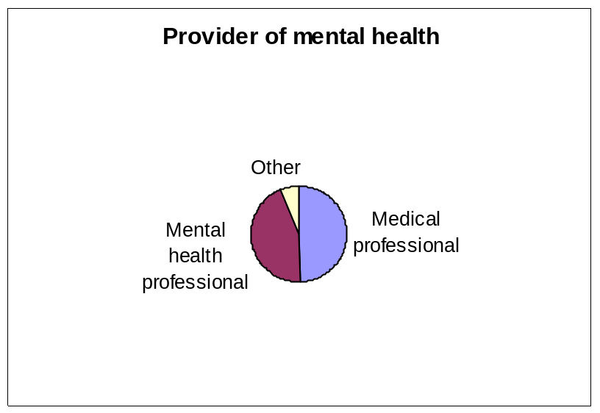
Dichotomous variables
Summary statistics
  Table
  Proportion
Graph
 | Male | Female
Number | 20 | 30
Percent | 40 | 60
Categorical variables
Summary statistics:
  Table
  Proportion
Graphs

Slide 15
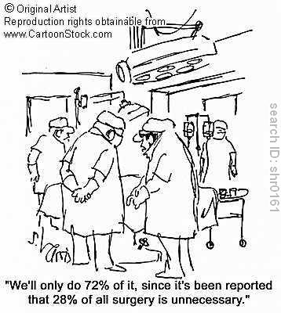
Is this the correct interpretation?

Slide 16
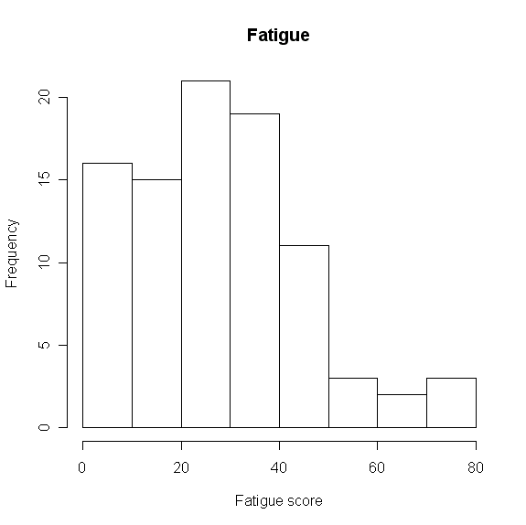
Ordinal variable
Summary statistics
  Mean- may be appropriate for scales or questionnaires
  Ordered table- appropriate for ordered categories with uncertain difference in magnitude
  Rank
 | Mild | Moderate | Severe
Number | 14 | 15 | 4

Slide 17
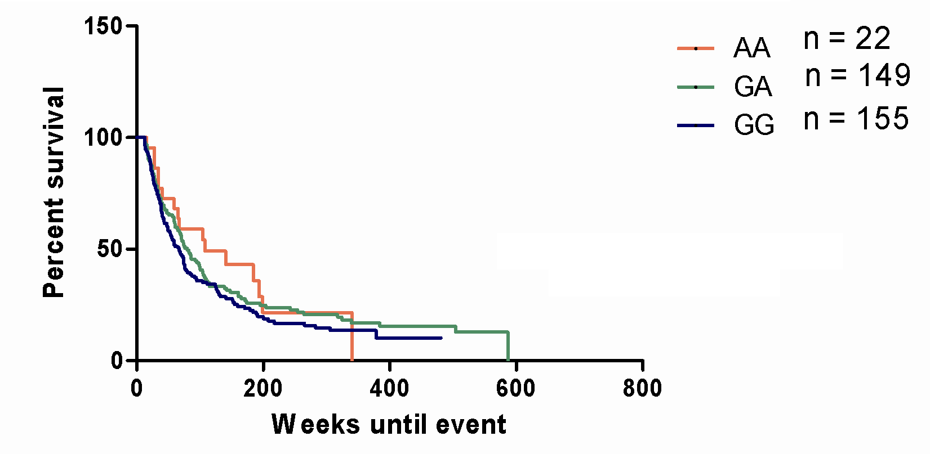
Time to event
Survival time
  Median
Graph
  Kaplan-Meier curve

Slide 18
Description vs. comparison
In many instances, description of the outcome variable is the focus
  Estimate and confidence interval
Based on results from survey, description is not enough, rather comparison is of interest
What do we need for comparison?
  Second variable-usually called explanatory variable

Slide 19
Explanatory variables
Explanatory variables are the independent variables that we believe affect the outcome variables in some way
In MS clinical studies, this can be
  Presence of disease
  Intervention/treatment (clinical trial)
  Genotype
  Expression of another cytokine
  Time

Slide 20
Types of analysis-independent samples
Outcome | Explanatory | Analysis
Continuous | Dichotomous | t-test, Wilcoxon test
Continuous | Categorical | ANOVA, linear regression
Continuous | Continuous | Correlation, linear regression
Dichotomous | Dichotomous | Chi-square test, logistic regression
Dichotomous | Continuous | Logistic regression
Time to event | Dichotomous | Log-rank test

Slide 21
Comparison of two groups
Question: Is the expression of CD-26 different in relapsing MS patients compared to progressive MS patients?
What is the outcome?
  We measure CD-26 using flow cytometry
  Continuous variable
What is the explanatory variable?
  Group membership (relapsing vs. progressive)
  Dichotomous variable
How would you answer this question?
  Collect a sample from each group

Slide 22
Results
Mean values:
  Relapsing patients=34.6
  Progressive patients=41.8
The progressive patients had greater production, but are we certain that there is a difference between these?
  Statistically significant
  Clinically meaningful
What is the variability in the data?

Slide 23
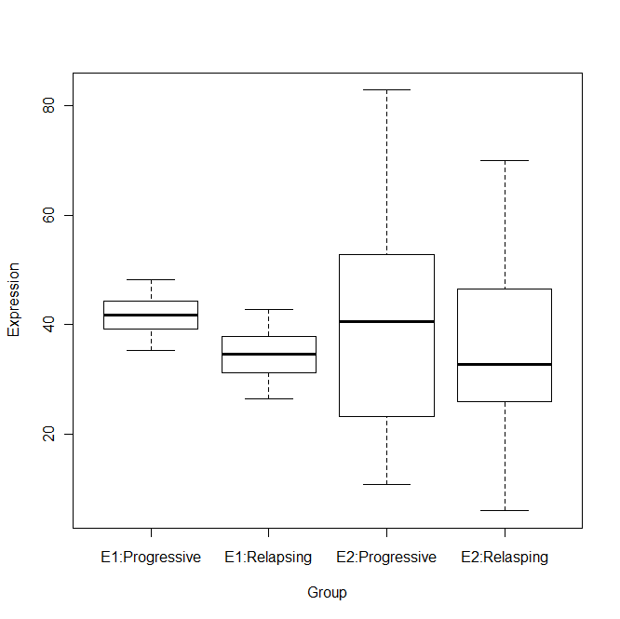
Means in two groups are the same in both experiments
Is there a difference in Experiment 1?
In Experiment 2?
Hypothesis test
Experiment 1
Experiment 2

Slide 24
Reasons for differences between groups
Actual effect-when there is a difference between the two groups
Chance
Bias
Confounding
Statistical tests are designed to determine if the observed difference between the groups was likely due to chance

Slide 25
Chance experiment
Experiment: I flip a coin
  If heads, I win $1
  If tails, you win $1
What if the following happened?
  2 heads in a row
  5 heads in a row
  15 heads in a row
Are you suspicious?

Slide 26
Null hypothesis
In all experiments, we have an initial belief
  In coin example, you believed that there was a 50/50 chance of heads
We always set up our null hypothesis so that we can reject the null hypothesis.
For our study, the null hypothesis is that the mean in the relapsing MS patients is the same as the mean in the progressive MS patients.

Slide 27
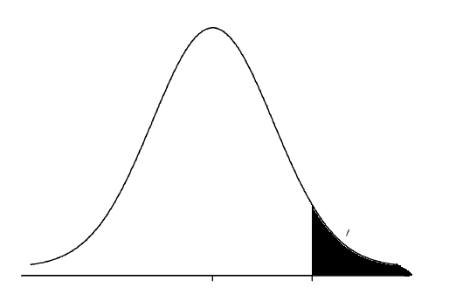
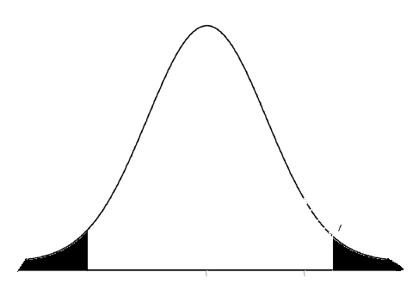
What is rare enough?
This curve is the distribution of the statistic under the null hypothesis
If the observed value is sufficiently rare under the null, we reject the null hypothesis
0.05 corresponds to a 1 out of 20 chance
0.05
0.05

Slide 28
P-value
Definition: the probability of the observed result or something more extreme under the null hypothesis
If the probability of the event is sufficiently small, we say that the difference is likely not due simply to chance and we have an actual effect.
If p-value is small enough, we call the effect statistically significant

Slide 29
What if p>0.05?
In this case, the difference between the groups is not statistically significant (at the 0.05 level).
“If two values are not significantly different, then by definition are they not identical?”
  No
  The two groups are not significantly different, but we cannot say that they are the same
  We fail to reject the null hypothesis; we do not accept that the null is true
  Bayesian statistics

Slide 30

Bias
Is there something in my design that led to my result?

Slide 31
Steps for hypothesis testing
State null hypothesis
State type of data for explanatory and outcome variable
Determine appropriate statistical test
State summary statistics if possible
Calculate p-value (stat package)
Decide whether to reject or not reject the null hypothesis
  NEVER accept null
Write conclusion

Slide 32
Example
H₀: mean_{relapsing} =mean_{progressive}
Explanatory: group membership- dichotomous
Outcome: cytokine production-continuous
What test can we use to compare a continuous outcome with a dichotomous explanatory variable?

Slide 33
Two sample t-test
A two sample t-test is a test for differences in means in two samples.
Assumption: Underlying population distribution is normal
The method of calculating the p-value is beyond the scope of this class, but it is easily found on-line
Can get p-value from statistical package

Slide 34
Results
mean_{relapsing} =34.6, mean_{progressive}=41.8
Calculate p-value:
Two Sample t-test
t = -1.19, df = 22.8, p-value = 0.25
95 percent confidence interval: (-5.3, 19.7)
Fail to reject the null hypothesis because p-value is less than 0.05
Conclusion: The difference between the groups is not statistically significant.

Slide 35
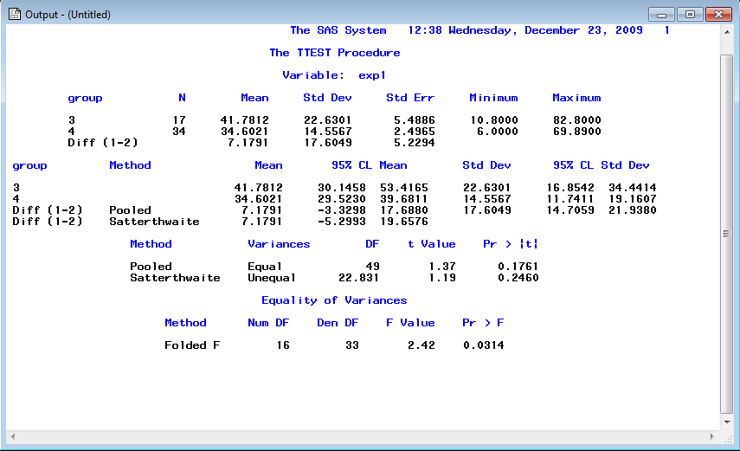
summary statistics
p-value

Slide 36
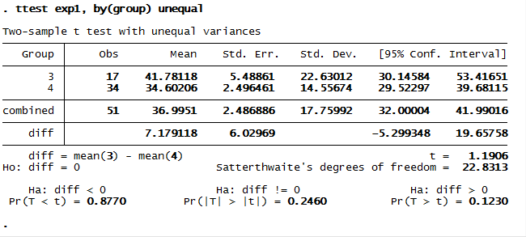
summary statistics
p-value

Slide 37
Significant difference in experiment 1
Added variance in experiment 2 led to non-significant result
What does this mean?
Experiment 1
Experiment 2
p=0.25
p<0.0001

Slide 38
Types of analysis-independent samples
Outcome | Explanatory | Analysis
Continuous | Dichotomous | t-test, Wilcoxon test
Continuous | Categorical | ANOVA, linear regression
Continuous | Continuous | Correlation, linear regression
Dichotomous | Dichotomous | Chi-square test, logistic regression
Dichotomous | Continuous | Logistic regression
Time to event | Dichotomous | Log-rank test

Slide 39
Example
Experimental Autoimmune Encephalomyelitis (EAE) in mice is the animal model for multiple sclerosis (MS)
The effect of various interventions are first tested in mice
A common hypothesis is that treating mice with a specific intervention will either inhibit or promote the disease
How do we measure the change in the disease?
What is the outcome?

Slide 40
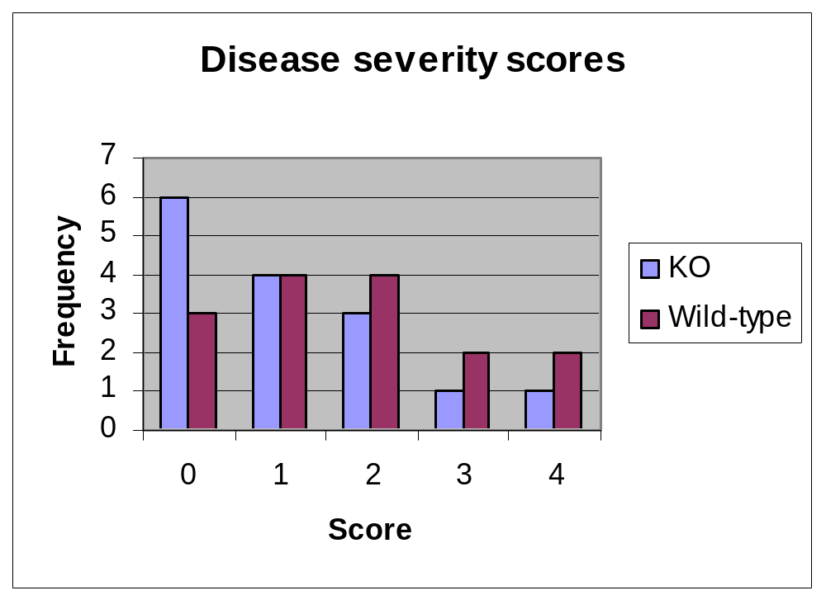
Monkey wrench
What if underlying data is not normal?
An outcome in an EAE study is the disease grade, which is an ordinal scale

Slide 41
Wilcoxon rank sum test
Wilcoxon rank sum test is a nonparametric test that allows group comparison if
  Ordinal data
  Rank data
  Underlying data are non-normal
  Outliers
Steps for hypothesis test using a Wilcoxon test are exactly the same

Slide 42
Hypothesis test
H₀: median_{KO} =median_{Wild type}
Predictor: dichotomous
Outcome: ordinal
Test: Wilcoxon rank sum test
Median_{KO}=1; Median_{Wild type}=2
Calculate p-value: p = 0.19
Fail to reject null hypothesis
There is not significant evidence of a difference between the two groups

Slide 43
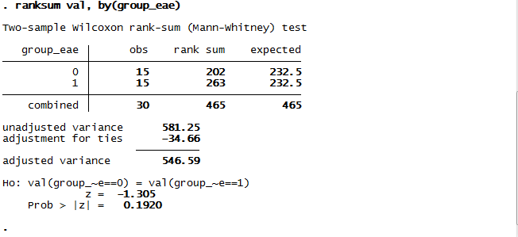
p-value

Slide 44
Dependent observations
Up to now we have assumed that observations are independent
What if we have related observations?
  On and off treatment on the same subject
  Left and right eye from the same subject
  Multiple observations over time
The big advantage of dependent observations is the same subject is observed under multiple conditions
Independent tests fail to account for correlation

Slide 45
Example
In MS patients, the intensity of areas of the brain on T1-weighted MRI are of interest to determine if there is damage
In particular, the intensity of the putamen of left and right side of the brain was measured in 35 MS patients
We believed that there would be more significant hypointensity in the left side

Slide 46
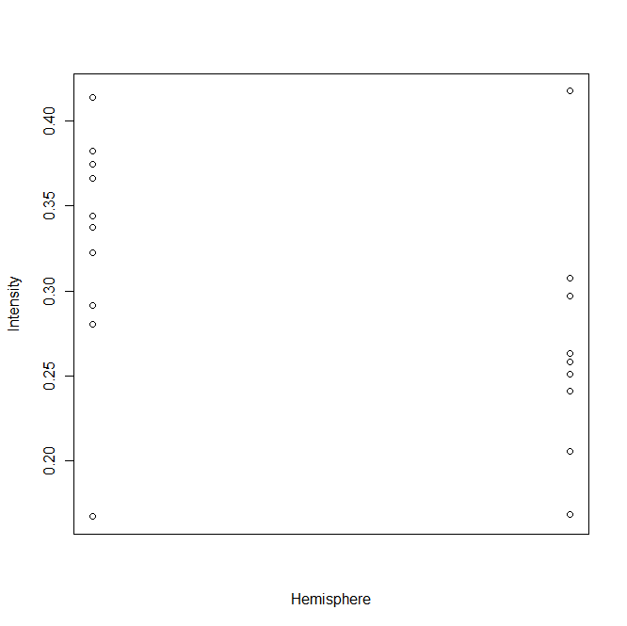
There may a difference between the groups
Are we interested just in the mean at each time point?

Slide 47
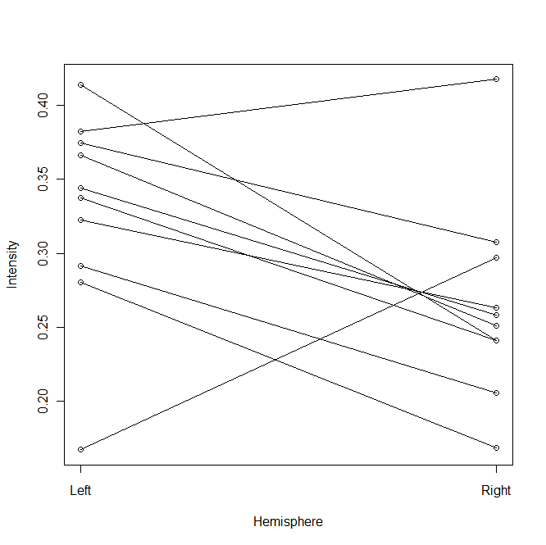
The difference between the time points is the outcome
Is the difference significantly different from 0?

Slide 48
Hypothesis test
H₀: mean_{left}=mean_{right}
Paired continuous data with side as explanatory variable
Paired t-test
Mean difference=0.063
p-value=0.046
Since the p-value is less than 0.05, we can reject the null hypothesis
We conclude that the intensity is unequal in the two sides of the brain

Slide 49
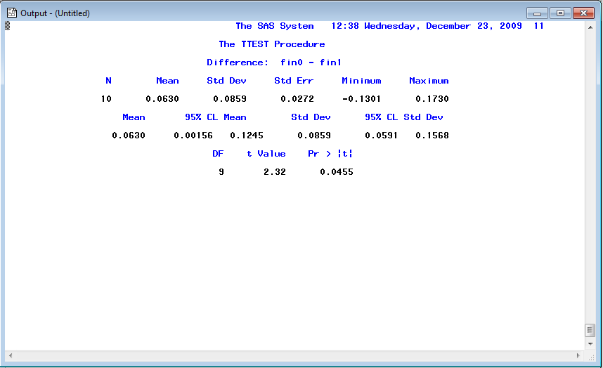
p-value

Slide 50
Types of analysis-dependent samples
Outcome | Predictor | Analysis
Continuous | Dichotomous | Paired t-test, Wilcoxon signed rank test
Continuous | Categorical | Repeated measures ANOVA
Continuous | Continuous | Mixed model
Dichotomous | Dichotomous | McNemar’s test
Dichotomous | Continuous | Repeated measures logistic regression

Slide 51
Other dependent samples
Continuous outcome/categorical explanatory variable
  Subject is measured under three conditions
  Subject is measures at three time points

Slide 52
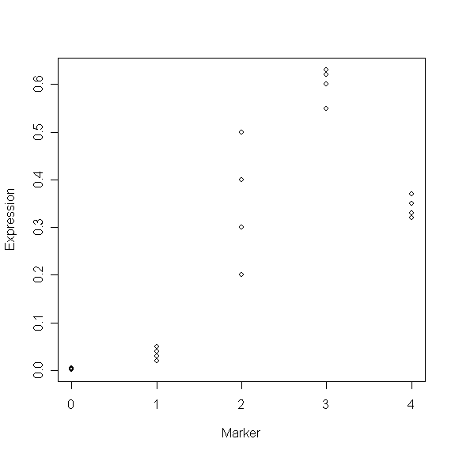
Each dot represents an observation for a mouse at each of the markers
There was a negative control in this experiment (Group = 0)

Slide 53
What should we do?
What is the hypothesis?
  Is the expression of any of the markers different than the control?
Repeated measures ANOVA/mixed model
  Can proceed with normal hypothesis test
Must always think about assumptions of model
  Do we have equal variance?
Consult a statistician

Slide 54
Why use dependent samples?
Sometimes it is required based on the study
Often can increase power depending on the outcome because one major source of variability is accounted for
  Changes over time
Consult a statistician if you want to determine the best study design

Slide 55
Helpful website
http://www.ats.ucla.edu/stat/stata/whatstat/default.htm
Shows how to complete many of these analyses in various statistical packages

Slide 56
What we learned (hopefully)
Using your outcome and predictor to determine the correct analysis
p-value
T-test
Wilcoxon test

