Slide 1
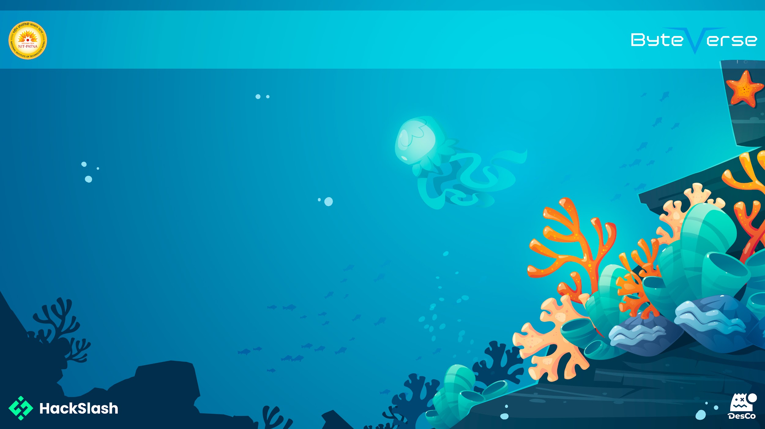
Basic Details of the Team
and Problem Statement
Problem Statement: Design a college website that provides easy access to resources, information, and services for the college community.
Team Name: VICTOR-X
Institute Name: NIT PATNA
Theme Name:

Slide 2

Idea/Approach Details
Describe your Use Cases here:
Information about courses, admissions, and faculty.
Access to library resources and online learning platforms.
News, announcements, and campus events.
Contact forms and social media links.
Student portal for grades, course materials, and online applications.
Payment gateway for tuition fees and other payments.
Describe your Dependencies/ Show Stopper here:
Server uptime and reliability
Internet connectivity
Content accuracy and updates
User-friendly interface
Cybersecurity measures
Regular maintenance and technical support

Slide 3

Idea/Approach Details
Describe your idea/Solution/Prototype here:
The college website provides a centralized platform for students, faculty, and staff.
A user-friendly interface enhances the overall user experience.
The website offers various resources, including course management and career services.
A single sign-on system streamlines access to college services.
The website's event calendar keeps users informed about important dates and events.
Describe your Technology stack here:
HTML
CSS
JavaScript

Slide 4
Team Member Details
Team Leader Name: RAJ
Branch (Btech/BCA etc): Btech Stream (ECE, CSE etc): CSE Year (I,II,III,IV): I
Team Member 1 Name: Abhinav
Branch (Btech/BCA etc): Btech Stream (ECE, CSE etc): CSE Year (I,II,III,IV): I
Team Member 2 Name: Varshneya
Branch (Btech/BCA etc): Btech Stream (ECE, CSE etc): CSE Year (I,II,III,IV): I

