Slide 1

Predicting Employee rate AND Attrition
Jon Paugh – Doing DATA SCIENCE – DS 6306 – FALL 2019

Slide 2
Data PROVIDED and GOALS
CaseStudy2-data.csv (Training data) – 870 rows of employee data, with all fields including Attrition and MonthlyRate
CaseStudy2CompSet No Salary.xlsx – 300 rows of employee data, no salary (MonthlyRate field).
Predict the Salary(MonthlyRate field, numeric).
CaseStudy2CompSet No Attrition.csv – 300 rows of employee data, no attrition. Identify top 3 factors that contribute to turnover. Predict the attrition (Yes/No)
All 3 data files have the same columns, except for the lack of Attrition of MonthlyRate fields as noted.

Slide 3
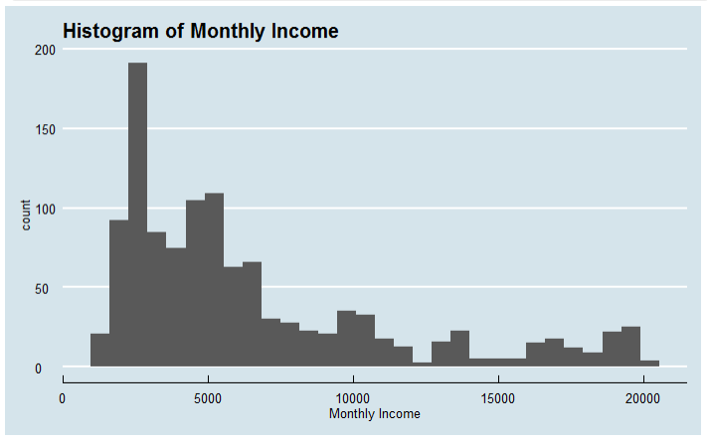
Predict Monthly Rate
Use data from the training data set + the “predict attrition” dataset.
Minimum goal : RMSE < $3000
Competition goal : Minimize RMSE
Mean = $6573

Slide 4
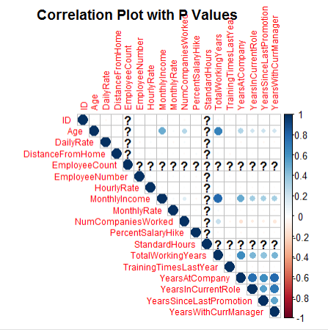
Exploratory Data ANALYSIS, Monthly Rate
Correlation Plot for full Training data combined with the “No Attrition” data. What is the correlation with MonthlyRate (numeric fields only)?
High Correlation | Medium Correlation | Light Correlation
Total Working Years | Age | Years In Current Role
 | Years At Company | Years Since Last Promotion
 |  | Years With Current Manager

Slide 5
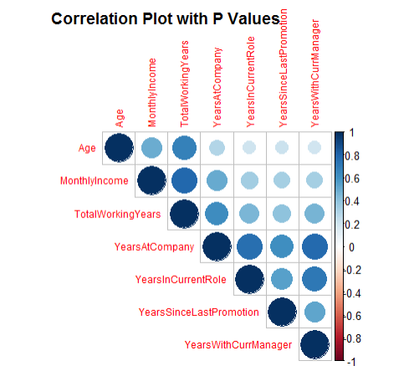
Age and Year Related Variables are correlated

Slide 6
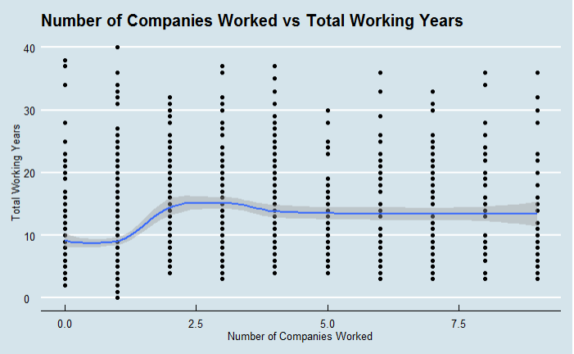
Total number of companies by total working years

Slide 7
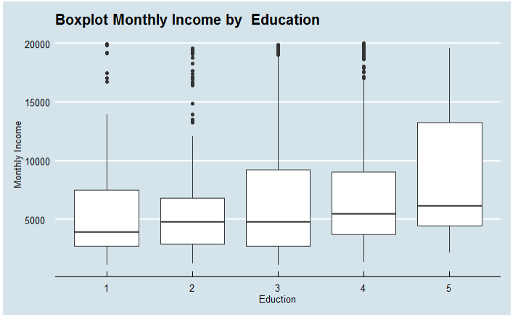
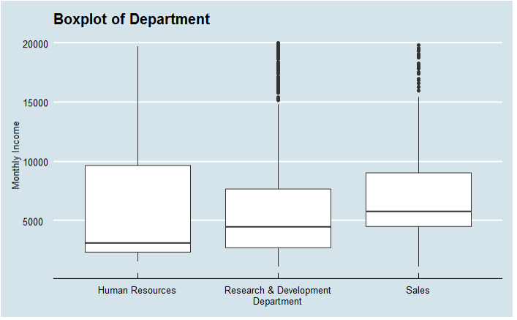
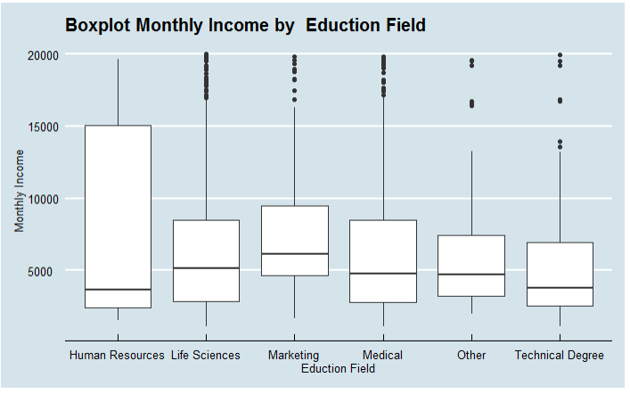
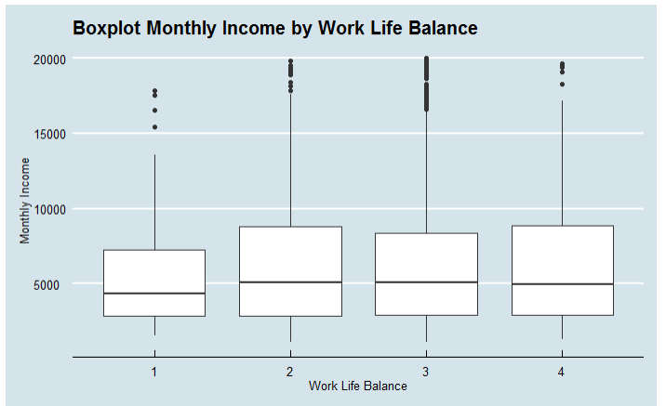
Categorical variables correlation with monthly Rate

Slide 8
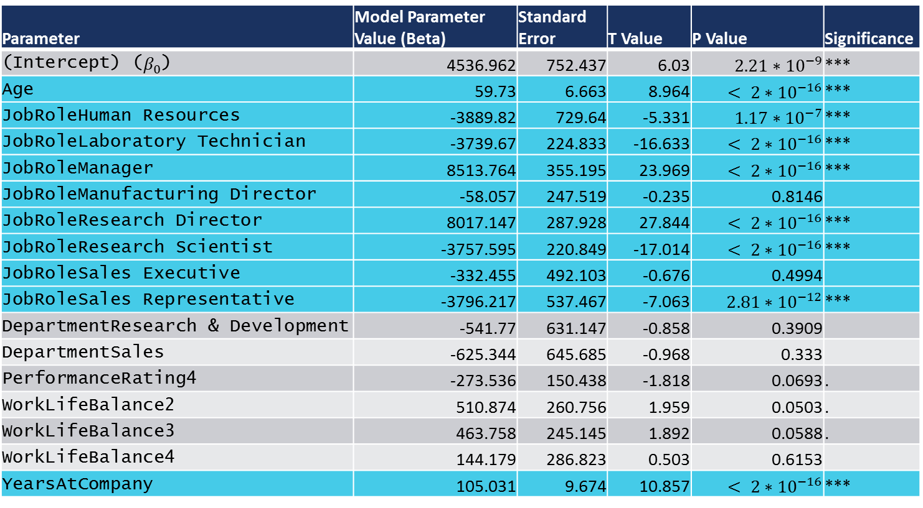
Linear MODEL parameters and significance
Parameter | Model Parameter Value (Beta) | Standard Error | T Value | P Value | Significance
(Intercept) ($β_{0}$) | 4536.962 | 752.437 | 6.03 | $$2.21∗{10}^{−9}$$ | ***
Age | 59.73 | 6.663 | 8.964 | $$< 2∗{10}^{−16}$$ | ***
JobRoleHuman Resources | -3889.82 | 729.64 | -5.331 | $$1.17∗{10}^{−7}$$ | ***
JobRoleLaboratory Technician | -3739.67 | 224.833 | -16.633 | $$< 2∗{10}^{−16}$$ | ***
JobRoleManager | 8513.764 | 355.195 | 23.969 | $$< 2∗{10}^{−16}$$ | ***
JobRoleManufacturing Director | -58.057 | 247.519 | -0.235 | 0.8146
JobRoleResearch Director | 8017.147 | 287.928 | 27.844 | $$< 2∗{10}^{−16}$$ | ***
JobRoleResearch Scientist | -3757.595 | 220.849 | -17.014 | $$< 2∗{10}^{−16}$$ | ***
JobRoleSales Executive | -332.455 | 492.103 | -0.676 | 0.4994
JobRoleSales Representative | -3796.217 | 537.467 | -7.063 | $$2.81∗{10}^{−12}$$ | ***
DepartmentResearch & Development | -541.77 | 631.147 | -0.858 | 0.3909
DepartmentSales | -625.344 | 645.685 | -0.968 | 0.333
PerformanceRating4 | -273.536 | 150.438 | -1.818 | 0.0693 | .
WorkLifeBalance2 | 510.874 | 260.756 | 1.959 | 0.0503 | .
WorkLifeBalance3 | 463.758 | 245.145 | 1.892 | 0.0588 | .
WorkLifeBalance4 | 144.179 | 286.823 | 0.503 | 0.6153
YearsAtCompany | 105.031 | 9.674 | 10.857 | $$< 2∗{10}^{−16}$$ | ***

Slide 9
Linear Model for Monthly Income – RMSE estimate
All data (train + no attrition data)
1. Split data into train and test
Training Data
Test Data
2. Train Model
Linear Regression Model
3. Use model to predict MonthlyIncome and calculate RMSE
Average RMSE : 1868.258

Slide 10
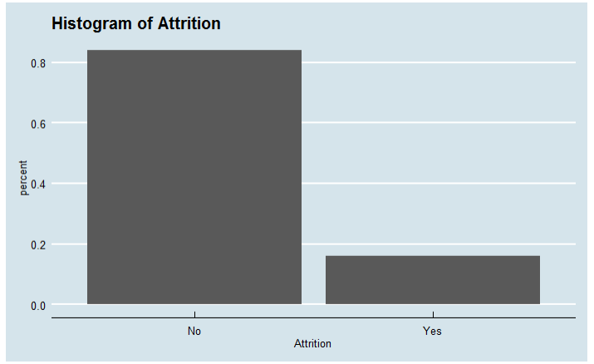
Predict employee attrition
Use data from the training dataset and the “predict monthly income” dataset.
Minimum goal : Sensitivity > 0.60, Specificity > 0.60
Competition goal : Maximize (Sensitivity + Specificity)

Slide 11
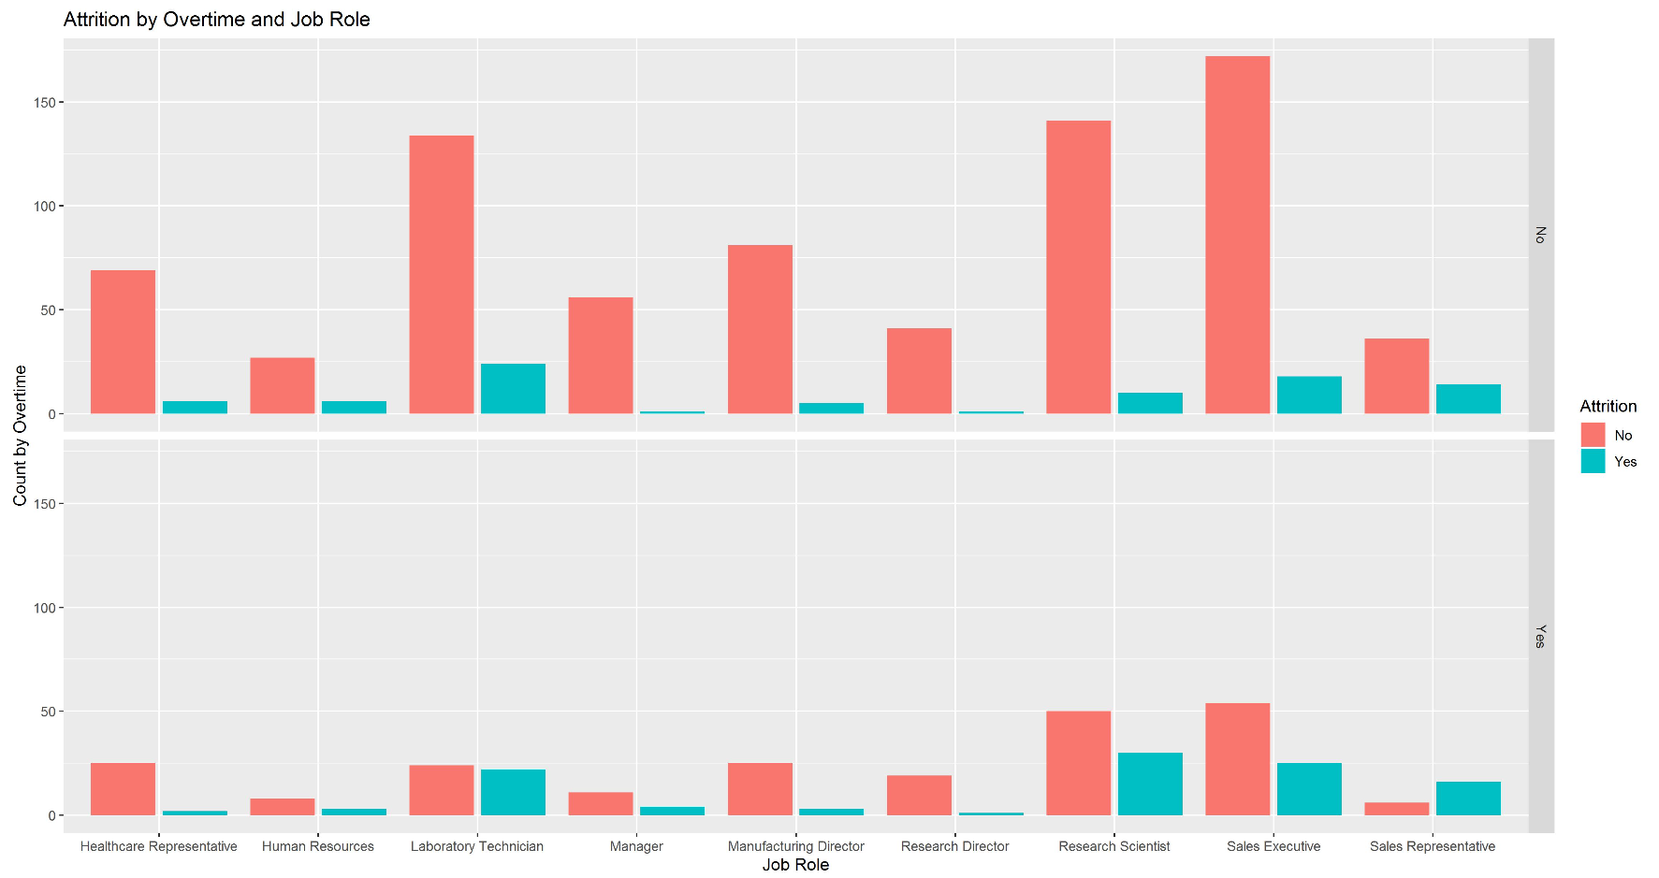
Top 3 factors attrition- 1 Overtime
Overtime = No
Overtime = Yes

Slide 12
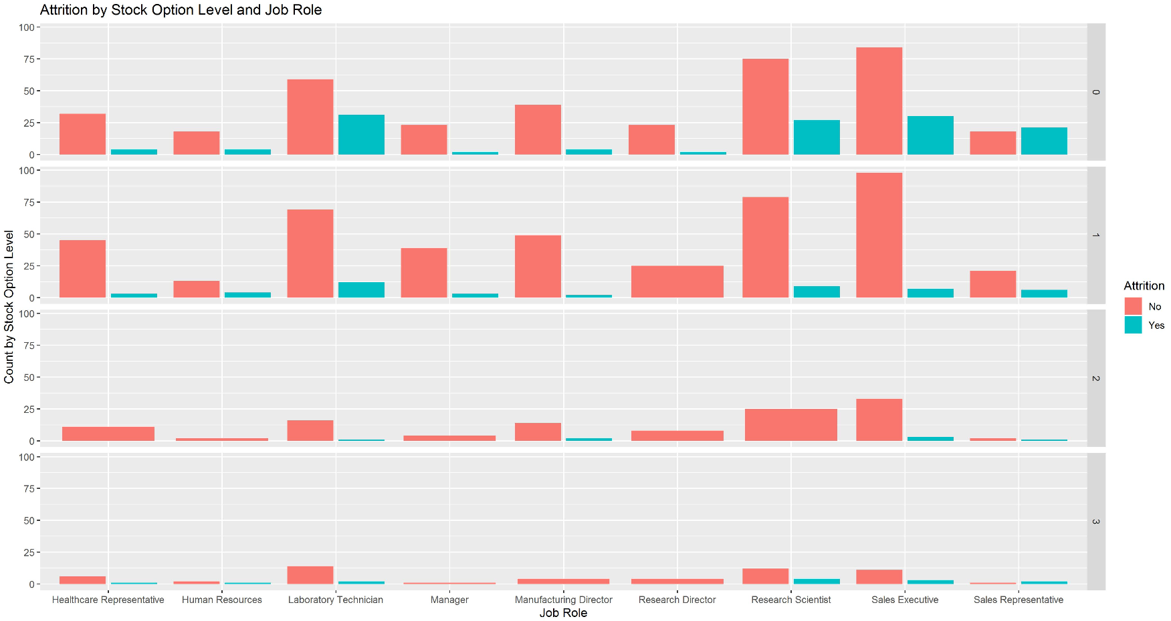
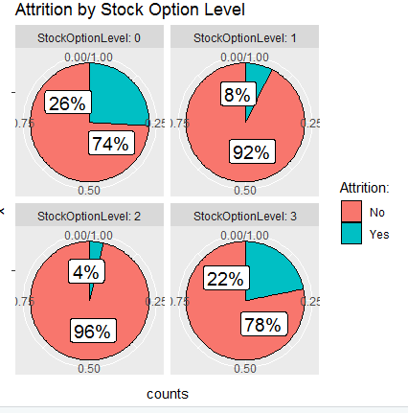
Top 3 factors attrition- 2 Stock Option LeveL
Stock Option Level 0
Stock Option Level 1
Stock Option Level 2
Stock Option Level 3

Slide 13
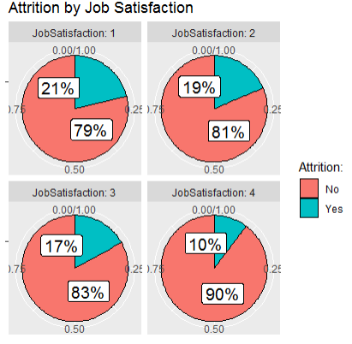
Top 3 factors attrition- 3 Job Satisfaction

Slide 14
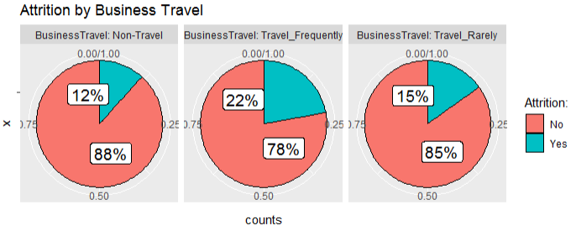
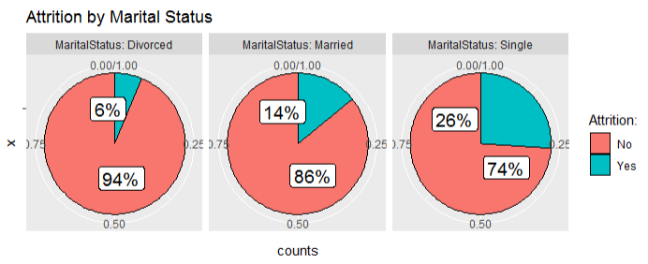
Other factors in attrition

Slide 15
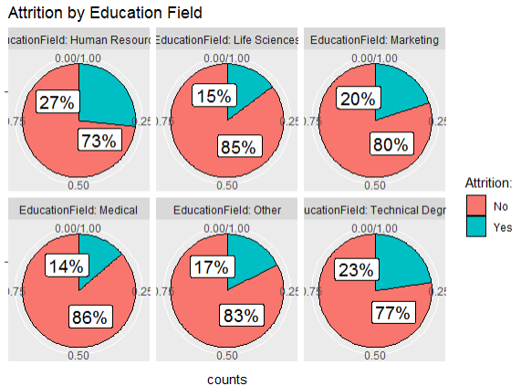
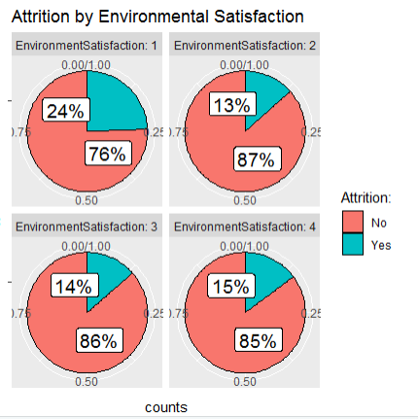
Other factors in attrition

Slide 16
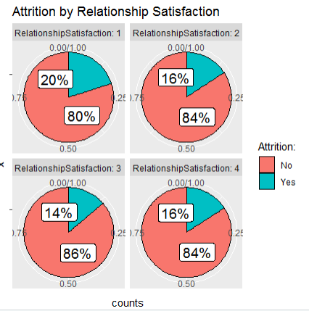
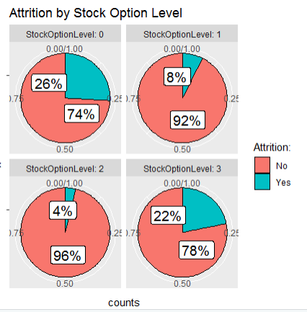
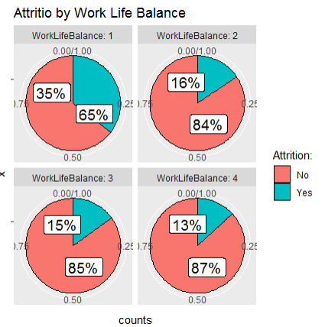
Other factors in attrition

Slide 17
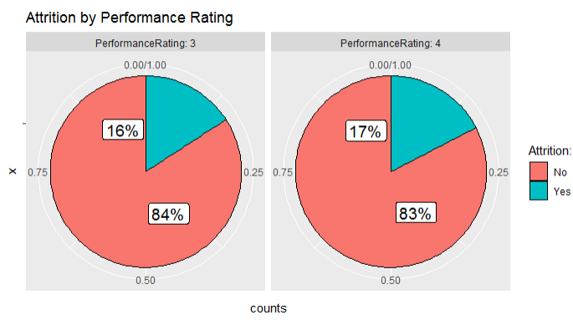
Performance rating is not a factor

Slide 18
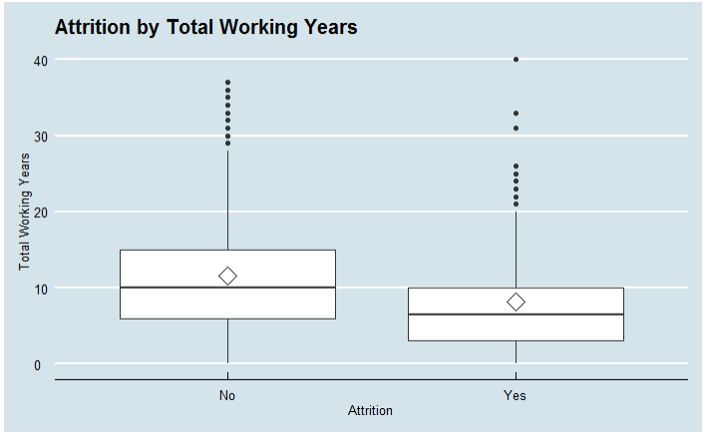
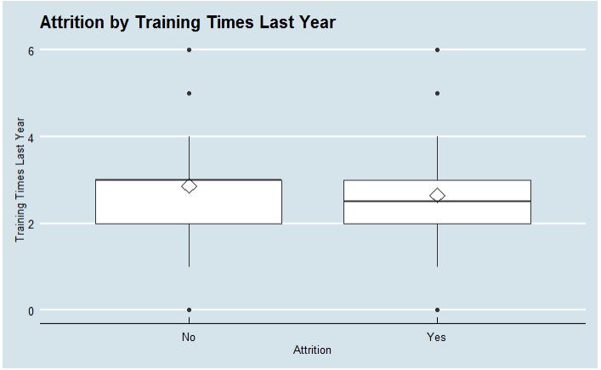
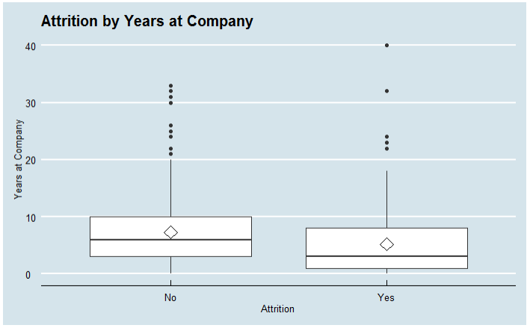
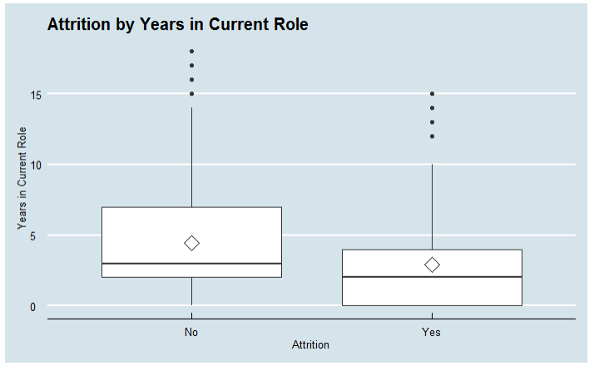
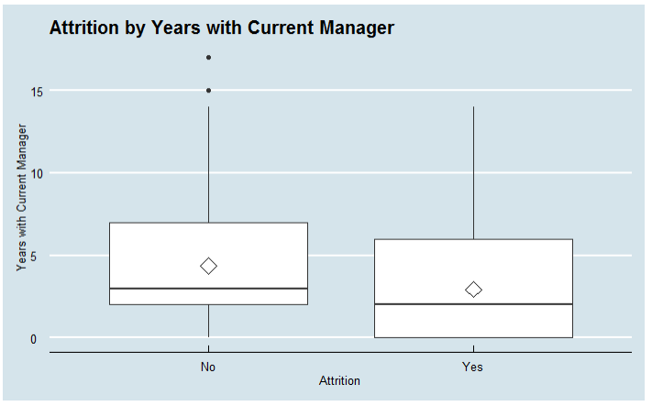
Attrition by numeric variable

Slide 19
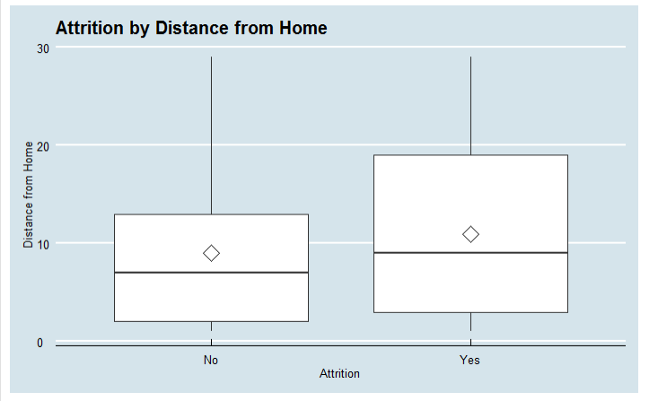
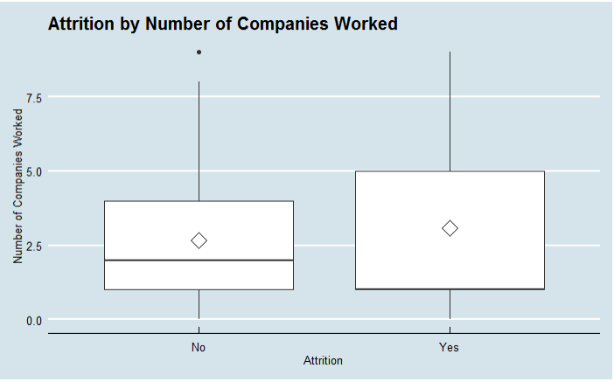
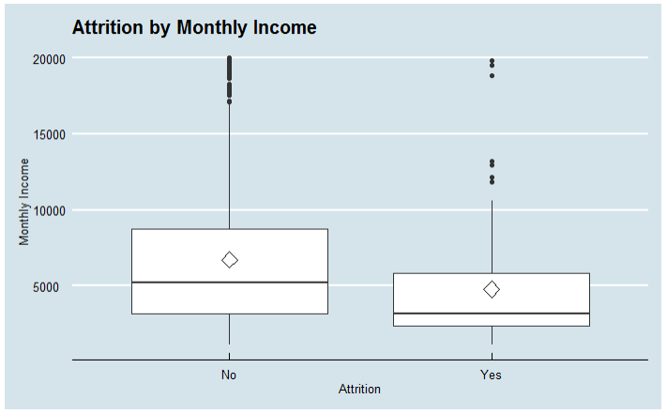
Attrition by numeric variable

Slide 20
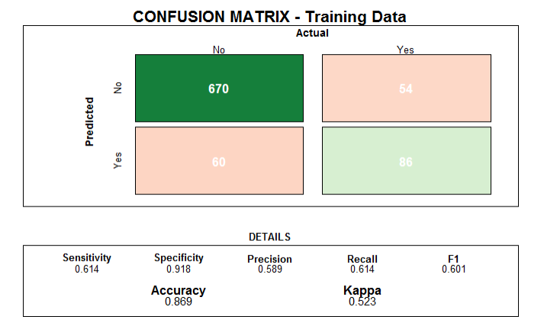
First attempt – predict attrition using naïve bayes model
Validation testing
Average Accuracy : 84.4%
Average Sensitivity : 53.5%
Average Specificity : 90.5%

Slide 21
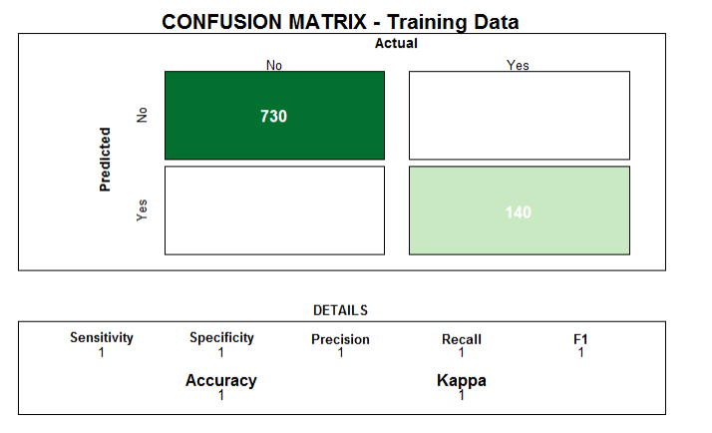
Predict using Random Forest – OVERFITTED!
Validation testing
Average Accuracy : 86.2%
Average Sensitivity : 14.29%
Average Specificity : 100%

Slide 22
Another try – use logistic regression – using AIC
Age | Business Travel | Daily Rate | Distance From Home | Environmental Satisfaction
Gender | HourlyRate | Job Involvement | Job Role | Job Satisfaction
Num Companies Worked | Overtimw | Relationship Satisfaction | Stock Option Level | Train Time Last Year
Work Life Balance | Years At Company | Years In Current Role | Years Since Last Promotion | Years With Current Manager
No Cross Validation

Slide 23
Manual logistic regression model using promising fields
Age | Business Travel | Daily Rate | Distance From Home | Education
Environmental Satisfaction | Hourly Rate | Job Level | Job Role | Num of Companies Worked
Overtime | Stock Option Level | Work Life Balance | Years At Company | Years Since Last Promotion

Slide 24
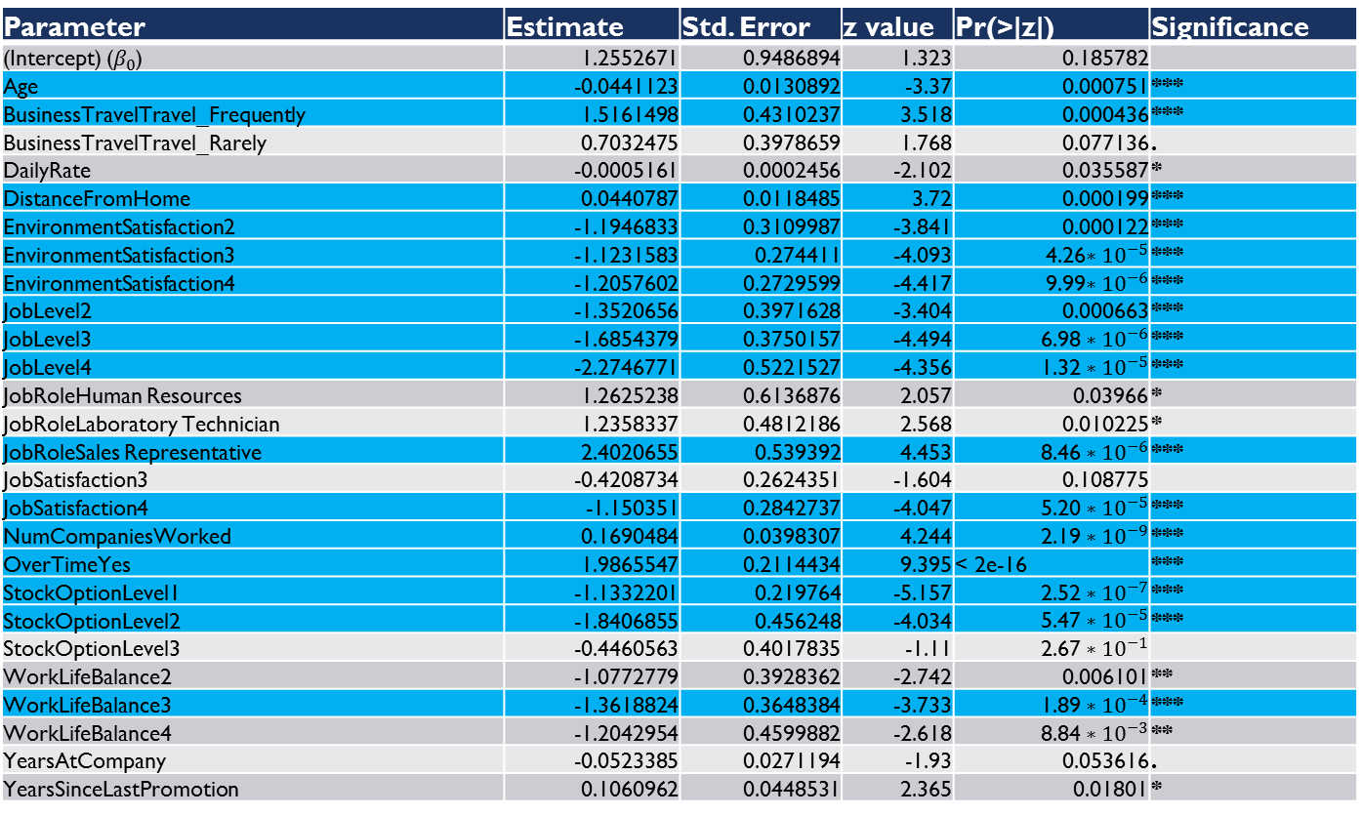
Manual logistic regression - parameters
Parameter | Estimate | Std. Error | z value | Pr(>|z|) | Significance
(Intercept) ($β_{0}$) | 1.2552671 | 0.9486894 | 1.323 | 0.185782
Age | -0.0441123 | 0.0130892 | -3.37 | 0.000751 | ***
BusinessTravelTravel_Frequently | 1.5161498 | 0.4310237 | 3.518 | 0.000436 | ***
BusinessTravelTravel_Rarely | 0.7032475 | 0.3978659 | 1.768 | 0.077136 | .
DailyRate | -0.0005161 | 0.0002456 | -2.102 | 0.035587 | *
DistanceFromHome | 0.0440787 | 0.0118485 | 3.72 | 0.000199 | ***
EnvironmentSatisfaction2 | -1.1946833 | 0.3109987 | -3.841 | 0.000122 | ***
EnvironmentSatisfaction3 | -1.1231583 | 0.274411 | -4.093 | 4.26$∗{10}^{−5}$ | ***
EnvironmentSatisfaction4 | -1.2057602 | 0.2729599 | -4.417 | 9.99$∗{10}^{−6}$ | ***
JobLevel2 | -1.3520656 | 0.3971628 | -3.404 | 0.000663 | ***
JobLevel3 | -1.6854379 | 0.3750157 | -4.494 | 6.98 $∗{10}^{−6}$ | ***
JobLevel4 | -2.2746771 | 0.5221527 | -4.356 | 1.32 $∗{10}^{−5}$ | ***
JobRoleHuman Resources | 1.2625238 | 0.6136876 | 2.057 | 0.03966 | *
JobRoleLaboratory Technician | 1.2358337 | 0.4812186 | 2.568 | 0.010225 | *
JobRoleSales Representative | 2.4020655 | 0.539392 | 4.453 | 8.46 $∗{10}^{−6}$ | ***
JobSatisfaction3 | -0.4208734 | 0.2624351 | -1.604 | 0.108775
JobSatisfaction4 | -1.150351 | 0.2842737 | -4.047 | 5.20 $∗{10}^{−5}$ | ***
NumCompaniesWorked | 0.1690484 | 0.0398307 | 4.244 | 2.19 $∗{10}^{−9}$ | ***
OverTimeYes | 1.9865547 | 0.2114434 | 9.395 | < 2e-16 | ***
StockOptionLevel1 | -1.1332201 | 0.219764 | -5.157 | 2.52 $∗{10}^{−7}$ | ***
StockOptionLevel2 | -1.8406855 | 0.456248 | -4.034 | 5.47 $∗{10}^{−5}$ | ***
StockOptionLevel3 | -0.4460563 | 0.4017835 | -1.11 | 2.67 $∗{10}^{−1}$
WorkLifeBalance2 | -1.0772779 | 0.3928362 | -2.742 | 0.006101 | **
WorkLifeBalance3 | -1.3618824 | 0.3648384 | -3.733 | 1.89 $∗{10}^{−4}$ | ***
WorkLifeBalance4 | -1.2042954 | 0.4599882 | -2.618 | 8.84 $∗{10}^{−3}$ | **
YearsAtCompany | -0.0523385 | 0.0271194 | -1.93 | 0.053616 | .
YearsSinceLastPromotion | 0.1060962 | 0.0448531 | 2.365 | 0.01801 | *

Slide 25
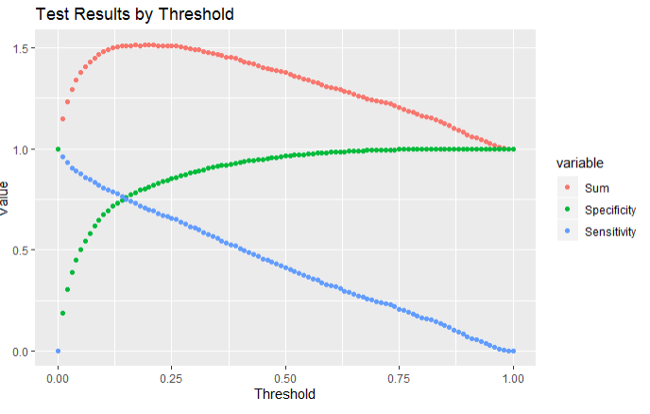
MANual LOGistic Regression - CROSS VALIDATION RESULTS
Using threshold = 0.15. Sensitivity was harder to achieve in other models and likely will suffer most when encountering new data.

Slide 26
Conclusion and Thank you!
Predicting the Monthly Income was straightforward using a linear model. Did not attempt further models.
Predicting the Attrition was more challenging – low sensivitiy in cross-validation across Naïve Bayes, Random Forest models
Could be because most employees do not leave? Data is unbalanced?
Using a logistic regression model allows you to tune the model by setting the threshold, was useful here
Further work – are there other classification algorithms that allow tuning to balance sensitivity and specificity? Could also try using 50/50 mix of Attrit=Yes and Attrit=No.

Slide 27
Additional unused slides follow

Slide 28
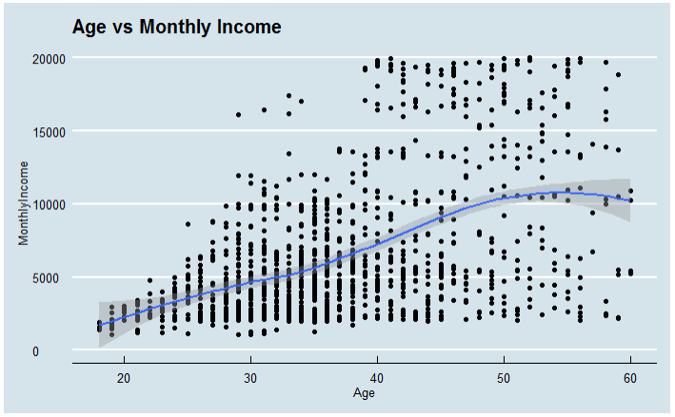
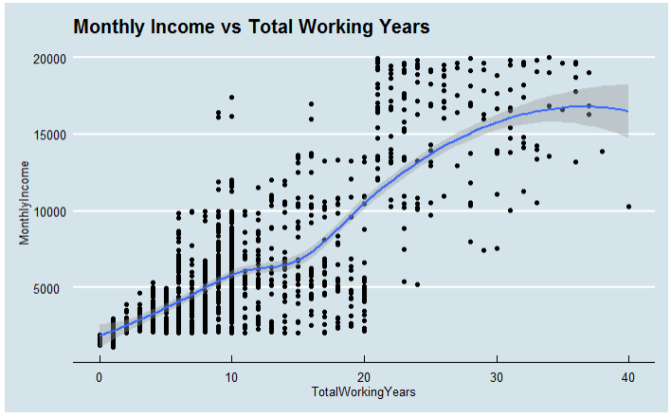
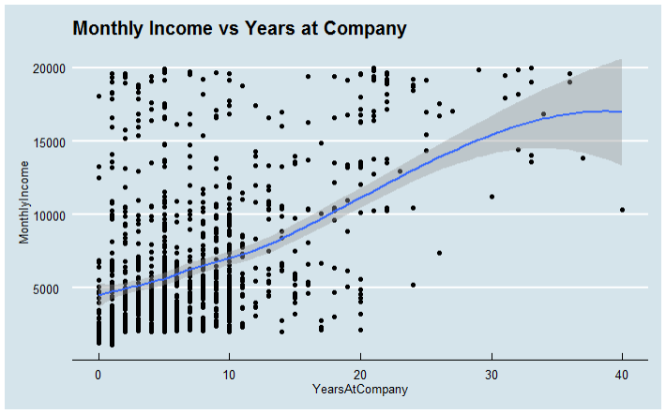
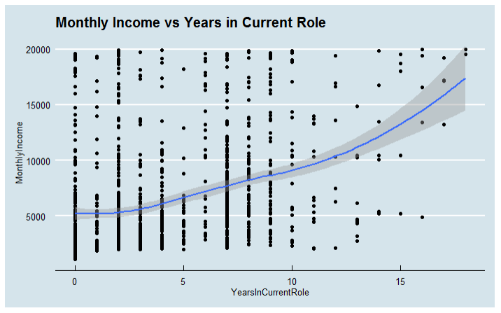
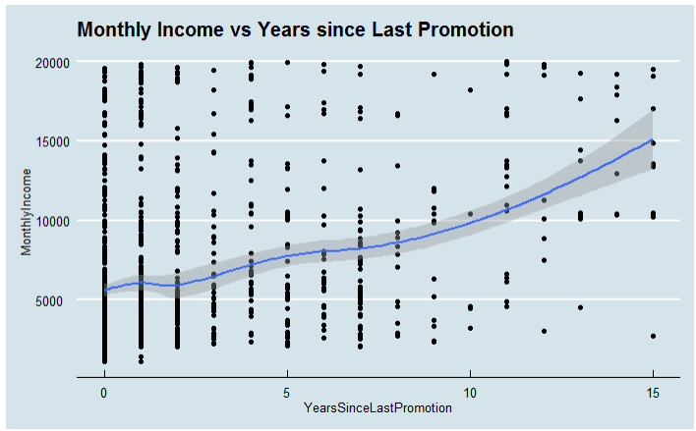
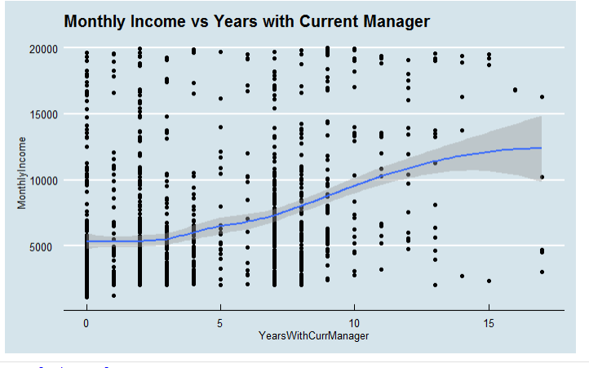
Numeric variables correlation with monthly Rate 2

Slide 29
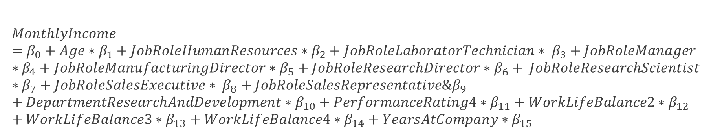
Predict Monthly Rate – Linear model
Use fields to predict : Age, JobRole, Department, PerformanceRating, WorkLifeBalance, YearsAtCompany
$$MonthlyIncome=β_{0}+Age∗β_{1}+JobRoleHumanResources∗β_{2}+JobRoleLaboratorTechnician∗ β_{3}+JobRoleManager∗β_{4}+JobRoleManufacturingDirector∗β_{5}+JobRoleResearchDirector∗β_{6}+ JobRoleResearchScientist∗β_{7}+JobRoleSalesExecutive∗ β_{8}+JobRoleSalesRepresentative\&β_{9}+DepartmentResearchAndDevelopment∗β_{10}+PerformanceRating4∗β_{11}+WorkLifeBalance2∗β_{12}+WorkLifeBalance3∗β_{13}+WorkLifeBalance4∗β_{14}+YearsAtCompany∗β_{15}$$

