Slide 1
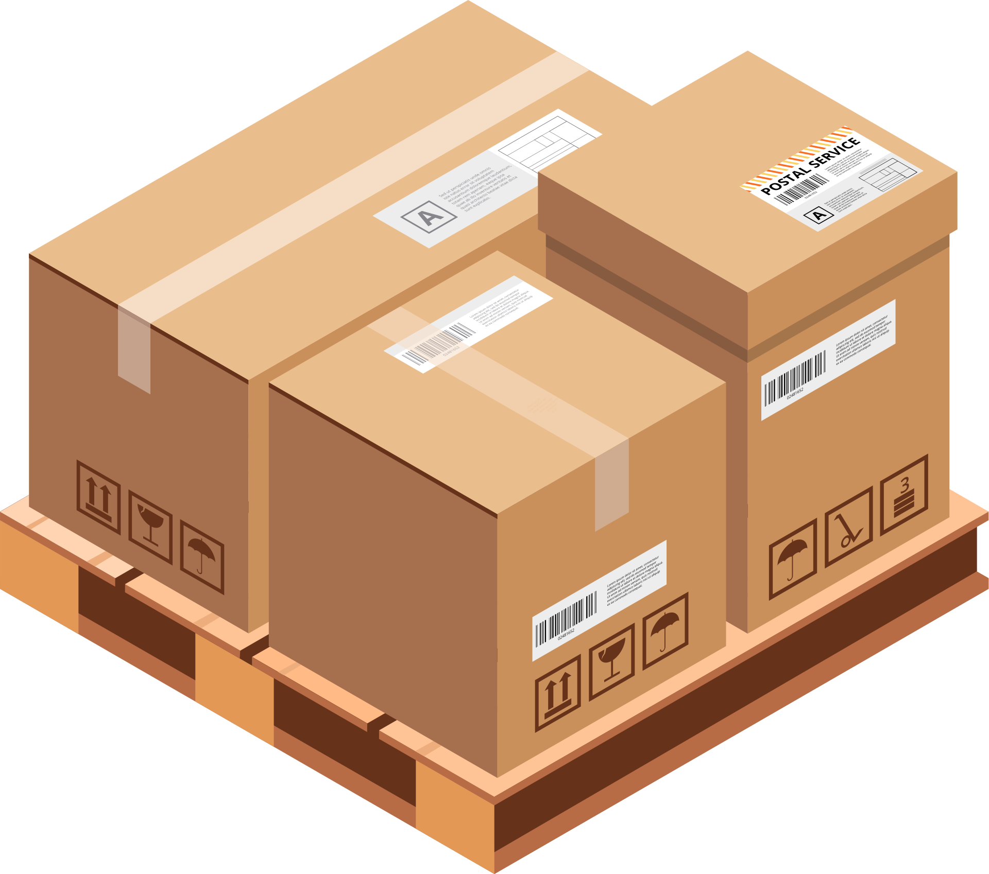
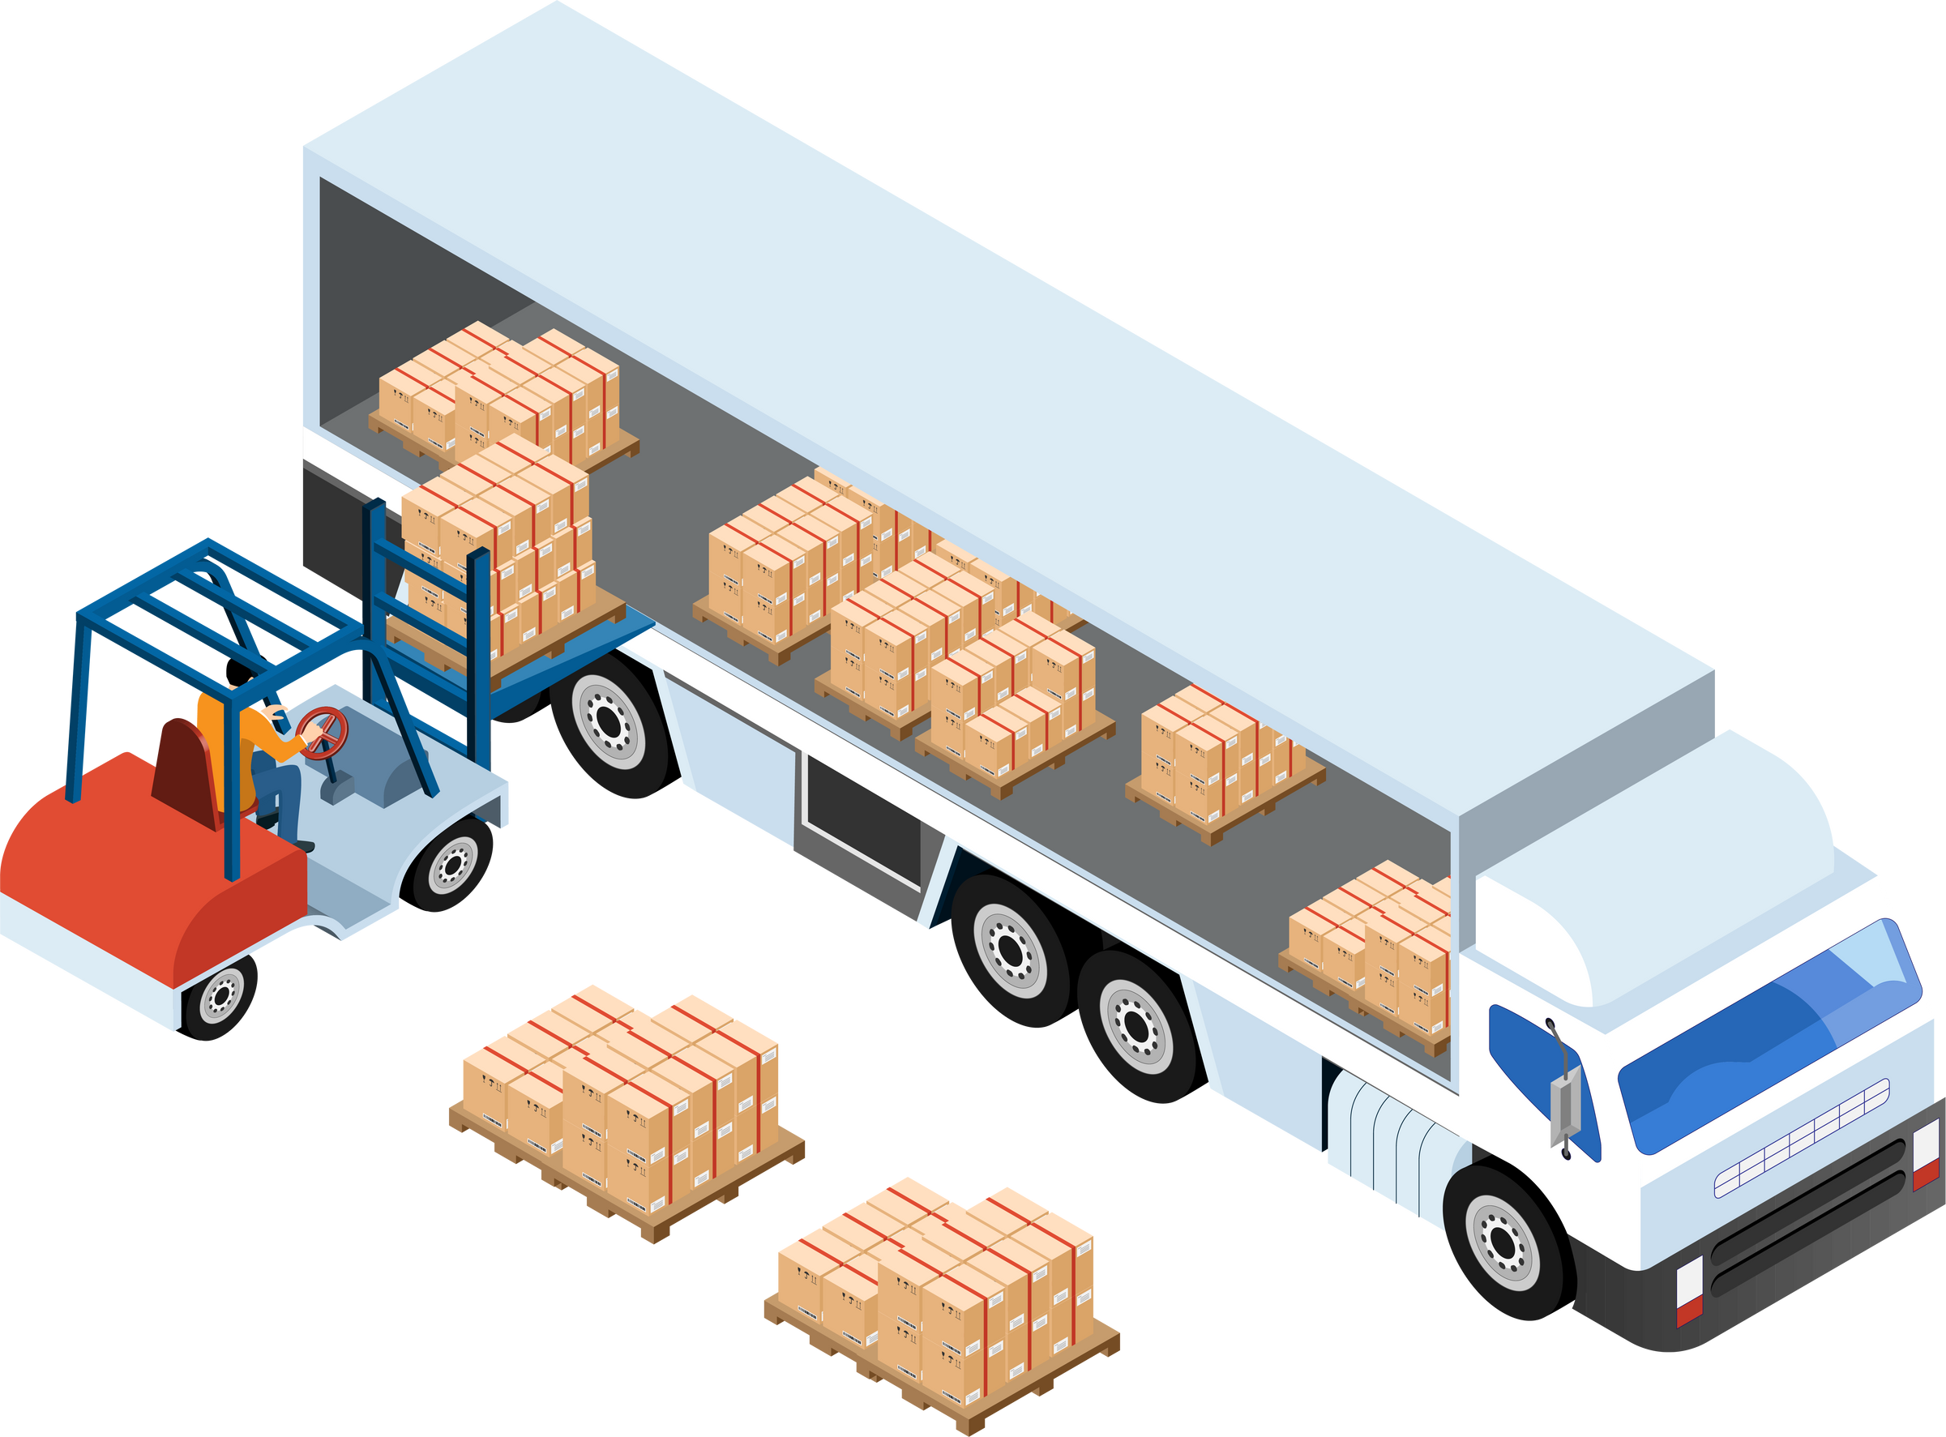
SectorCT
WayPoint
@sector_ct
WAY
POINT
The Seamless Movement of Goods

Slide 2

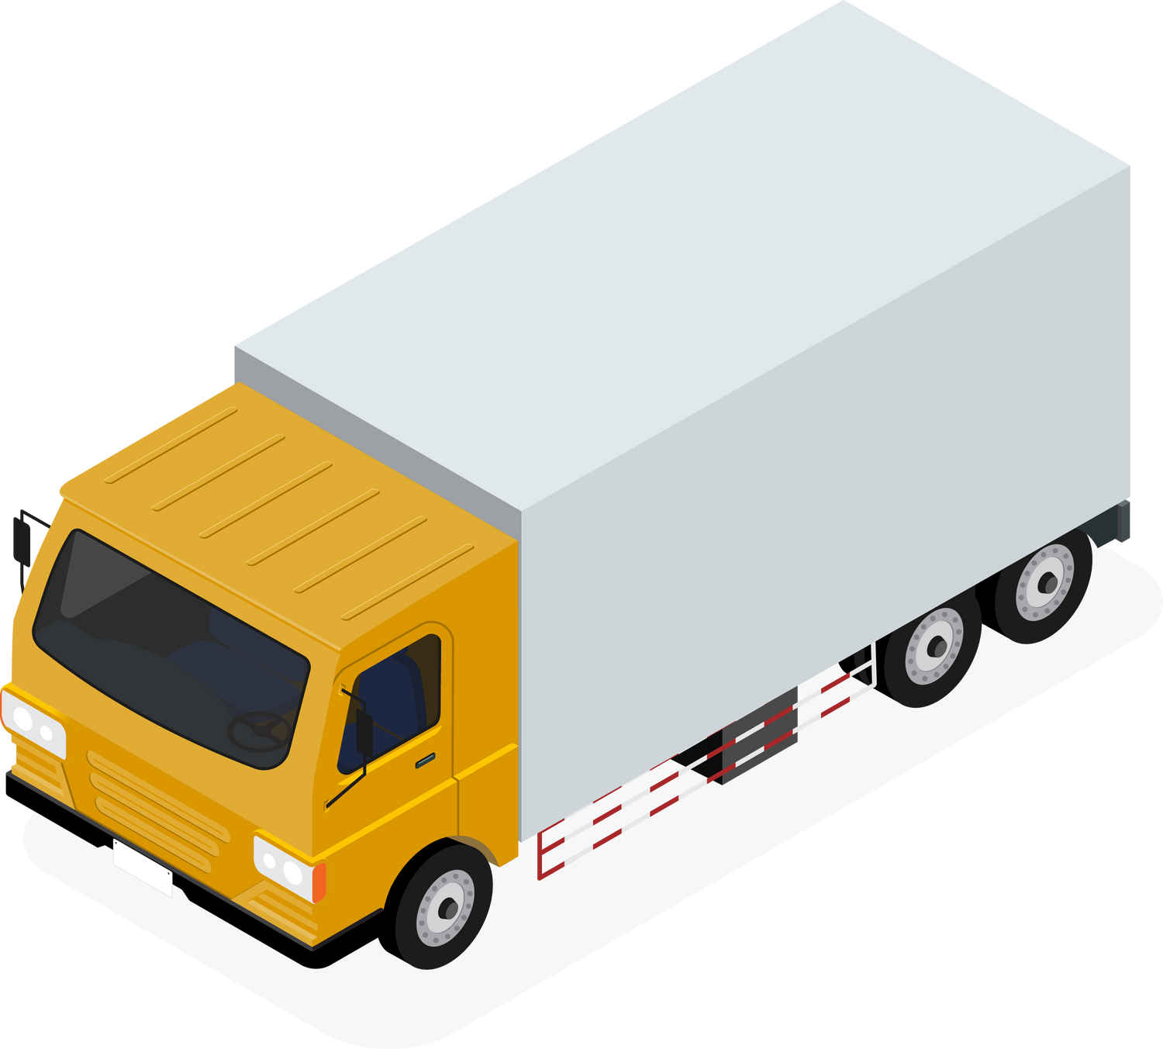

SectorCT
WayPoint
@sector_ct
The Current
Problems
Inefficient
Time-consuming
Prone to Errors

Slide 3


SectorCT
WayPoint
@sector_ct
Our
Solution
  Mobile app
  Real-time tracking
  Route optimization
  Automation of delivery tasks
  Faster and more efficient delivery

Slide 4
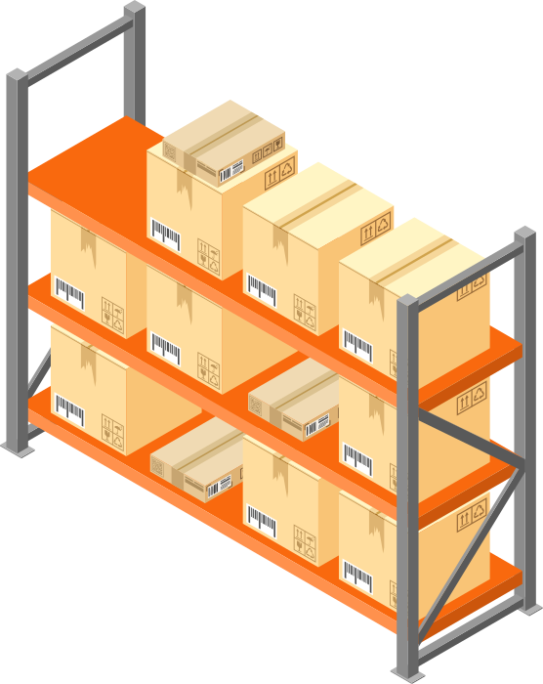
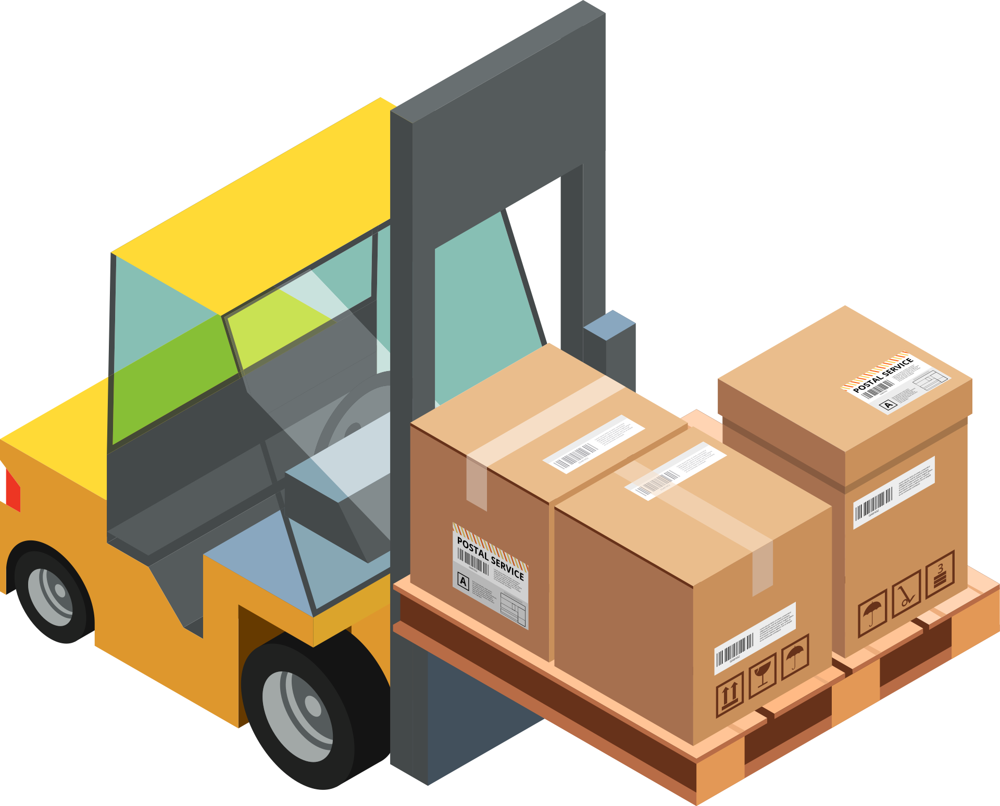
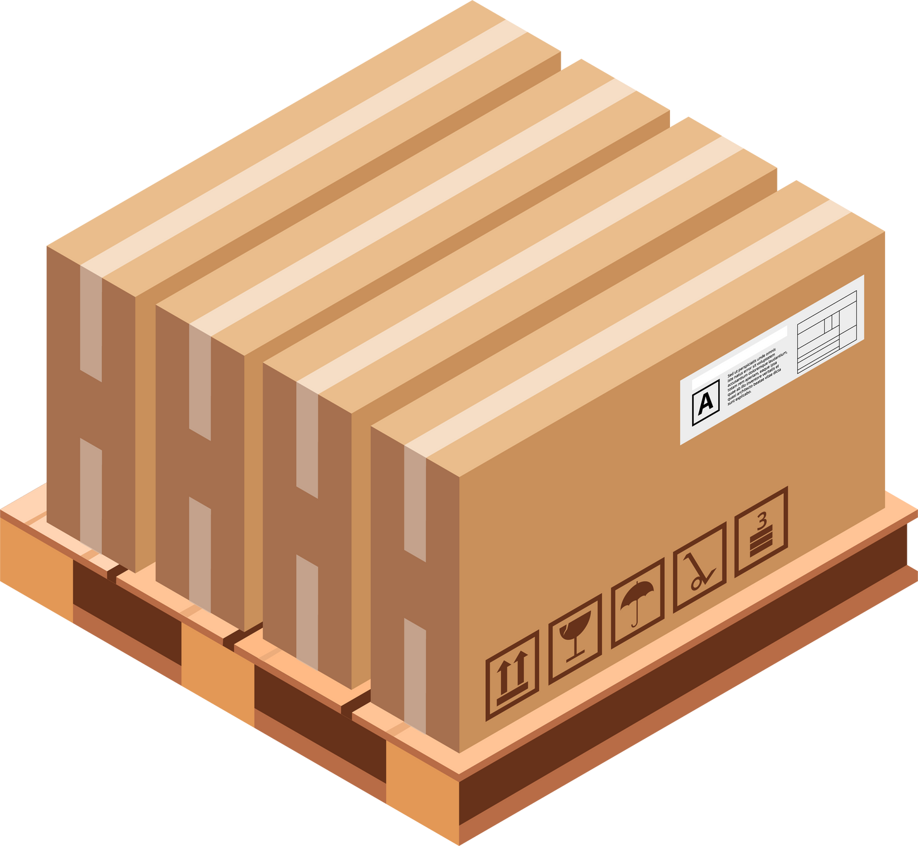
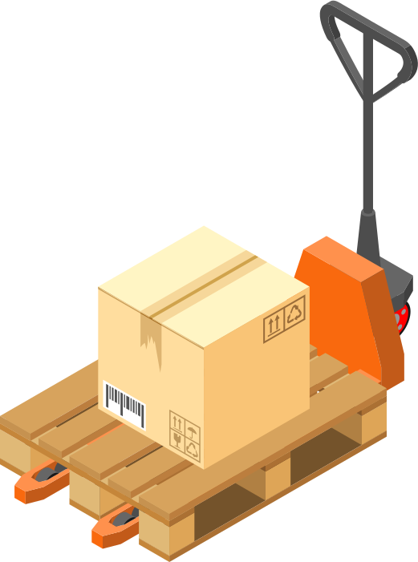
SectorCT
WayPoint
@sector_ct
How it
Works
📦 Add Packages for Delivery
📍 Grouping Locations by Zones
🧮 Calculating the route for every driver
🚚 Admin Dashboard - Real-time Monitoring

Slide 5
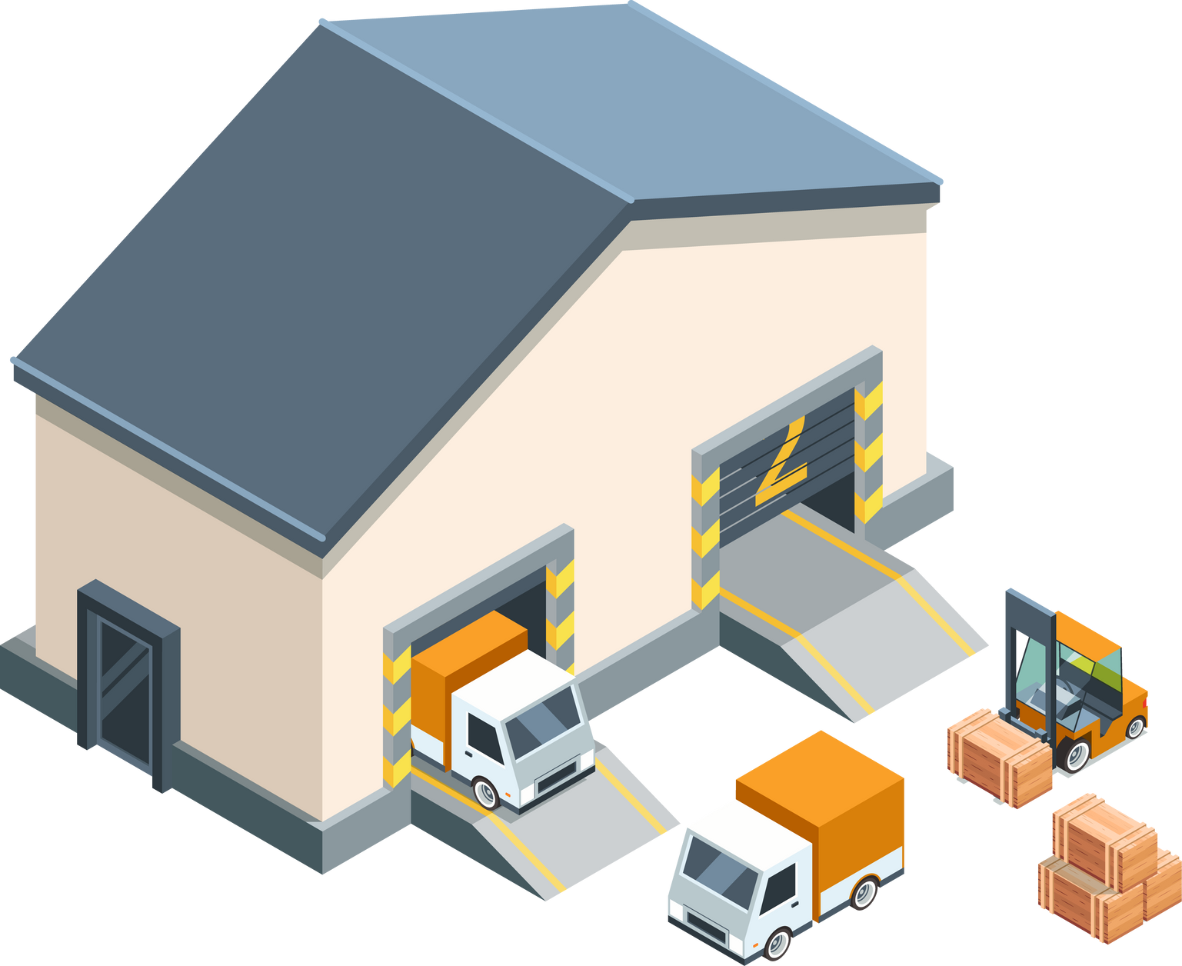
SectorCT
WayPoint
@sector_ct
LIVE
DEMO

Slide 6
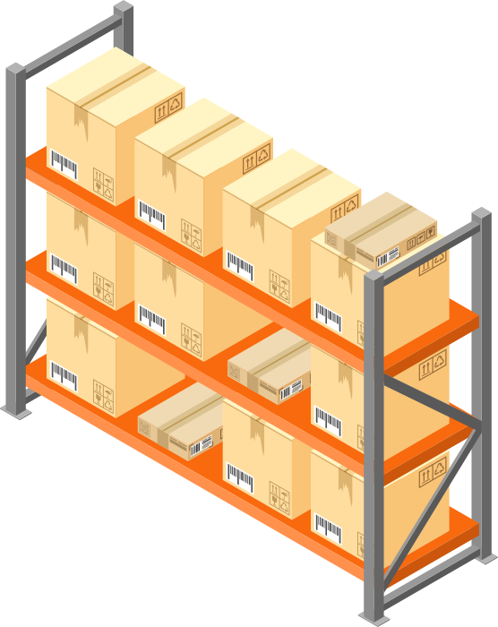

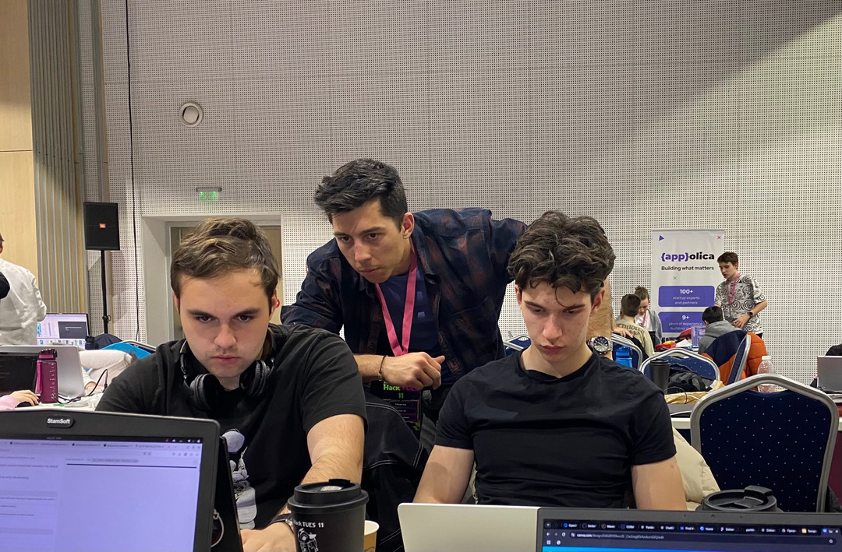




SectorCT
WayPoint
@sector_ct
Our
Team
Svetoslav
Frontend
Damyan
Frontend
Antonio
Backend
Nikola
Backend
Hristo - Mentor
Radoslav
Backend

Slide 7






SectorCT
WayPoint
@sector_ct
Used
Technologies

Slide 8
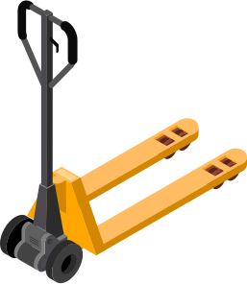
SectorCT
WayPoint
@sector_ct
Impact
Customer Satisfaction
Cost Efficiency
Competitive Advantage

Slide 9
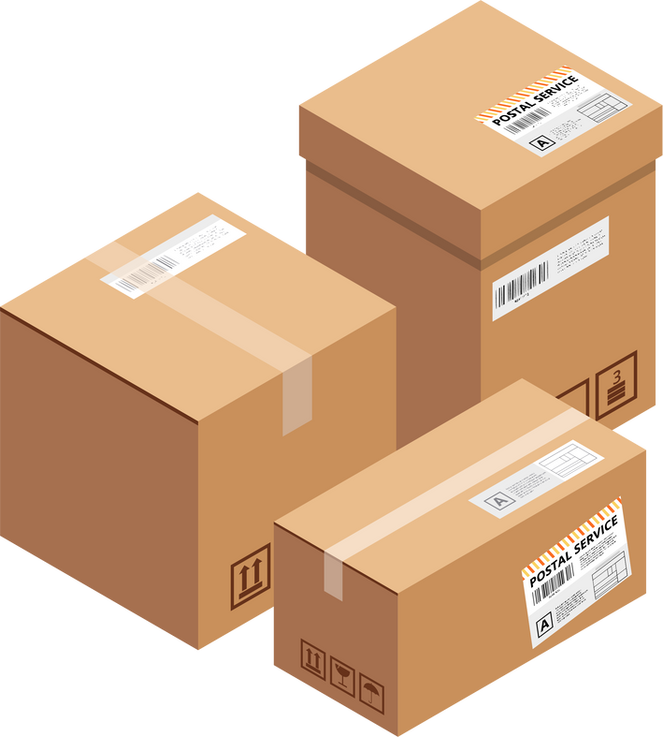

SectorCT
WayPoint
@sector_ct
Thank
You
Thank you for your time and attention.

