Slide 1

Security Farm SOC v10.0
Justin Mason
5 Feb 2026
Notes:
This template can be used as a starter file for presenting training materials in a group setting.
Sections
Right-click on a slide to add sections. Sections can help to organize your slides or facilitate collaboration between multiple authors.
Notes
Use the Notes section for delivery notes or to provide additional details for the audience. View these notes in Presentation View during your presentation.
Keep in mind the font size (important for accessibility, visibility, videotaping, and online production)
Coordinated colors
Pay particular attention to the graphs, charts, and text boxes.
Consider that attendees will print in black and white or grayscale. Run a test print to make sure your colors work when printed in pure black and white and grayscale.
Graphics, tables, and graphs
Keep it simple: If possible, use consistent, non-distracting styles and colors.
Label all graphs and tables.

Slide 2
Table of Contents
Overview
VM Configuration
SOC Overview
Portal Page
Rocket Chat
IRIS
Request Tracker
MediaWiki
Additional Notes
3 – 7
8 – 15
16 – 17
18 – 19
20 – 25
26 – 27
28 – 48
49 – 50
51 – 52

Slide 3
Overview
Rocket
IRIS
Incident Management
RT
Realtime Communication
MediaWiki
Documentation
Tasking / Network Operations

Slide 4

Rocket Chat
Real time communications between analysts to:
Collaborate on event investigation and incident handling.
Work through system maintenance issues.
Deconflict actions between teams/analysts.
MSL entries.

Slide 5

IRIS
Incident Management Platform
Incident and case management
Evidence collection and tracking
Tasking and workflow coordination
Reporting and audit trail

Slide 6

Request Tracker
A ticketing system to support:
Team and individual taskings / status updates, plans and projects tracking, outcomes, metrics and records of actions taken.
NetOps interaction when requesting information, changes to the network or other actions.
NetOps support for implementation of vulnerability mitigations.

Slide 7

MediaWiki
All Things Documentation
Analyst techniques, tactics and procedures.
Tool guides / examples.
General information appropriate for a wiki format; intended to compliment a file share.
File uploads are intended to be for static documentation that isn’t changed too often.

Slide 8
VM Configuration

Slide 9
VM Overview
Exported as sf_soc_10.0.qcow2
sha256sum: 0bf859e685f1f440f21788dc95e1a8ac9a703c0c8e75f2284420a8c077e6e0f3
Contact Security Farm PBC for custom deployments and other consulting services.
www.securityfarm.net

Slide 10
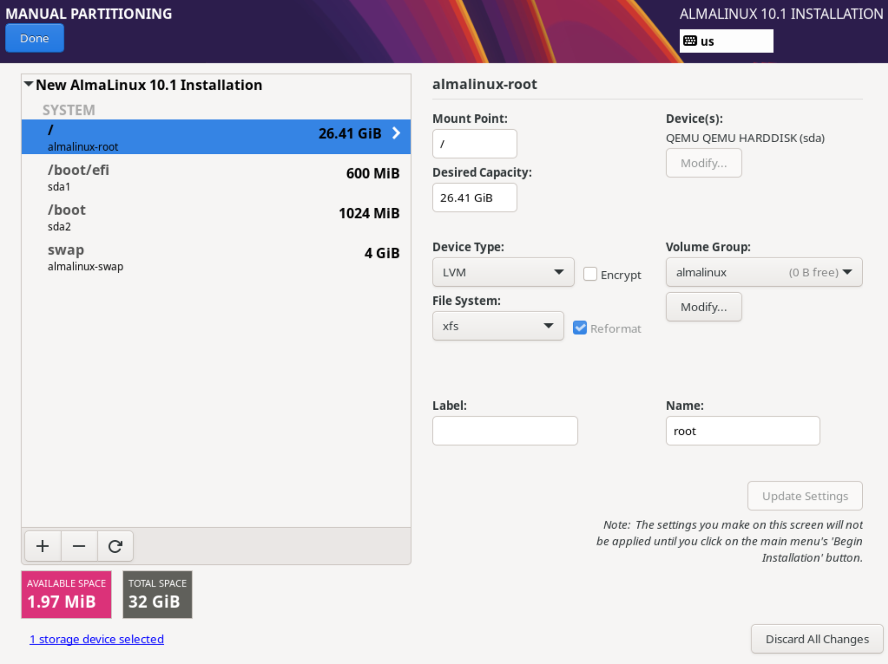
Deployment
Built on Alma Linux 10 minimal.
Login is root, password is “password”.
Suggested starting specs are 4 vCPUs and 8gb ram.
Provisioned for 32GiB; run `security_farm_soc` for a walkthrough on increasing capacity.

Slide 11
Setup
Configuration is done with: /opt/security_farm/security_farm_soc.py.
An alias of ‘security_farm_soc’ exists and requires this file to stay in the same location.
The backup/restore functionality depends on the backups residing in /opt/security_farm/backup/* with the naming convention defined in security_farm_soc.py. The directories will be created the first time you run a backup/restore.
The backup/restore script may take some time as more information is loaded in; please be patient and always review the terminal output.

Slide 12
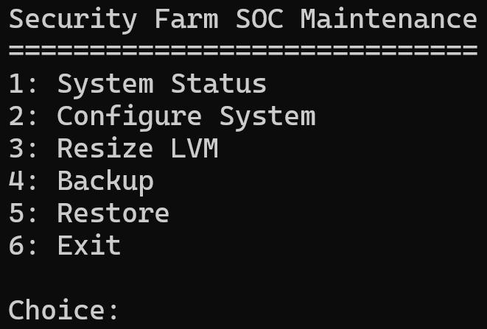
Setup
Login as root/password.
Run ‘security_farm_soc’
Enter ‘2’ to configure the system.

Slide 13
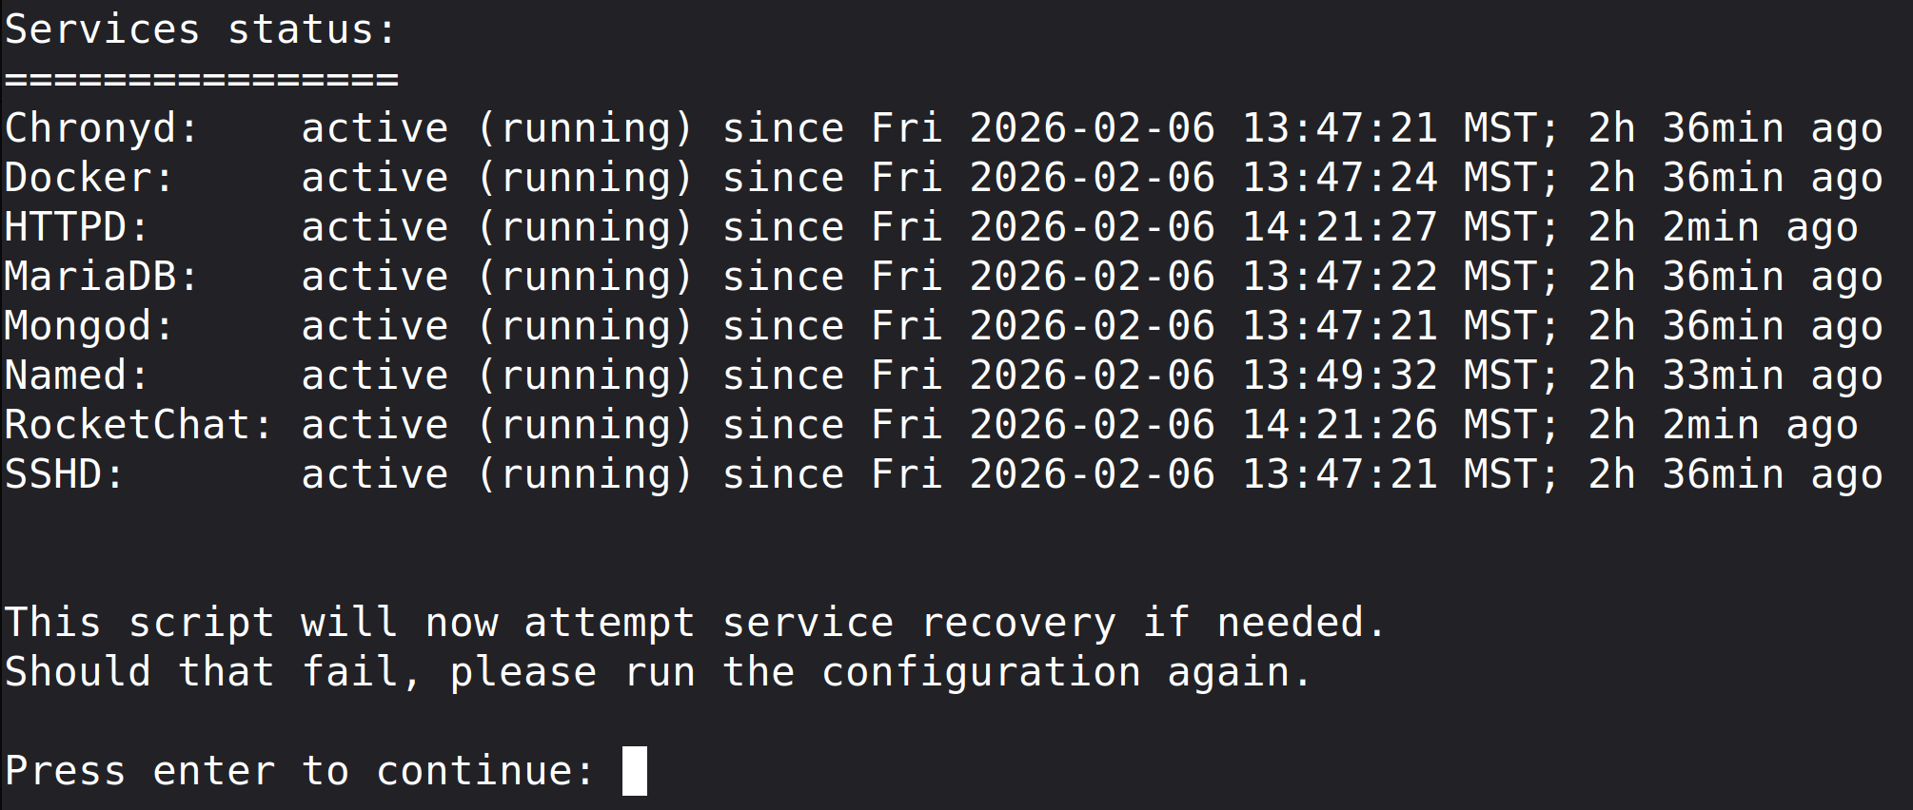
Setup
After running the configuration and rebooting type ‘1’ for the system status.
This will verify the services and firewall are configured correctly. If an error is detected it will attempt to fix it.

Slide 14
DNS Setup
After you’ve run through the configuration you must point your DNS at the VM’s IP address, or if using another DNS server, you will need the following records pointed at the vm:
iris.soc.lan
mediawiki.soc.lan
portal.soc.lan
rocket.soc.lan
rt.soc.lan
Special Note: to reach the services in your browser you must use https://{{service}}.soc.lan. I think it's because of the tld .lan that it will try to search for it if you leave off the protocol.

Slide 15
Notable Configuration Files
Available on GitHub
https://github.com/Security-Farm/security-farm-soc
If you review the role for each service, you can get a feel for notable configuration files in the templates folder.
All passwords (centos, database passwords, the web interface passwords, etc) need to be changed if you're going to use this in production. You will need to update security_farm_soc.py backup() and restore() with said passwords. Also generate a new `$wgSecretKey` and `$wgUpgradeKey` in MediaWiki's LocalSettings.php.

Slide 16
SOC Team Architecture

Slide 17
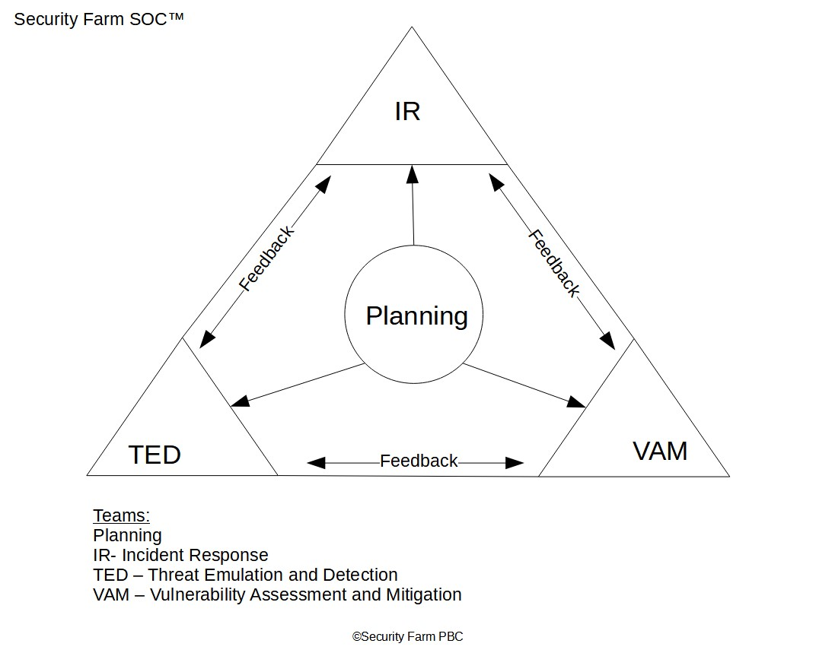
SFSOC
The services are pre-configured around the architecture laid out by Security Farm PBC.

Slide 18
Portal

Slide 19
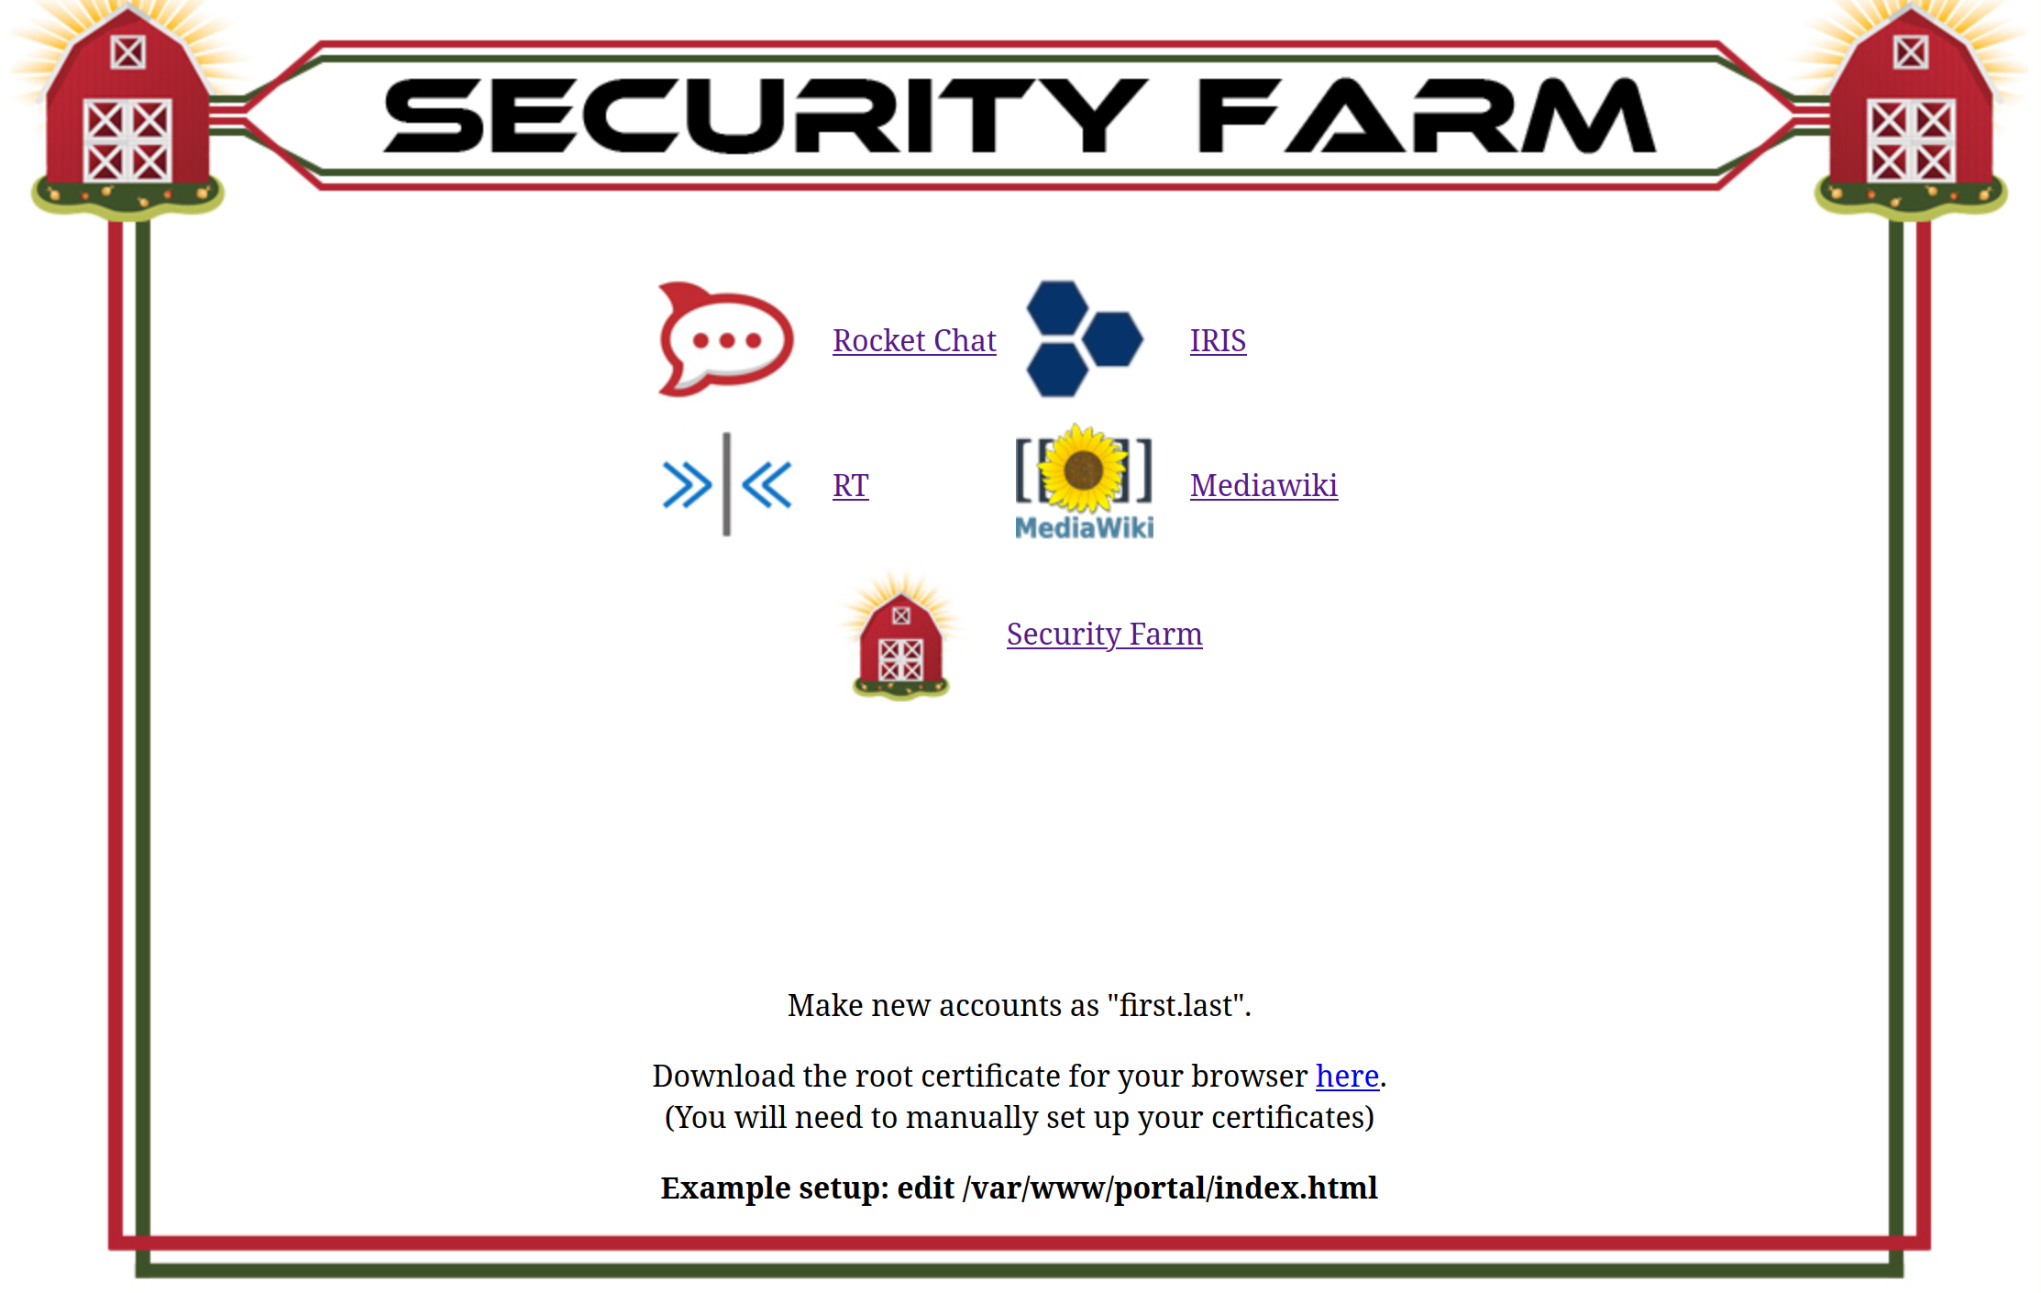
portal.soc.lan
The links for rocket, iris, rt and mediawiki work out of the box, anything else you will need to customize to your needs.
The index is in /var/www/portal/

Slide 20
Rocket Chat

Slide 21
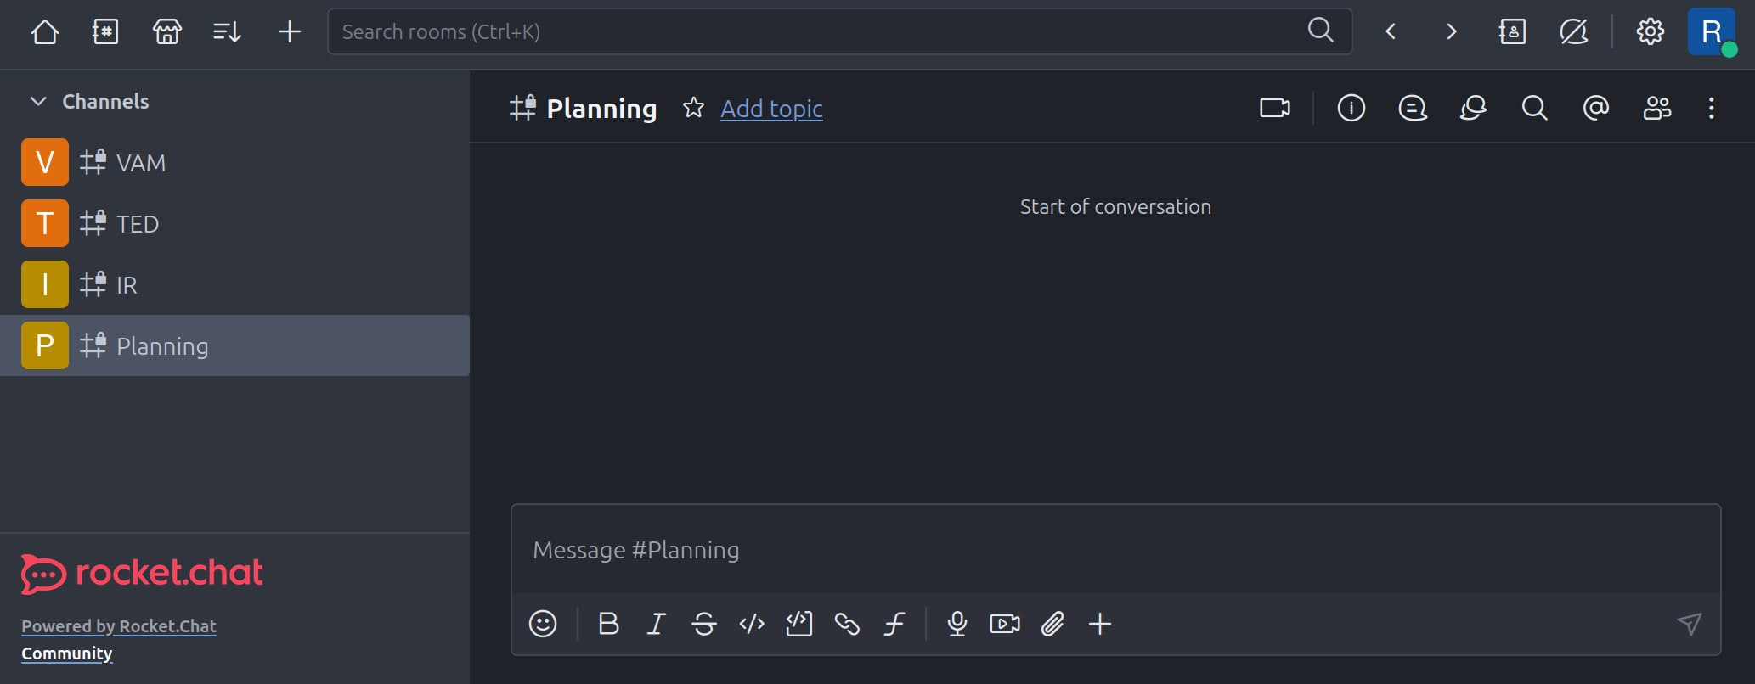
Rocket
When you first log in (root/password) the various channels are on the left, and for private channels, you can add users by opening the right-hand menu.
Rocket has been set up to disallow channel creation by users to keep things tidy.

Slide 22
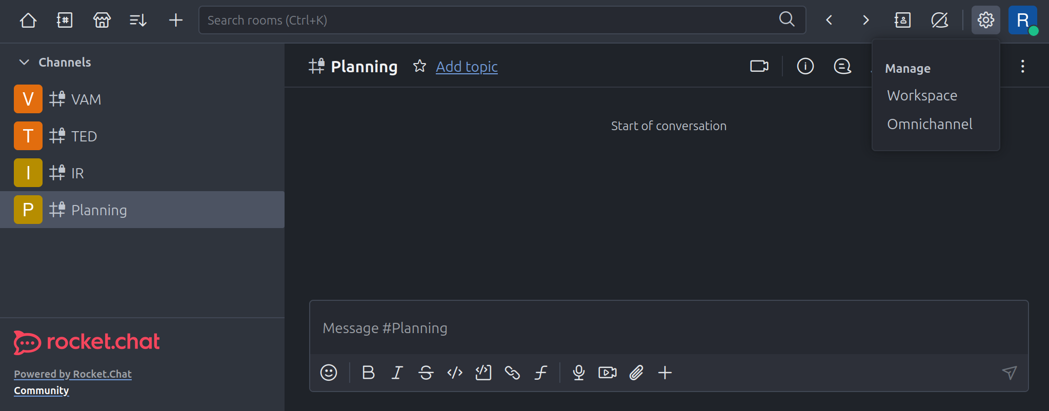
Rocket
Access the administrative menu with gear button.

Slide 23
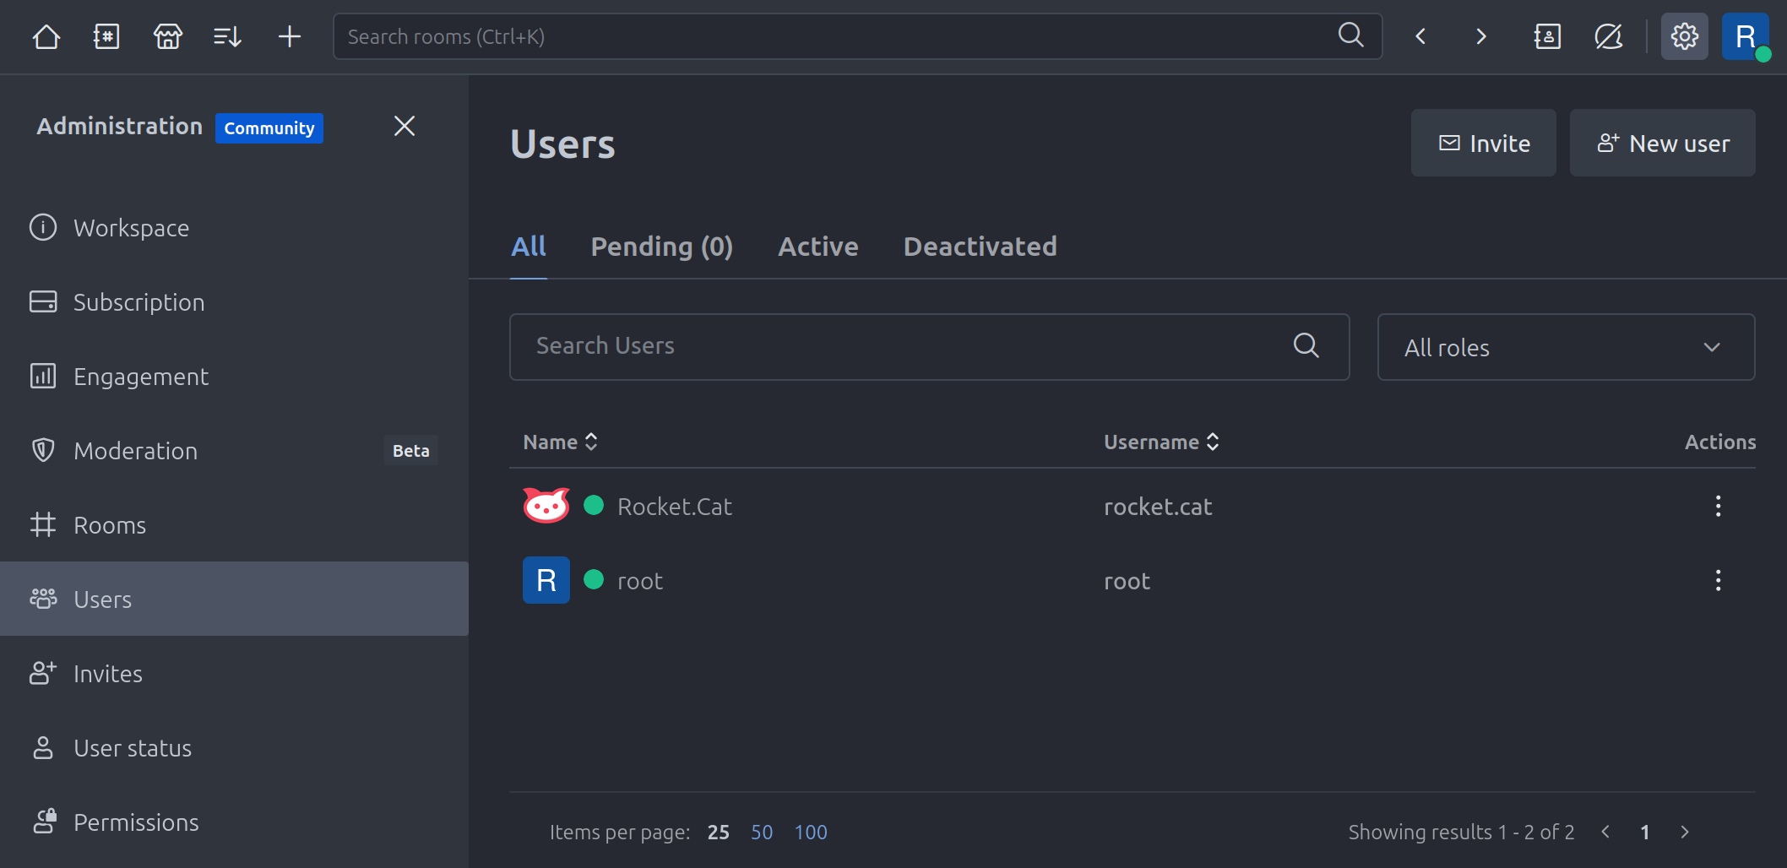
Rocket
Automatic approval is turned off (Accounts -> Manually approve new users). You can either create an account or have users register themselves. Once registered you will have to go into the users and activate them.

Slide 24
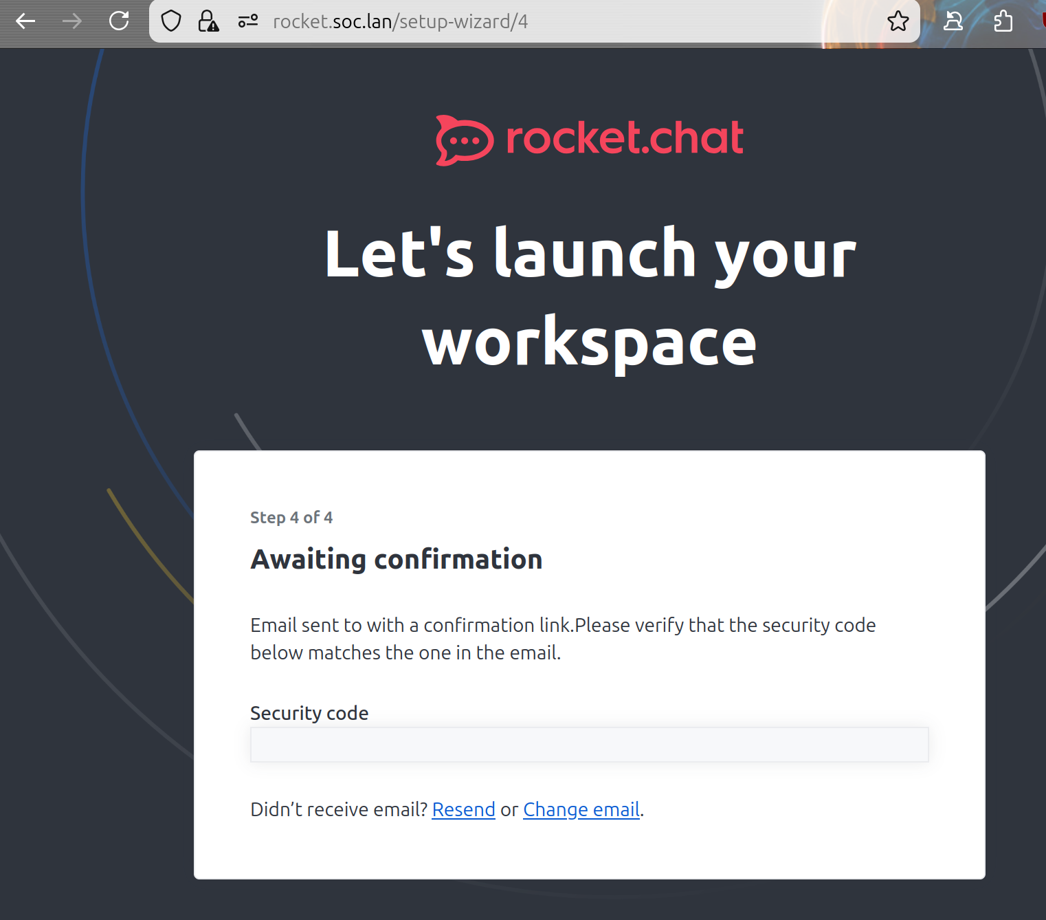
Rocket
If you start with a fresh Rocket Chat, when you create the first account it will ask for confirmation, but you can go back to https://rocket.soc.lan and it will still work.

Slide 25
Rocket
These are the applied changes
# Permissions
Uncheck Access Federation, Access Marketplace, Create Public Channels, Create Private Channels, and Create Team for the user role.
# Settings
Accounts -> Allow Name Change false
Accounts -> Allow Username Change false
Accounts -> Allow Email Change false
Accounts -> Enable TFA false
Accounts -> Password Policy -> 25 length, max repeating 3, no other options
Accounts -> Disable anything related to email
Accounts -> Manually Approve New Users true
Accounts -> Registration with Authentication Services false
Accounts -> Password Reset
File Uploads -> set to local filesystem and `/opt/rocket.chat/files/`
General -> Show Setup Wizard Completed
General -> Enable NPS Survey false
Layout -> Use Full Name Initials to Generate Default Avatar
Layout -> Use Real Name
Message -> Block Message Deleting After 5 Minutes
Message -> Keep Per Message Editing History
Mobile -> Allow Save Media to Gallery false
Setup Wizard -> Allow Marketing Emails false
User Data Download -> Enable User Data Download false

Slide 26
IRIS

Slide 27
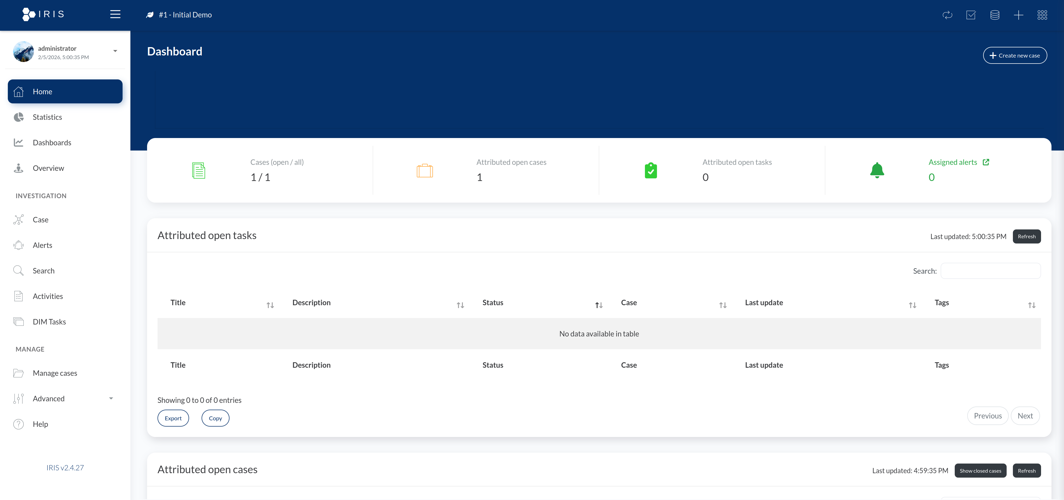
IRIS
IRIS replaced TheHive/FIR in this release of the Security Farm SOC; no configuration has been done yet. You’ll be greeted with a blank slate.
Default Login is administrator / irispassword

Slide 28
Request Tracker

Slide 29
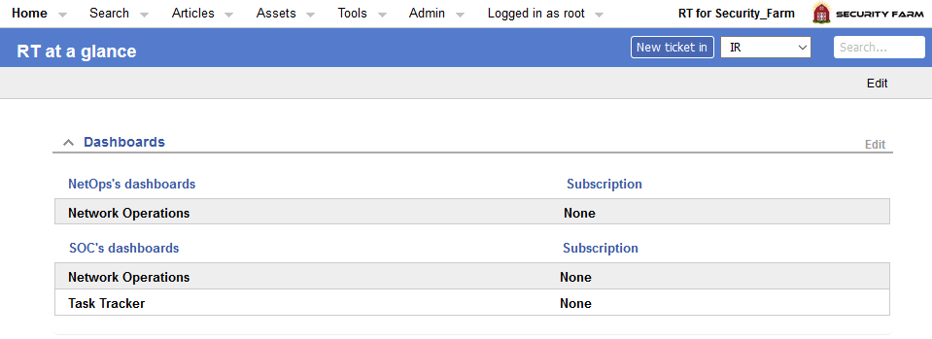
Request Tracker
The default login is root/password and there are two users, NetOps.Test and SOC.Test.
With some minor differences, the Network Operations dashboards are the same for both NetOps users and SOC users.
The Task Tracker dashboard is for administrative taskings for the SOC team (Hunt related information should stay on IRIS).
RT is very flexible; this is just a suggested setup.

Slide 30
Request Tracker
The Network Operations dashboard uses three queues for the SOC and NetOps to pass tickets between each other:
SOC
NetOps
Vulnerabilities (for remediation)
The Task Tracker is based on several ticket queues corresponding to the teams on the task tracker dashboard:
IR
TED
VAM
Planning
Maintenance

Slide 31
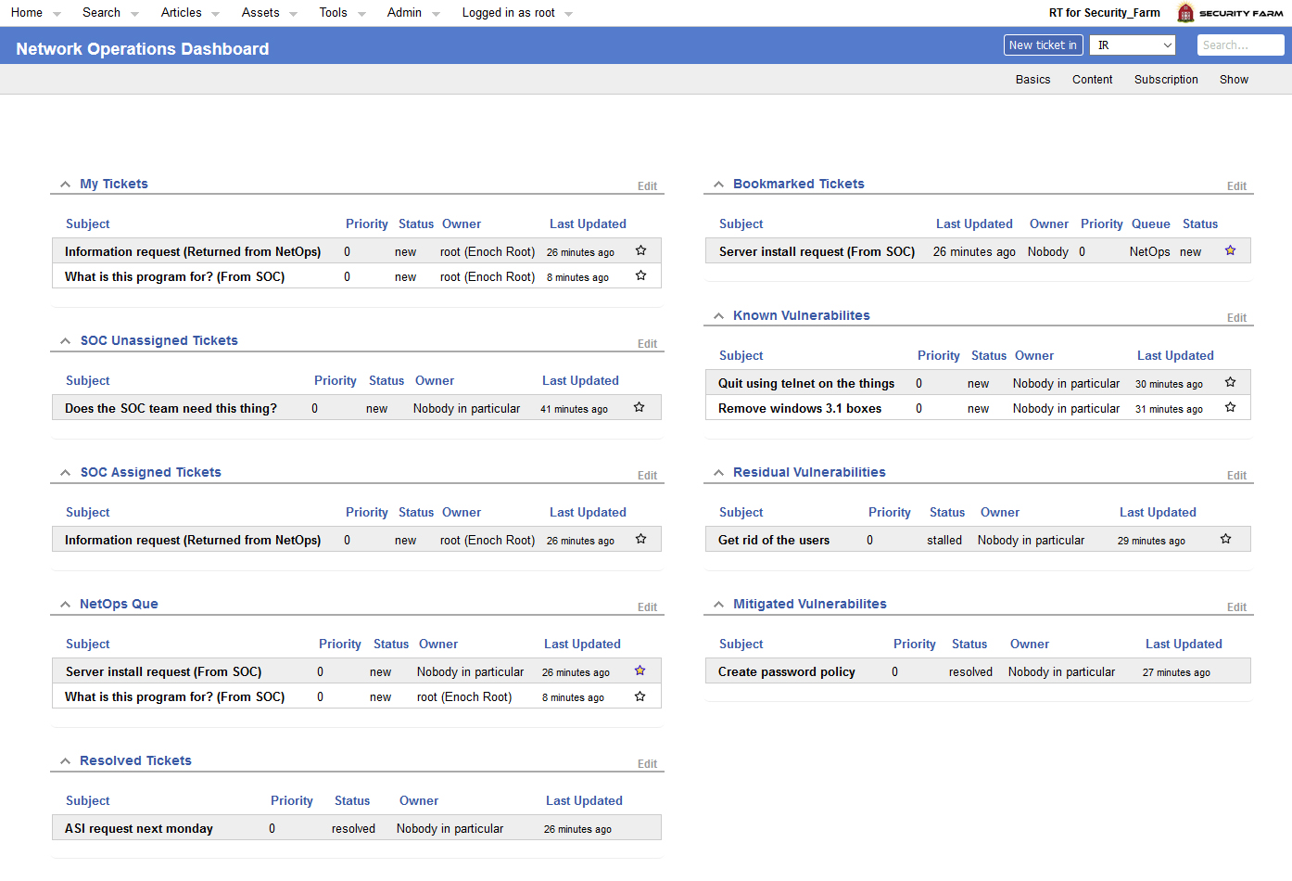
Request Tracker
This is a SOC user’s view of the NetOps Dashboard

Slide 32
Request Tracker
“My Tickets” will show all tickets currently assigned to you.
“Bookmarked Tickets” shows any ticket that you bookmark by clicking the star next to it.

Slide 33
Request Tracker
The user will see the queue for their assigned role (SOC / NetOps)
Primary workflow for information/work requests and general questions for the other team.
The SOC is given a view of tickets currently in NetOps queue.
Categorized by Unassigned, Assigned and Resolved(for both ques).

Slide 34
Request Tracker
This is the workflow for tracking vulnerability mitigations.
Categorized by known, residual and mitigated vulnerabilites.
Setting a ticket to “Stalled” will categorize it as a residual risk.
Only members of the Vulnerabilities Moderator group can create and modify tickets. Other users can only comment and reply.

Slide 35
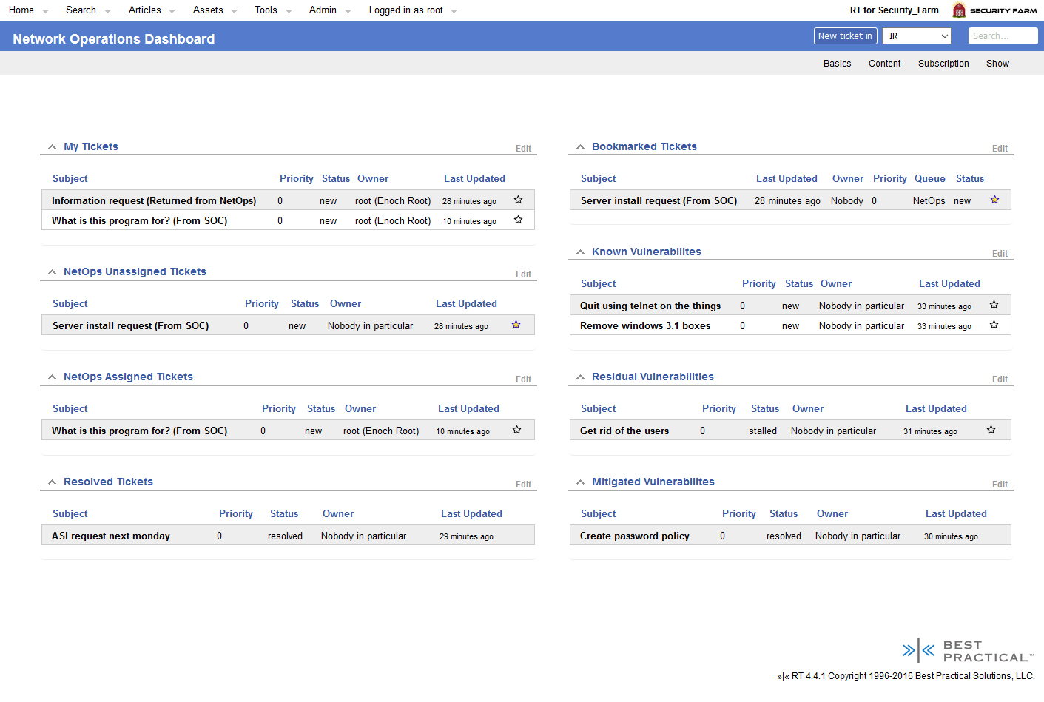
Request Tracker
The NetOps view does not does not display the SOC queue. NetOps can still manually search for and view tickets that are in the SOC queue though. This is to keep it as simple as possible for users that are not familiar with RT.

Slide 36
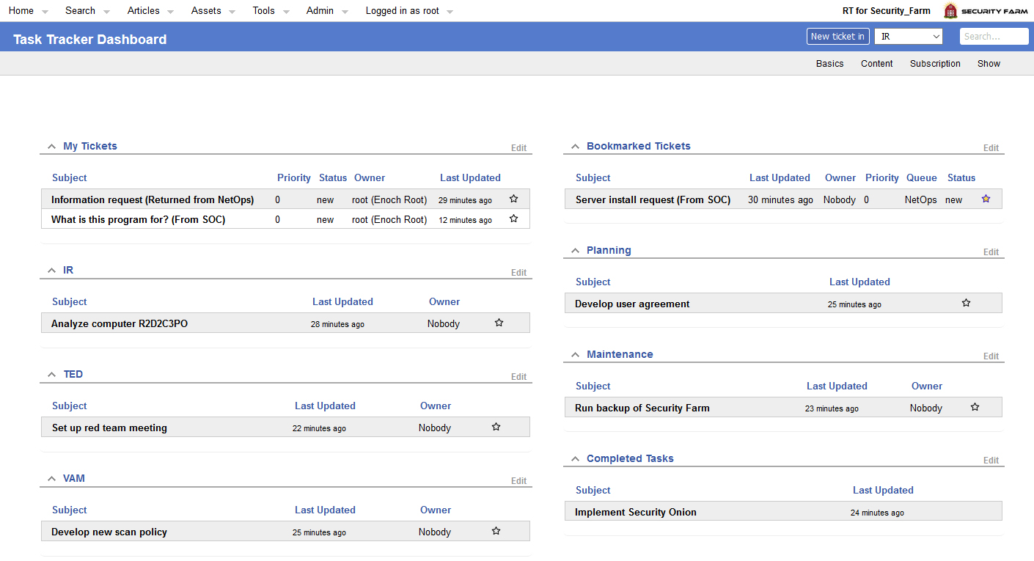
Request Tracker
The Task Tracker workflow is based on a ticket queue for each of the 3 teams, planning and maintenance.
Only members of the task tracker moderator group can create and modify tickets. Other users can only comment/reply. This should be controlled by team leads.

Slide 37
Request Tracker
Planning can hold overarching tasks / projects and can be linked to other dependent tasks in RT.

Slide 38
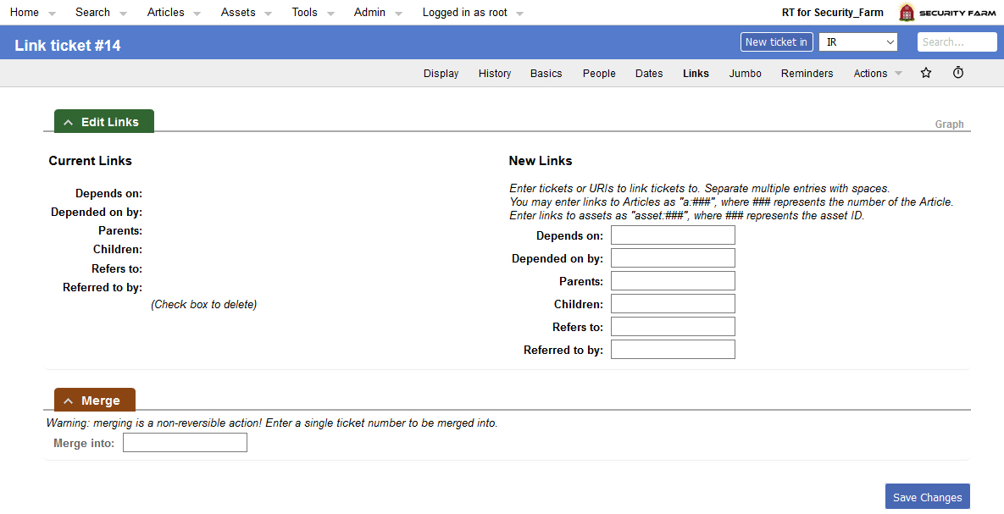
Request Tracker
Linking a ticket is done by opening the ticket, going to the links view and typing in the ticket number.

Slide 39
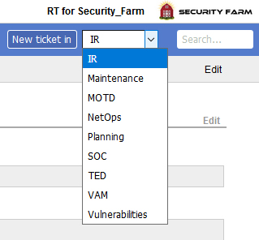
Request Tracker
Only the queues that a person has permission to create tickets in will be visible.

Slide 40
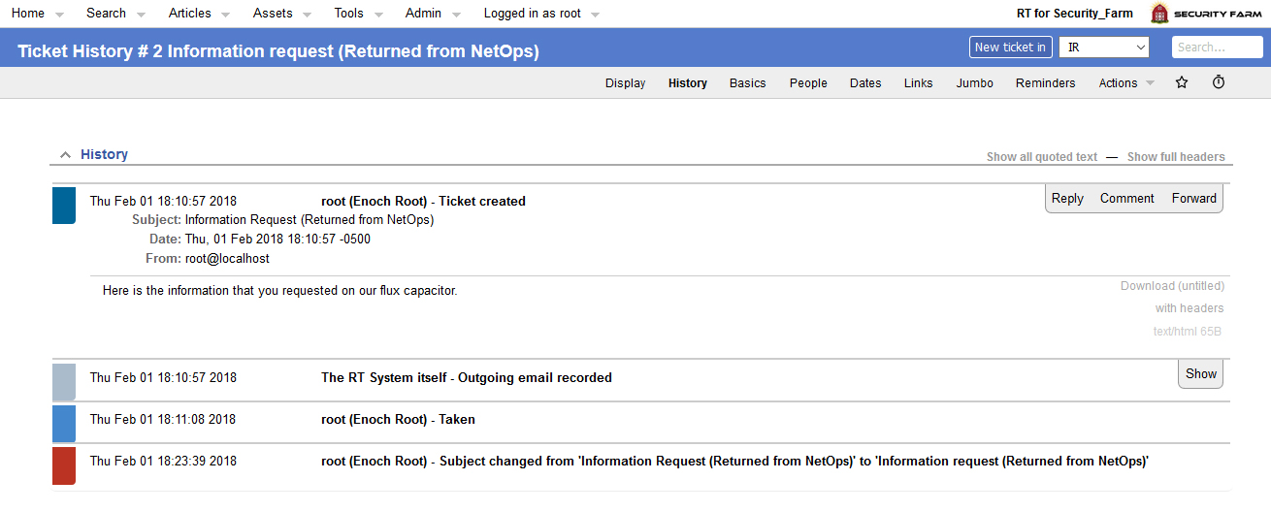
Request Tracker
Ticket history is where you will view the initial ticket, comments and replies.

Slide 41
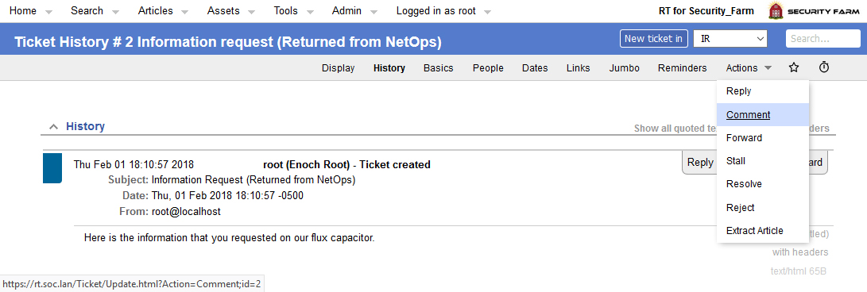
Request Tracker
If you reply directly to a comment it will include that comment. I think it is best to go to Actions → Comment; it keeps the replies/comments clean.

Slide 42
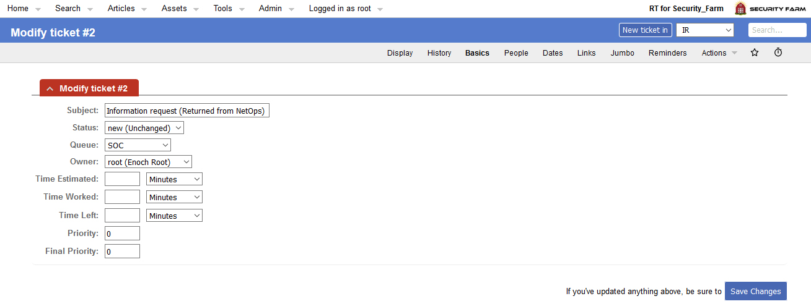
Request Tracker
Ticket basics is where you modify the status, queue, owner and priority.
You must change the ticket to the appropriate queue first before you can assign a ticket to a member that team (Applies to SOC and NetOps ques).
Under the “Display” tab, below reminders, you will see another “Owner” field… Many mistake that to be the owner of the ticket and it is not. You have to go through “Basics”

Slide 43
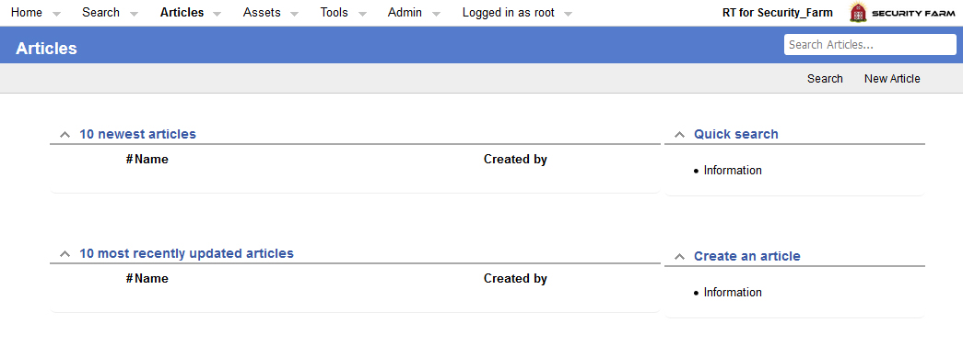
Request Tracker
Articles can be used to store commonly shared information that you want to attach to tickets.
SOC members can create and modify articles, NetOps can view them.

Slide 44
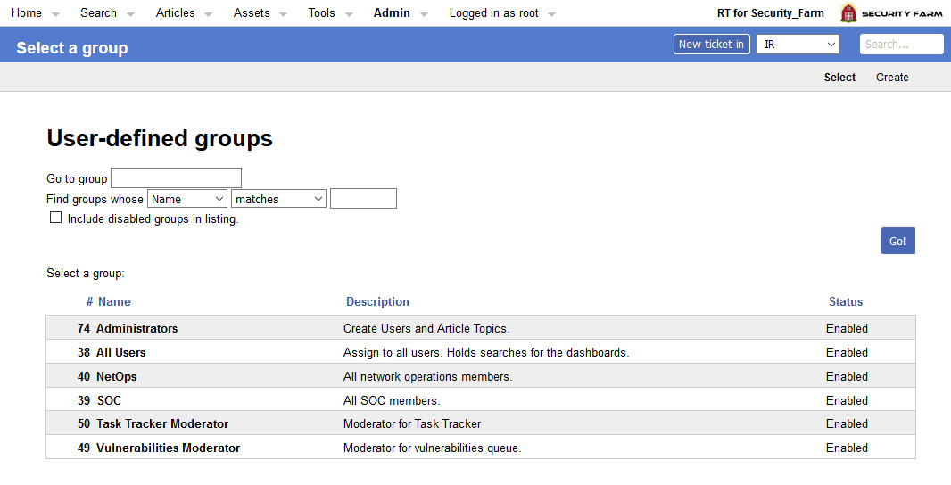
Request Tracker
Groups used to control permissions in RT.

Slide 45
Request Tracker
Three main types of rights in use:
Global Rights
Currently only used for the group “All Users” to allow users to change their own password and see articles.
Group Rights
Currently used only to allow “All Users” to view the saved searches that are used in dashboard creation.
Queue Rights
Each group is only allowed to perform certain actions on certain ques. Least privilege ensures that the workflows go as smooth as possible.

Slide 46
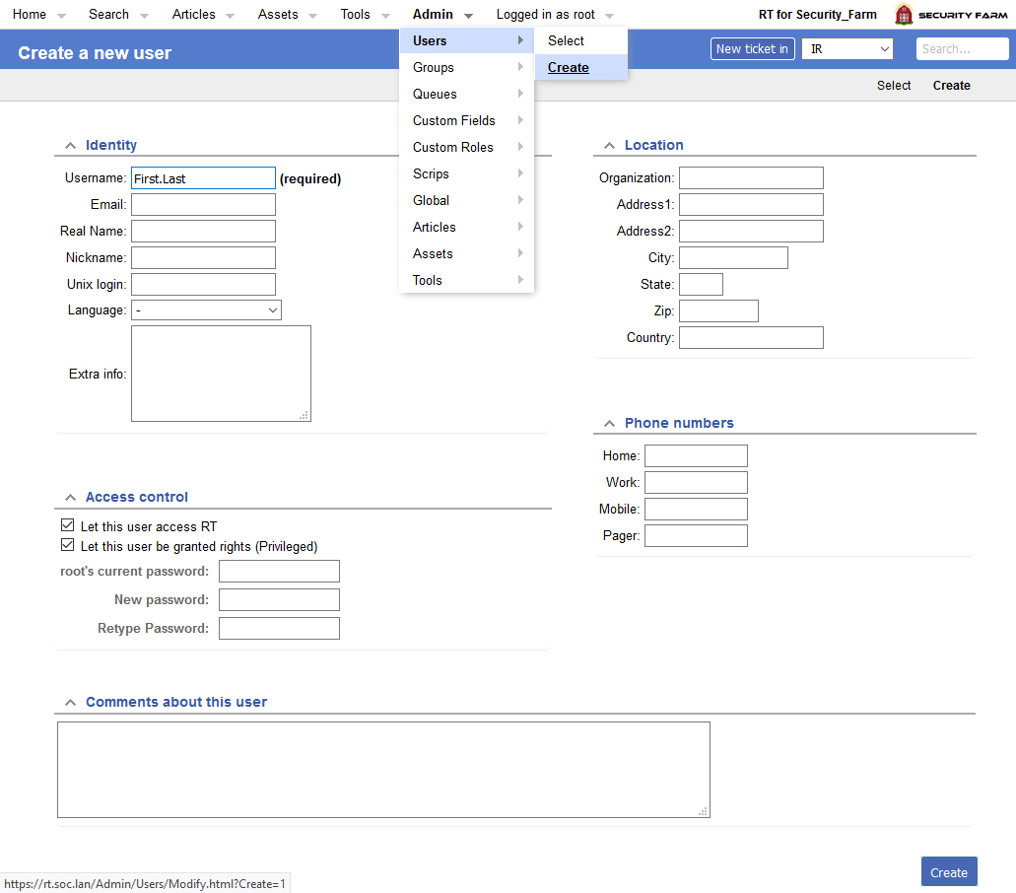
Request Tracker
Users -> Create
Insert username as First.Last (Capitalization affects display but not login)
Make sure both access control boxes are checked
Insert your password and their new password twice (they can change it later)

Slide 47
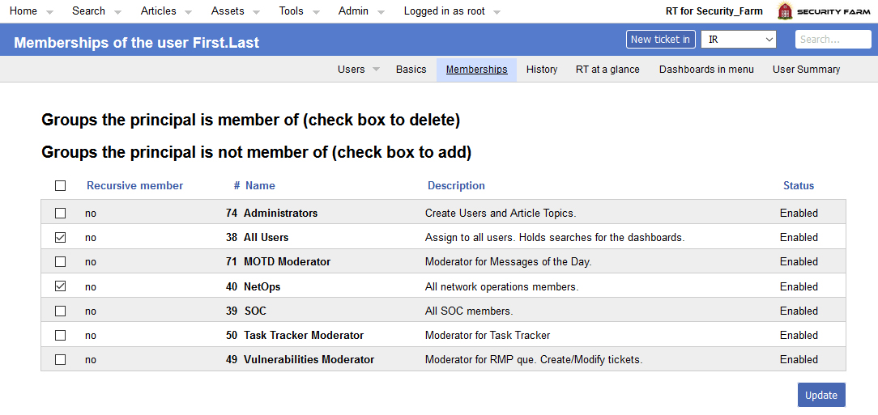
Request Tracker
Select Memberships, choose their groups and hit update:
Most users will only be assigned to two groups.
Every user MUST BE assigned to “All Users” or the dashboards won’t function.
Select Either SOC or NetOps. Other groups should be used sparingly.
VAM Team lead should be the Vulnerabilities Moderator.
Team leads should be Task Tracker Moderators.

Slide 48
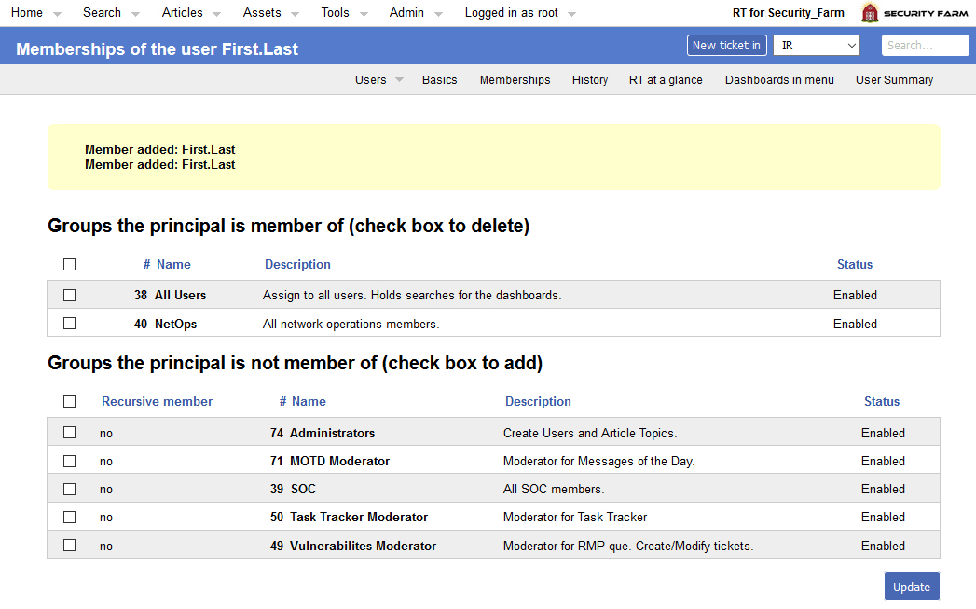
Request Tracker
Verify that the correct memberships were added.

Slide 49
MediaWiki

Slide 50
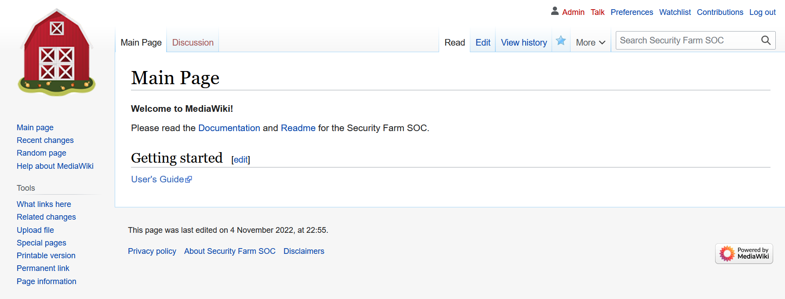
MediaWiki
Login is admin/P@ssword123
The main page is the only page protected from administration by everyone. The idea is to create a directory to organize the wiki so the user can explore it without having to search for specific pages. You can use pages as subdirectories.
To create a new page you simply search for it and if it’s not found you will be given the option to create it.
Encourage analysts to learn https://www.mediawiki.org/wiki/Help:Formatting

Slide 51
Notes

Slide 52
Additional Notes
The timezone for RT and MediaWiki is set in:
-/opt/rt6/etc/RT_SiteConfig.pm
-/var/www/mediawiki/LocalSettings.php
Restart Apache for changes to take effect.

Slide 53
The End
This is the first automated release of the Security Farm SOC; please report bugs/issues on GitHub: https://github.com/Security-Farm/security-farm-soc

