Slide 1
Hyundai Head Unit Hacking
BSides Sofia
Radoslav Gerganov
18 March 2023

Slide 2
whoami
Infosec @ VMware
Confidential Computing
Key Management solutions
DISCLAIMER: views are my own
github.com/rgerganov
twitter.com/rgerganov
https://xakcop.com

Slide 3
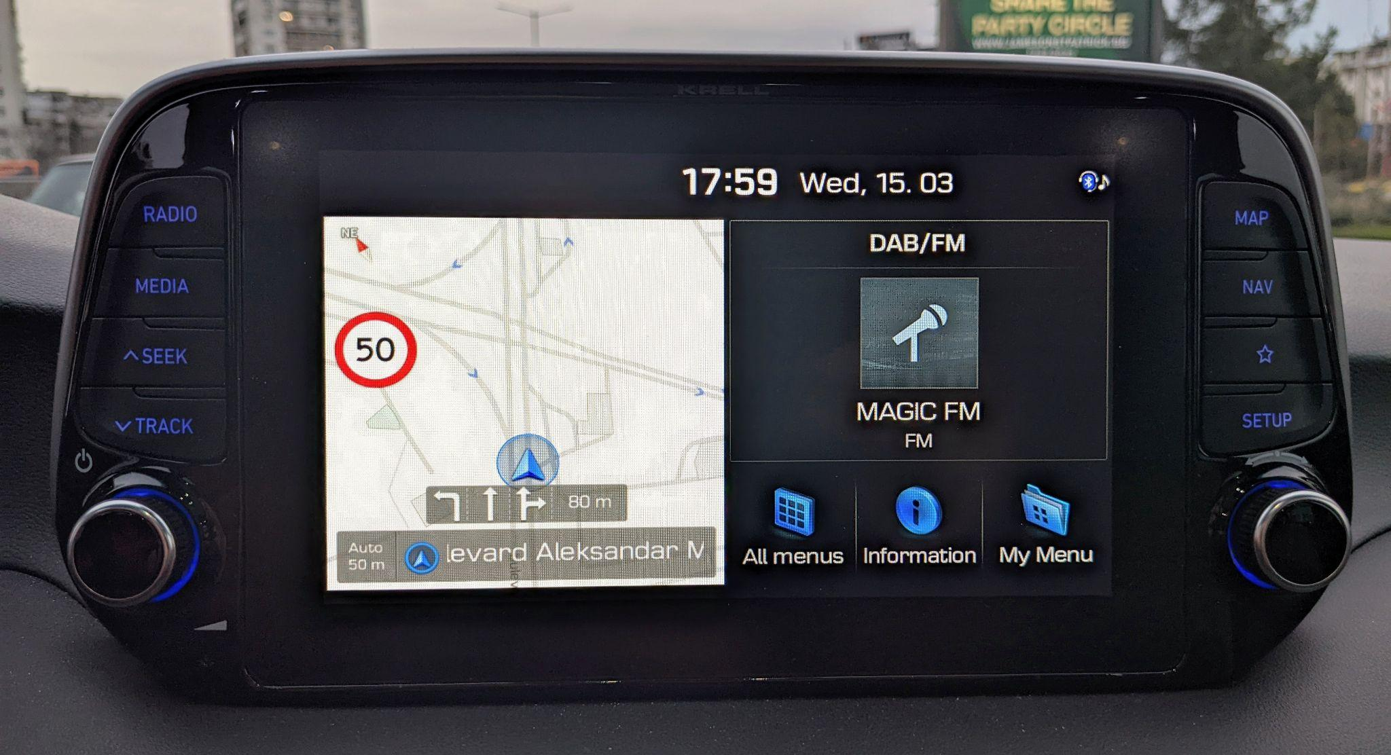
What is Head Unit?
Computer with GPS, Bluetooth, WiFi, USB, Camera, etc.

Slide 4
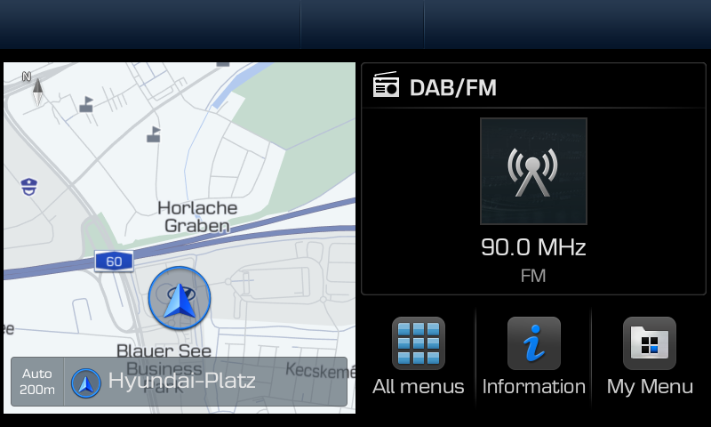
Standard Gen5 Navigation
Running on KIA, Hyundai and Genesis cars
KIA: Sportage 2017-20, Optima 2017-18, Optima Hybrid 2018, Sorento 2017-20, Cadenza 2018-19, Stinger 2018-20, Forte 2018-20, Carnival 2018-20, Rio 2017-20
Hyundai: i20 2018-20, i30 N 2017-20, i40 N 2017-19, Kona 2017-20, Kona Electric 2018-19, Santa Fe 2018-21, Tucson (TL) 2020, Venue
Genesis: G70 2019-21, G80 2019-20
Millions of cars

Slide 5
Motivation
“How I hacked my car” by greenluigi1
2021 Hyundai Ioniq SEL running D-Audio2V
Example encryption and signing keys being used (EPIC FAIL)
Didn’t work on my car (Hyundai Tucson 2020)
D-Audio (2017-2020)
D-Audio2V (2021-?)

Slide 6
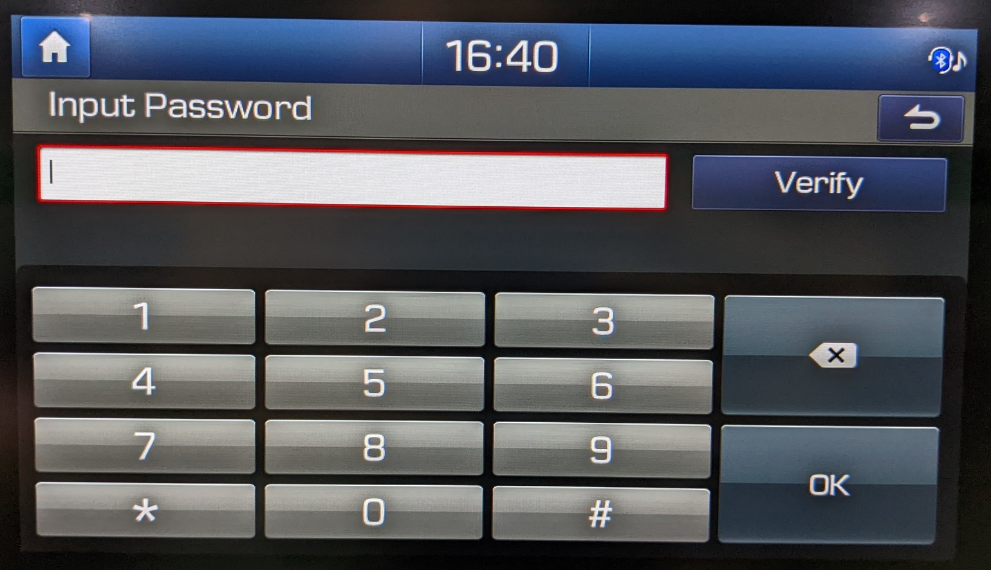
Engineering Mode
Debug settings behind a pass code

Slide 7
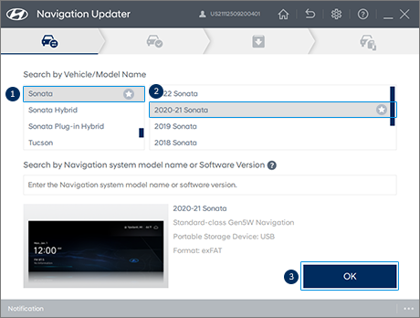
Firmware updates
Navigation Updater
Prepares a USB drive with update
Updates are installed from USB

Slide 8
Analysing the update
$ cat 2018_20_Tucson_EU.ver
+|22Q1|TLFL.EUR.SOP.V126.220421.STD_M|HM|2018_20_Tucson_EU|1477|1
2018_20_Tucson_EU\DAUDIOPLUS_M\eur|vr.img|10|623073973|97644544|1
2018_20_Tucson_EU\DAUDIOPLUS_M\eur\tlfl\update|checksum|10|-755847668|1888|1
2018_20_Tucson_EU\DAUDIOPLUS_M\eur\tlfl\update|info.ini|10|-2103668610|256|1
2018_20_Tucson_EU\DAUDIOPLUS_M\eur\tlfl\update|update.ini|10|-1246074861|1883|1
2018_20_Tucson_EU\DAUDIOPLUS_M\eur\tlfl\update\gps|gps.inf|10|-1353122717|69|1
2018_20_Tucson_EU\DAUDIOPLUS_M\eur\tlfl\update\gps|gps_module.bin|10|-1514928853|561740|1
2018_20_Tucson_EU\DAUDIOPLUS_M\eur\tlfl\update\micom|micom.inf|10|1086259435|68|1
2018_20_Tucson_EU\DAUDIOPLUS_M\eur\tlfl\update\micom|micom_sw.bin|10|-468017694|1048452|1
2018_20_Tucson_EU\DAUDIOPLUS_M\eur\tlfl\update\system|qb_data.sparse.img|10|-143168397|6160556|1
2018_20_Tucson_EU\DAUDIOPLUS_M\eur\tlfl\update\system|snapshot.sparse.img|10|475782429|53428308|1
2018_20_Tucson_EU\DAUDIOPLUS_M\eur\tlfl\update\system|update_package.zip|10|-678170682|227494562|1
...
The interesting stuff is in update_package.zip

Slide 9
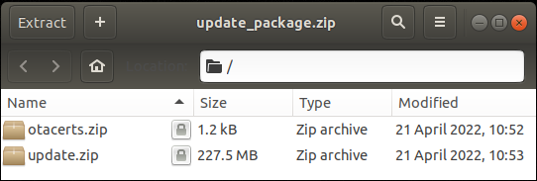
update_package.zip

Slide 10
PKZIP Encryption
Pseudo-random keystream is generated
Keystream XORed with plaintext to produce ciphertext
The password is used to initialize the keystream
96 bits state
Known plaintext attack by Biham and Kocher (2005)
2^40 with 12 bytes of plaintext

Slide 11
bkcrack
Open source implementation of the Biham-Kocher attack
Needs 12 bytes of plaintext
At least 8 of them must be contiguous
ZIP entries in update_package.zip are not compressed!
What would be a good candidate for known plaintext?

Slide 12
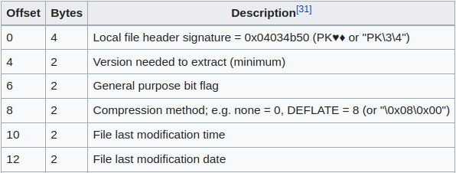
ZIP Local file header

Slide 13
Time vs Date bruteforce
Time is stored in seconds divided by 2 precision
24*60*30=43200 possibilities
Trying all dates for the last 5 years
5*365=1825 possibilities
Bruteforcing the date is more feasible
A single run takes 30min on a modern laptop
Time for a wild guess …

Slide 14
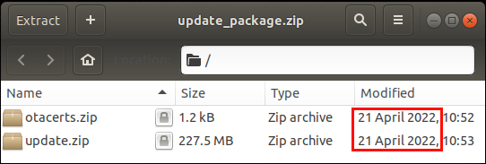
Hmmm ….

Slide 15
Cracking
$ bkcrack -C update_package.zip -c otacerts.zip -p plain2.bin -x 12 9554
bkcrack 1.5.0 - 2022-07-07
[15:03:29] Z reduction using 3 bytes of known plaintext
100.0 % (3 / 3)
[15:03:29] Attack on 1677473 Z values at index 6
Keys: 850725d9 64202f01 143f9452
2.8 % (47031 / 1677473)
[15:04:05] Keys
850725d9 64202f01 143f9452

Slide 16
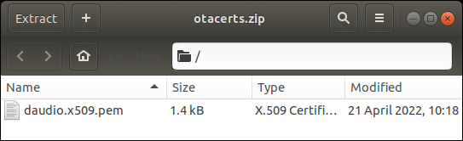
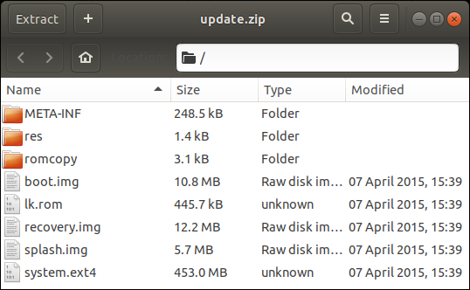
Success!

Slide 17
Reversing Car Apps
$ mkdir /tmp/car
$ sudo mount -t ext4 -o loop system.ext4 /tmp/car
$ ls /tmp/car/app/HKMC_EngineerMode.*
HKMC_EngineerMode.apk HKMC_EngineerMode.odex
$ java -jar baksmali-2.5.2.jar deodex -a 17 -d /tmp/car/framework -o engmode /tmp/car/app/HKMC_EngineerMode.odex
$ jadx

Slide 18
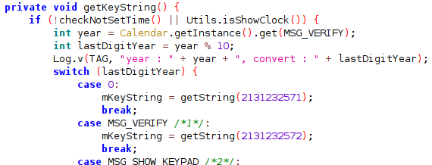
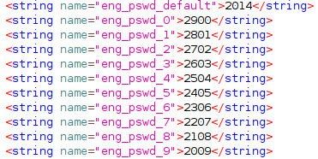
Eng Mode Password
com.hkmc.system.app.engineering.ime.InputPasswordExt#getKeyString()

Slide 19
Update Password
HKMC_SwUpdate.odex
Grep for "update_package.zip"
com.hkmc.system.app.swupdate.ImageFileCopy#getPassword()
Concatenates system properties and then SHA512
Hyundai Tucson 2020 pwd = 15DAA85C8D44B3979CD152A387F6
All system properties are written in /build.prop

Slide 20
Next steps
All future updates can be reversed
How to modify firmware and get r00t?
update_package.zip is signed with an RSA key
The key hasn’t leaked (at least I cannot find it)
Android OTA update

Slide 21
Exploit ideas
Attack vectors: USB, Bluetooth, WiFi
Linux kernel (3.10)
Unfortunately no kernel logs
Application bugs
3rd party library bugs
…
No luck with any of those :(

Slide 22
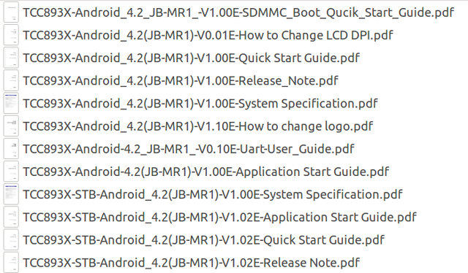
New information
Secret recovery mechanism
TCC893X SDK has been leaked

Slide 23
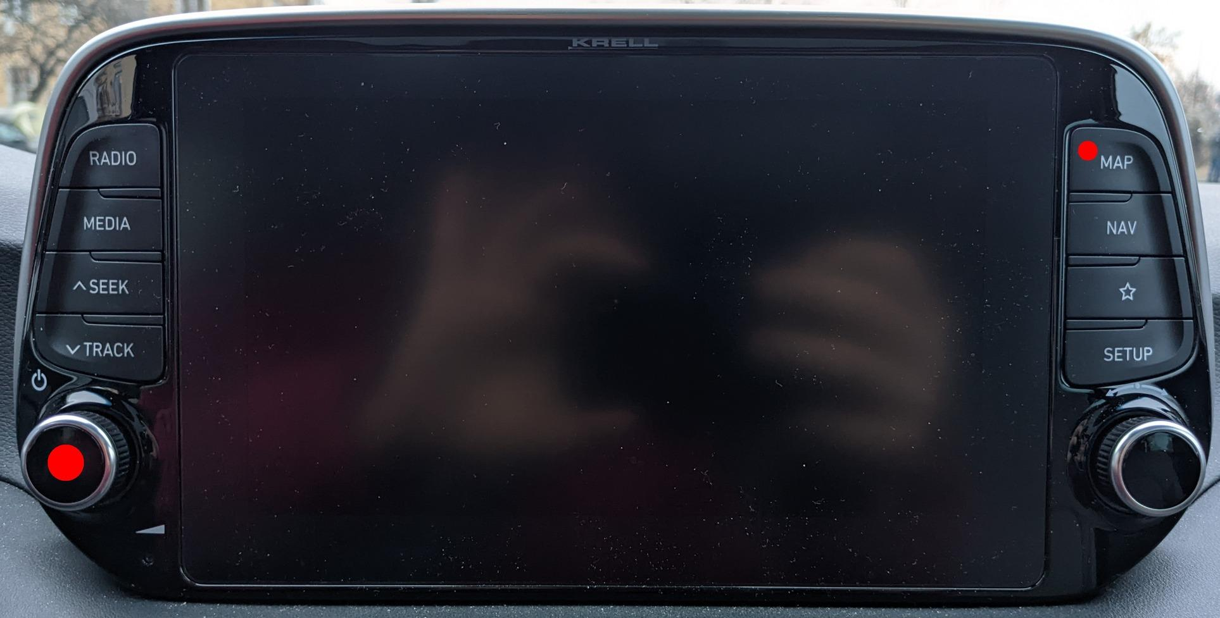
Secret recovery mechanism

Slide 24
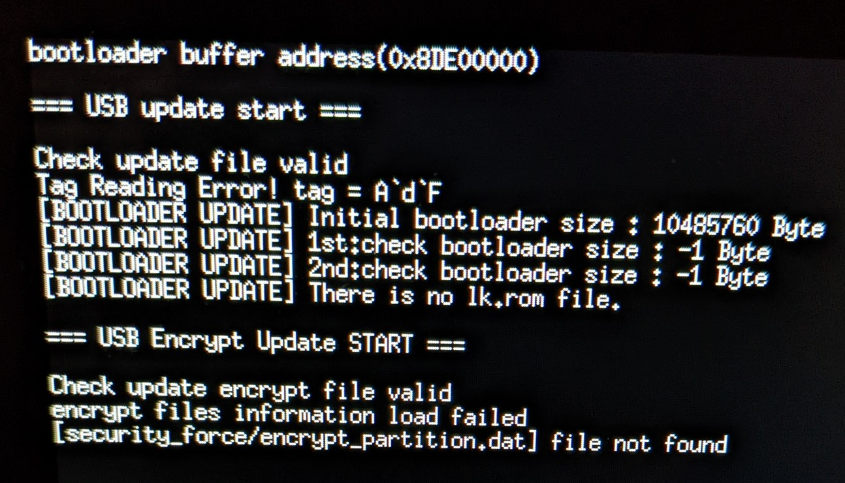
WAT?

Slide 25
Little Kernel
Grepping the strings leads to lk.rom from update.zip
LK stands for “little kernel”
Open source kernel for embedded platforms
The load address is 0x82000000
Bootstraps the system and then runs u-boot
"[DEBUG] U-Boot Recovery Button pushed .... \n"

Slide 26
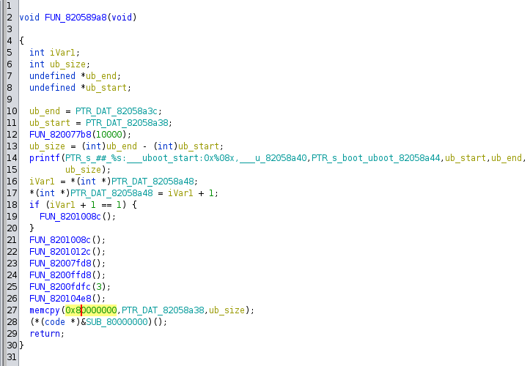
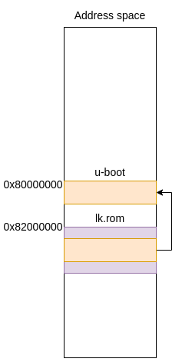
U-boot entry point

Slide 27
Reversing u-boot
dd if=lk.rom skip=$((0x1055c)) count=$((0x57894-0x1055c)) bs=1 of=uboot.rom
The load address is 0x80000000
Many debug strings which help to see what’s going on
security_force/encrypt_lk.rom
security_force/encrypt_boot.img
security_force/encrypt_system.img
security_force/encrypt_recovery.img
security_force/encrypt_splash.img
security_force/encrypt_partition.dat
AES-128-CBC encryption
key=”)1Zorxo^fAhGlh$#”
IV=”aoAkfwk+#1.6G{dE”

Slide 28
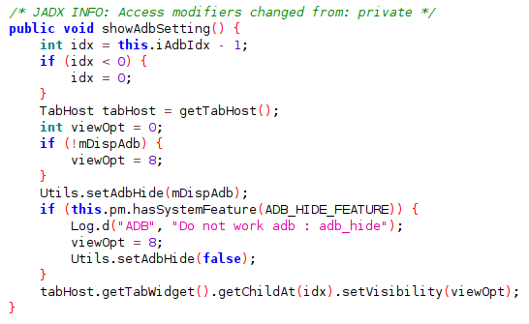
Enabling ADB in Eng Mode

Slide 29

Patching system.ext4
$ cat /tmp/car/etc/permissions/com.hkmc.software.engineermode.adb_hide.xml
<permissions>
<feature name="com.hkmc.software.engineermode.adb_hide" />
</permissions>
Mount, edit, unmount, encrypt, deploy, …, brick???

Slide 30
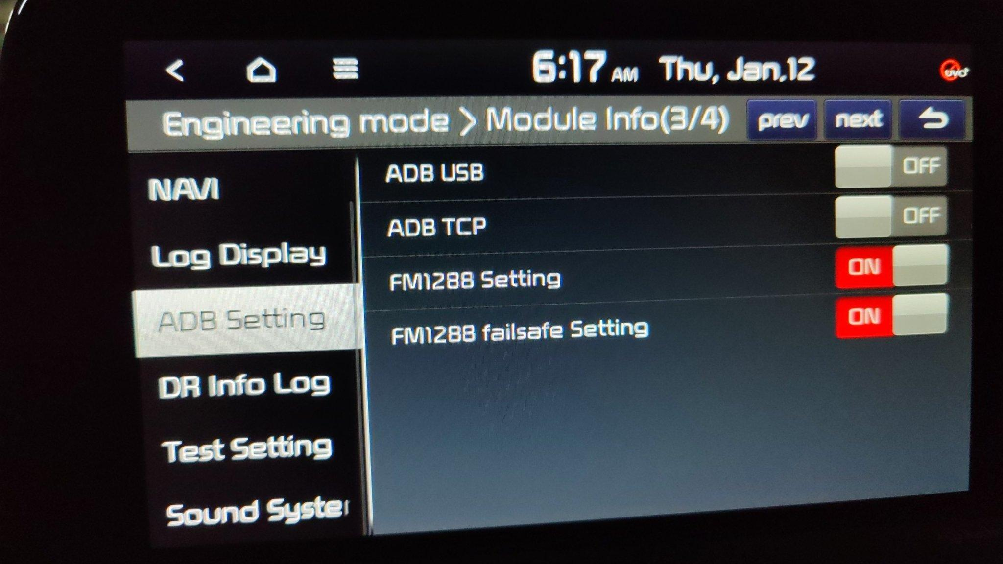
It worked :)

Slide 31
Getting root shell
$ ls -la bin/amossu
-rwsr-sr-x 1 root root 37216 Oct 6 08:29 bin/amossu
Decompile with Ghidra:
setgid(0);
setuid(0);
execv("/system/bin/sh",__argv);

Slide 32
References
https://xakcop.com/post/hyundai-hack/
https://xakcop.com/post/hyundai-hack-2/
https://github.com/rgerganov/gen5fw

Slide 33
Now what?

Slide 34
Black hats
Brick a car in 60 seconds
FlipperZero anyone?
Spyware
Pwn rental cars
Phishing connected phones?

Slide 35
White hats
3rd party apps
Dash cam
Multimedia codecs
…
Answer the fundamental question for every piece of hardware

Slide 36
Will it run DOOM?

Slide 37
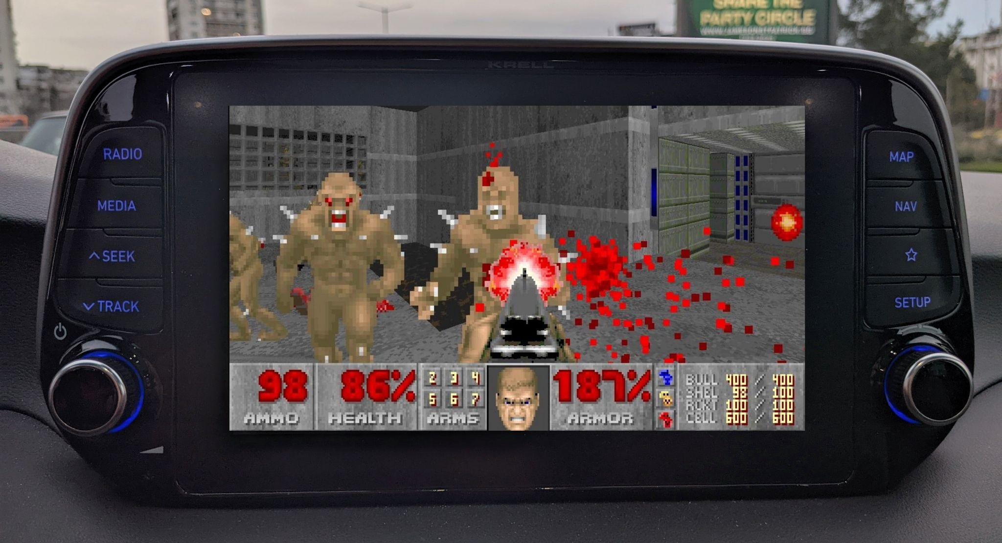
Work In Progress

Slide 38
Q&A

