Slide 1
Cracks in the Foundation
….or

Slide 2
No, you’re doing it wrong!

Slide 3

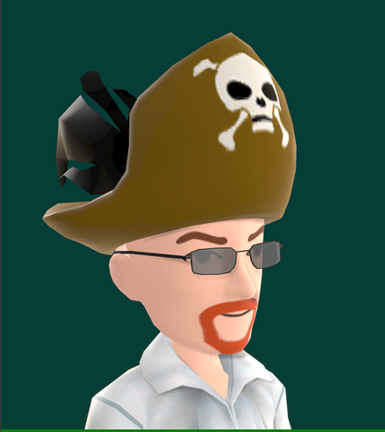
Who are these clowns?
Combined, your presenters have almost 40 years of Enterprise Operations, Support, and Security experience most major industries: Legal, Medical, Financial, Insurance, Manufacturing, & Technology (both inside and outside).
Joe Daw
Cybersecurity Architect
IBM
President Emeritus,
(ISC)2 CLE Chapter
CRob
Cat Herder
Red Hat Inc.
President,
(ISC)2 CLE Chapter
http://www.isc2chapter-cleveland.us/

Slide 4
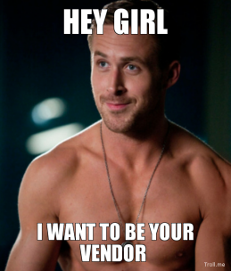
But wait!
We’ve had years of experience managing internal teams, dealing with vendors, working with internal partners.
Currently we now work for major Technology Companies and we get to work with many Fortune <insert value between 1 & 1000> companies.
We’re here to share some of the things we’ve observed and learned along the way.

Slide 5
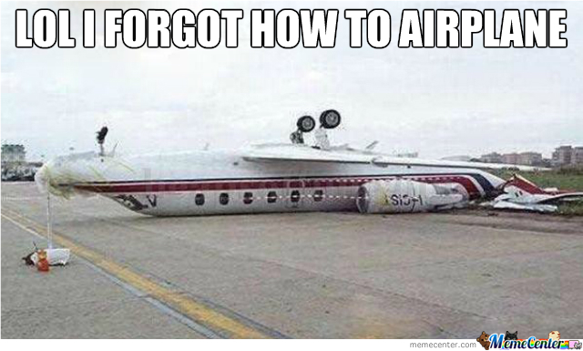
Fundamental Issues
No matter what the industry, the size of the team, or the technologies involved - there are certain almost universal patterns that emerge with InfoSec & Operations teams that most Organizations exhibit…..maybe you do too.

Slide 6
What will make you better is NOT new news
Process
People
Technology

Slide 7
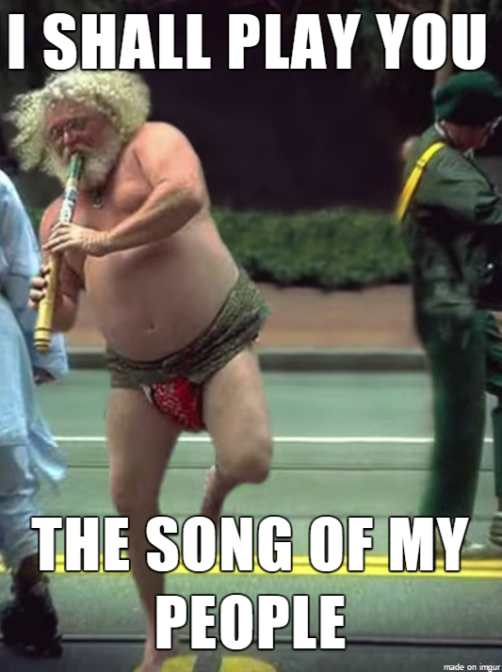
1.
Your People
Let’s start with a few slow ones right over the plate…..

Slide 8
33% of your problems are because of your people & your org structure
Do you REALLY have the right skills to pay the bills?
It’s great you’ve got that Win2K-certified engineer and all….
InfoSec’s Interpersonal “Skills”
“Dr. No”, “The Department of No”... InfoSec hasn’t had the best track record partnering
Silos
Every Org has them; The boundaries between them
are vast, and are hurting you

Slide 9

“Quotations are commonly printed as a means of inspiration and to invoke philosophical thoughts from the reader”

Slide 10
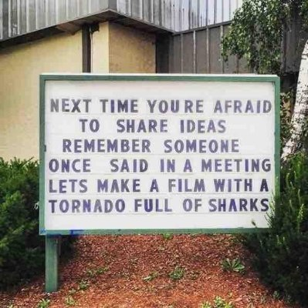

Slide 11
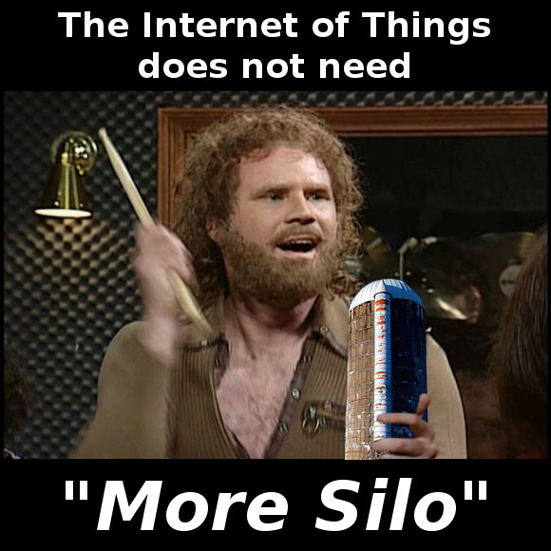

Slide 12

“Security SuperFriends”
Engage critical business and technical stakeholders
Convert them into your champions to multiply your message
Cooperatively help build a plan for security that accounts for and includes their viewpoints.

Slide 13
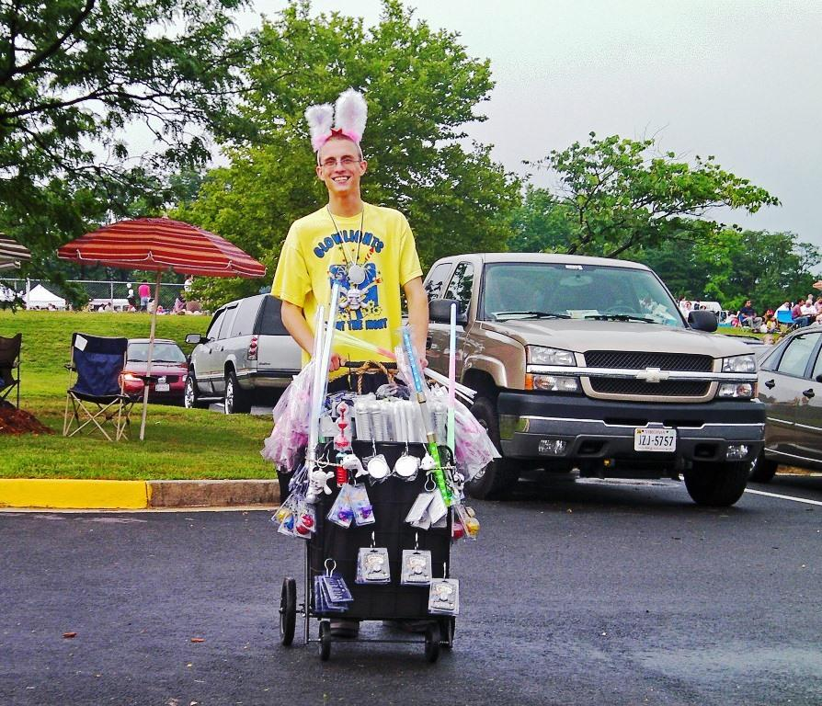
Sell Yourself and security always!

Slide 14

Big
concept
You are your Brand
Every Customer interaction either improves or detracts from that brand

Slide 15
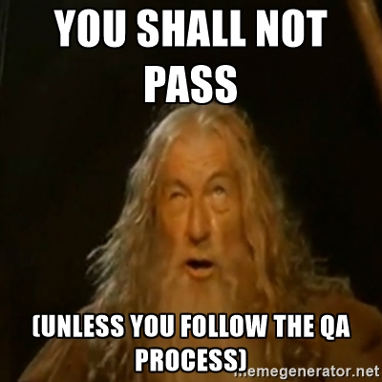
2.
Your Awful Processes
Just because you’ve always done it this way doesn’t mean it’s right.

Slide 16
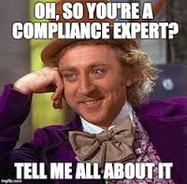
Your process means nothing if you aren’t following it
Incident Response Plans
There’s a reason Boy Scouts are so awesome...Always Be Prepared.
Compliance is not Security
Move beyond the checklist, focus on the intention.
WHERE exactly is your data?
Do you know what’s talking to your critical systems? Do you understand how those systems really work?
Inflexible Process
Attackers and your Business Competitors don’t care about your cool dashboard

Slide 17
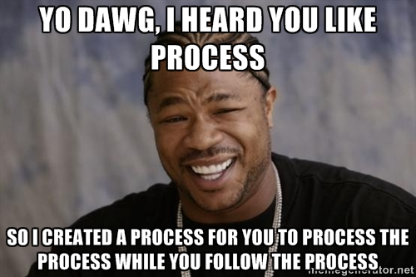
Processing….. for the sake of Process
Legacy means more than just a mainframe; it’s processes (and people) too.
Think in terms of the DEV phrase “technical debt”

Slide 18

Running the Department Like a Business
Engage critical business and technical stakeholders
Convert them into your champions to multiply your message
Cooperatively help build a plan for security that accounts for and includes their viewpoints.
Reward positive interactions with the team (awards, contests, recognition)

Slide 19
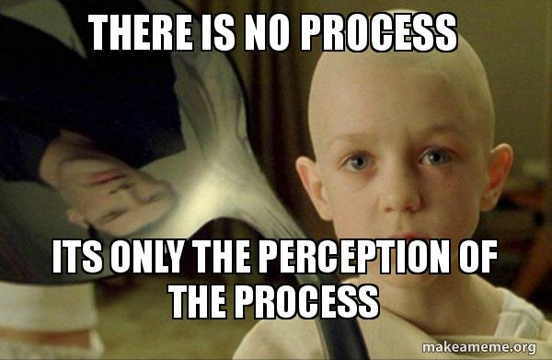
Big
concept
Sometimes you have to burn things to the ground before you can start to move forward again

Slide 20

3.
Your Technology
Why hasn’t someone told you having 3 of the same thing isn’t helping you if you can’t even manage 1

Slide 21

Notes:
STOP BUYING MORE SHIT. Figure out what you have first

Slide 22
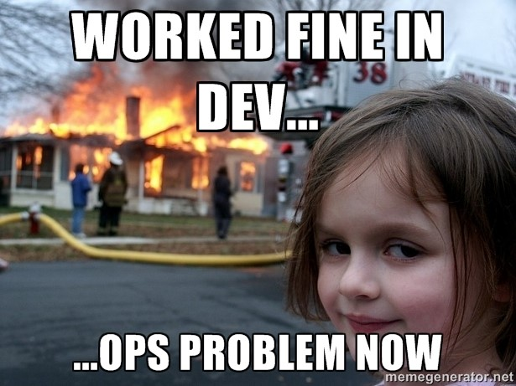
Technically Incorrect
Segmentation
How flat is your network? Y U NO SEGMENT?
Application/Server Documentation
Do you REALLY know how things work? IF you have this...how current is it?
Highway to Heck
Have a Security Roadmap? If you do, when did you update it last? If not….you better get up now and start researching one..
Tools
Poorly/under-used tools, duplicate tools, tools focused on the wrong risks

Slide 23
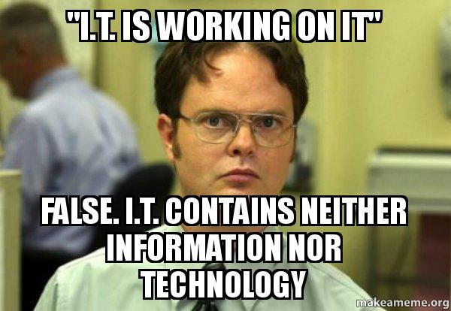
Automate the repeatable tasks, focus your talent on real problems
While that shiny new “next-gen” thing is cool and will solve all of your problems...
Do you even know where your data is, who is touching it, and where it’s going?
Logs
Logs are a solved problem. Why are you still wrestling with them? Why aren’t you doing them right?

Slide 24
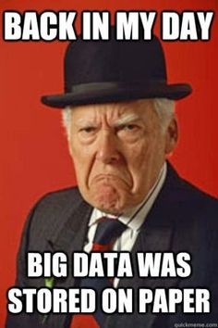
Know THyself
KNOW where the Business’ MOST
IMPORTANT data lives.
KNOW how the MOST IMPORTANT
Business systems work, communicate, and are accessed.
Critically look at IT processes to remove inefficiencies and control gaps

Slide 25
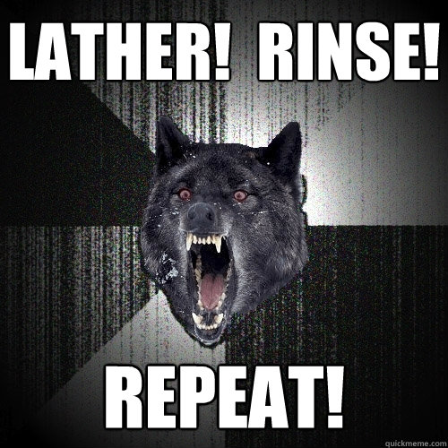
Insanity Wolf says...
Focus on an area, mature yourself, move on to the next

Slide 26
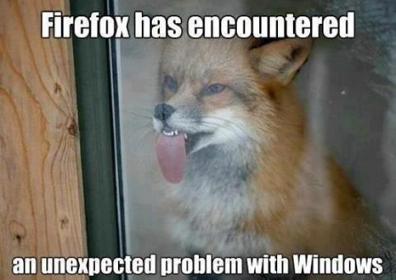
Big
concept
Do a gap analysis to understand where your current technology excels and fails you. Then make RISK-based choices to change, augment, or replace selectively. Understand your Business’ plans so you can help them achieve their goals.

Slide 27
Let’s review some concepts
Eliminate Tribal Knowledge
Document critical systems, plan & test for failures, KNOW where your data is and how it is used.
Talent
Do your people have the right technical and interpersonal skills? How can you either help them get those or find new ones that can get the Business where it needs to be?
Processes
Chances are REALLY good that your current processes suck. Look at rebuilding them and integrating “DevOps” wherever possible to allow fastest response and agility
Roadmap
Take the time to understand the Business’ plans and develop an agile, multi-year plan. Build a consensus of key stakeholders to develop and “sell” the plan. Be prepared to adjust parts of that plan annually.
Org Structure
Is your team aligned correctly with Business and Operations? Can you name your company;s top 3 Business objectives and describe how you’re supporting achieving them?
Compliance is NOT Security
Just having the box checked will NOT stop an attacker. Look at the real intention of the guidance and strive to protect what it is overseeing.
CRob and Joe are vendors
All vendors should be awesome like Joe and CRob!

Slide 28

THANKS!
Any questions?
Joe@daw.org or whatever
CRob@RedHat.com
@RedHatCRob

