Slide 1
CONTENT ADDRESSABLE NETWORK
Sylvia Ratsanamy, Mark Handley Paul Francis, Richard Karp Scott Shenker

Slide 2
OUTLINE
Introduction
Overview
Design
Improvements

Slide 3
Introduction
Key goal is scalable indexing system for large-scale decentralized storage applications on the Internet
P2P, Large scale storage management systems (OceanStore, Publius), wide-area name resolution services

Slide 4
Overview
CAN is a distributed system that maps keys onto values
Keys hashed into d dimensional space
Interface:
  insert(key, value)
  retrieve(key)

Slide 5
Overview
y
State of the system at time t
Peer
Resource
Zone
x
In this 2 dimensional space a key is mapped to a point (x,y)

Slide 6
DESIGN
  Routing
  Can Construction
  Maintenance

Slide 7

Routing
y
d-dimensional space with n zones
2 zones are neighbor if d-1 dim overlap
Routing path of length:
Algorithm:
  Choose the neighbor nearest to the destination
(x,y)
Peer
Q(x,y)
Query/
Resource
Q(x,y)
key

Slide 8
CAN: construction*
Bootstrap
node
new node
* From slides of Santashil

Slide 9
CAN: construction
Bootstrap
node
I
new node
1) Discover some node “I” already in CAN

Slide 10
CAN: construction
(x,y)
I
new node
2) Pick random point in space

Slide 11
CAN: construction
(x,y)
J
I
new node
3) I routes to (x,y), discovers node J

Slide 12
CAN: construction
J
new
4) split J’s zone in half… new owns one half

Slide 13
Maintenance
Use zone takeover in case of failure or leaving of a node
Send your neighbor table to neighbors to inform that you are alive at discrete time interval t
If your neighbor does not send alive in time t, takeover its zone
Zone reassignment is needed

Slide 14
Zone reassignment
3
1
1
3
2
4
2
4
Partition tree
Zoning

Slide 15
Zone reassignment
3
1
1
3
4
4
Partition tree
Zoning

Slide 16
Zone reassignment
3
1
1
3
2
4
2
4
Partition tree
Zoning

Slide 17
Zone reassignment
2
1
1
2
4
4
Partition tree
Zoning

Slide 18
Design Improvements
  Multi-Dimension
  Multi-Coordinate Spaces
  Overloading the Zones
  Multiple Hash Functions
  Topologically Sensitive Construction
  Uniform Partitioning
  Caching

Slide 19
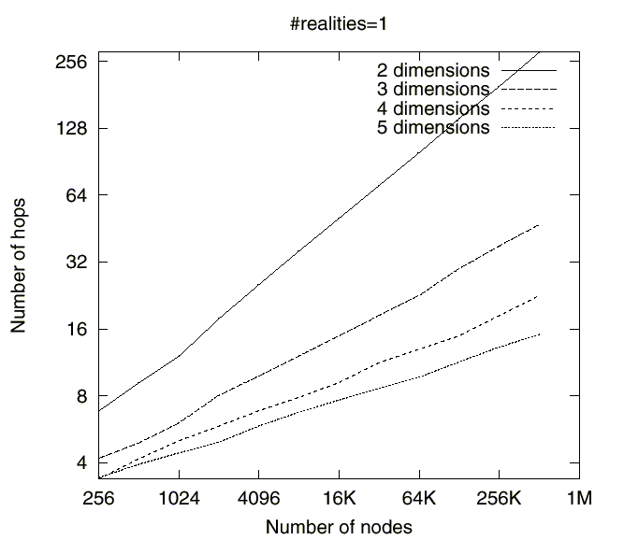
Multi-Dimension
Increase in the dimension reduces the path length

Slide 20
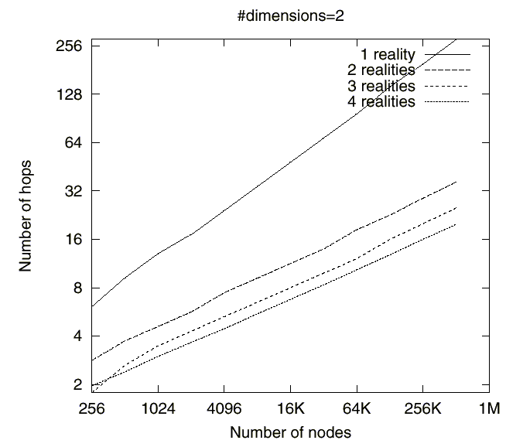
Multi-Coordinate Spaces
Multiple coordinate spaces
Each node is assigned different zone in each of them.
Increases the availability and reduces the path length

Slide 21
Overloading the Zones
More than one peer are assigned to one zone.
Increases availability
Reduces path length
Reduce per-hop latency

Slide 22
Topologically Sensitive Construction
Istanbul
Tokyo
Ankara
Predefined zones according to landmarks
Each new node measures round trip time to each zone and enters to the shortest
So topologically close nodes will reside in the same portion of space

Slide 23
Uniform Partitioning
Instead of splitting directly splitting the node occupant node
  Compare the volume of its zone with neighbors
  The one to split is the one having biggest volume

