Slide 1
Information Security – Creating Awareness, Educating Staff, and Protecting Information
Session 46
Chris Aidan, CISSP
Information Security Manager
Pearson

Slide 2
Topics Covered
Data Privacy
Spyware & Adware
SPAM & SPIM
Phishing
Passwords
Social Engineering
Email & Chat Services
Securing Workstations
Data Backups
Equipment Disposal
Data Recovery Demo
Data Disposal
Access Rights
Physical Security
Emerging Threats
Incident Response
Creating Awareness
Questions
Useful Links

Slide 3
Why Security?
Liability
Privacy Concerns
Copyright Violations
Identity Theft
Resource Violations
Reputation Protection
Meet Expectations
Laws & Regulations

Slide 4
Understanding Threats
What is valuable?
What is vulnerable?
What can we do to safeguard and mitigate threats?
What can we do to prepare ourselves?
Most believe they will win lottery before getting hit by malicious code

Slide 5
Keep Sensitive Data Private
Protecting Information like:
Social Security Number
Drivers license number
Insurance numbers
Passwords and PIN’s
Banking information

Slide 6
Terminology
Hackers
  white hat
  grey hat
  black hat
DOS & DDOS
1337 (Leet) speak
Warez
Script kiddies

Slide 7
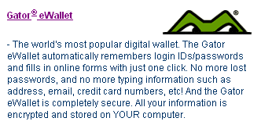
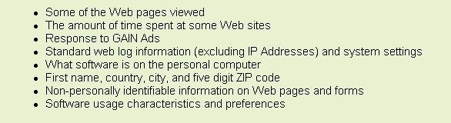
Spyware & Adware (Scumware)
Spyware-Applications that monitor activity without express permission
Adware-Applications that monitor activity with express permission
  Read the EULA

Slide 8
SPAM & SPIM
SPAM-
  Junk email
SPIM- SPAM has come to Instant Messaging
  Uncontrolled viewing (pop-up windows)
  Bot generated

Slide 9
Phishing
Phishing is a computer scam that uses SPAM, SPIM & pop-up messages to trick us into disclosing private information (Social Security Number, Credit Cards, banking data, passwords, etc)
  Often sent from someone that we “trust” or are in some way associated with us
  Appears to be a legitimate website
  Embedded in links emails & pop-up message
  Phishing emails often contain spyware designed to give remote control to our computer or track our online activities

Slide 10

Passwords
Select a good one
  At least 7 characters
  Mixture of upper and lowercase characters
  Mixture of alpha and numeric characters
  Don’t use dictionary words
Keep passwords safe
Change them often
Don’t share or reuse passwords
Two-factor authentication

Slide 11
Social Engineering
Social Engineering is the art of prying information out of someone else to obtain access or gain important details about a particular system through the use of deception

Slide 12
Email & Chat Services
Email and chat are sent in clear text over the Internet
Data can easily be captured and read by savvy computer users and systems administrators
Safeguards should be put into place prior to using these programs for sending/receiving sensitive information like Social Security Numbers

Slide 13
Enhance Our Work Area Security
Secure workstations
  Lock our systems (Ctrl-Alt-Delete)
  Shut down
  Run up to date virus scanning software
  Password protect files
  Apply software patches
  Install cable locks
  Run a desktop firewall

Slide 14
Is Our Data Being
Backed Up?
Test backups
Securely store backup media (offsite)
Restrict access to who can perform restoration

Slide 15
Equipment Disposal
What happens to old computer when they are replaced?
Do those systems contain sensitive information?
Several programs to securely remove data from computer systems are commercially available

Slide 16

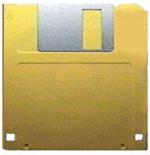
Data Recovery
DEMO

Slide 17
Dumpster Diving
We never know who is looking in our trash
Shred sensitive documents
Secure shred barrels, and make sure that proper handling procedures are in place

Slide 18
Access Rights
Only allow access that is absolutely required
Don’t grant accounts based on the fact that access “may” be required
Use least privilege access policies that state access will only be granted if required, not by default
Are accounts removed and passwords changed when someone changes jobs or is terminated?
Perform audits

Slide 19
Physical Security
Who has access?
Are sensitive documents secured?

Slide 20
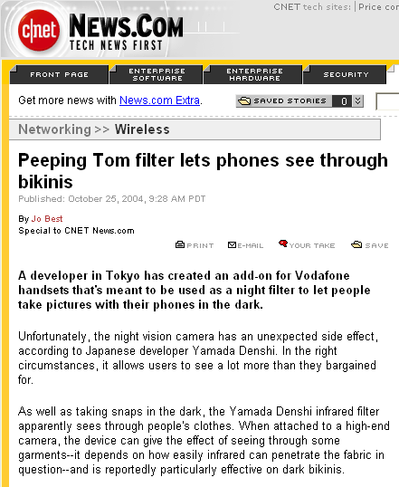
Emerging Threats
Wireless Technology
Memory Devices-iPod, USB Keys, Coke cans, etc
Camera phones
P2P File Sharing

Slide 21
Incident Response
Do you know what to do and who to contact if a security breach occurs?

Slide 22
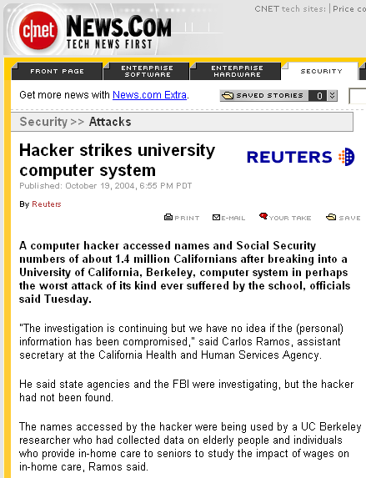
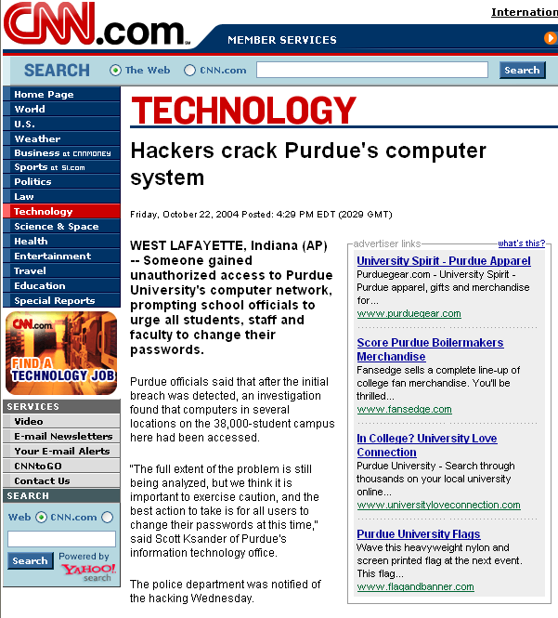
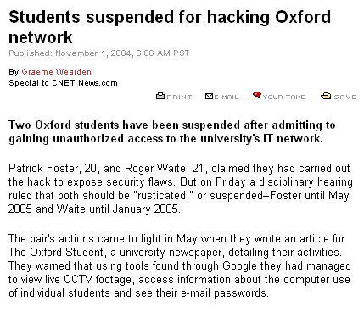
Recent News

Slide 23
Creating Awareness
Educate staff
  Train staff
  Document processes and outline expectations
Research potential candidates
  Perform background & credit checks
Track system changes
  Audit system access
  Audit system changes
Create & communicate policies:
  Define document and system disposal processes
  Define backup procedures
  Define clean work area policies
  Define computer usage policies

Slide 24
Be Aware
Report anything “strange”
Don’t give private information out
Properly dispose of sensitive information
Run up to date virus protection & software
Ask questions

Slide 25
Useful Links
National Cyber Security Alliance
http://www.staysafeonline.info/
National Institute of Standards and Technology:
http://csrc.nist.gov/sec-cert/
Recent News
  High Profile Computer Compromise
  High Profile Computer Compromise
A lot of Schools have great security resource pages, for example UC Davis and the University of Iowa websites:
http://security.ucdavis.edu/security101.cfm
http://cio.uiowa.edu/itsecurity/

Slide 26
Example Software References
Some various applications mentioned in the presentation*
Email Security
  PGP http://www.pgp.com
  Instant Messaging Security
  Simp http://www.secway.fr/products/all.php?PARAM=us,text
  Adware & Spyware Removal Applications
  Ad-aware http://www.lavasoftusa.com/software/adaware/
  Spybot http://www.safer-networking.org/en/download/
Secure File Deletion
  Secure Delete http://www.sysinternals.com/ntw2k/source/sdelete.shtml
System Disposal
  Secure Hard Drive cleaning http://www.accessdata.com/Product07_Overview.htm
* Use of these tools is not an endorsement or guarantee of product reliability or effectiveness

Slide 27
Sample Policies
Developing Security Policy
  http://www.sans.org/rr/papers/50/919.pdf
Acceptable Use
  http://www.sans.org/resources/policies/Acceptable_Use_Policy.pdf

Slide 28
Questions?
Please fill out the session evaluations & thank you for attending this session

