Slide 1
CS:4980:0001 Peer-to-Peer and Social Networks Fall 2017
Introduction

Slide 2
What is a P2P network
Uses the vast resource of the machines at the edge of the Internet to build an overlay network that allows resource sharing and content delivery without any central authority.
Client-Server vs. Peer-to-peer. A peer is both a client and a server. Control is decentralized.

Slide 3
Why study P2P
Past uses. Sharing (*often pirated*) music or movie on the Internet
Modern uses.
P2P TV, VOIP Telephony (Skype)
File sharing
Digital currency - blockchain
P2P Services (Uber, Lyft, AirBnB)
Content distribution
(Twitter and Facebook have their (BitTorrent-like) content distribution mechanism).

Slide 4
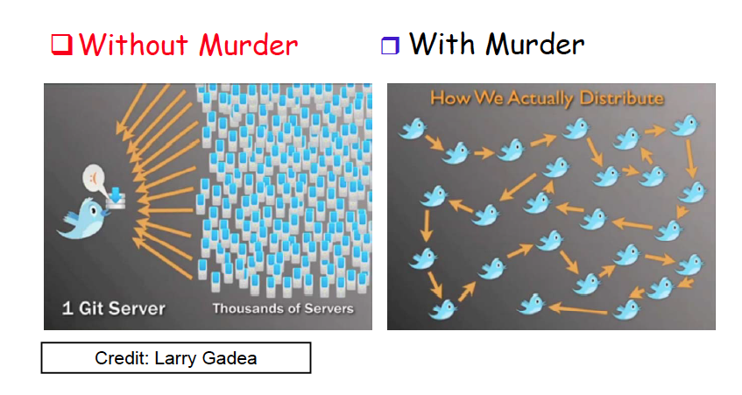
Twitter

Slide 5
Social Network
[Wikipedia definition]
A social network is a social structure made up of a set of actors (such as individuals or organizations) and the dyadic ties between these actors. The social network perspective provides a clear way of analyzing the structure of whole social entities.

Slide 6
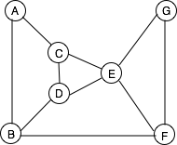
Social networks
Abstract representation is a graph G=(V,E)
This graph can represent various things. For example,
Each node is a friend and each edge is a friendship relation
Each node is an airport and each edge is an air route
Each node is power generating station, and each edge is a high voltage
link connecting a pair of generating stations

Slide 7
Example of networks
Biological networks
Protein–protein interactions networks
Predator-prey networks
Technological networks
Power grid
Telephone network
Internet
Classical Social networks
Intermarriage network among ruling families in Florence
Friendship among school children
Information networks
WWW graphs
P2P networks
Modern social networks
Facebook
Twitter
LinkedIn

Slide 8
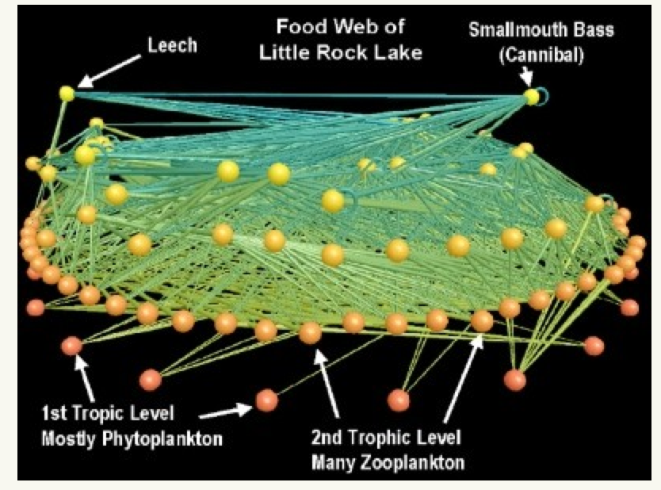
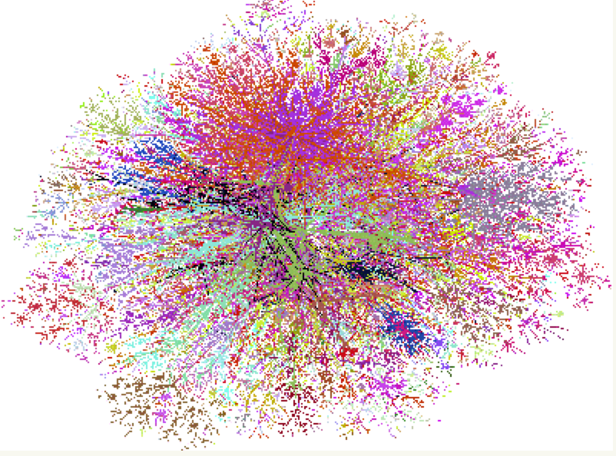
Example of networks
Food web at Little Rock Lake
(Credit: Mark Newman)
The Internet
Source: http://www.cheswick.com/ches/map/gallery/index.html

Slide 9
Social networks
Social networks existed from the dawn of civilization, much
before Facebook or Twitter were created ☺. Facebook or Twitter
only established an electronic platform to facilitate socialization.
In contrast, peer-to-peer networks are a much more recent invention
primarily aimed at content sharing and content distribution,
often without the assistance of a central server.

Slide 10
Six degrees of separation
Six Degrees of Separation is a 1993 American film.
(1929) Frigyes Karinthy, a novelist in of Budapest wrote a book that contained a story called “Chains.” A character in this story suggested that he could link to any other inhabitant in the world through a chain of five acquaintances.
(1967) Stanley Milgram conducted an experiment that validated this.

Slide 11
Milgram’s experiment
Milgram arranged to send 160 envelopes to a group of randomly
selected people from Wichita, Kansas and Omaha, Nebraska.
Each envelope contained the following:
1. A document with the logo of Harvard on it.
2. Name, address and occupation (stock broker) of Milgram's friend
in Boston, MA.
3. Instructions to get the package to the target person following
specific rules: each person could only send the package
to an acquaintance defined as being on "first name basis".

Slide 12
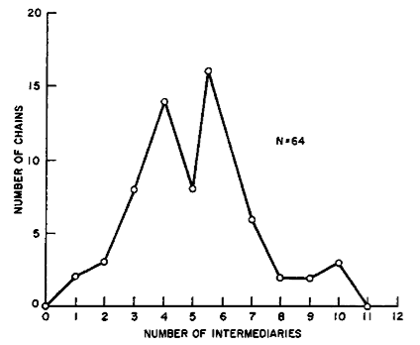
Milgram’s experiment
Taken from Kleinberg’s book
64 of the 160 envelopes reached the target person. The median length of the chain was six

Slide 13
Shortcomings of Milgram’s experiment
There were several shortcomings of this experiment.
Many envelopes did not reach the target person.
The sample size were too small
There was not much flexibility in the choice of the source
and the target
Should we still believe these results?

Slide 14
Facebook experiment
Karl Bunyan (2009)
Ran experiments on the Facebook platform with an application named "Six Degrees”, and calculated the degrees of separation between different pairs of users. Facebook had over 5.8 million users as seen from the group's page. The average separation between all pairs users of the application was 5.73 and the maximum degree of separation was found to be 12.
On Twitter, the average separation is close to 5.

Slide 15
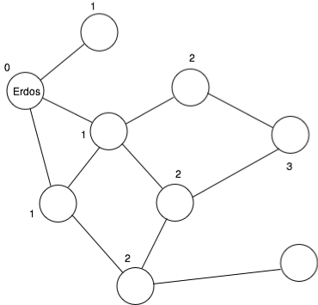
Erdős number
ErdősNumber (Erdős) = 0
If X is the coauthor of at least one
paper with a person whose Erdős
number is n, then Erdős number
of X = n+1.
These numbers are surprisingly small.
Albert Einstein’s Erdős Number is 2
Sriram Pemmaraju’s Erdős Number is 2
Doug Jones’ Erdős Number is 4
Sukumar Ghosh’s Erdős Number is 3
Co-authorship network

Slide 16
Kevin Bacon number
Refers to distance measures in the co-actor network
(available from Internet Movie Database IMDb)
Similar to Erdős number but applies to movie actors.
Actor Kevin Bacon’s number is 0 by definition.
Anyone who has acted in a film with an actor whose Kevin
Bacon number is has a Kevin Bacon number of
IMDb database has more than 200,000 actors and actresses, but the Kevin Bacon numbers for them are surprisingly small.

Slide 17
Important questions
How does a social network evolve?
What are their structural properties?
Why are the degrees of separation so small?
How can we use some of these structural properties?
What are some of the important issues in social networks?

