Slide 1
100 Great Publicity Ideas for your
Amateur Radio Club!
(OR: What Did I Get Myself Into? )
Jeff Reinhardt AA6JR © 2002

Slide 2
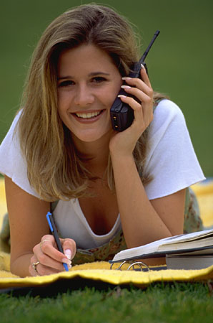
Radios + People
People: A great invention we can’t take credit for.
Radios: Didn’t invent those either, but we can invent fun things to do with both!
Notes:
Emphasize the combining of elements to create events that involve the members of your club engaging in fun activities that generate positive visibility in the community.

Slide 3
Create Events, Reap Publicity!
Events should:
Be fun
Have meaning
Combine elements
Be Prepared
Publicity should:
Have an objective
Tell a good story
Connect the elements
Reflect well on your club
Notes:
How to go about creating events. Components of the event and the sought-after publicity should create a synergy.
We have a lot of ideas and not much time, so here we go!

Slide 4

January
1. Parade coordination
2. Safe Ride Home
3. Kids Day
4. MLK Day celebration
5. Space contact demo
6. Spotlight on nets
7. New Year special event
8. Weather watch
9. Outreach with scouts
Notes:
Here we go with 9 activities for each month. If your club does one or two of these each month, you'll be busy and very visible in the community. Don't forget to get your club's meeting dates, time and place in the community activity section of your local newspaper!
Touch on each element:
1. New Year parades often need communications and safety coordination.
2. Safe ride home for people who party a bit too much. We can be "radio dispatched."
3. An ARRL Kids day happens in January, your club should participate.
4. Many cities celebrate Martin Luther King Day. We can help.
5. Work with a school or YMCA or Boys & Girls club
6. There are many Ham Nets. Someone in your club probably participates in one or more.
7. Special events are fun and many collect the unique QSLs.
8. Winter weather offers us opportunities to help others.
9. Do a demo fopr a Boy or Girls Scout troop!

Slide 5

February
1. Presidents Day Event
2. Valentine Radiograms
3. Space contact
4. Club “Guest Night”
5. Service to military
6. Mall demonstration
7. City proclamation
8. Winter sport tie-in
9. PTA demonstration
Notes:
1. IS there a nearby townor county that shares a name with a president? How about a special event station there?
2. Radiograms are fun, especially if they're personally delivered like the old telegrams. This can also keep our traffic nets busy!
3. Tie into some of the news about the ISS or communicate through an "easy sat"
4. Your club can invite local celebrities (politicians or others) to learn about all you do to support the community and teach others about technology.
5. Are there MARS members in your club? What can we do to help send goodwill messages to our service people overseas?
6. Do a ham demonstartion at a shopping mall. This may be a good place to solicitfor "free Valentines Radiograms."
7. Ask your city for a proclamation honoring the many contributions ham radio makes in times of need, or, they could honor a club member who has made a significant achievement. It could even be a "big" birthday or anniversary.
8. Many communities have winter carnivals or sporting events. They'll appreciate your communications help.
9. The local PTA might appreciate a demo of ham radio's many links with education programs. The League can help with info.

Slide 6

March
1. Contest spotlight
2. DF demo (T-hunt)
3. Nat’l Red Cross Month
4. Government outreach
5. RFI outreach
6. Spotlight on seniors
7. Licensing classes
8. Service club program
9. ARES demo
Notes:
1. You can generate a news story about some of the marathon ham radio constests. A member of your club is probably a participant.
2. Do a demo of Direction finding for law enforcement or others.
3. Do some outreach with the local Red Cross chapter. Make it a joint event or meeting.
4. Invite your mayor city councilman or congressman to address your club. Also make them aware of our concerns related to spectrum loss and the need for antennas.
5. Form a committee on your club to help the public with RFI problems. It may not see much activity but could be a good news release that gets your club in front of the community in a positive light.
6. Honor some seniors or "greatest generation" members with a special night at your club. Ask them to share stories about their youth with youngsters in your community. Rememebr those old glowing radios?
7. Do a licensing class. This is community outreach.
8. Invite the Rotary or Kiwanis or Optimists to your meeting, or go speak in front of them. They could also help you raise money for a project!
9. An ARES drill can generate good publicity, especially if done with local public safety agencies.

Slide 7

April
1. Skywarn program
2. Focus on women
3. Mobile operations
4. School event
5. ISS contact
6. Walk America
7. Ride to church
8. Search & Rescue Ops
9. “Build it” night
Notes:
1. April can be stormy in many areas of the country. Can your club be of service?
2. Let's do some outreach with women; helping them get licensed and feeling comfortable with ham radio. Maybe the women of your club can put on this month's program?
3. Demonstrating our mobile capabilities to public saftey agencies may make them aware of our considerable assets.
4. Schools are often looking for assembly programs or science club speakers. We should be there!
5. Maybe in combination with the above. It's newsworthy.
6. March of Dimes holds fundraisers across the country. They need help ensuring the safety of the walkers.
7. Many majoe religions have high holidays in the spring. Could we help provide rides to church or synagogue?
8. A search & rescue program or course is timely before the nice weather gets folks into outdoor activities.
9. Have your club do a "hands-on" event, building folding J-poles or crystal radios. It's great fun for the kids.

Slide 8

May
1. Mothers Day Radiograms
2. Coordinate comms at a local event
3. Community Safety Patrol
4. Focus on RACES
5. Memorial Day special event
6. YHOTY Nomination
7. Scholarship contribution
8. Coffee Break
9. Dayton Tie-in
Notes:
1. Get those radiograms to Moms across America!
2. Many communities have spring festivals. We can help make those vents safe and enjoyable.
3. Is there an outbreak of crime that can be fought with additional "eyes and ears?"
4. RACES operations take on added importance with and through the Office of Homeland Security. You could also help your community secure funsing for communications assets.
5. A special event station to honor the military or commemorate a local hero.
6. Your club can nominate someone for Young Ham of the Year.
7. Create a scholarship fund in your club's name. The Foundation for Amateur Radio could administrate it for you.
(they'r on the web.)
8. CBers used to do safety breaks at freeway rest stop, serving coffee and donuts. We could do that!
9. Someone in your club could be going to Dayton Hamvention. This could be a local news story that explains what ham radio is all about. Your club could designate the traver as its "delegate" to this annual event.

Slide 9

June
1. Present plaque to gov’t entity.
2. Flag Day event
3. Fathers Day Radiograms
4. Field Day pre-publicity
5. Safe Grad Night
6. A Ham wedding?
7. June Kid’s Day
8. Field Day and follow-up!
Notes:
1. Present a plaque to someone in local government who is a friend to ham radio. Even better if your city council meetings are on TV!
2. There must be some flag related town nearby that would make a good special event location. A town named Liberty or Star or Glory? MAybe they make flags nearby?
3. Get those traffic nets moving radiograms for Dad!
4. A pre-field day release on your clubs preparations could add to the publicty generated.
5. Safe rides home for partying grads could save a life.
6. June is wedding month. Two hams tying the knot may be newsworthy!
7. There's another Kids Day in June. Go to it!
8. Field Day publicity or a follow-up release can generate coverage.

Slide 10

July
1. Independence Day Special Event
2. National Night Out
3. Beach patrols
4. Demo at County Fair
5. Park event safety team
6. Ham Radio camp out
7. Antique radio event
8. Hamfest
9. Donate a radio
Notes:
1. Even better if you do it at a park where there are Fourth events.
2. Help fight crime in your community with radio patrols.
3. Crowded beaches offer communications opportunities.
4. The county fair attracts a great audience.
5. Summer Concerts may need communications for safety.
6. Your club can have a group camp out tied to ham radio.
7. Many communities have antique fairs. Make radio a part of it.
8. Sponsor a hamfest/swap meet.
9. Donate a new 2m HT to a needy local or senior ham. Cost is low, reward is high!

Slide 11
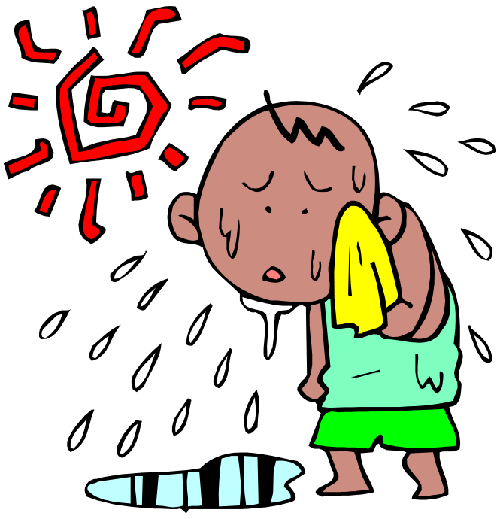
August
1. Hospital outreach
2. Back to school patrols
3. Hurricane watch
4. City’s “Birthday”
5. Homeland Security
6. VE Spotlight
7. Legislative Action
8. Father - son club event
9. APRS demo
Notes:
1. Is your local hospital in need of communications volunteers?
2. Help keep kids safe. Timely, given the recent news.
3. Hurricane season in the east but ham clubs across the country can also pass health & welfare traffic into stricken areas.
4. The actual date of founding may vary but a special event station honoring your city's 'birthday" is a natural.
5. New government agency may offer opportunities for participation and funding local communications efforts.
6. Host a VE session and/or put the publicity spotlight on your Volunteer Examiners who do a lot to help get others on the air.
7. Have your club send QSL cards to state & national reps asking for antenna relief and spectrum protection. Make it a news event.
8. Have a father-son event. Maybe a ham club presence at a ball game? They'll announce you on the PA and on the scoreboard!
9. Do an APRS geolocating demo for local public safety or others.

Slide 12
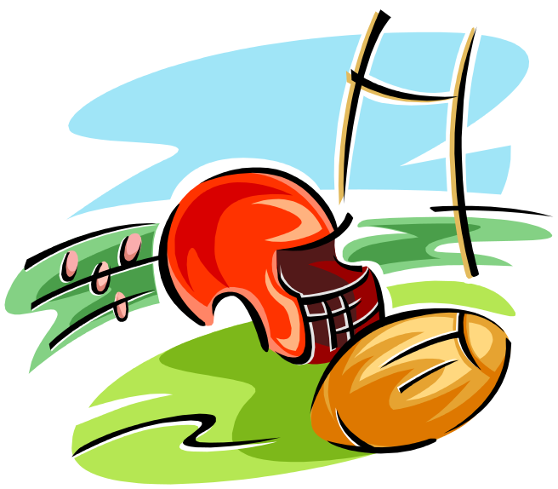
September
1. Salute to Heroes
2. “Kickoff” special event
3. Labor Day road patrols
4. Fundraiser
5. School program
6. Invite Scout Troop to club meeting
7. Blood drive
8. Fire patrols
9. Amateur Radio Awareness Day
Notes:
1. In the aftermath of 9/11 salute your local firefighters and or police with a plaque and/or a special event station at their facilities.
2. Maybe a special event at the local College/high school or pro football stadium.
3. Safety patrols during the holiday.
4. Help raise funds for an important community cause or Unitted Way. Your check presentation is a photo op.
5. It's back to school time. Let's do some outreach.
6. Scout troops are meeting again. Invite them to a club meeting that shows what Ham radio is all about!
7 Do a club blood drive. Another photo op. Also attrracts the community to your club.
8. Fire season in the west.
9. Awareness Day can be fun outreach at local mall or event.

Slide 13

October
1. Halloween safety patrol
2. JOTA
3. SET
4. Sputnik celebration
5. Fall licensing class
6. Demo at public library
7. NTS demo at club
8. Special event from graveyard
9. Remote control demo
Notes:
1. Work with local law enforcement to keep it safe & fun.
2. Boy Scout Jamboree on the AIr. Work with a troop.
3. The ARRL Simulated Emergency Test occurs this month!
4. A sputnik launch special event station?
5. Start a licensing class culminating in an exam.
6. Public libraries often seek displays.
7. Demonstrate traffic handling at a club meeting.
8. A guranteed halloween newsworthy event!
9. Remote control; robots/cars/aircraft are always fun.

Slide 14

November
1. Club elections + release
2. Food Bank patrol
3. Veterans Day special event
4. Santa parade support
5. Ham + another hobby meeting (RV, etc.)
6. Holiday lighting help
7. “Turkey Trot” support
8. Parking lot patrols
9. Food pantry donation
Notes:
1. When you elect new officers, send out a news release.
2. Start gathering food. Put out a release to call a given phone number some weekend and a radio dispatched car will pick up the donation.
3. Honor the local vets with a special event station. Maybe from a VA faclity?
4. Holiday parades need communications.
5. Make new friends. Invite another hobby club to your club.
6. Offer help with holiday lighting to seniors
7. Many communities have foot or bike races. We can help.
8. Add to holiday shopping safety.
9. Your gathered food donation to a local pantry is a photo op.

Slide 15
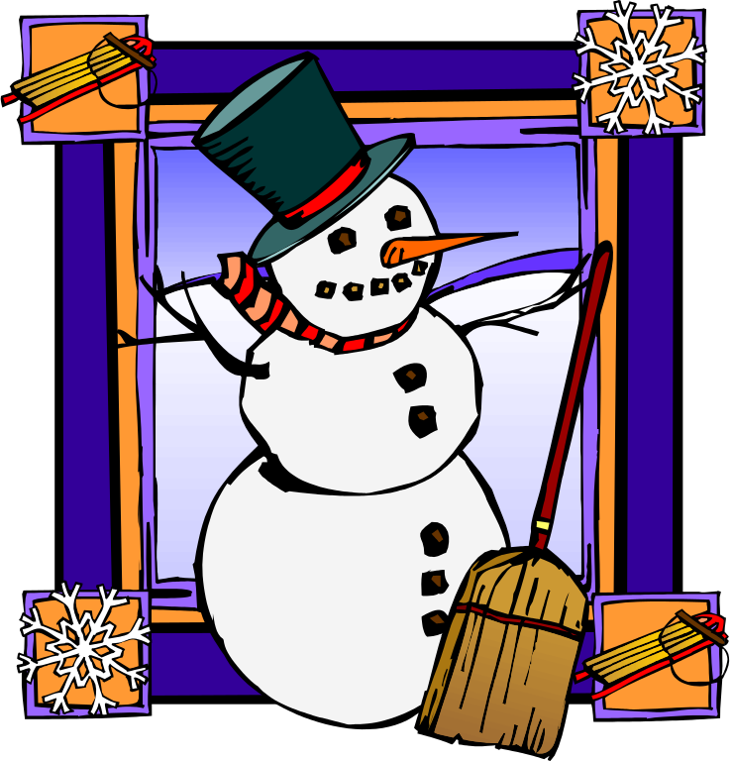
December
1. Santa on the radio
2. Shopping patrols
3. Ham of the year
4. Holiday special event
5. Holiday Radiograms
6. US Marines Toy Drive
7. Safe ride home
8. Field Day results
9. Straight Key Night
Notes:
1. Visit a children's hospital and put Santa (and Mrs. Santa) in touch with the kids.
2. Keep the holiday season safe for others.
3. Honor a local ham of the year. It's newsworthy!
4. Is there a holiday related town name nearby, like "Holly" or "Bethlehem" or similar? Create a nice certificate.
5. Send those radiograms into the traffic nets!
6. Collect toys and do a photo.
7. Keep those who party a bit too much safe.
8. FD results are anounced in December. Send out a release with your club's placement.
9. Straight Key Night could also be a news story. Get those Brass Pounders involved!

Slide 16

Your club’s activities are good news in the community.
(don’t keep them a secret!)
Notes:
These are just a few of the ideas your club can use to increase its visibility in the community while engaging in fun and meaningful activities. It all starts with your enthusiam and the support of those in your club. You'll be surprised at the many skills they bring! Good luck.

