Slide 1
Engineering Innovation
Adnan Akay – CMMI
Kesh Narayanan - IIP

Slide 2
Innovation Definition(s)
Innovation is the complex process of introducing novel ideas into use or practice - Lemelson/MIT
Innovation occurs at the intersection of invention and insight; it’s about application of invention -Council on Competitiveness
Knowledge applied to tasks that are new and different is Innovation – Peter Drucker
Research is the transformation of money into knowledge;
Innovation is the transformation of Knowledge into money – 3M

Slide 3
Innovation Theme
Research in the Science of Innovation
Education for Innovation
Partnerships Opportunities

Slide 4
Research on Innovation
Business Innovation
  Open Source Innovation
    Bell Labs Vs CISCO
Engineering Model
  Simulation and Modeling of Innovation Process
Innovation Policy

Slide 5
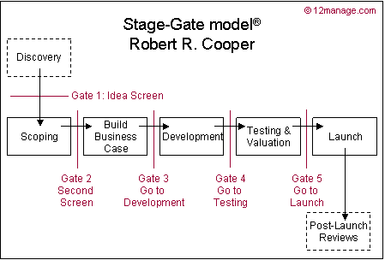
Innovation Process Flowchart

Slide 6
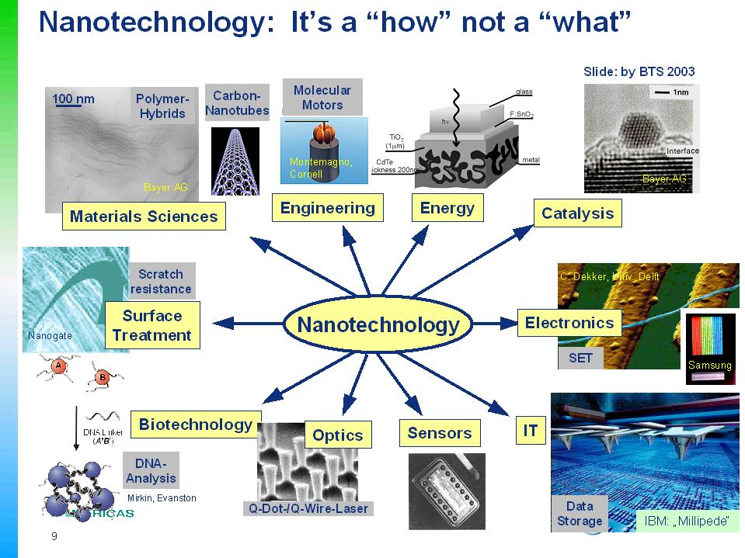
Notes:
At the same time we must remember that nanotechnology is a “how” and not a “what.” At Bayer MaterialScience we would agree with James Martin in that that we see nanotechnology as a so-called “enabling” technology. It is not a monolithic industry – a “what” – but rather a “how” that will influence applications from surfaces, to electronics, to biotechnology. Customers don’t come to us and ask explicitly for nanoparticles, they are more interested in finding solutions to their problems.

Slide 7
Science of
Science and Innovation Policy*
What are the critical elements of creativity and innovation?
What is the impact of globalization on creativity and productivity?
How to predict the likely returns from future R&D investments?
* Kaye Husbands Fealing,
Science of Science Policy Advisor
Social, Behvioral and Economic Sciences (SBE)

Slide 8
Science of Science and Innovation Policy
Three workshops: summer 2006
  The Scientific Basis of Individual and Team Innovation and Discovery
    memory and analogy mechanisms in creative design processes
  The Social Organization of Science and Science Policy
    interrelationships between inputs, outcome and policies in the national innovation system
  Knowledge Flows, Business Metrics, and Measurement of Strategies
    better measures of innovation
2007 SBE Draft Solicitation
  Role of ENG?

Slide 9
Education for Innovation
Deshpande Center for Technological Innovation at MIT
Kauffman Campuses
  Entrepreneurship Education
Supplement engineering research RIPE for Innovation
Bring innovation practice into classroom
  Help students see themselves as innovators

Slide 10
Partnerships
‘Industry’ seeks more translational research
  NSF day with ‘industry’ - San Diego
GUIRR – 2nd Phase support
Charge to AdCom sub-committee on university – industry partnerships
  Identify research needs to overcome innovation barriers
    Si CMOS
  Proactive matching
    Nine Sigma, InnoCentive
    Role for NSF?

Slide 11
Partnerships
2007 ERC Solicitation
  Build a culture of innovation in academe
    partnership with industry/practitioners
    engage small innovative firms to carry out translational research to speed innovation
Impact of NSB policy on ‘elimination’ of matching
  new solicitations: GOALI, I/UCRC, ERC

Slide 12
Innovation Discussion Topics
Research on Innovation
  ENG participation in SBE
  Simulation and modeling of innovation
Education for Innovation
Innovation through Partnerships
  Implication of new solicitations
What is the role for ENG?

