Slide 1
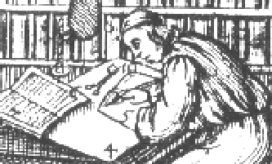
TEI Workshop
10. ROMA
Summer 2010

Slide 2
My schema and me
Remember that for a digitization project all XML must be valid against a schema.
You can use a schema in two ways
Write it yourself
Use someone else’s (e.g. international standards like MIX, MathML, XHTML, NewsML)
Use TEI and customize it

Slide 3
Getting a TEI Schema
XML CopyEditor, Oxygen and other applications might come with certain schemas out of the box (TEI, XHTML, DocBook...)
Get one from Roma

Slide 4
Modules structure of TEI
TEITEi is made up of 22 modules that group related elements and attributes.
The verse module e.g. contains special elements and attributes for use with poetry
Mandatory modules:
  tei
  teiHeader
  textstruc
  core

Slide 5
choose from 18 other modules
Module
Module
Module
verse
Module
linking
Module
gaiji
Module
Module
textstruc
Module
header
Module
core
Module
tei
Module

Slide 6
Go to ROMA
With the ROMA interface you can create and customize a TEI schema by:
  Choose TEI modules
  Delete unneeded elements from modules
  Restrict attribute values
  Create new elements
  Change language of documentation

Slide 7
Go to ROMA
ROMA returns you:
  The so-called ODD (one-document-does it all) customization file, where your changes are recorded ( .xml). (Don’t loose this)
  You schema (.rnc, .rng, .xsd, .dtd)
    (Relax NG compact, Relax NG XML-syntax, W3C Schema, DTD)
  (Optional:) Documentation (.html, .pdf, LateX...)

Slide 8
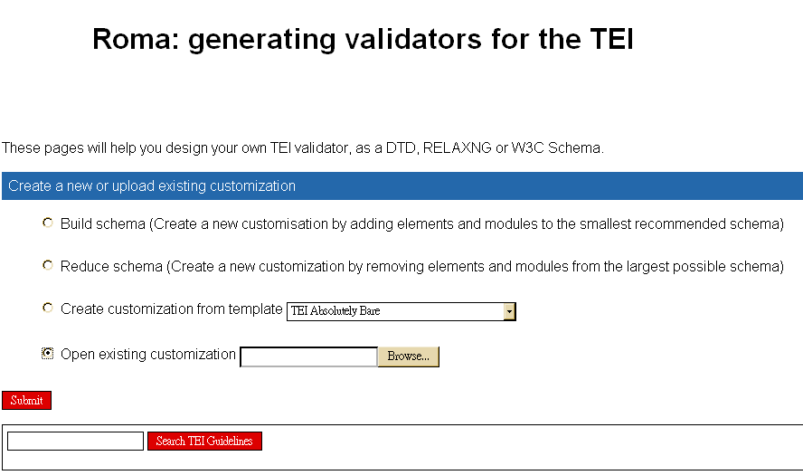

Slide 9
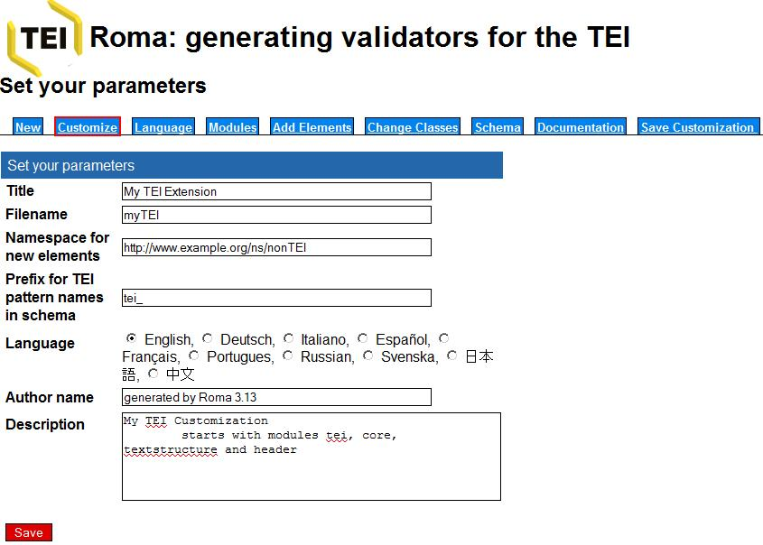

Slide 10
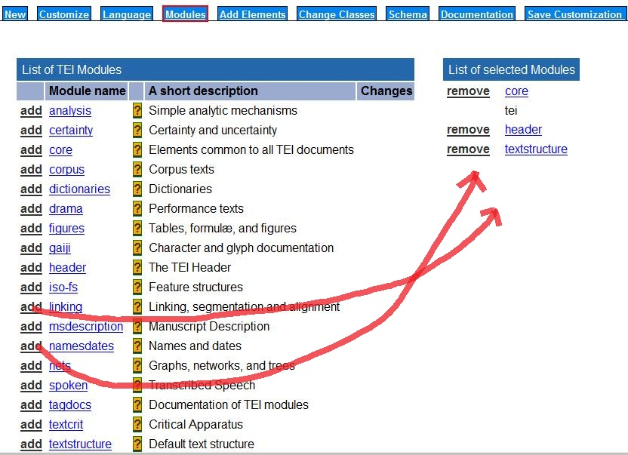
Add/delete modules

Slide 11
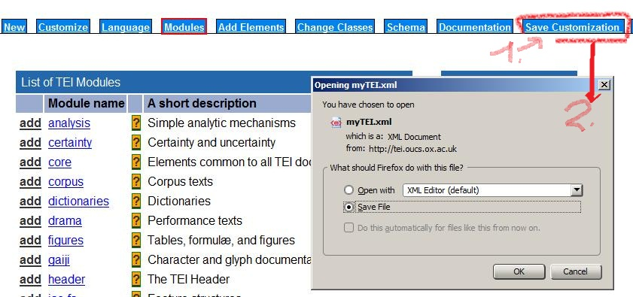
Download ODD file

Slide 12
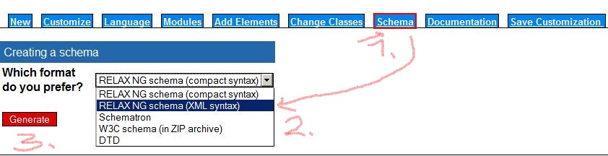
Download schema

Slide 13
And now
The ODD file contains the record of our customizations. We need the ODD file for further changes. After the first creation of a schema we want to upload the ODD file for our project and make further changes based on it.
Point your XML editor/parser to your schema and validate your files
Most editors support concurrent validation, ie. validation as you type.

Slide 14
Exercise
Part 1: Get a minimal schema from ROMA (Build Schema). Try to validate "songCrossing"
Part 2: Try to identify what elements are not in the schema and add the module that contains the elements. Go back to ROMA upload your ODD file, add the modules, download new ODD file and schema
Always click "save, start, submit" at the bottom

Slide 15
marcus bingenheimer 2006-2010

