Slide 1
CS162:
Operating Systems and
Systems Programming
Lecture 13:
Linux Memory Management /
Distributed Systems (intro)
13 July 2015
Charles Reiss
https://cs162.eecs.berkeley.edu/

Slide 2
Recall: Demand Paging
Key idea: Illusion of infinite memory
Process's memory lives on secondary storage
Memory is just a cache
  Block = page
  Fully associative
  Cache replacement = page fault

Slide 3
Recall: Demand Paging Policies
Ideal replacement policy: Belady's MIN
  Impossible to implement, but ideal (access time)
  Similar problems with SRTF
Possible replacement policy: Least Recently Used
  Still impossible to implement – too much overhead to track "uses"
Practical replacement policy: Clock algorithm
  "Not recently used"
  Use HW support of used bit, scan periodically
Practical replacement policy: Second chance list
  "Not recently used"
  Make inactive pages invalid to see if they're really unused

Slide 4
Recall: Reverse Page Mapping ("coremap")
Mapping from physical page frame # to all its locations in memory
Example uses:
  Scanning accessed/dirty bits of all its PTEs
  Marking page not present in all its PTEs when replacing with another
Linux implementation:
  Linked list of memory regions derived from an object (e.g. file)

Slide 5
Reality: Linux Memory Management
Three zones:
  ZONE_DMA: phys addr <16M, DMAable with ISA bus
  ZONE_NORMAL: 16M → 896MB
  ZONE_HIGHMEM: Everything else
Why?
  Hardware limitations
  On 32-bit, 0-896MB is always mapped in kernel space
Each zone has own freelist, LRU lists (active, inactive)

Slide 6
Linux Virtual Memory Map
0xFFFFFFFF
128TiB
0xFFFFFFFFFFFFFFFF
Kernel
Addresses
1GB
Kernel
Addresses
896MB
Physical
64 TiB
Physical
0xC0000000
User
Addresses
0xFFFF800000000000
3GB Total
Empty
Space
“Canonical Hole”
0x00007FFFFFFFFFFF
128TiB
User
Addresses
0x00000000
0x0000000000000000
32-Bit Virtual Address Space
64-Bit Virtual Address Space

Slide 7
Linux Virtual Memory Map
0xFFFFFFFF
128TiB
0xFFFFFFFFFFFFFFFF
Kernel
Addresses
1GB
Kernel
Addresses
896MB
Physical
64 TiB
Physical
0xC0000000
User
Addresses
0xFFFF800000000000
3GB Total
One-to-one maps of "bottom" of physical memory
Empty
Space
“Canonical Hole”
0x00007FFFFFFFFFFF
128TiB
User
Addresses
0x00000000
0x0000000000000000
32-Bit Virtual Address Space
64-Bit Virtual Address Space

Slide 8
Linux Virtual Memory Map
0xFFFFFFFF
128TiB
0xFFFFFFFFFFFFFFFF
Kernel
Addresses
1GB
Kernel
Addresses
896MB
Physical
64 TiB
Physical
Temporary mappings of higher addresses
0xC0000000
User
Addresses
0xFFFF800000000000
3GB Total
Empty
Space
“Canonical Hole”
0x00007FFFFFFFFFFF
128TiB
User
Addresses
0x00000000
0x0000000000000000
32-Bit Virtual Address Space
64-Bit Virtual Address Space

Slide 9
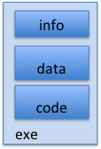
Recall: Create Address Space
disk (huge)
process VAS
kernel
OS needs to store this mapping
Part of PCB, in memory
What data structure?
stack
stack
heap
sbrk
heap
data
data
code
One method: Everything backed by disk
Just allocate space on disk
  Let page faults trigger it actually being read from disk

Slide 10
Linux Address Space
disk (huge)
process VAS
kernel
Linux: List of "memory regions" specifying backing object (file or anonymous memory region) and range from each
stack
stack
heap
sbrk
heap
data
data
code

Slide 11
Linux Address Space Region
task_struct (PCB/TCB)
struct vm_area_struct {
// start and end virtual address
unsigned long vm_start;
unsigned long vm_end;
// …
// permissions and policy
pgprot_t vm_page_prot;
unsigned long vm_flags; // MAP_PRIVATE == copy-on-write
// …
// backing store
// how many pages into the backing store
unsigned long vm_pgoff;
// mapped file (or NULL)
struct file * vm_file;
// …
};

Slide 12
Page/Protection Fault Handler
Lookup struct vm_area_struct*.
Look at type of access versus area protection flags
Main cases:
  Allocate new page (copy from file or zero page)
  Copy-on-write page (allocate + copy)
  Swap in non-file backed page (trick: store location on disk in unused bits of PTE)

Slide 13
Recall: TLB and page table changes
Consider copy-on-write.
Process A calls fork().
OS marks its pages as read-only. Tells MMU to clear those TLB entries.
After returning from fork it tries to write to its stack.
Triggers protection fault. OS makes a copy of the stack page, updates page table. Tells MMU to clear that TLB entry.
Restarts instruction.

Slide 14
What about multiple processors? (1)
Process A running on CPU 1 + 2 (different threads)
Process B on CPU 3
Process A
Page Table
Process B
Page Table
CPU 1
CPU 2
CPU 3

Slide 15
What about multiple processors? (2)
Page fault on CPU 1 needs to invalidate TLB on CPU 1 and 2
Process A
Page Table
Process B
Page Table
CPU 1
CPU 2
CPU 3

Slide 16
What about multiple processors? (3)
"TLB shootdown"
Interprocessor Interrupt
  Trigger an interrupt on another processor
  All of them – need synchronization to make sure another thread of process A doesn't start on CPU 3
  invlpg instruction or reset page table pointer (untagged TLB)
Process A
Page Table
Process B
Page Table
CPU 1
CPU 2
CPU 3

Slide 17
Linux Virtual Map Management
Kernel memory not visible to user
  Exception: shared memory for fast "system calls" (vDSO)
Forward mapping:
  PCB has list of vm_area_structs
  Also binary search tree (fast lookups by virtual address)
struct page describes physical page
  pointers to all its memory regions (coremap!)
  membership on all its "LRU" lists

Slide 18
Linux Page Allocation
struct page * alloc_pages(gfp_t gfp_mask, unsigned order)
  gfp_mask specifies valid zones (among other options)
  Allocate 2^{order} bytes from contiguous physical pages
struct page * alloc_page(gfp_t gfp_mask)
  Allocate one page
Allocator uses "buddy" system – fast, avoids fragmentation (somewhat)
Why would you need more than one contiguous page?
  Some platforms have bigger page tables
  IO with some devices (later)

Slide 19
Page Frame Reclaiming Algorithm
Implementation of "freelist" filling
Several triggers:
  Low on memory
  Hibernation (suspend-to-disk)
  Periodic – background kernel thread

Slide 20
Linux LRU approximation
Each zone keeps two "LRU" lists: Active, Inactive
Active LRU list
unused, 2 chances
Inactive LRU list
PTEs "not present"
used again
(twice for file-backed,
once otherwise)
Reclaimed by
page_alloc()
More aggressive behavior when tight on memory

Slide 21
Recall: Second-Chance List
LRU victim
Directly
Mapped Pages
Marked: RW
List: FIFO
Overflow
Second
Chance List
Marked: Invalid
List: LRU
Access
New
Active
Pages
New
SC
Victims
Page-in
From disk
Split memory in two: Active list (RW), SC list (Invalid)
Page Fault to access Second Chance List
  Move to front of access list on page fault
Victims from "front" of second chance list

Slide 22
Linux SLAB Allocator
Observation: object initialization time can be greater than allocation/deallocation time
Goal: allocate once, reuse objects
  Constructor run when first allocated only
  Not on subsequent free/allocation
  Handle actual page allocations (often >1 page at a time)
Freelist per object type (fast!)
(Objects of one type together → better locality??)

Slide 23
SLAB allocator: Cache use
task_struct_cachep =
kmem_cache_create("task_struct",
sizeof(struct task_struct),
ARCH_MIN_TASKALIGN,
SLAB_PANIC | SLAB_NOTRACK,
NULL);
...
struct task_struct *tsk;
tsk = kmem_cache_alloc(task_struct_cachep, GFP_KERNEL);
if (!tsk)
return NULL;
...
kmem_free(task_struct_cachep,tsk);

Slide 24
SLAB allocator Details (1)
SLAB allocator: objects of one type together on a page
  Example type: open file
  Better locality?
Cache coloring:
  Offset the beginning of each page to avoid conflict misses
  Idea: index bits of more popular fields of different copies of the same kind of object are less likely to be the same

Slide 25
SLAB allocator Details (2)
Generic kmalloc()/kfree() implemented with "caches" for powers of two
Support reclamation of memory:
  Scan global list of all caches for pages with no allocated objects to free

Slide 26
Recall: Other Examples of Caching
Demand paging (later)
  Leave unused parts of process memory on disk/SSD
File systems
  Contents of files
  Directory structure
Networking
  Hostname to IP address translations
  Web pages

Slide 27
Recall: Other Examples of Caching
Demand paging
  Leave unused parts of process memory on disk/SSD
File systems
  Contents of files
  Directory structure
Networking
  Hostname to IP address translations
  Web pages
On Linux, these are the
same cache!

Slide 28
Recall: Create Address Space
disk (huge)
process VAS
kernel
stack
stack
heap
sbrk
heap
data
Shortcut: Don't allocate extra space for files already on disk
data
code
One method: Everything backed by disk
Just allocate space on disk
  Let page faults trigger it being read from disk

Slide 29
How does read()/write() work?
(For regular files – terminal, network, devices, ... are different)
Load the current page of the file as one of the pages to handle with demand paging
  If it's already there, cache hit!
Copy to or from that page
Stays in memory until clock algorithm/etc. removes it

Slide 30
Writing Dirty Pages
Since this is used for write()...
Not acceptable to wait for file-backed page to be ready to free to write it back
  Lose days of data?
Solution: background thread scans for dirty pages
  Write back data to files after no more than ~30 s (configurable timeout)
  Keep enough non-dirty memory to allow fast page allocation (configurable threshold)

Slide 31
Linux VM Data Structures
task_struct
(TCB)
mm_struct
(virtual address space)
(page table)
address_space
(pages for file)
vm_area_struct
(single mapping)
anon_vma
(pages for non-file)
struct page
(physical page)
LRU/free/active/inactive list

Slide 32
Logistics
Midterm Wednesday
Review session during class Tuesday
Project 2 – Design reviews FRIDAY

Slide 33
Recall: What is an operating system? (4)
Always:
  Memory management
  I/O management
  CPU scheduling
  Communication?
Sometimes:
  Filesystems
  ? Multimedia support
  ? User interface
  ? Internet browser

Slide 34
CPU management
CPU scheduling with conflicting goals:
  Response time – interactivity
  Throughput – CPU and I/O
  Fairness and avoiding starvation
  Simplicity of scheduler
  Limiting overhead

Slide 35
CPU abstractions
The thread – a virtual CPU
Represents registers
Has independent stack
  but in (potentially shared) address space

Slide 36
Synchronization
Multiple (virtual) CPUs → things can happen "at the same time"
Abstractions:
  Monitors – Lock + Condition Variable
  Semaphores
  Locks

Slide 37
Recall: Monitor Example: Queue
Lock lock;
Condition dataready;
Queue queue;
AddToQueue(item) {
lock.Acquire(); // Get Lock
queue.enqueue(item); // Add item
dataready.signal(); // Signal a waiter, if any
lock.Release(); // Release Lock
}
RemoveFromQueue() {
lock.Acquire(); // Get Lock
while (queue.isEmpty()) {
dataready.wait(&lock); // If nothing, sleep
}
item = queue.dequeue(); // Get next item
lock.Release(); // Release Lock
return(item);
}

Slide 38
Lock Building Blocks
Single processor: Interrupt disabling
  lowlevel_acquire() { disable interrupts; }
  lowlevel_release() { enable interrupts; }
Between processors: Atomic read-modify-write
  lowlevel_acquire() { while (test&set(&lock)); }
  lowlevel_release() { lock = 0; }

Slide 39
Deadlock
AllocateOrWait(1MB)
/* 1 MB free */
AllocateOrWait(1MB)
  WAITS FOREVER
AllocateOrWait(1MB)
/* 0 MB free */
AllocateOrWait(1MB)
  WAITS FOREVER

Slide 40
Recall: Four Requirements
Mutual exclusion
  One thread at a time can use a resource
Hold and wait
  Thread holding a resource waits to acquire another resource
No preemption
  Resources are released voluntarily – threads can't steal instead of waiting
Circular wait:
  There exists a set {T1, …, Tn} of waiting threads
    T1 is waiting for a resource that is held by T2
    T2 is waiting for a resource that is held by T3
    …
    Tn is waiting for a resource that is held by T1

Slide 41
Process
One or more threads + address space

Slide 42
Address Translation Comparison
 | Advantages | Disadvantages
Segmentation | Fast context switching: Segment mapping maintained by CPU | External fragmentation
Paging (single-level page) | No external fragmentation, fast easy allocation | Large table size ~ virtual memory Internal fragmentation
Paged segmentation | Table size ~ # of pages in virtual memory, fast + easy allocation | Multiple memory references per page access
Two(+)-level pages
Inverted Table | Table size ~ # of pages in physical memory | Hash function more complex

Slide 43
System Calls
How do we get at all this functionality?
Controlled entry into kernel
  To well-known location
  Like every entry save registers
  Extract arguments out of registers + user memory

Slide 44
Recall: Dual Mode Operation
Hardware provides at least two modes:
  "Kernel" (or "supervisor" or "protected")
    Unix "kernel" runs here (part of OS running all the time)
  "User" mode
    Normal programs run here
    Even if "administrator" or "superuser" or "sudo"
Some operations prohibited in user mode
  e.g. changing the page table pointer
Notes:
Someone had a good question after class about how dual mode operation in hardware relates to "superuser" or "administrator" or "sudo" – where your program is "allowed" to do anything.
Application programs still always run in user mode. Things like sudo just make it so when they ask the OS to do something, it says yes. They still need to go through the kernel to do it.

Slide 45
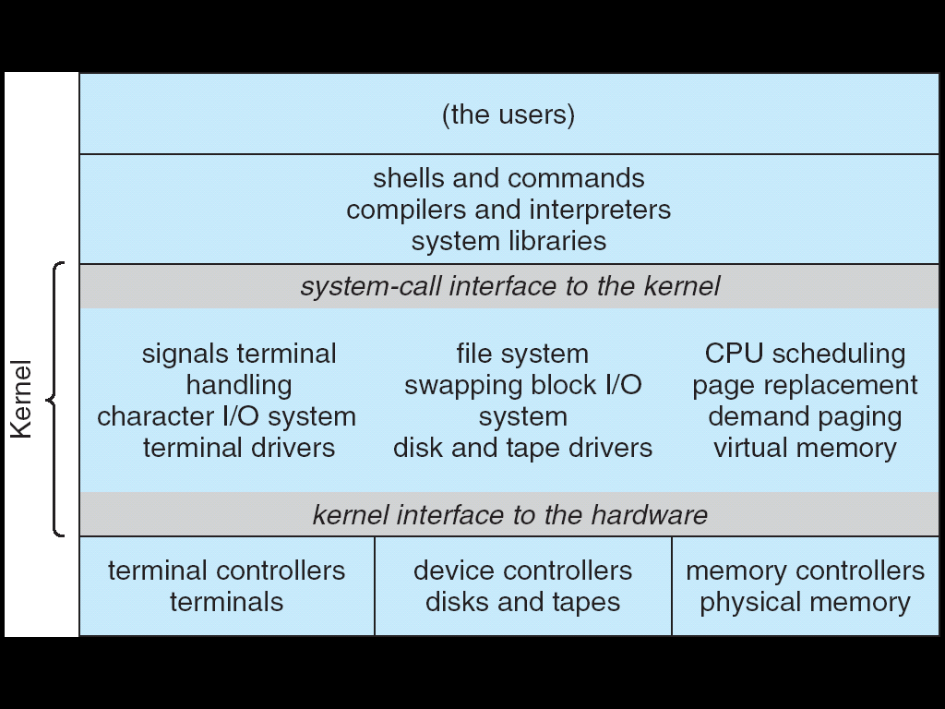
UNIX System Structure
Applications
User Mode
Standard Libs
Kernel Mode
Hardware

Slide 46
Process and Thread APIs
POSIX process APIs:
  fork – copy current into new address space
    copy-on-write
  wait – wait for forked process
  exec – replace current with program on disk
    completely new address space
    inherit file descriptors
Pintos thread APIs:
  thread_create (kind-of like fork)
    allocate new thread + stack for it
  thread_join (kind-of like wait)
    wait for thread to finish

Slide 47
POSIX IO APIs
Low-level (buffered only in kernel space)
  open
  read
  write
  close
High-level (buffered in userspace, too)
  fopen,
  fread, fgetc, fgets
  fwrite, fputs, fprintf
  fclos

Slide 48
Recall: POSIX IO: Everything is a file
Uniform interface for
  Devices (terminals, printers, etc.)
  Regular files on disk
  Networking (sockets)
  Local interprocess communication (pipes, sockets)
Part of the process state
  accessed with file descriptors

Slide 49
Break

Slide 50
Centralized versus Distributed
Server
Client/Server Model
Peer-to-Peer Model
Centralized system: System where major functions performed on one physical computer
Distributed system: Physically separate computers working together to perform a single task

Slide 51
Parallel versus Distributed
Distributed – different machines responsible for different parts of task
  Usually no centralized state
  Usually about different responsibilities or redundancy
Parallel – different parts of same task performed on different machines
  Usually about performance

Slide 52
Distributed: Why
Simple, cheaper components
Easy to add to incrementally
Let multiple users cooperate (maybe)
  Physical components owned by different users
  Enable collaboration between diverse users

Slide 53
Distributed: Promise
Availability
  One machine goes down, system up
Durability
  One machine loses data, system does not
Security
  Divide security problem into simpler pieces?

Slide 54
Distributed: Reality (sometimes)
Availability
  One machine takes them all down
Durability
  Any machine can lose your data
Security
  More places to break in

Slide 55
Distributed: Goal
Transparency: Hide distributedness, make system simpler
Kinds:
  Location – location of resources invisible/irrelevant
  Migration – location of resources changes invisibly
  Replication – invisible extra copies of resources (for reliability, performance)
  Parallelism – jobs split into pieces, look like on serial task
  Fault tolerance – components fail without users knowing

Slide 56
Recall: Illusion of "infinite" memory
∞
TLB
Page
Table
Physical
Memory
512 MB
Disk
500GB
Virtual
Memory
4 GB
How? Transparent layer of indirection
  the page table + page fault handlers

Slide 57
The Coordination Problem
Components communicate with network:
  Lets you send messages between machines
Need to use messages to agree on state
  Problem does not exist in centralized system

Slide 58
Protocols
Protocol is an agreement on how to communicate
  Syntax: "structure" – format, order of messages
  Semantics: "meaning" – actions taken when transmitting, receiving, or when timer expires
Formal description: state machine
A distributed system is embodied by a protocol

Slide 59
Human Protocols: Telephone
  (Pick up / open up the phone)
  Listen for a dial tone / see that you have service
  Dial
  Should hear ringing …
  Callee: “Hello?”
  Caller: “Hi, it’s John….”
  Or: “Hi, it’s me” (←- what’s that about?)
  Caller: “Hey, do you think … blah blah blah …” pause
  Callee: “Yeah, blah blah blah …” pause
  Caller: Bye
  Callee: Bye
  Hang up

Slide 60
Protocols With Humans:
Asking a Question
1. Raise your hand
2. Wait to be called on
or
1. Wait for speaker to pause.
2. Speak.

Slide 61
Models for Organizing
Distributed Systems
Client/server
Peer-to-peer
???

Slide 62
Clients and Servers
Client program
  Running on end host
  Requests service
  E.g., Web browser
GET /index.html

Slide 63
Client-Server Communication
Client “sometimes on”
  Initiates a request to the server when interested
  E.g., Web browser on your laptop or cell phone
  Doesn’t communicate directly with other clients
  Needs to know the server’s address
Server is “always on”
  Services requests from many client hosts
  E.g., Web server for the www.cnn.com Web site
  Doesn’t initiate contact with the clients
  Needs a fixed, well-known address

Slide 64
Peer-to-Peer Communication
No always-on server at the center of it all
  Hosts can come and go, and change addresses
  Hosts may have a different address each time
Example: peer-to-peer file sharing (e.g., BitTorrent)
  Any host can request files, send files, query to find where a file is located, respond to queries, and forward queries
  Scalability by harnessing millions of peers
  Each peer acting as both a client and server

Slide 65
Summary:
Distributed – multiple machines performing different parts of task
  Contrast to parallel: multiple (usually similar) things at the same time
Goal: Transparent – doesn't look like distributed system
Communication with messages
  Contrast with threads: shared memory

