Slide 1
Large scale upgrading strategy

Slide 2

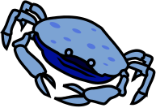



?

Slide 3

?
?

Slide 4
=

Slide 5




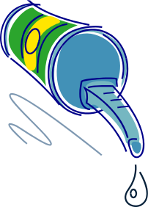
Year 1

Slide 6
Better quality
Year 5

Slide 7
Potentialities
Pharma
Nutraceutic
Functional food
Healthy food
Profit
Nutrition
Feed
Energy
Agriculture
Market capacity

Slide 8
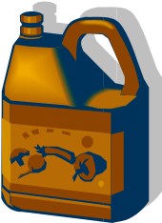
Even better quality
Year 10

Slide 9
Potentialities
Pharma
Nutraceutic
Functional food
Healthy food
Profit
Nutrition
Feed
Energy
Agriculture
Market capacity

Slide 10


Highest quality + Sorting
Year 35

Slide 11
Potentialities
Pharma
Nutraceutic
SORTING
Functional food
Healthy food
Profit
Nutrition
Feed
Energy
Agriculture
Market capacity

Slide 12

Mass transformation
Niche production
Created in 1960 with a cooperative status
80 people
Located in a place where 300.000 Tons / Year of fish and seafood are transformed
Main products: fishmeal, fishoil, hydrolysates (world leader), cosmetics and nutraceutics

