Slide 1
CS162:
Operating Systems and
Systems Programming
Lecture 20:
Networking: TCP/IP (finish),
RPC (start?)
23 July 2015
Charles Reiss
https://cs162.eecs.berkeley.edu/

Slide 2
Recall: Sockets
Abstraction of network I/O interface
  Bidirectional communication channel
  Uses file interface once established
    read, write, close
Server setup:
  socket(), bind(), listen(), accept()
  read, write, close from socket returned by accept
Client setup:
  socket(), connect()
  then read, write, close
getaddrinfo() to resolve names, addresses for bind() and connect()

Slide 3
Recall: Layering
Complex services from simpler ones
TCP/IP networking layers:
  Physical + Link (Wireless, Ethernet, ...)
    Unreliable, local exchange of limited-sized frames
  Network (IP) – routing between networks
    Unreliable, global exchange of limited-sized packets
  Transport (TCP, UDP) – routing
    Reliablity, streams of bytes instead of packets, …
  Application – everything on top of sockets

Slide 4
Recall: Glue: Adding Functionality
Physical Reality: Frames | Abstraction: Stream
Limited Size | Arbitrary Size
Unordered (sometimes) | Ordered
Unreliable | Reliable
Machine-to-machine | Process-to-process
Only on local area net | Routed anywhere
Asynchronous | Synchronous

Slide 5
Recall:
Hierarchical Networking: The Internet
Hierarchy of networks – scales to millions of host
Other
subnets
subnet1
Router
Transcontinental
Link
Router
Other
subnets
Router
subnet3
subnet2

Slide 6
Recall: Routing (2)
Internet routing mechanism: routing tables
  Each router does table lookup to decide which link to use to get packet closer to destination
  Don’t need 4 billion entries (or 2^128 for IPv6) in table: routing is by subnet
Routing table contains:
  Destination address range: output link closer to destination
  Default entry

Slide 7
Names versus Addresses
Names are
  meaningful
  memorable
  don't change if the resource moves
Addresses
  explain how to access a resource
  change if the resource moves
Example:
  int foo; ← variable in C
  'foo' is the name, address is a pointer to some place on the stack...

Slide 8

Naming in the Internet
Name
⇒
Address
You probably want to use human-readable names:
  www.google.com
  www.berkeley.edu
Network wants an IP address:
  that's what's in routing tables
  allows routing tables to take advantage of hierarchy
Mapping is done by the Domain Name System

Slide 9
Domain Name System (1)
Top-level
edu
com
berkeley.edu
MIT
169.229.131.81
berkeley
Mit.edu
www
calmail
eecs
eecs.berkeley.edu
128.32.61.103
www
DNS is a hierarchical mechanism for naming
  Name divided into "labels", right to left: www.eecs.berkeley.edu
Each domain owned by a particular organization
  Top level handled by ICANN
  Subsequent levels owned by organizations
128.32.139.48

Slide 10
Domain Name System (2)
Top-level
edu
com
berkeley.edu
MIT
169.229.131.81
berkeley
Mit.edu
www
calmail
eecs
eecs.berkeley.edu
128.32.61.103
www
Resolution by repeated queries:
  One server for each "domain" (<root>, edu, berkeley.edu)
  Plus backups: redundancy (available, not gaurenteed consistent)
128.32.139.48

Slide 11
Domain Name System (3)
How do you find the root server?
Hardcoded list of root servers and backups (updated rarely)
… or use your ISP's server (makes repeated queries on your behalf)
  called a recursive resolver

Slide 12
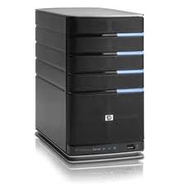
Recall: Iterative vs. Recursive Query
Master/Directory
Master/Directory
get(K14)
get(K14)
V14
K14
N3
N3
K14
N3
V14
get(K14)
get(K14)
Recursive
V14
Iterative
K14
V14
K14
V14
…
…
N1
N2
N3
N50
N1
N2
N3
N50
Recursive Query: Directory delegates
Iterative Query: Client delegates

Slide 13
IPv4 Packet Format
IP Header
Length
Size of datagram
(header+data)
Flags &
Fragmentation
to split large
messages
0
15
16
31
IP Ver4
4
IHL
ToS
Total length(16-bits)
16-bit identification
flags
13-bit frag off
IP header
20 bytes
Time to
Live (hops)
TTL
protocol
16-bit header checksum
32-bit source IP address
Type of
transport
protocol
32-bit destination IP address
options (if any)
Data
Destination machine

Slide 14
IPv4 Packet Format:
What the router cares about
IP Header
Length
Size of datagram
(header+data)
Flags &
Fragmentation
to split large
messages
0
15
16
31
IP Ver4
4
IHL
ToS
Total length(16-bits)
16-bit identification
flags
13-bit frag off
IP header
20 bytes
Time to
Live (hops)
TTL
protocol
16-bit header checksum
32-bit source IP address
Type of
transport
protocol
32-bit destination IP address
options (if any)
Data
Destination machine

Slide 15
Internet Protocol Features
Routing – IP packet goes anywhere
  Just need the IP address
Fragmentation – split big messages into smaller
  Still message size limit (64K)
  Reassemble at destination
  Hides differences in physical layers
Multiple protocols on top:
  1 byte to specify protocol:
    ICMP (1), TCP (6), UDP (17), IPSec (50, 51), …
  Registry of protocol numbers

Slide 16
Internet Protocol Non-Features
Unreliable delivery
  IP packets are not guaranteed
  May be lost by underlying physical layer (radio noise?)
  May be dropped if, e.g., router out of resources
Out-of-order/duplicate delivery
  Tolerance to physical layer retrying packets
  Tolerance to multiple paths

Slide 17
Layering
Complex services from simpler ones
TCP/IP networking layers:
  Physical + Link (Wireless, Ethernet, ...)
    Unreliable, local exchange of limited-sized frames
  Network (IP) – routing between networks
    Unreliable, global exchange of limited-sized packets
  Transport (TCP, UDP) – streams
    Reliablity, streams of bytes instead of packets, …
  Application – everything on top of sockets

Slide 18
Glue: Adding Functionality
Physical Reality: Frames | Abstraction: Stream
Limited Size | Arbitrary Size
Unordered (sometimes) | Ordered
Unreliable | Reliable
Machine-to-machine | Process-to-process
Only on local area net | Routed anywhere
Asynchronous | Synchronous

Slide 19
Ordered Messages: Problem
Want to divide message into packets, e.g.
  "GET /static/hw/hw1.pdf HTTP/1.0" into
  "GET /static" and "/hw/hw1.pdf HTTP/1.0"
Why? Not can't always fit request in one packet (IP: 64K limit – think of uploading a file)
IP might reorder these packets:
  "/hw/hw1.pdf HTTP/1.0", then
  "GET /static"

Slide 20
Ordered Message: Solution
Ordered messages on top of unordered ones:
  Assign sequence numbers to packets: 0,1,2,3,4….
  If packets arrive out of order, hold and put back in order before delivering to user (through socket interface)
  For instance, hold onto #3 until #2 arrives, etc.
Tricky case: packets from "old" connections

Slide 21
Reliable Message Delivery: Problem
All physical networks can garble and/or drop packets
  Physical hardware problems (bad wire, bad signal)
  Therefore, IP can garble/drop packets (doesn't fix this)
Building reliable message delivery
  Confirm that packets arrive exactly once
  Confirm that packets aren't garbled

Slide 22
Using Acknowledgements
A
B
A
B
Packet
Packet
Timeout
ack
Packet
ack
Checksum: detect garbled packets
Receiver send packet to acknowledge when packet received and ungarbled:
  No acknowledgement? Resend after timeout
What if ack dropped?
  Packet is resent (wasteful), second chance to acknowledge it.

Slide 23
What about duplicates?
Recall: Sequence number
Simplest version: 1 bit (0/1):
Problem: What if packet delayed
too much?
A
B
Pkt #0
Ack #0
Pkt #1
Ack #1
Pkt #0
Ack #0

Slide 24
Waiting for Acks: Performance
Time from Soda to google.com and back: 8 ms
Maximum packet size: ~1500 bytes
1500 bytes / 8 ms = 188 KByte/s
A
B
Pkt #0
Ack #0
Pkt #1
Ack #1
Pkt #0
Ack #0

Slide 25
Window-based acknowledgements (1)
A
B
Windowing protocol (not quite TCP)
Send up to N packets without ack
  Allows pipelining of packets
  N limits queue size
Both source and destination need to store N packets (why?)
Each packet has sequence number
  Ack says “received all packets up
  to sequence number X”
  Advances window
N=5
pkt#0
pkt#4
Queue
ack#0
ack#4

Slide 26
Sliding Window
0 1 2 3 4 5 6 7
ACK 0
0 1 2 3 4 5 6 7
Window represents packets:
  That might need to be retransmitted (dropped/garbled)
  That receiver needs space to buffer (ordering)

Slide 27
Window-based acknowledgements (2)
Packet lost?
  Resent by timeout, again
Acknowledgement lost?
  Packet resent, causing ack to be resent (again)
  If we're lucky acknowledged together with later packet instead
Discard out of order packets?
  If no, need some way to indicate "holes"

Slide 28
Transmission Control Protocol (TCP)
Stream in:
Stream out:
Router
Router
..zyxwvuts
gfedcba
Transmission Control Protocol (TCP)
  Reliable byte stream between two processes on different machines over Internet (read, write)
  Bi-directional (two streams for every connection)
TCP Details
  Fragments byte stream into packets, hands packets to IP
  Window-based acknowledgement protocol
  Automatically retransmits lost packets
  Adjusts rate of transmission to avoid congestion
    Mechanism: Window size

Slide 29
TCP Windows and Sequence Numbers
Sequence Numbers
Sent
acked
Sent
not acked
Not yet
sent
Sender
Received
Given to app
Received
Buffered
Not yet
received
Receiver
Sender has three regions:
  sent and ack’ed
  sent and not ack’ed
  not yet sent

Slide 30
TCP Windows and Sequence Numbers
Sequence Numbers
Sent
acked
Sent
not acked
Not yet
sent
Sender
Received
Given to app
Received
Buffered
Not yet
received
Receiver
Receiver has three regions:
  received and ack’ed (given to application)
  received and buffered
  not yet received (or discarded because out of order)

Slide 31
Window-Based Acknowledgements (TCP)
100
140
190
230
260
300
340
380
400
Seq:100
Size:40
Seq:140
Size:50
Seq:190
Size:40
Seq:230
Size:30
Seq:260
Size:40
Seq:300
Size:40
Seq:340
Size:40
Seq:
380
Size:
20
A:100/300
Seq:100
A:140/260
Seq:140
A:190/210
Seq:230
A:190/210
Seq:260
A:190/210
Seq:300
A:190/210
Retransmit!
Seq:190
A:340/60
Seq:340
A:380/20
Seq:380
A:400/0

Slide 32
Selective Acknowledgement Option (SACK)
Vanilla TCP Acknowledgement
  Every message encodes Sequence number and Ack
  Can include data for forward stream and/or ack for reverse stream
Selective Acknowledgement
  Acknowledgement information includes not just one number, but rather ranges of received packets
  TCP Option (extension) – often not used
  Turns out extending TCP is hard (compatibility problems)

Slide 33

Congestion
Router
Congestion: too much data somewhere in network
IP's solution: drop packets
Bad for TCP
  Lots of retransmission – wasted work
  Lots of waiting for timeouts – underutilized connection

Slide 34
Congestion Avoidance
Router
Solution: adjust window size
AIMD – Additive Increase, Multiplicative Decrease
  When packet dropped (missed ack) → decrease rapidly
  When packet successfully ack'd, increase slowly

Slide 35
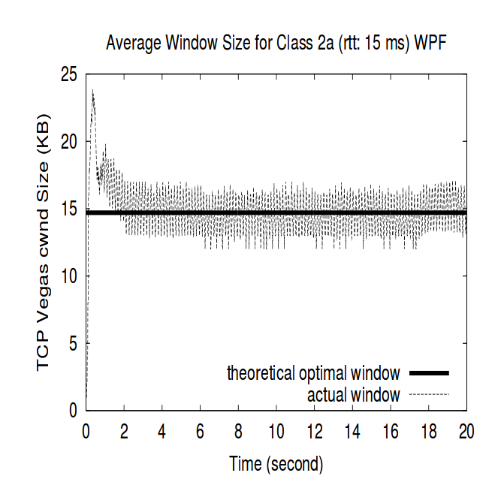
Congestion Avoidance: Changing Window
From Low, Peterson, and Wang, "Understanding vegas: Duality Model", J. ACM, March 2002.

Slide 36
Implementing Congestion Avoidance
Need to track window size
Need to keep buffer of unacknowledged packets
Need to keep buffer of received but unread packets
Need to resend packets when timer expires (one for each connection?)
Need to acknowledge packets and adjust window size
Who does this? On Linux – the kernel

Slide 37
Summary: Network Layering
Link layer (local network):
  Broadcast or Point-to-Point
  Send frames addressed to neighboring machines
  Ethernet, Wi-Fi
Network layer (connecting network):
  Forwarding between local networks
  Send packets addressed to machines anywhere
  IP
Transport layer (Making streams):
  Turn sequence of packets into reliable stream
  TCP

Slide 38
Summary: Names and Addresses
DNS name: human readable
  Mapped to IP address
  Distributed database
IP address:
  32-bit (IPv4) or 128-bit (IPv6) number
  Looked up in routing tables to decide where to send packets
Port number:
  16-bit number
  Used to identify service on particular machine

Slide 39
Logistics
HW2 due today (midnight)
Project 2 Checkpoint 2 due Monday

Slide 40
Break

Slide 41
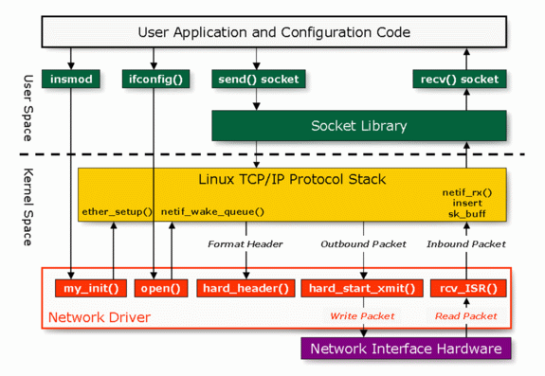
Linux Network Architecture

Slide 42
Implementing Congestion Avoidance
Need to track window size
Need to keep buffer of unacknowledged packets
Need to keep buffer of received but unread packets
Need to resend packets when timer expires (one for each connection?)
Need to acknowledge packets and adjust window size
Who does this? On Linux – the kernel

Slide 43
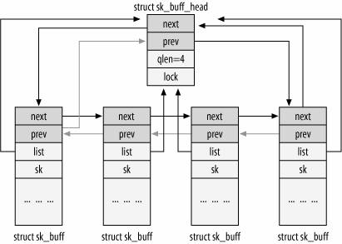
Linux Details: sk_buff structure
Socket Buffers: sk_buff structure
  The I/O buffers of sockets are lists of sk_buff
  Packet is linked list of sk_buff structures

Slide 44
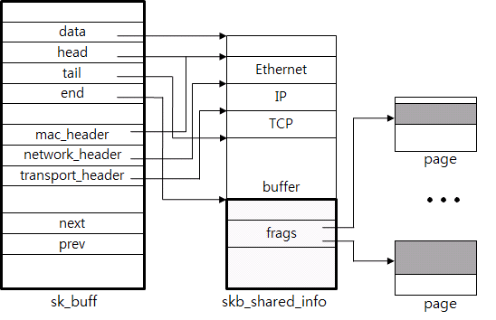
sk_buff: Headers and Fragments
The “linear region”: Space from skb->data to skb->end
  Convenience: header pointers point to parts of packet
And the fragments (in skb_shared_info) – pointers to seperate pages

Slide 45
sk_buff: Headers and Fragments
Point to parts of a big contiguous buffer – example, something copied from one call to write()
The “linear region”: Space from skb->data to skb->end
  Convenience: header pointers point to parts of packet
And the fragments (in skb_shared_info) – pointers to seperate pages

Slide 46
sk_buff: Headers and Fragments
Easily add headers containing on top of big contiguous user data chunks.
The “linear region”: Space from skb->data to skb->end
  Convenience: header pointers point to parts of packet
And the fragments (in skb_shared_info) – pointers to seperate pages

Slide 47
Recall: IPv4 Packet Format
IP Header
Length
Size of datagram
(header+data)
Flags &
Fragmentation
to split large
messages
0
15
16
31
IP Ver4
4
IHL
ToS
Total length(16-bits)
16-bit identification
flags
13-bit frag off
IP header
20 bytes
Time to
Live (hops)
TTL
protocol
16-bit header checksum
32-bit source IP address
Type of
transport
protocol
32-bit destination IP address
options (if any)
Data
Destination machine

Slide 48
IPv4 Packet in Context
Link-Layer (Ethernet, WiFi, ...) Header
4
IHL
ToS
Total length(16-bits)
16-bit identification
flags
13-bit frag off
TTL
protocol
16-bit header checksum
32-bit source IP address
32-bit destination IP address
options (if any)
Transport Protocol (e.g. TCP) Header (part of data)
Data

Slide 49
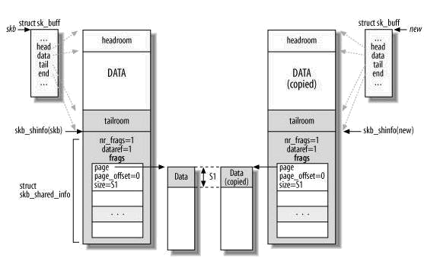
sk_buff: Copies, manipulation, etc
Lots of sk_buff manipulation functions for:
  removing and adding headers, merging data, pulling it up into linear region
  Copying/cloning sk_buff structures

Slide 50
Implementing Congestion Avoidance
Need to track window size
Need to keep buffer of unacknowledged packets
Need to keep buffer of received but unread packets
Need to resend packets when timer expires (one for each connection?)
Need to acknowledge packets and adjust window size
Who does this? On Linux – the kernel

Slide 51
Linux Internal Timer API
struct timer_list {
unsigned long expires;
void (*function)(unsigned long);
unsigned long data;
// ...
};
struct timer_list timer;
timer.expires = …; timer.function = timer_expired; ...
setup_timer(&timer);
function(data) called at time=expires
  by timer interrupt
Also APIs to remove, change timers if, e.g.,
  ACK received before timeout
  User closes socket

Slide 52
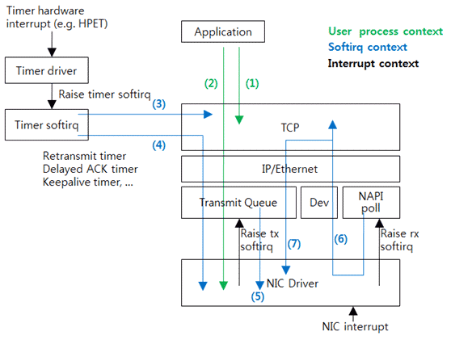
Network Processing Contexts

Slide 53
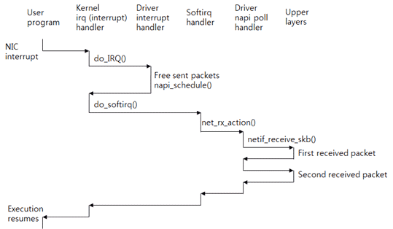
Avoiding Interrupts: NAPI
New API (NAPI): Use polling to receive packets (only some drivers)
Exit hard interrupt context as quickly as possible
  Do housekeeping and free up sent packets
  Schedule soft interrupt for further actions
Soft Interrupts: Handles receiption and delivery

Slide 54
Recall: The Mailbox Abstraction (2)
Interface:
  Mailbox (mbox): temporary holding area for messages
    Includes both destination location and queue
  Send(message,mbox)
    Send message to remote mailbox identified by mbox
  Receive(buffer,mbox)
    Wait until mbox has message, copy into buffer, and return
    If threads sleeping on this mbox, wake up one of them
Send
Network
Receive

Slide 55
Mailboxes on TCP (1)
Want messages, have stream
Need to separate messages
Same idea as storing multiple things in a file
Example: newline after each message
Example: size before each message

Slide 56
Mailboxes on TCP (2)
Want to send to many mailboxes
Solution: one connection for each destination
Reading from multiple sockets at once?
  Multiple threads + local synchronization
  select()/poll() – POSIX interface to wait for multiple files to have data
…

Slide 57
Remote Procedure Calls
Idea: make communication look like function calls
Wrapper library like for system calls
  Called stubs
Also wrappers at the receiving end
  Read messages from socket, make function calls
Look "like" local function calls

Slide 58
RPC Information Flow
bundle
args
Client
(caller)
call
Client
Stub
send
Socket
Handler
return
receive
unbundle
ret vals
Machine A
Network
Network
Machine B
bundle
ret vals
Server
(callee)
return
Server
Stub
send
Socket
Handler
call
receive
unbundle
args

Slide 59
RPC (Pseudo)code
Client
#include <myprotocol.stubs.h> /* generated by tool */
RPCContext ctx = myprotocol_ConnectToServer(hostname, port);
…
result = myprotocol_mkdir(ctx, "/directory/name");
…
Server
#include <myprotocol.stubs.h>
main() {
myprotocol_SetupRPCServer(port);
}
int real_myprotocol_mkdir(RPCContext ctx, char *name)
{
…
}

Slide 60
RPC Details
Setup: Need to specify remote machine somehow
  Example: host:port
Need to marshall arguments over the network:
  Sometimes also called serialization
  Done by stub
Typically code generated from file specifying protocol
  Called Interface Definition Language (IDL)
  Generates stubs
  … including marshalling/demarshalling code

Slide 61
Interface Definition Language
Pseudocode:
protocol myprotocol {
1: int32 mkdir(string name);
2: int32 rmdir(string name);
}
Marshalling example: mkdir("/directory/name") returning 0
Client sends: \001/directory/name\0
Server sends: \0\0\0\0

Slide 62
Marshalling Details
Marshalling with different architectures
  Remember endianness?
  Need to choose a consistent format
  Option: Native format, mark
Marshalling with pointers
  Need to chase pointers
  Something like a graph? Doubly linked list? Gets complicated.

Slide 63
RPC Naming
One option: Well known ports
Another: "Dynamic binding"
  well-known service gives readable names
  NFS (Network File Server) uses this
  just specify the server name and RPC service
  allows multiple services on the same port

Slide 64
RPC: Really Like a Function Call? (1)
What if something fails?
result = myprotocol_mkdir(ctx, "/directory/name");
What should result be?
Did the server make the directory?

Slide 65
RPC: Really Like a Function Call (2)
RPC for high-level POSIX IO?
RemoteFile* rfh = remoteio_open(ctx, "foo.txt");
remoteio_puts(ctx, rfh, "Text.\n");
remoteio_close(ctx, rfh);
What happens if client fails? Will the file be left open forever?
Note: not a problem for normal applications – the process dies, its files are closed.

Slide 66
RPC: Really Like a Function Call? (3)
for (big list of directories) {
myprotocol_mkdir(ctx, current-name);
}
Local procedure call: ~1 ns
Local system call: ~100 ns
Network part only of remote procedure call:
  with typical local network: >400 000 ns
  with exceptionally fast local network: 2 600 ns

Slide 67
RPC Locally
Doesn't need to be used between different machines – maybe just different address spaces
Gives location transparency
  Move service whereever convenient
  Easier to treat one machine as a big machine
Much faster implementations available locally
  Shared memory

Slide 68
Interlude: Microkernels (1)
Split OS into separate processes
  Example: Filesystem, Network driver is external process
Use RPC to these components instead of system calls
App
App
App
App
File
sys
windows
file system
Windowing
address
spaces
RPC
VM
Networking
Threads
threads
Monolithic Structure
Microkernel Structure

Slide 69
Interlude: Microkernels (2)
Microkernel provides only services it "needs" to:
  communication
  address space management
  thread scheduling
  almost-direct access to devices for service processes
App
App
App
App
File
sys
windows
file system
Windowing
address
spaces
RPC
VM
Networking
Threads
threads
Monolithic Structure
Microkernel Structure

Slide 70
Interlude: Why Microkernels?
Pro
  Failure isolation
  Easier to update/replace parts
  Easier to distribute – way to build OS that runs "across many machines"
Con
  More communication overhead/context switches
  Maybe harder to program?

Slide 71
Recall: What is an operating system?
Always:
  Memory management
  I/O management
  CPU scheduling
  Communication?
Sometimes:
  Filesystems
  ? Multimedia support
  ? User interface
  ? Internet browser
Core OS service – not provided by kernel in
"true" microkernel design

Slide 72
Microkernels in the Wild
Does anyone use a microkernel?
  Yes. Some embedded-targetted systems (Symbian, QNX, (se)L4)
  Some less "pure" microkernel than others (maybe some device drivers not separate services)
Many OSs provide some services like a microkernel
  OS X, Linux: Windowing (graphics + user inputs)
Some OSs started with microkernels
  Windows NT/XP/2000+/7/8: originally microkernel design (changed for performance?)
  OS X: hybrid of Mach microkernel and FreeBSD monolithic kernel

Slide 73
Distributed Operating Systems
Microkernel design lets OS be placed across a set of machines – just implement RPC, applications don't need to know
Questions:
  What about machine failures?
  What about the slowness of intermachine calls?
  What about sharing memory between machines?
  What about moving processes to/starting processes on remote machines?

Slide 74
Distributed Operating Systems
Microkernel design lets OS be placed across a set of machines – just implement RPC, applications don't need to know
Questions:
  What about machine failures?
  What about the slowness of intermachine calls?
  What about sharing memory between machines?
  What about moving processes to/starting processes on remote machines?
Good solutions to these problems – out of scope for this course

Slide 75
Distributed Operating Systems
Microkernel design lets OS be placed across a set of machines – just implement RPC, applications don't need to know
Questions:
  What about machine failures?
  What about the slowness of intermachine calls?
  What about sharing memory between machines?
  What about moving processes to/starting processes on remote machines?
Can live with these problems, but … not great.
More recently: fault-tolerant designs, application awareness of locality

Slide 76
Summary: Networks
Network: physical connection that allows two computers to communicate
  Packet: sequence of bits carried over the network
Broadcast Network: Shared Communication Medium
  Transmitted packets sent to all receivers
  Arbitration: act of negotiating use of shared medium
    Ethernet: Carrier Sense, Multiple Access, Collision Detect
Point-to-point network: a network in which every physical wire is connected to only two computers
  Switch: a bridge that transforms a shared-bus (broadcast) configuration into a point-to-point network.

Slide 77
Summary: Example Protocols
Protocol: Agreement between two parties as to how information is to be transmitted
Internet Protocol (IP)
  Used to route messages through routes across globe
  32-bit addresses, 16-bit ports
DNS: System for mapping from names to IP addresses
  Hierarchical mapping from authoritative domains
Remote Procedure Call (RPC): Call procedure on remote machine
  Provides same interface as procedure
  Automatic packing and unpacking of arguments without user programming (in stub)

