Slide 1
Games and the Impossibility of Realizable Ideal Functionality
Anupam Datta
CMU
Joint work with Ante Derek, John C. Mitchell, Ajith Ramanathan (Stanford) and Andre Scedrov (UPenn)
2006 Theory of Cryptography Conference

Slide 2


Stanford vs. UC:
The Big Game
A. Datta, A. Derek, J. C. Mitchell,
A. Ramanathan & A. Scedrov
CRYPTO 2005 rump session

Slide 3
Outline
Introduction
  Motivation, games vs functionalities
  Contributions of this paper
Background:
  Game-based specification
  UC-based specification
  Formalism: Probabilistic Process Calculus
Contribution of this work:
  Definition of Ideal Functionality
  Impossibility Theorem for bit-commitment
  Other results

Slide 4
Motivation
Games [GM84]:
  Defines specific moves for each player and properties that need to hold
  Not composable
  Examples: IND-CPA, IND-CCA for encryption
Functionalities [Can01, PW01]:
  Simulation relation between real protocol and ideal functionality, which is “secure by construction”
  Composable (main advantage)
  Example: Secure channel using trusted party
Goal: Investigate relationships between the two specification methods

Slide 5
Contributions
Formalize the connection between two notions
  For a primitive P specified by games we propose a definition of an ideal functionality for P
Impossibility theorem for bit-commitment
  No ideal functionality for bit-commitment can be realizable (plain model)
Generalizations
  Variants of symmetric encryption and group signatures

Slide 6
Background: Bit-commitment Games
Challenger
Attacker
Challenger
Attacker
Commit(b)
Commit(b)
b’
Open(1-b)
Attacker wins if b’ = b
Attacker wins if she can produce 2nd message
Hiding Game
Binding Game

Slide 7
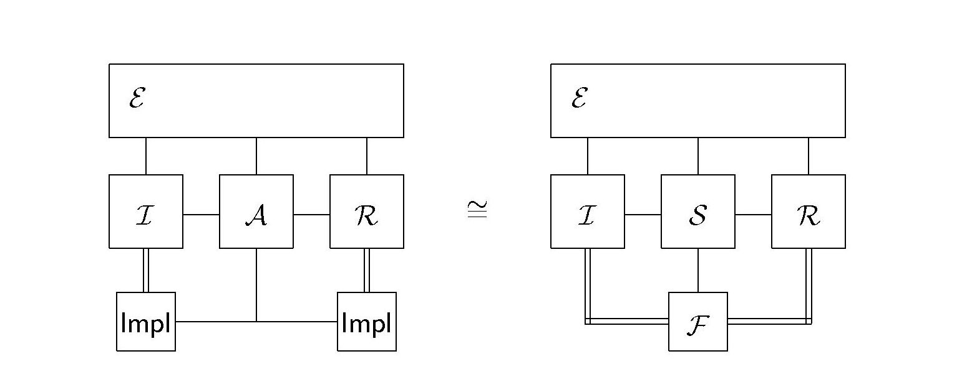
Background: UC
Two worlds: Real protocol P and Ideal functionality F
Require:
  For every adversary A for P, there exists an adversary S for F s.t. the two configurations are computationally indistinguishable to any environment E

Slide 8
UC Bit-commitment specification
Environment E
b
I: Commit
Open: b
I
R
I: Commit
Commit: b
Open: b
Simulator S
Open
I,R:Commit
Ideal F
Open: b

Slide 9
Background: PPC
Process Algebra
  Convenient for expressing both games and functionalities [DKMRS04,DKMR05] in the same language
  Probabilistic computation model, Can express any poly-time computation or adversary

Slide 10
Background: PPC (contd.)
Syntax:
  P :: = 0
  | out(c,T). P evaluate T, send it
  | in(c,x). P receive
  | υc .(P) private channel
  | [T] P test
  | P | P parallel composition
  | ! _{q(|n|)} . P bounded replication
Central notion: equivalence relations
  P ≅ Q computational indistinguishability
  P = Q statistical equivalence

Slide 11
PPC extensions
Standard game-based definitions are given for non-interactive algorithms
  Encryption has KeyGen, Encrypt, Decrypt
We allow protocols
  Need a mechanism to “call” an implementation of a protocol
Solution: Call and return interface
  Principal sends a message with all arguments on a dedicated private channel
  Implementation listens on private channel and conducts protocol

Slide 12
Primitives
A primitive P is defined by specifying the interface and the security requirements
Bit-commitment interface:
  SendCommit(b,C) returns σ
  GetCommit(C) returns σ
  Open (σ,C) returns ε
  Verify(σ,C) returns {0,1,#}
Bit-commitment security requirements:
  Correctness
  Hiding
  Binding

Slide 13
Security requirements (games)
Hiding (binding and correctness similar)
G
b = rand
SendCommit(b,C) returns σ
in(c,b’)
out(c,”yes” if b = b’)
  G’
  b = rand
  SendCommit(b,C) returns σ.
  in(c,b’)
  out(c,”yes” if rand = 0)
Implementation I provides hiding if:
G | I ≅ G’ | I

Slide 14
Intuition: What is Ideal about a Functionality?
P a primitive, security defined by games
G
G
L
F
L
L
P
A
A
Adv ≅ 0
Adv = 0
F speaks the same language
F satisfies security requirements perfectly

Slide 15
Ideal functionality
Any implementation of the calling interface that satisfies the games (G_{i}, G_{i}’)
INFORMATION THEORETICALLY
G_{i} | F = G_{i}’ | F
Intuition: Secure by construction
(may use mechanism like TTP, secure and authenticated channels)

Slide 16
Impossibility Theorem
If F is any ideal functionality for bit-commitment, then no real protocol UC-securely realizes F
Proof idea: Can construct information- theoretically hiding and binding protocol for BC that does not use TTP
Notes:
Also need “terminating” P

Slide 17
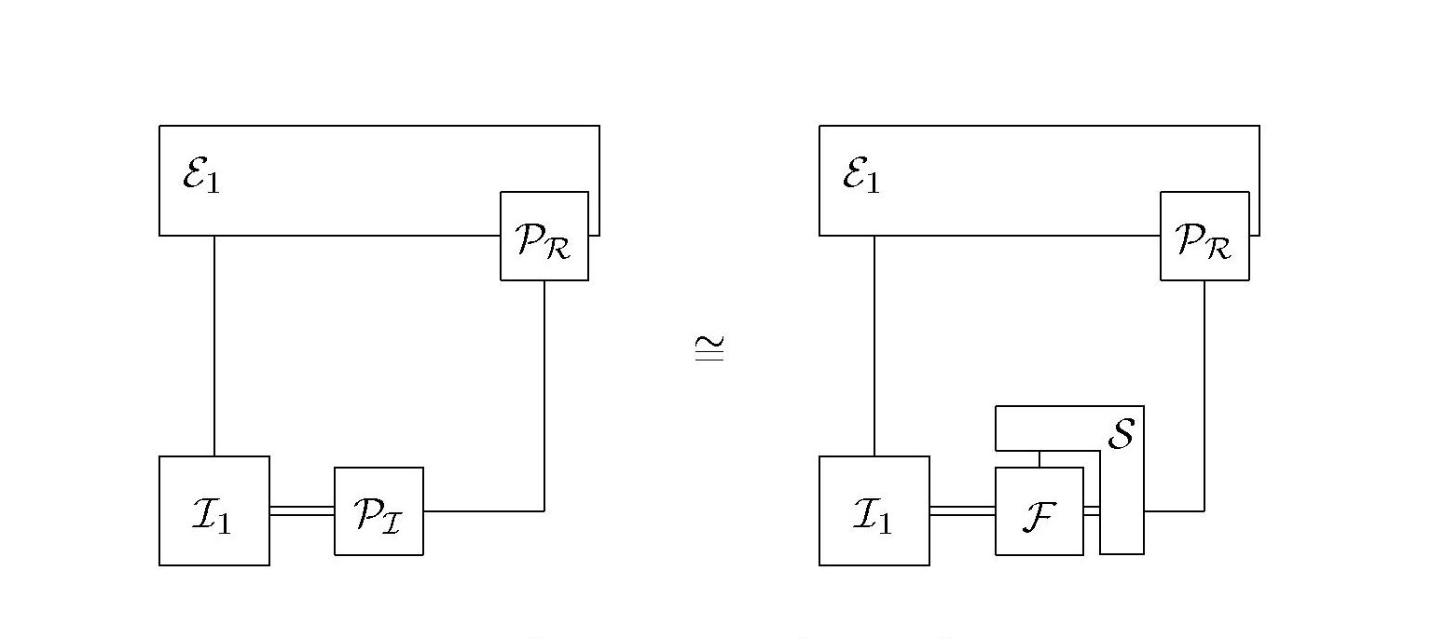
Proof: Phase 1

Slide 18
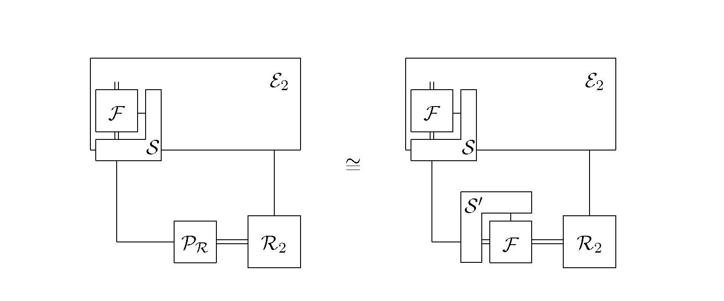
Proof: Phase 2

Slide 19
Proof:
So F|S and F|S’ together constitute a real implementation for BC that is
  Info-theoretically binding
  Info-theoretically hiding
  Correct
  A contradiction
Proof notes:
  Plain model (no “setup assumptions”)
  First phase same as in [CF2001]
  Only the last step specific to bit-commitment

Slide 20
Other results
Any property that gives BC cannot be realized
  Composition theorem
Variant of Symmetric encryption
  Semantic security and Ciphertext integrity
Variant of Group signatures
  Anonymity and Traceability (strong variant)

Slide 21
Generalizations
Handle setup assumptions (PKI, Random oracle, CRS)
  Model setup assumption as a functionality in the hybrid model that only work in the initial phase
  Similar impossibility results if these functionalities are global
Proof not specific to bit-commitment
  Intuition: contradicting game requirements lead to unrealizable functionalities
  Like to have: a result connecting information-theoretic impossibility of satisfying games with impossibility of a realizable ideal functionality

Slide 22
Related Work
Bit-commitment
  [CF2001] Impossibility result in the plain model for a specific functionality, constructions using CRS
  [DN2002] More constructions using CRS
Impossibility results
  [Can2001] Coin-tossing, zero knowledge
  [CKL2003] Multi-party computation
Models
  [PS2004] Achieves bit-commitment in plain model
Other notions of composable security
  [DDMP2004] Conditional security

Slide 23
Summary
Formalize the notion of an ideal functionality for a primitive
  Information theoretic security
Impossibility theorem for bit-commitment
  No ideal functionality for bit-commitment can be realizable (plain model)
  Variants of symmetric encryption and group signatures
Work in progress
  Handle setup assumptions
  Generalizations
May need an alternative approach to universal composability
  Conditional composability instead of universal composability

Slide 24
Questions?

