Slide 1
Data Collection Changes for 2021-22 school year Melissa Marino – Data Collection Supervisor

Slide 2
Contents
01
General Reminders
02
2021-22 data collection changes
CONTENTS
03
Q&A

Slide 3
Reminders
01

Slide 4
Reminders
Updated versions of the data handbooks will be posted this summer. For October, remember to refer to the updated data handbooks online and error lists to help with your data submissions.
Add ‘SIMS Contact’, ‘EPIMS Contact’, and/or ‘SSDR Contact’ functions to your security portal username if you want to be included in data collection related communication from DESE on these topics.
Remember to do a clean up of Directory Administration for your district to reflect any necessary changes for the new school year.
Reminder to add Non-Binary gender marker to registration materials

Slide 5
2021-22 Data Collection Changes
02

Slide 6
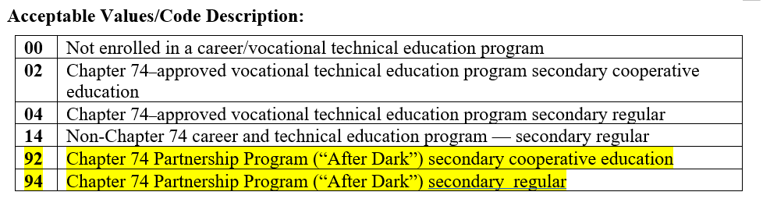
SIMS: DOE035 CVTE - Type of Program
This element will have two values added
These “After Dark” partnership values will allow districts to report their students who are participating in a program at a partnering district that offers the Chapter 74 program. The specific Ch74 program code will be reported in DOE043.
For a list of designated Chapter 74 “After Dark” Partnerships: www.doe.mass.edu/ccte/cvte/afterdark

Slide 7
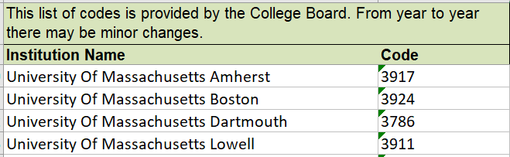
SIMS: DOE046 HQCP Program Participation
This element will have new values added
The new codes will be the four-digit codes for the Institutions of Higher Education (IHE) in MA, so districts can report which IHE partnership an Early College student is enrolled in
For students reported as Early College (DOE045 value of 02), a four-digit IHE code will be required in DOE046.
List of Early College Designees
Examples of IHE codes:

Slide 8
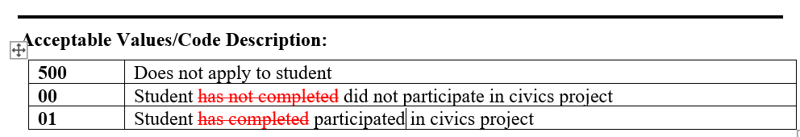
SIMS: DOE053 Civics Project
This is a change in the value descriptions
Element name “Civics Project Completer” will be changed to “Civics Project”
Per Chapter 296 of 2018, Section 4(c) Each public school serving students in the eighth grade and each public high school shall provide not less than 1 student-led, non-partisan civics project for each student

Slide 9
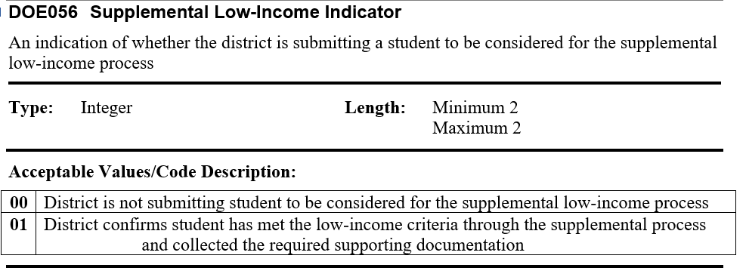
SIMS: DOE056 Supplemental Low-Income Indicator
This is the addition of a new data element in the StudentPersonal SIF object

Slide 10
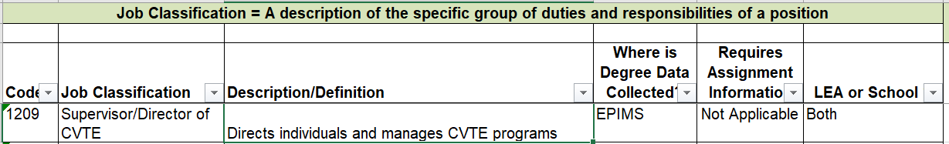
EPIMS: WA07 Job Classification
This element will have one new value added
Code 1209 will be available for districts to report CVTE Director

Slide 11
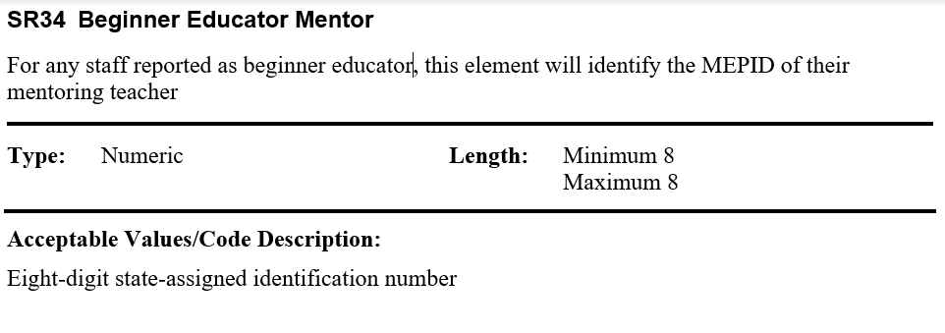
EPIMS: SR34 Beginner Educator Mentor
This is the addition of a new data element in the Staff Roster (StaffAssignment object in SIF Profile)
“Beginner educator” is an educator in the first year of their profession (their primary job classification), this is collected in SR38. New teachers are required to complete an induction and mentoring program.
This new Beginner Educator Mentor field is for districts to report the MEPID of the mentoring teacher for all educators who are identified in SR38 as Beginner Educators (SR34 will be required where SR38 value = 01)

Slide 12
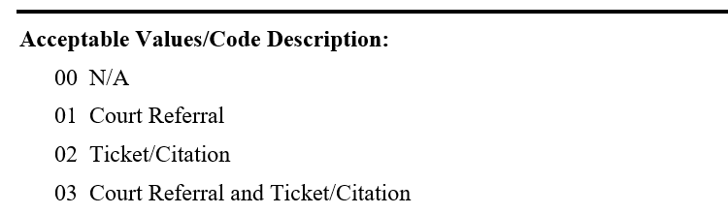
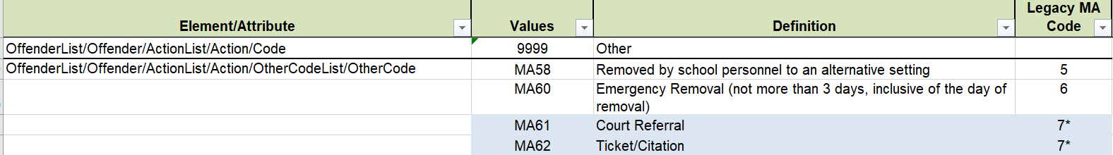
SSDR: Law Enforcement Referral
This element will change from Y/N to unique categories
This change is to ensure the different types of law enforcement referrals are captured in distinct categories.
SIF Action Code MA61 will be translated to 01 in LAWENFREF field
MA62 will be translated to 02
If both MA61 and MA62 are reported for the same incident/student, will be translated to 03
*if only MA61 or MA62 are reported, and no school issued suspension/removal is associated with the incident, DAT value will be 7

Slide 13
Allegations of bullying
State law requires DESE to collect three things in relation to bullying from all MA districts and schools:
The number of allegations of bullying 2. The number of substantiated incidents of bullying 3. The associated disciplines with substantiated incidents of bullying
DESE already collects #2 and 3 through the SSDR (all substantiated incidents of bullying need to be reported through the SSDR regardless of discipline)
Allegation counts will be collected as an aggregate count by school. The counts will be entered manually in a separate page in the SSDR application, and will be required starting next year (2021-22).
This year (2020-21) the Allegation count page is in the SSDR application, but it is not mandatory in order to certify SSDR.

Slide 14
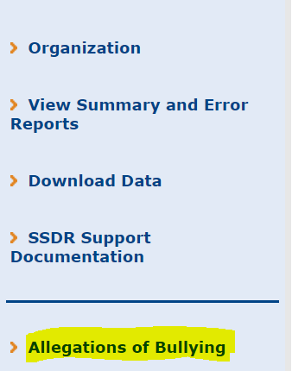
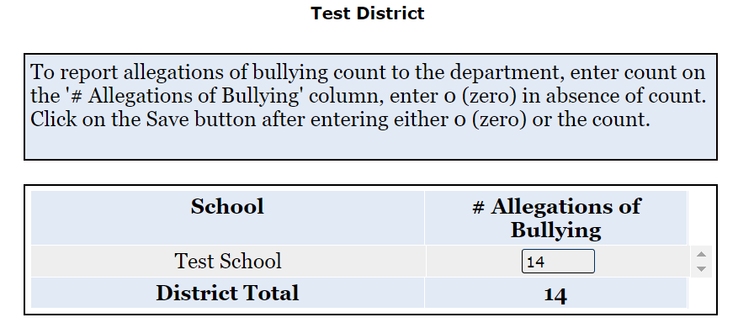
Allegations of bullying
Allegations of Bullying page is found in the SSDR application

Slide 15
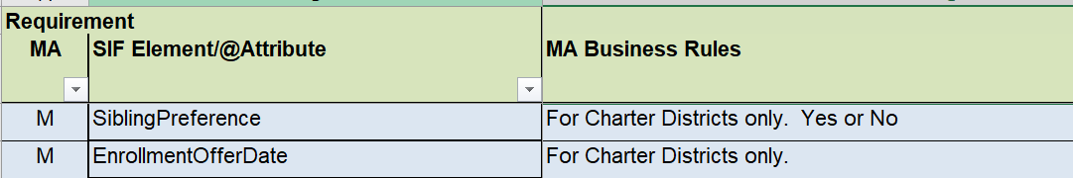
SIF: Charter School Sibling Preference
This is the addition of two new data elements to the SIF Profile in the StudentSchoolEnrollment object
Sibling Preference Yes/No
Enrollment Offer Date
These elements will allow Charter Districts to more easily and efficiently report to DESE which students have been admitted through sibling preference, something that the Charter School Office and School Finance Office now collects manually. The Charter School Office will have more information for Charter Schools on this.

Slide 16
Q&A
03

Slide 17
THANK YOU
More details and guidance to come on these changes as we get closer to the new school year.
Melissa.r.marino@mass.gov

