Slide 1

Distributed Scrum
Jose Michael Joseph

Slide 2

Key Factors that influenced need for Scrum
Uncertainty is inherent and inevitable in software development processes and products
For a new software system the requirements will not be completely known until after the users have used it
It is not possible to completely specify an interactive system
Ambiguous and changing requirements, combined with evolving tools and technologies make implementation strategies unpredictable

Slide 3

“All-at-once” model
“All-at-Once” model is a single super-programmer creating and delivering an application from beginning to end
Concept has a fatal flaw in that there are at most one or two individuals even in a large company that can execute this model
The next level of “All-at-Once” development is handcuffing two programmers together. Pair programming, an eXtreme Programming practice, is an implementation of this
This has been shown to deliver better code (usability, maintainability, flexibility, extendibility) faster than two developers working individually. The challenge is to achieve a similar productivity effect with more than two people.

Slide 4

“Vanilla” Scrum Highlights
Scrum process is characterized by 15 minute daily meetings where each person answers three questions - what did you accomplish yesterday, what will you do today, and what impediments are getting in your way?
Developers consider sets of possible solutions and gradually narrow the set of possibilities to converge on a final solution. Decisions on how and where to implement a feature is delayed until the last possible moment.

Slide 5
Conversion of Scrum to “distributed” Scrum
Best practices for distributed Scrum seen consist of
daily Scrum team meetings of all developers from multiple sites,
daily meetings of Product Owner team
hourly automated builds from one central repository,
no distinction between developers at different sites on the same team,
seamless integration of XP practices like pair programming with Scrum.

Slide 6
Distributed Team Models
Isolated Scrums: Teams are isolated across geographies. In most cases off-shore teams are not cross-functional and may not be using the Scrum process.
Distributed Scrum of Scrums: Scrum teams are isolated across geographies and integrated by a Scrum of Scrums that meets regularly across geographies.
Totally Integrated Scrums: Scrum teams are cross- functional with members distributed across geographies.

Slide 7
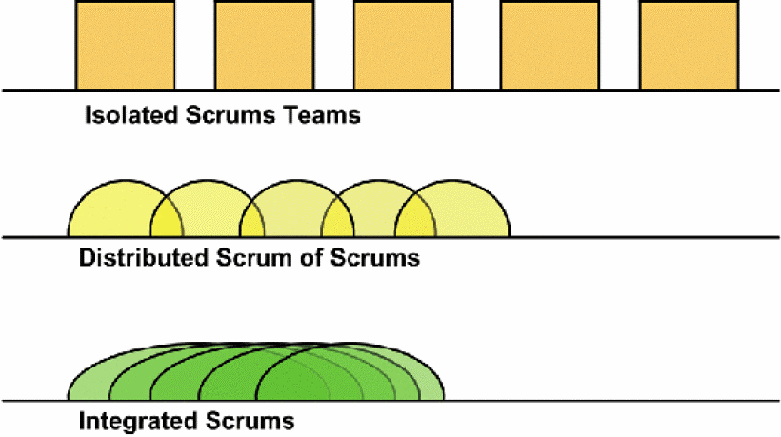

Slide 8

Problems with implementing Distributed Scrum
Most outsourced development efforts use a degenerative form of the Isolated Scrums model where outsourced teams are not cross-functional and not Agile.
Typically, cross-cultural communication problems are compounded by differences in work style in the primary organization vs. the outsourced group. In the worst case, outsourced teams are not using Scrum and their productivity is typical of waterfall projects further delayed by cross-continent communications lag time.
Outsourced teams not using Scrum will typically achieve less than half the velocity of a primary site using Scrum.

Slide 9

Hidden Costs of Outsourcing
The hidden costs of outsourcing are significant, beginning with startup costs.
Barthelemy surveyed 50 companies and found that 14% of outsourcing operations were failures. In the remainder, costs of transitioning to a new vendor often canceled out anticipated savings from low labor costs.
The average time from evaluating outsourcing to beginning of vendor performance was 18 months for small projects.
The MIT Sloan Management Review advises readers not to outsource critical IT functions.

Slide 10
Top Issues in Distributed Development
The SSCI has carefully researched top issues in distributed development:
Strategic: Difficult leveraging available resources, best practices are often deemed proprietary, are time consuming and difficult to maintain.
Project and process management: Difficulty synchronizing work between distributed sites.
Communication: Lack of effective communication mechanisms.
Cultural: Conflicting behaviors, processes, and technologies.
Technical: Incompatible data formats, schemas, and standards.
Security: Ensuring electronic transmission confidentiality and privacy.

Slide 11

Best Distributed Scrum Model
Best practice recommended by the Scrum Alliance is a Distributed Scrum of Scrums model.
This model partitions work across cross-functional, isolated Scrum teams while eliminating most dependencies between teams. Scrum teams are linked by a Scrum-of-Scrums where ScrumMasters (team leaders/project managers) meet regularly across locations.
This encourages communication, cooperation, and cross-fertilization and is appropriate for newcomers to Agile development.

Slide 12

Components of Distributed Scrum
Team formation
This was achieved by splitting teams across sites and fine tuning daily Scrum meetings.
Scrum Meetings
Each individual reports on what they did since the last meeting, what they intend to do next, and what impediments are blocking their progress.
Teams found it necessary to distribute answers to the three Scrum questions in writing before the Scrum meeting.

Slide 13

Sprints
Sprints are two weeks long on the SirsiDynix project. There is a Sprint planning meeting similar to an XP release planning meeting in which requirements from User Stories are broken down into development tasks.
Product Specification
Requirements are in the form of User Stories used in many Scrum and XP implementations. Some of them are lengthy and detailed, others are not.

Slide 14

Testing
Developers write unit tests.
The Test team and Product Owners do manual testing.
An Automation Test team creates scripts for an automated testing tool.
Stress testing is as needed.

Slide 15

Case Study #1: Scrum vs Waterfall
A project that was done initially with a waterfall team and then re-implemented with a Scrum team.
The waterfall team took 9 months with 60 people and generated 54000 lines of code.
It was re-implemented by a Scrum team of 4.5 people in 12 months. The resulting 50,803 lines of code had more functionality and higher quality.

Slide 16
Capers Jones of Software Productivity Research has published extensive tables on average number of function points per lines of code for all major languages.
Since the average lines of code per function point for Java is 53, we can estimate the number of function points in the Scrum application. The waterfall implementation is known to have fewer function points.

Slide 17
Case Study #2: Distributed Scrum vs World
Distributed teams working on Horizon 8.0 generated 671,688 lines of code in 14.5 months with 56 people. During this period they radically refactored the code on two occasions and reduced the code based by 275,000.
They have not been penalized for refactoring as that is rarely done in large waterfall projects in the database from which Capers derived his numbers.
They have also not been rewarded for refactoring even though reducing lines of code is viewed as important as adding new code on well run Agile projects.

Slide 18
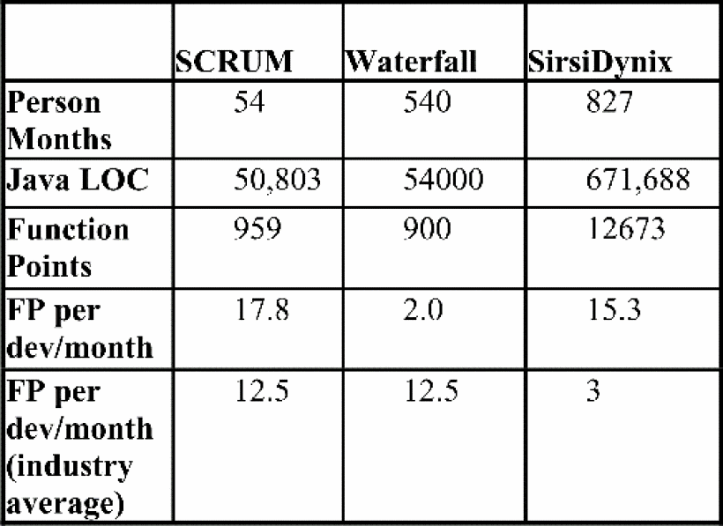
Jones has also shown from his database of tens of thousands of projects that industry average productivity is 12.5 function points per developer/month for a project of 900 function points and that this drops to 3 for a project with 13000 function points.

Slide 19
Conclusion
This case study is a proof point for the argument that distributed teams and even outsourced teams can be as productive as a small collocated team.
This requires excellent implementation of Scrum along with good engineering practices. The entire set of teams must function as a single team with one global build repository, one tracking and reporting tool, and daily meetings across geographies.
Outsourced teams must be highly skilled Agile teams and project implementation must enforce geographic transparency with cross-functional teams at remote sites fully integrated with cross-functional teams at the primary site.

