Slide 1
Customer Service

Slide 2
Learning Objectives
At the end of this module, participants will be able to:
Recognize the variety of laboratory customer groups.
Develop methods to measure customer satisfaction.
Discuss problems that may develop with customers.
Suggest solutions for customer service problems.
Discuss how quality management processes help the laboratory meet customer group needs and requirements.

Slide 3
Scenario
A few of your customers have complained about long delays in reporting HIV test results. You have confirmed that the delay is unreasonable and you solved the problem.
How can you restore confidence with your customers?

Slide 4
The Quality Management System
Organization
Personnel
Equipment
Process Control
Purchasing
&
Inventory
Information Management
Assessment
Documents
&
Records
Occurrence Management
Process Improvement
Customer Service
Facilities
&
Safety

Slide 5

Quality is meeting
customer needs
Philip Crosby
Four Absolutes of Quality Management
1979

Slide 6
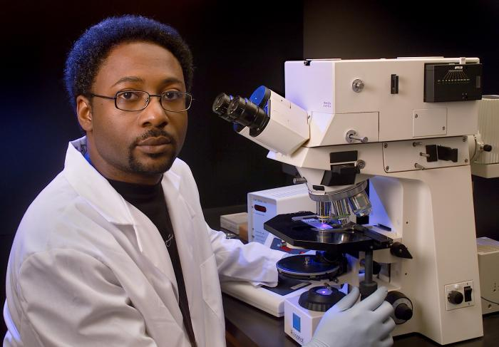
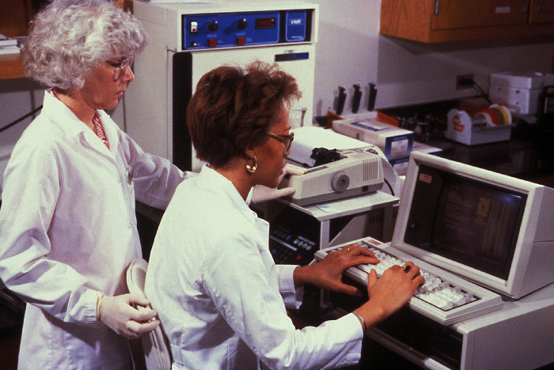
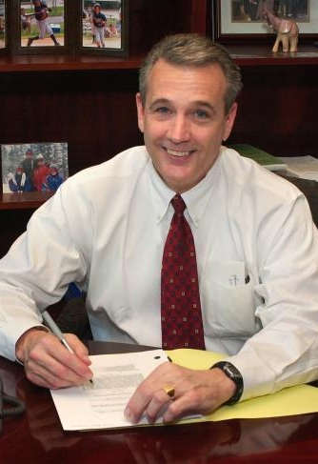

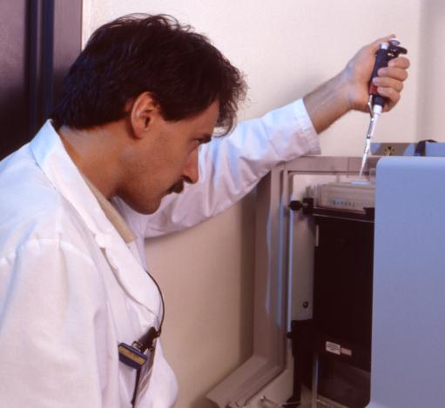
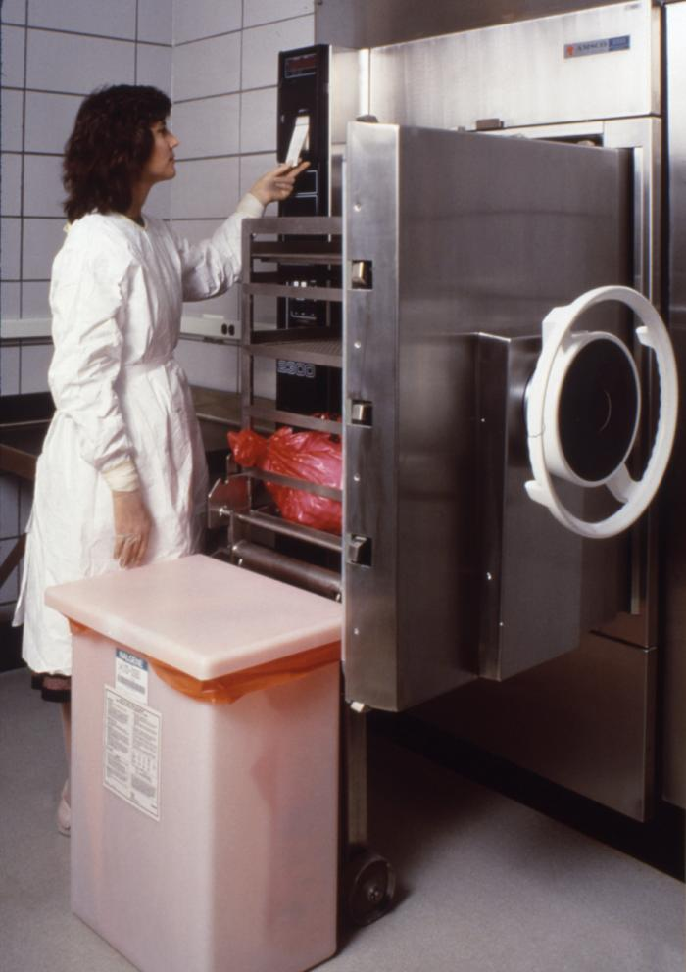
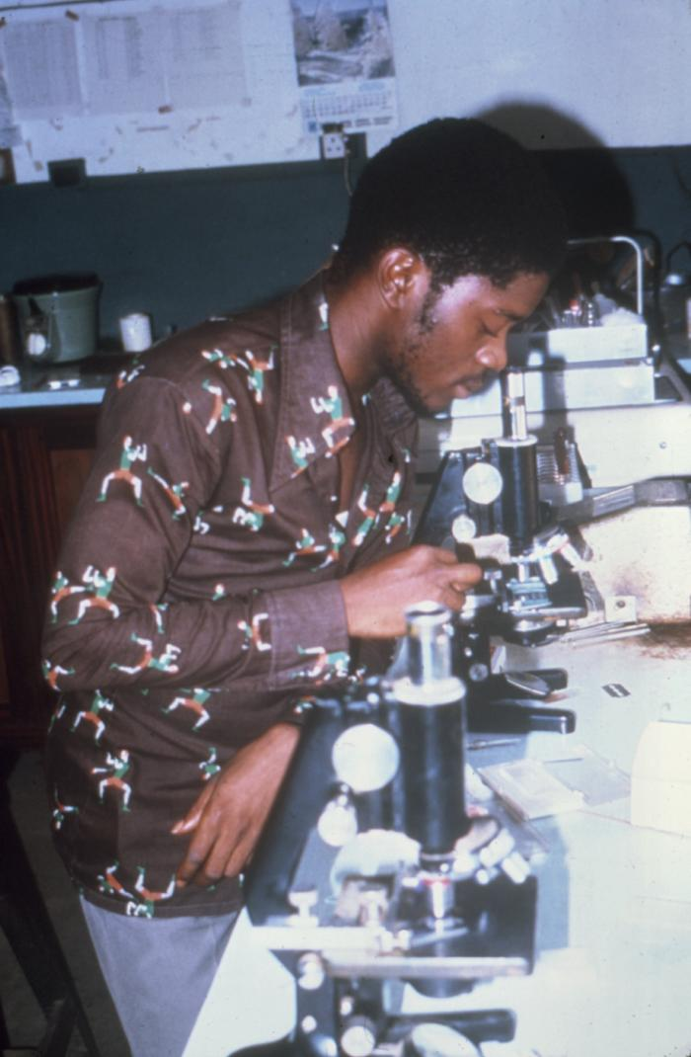

Who is Responsible for Customer Service?
Everyone in the laboratory!

Slide 7
Program for improving customer satisfaction
Requires:
commitment from all staff
planning
knowledge of monitoring tools
resources

Slide 8
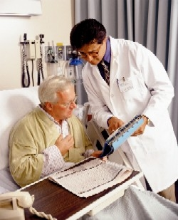

The Laboratory and its Clients
Laboratory
Public Health
Community
Patients
Physicians
Health care
provider

Slide 9

The laboratory shall be legally identifiable
name
address
director
contact information
  telephone
  facsimile
  electronic

Slide 10
Physician Requirements
Community
Physicians
Patients
Public Health
Accurate information
Interpretable information
Timeliness
Laboratory

Slide 11



Actions to Meet Physician Requirements
Preexamination | Examination | Postexamination
test menu collection manual requisition forms timely delivery system | competency assessment test validation quality control quality assessment sample control process management occurrence management | laboratory information system results verification timely results interpretable results timely delivery accurate delivery

Slide 12
Patient Requirements
Community
Patients
Physicians
Public Health
Information
Safety
Comfort
Privacy
Laboratory

Slide 13
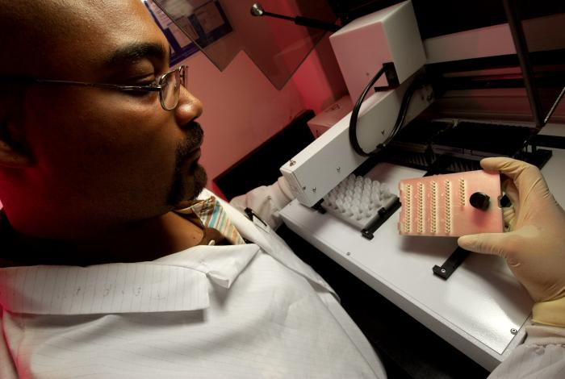
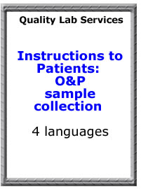

Actions to meet patient requirements
provide collection information
provide collection facilities
trained and knowledgeable personnel
confidentiality of records
maintenance of records
CONFIDENTIAL

Slide 14

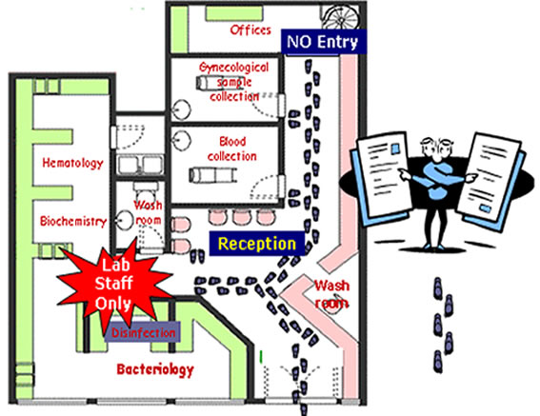
Provide information for patients
laboratory address and location –
directions
hours of operation
bilingual/
multilingual staff

Slide 15
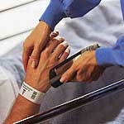
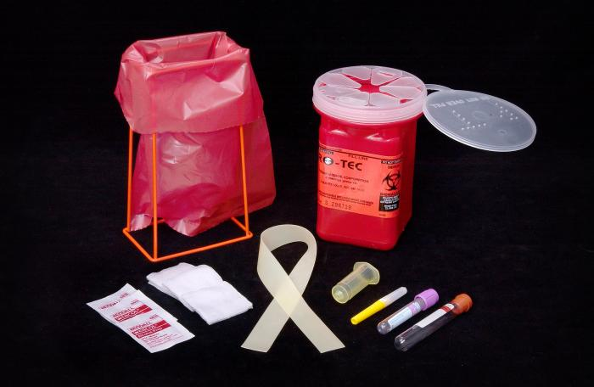
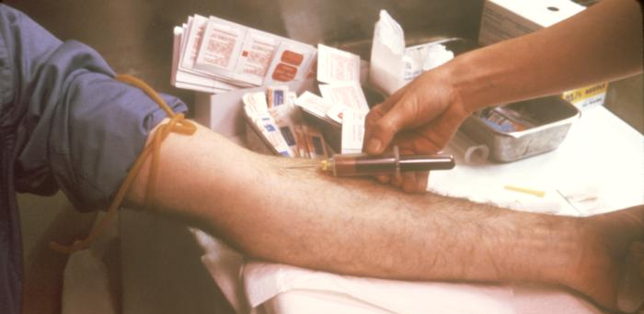

Collection Requirements
patient identification
patient preparation
type of sample required
type of container needed
labeling
special handling
safety precautions

Slide 16
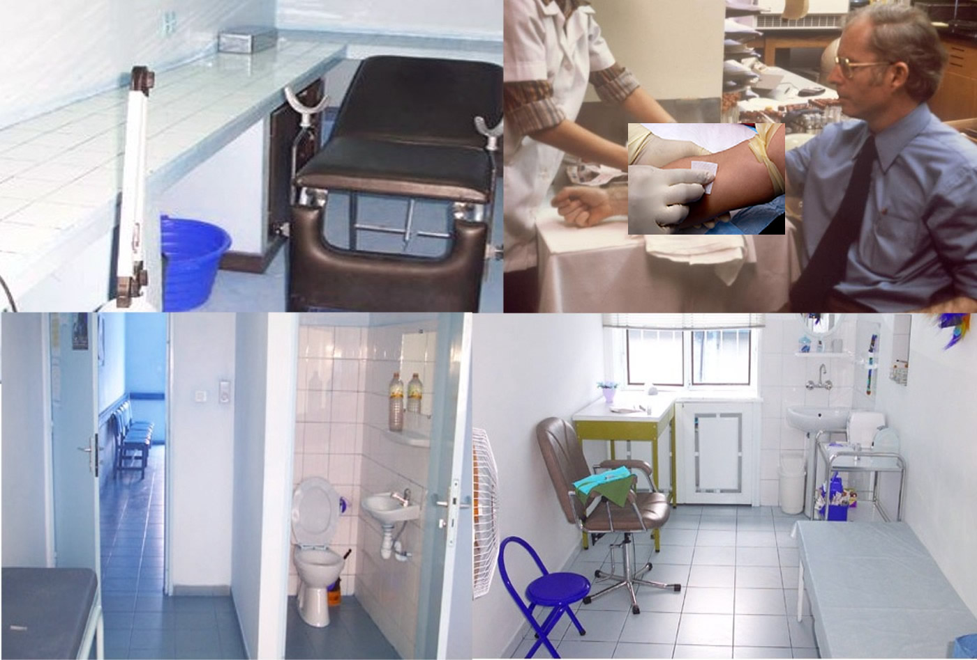
Provide clean, private sample collection rooms

Slide 17
Public Health Requirements
Community
Patients
Physicians
Public Health
Community
Information
Materials
Safety
Containment
Laboratory

Slide 18

Meeting the Community, Public Requirements
Communicable
disease alert,
surveillance,
and response
Waste
management
Safety
Laboratory
Transport of
dangerous
goods
Security
Containment

Slide 19

Client Requirements
Laboratory inspected and accredited to high standards
ACCREDITATION
ACCREDITATION
2007
2008, 2009,
2010…
PRIMARY
MAINTAINED

Slide 20
Good customer service provides:
Customer service is an
integral part of a
quality management system
valuable information for best patient care
valuable information to improve surveillance
professional image of laboratory

Slide 21
Methods for Assessing Customer Satisfaction
complaint
monitoring
interviews,
focus groups
quality
indicators
MONITOR
satisfaction
surveys
internal
audit
management
review

Slide 22


Received complaints may reflect only the “Tip of the Iceberg”

Slide 23





Complaints
Actual
dissatisfied customers!

Slide 24
Assessment Methods
Monitoring
quality indicators
Conducting internal audits
Reviewing by
management
ACTION

Slide 25
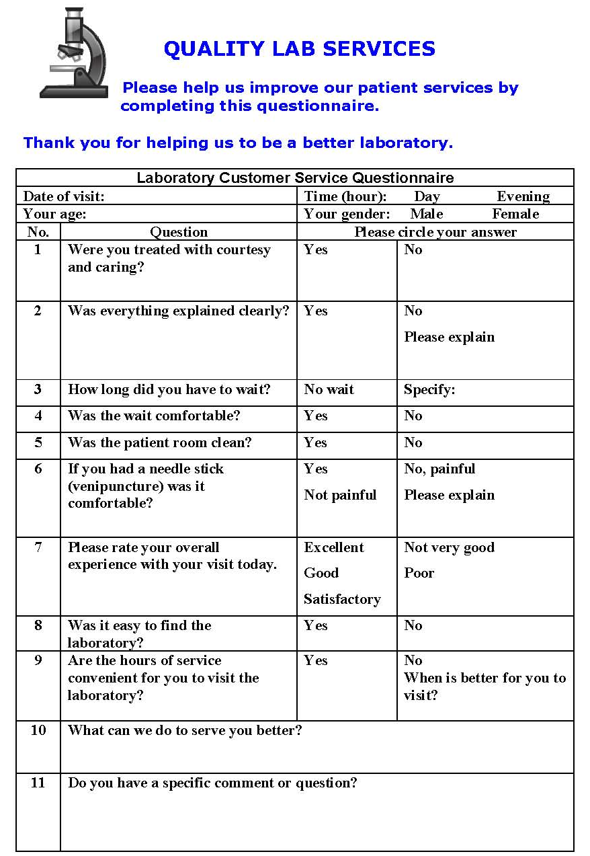
Customer surveys are a requirement of quality management systems
(ISO 9001)

Slide 26


Customer Surveys
planned
analyzed
in a timely
manner
organized
Successful
surveys
no leading
questions,
unbiased
pre-tested

Slide 27

Survey Interview Tips
write out questions in advance
ask specific questions and an open-ended question
→ provide honest feedback
“How could the laboratory improve its service to you?”

Slide 28

Focus groups
When conducting focus
group discussions, consider:
using small groups of 8-10 people
including people with diverse backgrounds and laboratory needs
start by asking questions that build trust
develop a focus group guide for consistency between groups
ask only open-ended questions
—not “yes or no”.

Slide 29
Measuring Customer Satisfaction: Opportunity for Improvement
Surveys, indicators, audits
Information
Process improvement

Slide 30
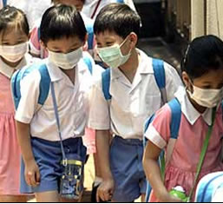
An active
Quality Management System
ensures laboratories meet
all client requirements

Slide 31
Summary
Customer service is an integral part of a quality management system. It is important for the laboratory to:
have commitment to process
conduct planning and monitoring
know and understand clients and their needs
provide resources for program

Slide 32
Key Messages
Meeting customer needs is a primary goal of the laboratory
An active quality management system ensures laboratories meet all client requirements
Everyone in the laboratory is responsible for quality, and therefore for customer service

Slide 33
Questions?
Comments?
Organization
Personnel
Equipment
Process Control
Purchasing
&
Inventory
Information Management
Assessment
Documents
&
Records
Occurrence Management
Process Improvement
Customer Service
Facilities
&
Safety

