Slide 1
CS162:
Operating Systems and
Systems Programming
Lecture 28:
Security
6 August 2015
Charles Reiss
https://cs162.eecs.berkeley.edu/

Slide 2
What is Computer Security?
Computing in the presence of an adversary!
Reliability, robustness, and fault tolerance
  Dealing with Mother Nature (random failures)
AND Security
  Dealing with actions of a knowledgeable attacker dedicated to causing harm
Malice, not just mischance

Slide 3
Protection vs. Security
Protection: mechanisms for controlling access of programs, processes, or users to resources
  Page table mechanism; round-robin schedule; data encryption
Security: use of protection to prevent misuse of resources
  Misuse defined with respect to policy
    E.g.: prevent exposure of certain sensitive information
    E.g.: prevent unauthorized modification/deletion of data
  Need to consider external environment the system operates in
    Will user accidentally reveal password?

Slide 4
An adversary?
Malicious – the adversary will always do the worst thing they can do
Key question – what access do they have?
  Can they replace my keyboard?
  Can they intercept all my network communications?
  Can they grab my hard disk when I'm not using it?

Slide 5
"Misuse of resources"?
Depends on the system!
Is it okay if other people can read my files?
  Web server: yes! (some of them)
  My laptop: no!
Is it okay if other people can store data on my machine?
  Mail server: yes!
  My laptop: no!

Slide 6
Example Security Tasks
Authentication
  Ensures that a user is who is claiming to be
Data integrity
  Ensure that data is not changed from source to destination or after being written on a storage device
Confidentiality
  Ensures that data is read only by authorized users
Non-repudiation
  Sender/client can’t later claim didn’t send/write data
  Receiver/server can’t claim didn’t receive/write data

Slide 7
Authorization: Who Can Do What?
How do we decide who is
authorized to do actions in the
system?

Slide 8
Authorization vs Authentication
How do we decide who is
authorized to do actions in the
system?
Assumes we already know who the user is!

Slide 9
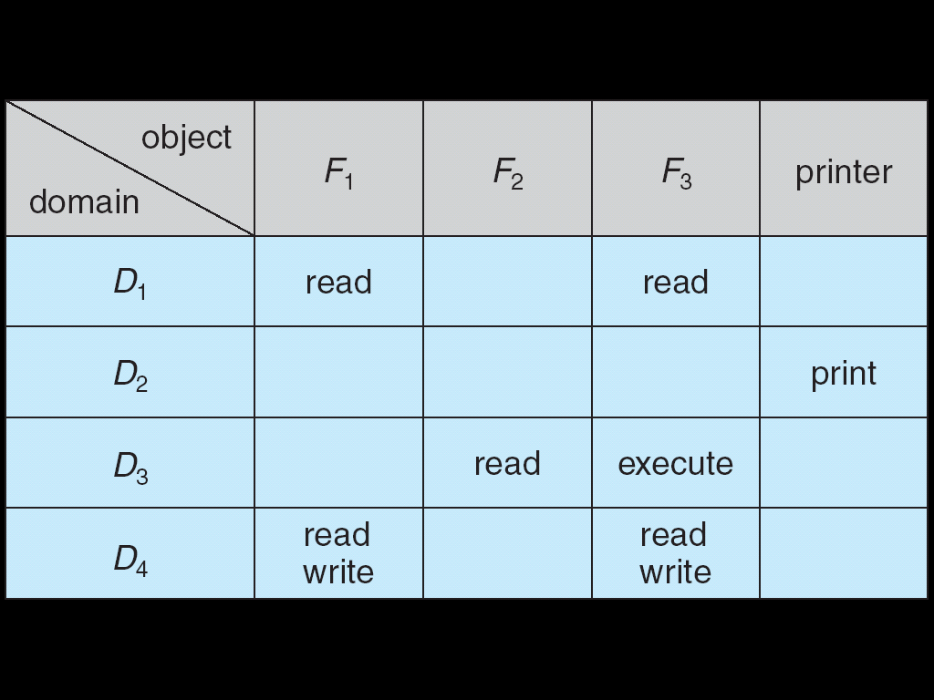
Authorization: Who Can Do What?
How do we decide who is
authorized to do actions in the
system?
Access Control Matrix: contains
all permissions in the system
  Resources across top
    Files, Devices, etc…
  Domains in columns
    A domain might be a user or a
    group of users
    E.g. above: User D3 can read F2 or execute F3
  In practice, table would be huge and sparse!

Slide 10
Authorization: Two Implementation Choices
Access Control Lists: store permissions with object
  Who (what processes) are allowed to do what to this object?
Capability List: each process tracks which objects has permission to touch
  What objects am I (my process) allowed to do things with?
  "Keys" to the object – sometimes can be passed between processes

Slide 11
Capability List
Example: page table
  List of physical pages process has access to
Example: file descriptors
  List of open files process has access to
Trick: List of objects that can be used can be same as "handle" to access objects
  Doesn't have to work this way

Slide 12
Capabilities as Addresses
One approach: give each object a long random ID
Its ID is a capability to access it
  Like file descriptor is capability to access file
ID can be passed around freely
  Perhaps even over a network
Can't be forged – can't guess random number

Slide 13
Access Control Lists
Store permissions with object
Example: NTFS files – in metadata for each file
  List of (user or group, read or write or execute or …)
Example: Unix files – in metadata for each file
  One user ("owner") – read and/or write and/or execute
    Owner also has "change access control list" access
  One group – read and/or write and/or execute
  Default setting ("world") – read and/or write and/or execute

Slide 14
Access Control Lists
Cons:
  Maybe lots of users
  Settings scattered across many files

Slide 15
Authorization: Two Implementation Choices
Access Control Lists: store permissions with object
  Who (what processes) are allowed to do what to this object?
Capability List: each process tracks which objects has permission to touch
  What objects am I (my process) allowed to do things with?

Slide 16
Authorization: Combination Approach
Users have capabilities – groups or roles
Everyone with a particular role/group is "equivalent" for group resources
Each process is assigned one more users/groups/roles
Can access resources if any ACL entry matches
Objects have ACLs
  ACLs can refer to roles – users or groups
  Change object permissions object by modifying ACL
  Change broad user permissions via changes in group membership
  Possessors of proper credentials get access

Slide 17
Authorization: How to Revoke?
How does one revoke someone’s access rights to a particular object?
  Easy with ACLs: just remove entry from the list
  Takes effect immediately
Harder to do with capabilities – how to find capability to change?:
  Not so bad in a single machine: could keep all capability lists in a well-known place (e.g., the OS capability table).
  Very hard in distributed system, where remote hosts may have crashed or may not cooperate (more in a future lecture)

Slide 18
Revoking Capabilities
Various approaches to revoking capabilities:
  Put expiration dates on capabilities and force reacquisition
  Put epoch numbers on capabilities and revoke all capabilities by bumping the epoch number (which gets checked on each access attempt)
  Maintain back pointers to all capabilities that have been handed out
  Maintain a revocation list that gets checked on every access attempt

Slide 19
Authorization on Unix
Combination approach:
  Two "capabilities" associated with process
  Checked against ACLs/static policies
Information in process control block:
  User ID
  Group ID list
Inherited on fork
Checked against file permissions stored in inode on open():
  User ID + read/write/execute
  Group ID + read/write/execute

Slide 20
Authorization on Unix: Files
User ID + Group ID in PCB
Checked against file permissions stored in inode on open():
  User ID + read/write/execute
  Group ID + read/write/execute
Limited access control list

Slide 21
Authorization on Unix: UID = UID
sigaction() + kill()?
  Rule: can only send signals caller's UID matches your UID
Changing file permissions?
  UID needs to match file "owner"
Very limited access control list

Slide 22
Authorization on Unix:
Enforced where?
Checked on system call entry
Can't be checked in the system library, programs could cheat and substitute their own system library

Slide 23
Authorization on Unix: Superuser
User ID 0 is special:
  AKA superuser, root
  Some system calls only work as root – shutdown, mount new filesystems, etc.
  Automatically passes all permission checks

Slide 24
How does login work?
somemachine login: joeuser
Password: ********
How does this program work? It needs to...
Change user IDs, and
Check if the password is correct

Slide 25
How does login work?
somemachine login: joeuser
Password: ********
How does this program work? It needs to...
Change user IDs, and
Check if the password is correct

Slide 26
Changing user IDs
System call (with OS library wrapper):
int setuid(uid_t uid);
Changes UID of current process
Only works for superuser (mostly)

Slide 27
How does login work?
somemachine login: joeuser
Password: ********
How does this program work? It needs to...
Change user IDs, and
Read passwords

Slide 28
Local Unix password storage
/etc/shadow
  not readable anyone but superuser
  contains passwords processed with one-way function
Why a one-way function?
  Make it less bad if someone gets a copy of /etc/shadow
  They can still try a lot of passwords – trillions easily!

Slide 29
How does sudo work?
joeuser@somemachine$ sudo restart
Password: ********
sudo: utility to run a command with superuser permissions
  Started by non-superuser
Recall: current UID inherited across fork()

Slide 30
How does sudo work?
Extra file metadata on executables:
  set-user-ID
exec() system call changes user ID if this is set to the owner of the executable
sudo program is owned by root and has set-user-ID bit set
  Allows it to read /etc/shadow, config files

Slide 31
set-user-ID programs
"Gate" to higher privilege
  Give controlled access to extra functionality
  Make authorization policy outside of the kernel
  Make authentication policy (decide who is who) outside of kernel
Need to write such programs really carefully
  What if stdin, stdout, stderr start closed?
  What if PATH environment variable is set to something ridiculous?
  …

Slide 32
Recall: Handling system calls safely
Same work as interrupts to enter/leave
Copy arguments from user registers/memory (!)
  Carefully check memory locations!
Validate arguments
  Kernel can't crash if user code is broken/malicious
Do operation
Copy result back into user registers/memory
  Carefully check memory locations!

Slide 33

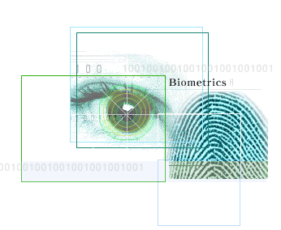
Authentication: Identifying Users
Passwords/passphrases
  Shared secret between two parties
  Typically typed by user
Unix model: Validated by login
  Usually stored in file only accessible to root
  Alternative approaches: network service (example: instructional labs)

Slide 34
Authentication: Identifying Users
Authentication Tokens / Smart Cards
  Electronics embedded in card capable of providing long passwords or satisfying challenge/response queries
  Sometimes with display to show temporary password
  Typical goals: can't be copied; need to have it physically to use it
Biometrics
  Use of one or more intrinsic physical or behavioral traits to identify someone
  Examples: fingerprint reader, palm reader, retinal scan
  Can be copied
  Most useful if someone will arrest you if you're putting a piece of gel on the fingerprint scanner

Slide 35
Alternative Permission Models
Users and groups are very coarse-grained
Example: user on consumer machine probably can access everything that matters
Maybe better to have finer-grained permissions
  "Can access files in directory /home/user/browser-cache, the display, the keyboard, the audio device, but nothing else"
Some partial support for this, e.g. "sandboxing" in web browsers

Slide 36
Passwords: How easy to guess?
Ways of Compromising Passwords
  Password Guessing:
    Often people use obvious information like birthday, favorite color, girlfriend’s name, etc…
  Dictionary Attack:
    Work way through dictionary and compare encrypted version of dictionary words with entries in /etc/passwd
  Dumpster Diving:
    Find pieces of paper with passwords written on them
    (Also used to get social-security numbers, etc)
Paradox:
  Short passwords are easy to crack
  Long ones, people write down!
Technology means we have to use longer passwords
  UNIX initially required lowercase, 5-letter passwords: total of 265=10million passwords
    In 1975, 10ms to check a password1 day to crack
    In 2005, .01μs to check a password0.1 seconds to crack
    Even faster today (use multiple processors)
  Takes less time to check for all words in the dictionary!

Slide 37

https://xkcd.com/936/

Slide 38
Passwords: Secrecy
“eggplant”
System must keep copy of secret to
check against passwords
  What if malicious user gains access to list
  of passwords?
    Need to obscure information somehow
  Mechanism: utilize a transformation that is difficult to reverse without the right key (e.g. encryption)
Example: old UNIX /etc/passwd file
  passwdone way transform(hash)hashed passwd
  System stores only hashed version, so OK even if someone reads the file!
  When you type in your password, system compares hashed version
Problem: Can you trust hashing algorithm?
  It's one way – but can how fast can you try lots of passwords?
  Better not to have to worry

Slide 39
Securing Communication: Cryptography
Cryptography: communication in the presence of adversaries
Studied for thousands of years
  See the Simon Singh’s The Code Book for an excellent, highly readable history
Central goal: confidentiality
  How to encode information so that an adversary can’t extract it, but a friend can
General premise: there is a key, possession of which allows decoding, but without which decoding is infeasible
  Thus, key must be kept secret and not guessable

Slide 40
An Untrusted Network
Assume adversary Eve on network can
  drop messages
  change messages
  read message
  repeat messages
  create messages with arbitrary content
But can't:
  access our machines except by sending messages on the network

Slide 41
Some Untrusted Storgae
Assume adversary Eve on filesystem can
  remove files
  change files
  read files
  copy files
  create files with arbitrary content
But can't:
  access our programs except by sending messages on the network (they're stored on a different filesystem)

Slide 42
Goal: The Secure Channel
Alice sends a sequence of messages to Bob
Goals:
  Confidentiality: Eve does not learn the contents of the messages
  Authenticity: Bob receives messages only from Alice with the contents she choose
  Bob knows what order the messages come in and if there are holes
Idea: Like a private wire from Alice to Bob

Slide 43
Do we have enough?
If Eve and Alice start with the same information...
How can Bob tell who sent him a message?
Answer: He can't.

Slide 44
One solution: Shared secrets
Bob needs to know something about Alice securely (or vice-versa).
One example:
  They agree on a password in advance (knowing Eve isn't watching)

Slide 45
Symmetric Key Encryption
Math to rescue!
  encryption function E(key, message)
  decryption function D(key, message)
Confidentality: Eve can't learn anything about message or key from E(key, message) without knowing key
Plaintext (m)
m
Alice
Bob
Internet
Encrypt with
secret key
Decrypt with
secret key
Ciphertext = Encrypt(secret, m)

Slide 46
Encryption != authenticatoin
Problem: What if Eve sends junk? Is that a valid message?
What will Decrypt(secret, random junk) be?
Plaintext (m)
m
Encrypt with
secret key
Internet
(with Eve)
Decrypt with
secret key
Ciphertext = Encrypt(secret, m)
Random Junk

Slide 47
Encryption != authenticatoin
Eve might be able to manipulate messages meaningfully
  "Transfer $10 to Eve"
  Example: Change value to something else by replacing that part of the message with junk (or can do even better, sometimes!)
Plaintext (m)
m'
Encrypt with
secret key
Internet
(with Eve)
Decrypt with
secret key
Ciphertext = Encrypt(secret, m)
Ciphertext' = f(Encrypt(secret, m))

Slide 48
Symmetric Key Authentication:
Message Authentication Codes
More math to the rescue!
  authenticate: tag = MAC(key, message)
Authentication: Eve can't produce the correct tag without knowing the correct tag
Plaintext (m)
m
Alice
Bob
Internet
Encrypt + Authenticate
with secret keys
Decrypt + Verify with
secret key
Ciphertext = Encrypt(secret1, m)
Tag = MAC(secret2, Ciphertext)

Slide 49
Symmetric Key Authentication:
Message Authentication Codes
More math to the rescue!
  authenticate: tag = MAC(key, message)
Authentication: Eve can't produce the correct tag without knowing the correct tag
Plaintext (m)
message was invalid
Alice
Bob
Internet (Eve)
Encrypt + Authenticate
with secret keys
Decrypt + Verify with
secret key
tag, ciphertext
tag, changed ciphertext

Slide 50
Authenticated Encryption
ciphertext, tag = EncryptThenMAC(key, message)
invalid or message =
ValidateThenDecrypt(key, message)
Combine and encryption and MAC function
  AES-GCM = encryption AES-CTR + MAC AES-GMAC
  AES-CBC + HMAC-SHA256
  (Caution: want independent keys!)

Slide 51
Authenticated Encryption
Cryptographic primitives: Building blocks!
Example: AES (Advanced Encryption Standard):
AES-Encrypt(key, 128-bit block X) = 128-bit block Y
AES-Decrypt(key, 128-bit block Y) = 128-bit block X
Use these to build encryption, authentication for arbitrary-length messages
ciphertext, tag = EncryptThenMAC(key, message)
invalid or message =
ValidateThenDecrypt(key, message)
Combine and encryption and MAC function
  AES-GCM = encryption AES-CTR + MAC AES-GMAC
  AES-CBC + HMAC-SHA256
  (Caution: want independent keys!)

Slide 52
Recall: The Secure Channel
Alice sends a sequence of messages to Bob
Goals:
  Confidentiality: Eve does not learn the contents of the messages
  Authenticity: Bob receives messages only from Alice with the contents she choose
  Bob knows what order the messages come in and if there are holes
Idea: Like a private wire from Alice to Bob

Slide 53
Guaranteeing Order
Bob knows what order the messages come in and if there are holes
One solution: All messages start with a message number
  Bob needs to remember the last message number used with the secret key
  Note that Eve can resend a very old message, so Bob can't reset the numbering without choosing a new key

Slide 54
Using Symmetric Keys
Same key for encryption and decryption
Achieves confidentiality
Vulnerable to tampering and replay attacks
Plaintext (m)
m
Internet
Encrypt with
secret key
Decrypt with
secret key
Ciphertext

Slide 55
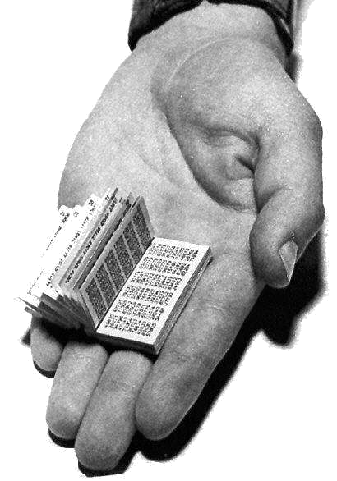
Symmetric Keys
Can just XOR plaintext with the key
  Easy to implement, but easy to break using frequency analysis
  Unbreakable alternative: XOR with one-time pad
    Use a different key for each message

Slide 56
Symmetric Keys
Can just XOR plaintext with the key
  Easy to implement, but easy to break using frequency analysis
  Unbreakable alternative: XOR with one-time pad
    Use a different key for each message

Slide 57
Symmetric Key Ciphers - DES & AES
Data Encryption Standard (DES)
  Developed by IBM in 1970s, standardized by NBS/NIST
  56-bit key (decreased from 64 bits at NSA’s request)
  Still fairly strong other than brute-forcing the key space
    But custom hardware can crack a key in < 24 hours
  Today many financial institutions use Triple DES
    DES applied 3 times, with 3 keys totaling 168 bits
Advanced Encryption Standard (AES)
  Replacement for DES standardized in 2002
  Key size: 128, 192 or 256 bits
How fundamentally strong are they?
  No one knows (no proofs exist)

Slide 58
Authentication via Secret Key
Main idea: entity proves identity by decrypting a secret encrypted with its own key
  K – secret key shared only by A and B
A can asks B to authenticate itself by decrypting a nonce, i.e., random value, x
  Avoid replay attacks (attacker impersonating client or server)
Vulnerable to man-in-the middle attack
A
B
E(x, K)
Notation: E(m,k) – encrypt message m with key k
x

Slide 59
Integrity: Cryptographic Hashes
Basic building block for integrity: cryptographic hashing
  Associate hash with byte-stream, receiver verifies match
    Assures data hasn’t been modified, either accidentally – or maliciously
Approach:
  Sender computes a secure digest of message m using H(x)
    H(x) is a publicly known hash function
    Digest d = HMAC (K, m) = H (K | H (K | m))
    HMAC(K, m) is a hash-based message authentication function
  Send digest d and message m to receiver
  Upon receiving m and d, receiver uses shared secret key, K, to recompute HMAC(K, m) and see whether result agrees with d

Slide 60
Public Key Cryptography
Problem: Need to agree on a secret
Can we avoid that?
Alternative: key pair
  One key Bob can publish to everyone (Alice and Carol) – a public key
  One key Bob can keep to himself only – a private key
Advantage:
  Can distribute key to everybody

Slide 61
Asymmetric Encryption
Encrypt(public-key, message) = ciphertext
Decrypt(private-key, ciphertext) = message
Plaintext (m)
m
Alice
Bob
Internet
Encrypt with
Bob's public key
Decrypt with
Bob's private key
Ciphertext = Encrypt(Bob's public key, m)

Slide 62
Asymmetric Authentication
AKA Digital Signatures
Sign(private-key, message) = signature
Verify(public-key, signature, message) = yes or no
Plaintext (m)
m
Alice
Bob
Internet
Sign with
Alice's private key
Verify with
Alice's public key
m, Signature = Sign(Alice's private key, m)

Slide 63
Asymmetric Authentication
AKA Digital Signatures
Sign(private-key, message) = signature
Verify(public-key, signature, message) = yes or no
Plaintext (m)
INVALID MESSAGE
Alice
Bob
Internet
(Eve)
Sign with
Alice's private key
Verify with
Alice's public key
m, Signature = Sign(Alice's private key, m)
m', Fake Signature

Slide 64
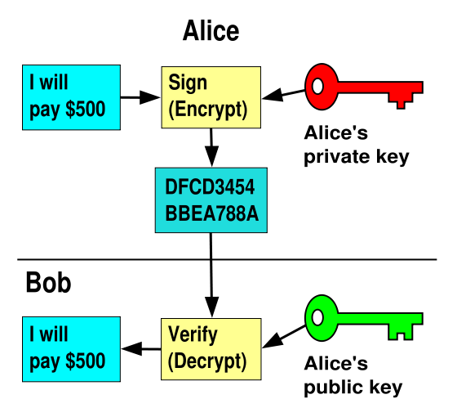
Signatures
I will pay Bob $500
I will pay Bob $500

Slide 65
Bootstraping Symmetric Crypto
Alice wants to share a secret with Bob?
  Encrypt(Alice's public key,
  "The password is bar")
Then use symmetric encryption + authentication

Slide 66
Bootstraping Asymmetric Crypto
Suppose: Alice and Bob both trust Trent and know his public key.
Trent produces this message:
  Sign(Trent's private key,
  "Alice's public key is XXXXXXXX")
  Called a certificate
Then Bob can send this to Alice.
Trent is called a certificate authority

Slide 67
Certificate Authorities in the Wild
List of Trents distributed with operating systems, browsers
Trusted to produce public keys for websites
Are they worthy of this trust????

Slide 68
Certificate Validation
Certificate
E(H_{SHA256}(KA_{public}, www.amazon.com, …), KS_{private})),
KA_{public}, www.amazon.com, …
E(H_{SHA256}(…), KS_{public}))
(recall, KS_{public} hardwired)
H_{SHA256}(KA_{public}, www.amazon.com, ..)
H_{SHA256}(KA_{public}, www.amazon.com, …)
H_{SHA256}(KA_{public}, www.amazon.com, …)
No
=
Validation failed
Yes
Validation successful

Slide 69
TLS / HTTPS (1)
Browser
Amazon
HTTPS → "secure" HTTP
Handshake:
  Browser says what types of symmetric, asymmetric encryption it supports
  Server chooses from browser's list, sends certificate
Next step depends on what's selected
Hello. I support
(RSA+AES128+SHA2) or
(ECDHE+RSA+AES128+SHA2) or …
Let’s use
TLS+RSA+AES128+SHA2
Here’s my cert
~1 KB of data

Slide 70
TLS / HTTPS (2)
Browser
Amazon
One example: RSA key exchange
Client sends a random value encrypted to the key in the certificate
This value is used to create symmetric keys
Not the best approach in TLS: want "forward secrecy"
  Use temporary key pairs so compromising the permanent key won't allow decryption after the fact
Encrypt(server's public key, random value)
Encrypt(random value + other stuff, ...)

Slide 71
Public Key Cryptography (1)
Invented in the 1970s
  Revolutionized cryptography
  (Was actually invented earlier by British intelligence)
How can we construct an encryption/decryption algorithm using a key pair with the public/private properties?
  Answer: Number Theory
Generally slower, larger messages than symmetric crypto

Slide 72
Public Key Crypto Algorithms
Based on modular exponentiation of large integers:
  RSA-based
    Rivest / Shamir / Adleman, 1977; RFC 3447
    Probably most widely used
  DH-based schemes (ElGamal, DSA, ...)
Elliptic curve-based approaches:
  Mathematically similar to DH-based schemes
  Based on "curves" (fields in the abstract Algebra sense) in a Galois-field space
  Shorter keys and signatures and encrypted messages than modular-exponentiation-based approaches
(and more, less common ones)

Slide 74
Logistics
Project 3 Due Monday
HW3 due next Wednesday
Final exam next Thursday
Final review Tuesday and discussion M/Tu

Slide 75
Break

