Slide 1
CS162:
Operating Systems and
Systems Programming
Lecture 3:
Unix Process and IO Interfaces
24 June 2015
Charles Reiss
https://cs162.eecs.berkeley.edu/

Slide 2
Recall: Four OS concepts
Thread
  Single unique execution context
  Program Counter, Registers, Stack
Address Space w/ Translation
  Programs execute in an address space that is distinct from the memory space of the physical machine
Process
  An instance of an executing program is a process consisting of an address space and one or more threads of control
Dual Mode operation/Protection
  Only the “system” has the ability to access certain resources
  The OS and the hardware are protected from user programs and user programs are isolated from one another by controlling the translation from program virtual addresses to machine physical addresses

Slide 3
Recall: Process
Execution environment with restricted rights
  Address space + Thread(s)
  File descriptors, other resources, ...
Protected from each other
  Compromise: sharing harder, less efficient
OS protected from processes

Slide 4
Recall: Illusion of Multiple Processors
vCPU1
vCPU2
vCPU3
T1
T2
vCPU1
vCPU2
vCPU3
vCPU1
vCPU2
Shared Memory
Time
Threads are virtual cores
At T1: vCPU1 on real core; vCPU2 in memory
At T2: vCPU1 in memory; vCPU2 on real core
What happened?
  OS ran [how?]
  Saved PC, SP, … in vCPU1's thread control block (memory)
  Loaded PC, SP, … from vCPU2's thread control block

Slide 5
Recall:: Base and Bound
code
0000…
code
static data
static data
heap
Base
heap
1000…
stack
stack
code
1000…
Program
address
+
static data
Bound
heap
<
0100…
stack
code
1100…
static data
heap
stack
FFFF…
Notes:
This scheme doesn't require relocation. The OS can load the program anywhere in memory it has room without modifying the program – without the program being able to notice.
But it does mean the program's size needs to be fixed when we start it.

Slide 6
Recall: Base and Bound
code
0000…
code
static data
static data
heap
Base
heap
1100…
stack
stack
1000…
Program
address
+
Bound
<
0100…
code
1100…
static data
heap
stack
FFFF…
Notes:
This scheme doesn't require relocation. The OS can load the program anywhere in memory it has room without modifying the program – without the program being able to notice.
But it does mean the program's size needs to be fixed when we start it.

Slide 7
Recall: Switching Processes
0000…
Proc 1
Proc 2
Proc n
code
…
static data
heap
OS
stack
code
sysmode
1
static data
1000…
1000 …
1000 …
Base
1000...
(effectively 0000…)
heap
1100 …
1100 …
(effectively FFFF…)
Bound
1100...
0000 1234
0000 1234
stack
uPC
0000 ...
regs
regs
PC
IntVector[i]
code
00FF…
1100…
00FF…
static data
regs
heap
…
stack
FFFF…

Slide 8
Recall: Switching Processes
0000…
Proc 1
Proc 2
Proc n
code
RTU
…
static data
heap
OS
stack
code
1000…
sysmode
0
static data
1000 …
1000 …
Base
1000...
heap
1100 …
1100 …
Bound
1100...
0000 1234
0000 1234
stack
uPC
0000 1111
regs
regs
PC
0000 ...
code
00FF…
1100…
00FF…
static data
regs
heap
…
stack
FFFF…

Slide 9
Recall: Switching Processes
0000…
Proc 1
Proc 2
Proc n
code
RTU
…
static data
heap
OS
stack
code
1000…
sysmode
0
static data
1000 …
1000 …
Base
1000...
heap
1100 …
1100 …
Bound
1100...
0000 1234
0000 1234
stack
uPC
????...
regs
regs
PC
0000 ...
code
00FF…
1100…
00FF…
static data
regs
heap
…
stack
FFFF…

Slide 10
Recall:
Types of (U->K) Mode Switches
System call (syscall)
  "Function call" to the kernel
  Example: exit, read
  Kernel reads syscall id + args from user registers
Interrupt
  External asynchronous events: timer, I/O
Trap or Exception
  Special event in process
  Protection violation (segfault), divide by zero, …

Slide 11
Recall: Process Control Block (PCB)
Kernel representation of each process
  Status (running, ready, blocked)
  Register state (if not ready) [Thread]
  Process ID
  Execution time
  Memory translations [Address space]
  …
Scheduler maintains a data structure of PCBs
Scheduling algorithm decides what to run

Slide 12
Recall: The Scheduler
vCPU1
vCPU2
vCPU3
vCPU1
vCPU2
Time
if ( readyProcesses(PCBs) ) {
nextPCB = selectProcess(PCBs);
run( nextPCB );
} else {
run_idle_process();
}

Slide 13
Process Operations
Processes need to manipulate processes:
  Start
  Exit
  Wait for them
Processes need to do I/O
How? System calls!

Slide 14
But I've never written a syscall...
Application programmers generally don't...
Can't in C without inline assembly, etc. …
Instead, OS libraries do this...

Slide 15
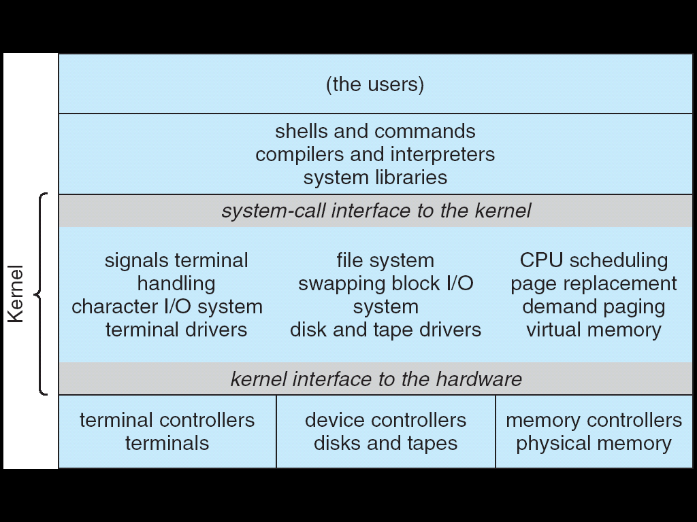
UNIX System Structure
Applications
User Mode
Standard Libs
Kernel Mode
Hardware

Slide 16
OS runtime library
Proc 1
Proc 2
Proc n
…
OS
Appln
Shell
Window Manager
…
OS library
OS library
OS library
OS

Slide 17
A Narrow Waist
Word Processing
Compilers
Web Browsers
Email
Databases
Web Servers
Application / Service
Portable OS Library
OS
User
System Call
Interface
System
Portable OS Kernel
Software
Platform support, Device Drivers
Hardware
x86
PowerPC
ARM
PCI
Ethernet (10/100/1000)
802.11 a/b/g/n
SCSI
IDE
Graphics

Slide 18
POSIX / Unix
Portable Operating System Interface [X?]
Defines "Unix", derived from AT&T Unix
  Created to bring order to many Unix-derived OSs
Interface for application programmers (mostly)

Slide 19
pid.c
#include <stdlib.h>
#include <stdio.h>
#include <unistd.h>
#include <sys/types.h>
int main(int argc, char *argv[])
{
/* get current processes PID */
pid_t pid = getpid();
printf("My pid: %d\n", (int) pid);
exit(0);
}

Slide 20
Creating Processes
pid_t fork(); – copy the current process
  New process has different pid
Returns twice:
  In parent: pid of the child process
  In child: 0
Everything (but pid) duplicated in parent, child:
  Memory
  File descriptors (later)
  Registers at time of system call

Slide 21
Fork
0000…
Parent
Child
code
…
static data
heap
OS
stack
code
sysmode
1
static data
1000…
1000 …
1000 …
Base
1000...
(effectively 0000…)
heap
1100 …
0100 …
(effectively FFFF…)
Bound
0100...
0000 1234
0000 1234
stack
uPC
0000 ...
1100…
regs
regs
code
00FF…
PC
00FF…
static data
regs
1000 …
heap
1100 …
…
1100 …
1100 …
stack
FFFF…
0000 1234
0000 1234
regs
regs
00FF…
00FF…

Slide 22
fork1.c
#include <stdlib.h>
#include <stdio.h>
#include <unistd.h>
#include <sys/types.h>
int main(int argc, char *argv[]) {
pid_t cpid, mypid,;
pid_t pid = getpid(); /* get current processes PID */
printf("Parent pid: %d\n", (int) pid);
cpid = fork();
if (cpid > 0) { /* Parent Process */
mypid = getpid();
printf("[%d] parent of [%d]\n", (int) mypid, (int) cpid);
} else if (cpid == 0) { /* Child Process */
mypid = getpid();
printf("[%d] child\n", (int) mypid);
} else {
perror("Fork failed");
}
}

Slide 23
fork_race.c
...
if (cpid > 0) {
for (i=0; i<100; i++) {
printf("[%d] parent: %d\n", mypid, i);
// sleep(1);
}
} else if (cpid == 0) {
for (i=0; i>-100; i--) {
printf("[%d] child: %d\n", mypid, i);
// sleep(1);
}
...
What does this print?
Would adding the sleeps matter?

Slide 24
fork_race.c
...
if (cpid > 0) {
for (i=0; i<100; i++) {
printf("[%d] parent: %d\n", mypid, i);
// sleep(1);
}
} else if (cpid == 0) {
for (i=0; i>-100; i--) {
printf("[%d] child: %d\n", mypid, i);
// sleep(1);
}
...
Parent
Child
Parent
Child
Parent
Time

Slide 25
Unix process management
fork – copy the current process
exec – change the program being run by the current process
wait – wait for a process to finish
kill – send a signal (interrupt-like notification) to another process
sigaction – set handlers for signals

Slide 26
Shell
Job control systems
  Allows user to create/manage applications to do tasks
  User's wrapper around process management functions
  Windows, OS X, Linux all have shells
Homework 1: make a simple shell for POSIX

Slide 27
Unix process management
fork – copy the current process
exec – change the program being run by the current process
wait – wait for a process to finish
kill – send a signal (interrupt-like notification) to another process
sigaction – set handlers for signals

Slide 28
fork2.c
...
cpid = fork();
if (cpid > 0) { /* Parent Process */
mypid = getpid();
printf("[%d] parent of [%d]\n",
(int) mypid, (int) cpid);
tcpid = wait(&status);
printf("[%d] bye %d\n", mypid, tcpid);
} else if (cpid == 0) { /* Child Process */
mypid = getpid();
printf("[%d] child\n", (int) mypid);
}
...

Slide 29
Unix process management
fork – copy the current process
exec – change the program being run by the current process
wait – wait for a process to finish
kill – send a signal (interrupt-like notification) to another process
sigaction – set handlers for signals

Slide 30
fork3.c
...
cpid = fork();
if (cpid > 0) { /* Parent Process */
tcpid = wait(&status);
} else if (cpid == 0) { /* Child Process */
char *args[] = {"ls", "-l", NULL};
execv("/bin/ls", args);
/* execv doesn't return when it works.
So, if we got here, it failed! */
perror("execv");
exit(1);
}
...

Slide 31
Unix Process Management

Slide 32
Unix process management
fork – copy the current process
exec – change the program being run by the current process
wait – wait for a process to finish
kill – send a signal (interrupt-like notification) to another process
sigaction – set handlers for signals

Slide 33
inf_loop.c
#include <stdlib.h>
#include <stdio.h>
#include <sys/types.h>
#include <unistd.h>
#include <signal.h>
void signal_callback_handler(int signum) {
printf("Caught signal!\n");
exit(1);
}
int main() {
struct sigaction sa;
sa.sa_flags = 0;
sigemptyset(&sa.sa_mask);
sa.sa_handler = signal_callback_handler;
sigaction(SIGINT, &sa, NULL);
while (1) {}
}

Slide 34
inf_loop.c
#include <stdlib.h>
#include <stdio.h>
#include <sys/types.h>
#include <unistd.h>
#include <signal.h>
void signal_callback_handler(int signum) {
printf("Caught signal!\n");
exit(1);
}
int main() {
struct sigaction sa;
sa.sa_flags = 0;
sigemptyset(&sa.sa_mask);
sa.sa_handler = signal_callback_handler;
sigaction(SIGINT, &sa, NULL);
while (1) {}
}
Unsafe if loop called printf,
malloc, etc.
  What if printf was resizing its buffer...?
Limited set of "signal-safe" functions
  Includes low-level I/O (later)

Slide 35
Common Unix Signals
SIGINT – control-C
SIGTERM – default for 'kill' shell command
SIGTSTP – control-Z (default action: stop process)
SIGKILL, SIGSTOP – terminate/stop process
  Can't be changed with sigaction

Slide 36
Logistics
Do homework 0 – due Friday
Groups – due Friday
Project 1 out Monday

Slide 37
Break

Slide 38
POSIX IO: Everything is a file
Uniform interface for
  Devices (terminals, printers, etc.)
  Regular files on disk
  Networking (sockets)
  Local interprocess communication (pipes, sockets)
Based on open(), read(), write(), close()

Slide 39
POSIX IO: Everything is a file
Open before use
  Access control, setup happens here
Byte-oriented
  Least common denominator
  OS responsible for hiding that real devices aren't!
Explicit close

Slide 40
POSIX IO: Kernel buffering
Reads are buffered
  Part of making everything byte-oriented
  Process is blocked while waiting for device
  Let other processes run while gathering result
Writes are buffered
  Complete in background (more later in semester)
  (Return to user when "handed off" to kernel)

Slide 41
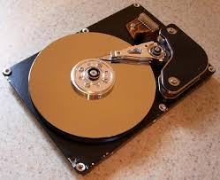
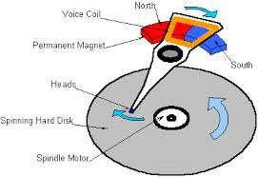
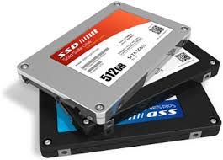

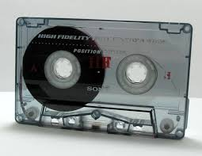
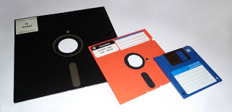
I/O and Storage Layers
Application / Service
streams
High Level I/O
Low Level I/O
file descriptors
Syscall
registers
File System
open file
I/O Driver
Commands and Data Transfers
Disks, Flash, Controllers, DMA

Slide 42
I/O and Storage Layers
Application / Service
streams
High Level I/O
Low Level I/O
file descriptors
Syscall
registers
File System
open file
I/O Driver
Commands and Data Transfers
Disks, Flash, Controllers, DMA

Slide 43
The File System abstraction
Regular File
  Named collection of data
  POSIX: list of bytes
    Could really be text, binary, serialized objects, etc.
  Also size, modification time, owner, access control info
Directory
  "Folder" containing files and directories
  Hierarchical naming
    /home/ff/cs162/...

Slide 44
C stdio (high level) file API: streams
FILE* – stream, sequence of bytes and position
#include <stdio.h>
FILE *fopen( const char *filename, const char *mode );
int fclose( FILE *fp );
Mode Text | Binary | Descriptions
r | rb | Open existing file for reading
w | wb | Open for writing; created if does not exist
a | ab | Open for appending; created if does not exist
r+ | rb+ | Open existing file for reading & writing.
w+ | wb+ | Open for reading & writing; truncated to zero if exists, create otherwise
a+ | ab+ | Open for reading & writing. Created if does not exist. Read from beginning, write as append

Slide 45
Connecting processes and filesystem
Process has a "current working directory" (CWD)
Absolute paths
  /home/ff/cs162
Relative paths
  index.html, ./index.html – in CWD
  ../index.html – parent of CWD
  ~, ~cs162 – home directory (shell only)

Slide 46
Standard streams
Three predefined streams:
  FILE* stdin – normal source of input
  FILE* stdout – normal source of output
  FILE* stderr – for error output
All can be redirected:
  find | grep | wc …
    Find's stdout goes to grep's stdin, etc.

Slide 47
C streams: Read/Write
#include <stdio.h>
// character oriented
int fputc( int c, FILE *fp ); // rtn c or EOF on err
int fputs( const char *s, FILE *fp ); // rtn >0 or EOF
int fgetc( FILE * fp );
char *fgets( char *buf, int n, FILE *fp );
// block oriented
size_t fread(void *ptr, size_t size_of_elements,
size_t number_of_elements, FILE *a_file);
size_t fwrite(const void *ptr, size_t size_of_elements,
size_t number_of_elements, FILE *a_file);
// formatted
int fprintf(FILE *stream, const char *format, ...);
int fscanf(FILE *stream, const char *format, ... );

Slide 48
C streams: Example – char-by-char
#include <stdio.h>
int main(void) {
FILE* input = fopen("input.txt", "r");
FILE* output = fopen("output.txt", "w");
int c;
c = fgetc(input);
while (c != EOF) {
fputc(output, c);
c = fgetc(input);
}
fclose(input);
fclose(output);
}

Slide 49
C streams: Example – block-by-block
#include <stdio.h>
#define BUFFER_SIZE 1024
int main(void) {
FILE* input = fopen("input.txt", "r");
FILE* output = fopen("output.txt", "w");
char buffer[BUFFER_SIZE];
size_t length;
length = fread(buffer, BUFFER_SIZE, sizeof(char), input);
while (length > 0) {
fwrite(buffer, length, sizeof(char), output);
length = fread(buffer, BUFFER_SIZE, sizeof(char), input);
}
fclose(input);
fclose(output);
}

Slide 50
C streams: Positioning
int fseek(FILE *stream,
long int offset,
int whence);
long int ftell (FILE *stream)
void rewind (FILE *stream)

Slide 51
I/O and Storage Layers
Application / Service
streams
High Level I/O
Low Level I/O
handles
Syscall
registers
File System
open file
I/O Driver
Commands and Data Transfers
Disks, Flash, Controllers, DMA

Slide 52
POSIX Low-level I/O
Operations on file descriptors (ints)
  Per-process table pointing to open file descriptions
Created by open(), removed by close()
#include <fcntl.h>
#include <unistd.h>
#include <sys/types.h>
int open (const char *filename, int flags [, mode_t mode])
int creat (const char *filename, mode_t mode)
int close (int filedes)
Bit vector of:
Access modes (Rd, Wr, …)
Open Flags (Create, …)
Operating modes (Appends, …)
Bit vector of Permission Bits:
User|Group|Other X R|W|X

Slide 53
Low-level I/O: standard descriptors
#include <unistd.h>
STDIN_FILENO - macro has value 0
STDOUT_FILENO - macro has value 1
STDERR_FILENO - macro has value 2
Correspond to stdio.h's stdin, stdout, stderr
Do not mix with stdio.h

Slide 54
Low-level I/O: operations
ssize_t read(int filedes, void *buffer, size_t maxsize)
- returns bytes read, 0 => EOF, -1 => error
ssize_t write(int filedes, void *buffer, size_t size)
- returns bytes written
off_t lseek(int filedes, off_t offset, int whence)
int fsync(int fildes) – wait for i/o to finish
void sync(void) – wait for ALL to finish
When write() returns, data is on its way to disk (for regular files), but it may not be permanent

Slide 55
Low-level I/O: Example
#include <fcntl.h>
#include <unistd.h>
#define BUFFER_SIZE 1024
int main(void) {
int input_fd = open("input.txt", O_RDONLY);
int output_fd = open("output.txt", O_WRONLY | O_TRUNC);
char buffer[BUFFER_SIZE];
ssize_t length;
length = read(input_fd, buffer, BUFFER_SIZE);
while (length > 0) {
write(output_fd, buffer, length);
length = read(input_fd, buffer, BUFFER_SIZE);
}
close(input_fd);
close(output_fd);
}

Slide 56
Low-level I/O: Other operations
Operations specific to terminals, devices, networking, …
Memory-mapping files
File locking
Asynchronous I/O
Duplicating descriptors – dup2, dup

Slide 57
Why buffer in userspace?
Overhead!
Avoid system call overhead
  Time to copy registers, jump to system call handler, etc.
Minimum syscall time: ~100s of nanoseconds
  Read/write a file byte-by-byte? Max ~10MB/second!

Slide 58
Streams versus File Descriptors
Streams are buffered in userspace
  printf("Beginning of line ");
  sleep(60); /* pause for 60 seconds */
  printf("and end of line\n");
Outputs everything at once
File descriptors operations are visible immediately
  write(STDOUT_FILENO, "Beginning of line ", 18);
  sleep(60); /* pause for 60 seconds */
  write(STDOUT_FILENO, "and end of line\n", 16);
Outputs "Beginning of line" 60 seconds earlier

Slide 59
Why buffer in userspace?
Overhead!
Avoid system call overhead
  Time to copy registers, jump to system call handler, etc.
Minimum syscall time: ~100s of nanoseconds
  Read/write a file byte-by-byte with read()?
  Max ~10MB/second!
  With fgetc()? Keeps up with your SSD.

Slide 60
Why buffer in userspace? Functionality.
System call operations less capable
  Simplifies OS
Example: no low-level "read until newline" operation
  Solution: make a big read system call, find the first newline in userspace
  (Could simulate by one syscall per character...)

Slide 61
I/O and Storage Layers
Application / Service
streams
High Level I/O
Low Level I/O
handles
Syscall
registers
File System
open file
I/O Driver
Commands and Data Transfers
Disks, Flash, Controllers, DMA

Slide 62
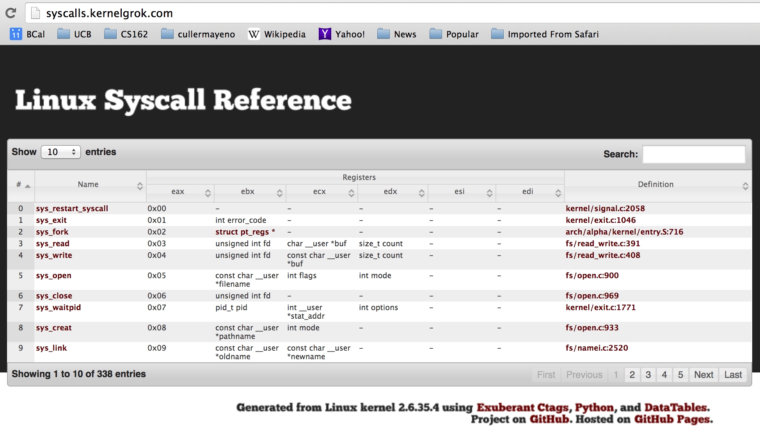
Syscalls
Usually: one low-level I/O operation ↔ one syscall
System library puts parameters in registers,
invokes special instruction

Slide 63
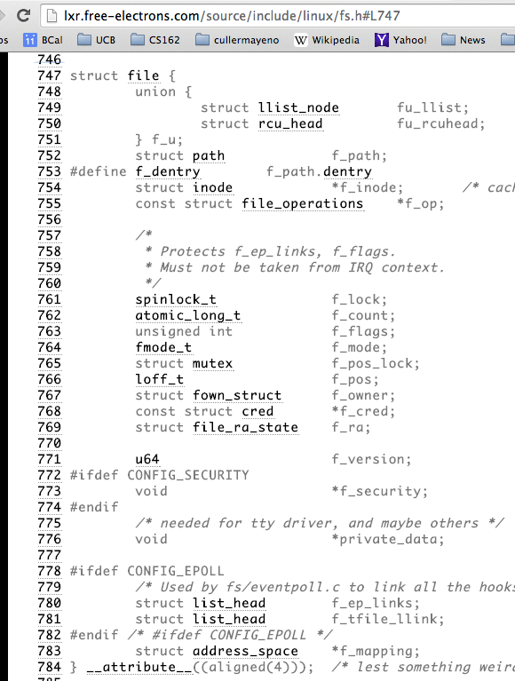
Internal OS open file description
Internal data structure (struct file in Linux) describes everything about the open file
Looked up within PCB by file descriptor number

Slide 64
I/O and Storage Layers
Application / Service
streams
High Level I/O
Low Level I/O
handles
Syscall
registers
File System
open file
I/O Driver
Commands and Data Transfers
Disks, Flash, Controllers, DMA

Slide 65
Device driver
Two parts:
  "Top half": accessed from system calls
    open(), read(), write(), ioctl(), …
    Starts I/O
  "Bottom half": called from interrupt handler
    Gets input or transfers output when device ready
    Responsible for waking blocked threads if I/O is complete

Slide 66
File System: from syscall to driver
In fs/read_write.c
ssize_t vfs_read(struct file *file, char __user *buf, size_t count, loff_t *pos)
{
ssize_t ret;
if (!(file->f_mode & FMODE_READ)) return -EBADF;
if (!file->f_op || (!file->f_op->read && !file->f_op->aio_read))
return -EINVAL;
if (unlikely(!access_ok(VERIFY_WRITE, buf, count))) return -EFAULT;
ret = rw_verify_area(READ, file, pos, count);
if (ret >= 0) {
count = ret;
if (file->f_op->read)
ret = file->f_op->read(file, buf, count, pos);
else
ret = do_sync_read(file, buf, count, pos);
if (ret > 0) {
fsnotify_access(file->f_path.dentry);
add_rchar(current, ret);
}
inc_syscr(current);
}
return ret;
}

Slide 67
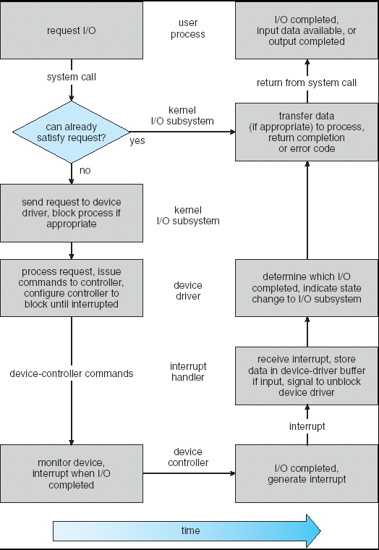
Life Cycle of an I/O request
User
Program
Kernel I/O
Subsystem
Device Driver
Top Half
Device Driver
Bottom Half
Device
Hardware

Slide 68
What happens when you fgetc()?
Application / Service
streams
High Level I/O
Low Level I/O
file descriptors
Syscall
registers
File System
open file
I/O Driver
Commands and Data Transfers
Disks, Flash, Controllers, DMA

Slide 69
Conclusion
Process: Address Space + Threads
  Owns memory, file descriptors, …
  POSIX interface: fork, exec, wait
File I/O: open/read/write/seek/close
  POSIX: files are the universal interface
Device drivers:
  Customized interface to HW
  Half executed from syscall; half from interrupt

