Slide 1
Abstractions 1: Threads and Processes
Sam Kumar
CS 162: Operating Systems and System Programming
Lecture 3
https://inst.eecs.berkeley.edu/~cs162/su20
Read: A&D 3.1, 5.1-5.3

Slide 2
Recall: Four Fundamental OS Concepts
Thread: Execution Context
Program Counter, Registers, Execution Flags, Stack
Address Space (with Translation)
Program’s view of memory is distinct from physical machine
Process: Instance of a Running Program
Address space + one or more threads + …
Dual-Mode Operation and Protection
Only the “system” can access certain resources
Combined with translation, isolates programs from each other

Slide 3
Recall: Thread
Definition: A single, unique execution context
Program counter, registers, stack
A thread is the OS abstraction for a CPU core
A “virtual CPU” of sorts
Registers hold the root state of the thread:
Including program counter – pointer to the currently executing instruction
The rest is “in memory”
Registers point to thread state in memory:
Stack pointer to the top of the thread’s (own) stack

Slide 4
Recall: Illusion of Multiple Processors
vCPU1
vCPU2
vCPU3
Threads are virtual cores
Multiple threads: Multiplex hardware in time
A thread is executing on a processor when it is resident in that processor's registers
Each virtual core (thread) has PC, SP, Registers
Where is it?
On the real (physical) core, or
Saved in memory – called the Thread Control Block (TCB)
Shared Memory
On a single physical CPU:
vCPU1
vCPU2
vCPU3
vCPU1
vCPU2
Time

Slide 5
Recall: Address Space
Program operates in an address space that is distinct from the physical memory space of the machine
0x000…
Processor
Translator
Memory
Registers
0xFFF…

Slide 6
Recall: Process
Definition: execution environment with restricted rights
One or more threads executing in a single address space
Owns file descriptors, network connections
Instance of a running program
When you run an executable, it runs in its own process
Application: one or more processes working together
Protected from each other; OS protected from them
In modern OSes, anything that runs outside of the kernel runs in a process

Slide 7
Recall: Dual-Mode Operation
Processes (i.e., programs you run) execute in user mode
To perform privileged actions, processes request services from the OS kernel
Carefully controlled transition from user to kernel mode
Kernel executes in kernel mode
Performs privileged actions to support running processes
… and configures hardware to properly protect them (e.g., address translation)
Together, address translation and dual-mode operation allow the kernel to protect processes from each other and itself from processes

Slide 8
Today: The Thread Abstraction
What threads are
And what they are not
Why threads are useful (motivation)
How to write a program using threads
Alternatives to using threads

Slide 9
What Threads Are
Definition from before: A single unique execution context
Describes its representation
It provides the abstraction of: A single execution sequence that represents a separately schedulable task
Also a valid definition!
Threads are a mechanism for concurrency
Protection is an orthogonal concept
A protection domain can contain one thread or many

Slide 10
Motivation for Threads
Operating systems must handle multiple things at once (MTAO)
Processes, interrupts, background system maintenance
Networked servers must handle MTAO
Multiple connections handled simultaneously
Parallel programs must handle MTAO
To achieve better performance
Programs with user interface often must handle MTAO
To achieve user responsiveness while doing computation
Network and disk bound programs must handle MTAO
To hide network/disk latency
Sequence steps in access or communicatoin

Slide 11
Threads Allow Handling MTAO
Threads are a unit of concurrency provided by the OS
Each thread can represent one thing or one task

Slide 12
Concurrency is not Parallelism
Concurrency is about handling multiple things at once (MTAO)
Parallelism is about doing multiple things simultaneously
Example: Two threads on a single-core system...
… execute concurrently …
… but not in parallel
Each thread handles or manages a separate thing or task…
But those tasks are not necessarily executing simultaneously!

Slide 13
Multiprocessing vs. Multiprogramming
Multiprocessing: Multiple cores
Multiprogramming: Multiple jobs/processes
Multithreading: Multiple threads/processes
What does it mean to run two threads concurrently?
Scheduler is free to run threads in any order and interleaving
A
Multiprocessing
B
C
A
B
C
Multiprogramming
A
B
C
A
B
C
B

Slide 14
Silly Example for Threads
Imagine the following program:
main() {
ComputePI(“pi.txt”);
PrintClassList(“classlist.txt”);
}
What is the behavior here?
Program would never print out class list
Why? ComputePI would never finish

Slide 15
Adding Threads
Version of program with threads (loose syntax):
main() {
create_thread(ComputePI, “pi.txt”);
create_thread(PrintClassList, “classlist.txt”);
}
create_thread: Spawns a new thread running the given procedure
Should behave as if another CPU is running the given procedure
Now, you would actually see the class list
CPU1
CPU2
CPU1
CPU2
CPU1
CPU2
Time

Slide 16
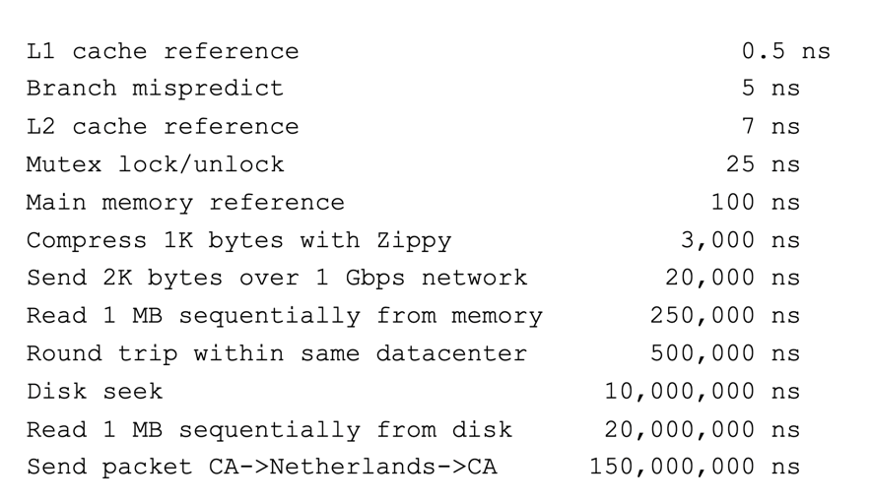
More Practical Motivation
Back to Jeff Dean’s “Numbers Everyone Should Know”
Handle I/O in separate thread, avoid blocking other progress

Slide 17
Threads Mask I/O Latency
A thread is in one of the following three states:
RUNNING – running
READY – eligible to run, but not currently running
BLOCKED – ineligible to run
If a thread is waiting for an I/O to finish, the OS marks it as BLOCKED
Once the I/O finally finishes, the OS marks it as READY
vCPU1
vCPU2
vCPU1
vCPU2
vCPU1
vCPU2
Time

Slide 18
Threads Mask I/O Latency
If no thread performs I/O:
vCPU1
vCPU2
vCPU1
vCPU2
vCPU1
vCPU2
Time
If thread 1 performs a blocking I/O operation:
vCPU1 starts I/O operation
I/O operation completes
vCPU1
vCPU2
vCPU1
vCPU2
Time

Slide 19
Little Better Example for Threads
Version of program with threads (loose syntax):
main() {
create_thread(ReadLargeFile, “pi.txt”);
create_thread(RenderUserInterface);
}
What is the behavior here?
Still respond to user input
While reading file in the background

Slide 20
Multithreaded Programs
You know how to compile a C program and run the executable
This creates a process that is executing that program
Initially, this new process has one thread in its own address space
With code, globals, etc. as specified in the executable
Q: How can we make a multithreaded process?
A: Once the process starts, it issues system calls to create new threads
These new threads are part of the process: they share its address space

Slide 21
System Calls (“Syscalls”)
Word Processing
Compilers
Web Browsers
“But, I’ve never seen a syscall!”
OS library issues system call
Language runtime uses OS library…
Email
Databases
Web Servers
Application / Service
Portable OS Library
OS
User
System Call
Interface
System
Portable OS Kernel
Software
Platform support, Device Drivers
Hardware
x86
PowerPC
ARM
PCI
Ethernet (1Gbs/10Gbs)
802.11 a/g/n/ac
SCSI
Graphics
Thunderbolt

Slide 22
OS Library Issues Syscalls
Proc 1
Proc 2
Proc n
…
OS
Appln
login
Window Manager
…
libc
OS library
OS library
OS library
OS

Slide 23
OS Library API for Threads: pthreads
int pthread_create(pthread_t *thread, const pthread_attr_t *attr, void *(*start_routine)(void*), void *arg);
thread is created executing start_routine with arg as its sole argument.
return is implicit call to pthread_exit
void pthread_exit(void *value_ptr);
terminates the thread and makes value_ptr available to any successful join
int pthread_join(pthread_t thread, void **value_ptr);
suspends execution of the calling thread until the target thread terminates.
On return with a non-NULL value_ptr the value passed to pthread_exit() by the terminating thread is made available in the location referenced by value_ptr.
man pthread
https://pubs.opengroup.org/onlinepubs/7908799/xsh/pthread.h.html

Slide 24
Peeking Ahead: System Call Example
What happens when pthread_create(…) is called in a process?
Library:
int pthread_create(…) {
Do some work like a normal fn…
asm code … syscall # into %eax
put args into registers %ebx, …
special trap instruction
Kernel:
get args from regs
dispatch to system func
Do the work to spawn the new thread
Store return value in %eax
get return values from regs
Do some more work like a normal fn…
};

Slide 25
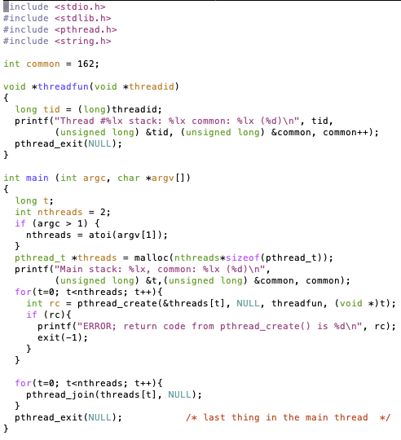

Threads Example
How many threads are in this program?
Does the main thread join with the threads in the same order that they were created?
Do the threads exit in the same order they were created?
If we run the program again, would the result change?

Slide 26
Fork-Join Pattern
create
exit
join
Main thread creates (forks) collection of sub-threads passing them args to work on…
… and then joins with them, collecting results.

Slide 27
Memory Layout with Two Threads
0xFFF…
Two sets of CPU registers
Two sets of Stacks
Issues:
How do we position stacks relative to each other?
What maximum size should we choose for the stacks?
What happens if threads violate this?
How might you catch violations?
Stack 1
Stack 2
Address Space
Heap
Global Data
Code
0x000…

Slide 28
Announcements
Homework 0 due tomorrow night
Start on it soon if you have not done so already
Quiz 0 available on online exam platform today right after lecture
C Review Session tomorrow 6-7 PM
Reminder to look for groups
“Search for Teammates” thread on Piazza
Work with prospective teammates on Project 0

Slide 29
Interleaving and Nondeterminism

Slide 30
Thread Abstraction
Illusion: Infinite number of processors
Reality: Threads execute with variable “speed”
Programs must be designed to work with any schedule

Slide 31
Programmer vs. Processor View

Slide 32
Possible Executions

Slide 33
Correctness with Concurrent Threads
Non-determinism:
Scheduler can run threads in any order
Scheduler can switch threads at any time
This can make testing very difficult
Independent Threads
No state shared with other threads
Deterministic, reproducible conditions
Cooperating Threads
Shared state between multiple threads
Goal: Correctness by Design

Slide 34
Race Conditions
What are the possible values of x below after all threads finish?
Initially x == 0 and y == 0
Thread A
x = 1;
Thread B
y = 2;
Must be 1. Thread B does not interfere.

Slide 35
Race Conditions
What are the possible values of x below?
Initially x == 0 and y == 0
Thread A
x = y + 1;
Thread B
y = 2;
y = y * 2;
1 or 3 or 5 (non-deterministic)
Race Condition: Thread A races against Thread B

Slide 36
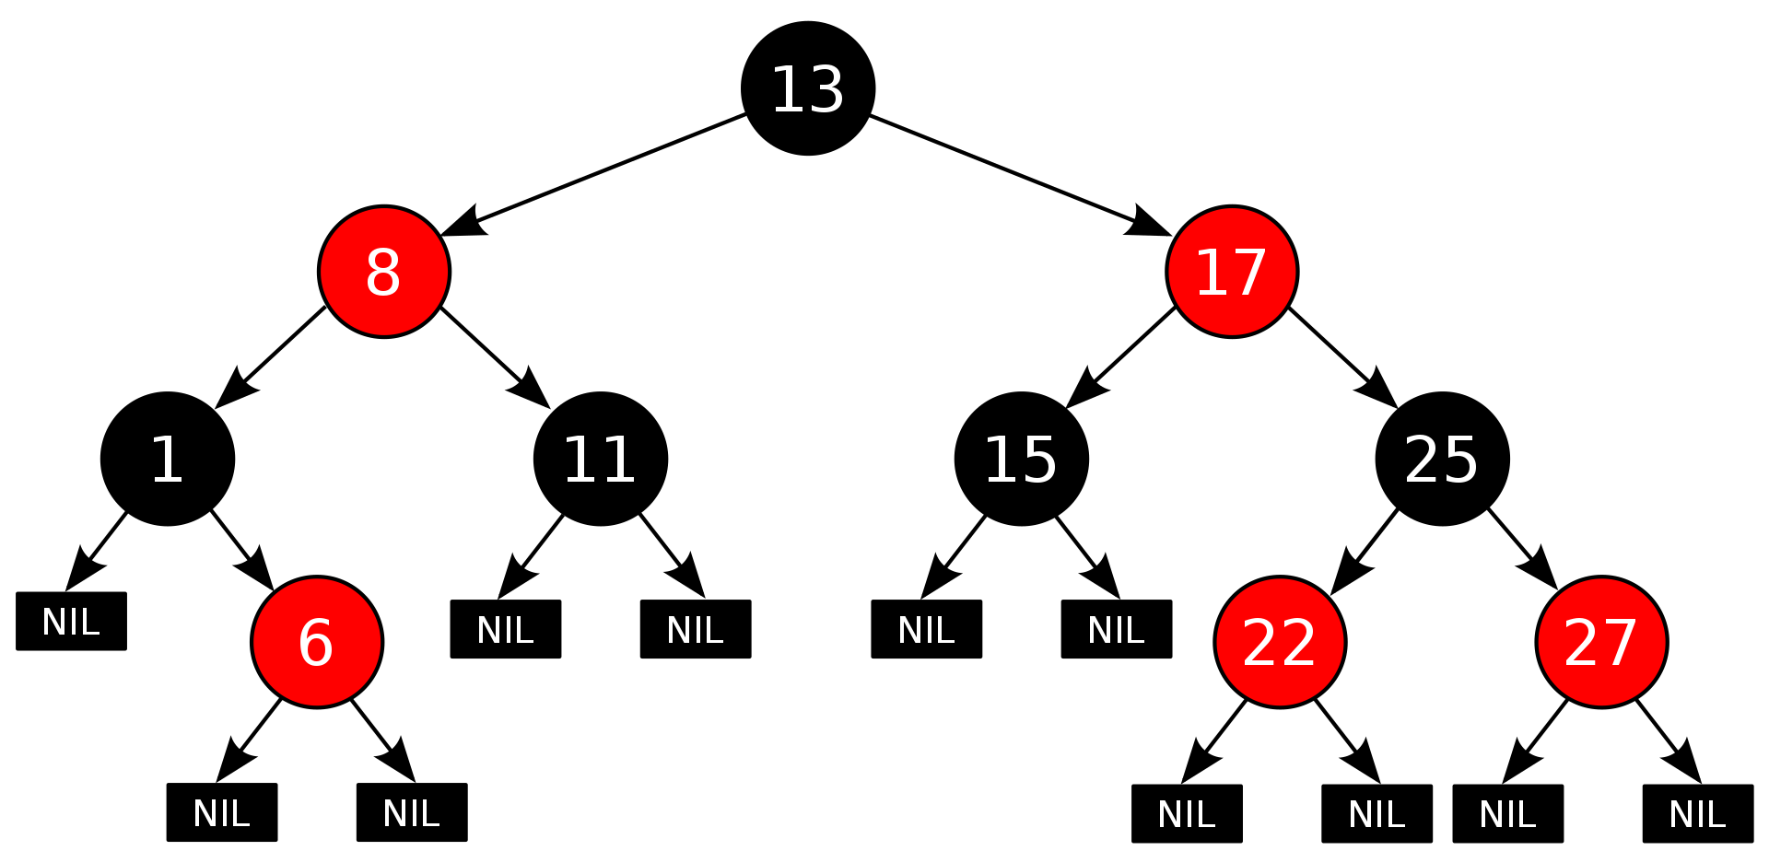
Example: Shared Data Structure
Thread A
Insert(3)
Thread B
Insert(4)
Get(6)
Tree-Based Set Data Structure

Slide 37
Relevant Definitions
Synchronization: Coordination among threads, usually regarding shared data
Mutual Exclusion: Ensuring only one thread does a particular thing at a time (one thread excludes the others)
Type of synchronization
Critical Section: Code exactly one thread can execute at once
Result of mutual exclusion
Lock: An object only one thread can hold at a time
Provides mutual exclusion

Slide 38
Locks
Locks provide two atomic operations:
Lock.acquire() – wait until lock is free; then mark it as busy
After this returns, we say the calling thread holds the lock
Lock.release() – mark lock as free
Should only be called by a thread that currently holds the lock
After this returns, the calling thread no longer holds the lock
For now, don’t worry about how to implement locks!
We’ll cover that in substantial depth later on in the class

Slide 39
Example: Shared Data Structure
Thread A
Insert(3)
Lock.acquire()
Insert 3 into the data structure
Lock.release()
Thread B
Insert(4)
Lock.acquire()
Insert 4 into the data structure
Lock.release()
Get(6)
Lock.acquire()
Check for membership
Lock.release()
Tree-Based Set Data Structure

Slide 40
OS Library Locks: pthreads
int pthread_mutex_init(pthread_mutex_t *mutex, const pthread_mutexattr_t *attr)
int pthread_mutex_lock(pthread_mutex_t *mutex);
int pthread_mutex_unlock(pthread_mutex_t *mutex);
You’ll get a chance to use these in Homework 1

Slide 41
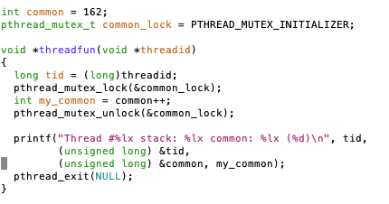
Our Example
Critical section

Slide 42
Semaphore
Semaphores are a kind of generalized lock
First defined by Dijkstra in late 60s
Main synchronization primitive used in original UNIX (& Pintos)
Definition: a Semaphore has a non-negative integer value and supports the following two operations:
P() or down(): atomic operation that waits for semaphore to become positive, then decrements it by 1
V() or up(): an atomic operation that increments the semaphore by 1, waking up a waiting P, if any
P() stands for “proberen” (to test) and V() stands for “verhogen” (to increment) in Dutch

Slide 43
Two Important Semaphore Patterns
Mutual Exclusion: (Like lock)
Called a "binary semaphore"
initial value of semaphore = 1;
semaphore.down(); // Critical section goes here semaphore.up();
Signaling other threads, e.g. ThreadJoin
Initial value of semaphore = 0
ThreadJoin {
semaphore.down(); }
ThreadFinish {
semaphore.up(); }

Slide 44
Break (If Time)

Slide 45
Recall: Process
Definition: execution environment with restricted rights
One or more threads executing in a single address space
Owns file descriptors, network connections
Instance of a running program
When you run an executable, it runs in its own process
Application: one or more processes working together
Protected from each other; OS protected from them
In modern OSes, anything that runs outside of the kernel runs in a process

Slide 46
Recall: Life of a Process
User Mode
interrupt
exception
syscall
rtn
rfi
Kernel Mode
exit
exec
Limited HW access
Full HW access

Slide 47
Processes
How to manage process state?
How to create a process?
How to exit from a process?
Remember: Everything outside of the kernel is running in a process!
Including the shell! (Homework 2)
Processes are created and managed… by processes!

Slide 48
Bootstrapping
If processes are created by other processes, how does the first process start?
First process is started by the kernel
Often configured as an argument to the kernel before the kernel boots
After this, all processes on the system are created by other processes

Slide 49
Process Management API
exit – terminate a process
fork – copy the current process
exec – change the program being run by the current process
wait – wait for a process to finish
kill – send a signal (interrupt-like notification) to another process
sigaction – set handlers for signals

Slide 50
Process Management API
exit – terminate a process
fork – copy the current process
exec – change the program being run by the current process
wait – wait for a process to finish
kill – send a signal (interrupt-like notification) to another process
sigaction – set handlers for signals

Slide 51
pid.c
#include <stdlib.h>
#include <stdio.h>
#include <string.h>
#include <unistd.h>
#include <sys/types.h>
int main(int argc, char *argv[])
{
/* get current processes PID */
pid_t pid = getpid();
printf("My pid: %d\n", pid);
exit(0);
}
Q: What if we let main return without ever calling exit?
The OS Library calls exit() for us!
The entrypoint of the executable is in the OS library
OS library calls main
If main returns, OS library calls exit
You’ll see this in Project 0: init.c

Slide 52
Process Management API
exit – terminate a process
fork – copy the current process
exec – change the program being run by the current process
wait – wait for a process to finish
kill – send a signal (interrupt-like notification) to another process
sigaction – set handlers for signals

Slide 53
Creating Processes
pid_t fork() – copy the current process
New process has different pid
New process contains a single thread
Return value from fork(): pid (like an integer)
When > 0:
Running in (original) Parent process
return value is pid of new child
When = 0:
Running in new Child process
When < 0:
Error! Must handle somehow
Running in original process
State of original process duplicated in both Parent and Child!
Address Space (Memory), File Descriptors (covered later), etc…

Slide 54
fork1.c
#include <stdlib.h>
#include <stdio.h>
#include <unistd.h>
#include <sys/types.h>
int main(int argc, char *argv[]) {
pid_t cpid, mypid;
pid_t pid = getpid(); /* get current processes PID */
printf("Parent pid: %d\n", pid);
cpid = fork();
if (cpid > 0) { /* Parent Process */
mypid = getpid();
printf("[%d] parent of [%d]\n", mypid, cpid);
} else if (cpid == 0) { /* Child Process */
mypid = getpid();
printf("[%d] child\n", mypid);
} else {
perror("Fork failed");
}
}

Slide 55
fork1.c
#include <stdlib.h>
#include <stdio.h>
#include <unistd.h>
#include <sys/types.h>
int main(int argc, char *argv[]) {
pid_t cpid, mypid;
pid_t pid = getpid(); /* get current processes PID */
printf("Parent pid: %d\n", pid);
cpid = fork();
if (cpid > 0) { /* Parent Process */
mypid = getpid();
printf("[%d] parent of [%d]\n", mypid, cpid);
} else if (cpid == 0) { /* Child Process */
mypid = getpid();
printf("[%d] child\n", mypid);
} else {
perror("Fork failed");
}
}
c
p

Slide 56
fork1.c
#include <stdlib.h>
#include <stdio.h>
#include <unistd.h>
#include <sys/types.h>
int main(int argc, char *argv[]) {
pid_t cpid, mypid;
pid_t pid = getpid(); /* get current processes PID */
printf("Parent pid: %d\n", pid);
cpid = fork();
if (cpid > 0) { /* Parent Process */
mypid = getpid();
printf("[%d] parent of [%d]\n", mypid, cpid);
} else if (cpid == 0) { /* Child Process */
mypid = getpid();
printf("[%d] child\n", mypid);
} else {
perror("Fork failed");
}
}
p
c

Slide 57
fork_race.c
Recall: a process consists of one or more threads executing in an address space
In this case, each process has a single thread
These threads execute concurrently
int i;
pid_t cpid = fork();
if (cpid > 0) {
for (i = 0; i < 10; i++) {
printf("Parent: %d\n", i);
// sleep(1);
}
} else if (cpid == 0) {
for (i = 0; i > -10; i--) {
printf("Child: %d\n", i);
// sleep(1);
}
}
What does this print?
Would adding the calls to sleep matter?

Slide 58
Process Management API
exit – terminate a process
fork – copy the current process
exec – change the program being run by the current process
wait – wait for a process to finish
kill – send a signal (interrupt-like notification) to another process
sigaction – set handlers for signals

Slide 59
fork2.c – parent waits for child to finish
int status;
pid_t tcpid;
…
cpid = fork();
if (cpid > 0) { /* Parent Process */
mypid = getpid();
printf("[%d] parent of [%d]\n", mypid, cpid);
tcpid = wait(&status);
printf("[%d] bye %d(%d)\n", mypid, tcpid, status);
} else if (cpid == 0) { /* Child Process */
mypid = getpid();
printf("[%d] child\n", mypid);
}
…

Slide 60
Running Another Program
With threads, we could call pthread_create to create a new thread executing a separate function
With processes, the equivalent would be spawning a new process executing a different program
How can we do this?

Slide 61
Process Management API
exit – terminate a process
fork – copy the current process
exec – change the program being run by the current process
wait – wait for a process to finish
kill – send a signal (interrupt-like notification) to another process
sigaction – set handlers for signals

Slide 62
fork3.c
…
cpid = fork();
if (cpid > 0) { /* Parent Process */
tcpid = wait(&status);
} else if (cpid == 0) { /* Child Process */
char *args[] = {“ls”, “-l”, NULL};
execv(“/bin/ls”, args);
/* execv doesn’t return when it works.
So, if we got here, it failed! */
perror(“execv”);
exit(1);
}
…

Slide 63
Process Management API
exit – terminate a process
fork – copy the current process
exec – change the program being run by the current process
wait – wait for a process to finish
kill – send a signal (interrupt-like notification) to another process
sigaction – set handlers for signals

Slide 64
inf_loop.c
Q: What would happen if the process receives a SIGINT signal, but does not register a signal handler?
A: The process dies!
For each signal, there is a default handler defined by the system
#include <stdlib.h>
#include <stdio.h>
#include <sys/types.h>
#include <unistd.h>
#include <signal.h>
void signal_callback_handler(int signum) {
printf(“Caught signal!\n”);
exit(1);
}
int main() {
struct sigaction sa;
sa.sa_flags = 0;
sigemptyset(&sa.sa_mask);
sa.sa_handler = signal_callback_handler;
sigaction(SIGINT, &sa, NULL);
while (1) {}
}

Slide 65
Common POSIX Signals
SIGINT – control-C
SIGTERM – default for kill shell command
SIGSTP – control-Z (default action: stop process)
SIGKILL, SIGSTOP – terminate/stop process
Can’t be changed with sigaction
Why?

Slide 66
Shell
A shell is a job control system
Allows programmer to create and manage a set of programs to do some task
You will build your own shell in Homework 2…
… using fork and exec system calls to create new processes…
… and the File I/O system calls we’ll see next time to link them together

Slide 67
Process vs. Thread APIs
Why have fork() and exec() system calls for processes, but just a pthread_create() function for threads?
Convenient to fork without exec: put code for parent and child in one executable instead of multiple
It will allow us to programmatically control child process’ state
By executing code before calling exec() in the child
We’ll see this in the case of File I/O next time
Windows uses CreateProcess() instead of fork()
Also works, but a more complicated interface

Slide 68
Threads vs. Processes
If we have two tasks to run concurrently, do we run them in separate threads, or do we run them in separate processes?
Depends on how much isolation we want
Threads are lighter weight [why?]
Processes are more strongly isolated

Slide 69
Conclusion
Threads are the OS unit of concurrency
Abstraction of a virtual CPU core
Can use pthread_create, etc., to manage threads within a process
They share data → need synchronization to avoid data races
Processes consist of one or more threads in an address space
Abstraction of the machine: execution environment for a program
Can use fork, exec, etc. to manage threads within a process
We saw the role of the OS library
Provide API to programs
Interface with the OS to request services

