Slide 1
Documents and Records

Slide 2
Learning Objectives
At the conclusion of this session, you will be able to:
  explain the difference between documents and records;
  describe the hierarchy of documents and the role of each level;
  outline the contents of a quality manual;
  outline the content that should be included in a standard operating procedure;
  explain the important steps, or elements, of a laboratory document management system;
  describe methods and tools to properly store documents and records.

Slide 3
Scenario
You have found all these papers lying on a desk. Which of these are documents and which are records?
testing algorithm
safety manual
client test results
standard operation procedures (SOPs) for an approved HIV rapid test
manufacturer test kit inserts
summary of findings from on-site evaluation visit
report of corrective actions
temperature log (blank form)
quality control record (blank form)
daily maintenance log (completed)
stock cards and stock book (completed)
EQA specimen transfer log (completed)

Slide 4
The Quality Management System
Organization
Personnel
Equipment
Process Control
Purchasing
&
Inventory
Information Management
Assessment
Documents
&
Records
Occurrence Management
Process Improvement
Customer Service
Facilities
&
Safety

Slide 5

Why do laboratories need to manage documents and records?
To find information
whenever it is needed!

Slide 6



Documents and Records—How do they differ?
Documents
  communicate information via policies, processes, and procedures
  need updating
Records
  capture information on worksheets, forms, labels, and charts
  permanent, do not change
RECORDS

Slide 7

Information is the
major product
of the laboratory

Slide 8




Policies
Laboratory
Documents
Procedures
Processes

Slide 9
Policies - The “WHAT TO DO”
“A written statement of overall intentions and directions defined by those in the organization and endorsed by management.” (CLSI HS1-A3)
  Policies:
  tell “what to do” in a broad and general way
  include the organizational mission, goals, and purpose
  serve as the framework for the quality system
  should always be specified in the quality manual

Slide 10
Processes - The “HOW IT HAPPENS”
A “set of interrelated or interacting activities that transform inputs into outputs.” (ISO 9000 4.3.1)
Processes:
describe the steps involved to carry out quality policies
easily represented in flow charts
involve a series of steps, usually occurring over a period of time

Slide 11
Procedures - The “HOW TO DO IT”
Standard operating procedures (SOP)
  step-by-step instructions for performing a single activity
Job aid
  a shortened version of the SOP
  does not replace the SOP

Slide 12
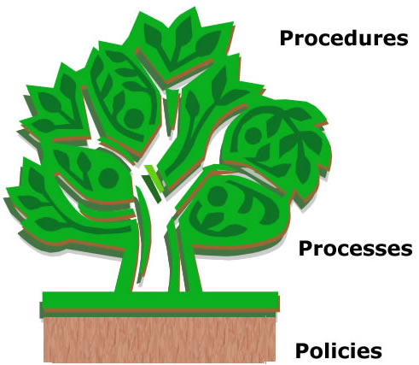
Hierarchy of Documents
“How to do it”
“How it happens”
“What to do”

Slide 13
Why are documents important?
essential guidelines for laboratory
  quality manual
  SOPs
  reference materials
required by formal laboratory standards

Slide 14





Documents are the communicators of the quality management system
Verbal instructions often are:
not heard
misunderstood
quickly forgotten
difficult to follow

Slide 15

Documents are a reflection of the laboratory’s organization and its quality management.
A good rule to follow is:
“Do what you wrote and write what you are doing.”

Slide 16

Good Documents are:
clear
concise
user-friendly
explicit
accurate
up-to-date

Slide 17
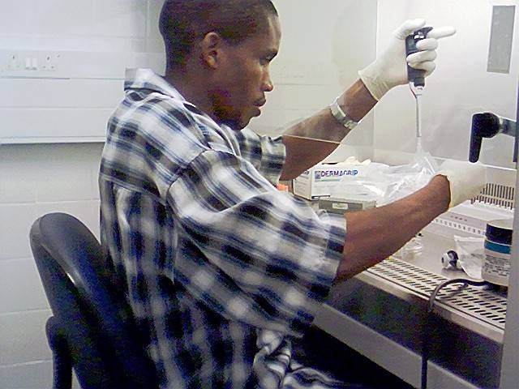
Documents for work processes should be accessible to staff at the work site :
instructions on handling incoming samples
SOPs for each test
quality control charts
and trouble-shooting
instructions
safety manuals
and precautions

Slide 18
The Quality Manual
is a document describing the
quality management system
of an organization
(ISO 15189)

Slide 19

Quality Manual
communicates information
serves as a framework or roadmap for meeting quality management system requirements
demonstrates management commitment to quality

Slide 20
Writing a Quality Manual
Style and structure are flexible;
make to best meet the needs of
the laboratory and its customers

Slide 21
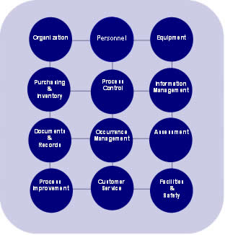
Writing a Quality Manual
Form a Steering Committee
Set policy for
12 QS
essentials
Describe how the related quality processes occur
Reference procedures

Slide 22
Key Points: Quality Manual
only ONE official version
never “done”, always being improved
read and accepted by everyone
use the best-adapted language
Very big job, but very useful

Slide 23
Standard Operating Procedures (SOPs) are documents that:
describe how to perform a test using step-by-step instructions
written SOPs help ensure:
  consistency
  accuracy
  quality

Slide 24
A Good SOP
provides detailed, clear, and concise direction for testing techniques
is easily understood by new personnel
is reviewed and approved by management
is updated on a regular basis

Slide 25
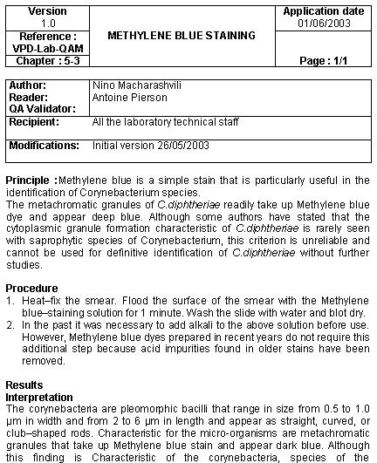
Standardized SOP Format
Computerized procedure
Standardization:
  Header
  Version/chapter/reference
  Author/reader/validator
  Recipients
  Version date/Application date
  Typical outline
Updating and storage of different versions is easy
J Johnson,
RB Smith

Slide 26
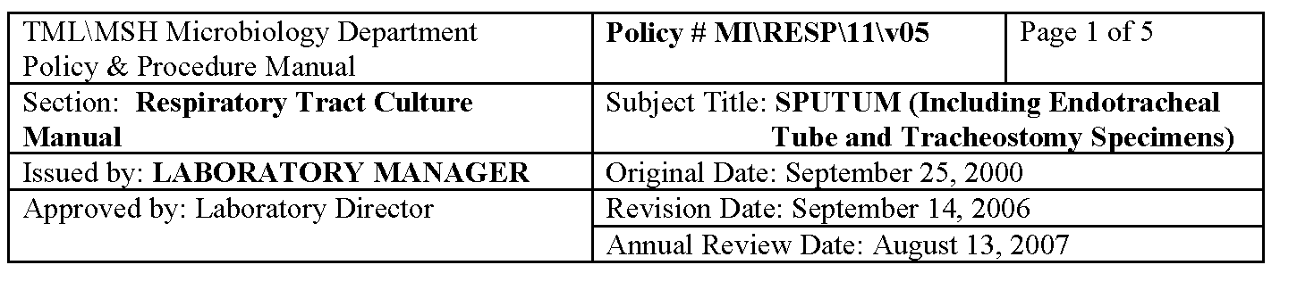
Complete Standardized Header
Use at the top of the first page only

Slide 27
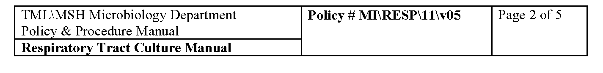
Reduced Standardized Header
other pages of every procedure
use at the top of all other pages

Slide 28


When Preparing SOPs
determine
procedure
to use
establish
means for
updating
assess
scientific
validity
gather all
documents
include
each step

Slide 29
Suggested Outline for SOPs
Title: Name of Test
Purpose: Medical use
Instructions:
  Preexamination
  Examination
  Postexamination
References to verify the method is established
Author’s name
Approval signature(s)–initial and date

Slide 30


Avoid Drowning in Detail…..
BAD EXAMPLE: “The purpose of this procedure is to document the aforementioned activities, herin after referred to as the prescribed tasks in terms that preclude their execution in an inconsistent manner, wherin such inconsistency may potentially result in the prescribed tasks delivering a result that is not repeatable or reproducible”…

Slide 31
Do not rely solely on manufacturer product inserts
Inserts do not provide specific information for test sites,
such as:
materials required, but not in kit
specific safety requirements
external quality control requirements

Slide 32


Job Aids
shortened version of SOPs
hand written or printed
visible location at testing site
useful tool to assure all testing steps are correctly performed

Slide 33
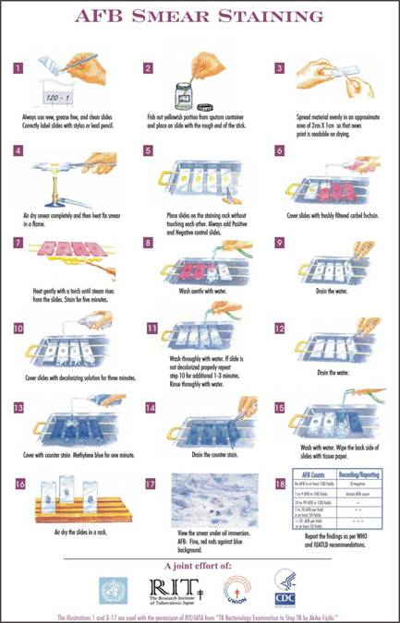
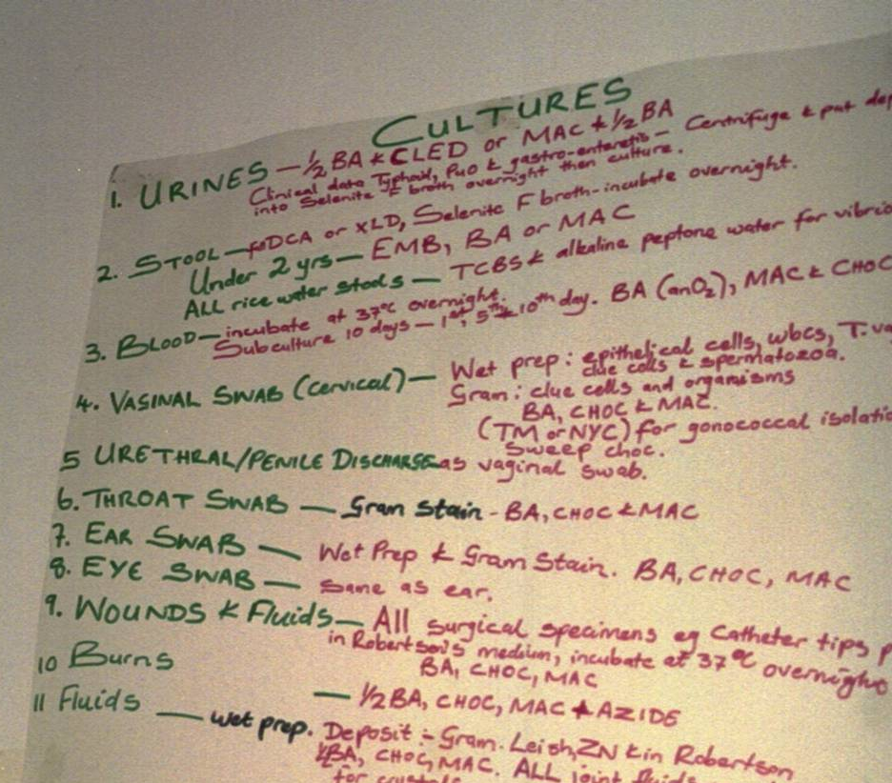
Job Aids

Slide 34
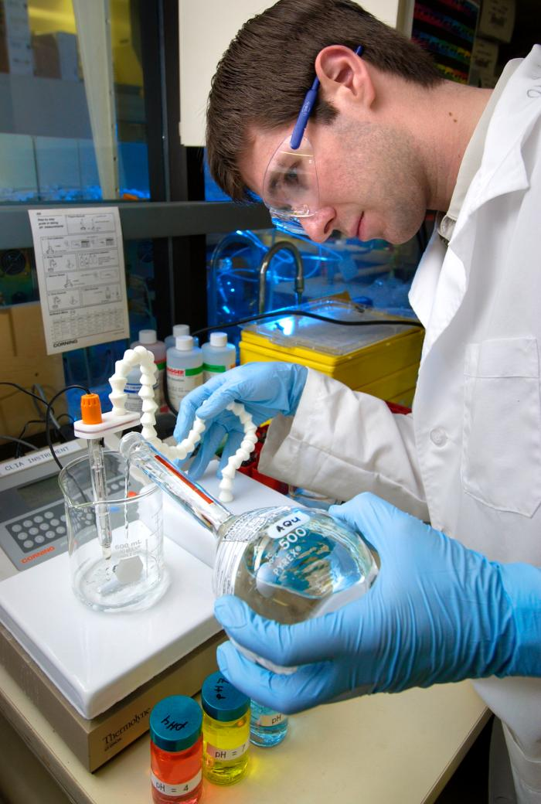
Job Aids

Slide 35


Document Control
ensures availability
when needed
assures that the
most current
version is used
  organizational tool

Slide 36
Document Control Elements
system for organizing, such as numbering or coding system
approval, distribution, and revision process
master log that describes which documents are in circulation
accessibility of documents at the point of use
system for archiving

Slide 37
SOPs
regulations
and
standards
Controlled
documents
equipment
service
manuals
texts,
articles,
reference
books

Slide 38
Documents of External Origin
Include in the laboratory document control system:
  instrument service manuals
  industry regulations
  ISO standards
  references used for documentation

Slide 39
Numbering System
need uniform numbering system
do not change a current system that works
one system: letter for the type of document and then an incremented number: B1, B2, B3 for books and T1, T2 for official texts
number all pages of document
reference by document code, pages, location code: Book number 2, pages 188-200, on bookshelf 1: B2,188-200, BS1

Slide 40
Document Preparation and Control Process
Preparation
Issue
Distribution
Review
Revision
Approval

Slide 41
Implementing Document Control
collect existing documents and records
review and update
determine additional needs
develop or obtain documents, forms, worksheets, logbooks, reports
involve stakeholders

Slide 42

Common Document Control Problems
outdated documents
too many documents are distributed and the system
cannot be maintained
lack of control of documents
of external and internal origin

Slide 43

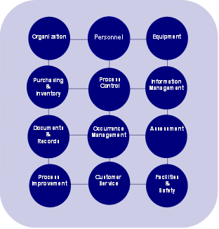
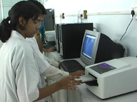
Why are records essential?
Sample
tracking
throughout
process
Continuous
monitoring
of
quality system
Management
tool
Identify problems

Slide 44

Sample
log book
or register
Patient
test reports
Workbooks
Worksheets
Laboratory Records
EQA /
PT records
Instrument
printouts
Quality
control
data
Maintenance
records

Slide 45

Personnel
records
Critical
communications
Internal
audits
results
More Records
Customer
feedback
External
audits
results
User
surveys
Continuous
improvement

Slide 46

Keep the Things You Might
Forget!
disposition of rejected samples
referral of samples to another laboratory
records of adverse occurrences or problems
inventory and storage records
equipment purchase data, preventive maintenance, and troubleshooting

Slide 47
Test Report Contents ISO 15189
test identification
laboratory identification
patient unique identification and location
name and address of requestor
date and time of collection
time of receipt in lab
date and time of release of report
primary sample type
results (SI units)
biological reference intervals
interpretive comments
person authorizing release, with signature when possible
note if reporting a corrected result

Slide 48

Paper Systems
Permanence
  bind books
  number pages
  use permanent ink
  control storage
Accessibility
  use system that will allow ease of access
Security
  maintain confidentiality
  keep safe from environmental hazards
Traceability
  allow for tracking of a specimen throughout all processes

Slide 49
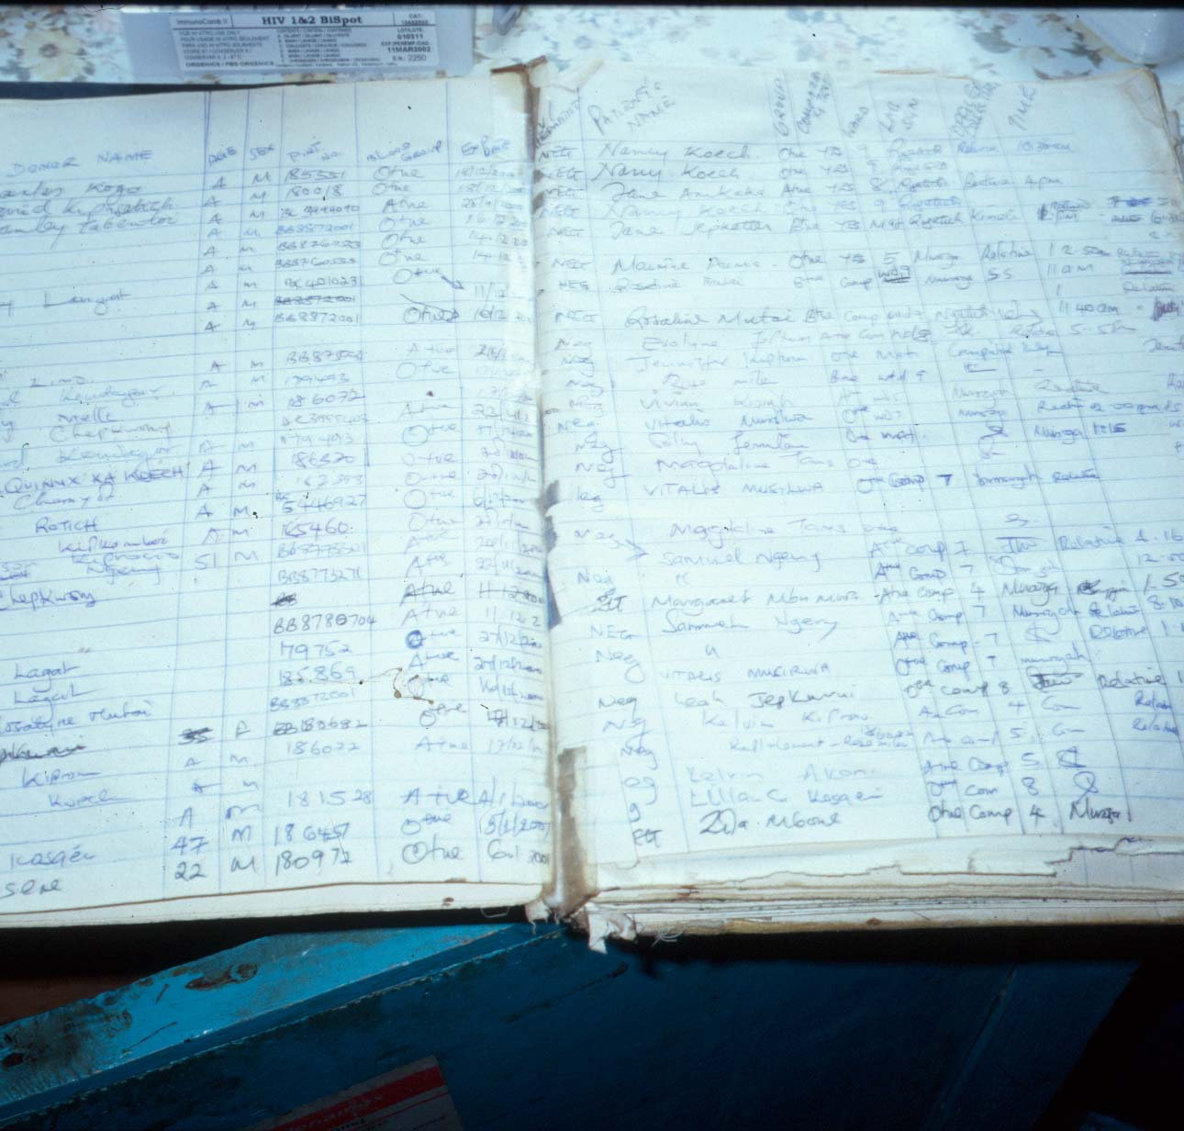
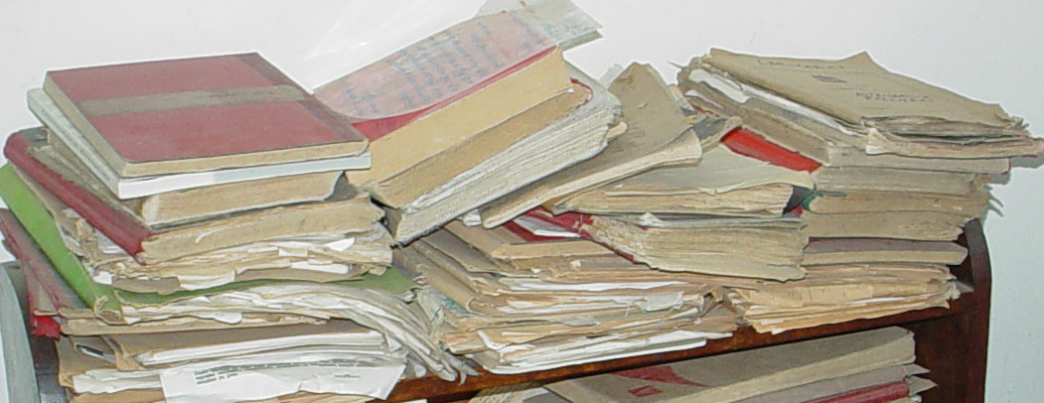

Slide 50



Electronic Systems
permanence
  computer system maintenance, backups
security
  access
  confidentiality
traceability

Slide 51

National
legislation
and
regulation
Testing
process
review
Factors
affecting
retention
times
Research
purposes
Time
between
assessments
-audits

Slide 52
Summary
Documents:
include written policies, processes, and procedures
need to be updated and maintained
Records:
include information captured in processes
are permanent, do not require updating
A good document control program:
most current version used
availability and ease of access

Slide 53
Key Messages
Information is our product.
Documents are essential for assuring accuracy and consistency in the laboratory.

Slide 54
Scenario
You have found all these papers lying on a desk. Which of these are documents and which are records?
testing algorithm
safety manual
client test results
standard operation procedures (SOPs) for an approved HIV rapid test
manufacturer test kit inserts
summary of findings from on-site evaluation visit
report of corrective actions
temperature log (blank form)
quality control record (blank form)
daily maintenance log (completed)
stock cards and stock book (completed)
EQA sample transfer log (completed)

Slide 55
Scenario
You have found all these papers lying on a desk. Which of these are documents and which are records?
testing algorithm
safety manual
client test results
standard operation procedures (SOPs) for an approved HIV rapid test
manufacturer test kit inserts
summary of findings from on-site evaluation visit
report of corrective actions
temperature log (blank form)
quality control record (blank form)
daily maintenance log (completed)
stock cards and stock book (completed)
EQA sample transfer log (completed)

Slide 56
Questions?
Comments?
Organization
Personnel
Equipment
Process Control
Purchasing
&
Inventory
Information Management
Assessment
Documents
&
Records
Occurrence Management
Process Improvement
Customer Service
Facilities
&
Safety

